Slide 1
KICGPT - KICMISTRAL

Slide 2

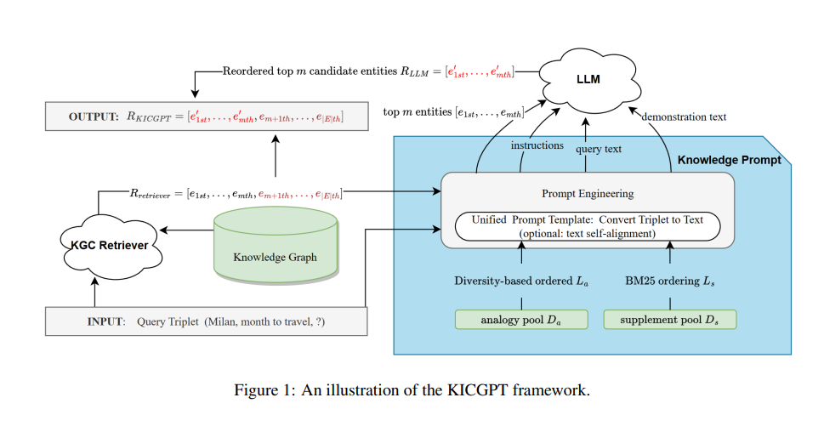
Methology:

Slide 3
Comparison &Inspiration using SMALL Test Dataset
100 samples | Mistral-7B-Instruct-v0.1 |  |  |  | Mistral-7B-Instruct-v0.1 tsa
Candidates | MRR | Hits@1 | Hits@3 | Hits@10 | MRR | Hits@1 | Hits@3 | Hits@10
10 | 0.1886 | 0.1200 | 0.2300 | 0.3200 | 0.1295 | 0.0900 | 0.1600 | 0.2000
20 | 0.1533 | 0.1100 | 0.1800 | 0.2300 | 0.1277 | 0.0800 | 0.1500 | 0.2300
30 | 0.1775 | 0.1200 | 0.2200 | 0.2800 | 0.1057 | 0.0500 | 0.1600 | 0.1900
40 | 0.1429 | 0.1000 | 0.1700 | 0.2300 | 0.1280 | 0.0900 | 0.1400 | 0.2000
50 | 0.0980 | 0.0300 | 0.1600 | 0.1900 | 0.1723 | 0.1200 | 0.2000 | 0.2700
*Use the first 100 samples from the test dataset of WN18RR

Slide 4
Comparison &Inspiration using SMALL Test Dataset
100 samples | Mistral-7B-Instruct-v0.1 |  |  |  | Mistral-7B-Instruct-v0.1 tsa
Candidates | MRR | Hits@1 | Hits@3 | Hits@10 | MRR | Hits@1 | Hits@3 | Hits@10
10 | 0.2595 | 0.1900 | 0.3000 | 0.4300 | 0.2199 | 0.1500 | 0.2800 | 0.3700
20 | 0.3174 | 0.2300 | 0.3700 | 0.5100 | 0.2423 | 0.1800 | 0.2800 | 0.3700
30 | 0.2704 | 0.1800 | 0.3200 | 0.4600 | 0.2352 | 0.1600 | 0.2800 | 0.3700
40 | 0.3063 | 0.2300 | 0.3600 | 0.4500 | 0.2209 | 0.1500 | 0.2600 | 0.3900
50 | 0.3262 | 0.2300 | 0.3800 | 0.5200 | 0.2603 | 0.1800 | 0.3100 | 0.4200
*Use the first 100 samples from the test dataset of WN18RR

Slide 5
Comparison based on WN18RR
 | MRR | Hits@1 | Hits@3 | Hits@10
KICGPT | 0.549 | 0.474 | 0.585 | 0.641
KICGPT tsa | 0.581 | 0.478 | 0.612 | 0.677
KICMistral 7B_10 | 0.1519 | 0.0970 | 0.1873 | 0.2792
KICMistral 7B_50 | 0.1390 | 0.0951 | 0.1669 | 0.2265
KICMistral 8X7B-10 | 0.2993 | 0.2176 | 0.3577 | 0.4579
KICMistral 8X7B-50
KICMistral 8X7B-50 tsa

