Slide 1
KICGPT - KICMISTRAL

Slide 2

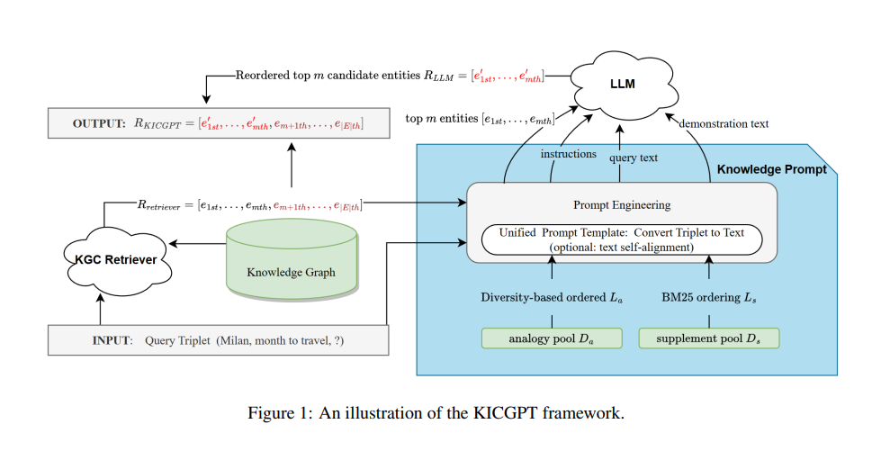
Methology:

Slide 3
Comparison &Inspiration using SMALL Test Dataset
100 samples | Mistral-7B-Instruct-v0.1 |  |  |  | Mistral-7B-Instruct-v0.1 tsa
Candidates | MRR | Hits@1 | Hits@3 | Hits@10 | MRR | Hits@1 | Hits@3 | Hits@10
10 | 0.1886 | 0.1200 | 0.2300 | 0.3200 | 0.1456 | 0.1000 | 0.1800 | 0.2300
20 | 0.1760 | 0.1300 | 0.2000 | 0.2600 | 0.1430 | 0.0900 | 0.1700 | 0.2600
30 | 0.1895 | 0.1200 | 0.2400 | 0.3100 | 0.1349 | 0.0700 | 0.2000 | 0.2300
40 | 0.1681 | 0.1200 | 0.2000 | 0.2600 | 0.1580 | 0.1200 | 0.1700 | 0.2300
50 | 0.1005 | 0.0300 | 0.1600 | 0.2000 | 0.1858 | 0.1200 | 0.2200 | 0.3000
*Use the first 100 samples from the test dataset of WN18RR // The format of outputs vary

Slide 4
GIVE UP MISTRAL 7B

Slide 5
Comparison &Inspiration using SMALL Test Dataset
100 samples | KICMistral |  |  |  | KICMistral 8X7B-50 tsa
Candidates | MRR | Hits@1 | Hits@3 | Hits@10 | MRR | Hits@1 | Hits@3 | Hits@10
10 | 0.3260 | 0.2400 | 0.3800 | 0.5400 | 0.3383 | 0.2300 | 0.4400 | 0.5500
20 | 0.3241 | 0.2300 | 0.3800 | 0.5300 | 0.3424 | 0.2500 | 0.3800 | 0.5400
30 | 0.3079 | 0.2000 | 0.3800 | 0.5200 | 0.3001 | 0.1900 | 0.3500 | 0.5400
40 | 0.3446 | 0.2600 | 0.4000 | 0.5100 | 0.3206 | 0.2000 | 0.4000 | 0.5700
50 | 0.3523 | 0.2500 | 0.4100 | 0.5600 | 0.3064 | 0.2000 | 0.3800 | 0.5000
*Use the first 100 samples from the test dataset of WN18RR // The format of outputs vary

Slide 6
Comparison &Inspiration using SMALL Test Dataset
100 samples | KICMistral |  |  |  | KICMistral 8X7B-50 tsa
eff_demon_step | MRR | Hits@1 | Hits@3 | Hits@10 | MRR | Hits@1 | Hits@3 | Hits@10
1 | 0.3149 | 0.1900 | 0.3800 | 0.5500
2 | 0.3200 | 0.1900 | 0.4000 | 0.5700
3 | 0.3432 | 0.2200 | 0.4300 | 0.5700
4 | 0.3229 | 0.2100 | 0.4200 | 0.5600
5 | 0.3336 | 0.2300 | 0.3900 | 0.5400
6
7 | 0.3748 | 0.2600 | 0.4600 | 0.6200
8
9
10 | 0.3523 | 0.2500 | 0.4100 | 0.5600
*Use the first 100 samples from the test dataset of WN18RR // The format of outputs vary

Slide 7
Comparison based on WN18RR
 | MRR | Hits@1 | Hits@3 | Hits@10
KICGPT | 0.549 | 0.474 | 0.585 | 0.641
KICGPT tsa | 0.581 | 0.478 | 0.612 | 0.677
KICMistral 8X7B-10 | 0.2992 | 0.2176 | 0.3577 | 0.4579
KICMistral 8X7B-50 | 0.3338 | 0.2317 | 0.3950 | 0.5265
KICMistral 8X7B-50 tsa

