Slide 1
KICGPT - KICMISTRAL

Slide 2
Comparison based on WN18RR
 | MRR | Hits@1 | Hits@3 | Hits@10
KICGPT | 0.549 | 0.474 | 0.585 | 0.641
KICGPT tsa | 0.581 | 0.478 | 0.612 | 0.677
KICMistral 7B_10 | 0.1519 | 0.0970 | 0.1873 | 0.2792
KICMistral 7B_50 | 0.1390 | 0.0951 | 0.1669 | 0.2265
KICMistral 8X7B-10 | 0.2993 | 0.2176 | 0.3577 | 0.4579

Slide 3
Comparison &Inspiration using SMALL Test Dataset
 | 10 Candidates |  |  |  | 50 Candidates
Model | MRR | Hits@1 | Hits@3 | Hits@10 | MRR | Hits@1 | Hits@3 | Hits@10
Mistral-7B-Instruct-v0.1 | 0.2348 | 0.1818 | 0.2727 | 0.2727 | 0.0227 | 0.0000 | 0.0000 | 0.0909
Mistral-7B-Instruct-v0.2 | 0.3930 | 0.2727 | 0.5455 | 0.5455
Mixtral-8x7B-Instruct-v0.1 | 0.4091 | 0.3636 | 0.4545 | 0.4545 | 0.3159 | 0.2727 | 0.2727 | 0.5455
mistral-large-latest | 0.3667 | 0.2727 | 0.4545 | 0.5455 | 0.4069 | 0.2727 | 0.4545 | 0.6364
gpt-4o-mini | 0.3818 | 0.2727 | 0.4545 | 0.5455 | 0.3295 | 0.1818 | 0.5455 | 0.6364
gpt-4-turbo | 0.2985 | 0.1818 | 0.3636 | 0.5455 | 0.3353 | 0.1818 | 0.4545 | 0.6364
*Use the first 11 samples from the test dataset of WN18RR

Slide 4
Comparison of Text Alignment Prompt
 |  | 10 Candidates |  |  |  | 50 Candidates
Directly | Model | MRR | Hits@1 | Hits@3 | Hits@10 | MRR | Hits@1 | Hits@3 | Hits@10
TEXT ALIGNMENT USING MISTRAL7B | Mistral-7B-Instruct-v0.1 | 0.1061 | 0.0000 | 0.1818 | 0.2727 | 0.1288 | 0.0000 | 0.1818 | 0.3636
 | Mixtral-8x7B-Instruct-v0.1 | 0.4091 | 0.3636 | 0.4545 | 0.5455 | 0.3159 | 0.2727 | 0.2727 | 0.5455
TEXT ALIGNMENT USING MISTRAL8x7B | Mistral-7B-Instruct-v0.1 | 0.2576 | 0.1818 | 0.3636 | 0.3636 | 0.1340 | 0.0000 | 0.2727 | 0.3636
 | Mixtral-8x7B-Instruct-v0.1 | 0.4221 | 0.3636 | 0.4545 | 0.5455 | 0.3636 | 0.3636 | 0.3636 | 0.3636
*Use the first 11 samples from the test dataset of WN18RR

Slide 5
Text Alignment Prompt from Mistral 7B
{
"_member_of_domain_usage": "[T] is a usage of [H].",
"_has_part": "[T] is a subunit of [H].",
"_also_see": "[T] is a related term to [H].",
"_hypernym": "[T] is a broader category of [H].",
"_synset_domain_topic_of": "is a genre or subfield of the something else.",
"_derivationally_related_form": "[T] is formed by adding a prefix to [H].",
"_similar_to": "Here are some summaries and descriptions of the meaning of \"is similar to\" based on the provided examples:\n\n1. Harmful - is close in meaning to detention.\n2. Exchange - is close in meaning to attractive.\n3. Limpet - is close in meaning to refined.\n4. Jail delivery - is close in meaning to dead.\n5. Caudated is similar to fire.\n6. Wicked is similar to lobefin.",
"_instance_hypernym": "[T] is a subcategory of [H].",
"_verb_group": "[T] is a subcategory of [H].\n\nFor example:\n\"wring is the verb group of wring",
"_member_meronym": "[T] is a part or subcategory of [H].",
"_member_of_domain_region": "that X is associated with Y or belongs to the domain of Y."
}

Slide 6
Text Alignment Prompt from Mistral 8x7B
{
"_member_of_domain_usage": "[T] is a type/example of [H]'s usage.\n\nHere, \"usages\" refers to the various ways in which a",
"_has_part": "[T] is a component or subset of [H]. This type of relationship indicates a whole-part hierarchy, where [H] is the whole entity and [T] is a part that makes up the whole.",
"_also_see": "[T] is a synonym of [H]. This format is used to provide alternative words or phrases that have similar meanings to the original word, helping in expanding vocabulary and understanding the context better.",
"_hypernym": "[T] is a type of [H]. This relationship is often used in hierarchical classifications, where [H] is a broader category that includes [T] as a more specific subclass.",
"_synset_domain_topic_of": "[T] is a specific aspect or subfield of [H]. For instance, \"philosophy is synset domain topic of esthetic\" can be summarized as \"philosophy is a subfield of esthetics.\" This pattern indicates that the item on the left is a more specialized concept that falls under the broader category on the right.",
"_derivationally_related_form": "[T] is a word derived from [H].\n\n(or)\n\n\"Derivationally related form of\" refers to a relationship between two words, where one word is derived from the other through various linguistic processes such as affixation, inflection, or conversion.",
"_similar_to": "[T] is a synonym of [H]. This list provides pairs of words that have similar meanings or are synonyms.",
"_instance_hypernym": "[T] is a **general category** of [H]. For example, \"physician\" is a hypernym of \"Huntington",
"_verb_group": "[T] is a verb that can be used with [H] in different contexts. In other words, [H] is the object or subject that can be acted upon by the verb [T]. This pattern is used to list and illustrate various verbs with their corresponding objects or subjects.",
"_member_meronym": "[T] is a **part** of [H]. [T] meronym is a part of a whole, so if [T] is a member of the meronym of [H], then [T] is a part of the whole entity [H]. For instance, in \"genus plasmodium is a member of meronym of sporozoa,\" genus plasmodium is a part of the group sporozoa.",
"_member_of_domain_region": "[T] is a concept or item originating from or closely associated with region [H].\n\nIn these examples, the \"domain regions\" term is used to indicate the geographical or cultural origins of various concepts, items, or phenomena. Therefore, the masked statement could be: \"If [T] is a member of domain regions of [H], then [T] is a concept or item from region [H]."
}

Slide 7
Text Alignment Prompt from Mistral large
{
"_member_of_domain_usage": "[T] is a type of [H].",
"_has_part": "[T] is a component of [H].",
"_also_see": "[T] is **synonymous with** [H].",
"_hypernym": "[T] is a broader category of [H].",
"_synset_domain_topic_of": "[T] is a category of [H].",
"_derivationally_related_form": "[T] is a linguistic form derived from [H].",
"_similar_to": "[T] is **synonymous with** [H].",
"_instance_hypernym": "[T] is a **category** of [H].",
"_verb_group": "[T] is a synonym or related action of [H].",
"_member_meronym": "[T] is a part or type of [H].",
"_member_of_domain_region": "[T] is associated with or found in [H]."
}

Slide 8
Text Alignment Prompt from Mistral small
{
"_member_of_domain_usage": "[T] is an example of [H].",
"_has_part": "[T] is **a part** of [H].",
"_also_see": "[T] is **synonymous with** [H].",
"_hypernym": "[T] is a category/group of [H].",
"_synset_domain_topic_of": "[T] is the **category** of [H].",
"_derivationally_related_form": "[T] is a **linguistic variant** of [H].",
"_similar_to": "[T] is **analogous** to [H].",
"_instance_hypernym": "[T] is a category of [H].",
"_verb_group": "[T] is a synonym or related verb of [H].",
"_member_meronym": "[T] is a part of [H].",
"_member_of_domain_region": "[T] is **associated with** [H]."
}

Slide 9

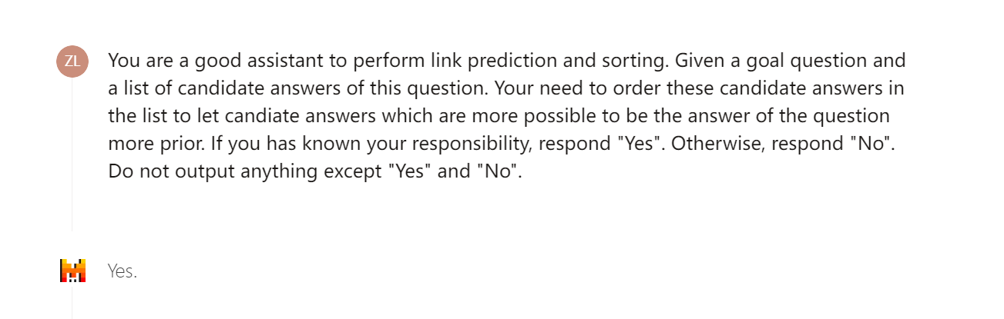
Knowledge Prompt ID0
https://chat.mistral.ai/chat/40c9cfa5-8c10-4e0b-94cb-9408a9d1d902

Slide 10
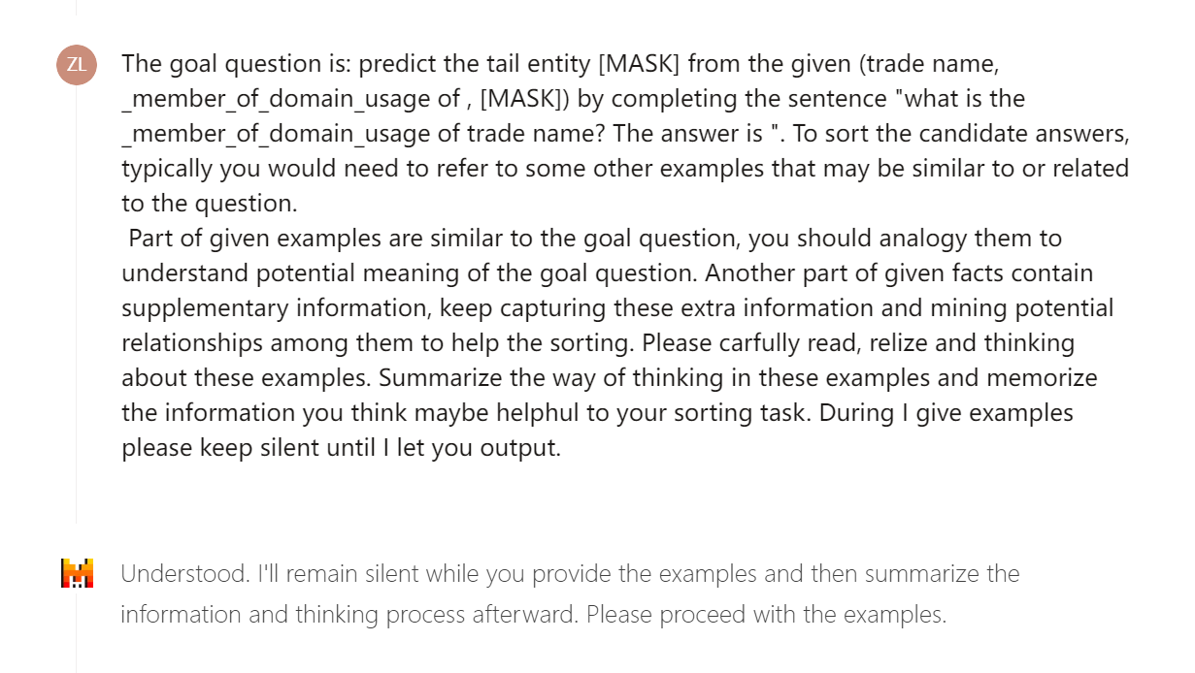
Knowledge Prompt
https://chat.mistral.ai/chat/40c9cfa5-8c10-4e0b-94cb-9408a9d1d902

Slide 11
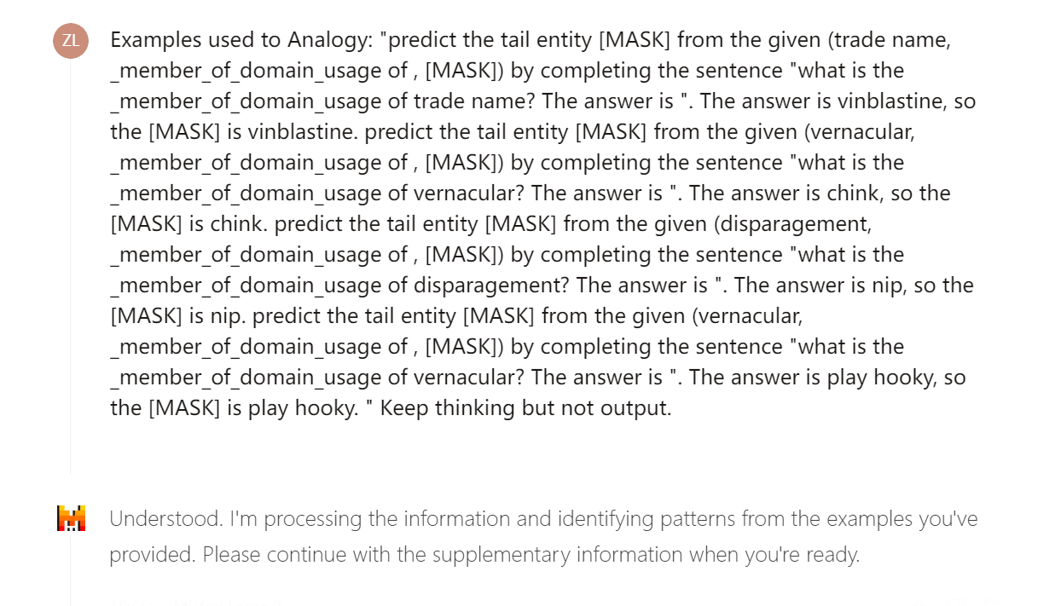
Knowledge Prompt
https://chat.mistral.ai/chat/40c9cfa5-8c10-4e0b-94cb-9408a9d1d902

Slide 12
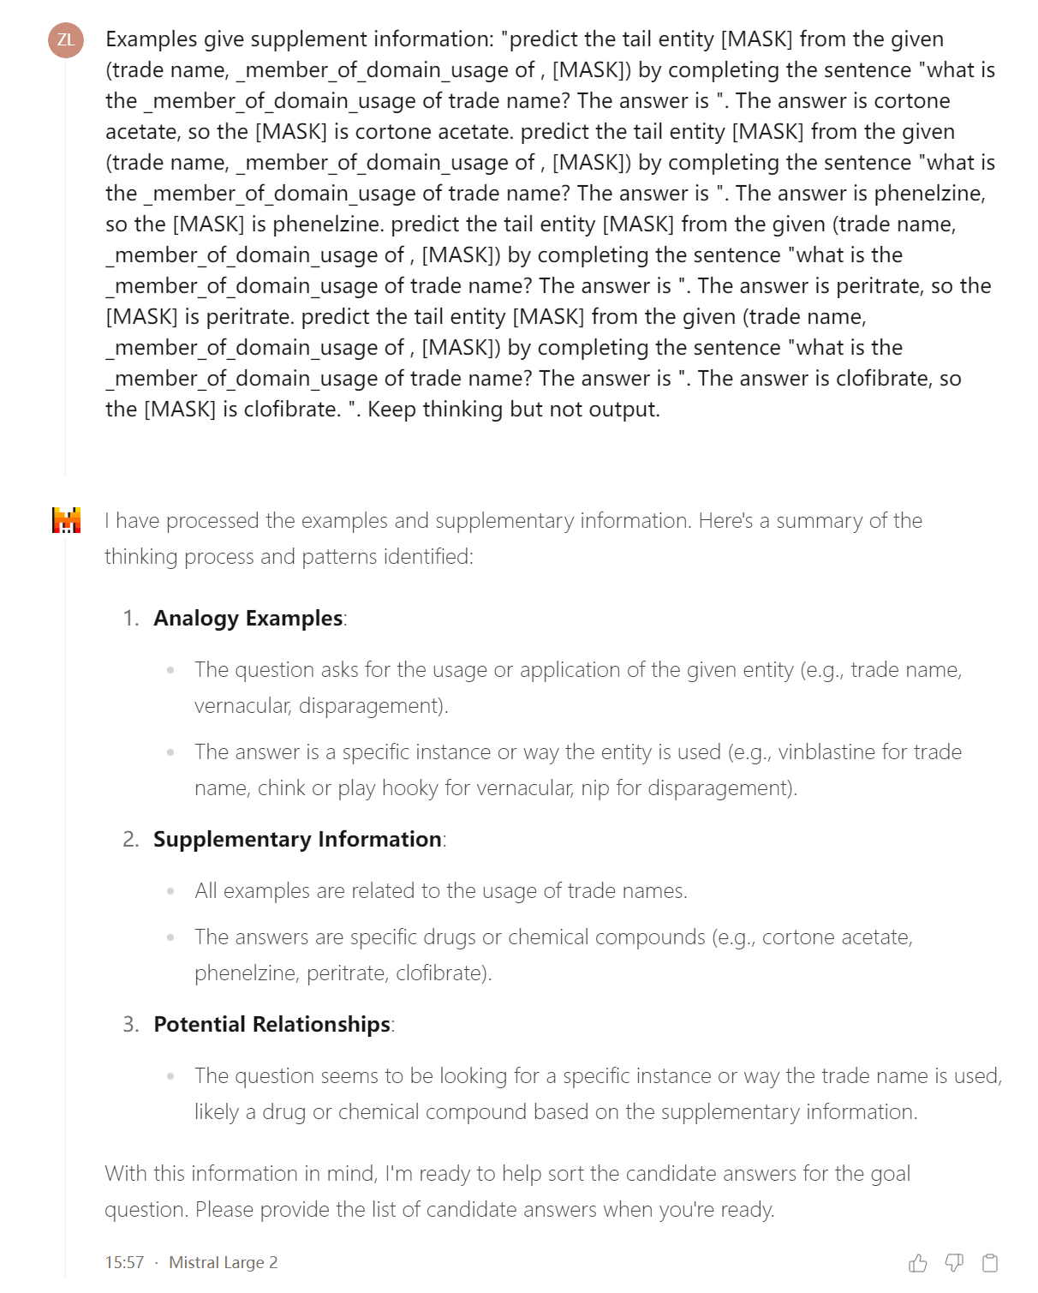
Knowledge Prompt
https://chat.mistral.ai/chat/40c9cfa5-8c10-4e0b-94cb-9408a9d1d902

Slide 13
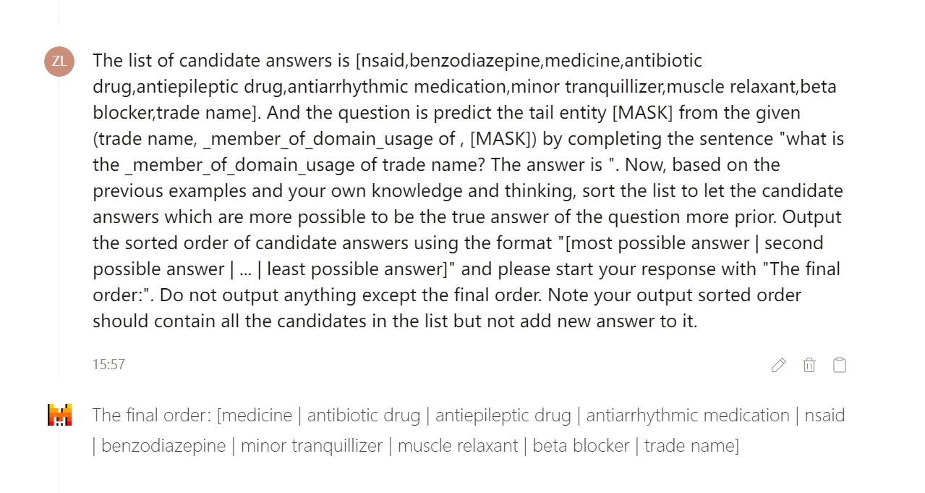
Knowledge Prompt
https://chat.mistral.ai/chat/40c9cfa5-8c10-4e0b-94cb-9408a9d1d902

Slide 14
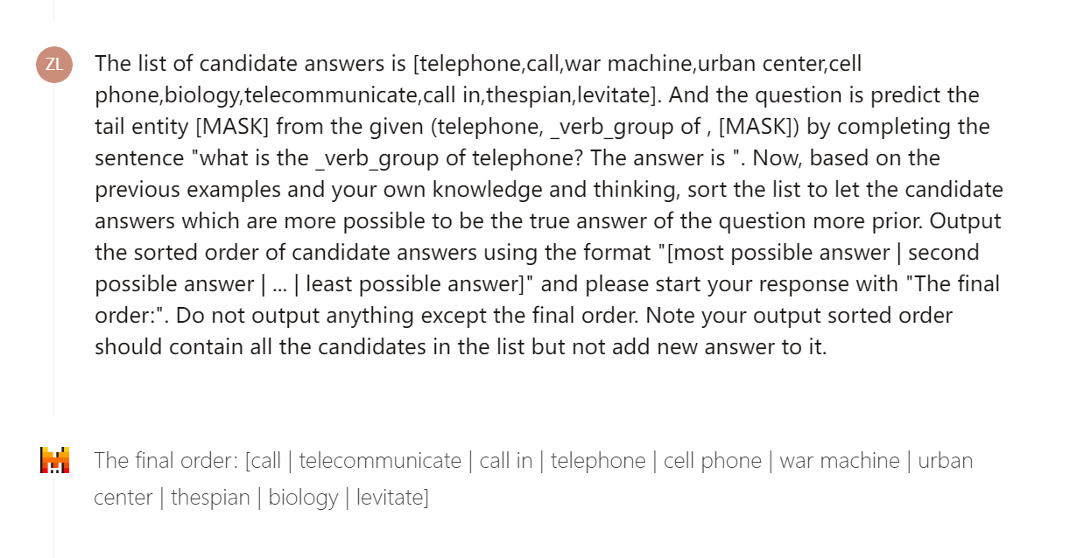
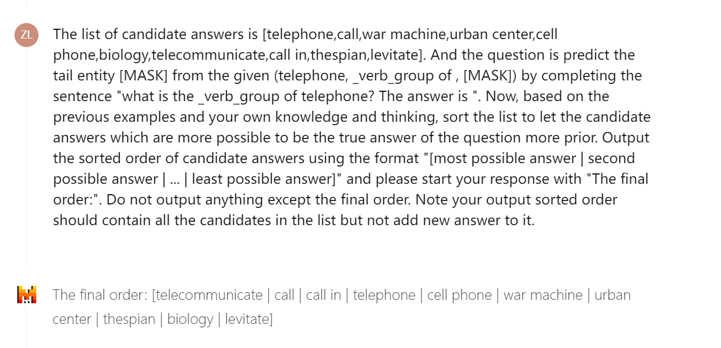
Knowledge Prompt ID1
https://chat.mistral.ai/chat/da3466c2-aa1e-4e99-b324-393b9ab6e424
https://chat.mistral.ai/chat/e73f1a04-e83d-4319-974e-f5ee70f2af38
MULTIPLE Demonstrations ARE NOT A GOOD IDEA!

Slide 15
Difficulties:
Deployment of different Mistral Model
Slow Inference &Memory Error → As the number of samples in the test set increases
Divide the wn18rr test machine into five small testsets and run them simultaneously on colab *(Colab Pro provides High-RAM)
Multiprocessing ❌
Too Many Query through API & Limits for Serverless Inference for Mistral 8x7B and Mistral 7B
Hugging Face Pro
Trivial of different API
Pricing
Expensive : GPT-4 Turbo, Mistral Large
Notes:
OPENAI res = openai.ChatCompletion.create() dict
Mistral_large res = self.client.chat.complete() no dict
Mistral_free res = self.client.chat_completion() dict

Slide 16
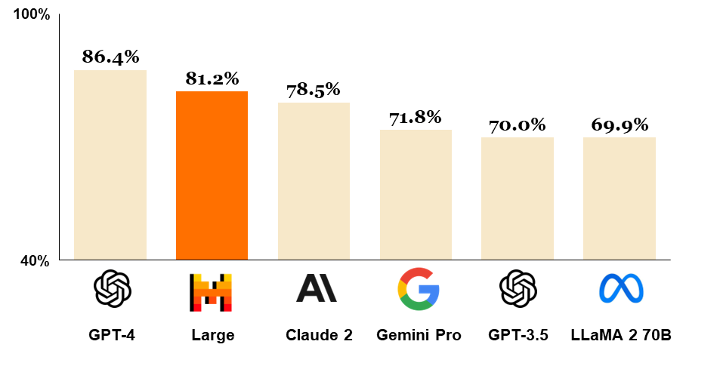
Comparison of LLMs
Comparison of GPT-4, Mistral Large (pre-trained), Claude 2, Gemini Pro 1.0, GPT 3.5 and LLaMA 2 70B on MMLU (Measuring massive multitask language understanding).
Source：https://mistral.ai/news/mistral-large/

Slide 17
Introduction
This paper focuses on the link prediction task in KGC, which is to predict the missing entity in an incomplete triple.
There are several challenges that hinder the application of LLM on KGC tasks.
First, the LLM outputs can be unconstrained and may fall outside the scope of entities in the KGs.
Second, LLMs impose length limits on the input tokens, and the limits are far from sufficient for describing a complete KGC task.
Lastly, there is no effective in-context learning prompt design for LLM on KGC tasks.
KICGPT: Knowledge In Context with GPT framework

Slide 18
Contributions:
We propose a novel cost-effective framework KICGPT for KGC tasks. To the best of our knowledge, this is the first work that combines LLMs with triple-based KGC methods, offering a unique solution to address the task.
We propose a novel in-context learning strategy, Knowledge Prompt, specifically designed for KGC.
Extensive experiments on benchmark datasets demonstrate that KICGPT achieves state-of-the-art performance with low training overhead.

Slide 19
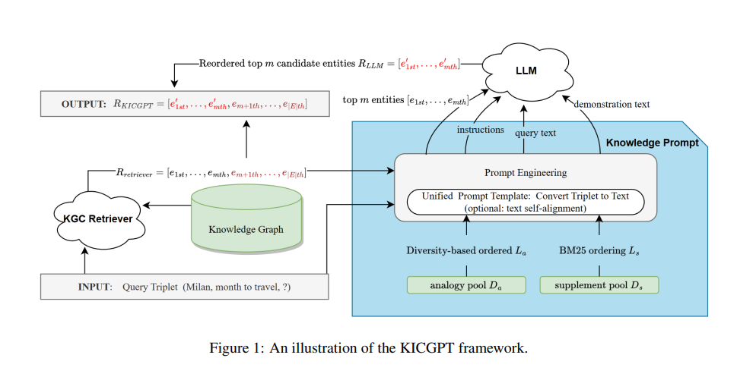
Methology:

Slide 20
Inspiration For Master Thesis
Mistral 8x7B performs better than Mistral 7B
Relation Ranking through LLMs to narrow down the subgraph search space

