Slide 1
CSE 5524 HW4
Yi Zhao

Slide 2
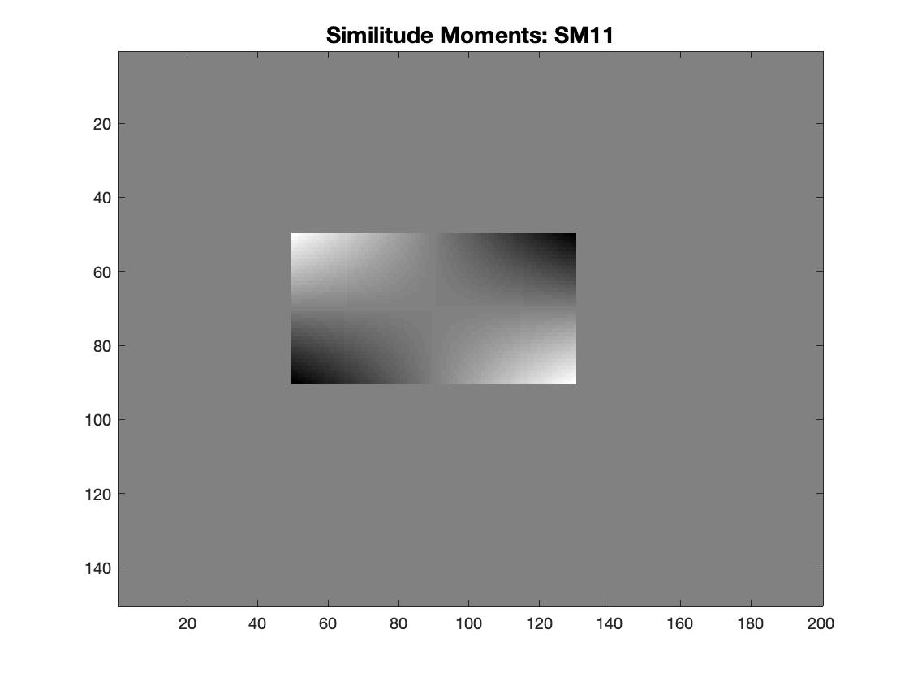

Image001: Origin vs. m11

Slide 3
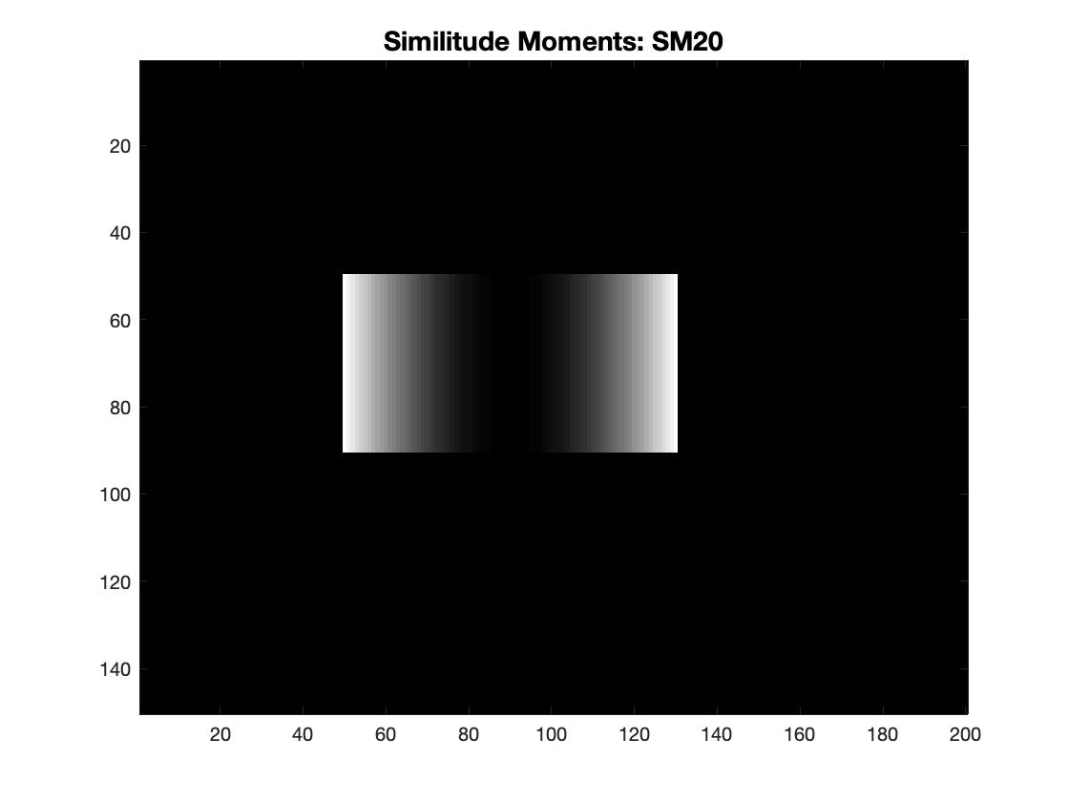
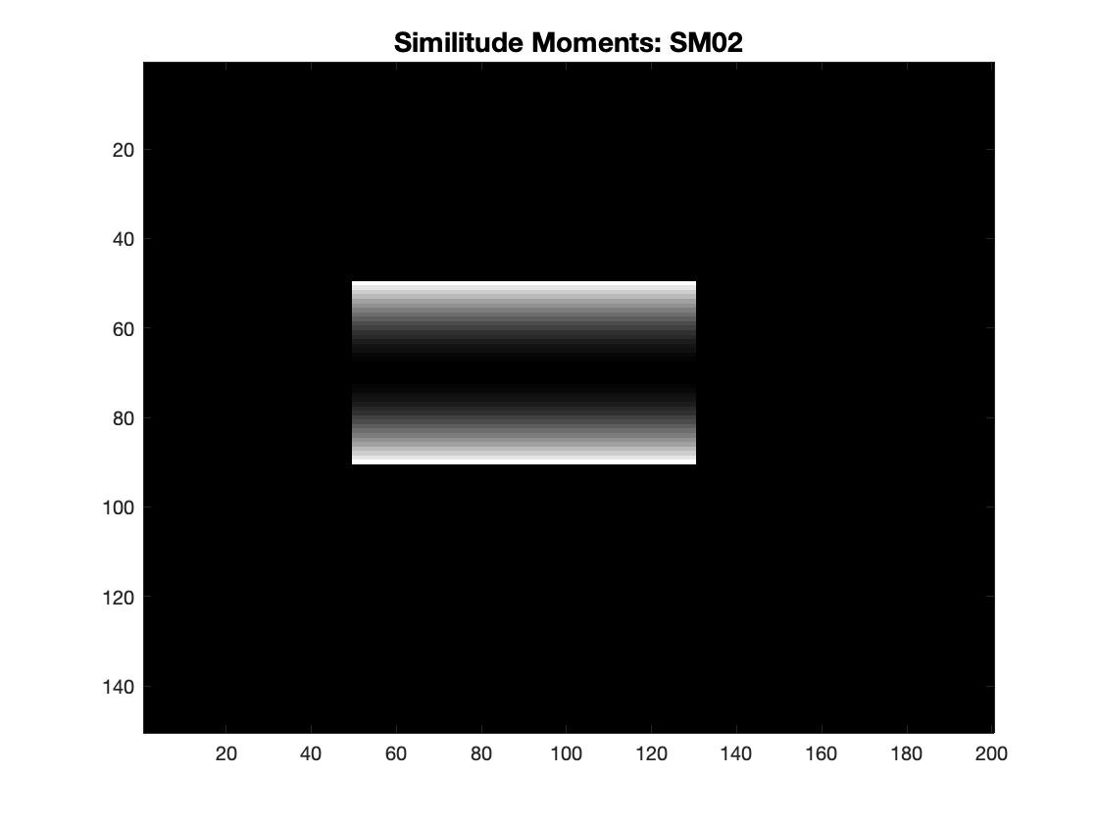
Image001: m20 vs. m02

Slide 4
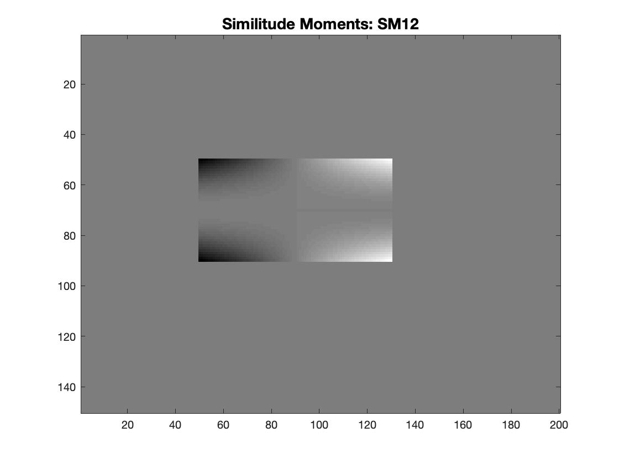
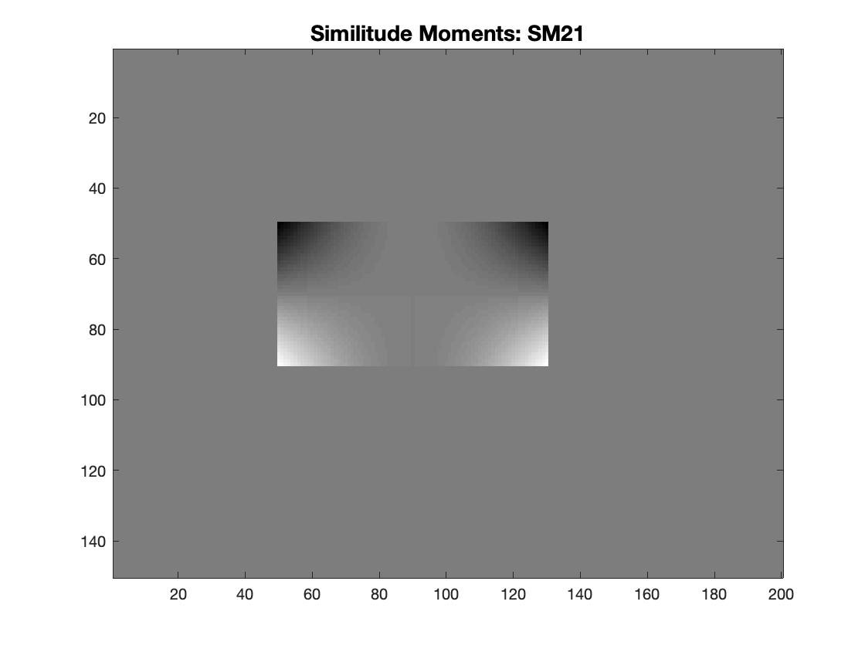
Image001: m12 vs. m21

Slide 5
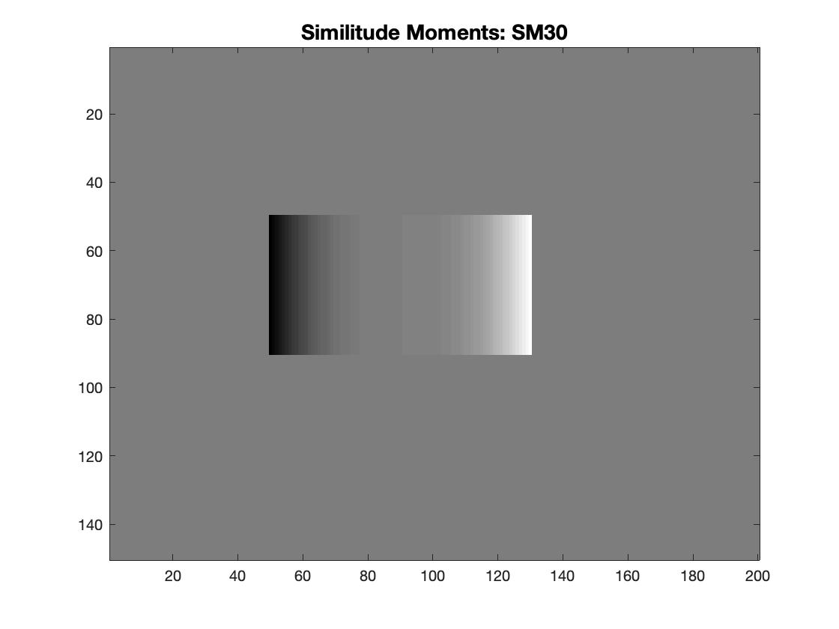
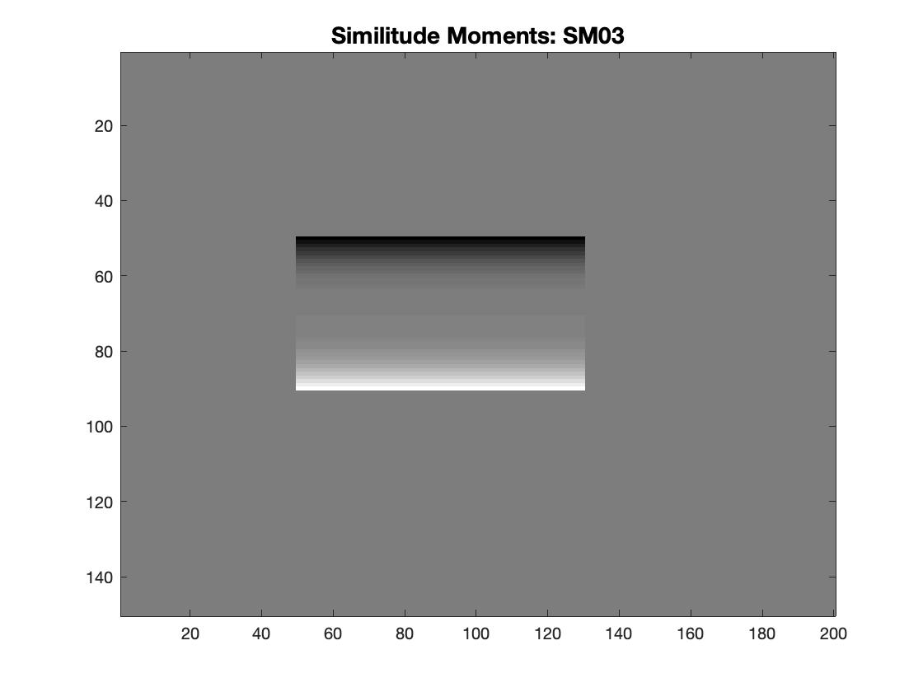
Image001: m30 vs. m03

Slide 6
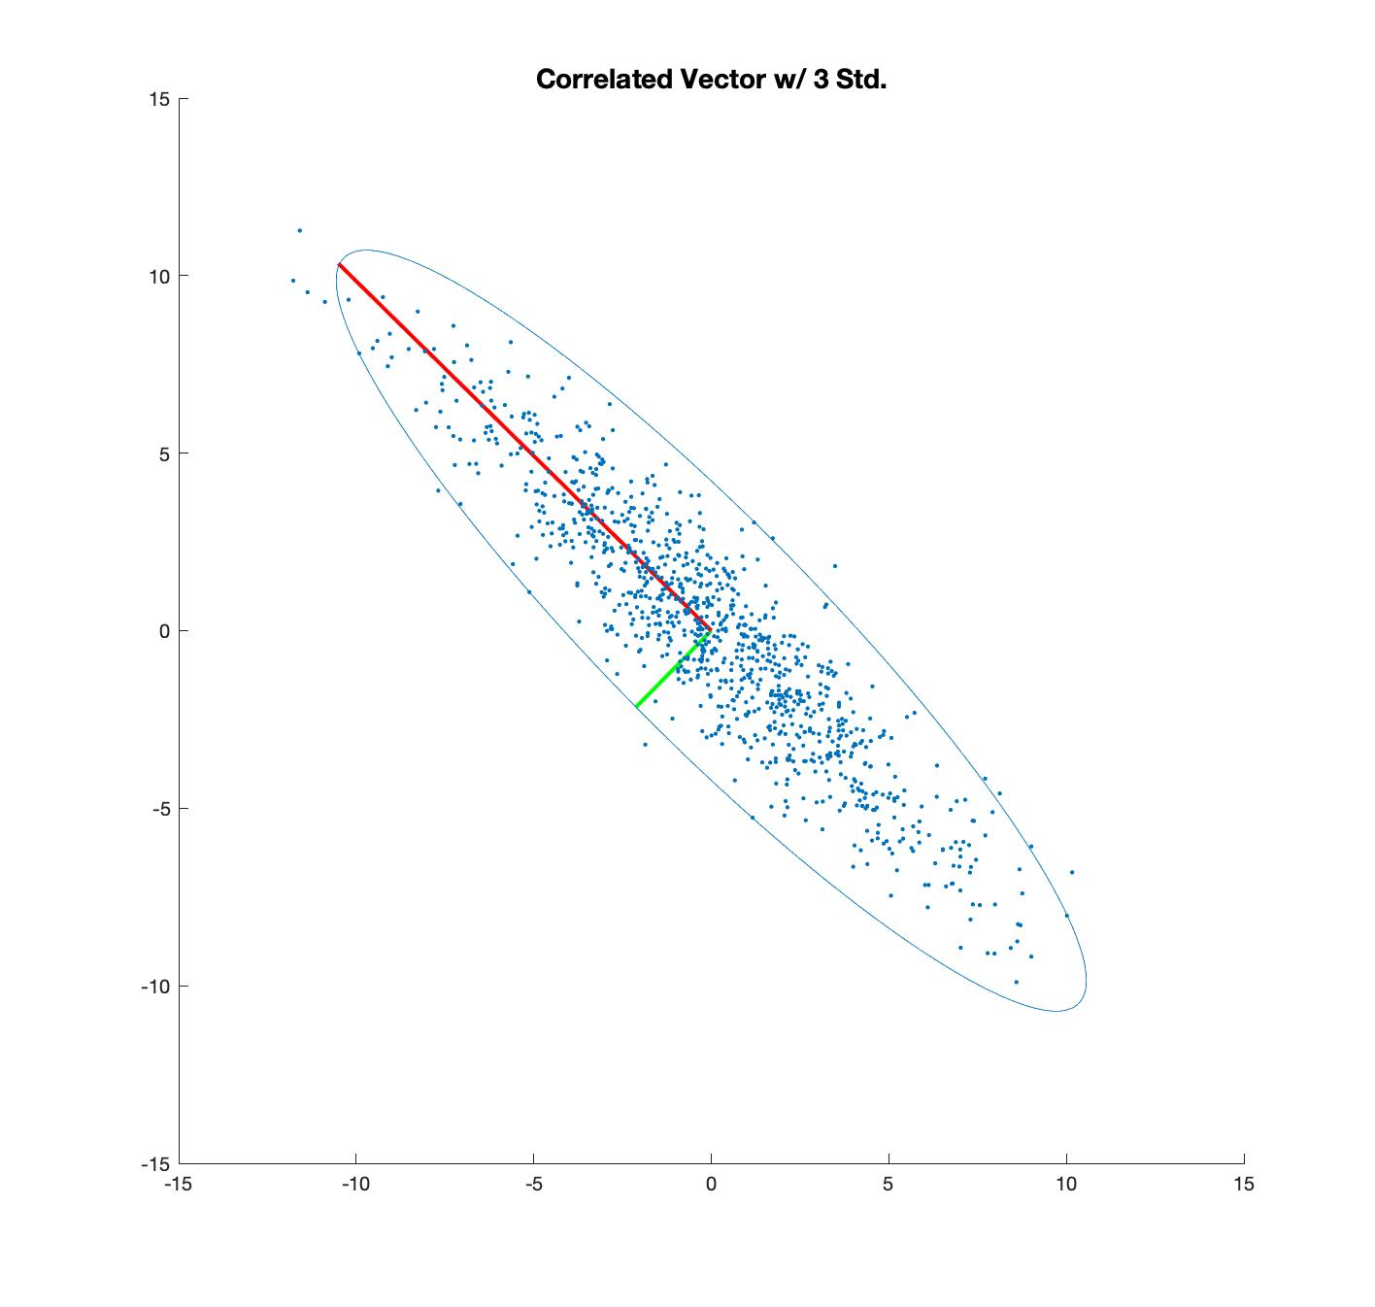
In MatLab:
U = [-0.7016, -0.7126;
-0.7126, 0.7016]
V = [1.0142, 0;
0,24.1385]

Slide 7
