Slide 1
Weakly- and Semi-Supervised Learning of a Deep Convolutional Network for Semantic Image Segmentation George Papandreou et.al
Zhihao Zhao

Slide 2
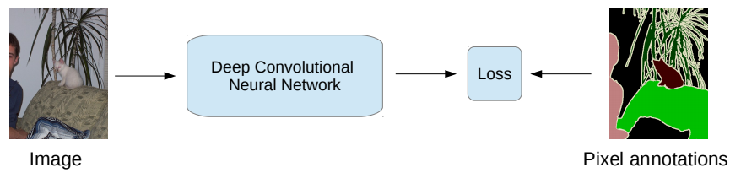
Problem
Sometimes we do not have large pixel-level dataset. But it’s much easier to get image-level dataset, i.e., dataset on multi-label recognition. Can we get pixel-level parse with pixel-level dataset?

Slide 3
Model and inference

Slide 4


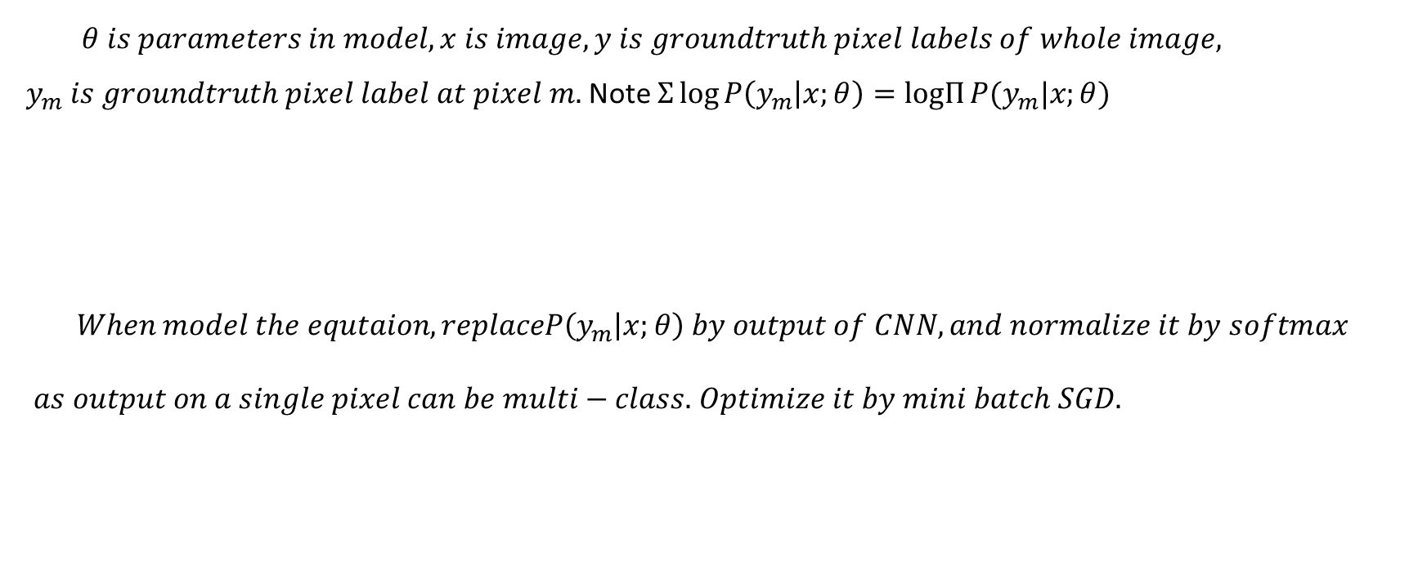
Fully Supervised – pixel level label available
$θ is parameters in model, x is image, y is groundtruth pixel labels of whole image, y_{m} is groundtruth pixel label at pixel m.$Note $Σ\log{P\left(y_{m} | x;θ\right)=logΠ{P(y_{m}|x;θ)}}$
$$When model the equtaion, replaceP\left(y_{m} | x;θ\right) by output of CNN, and normalize it by softmax$$
$as output on a single pixel can be multi−class.$ $Optimize it by mini batch SGD.$

Slide 5

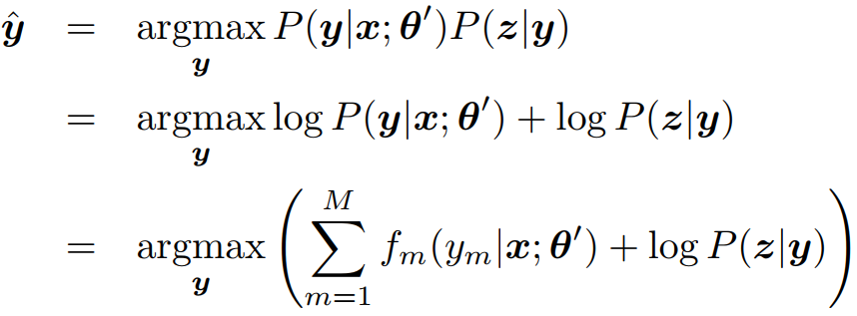
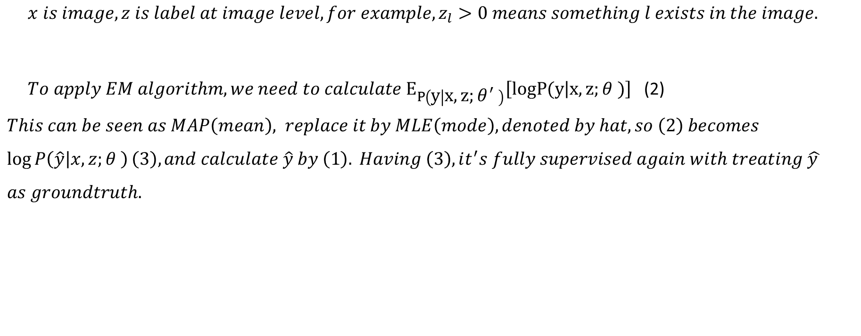
Weakly Supervised – image level label available Model the problem
$x is image, z is label at image level, for example, z_{l}>0 means something l exists in the image.$
$To apply EM algorithm, we need to calculate E_{P\left(y | x,z;θ^{′} \right)}\left[logP(y | x,z;θ^{ })\right]$ (2) $This can be seen as MAP\left(mean\right), replace it by MLE\left(mode\right), denoted by hat, so \left(2\right) becomes$
$$\log{P\left(\hat{y} | x,z;θ^{ }\right)}\left(3\right), and calculate \hat{y} by \left(1\right). Having \left(3\right), it^{′}s fully supervised again with treating \hat{y }$$
$$as groundtruth.$$
(1)

Slide 6

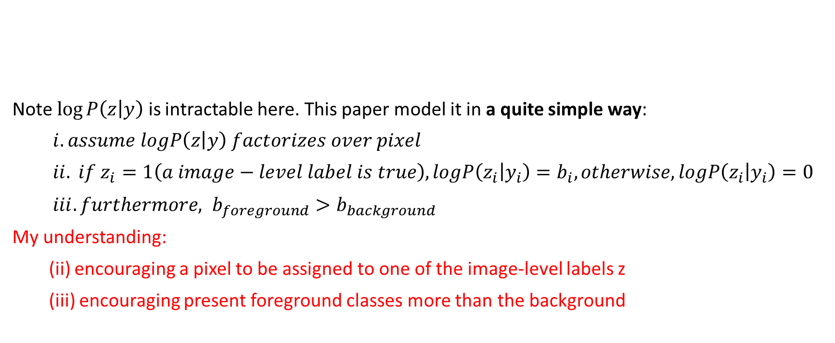
Weakly Supervised – image level label available Model the problem
Note $\log{P\left(z | y\right)}$ is intractable here. This paper model it in a quite simple way:
$i. assume logP\left(z | y\right) factorizes over pixel$
$ii. if z_{i}=1\left(a image−level label is true\right), logP\left(z_{i} | y_{i}\right)=b_{i}, otherwise, logP\left(z_{i} | y_{i}\right)=0$
$iii. furthermore, b_{foreground}>b_{background}$
My understanding:
(ii) encouraging a pixel to be assigned to one of the image-level labels z
(iii) encouraging present foreground classes more than the background

Slide 7

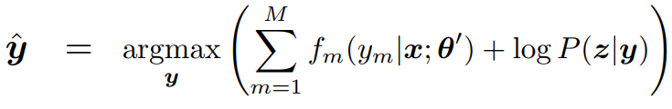

Weakly Supervised – image level label available Inference the model
E-step, calculate $logP(\hat{y}|x,θ)$
M-step, optimize $θ$
What we changed compared to a normal CNN is that we just add our prior of $logP\left(z_{m} | y_{m}\right) \text{on}{ y}_{m}$

Slide 8
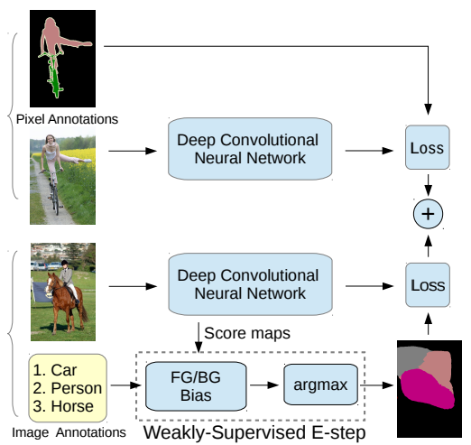
Semi-Supervised
Some images have pixel-level label,
some have image-level label.
Simply add their loss in every batch.

Slide 9
Reproducibility

Slide 10
Reproducibility
Source code, configuration files, and trained models are available at
https://bitbucket.org/ deeplab/deeplab-public
Implemented by extending Caffe.
Dataset: PASCAL VOC 2012, MS-COCO
Time: Fine-tuning on PASCAL VOC 2012 takes about 12 hours on a NVIDIA Tesla K40 GPU

