Slide 1

Generalized Advantage Estimation
广义优势估计
东川路第一可爱猫猫虫

Slide 2

主要内容
优势函数
N步优势函数估计器
方差与偏差的权衡
指数加权平均
$γ$与$λ$
代码实现

Slide 3

优势函数
$A\left(s_{t},a_{t}\right)=Q_{π}\left(s_{t},a_{t}\right)−V_{π}\left(s_{t}\right)$
$Q_{π}\left(s_{t},a_{t}\right)$
$a_{t}$的动作价值
$V_{π}\left(s_{t}\right)$
$s_{t}$的状态价值

Slide 4
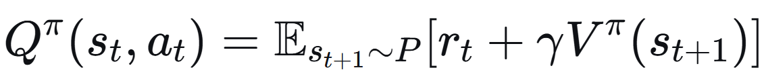
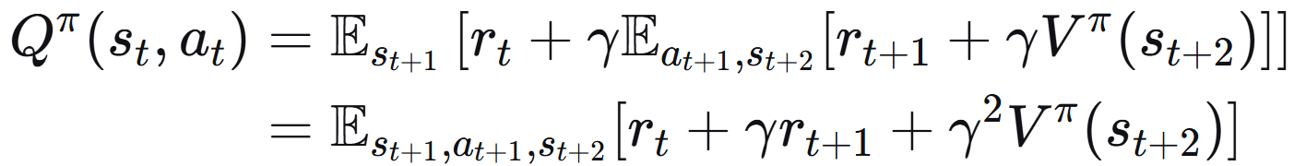

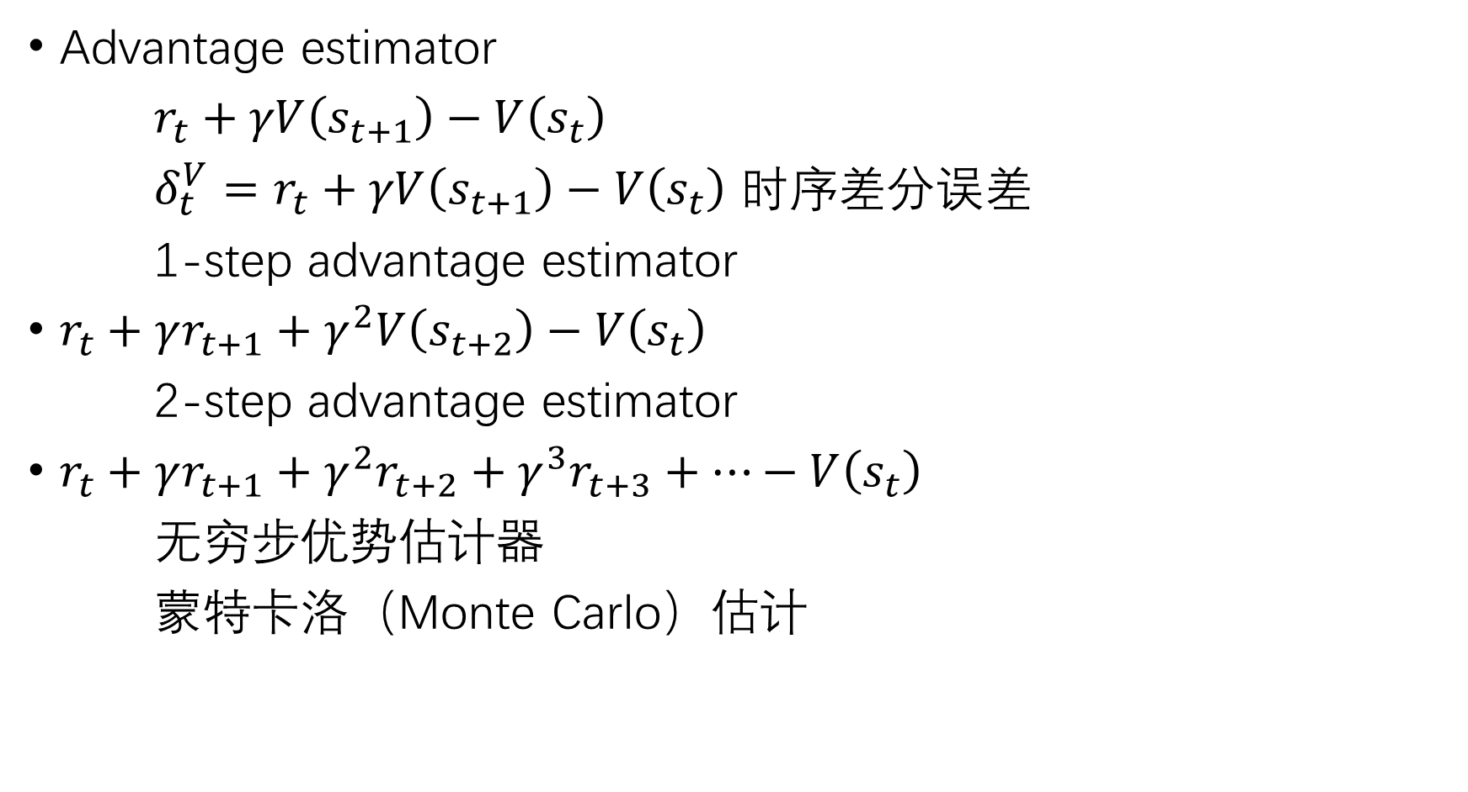

对期望$Q_{π}\left(s_{t},a_{t}\right)−V_{π}\left(s_{t}\right)$进行估计
Advantage estimator
$r_{t}+γV\left(s_{t+1}\right)−V\left(s_{t}\right)$
$δ_{t}^{V}=r_{t}+γV\left(s_{t+1}\right)−V\left(s_{t}\right)$ 时序差分误差
1-step advantage estimator
$r_{t}+γr_{t+1}+γ^{2}V\left(s_{t+2}\right)−V\left(s_{t}\right)$
2-step advantage estimator
$r_{t}+γr_{t+1}+γ^{2}r_{t+2}+γ^{3}r_{t+3}+…−V\left(s_{t}\right)$
无穷步优势估计器
蒙特卡洛（Monte Carlo）估计

Slide 5
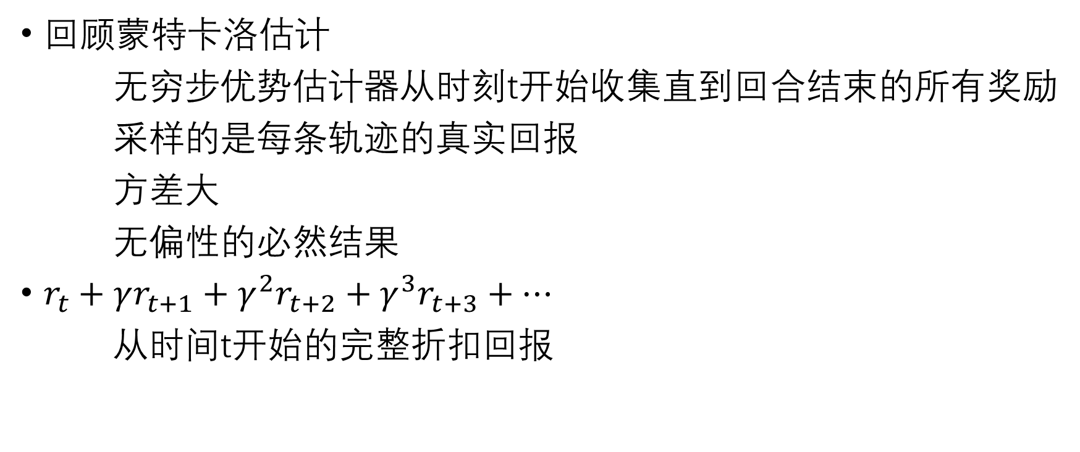
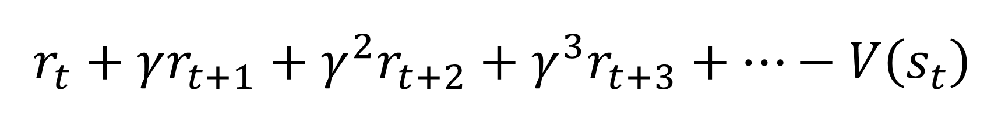
$$r_{t}+γr_{t+1}+γ^{2}r_{t+2}+γ^{3}r_{t+3}+…−V\left(s_{t}\right)$$
回顾蒙特卡洛估计
无穷步优势估计器从时刻t开始收集直到回合结束的所有奖励
采样的是每条轨迹的真实回报
方差大
无偏性的必然结果
$r_{t}+γr_{t+1}+γ^{2}r_{t+2}+γ^{3}r_{t+3}+…$
从时间t开始的完整折扣回报

Slide 6
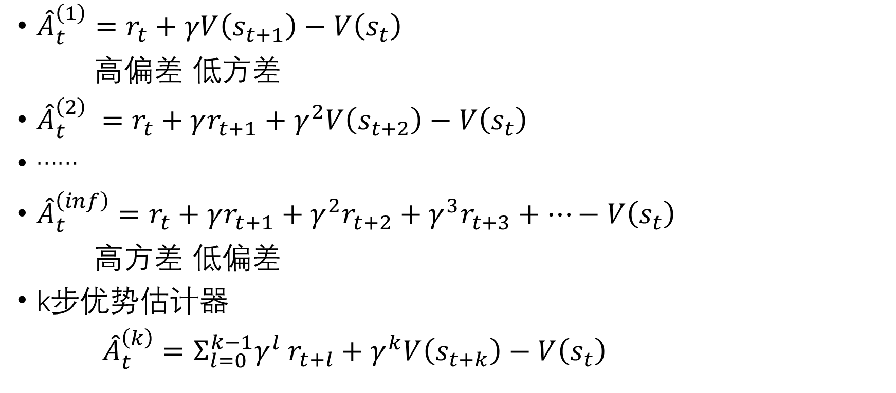
n-step advantage estimator里的方差和偏差
${\hat{A}}_{t}^{\left(1\right)}=r_{t}+γV\left(s_{t+1}\right)−V\left(s_{t}\right)$
高偏差 低方差
${\hat{A}}_{t}^{\left(2\right)} =r_{t}+γr_{t+1}+γ^{2}V\left(s_{t+2}\right)−V\left(s_{t}\right)$
……
${\hat{A}}_{t}^{\left(inf\right)}=r_{t}+γr_{t+1}+γ^{2}r_{t+2}+γ^{3}r_{t+3}+…−V\left(s_{t}\right)$
高方差 低偏差
k步优势估计器
${\hat{A}}_{t}^{\left(k\right)}=Σ_{l=0}^{k−1}γ^{l} r_{t+l}+γ^{k}V\left(s_{t+k}\right)−V\left(s_{t}\right)$
web.stanford.edu/class/cs234/slides/lecture7pre.pdf

Slide 7
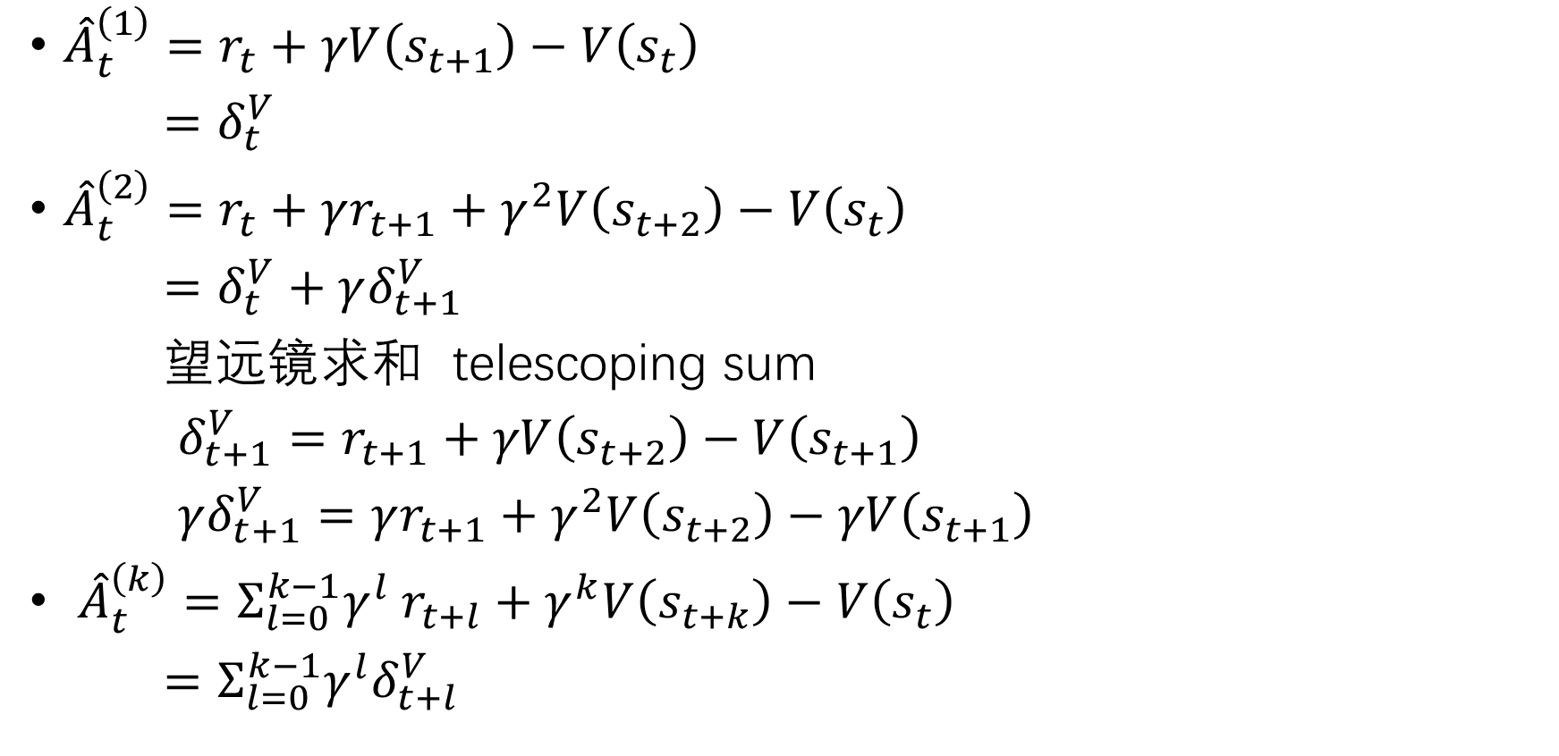
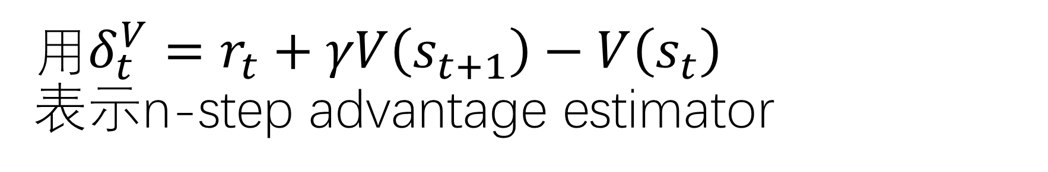
用$δ_{t}^{V}=r_{t}+γV\left(s_{t+1}\right)−V\left(s_{t}\right)$
表示n-step advantage estimator
${\hat{A}}_{t}^{\left(1\right)}=r_{t}+γV\left(s_{t+1}\right)−V\left(s_{t}\right)$
$=δ_{t}^{V}$
${\hat{A}}_{t}^{\left(2\right)}=r_{t}+γr_{t+1}+γ^{2}V\left(s_{t+2}\right)−V\left(s_{t}\right)$
$=δ_{t}^{V}+γδ_{t+1}^{V}$
望远镜求和 telescoping sum
$δ_{t+1}^{V}=$ $r_{t+1}+γV\left(s_{t+2}\right)−V\left(s_{t+1}\right)$
$γδ_{t+1}^{V}=γr_{t+1}+γ^{2}V\left(s_{t+2}\right)−γV\left(s_{t+1}\right)$
${\hat{A}}_{t}^{\left(k\right)}=Σ_{l=0}^{k−1}γ^{l} r_{t+l}+γ^{k}V\left(s_{t+k}\right)−V\left(s_{t}\right)$
$=Σ_{l=0}^{k−1}γ^{l}δ_{t+l}^{V}$
web.stanford.edu/class/cs234/slides/lecture7pre.pdf

Slide 8
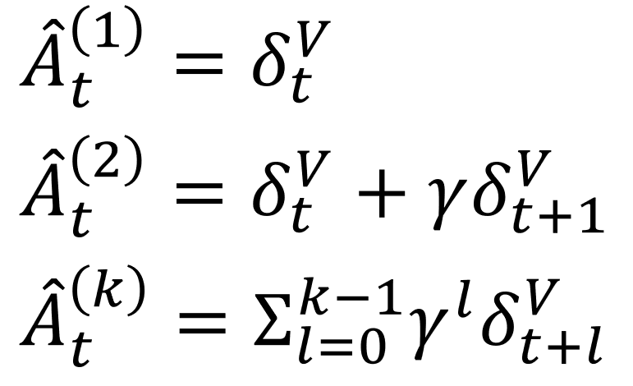
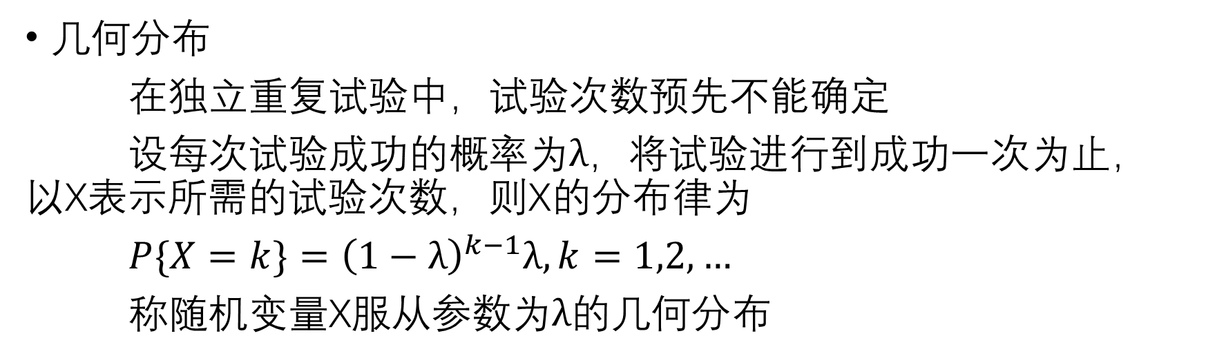

GAE用指数进行指数加权平均
几何分布
在独立重复试验中，试验次数预先不能确定
设每次试验成功的概率为$λ$，将试验进行到成功一次为止，以X表示所需的试验次数，则X的分布律为
$P\{X=k\}={\left(1−λ\right)}^{k−1}λ,k=1,2,…$
称随机变量X服从参数为$λ$的几何分布
几何分布 首项为$λ$，公比为$1−λ$
GAE权重 首项为$1−λ$，公比为$λ$
指数加权平均
web.stanford.edu/class/cs234/slides/lecture7pre.pdf

Slide 9
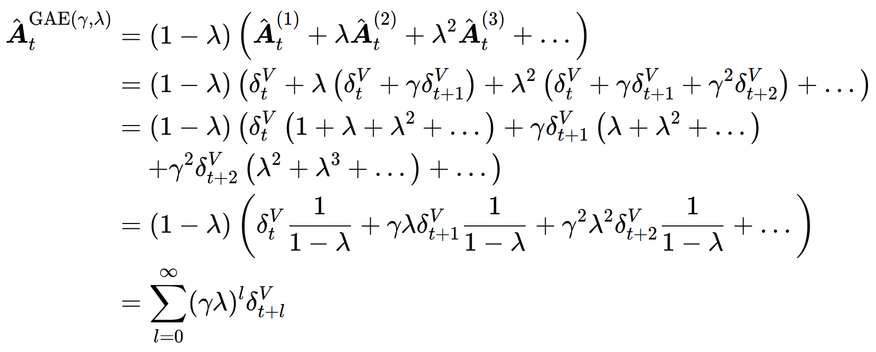

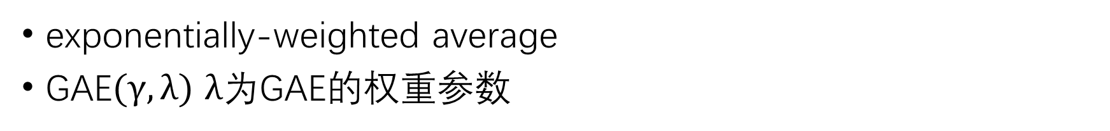
GAE就是k步优势估计器的指数加权平均
exponentially-weighted average
GAE$(γ,λ)$ $λ$为GAE的权重参数

Slide 10


GAE$(γ,0)$与GAE$(γ,1)$
GAE$(γ,0)即为$TD
GAE退化成了经典Actor-Critic算法
基于TD(0)残差的优势函数估计
依赖单步reward
偏差高，方差低
GAE$(γ,1)$即为MC
GAE退化成了reinforce算法
基于蒙特卡洛方法的优势函数估计
偏差低，方差高

Slide 11
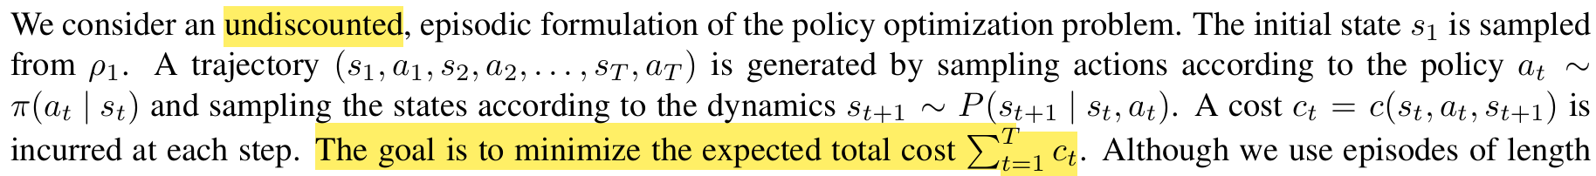
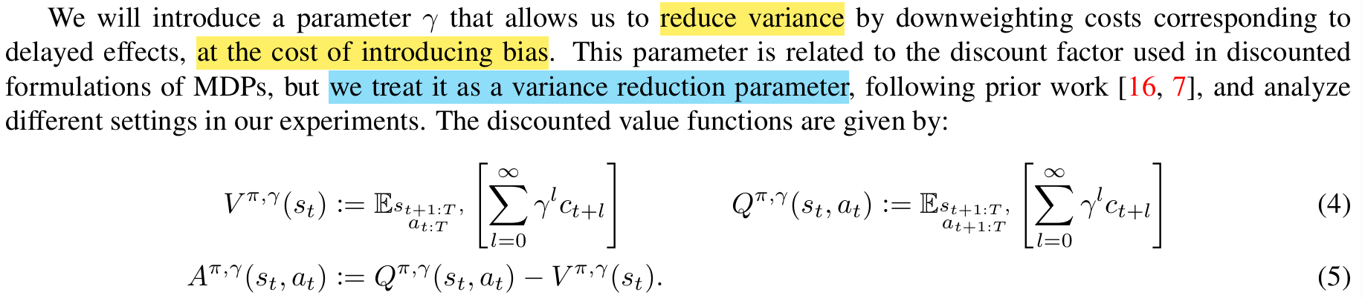


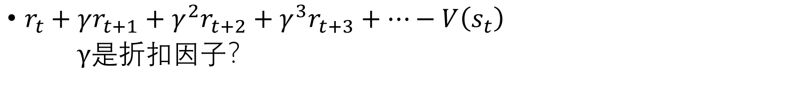
GAE$(γ,λ)$里的$γ$
$r_{t}+γr_{t+1}+γ^{2}r_{t+2}+γ^{3}r_{t+3}+…−V\left(s_{t}\right)$
$γ$是折扣因子？
以无折扣成本总和为优化目标
没有折扣因子$γ$

Slide 12

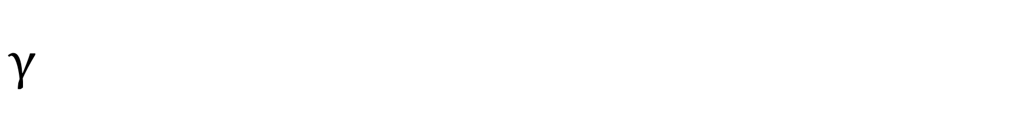
$$γ$$
论文里的$γ$是一个为了工程实践而引入的算法参数
而非问题定义的一部分
引入$γ$以后
优化目标从无折扣变成了有折扣
这就引入了偏差 变成了有偏估计
用一个有偏差但低方差的梯度估计器，去优化一个无偏差的目标函数

Slide 13

GAE的代码实现
$$δ_{t}^{V}=r_{t}+γV\left(s_{t+1}\right)−V\left(s_{t}\right)$$

Slide 14
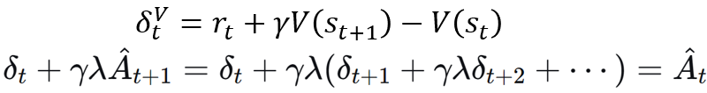
https://github.com/labmlai/annotated_deep_learning_paper_implementations/tree/master/labml_nn/rl/ppo/gae.py
import numpy as np
class GAE:
def __init__(self, n_workers: int, worker_steps: int, gamma: float, lambda_: float):
self.lambda_ = lambda_
self.gamma = gamma
self.worker_steps = worker_steps
self.n_workers = n_workers
def __call__(self, done: np.ndarray, rewards: np.ndarray, values: np.ndarray) -> np.ndarray:
advantages = np.zeros((self.n_workers, self.worker_steps), dtype=np.float32)
last_advantage = 0
last_value = values[:, -1]
for t in reversed(range(self.worker_steps)):
mask = 1.0 - done[:, t]
last_value = last_value * mask
last_advantage = last_advantage * mask
delta = rewards[:, t] + self.gamma * last_value - values[:, t]
last_advantage = delta + self.gamma * self.lambda_ * last_advantage
advantages[:, t] = last_advantage
last_value = values[:, t]
return advantages

Slide 15
参数: n_workers=2, worker_steps=3, gamma=0.9, lambda=0.8
输入数据:
done:
[[0. 0. 1.]
[0. 0. 0.]]
rewards:
[[1. 2. 3. ]
[0.5 1.5 2.5]]
values:
[[0.1 0.2 0.3 0. ]
[0.1 0.2 0.3 0. ]]
初始化: last_value = [0. 0.], last_advantage = 0

Slide 16
--- 时间步 t=2 ---
done[:, 2] = [1. 0.]
mask = 1 - done[:, 2] = [0. 1.]
应用mask前: last_value = [0. 0.], last_advantage = 0
应用mask后: last_value = [0. 0.], last_advantage = [0. 0.]
rewards[:, 2] = [3. 2.5]
values[:, 2] = [0.3 0.3]
delta = rewards + gamma*last_value - values = [2.7 2.2]
new last_advantage = delta + gamma*lambda*last_advantage = [2.7 2.2]
advantages[:, 2] = [2.7 2.2]
更新last_value = values[:, 2] = [0.3 0.3]

Slide 17
--- 时间步 t=1 ---
done[:, 1] = [0. 0.]
mask = 1 - done[:, 1] = [1. 1.]
应用mask前: last_value = [0.3 0.3], last_advantage = [2.7 2.2]
应用mask后: last_value = [0.3 0.3], last_advantage = [2.7 2.2]
rewards[:, 1] = [2. 1.5]
values[:, 1] = [0.2 0.2]
delta = rewards + gamma*last_value - values = [2.07 1.5699999]
new last_advantage = delta + gamma*lambda*last_advantage = [4.014 3.154]
advantages[:, 1] = [4.014 3.154]
更新last_value = values[:, 1] = [0.2 0.2]

Slide 18
--- 时间步 t=0 ---
done[:, 0] = [0. 0.]
mask = 1 - done[:, 0] = [1. 1.]
应用mask前: last_value = [0.2 0.2], last_advantage = [4.014 3.154]
应用mask后: last_value = [0.2 0.2], last_advantage = [4.014 3.154]
rewards[:, 0] = [1. 0.5]
values[:, 0] = [0.1 0.1]
delta = rewards + gamma*last_value - values = [1.0799999 0.58 ]
new last_advantage = delta + gamma*lambda*last_advantage = [3.97008 2.8508801]
advantages[:, 0] = [3.97008 2.8508801]
更新last_value = values[:, 0] = [0.1 0.1]
最终advantages矩阵:
[[3.97008 4.014 2.7 ]
[2.8508801 3.154 2.2 ]]

