Slide 1
DPO
Direct Preference Optimization
东川路第一可爱猫猫虫

Slide 2
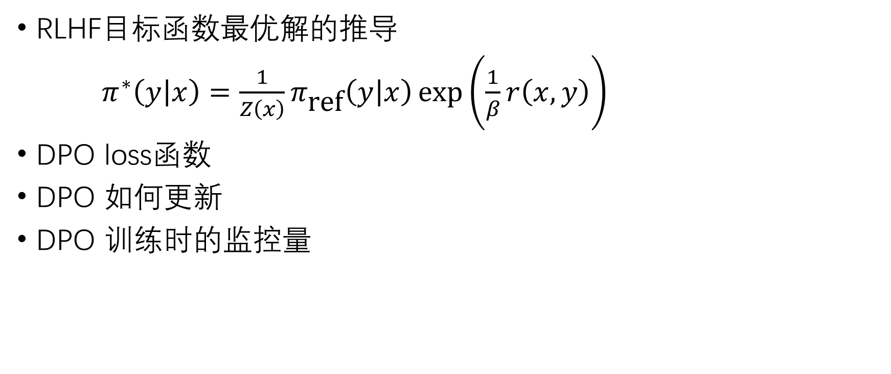
主要内容
感谢
宽人克己是謂上策
阿萨李逍遥张小凡
蕾西亚万岁啊我透
bcdfgh
居居熊哒
JasonCZH4
RLHF目标函数最优解的推导
$π^{∗}\left(y | x\right)=\frac{1}{Z\left(x\right)}π_{\text{ref}}\left(y | x\right)\exp\left(\frac{1}{β}r\left(x,y\right)\right)$
DPO loss函数
DPO 如何更新
DPO 训练时的监控量

Slide 3
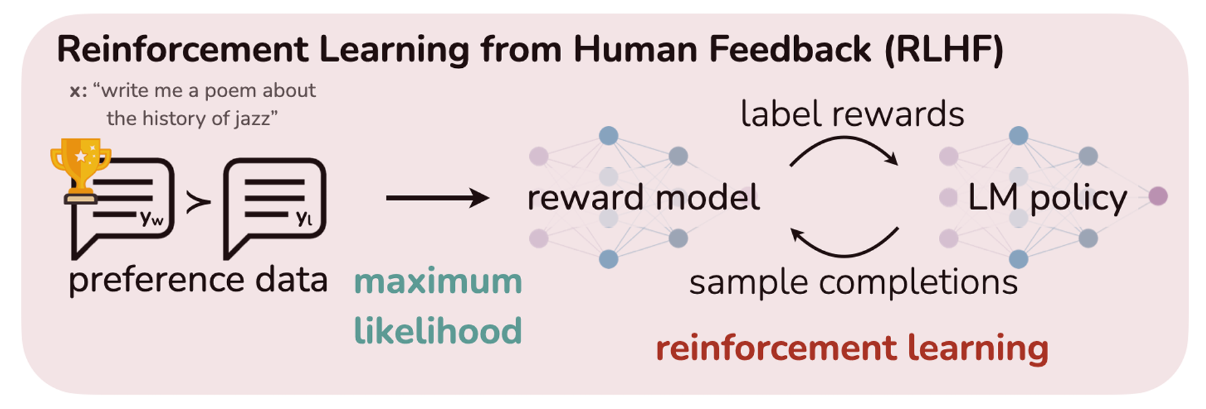
RLHF (InstructGPT 2022.03)

Slide 4
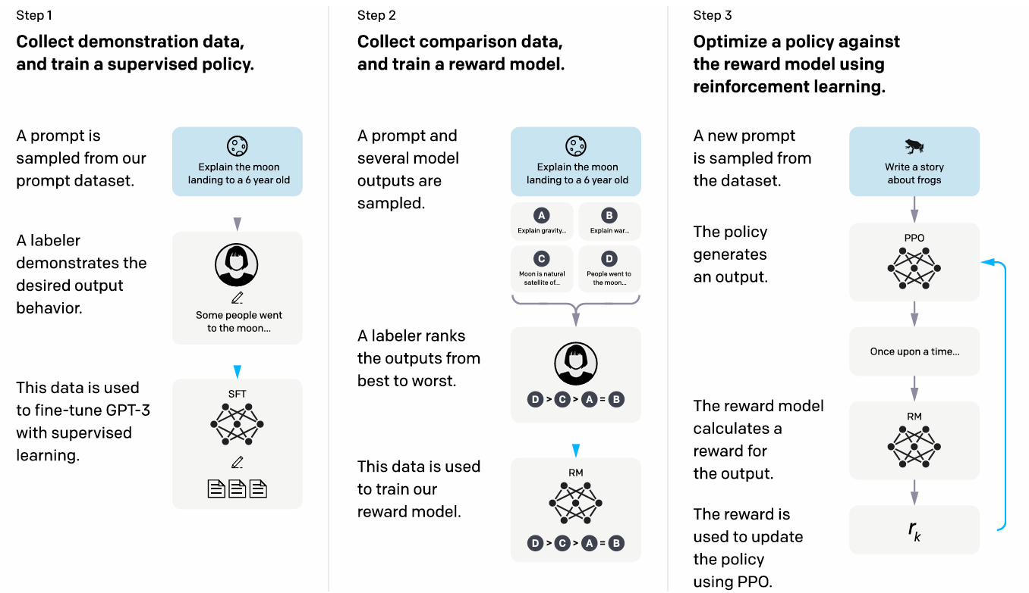

Slide 5
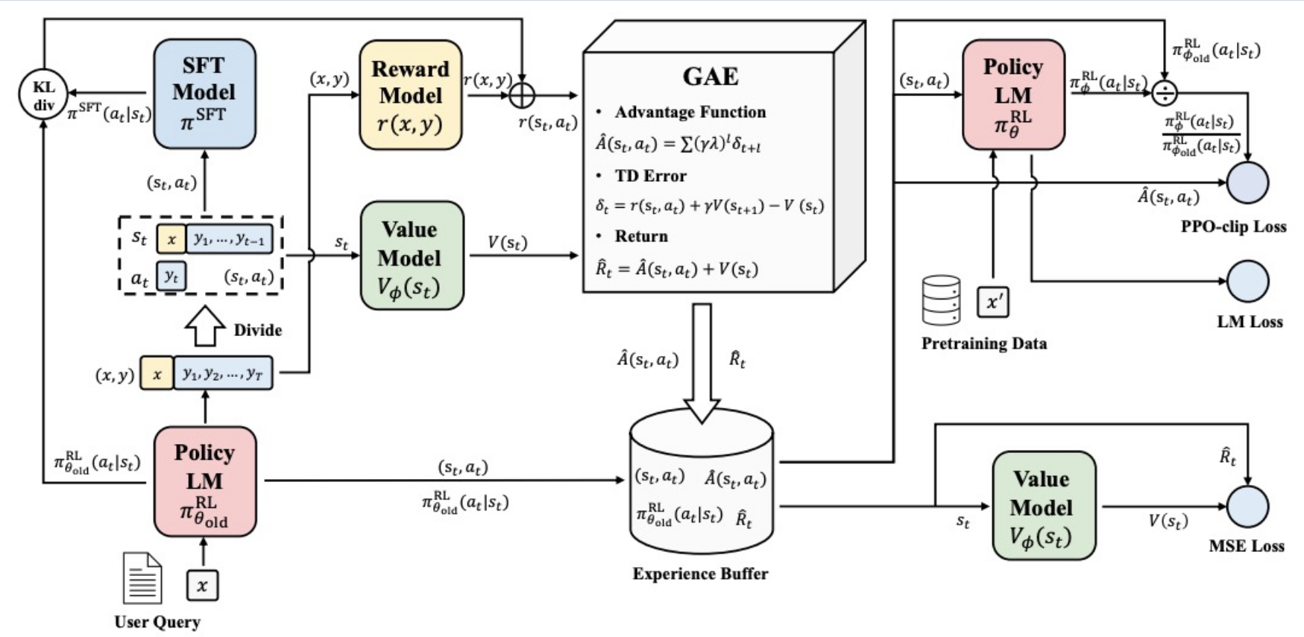

Slide 6
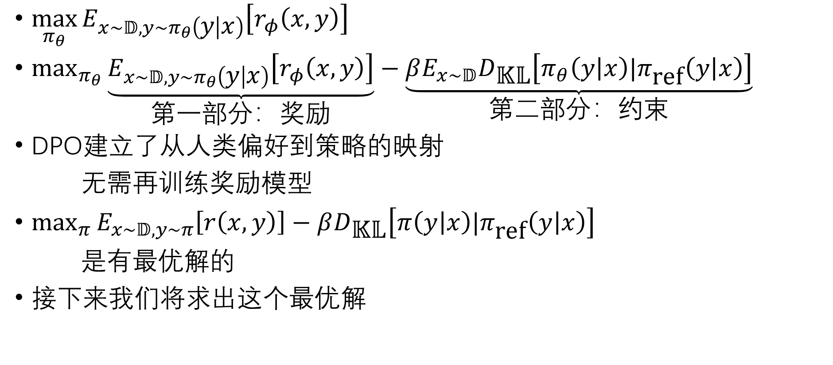
目标函数
$\max_{π_{θ}}{E_{x∼𝔻,y∼π_{θ}\left(y | x\right)}\left[r_{φ}\left(x,y\right)\right]}$
$\max_{π_{θ}}{\underset{\text{第一部分}：奖励}{\underbrace{E_{x∼𝔻,y∼π_{θ}\left(y | x\right)}\left[r_{φ}\left(x,y\right)\right]}}}−\underset{\text{第二部分：约束}}{\underbrace{βE_{x∼𝔻}D_{\text{𝕂𝕃}}\left[π_{θ}\left(y | x\right)|π_{\text{ref}}\left(y | x\right)\right]}}$
DPO$建立了从人类偏好到策略的映射$
无需$再训练奖励模型$
$\max_{π}{E_{x∼𝔻,y∼π}\left[r\left(x,y\right)\right]}−βD_{\text{𝕂𝕃}}\left[π\left(y | x\right)|π_{\text{ref}}\left(y | x\right)\right]$
是有$最优解的$
接下来$我们将求出这个最优解$

Slide 7
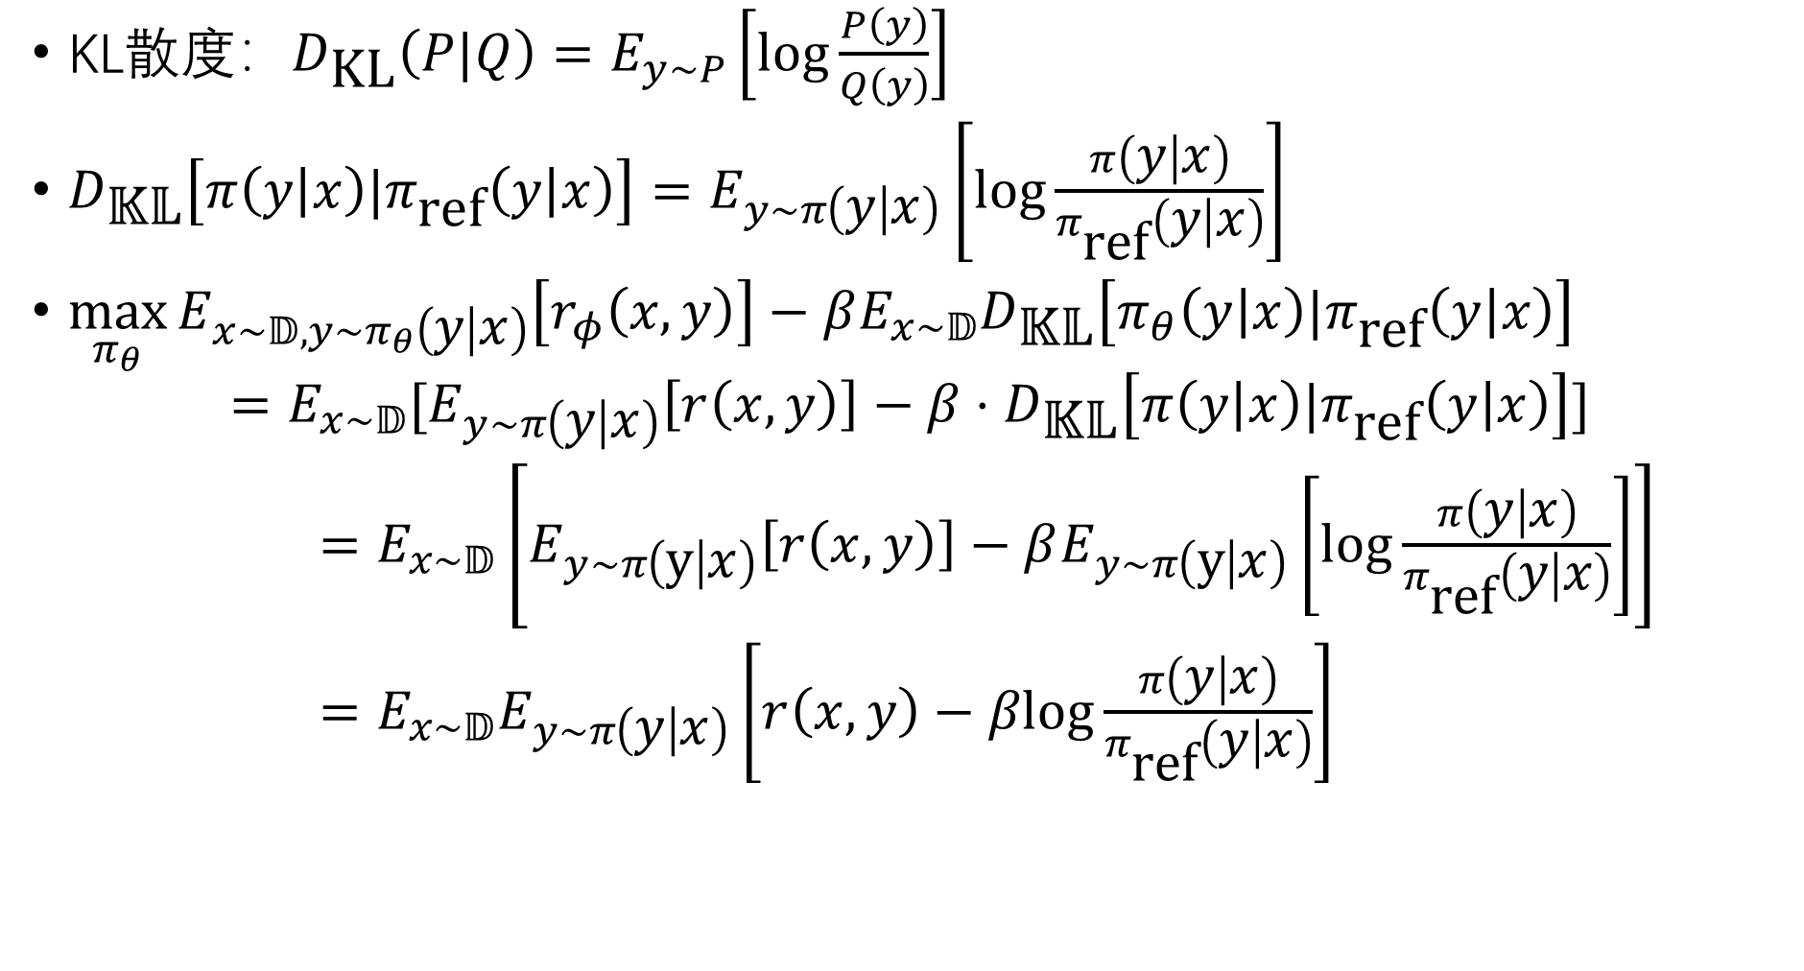
KL散度：$D_{\text{KL}}\left(P|Q\right)=E_{y∼P}\left[log\frac{P\left(y\right)}{Q\left(y\right)}\right]$
$D_{\text{𝕂𝕃}}\left[π\left(y | x\right)|π_{\text{ref}}\left(y | x\right)\right]=E_{y∼π\left(y | x\right)}\left[\log{\frac{π\left(y | x\right)}{π_{\text{ref}}\left(y | x\right)}}\right]$
$\max_{π_{θ}}{E_{x∼𝔻,y∼π_{θ}\left(y | x\right)}\left[r_{φ}\left(x,y\right)\right]}−βE_{x∼𝔻}D_{\text{𝕂𝕃}}\left[π_{θ}\left(y | x\right)|π_{\text{ref}}\left(y | x\right)\right]$
$$=E_{x∼𝔻}[E_{y∼π\left(y | x\right)}\left[r\left(x,y\right)\right]−β⋅D_{\text{𝕂𝕃}}\left[π\left(y | x\right)|π_{\text{ref}}\left(y | x\right)\right]]$$
$=E_{x∼𝔻}\left[E_{y∼π\left(y | x\right)}\left[r\left(x,y\right)\right]−βE_{y∼π\left(y | x\right)}\left[log\frac{π\left(y | x\right)}{π_{\text{ref}}\left(y | x\right)}\right]\right]$
$=E_{x∼𝔻}E_{y∼π\left(y | x\right)}\left[r\left(x,y\right)−βlog\frac{π\left(y | x\right)}{π_{\text{ref}}\left(y | x\right)}\right]$

Slide 8
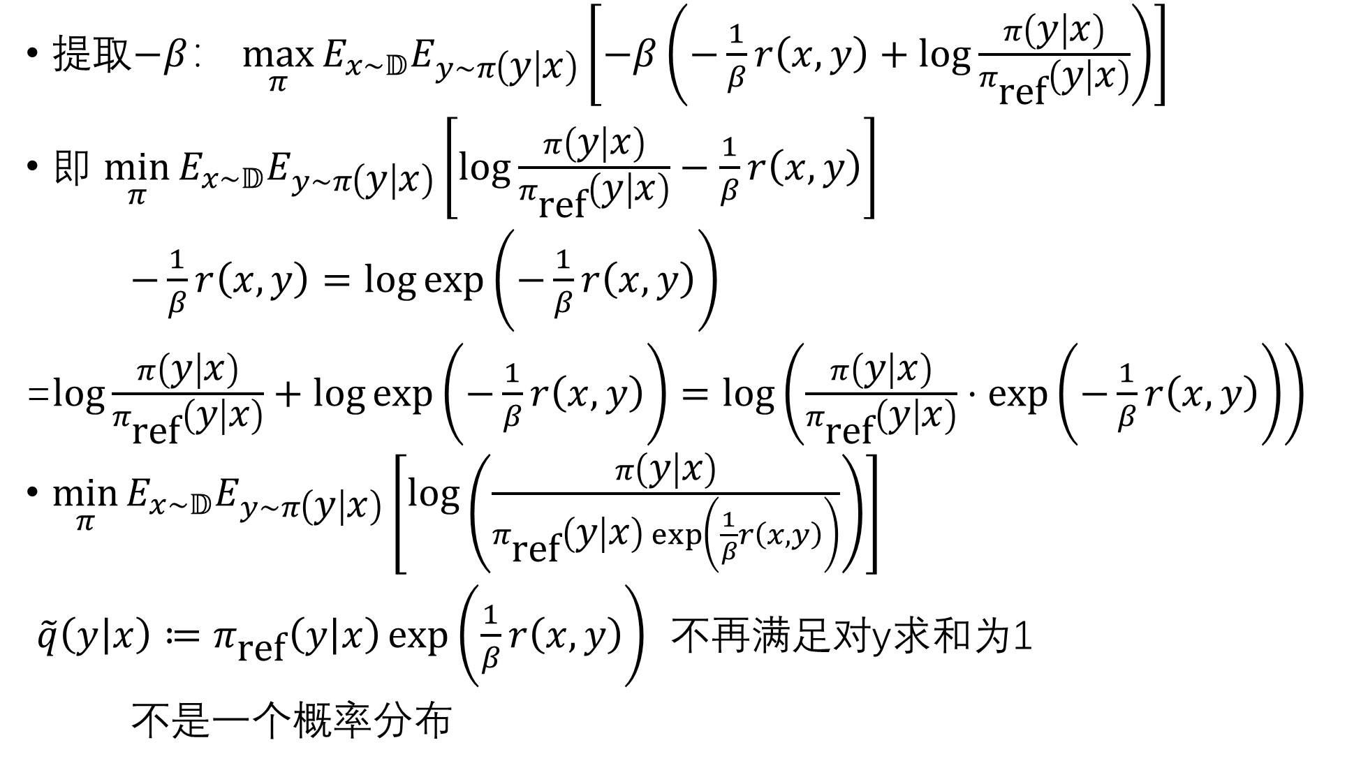
提取$−β$： $\max_{π}{E_{x∼𝔻}E_{y∼π\left(y | x\right)}\left[−β\left(−\frac{1}{β}r\left(x,y\right)+log\frac{π\left(y | x\right)}{π_{\text{ref}}\left(y | x\right)}\right)\right]}$
即 $\min_{π}{E_{x∼𝔻}E_{y∼π\left(y | x\right)}\left[log\frac{π\left(y | x\right)}{π_{\text{ref}}\left(y | x\right)}−\frac{1}{β}r\left(x,y\right)\right]}$
$−\frac{1}{β}r\left(x,y\right)=\log{\exp\left(−\frac{1}{β}r\left(x,y\right)\right)}$
=$log\frac{π\left(y | x\right)}{π_{\text{ref}}\left(y | x\right)}+\log{\exp\left(−\frac{1}{β}r\left(x,y\right)\right)}=\log\left(\frac{π\left(y | x\right)}{π_{\text{ref}}\left(y | x\right)}⋅\exp\left(−\frac{1}{β}r\left(x,y\right)\right)\right)$
$\min_{π}E_{x∼𝔻}E_{y∼π\left(y | x\right)}\left[\log\left(\frac{π\left(y | x\right)}{π_{\text{ref}}\left(y | x\right)\exp\left(\frac{1}{β}r\left(x,y\right)\right)}\right)\right]$
$\tilde{q}\left(y | x\right)≔π_{\text{ref}}\left(y | x\right)\exp\left(\frac{1}{β}r\left(x,y\right)\right)$ 不再满足对y求和为1
不是一个概率分布

Slide 9
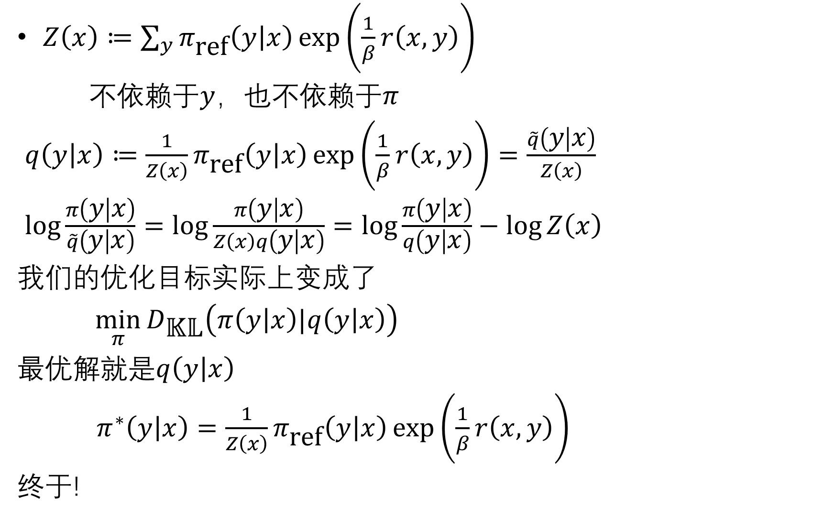
$Z\left(x\right)≔\sum_{y}{π_{\text{ref}}\left(y | x\right)}\exp\left(\frac{1}{β}r\left(x,y\right)\right)$
不依赖于$y$，也不依赖于$π$
$q\left(y | x\right)≔\frac{1}{Z\left(x\right)}π_{\text{ref}}\left(y | x\right)\exp\left(\frac{1}{β}r\left(x,y\right)\right)=\frac{\tilde{q}\left(y | x\right)}{Z\left(x\right)}$
$log\frac{π\left(y | x\right)}{\tilde{q}\left(y | x\right)}=log\frac{π\left(y | x\right)}{Z\left(x\right)q\left(y | x\right)}=log\frac{π\left(y | x\right)}{q\left(y | x\right)}−\log{Z\left(x\right)}$
我们的优化目标实际上变成了
$\min_{π}{D_{\text{𝕂𝕃}}\left(π\left(y | x\right)|q\left(y | x\right)\right)}$
最优解就是$q\left(y | x\right)$
$π^{∗}\left(y | x\right)=\frac{1}{Z\left(x\right)}π_{\text{ref}}\left(y | x\right)\exp\left(\frac{1}{β}r\left(x,y\right)\right)$
终于!

Slide 10
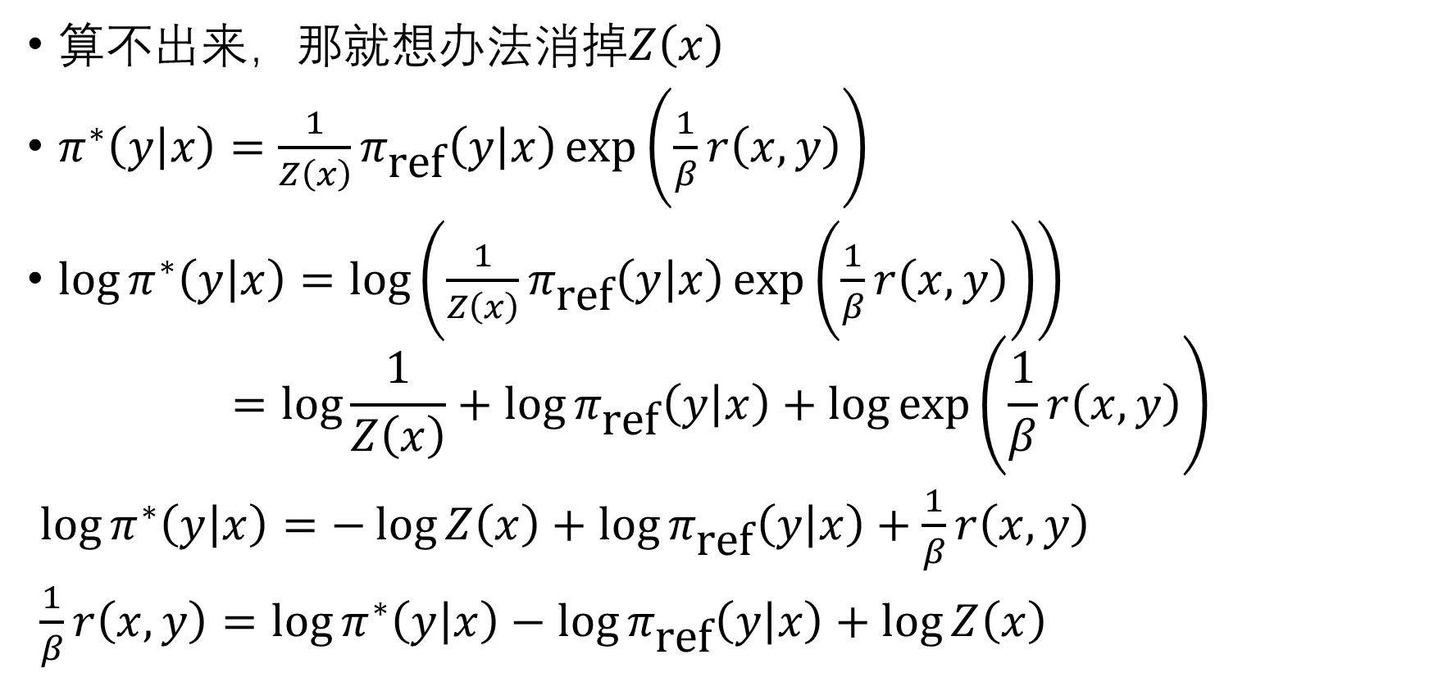

我们无法算出$\sum_{y}{π_{\text{ref}}\left(y | x\right)}\exp\left(\frac{1}{β}r\left(x,y\right)\right)$
算不出来，那就想办法消掉$Z\left(x\right)$
$π^{∗}\left(y | x\right)=\frac{1}{Z\left(x\right)}π_{\text{ref}}\left(y | x\right)\exp\left(\frac{1}{β}r\left(x,y\right)\right)$
$\log{π^{∗}\left(y | x\right)}=\log\left(\frac{1}{Z\left(x\right)}π_{\text{ref}}\left(y | x\right)\exp\left(\frac{1}{β}r\left(x,y\right)\right)\right)$
$$=log\frac{1}{Z\left(x\right)}+\log{π_{\text{ref}}\left(y | x\right)}+\log{\exp\left(\frac{1}{β}r\left(x,y\right)\right)}$$
$\log{π^{∗}\left(y | x\right)}=−\log{Z\left(x\right)}+\log{π_{\text{ref}}\left(y | x\right)}+\frac{1}{β}r\left(x,y\right)$
$\frac{1}{β}r\left(x,y\right)=\log{π^{∗}\left(y | x\right)}−\log{π_{\text{ref}}\left(y | x\right)}+\log{Z\left(x\right)}$

Slide 11
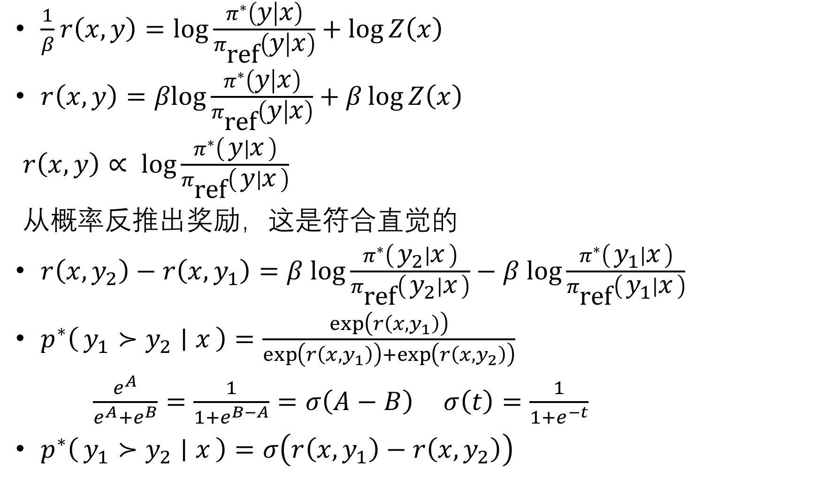
$\frac{1}{β}r\left(x,y\right)=log\frac{π^{∗}\left(y | x\right)}{π_{\text{ref}}\left(y | x\right)}+\log{Z\left(x\right)}$
$r\left(x,y\right)=βlog\frac{π^{∗}\left(y | x\right)}{π_{\text{ref}}\left(y | x\right)}+β\log{Z\left(x\right)}$
$r\left(x,y\right)∝ log\frac{π^{∗}\left(y ∣ x\right)}{π_{\text{ref}}\left(y ∣ x\right)}$
从概率反推出奖励，这是符合直觉的
$r\left(x,y_{2}\right)−r\left(x,y_{1}\right)=β log\frac{π^{∗}\left(y_{2} ∣ x\right)}{π_{\text{ref}}\left(y_{2} ∣ x\right)}−β log\frac{π^{∗}\left(y_{1} ∣ x\right)}{π_{\text{ref}}\left(y_{1} ∣ x\right)}$
$p^{∗}\left(y_{1}≻y_{2} ∣ x\right)=\frac{\exp\left(r\left(x,y_{1}\right)\right)}{\exp\left(r\left(x,y_{1}\right)\right)+\exp\left(r\left(x,y_{2}\right)\right)}$
$\frac{e^{A}}{e^{A}+e^{B}}=\frac{1}{1+e^{B−A}}=σ\left(A−B\right)$ $σ\left(t\right)=\frac{1}{1+e^{−t}}$
$p^{∗}\left(y_{1}≻y_{2} ∣ x\right)=σ\left(r\left(x,y_{1}\right)−r\left(x,y_{2}\right)\right)$

Slide 12
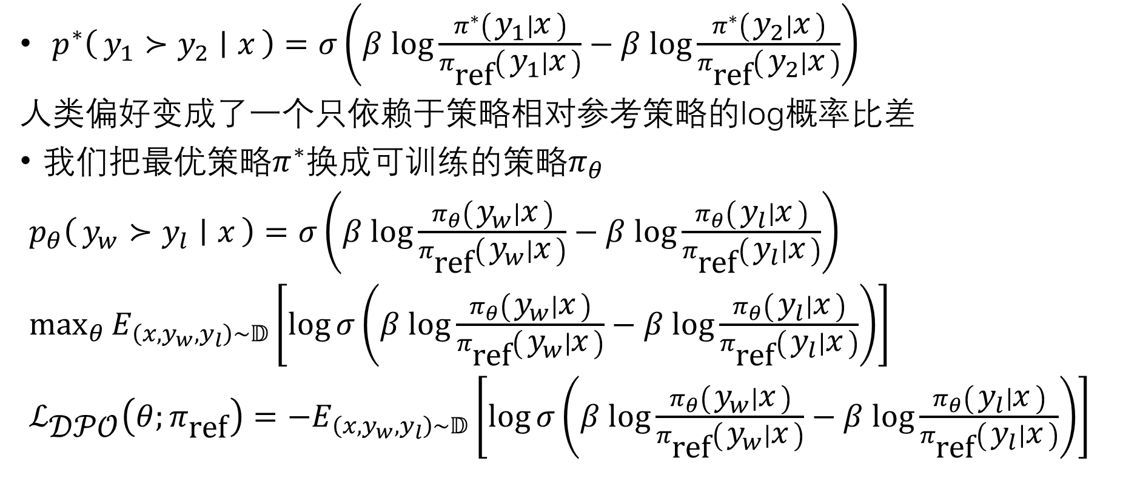
继续推导
$p^{∗}\left(y_{1}≻y_{2} ∣ x\right)=σ\left(β log\frac{π^{∗}\left(y_{1} ∣ x\right)}{π_{\text{ref}}\left(y_{1} ∣ x\right)}−β log\frac{π^{∗}\left(y_{2} ∣ x\right)}{π_{\text{ref}}\left(y_{2} ∣ x\right)}\right)$
人类偏好变成了一个只依赖于策略相对参考策略的log概率比差
我们把最优策略$π^{∗}$换成可训练的策略$π_{θ}$
$p_{θ}\left(y_{w}≻y_{l} ∣ x\right)=σ\left(β log\frac{π_{θ}\left(y_{w} ∣ x\right)}{π_{\text{ref}}\left(y_{w} ∣ x\right)}−β log\frac{π_{θ}\left(y_{l} ∣ x\right)}{π_{\text{ref}}\left(y_{l} ∣ x\right)}\right)$
$\max_{θ}{E_{\left(x,y_{w},y_{l}\right)∼𝔻}\left[\log{σ\left(β log\frac{π_{θ}\left(y_{w} ∣ x\right)}{π_{\text{ref}}\left(y_{w} ∣ x\right)}−β log\frac{π_{θ}\left(y_{l} ∣ x\right)}{π_{\text{ref}}\left(y_{l} ∣ x\right)}\right)}\right]}$
$ℒ_{\text{𝒟𝒫𝒪}}\left(θ;π_{\text{ref}}\right)=−E_{\left(x,y_{w},y_{l}\right)∼𝔻}\left[\log{σ\left(β log\frac{π_{θ}\left(y_{w} ∣ x\right)}{π_{\text{ref}}\left(y_{w} ∣ x\right)}−β log\frac{π_{θ}\left(y_{l} ∣ x\right)}{π_{\text{ref}}\left(y_{l} ∣ x\right)}\right)}\right]$

Slide 13
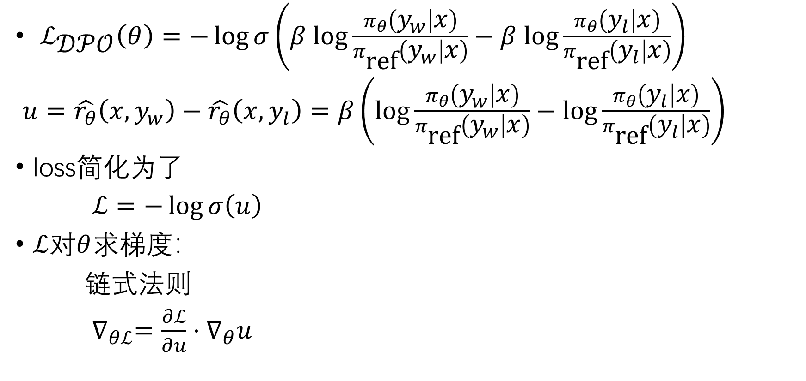
DPO如何更新
$ℒ_{\text{𝒟𝒫𝒪}}\left(θ\right)=−\log{σ\left(β log\frac{π_{θ}\left(y_{w} | x\right)}{π_{\text{ref}}\left(y_{w} | x\right)}−β log\frac{π_{θ}\left(y_{l} | x\right)}{π_{\text{ref}}\left(y_{l} | x\right)}\right)}$
$u=\hat{r_{θ}}\left(x,y_{w}\right)−\hat{r_{θ}}\left(x,y_{l}\right)=β\left(log\frac{π_{θ}\left(y_{w} | x\right)}{π_{\text{ref}}\left(y_{w} | x\right)}−log\frac{π_{θ}\left(y_{l} | x\right)}{π_{\text{ref}}\left(y_{l} | x\right)}\right)$
loss简化为了
$ℒ=−\log{σ\left(u\right)}$
$ℒ$对$θ$求梯度：
链式法则
$∇_{θℒ}=\frac{∂ℒ}{∂u}⋅∇_{θ}u$

Slide 14
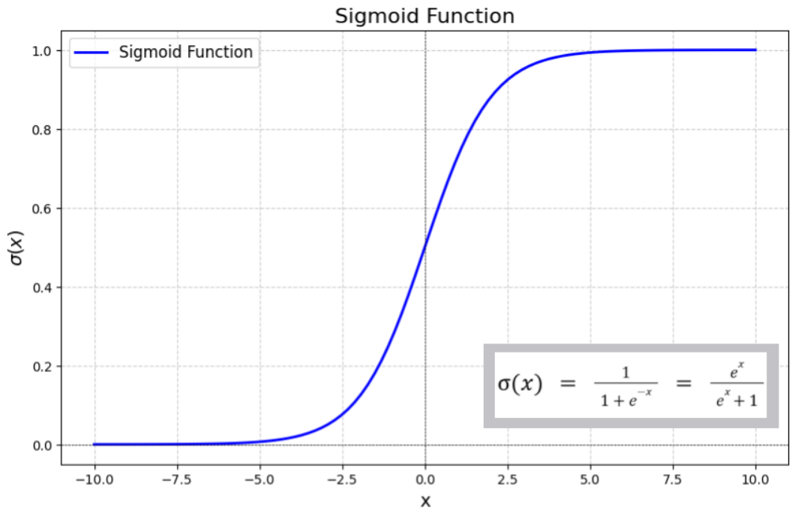
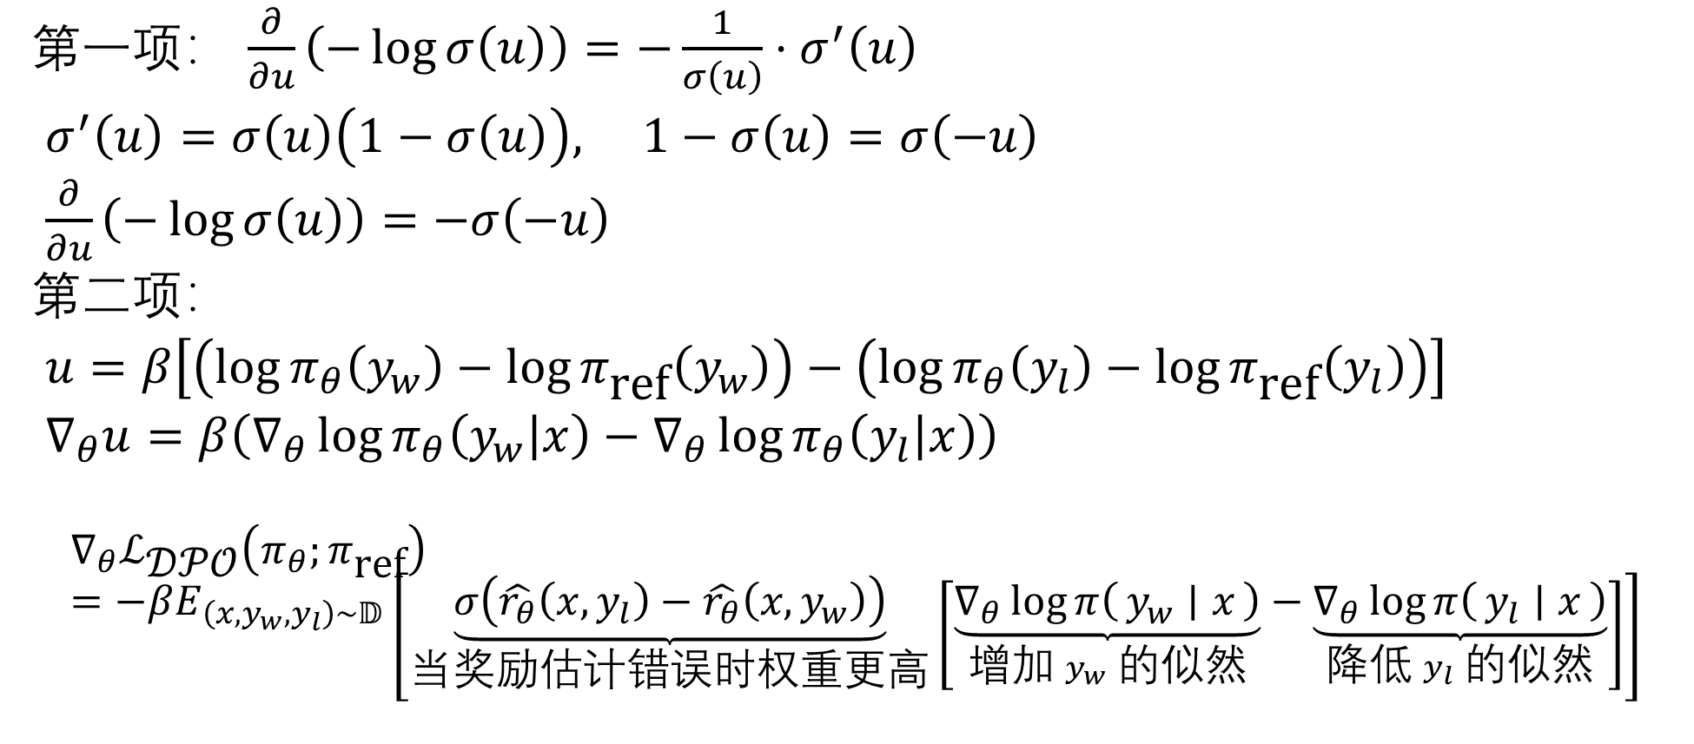
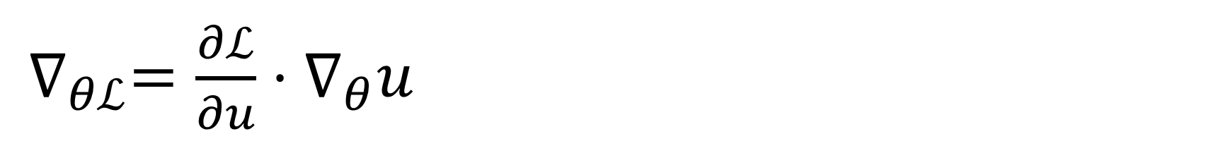
$∇_{θℒ}=\frac{∂ℒ}{∂u}⋅∇_{θ}u$
第一项： $\frac{∂}{∂u}\left(−\log{σ\left(u\right)}\right)=−\frac{1}{σ\left(u\right)}⋅σ^{′}\left(u\right)$
$σ^{′}\left(u\right)=σ\left(u\right)\left(1−σ\left(u\right)\right), 1−σ\left(u\right)=σ\left(−u\right)$
$\frac{∂}{∂u}\left(−\log{σ\left(u\right)}\right)=$ $−σ\left(−u\right)$
第二项：
$u=β\left[\left(\log{π_{θ}\left(y_{w}\right)}−\log{π_{\text{ref}}\left(y_{w}\right)}\right)−\left(\log{π_{θ}\left(y_{l}\right)}−\log{π_{\text{ref}}\left(y_{l}\right)}\right)\right]$
$∇_{θ}u=β\left(∇_{θ}\log{π_{θ}\left(y_{w} | x\right)}−∇_{θ}\log{π_{θ}\left(y_{l} | x\right)}\right)$
$$∇_{θ}ℒ_{\text{𝒟𝒫𝒪}}\left(π_{θ};π_{\text{ref}}\right)=−βE_{\left(x,y_{w},y_{l}\right)∼𝔻}\left[\underset{\text{当奖励估计错误时权重更高}}{\underbrace{σ\left(\hat{r_{θ}}\left(x,y_{l}\right)−\hat{r_{θ}}\left(x,y_{w}\right)\right)}}\left[\underset{\text{增加} y_{w} \text{的似然}}{\underbrace{∇_{θ}\log{π\left(y_{w} ∣ x\right)}}}−\underset{\text{降低} y_{l} \text{的似然}}{\underbrace{∇_{θ}\log{π\left(y_{l} ∣ x\right)}}}\right]\right]$$

Slide 15

监控量
Reward Accuracy
$Acc=E\left[1\left(r^{+}>r^{−}\right)\right]$
Reward Margin
$\text{Margin}=E\left[r^{+}−r^{−}\right]$
Rewards Chosen & Rewards Rejected
$\hat{r_{θ}}\left(x,y_{w}\right)$ $\hat{r_{θ}}\left(x,y_{l}\right)$

Slide 16
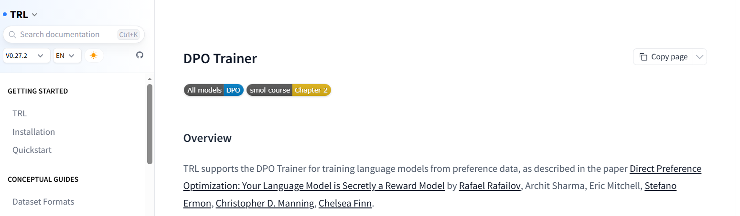
快速上手
模型： Qwen/Qwen2-0.5B-Instruct
数据集： openbmb/UltraFeedback
教程：https://huggingface.co/docs/trl/dpo_trainer

Slide 17
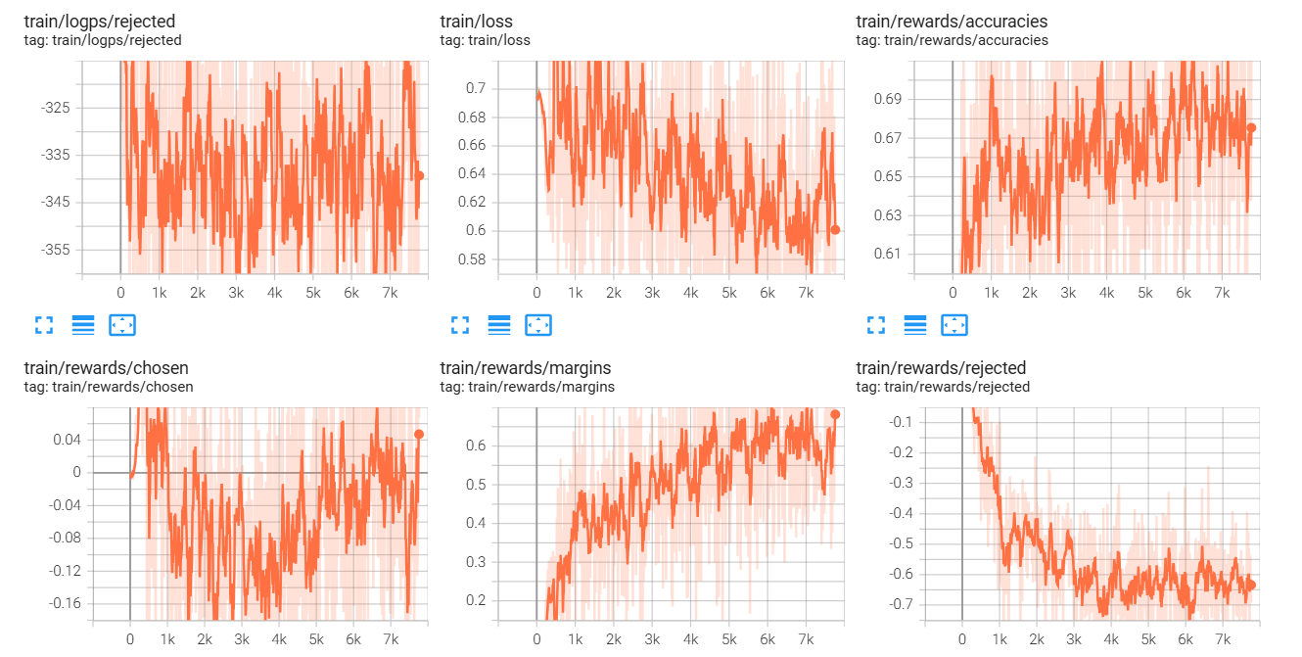
https://github.com/ZHAOoops/dpo-qwen2-0.5b

