Slide 1
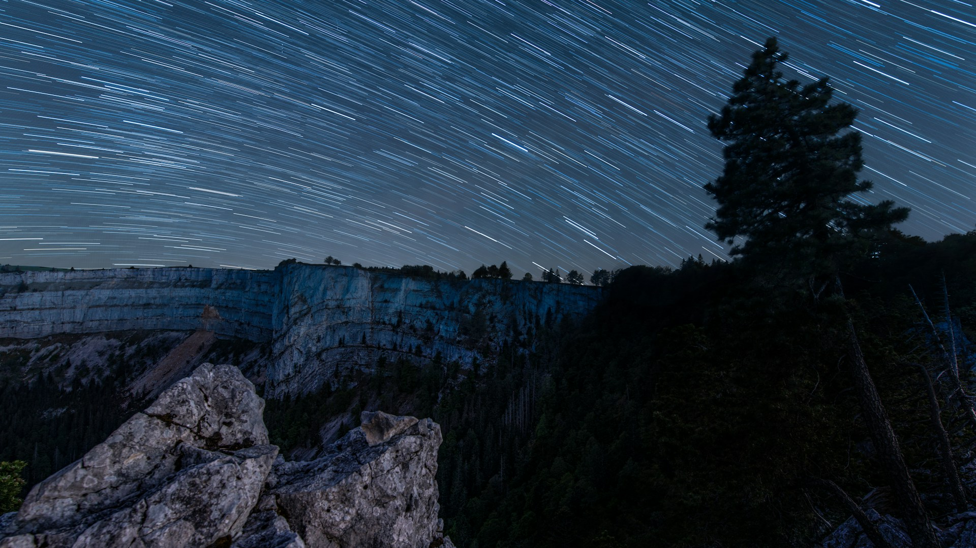
Introduction to Machine-Learning in Aviation
Traffic Systems Operation (TSO)
Benoit Figuet, Centre for Aviation, Zurich University of Applied Sciences

Slide 2
Introduction to Machine-Learning in Aviation
Agenda
 | Supervised Machine Learning
 | Introduction
 | Unsupervised Machine Learning
 | Machine Learning Steps
 | Focus on Decision Trees
 | Focus on Binary Classification Metrics
 | Conclusion

Slide 3
Learning Objectives
You can explain in your own words the different types of machine learning models.
You can describe the key ideas of dimensionality reduction and clustering.
You can describe the typical steps in PCA and K-means.
You understand how DBSCAN works
Notes:
By working through this video and the associated exercises, you will achieve the learning objectives specified on the slide.

Slide 4
Introduction
Traffic Systems Operation (TSO)

Slide 5
Machine Learning 101
Three Main Categories of Machine Learning
Supervised Learning
The model learns from input-output pairs (X->Y)
Goal: Predict outcomes based on past examples
Examples in Aviation:
Predict delays, take-off weight, runway occupancy times …
Unsupervised Learning
The model finds hidden patterns in data without predefined outputs.
Goal: Group similar data points (clustering) or detect anomalies
Examples in Aviation:
Cluster airport operation types
Find anomalies in trajectories, in maintenances…
Reinforcement Learning
An agent interacts with an environment and learns by rewards / punishments.
Goal: optimize actions to maximize long-term rewards.
Examples in Aviation:
Air traffic flow optimizations…

Slide 6
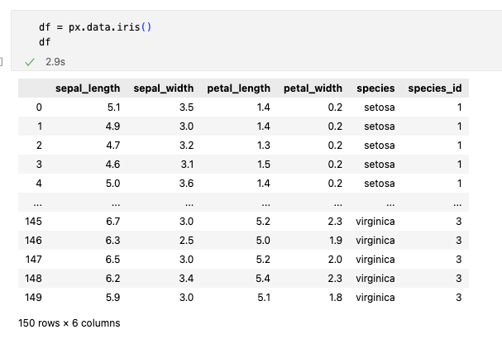
Iris Dataset
Running Example
We will use the classic Iris dataset:
150 sample of flowers
4 numerical features:
sepal_length
sepal_width
petal_length
petal_width
One categorical label: species (setosa, versicolor, virginica)
If we don’t know the species labels. Can we group or understand the data structure just from the features?

Slide 7
Unsupervised Learning Use Case
Real-world data is often unlabelled
Common tasks / use cases:
Find groups: clustering
Detect anomalies
Understand structure
Reduce dimensionality
Example:
Grouping flights with similar trajectories
Segmenting customers by travel behaviour for targeted marketing strategies
Visualizing high-dimensional data

Slide 8
Dimensionality Reduction
Traffic Systems Operation (TSO)

Slide 9
Unsupervised Learning Algorithms
Dimensionality Reduction
What is Dimensionality Reduction:
Reduce the number of features (dimensions) in a dataset while preserving relevant information.
Why? High-dimensional data is hard to visualize, analyse or process efficiently.
Goal: Simplify data without losing relevant patterns.
Key Technique:
Principal Component Analysis (PCA):
Find directions (principal components) of maximum variance in the data.
Project data onto fewer dimensions (e.g., from 4D to 2D for Iris).

Slide 10
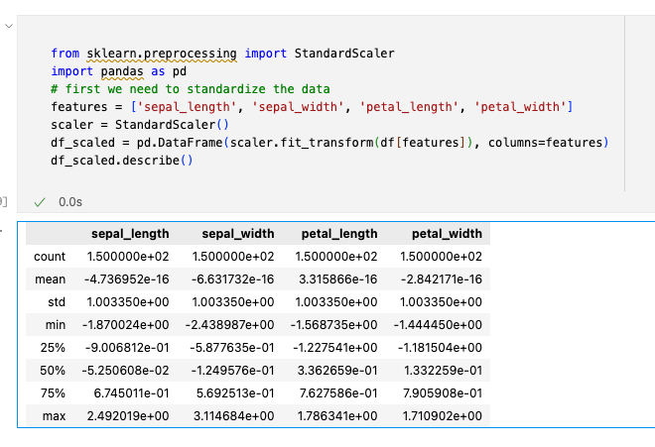
Unsupervised Learning Algorithms
Dimensionality Reduction
Workflow:
Normalize / Standardize data (mean=0, variance=1) to treat all features equally
Calculate covariance matric to see how features vary together
Find Eigenvectores (directions) and eigenvalues to pick top cmponents
Project data onto these components

Slide 11
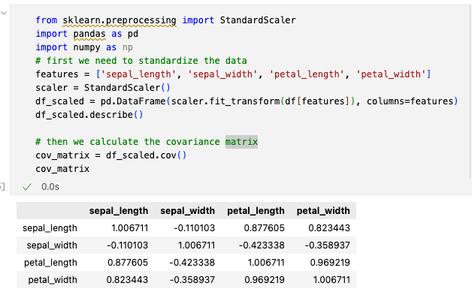
Unsupervised Learning Algorithms
Dimensionality Reduction
Workflow:
Standardize data (mean=0, variance=1) to treat all features equally
Calculate covariance matric to see how features vary together
Find Eigenvectores (directions) and eigenvalues to pick top cmponents
Project data onto these components

Slide 12
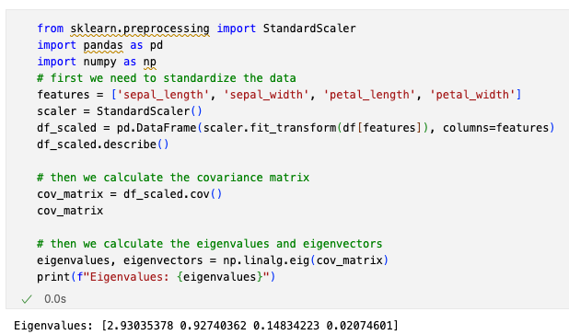
Unsupervised Learning Algorithms
Dimensionality Reduction
Workflow:
Standardize data (mean=0, variance=1) to treat all features equally
Calculate covariance matric to see how features vary together
Find Eigenvectors (directions) and eigenvalues to pick top components
Project data onto these components

Slide 13
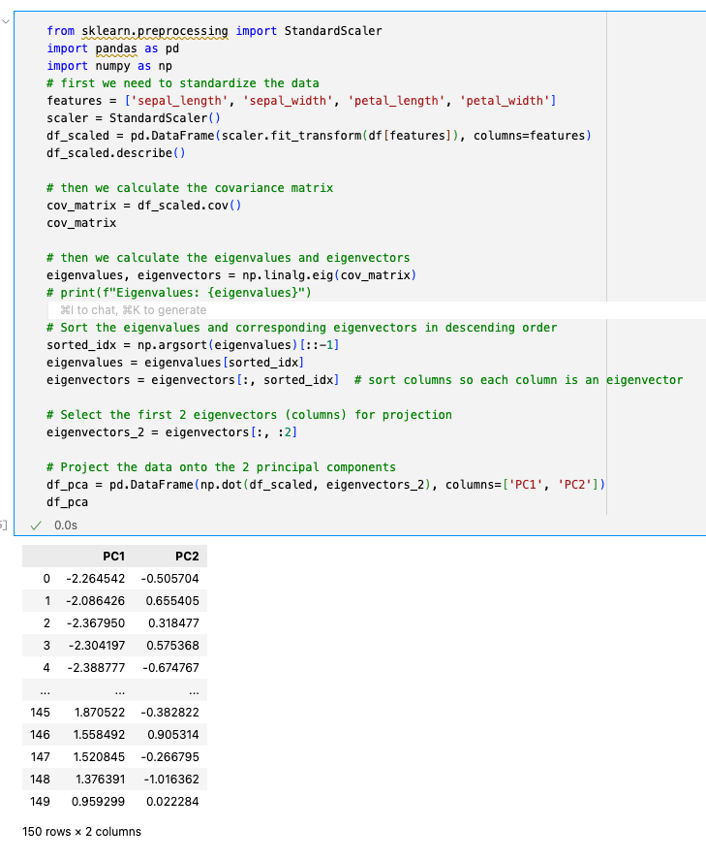
Unsupervised Learning Algorithms
Dimensionality Reduction
Workflow:
Standardize data (mean=0, variance=1) to treat all features equally
Calculate covariance matric to see how features vary together
Find Eigenvectors (directions) and eigenvalues to pick top components
Project data onto these components

Slide 14
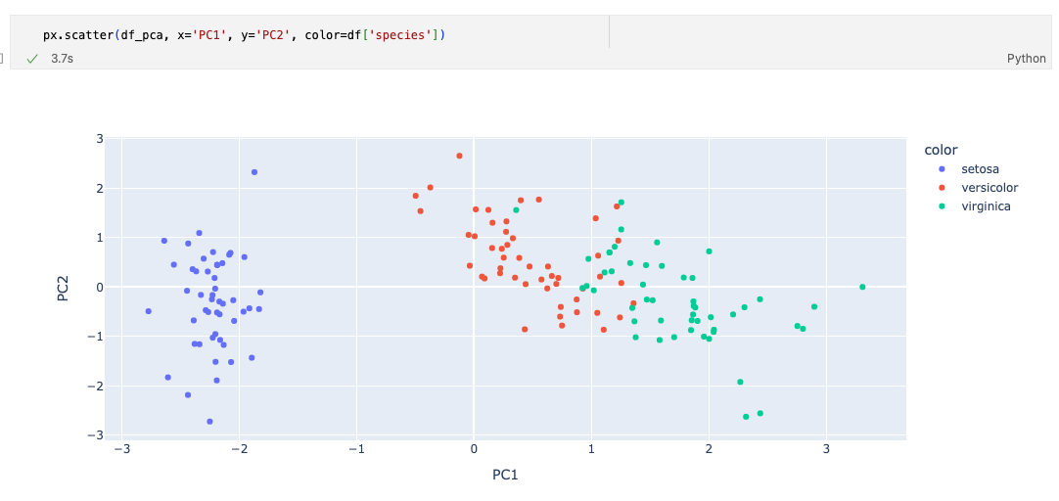
Unsupervised Learning Algorithms
Dimensionality Reduction

Slide 15
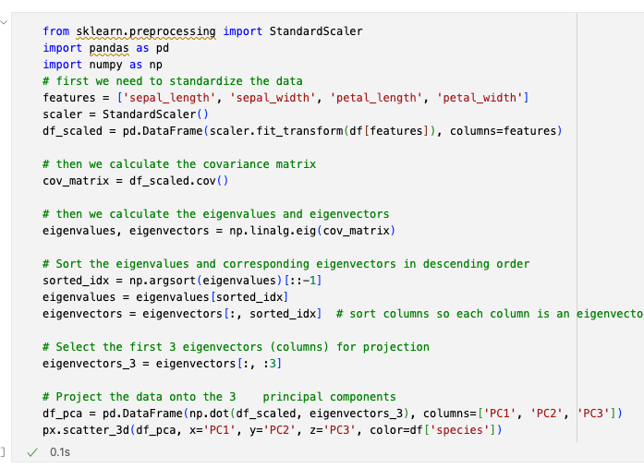
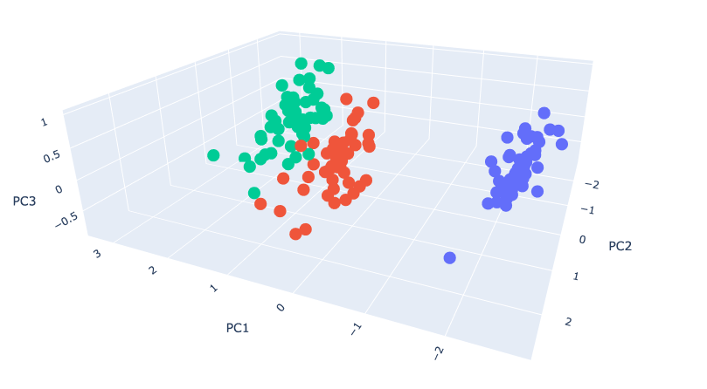
Unsupervised Learning Algorithms
Dimensionality Reduction
We could have reduced the data into 3 dimensions:

Slide 16
Clustering
Traffic Systems Operation (TSO)

Slide 17
Unsupervised Learning Algorithms
Clustering
What is Clustering:
Groups similar data points together based on their features, without knowing categories in advance.
Why? High-dimensional data is hard to visualize, analyse or process efficiently.
Goal: Discover inherent structures in unlabelled data.
Key Techniques:
K-means Clustering:
Partition Data into K clusters by minimizing distance to cluster centroids.
K, the number of clusters, is a parameter.
DBSCAN:
Groups based on density, flags outliers.
The number of clusters is not a known in advance and will be found by the algorithm.

Slide 18
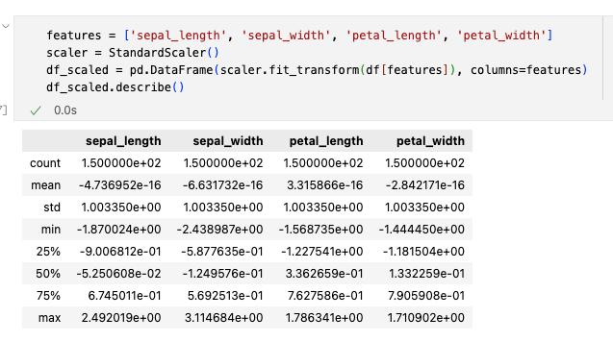
Unsupervised Learning Algorithms
Clustering
K-means Workflow:
Standardize data (mean=0, variance=1) to treat all features equally
Randomly chose K centroids
Assign each point (row) to the nearest centroid based on Euclidian distance.
Recalculate centroids as the mean of assigned points
Repeat until centroids don’t move much

Slide 19
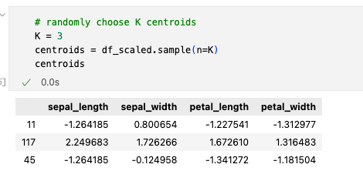
Unsupervised Learning Algorithms
Clustering
K-means Workflow:
Standardize data (mean=0, variance=1) to treat all features equally
Randomly chose K centroids
Assign each point (row) to the nearest centroid based on Euclidian distance.
Recalculate centroids as the mean of assigned points
Repeat until centroids don’t move much

Slide 20
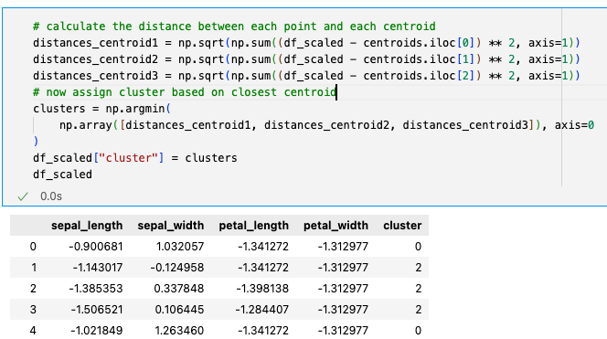
Unsupervised Learning Algorithms
Clustering
K-means Workflow:
Standardize data (mean=0, variance=1) to treat all features equally
Randomly chose K centroids
Assign each point (row) to the nearest centroid based on Euclidian distance.
Recalculate centroids as the mean of assigned points
Repeat until centroids don’t move much

Slide 21
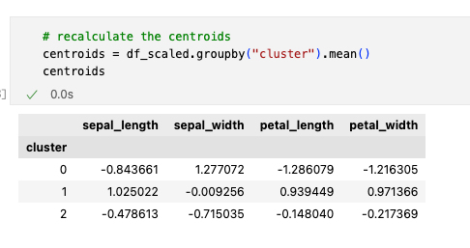
Unsupervised Learning Algorithms
Clustering
K-means Workflow:
Standardize data (mean=0, variance=1) to treat all features equally
Randomly chose K centroids
Assign each point (row) to the nearest centroid based on Euclidian distance.
Recalculate centroids as the mean of assigned points
Repeat until centroids don’t move much

Slide 22
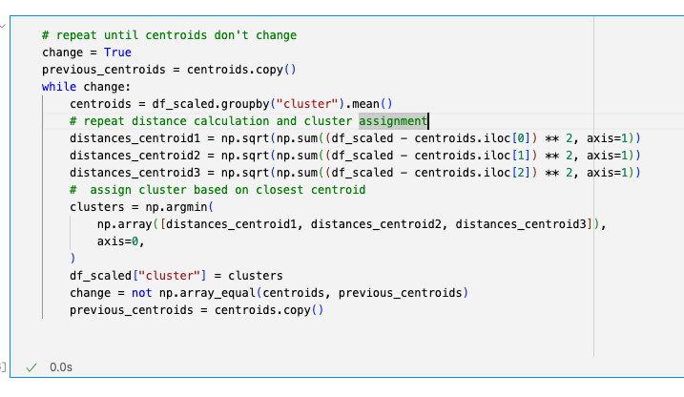
Unsupervised Learning Algorithms
Clustering
K-means Workflow:
Standardize data (mean=0, variance=1) to treat all features equally
Randomly chose K centroids
Assign each point (row) to the nearest centroid based on Euclidian distance.
Recalculate centroids as the mean of assigned points
Repeat until centroids don’t move much

Slide 23
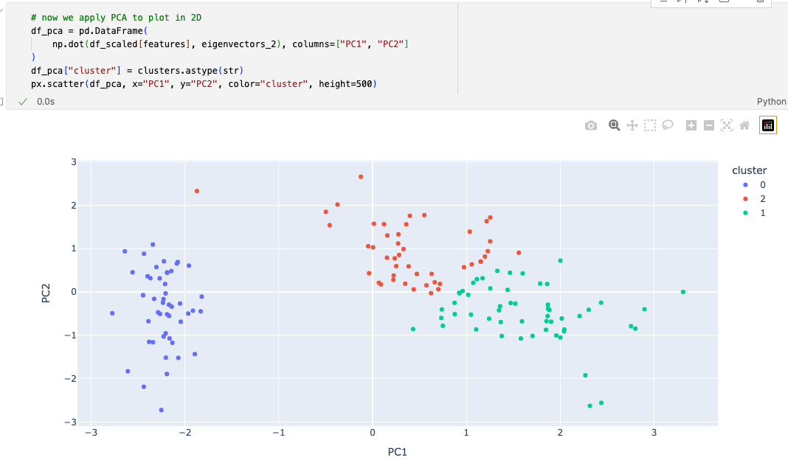
Unsupervised Learning Algorithms
Clustering

Slide 24
Unsupervised Learning Algorithms
Clustering
What is DBSCAN?
DBSCAN stands for Density-Based Spatial Clustering of Applications with Noise.
Unlike K-means, it doesn’t require specifying the number of clusters (K) in advance.
It groups data points based on density: areas with many nearby points form clusters, while sparse areas are labelled as noise (outliers).
Key Idea: Clusters are dense regions separated by less dense areas, ideal for irregularly shaped groups.
Core Concepts
Epsilon : A distance threshold defining the neighbourhood around a point (e.g., how close points must be to be “nearby”).
MinPts: Minimum number of points needed in a neighbourhood to form a cluster.
https://www.naftaliharris.com/blog/visualizing-dbscan-clustering/

Slide 25
Conclusion
Traffic Systems Operation (TSO)

Slide 26
Conclusion & Takeaways
Now you are able to:
Explain what dimension reduction is.
Explain what clustering is.
Describe the typical steps in an unsupervised machine learning workflow.
Understand how PCA and K-means, DBSCAN work.
Notes:
This brings us to the end of this video. I would like to briefly summarise the most important points:

Slide 27

Useful Resources
Python Libraries:
Core Libraries:
Numpy
Pandas
Plotly / Matplotlib
Scipy
Machine Learning
Scikit-learn
XGBoost / LightGBM
Youtube Channel:

