Slide 1

Introduction to Machine-Learning in Aviation
Traffic Systems Operation (TSO)
Benoit Figuet, Centre for Aviation, Zurich University of Applied Sciences

Slide 2
Introduction to Machine-Learning in Aviation
Agenda
 | Supervised Machine Learning
 | Introduction
 | Supervised Machine Learning
 | Machine Learning Steps
 | Focus on Decision Trees
 | Focus on Binary Classification Metrics
 | Conclusion

Slide 3
Learning Objectives
You can explain in your own words the different types of machine learning models.
You can describe the key ideas between regression and classification tasks.
You can describe the typical steps in a machine learning workflow including training, testing and evaluation.
Notes:
By working through this video and the associated exercises, you will achieve the learning objectives specified on the slide.

Slide 4
Introduction
Traffic Systems Operation (TSO)

Slide 5
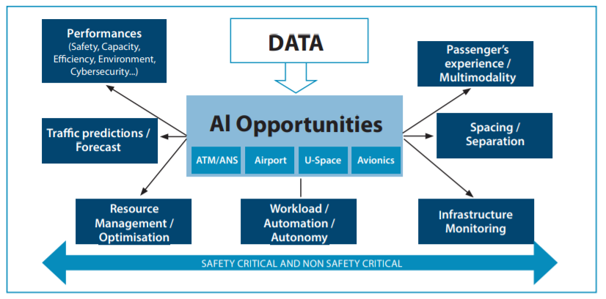
Introduction
Introduction to Data-Science in aviation
Data-driven decision making to improve safety, efficiency, and capacity in aviation operations
Focus of This Course: Understand the basics of machine learning and how it can be applied to Aviation Operation.
Real-World Applications Examples:
Predictive maintenance for aircraft (forecast component failures).
Flight delay predictions and schedule optimization.
Air traffic management enhancements (route optimization, traffic flow predictions).
Source: Fly AI Report - Demystifying and Accelerating AI in Aviation/ATM - Eurocontrol

Slide 6
Machine Learning 101
Three Main Categories of Machine Learning
Supervised Learning
The model learns from input-output pairs (X->Y)
Goal: Predict outcomes based on past examples
Examples in Aviation:
Predict delays, take-off weight, runway occupancy times …
Unsupervised Learning
The model finds hidden patterns in data without predefined outputs.
Goal: Group similar data points (clustering) or detect anomalies
Examples in Aviation:
Cluster airport operation types
Find anomalies in trajectories, in maintenances…
Reinforcement Learning
An agent interacts with an environment and learns by rewards / punishments.
Goal: optimize actions to maximize long-term rewards.
Examples in Aviation:
Air traffic flow optimizations…

Slide 7
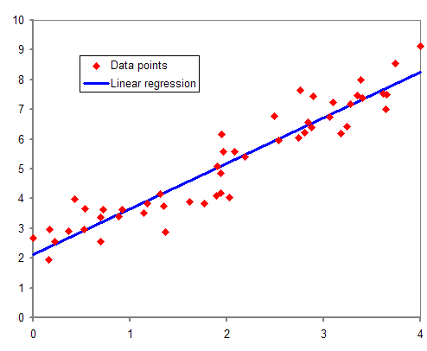
Regression
Reminder
Regression is a statistical method for modelling the relationship between a dependent variable (Y) and one or more independent variables (X). It helps in understanding how changes in X affect Y.
Regression aims to find the best-fit function f(X) that predicts Y from X, often by minimizing error.
Source: Wikipedia – Regression Analysis

Slide 8
Supervised Machine Learning
Traffic Systems Operation (TSO)

Slide 9
Supervised Machine Learning
Definition: Supervised learning is a type of machine learning where an algorithm learns from labeled data. The model is trained on input-output pairs to make predictions on new, unseen data.
Key Concepts:
Labelled Data: Each training example has an input (features) and a corresponding output (label)
Training: The model learns by minimizing errors using a cost function.
Prediction: Once trained, the model can predict outputs for new inputs (generalization).
Typed of Problems:
Classification: Predicting categories (e,g., sentiment analysis, delayed,…)
Regression: Predicting continuous values (e.g., price estimation, delay estimation).
Common Algorithms:
Linear Regression, Decision Trees, Gradient Boosting, Support Vector Machines, Neural Networks, …

Slide 10
Regression vs Classification
 | Regression | Classification
Goal | Predict a continuous value | Predict a categorical label
Output | Real numbers (e.g., delay in minutes) | Class labels (e.g., flight status: delayed/on time)
Examples | - Estimate aircraft fuel consumption for a flight - Predict runway occupancy time based on aircraft type / weather | - Predict if a flight will be delayed or not - Classify weather conditions as good / bad
Algorithms | Linear regression, decision tree regressor | Logistic regression, decision tree, k-NN, SVM
Evaluation | MSE, MAE, R² score | Accuracy, Precision, Recall, F1 Score

Slide 11
Supervised Machine Learning
Application Example
Application: Actual Departure Time prediction
Problem: Airlines and airports need to predict flight departure times to optimize operations and improve passenger experience.
Solution: A supervised machine learning model can be trained to predict actual departure times based on historical flight data.
Input Features: Callsign, weather, time, airport congestion, …
Output:
Classification: On Time or Delayed
Regression: Delay duration

Slide 12
Machine Learning Steps
Traffic Systems Operation (TSO)

Slide 13
Steps to Perform a Supervised Machine Learning Activity
1) Define the problem
What do I want to solve?
Clearly identify the goal of the ML model
Is it a regression or a classification?

Slide 14
Steps to Perform a Supervised Machine Learning Activity
2) Collect, Understand and Pre-Process the Data
Gather relevant data from reliable sources.
Prepare the data:
Aggregate all data together.
Handle missing values (remove, fill, or impute).
Feature engineering: Drop irrelevant / redundant columns or build new ones based on expert knowledge.
Encode categorical values. Example: Convert “Manufacturer” column into numerical format (e.g., Boeing = 0, Airbus = 1, Embraer=0).
Standardize or normalize numerical features.
Split the data into a Training / Testing / Validation datasets

Slide 15
Steps to Perform a Supervised Machine Learning Activity
3) Train a Machine Learning Model
Choose an appropriate model (e.g., Linear Regression, Decision Tree, Xgboost …)
Chose appropriate loss function depending on the task:
Common loss functions for regression:
Root Mean Squared Error
Mean Absolute Error
Quantile Loss
Common loss for classification:
Cross Entropy Loss (For multi-class classification)
Binary Cross-Entropy (for binary classification)
Focal Loss
Fit the model to the training data
Tune Hyperparameters to improve performance

Slide 16
Steps to Perform a Supervised Machine Learning Activity
4) Evaluate the model
Use data that was not used to train the mode: the test data to assess the performance of the model
Chose the correct metrics depending on your task:
Common metrics for regression:
Root Mean Squared Error
Mean Absolute Error
Common metrics classification:
Accuracy
Precision
Recall,
F1 score

Slide 17
Focus on Decision Trees
Traffic Systems Operation (TSO)

Slide 18
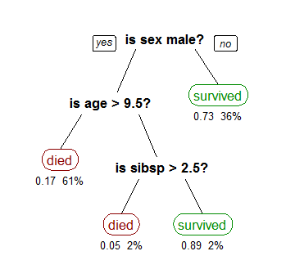
Focus on Decision Trees
What is a Decision Tree?
A flowchart-like structure used for classification or regression, where data is split into branches based on feature values
Titanic Survival Decision Tree
Source: Wikipedia

Slide 19
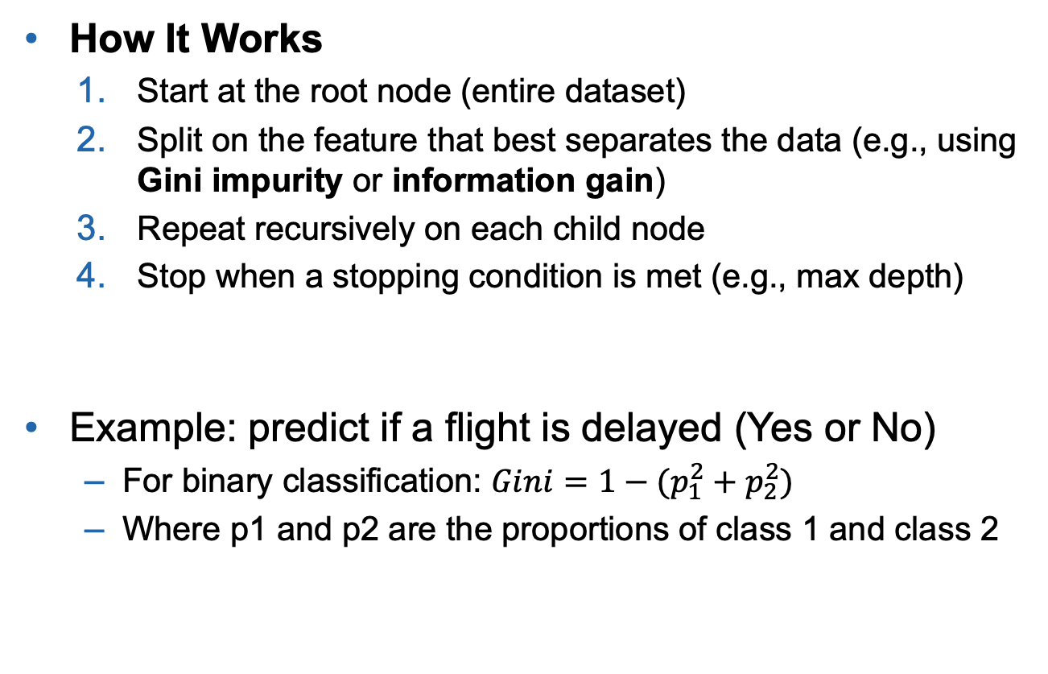
Focus on Decision Trees
How It Works
Start at the root node (entire dataset)
Split on the feature that best separates the data (e.g., using Gini impurity or information gain)
Repeat recursively on each child node
Stop when a stopping condition is met (e.g., max depth)
Example: predict if a flight is delayed (Yes or No)
For binary classification: $Gini=1−(p_{1}^{2}+p_{2}^{2})$
Where p1 and p2 are the proportions of class 1 and class 2
Weather | Haul | Delay
Sunny | Long | No
Sunny | Long | No
Sunny | Short | No
Sunny | Short | No
Rainy | Long | No
Rainy | Long | Yes
Rainy | Short | Yes
Rainy | Short | No
Notes:
The Gini Index (or Gini Impurity) tells us how mixed a group is.
• If a group contains only one class (e.g. all flights delayed), Gini = 0 → it’s pure
• If a group is evenly mixed (e.g. 50% delayed, 50% on time), Gini = 0.5 → it’s impure

Slide 20
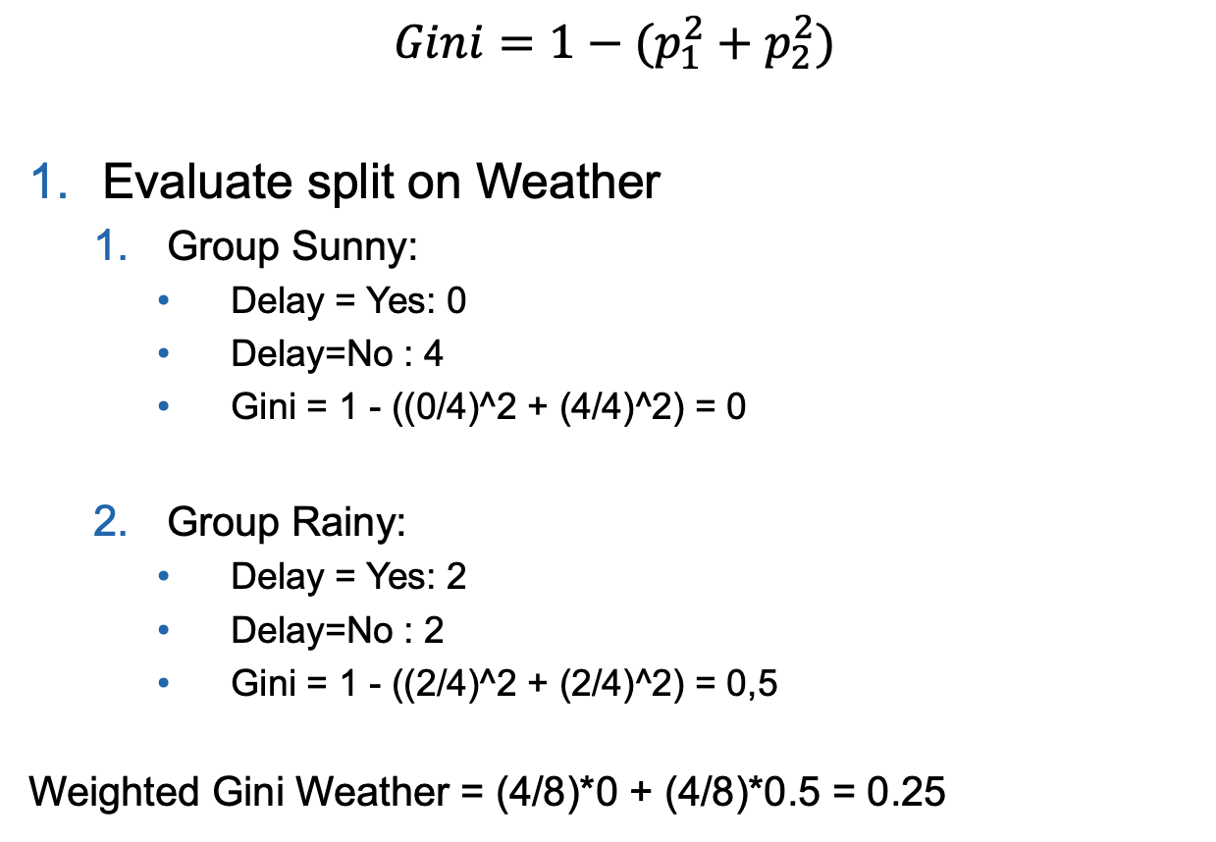
Focus on Decision Trees
Weather | Haul | Delay
Sunny | Long | No
Sunny | Long | No
Sunny | Short | No
Sunny | Short | No
Rainy | Long | No
Rainy | Long | Yes
Rainy | Short | Yes
Rainy | Short | No
$$Gini=1−(p_{1}^{2}+p_{2}^{2})$$
Evaluate split on Weather
Group Sunny:
Delay = Yes: 0
Delay=No : 4
Gini = 1 - ((0/4)^2 + (4/4)^2) = 0
Group Rainy:
Delay = Yes: 2
Delay=No : 2
Gini = 1 - ((2/4)^2 + (2/4)^2) = 0,5
Weighted Gini Weather = (4/8)*0 + (4/8)*0.5 = 0.25

Slide 21
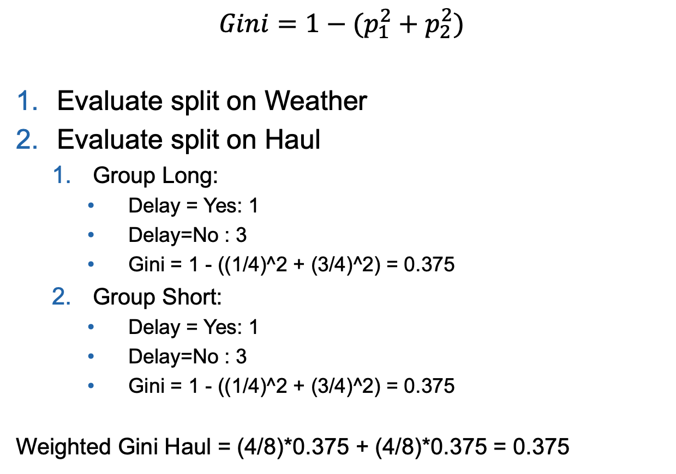
Focus on Decision Trees
Weather | Haul | Delay
Sunny | Long | No
Sunny | Long | No
Sunny | Short | No
Sunny | Short | No
Rainy | Long | No
Rainy | Long | Yes
Rainy | Short | Yes
Rainy | Short | No
$$Gini=1−(p_{1}^{2}+p_{2}^{2})$$
Evaluate split on Weather
Evaluate split on Haul
Group Long:
Delay = Yes: 1
Delay=No : 3
Gini = 1 - ((1/4)^2 + (3/4)^2) = 0.375
Group Short:
Delay = Yes: 1
Delay=No : 3
Gini = 1 - ((1/4)^2 + (3/4)^2) = 0.375
Weighted Gini Haul = (4/8)*0.375 + (4/8)*0.375 = 0.375

Slide 22
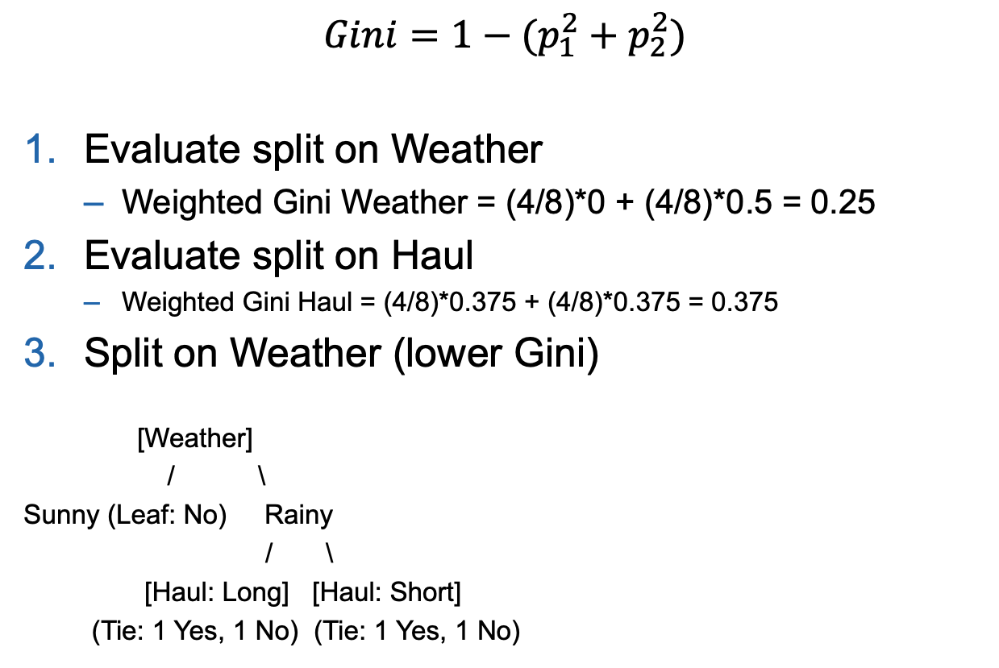
Focus on Decision Trees
Weather | Haul | Delay
Sunny | Long | No
Sunny | Long | No
Sunny | Short | No
Sunny | Short | No
Rainy | Long | No
Rainy | Long | Yes
Rainy | Short | Yes
Rainy | Short | No
$$Gini=1−(p_{1}^{2}+p_{2}^{2})$$
Evaluate split on Weather
Weighted Gini Weather = (4/8)*0 + (4/8)*0.5 = 0.25
Evaluate split on Haul
Weighted Gini Haul = (4/8)*0.375 + (4/8)*0.375 = 0.375
Split on Weather (lower Gini)
[Weather]
/ \
Sunny (Leaf: No) Rainy
/ \
[Haul: Long] [Haul: Short]
(Tie: 1 Yes, 1 No) (Tie: 1 Yes, 1 No)

Slide 23
Focus on Decision Trees
Advantages
Easy to understand and visualize
Handles both numerical and categorical data
No need to normalize data
Works well with small datasets
Disadvantages
Prone to overfitting
Unstable to small changes in data
Greedy: might not find the best tree globally
Can be improved with ensembles (Random Forests, Gradient Boosting)

Slide 24
Focus on Classification Metrics
Traffic Systems Operation (TSO)

Slide 25
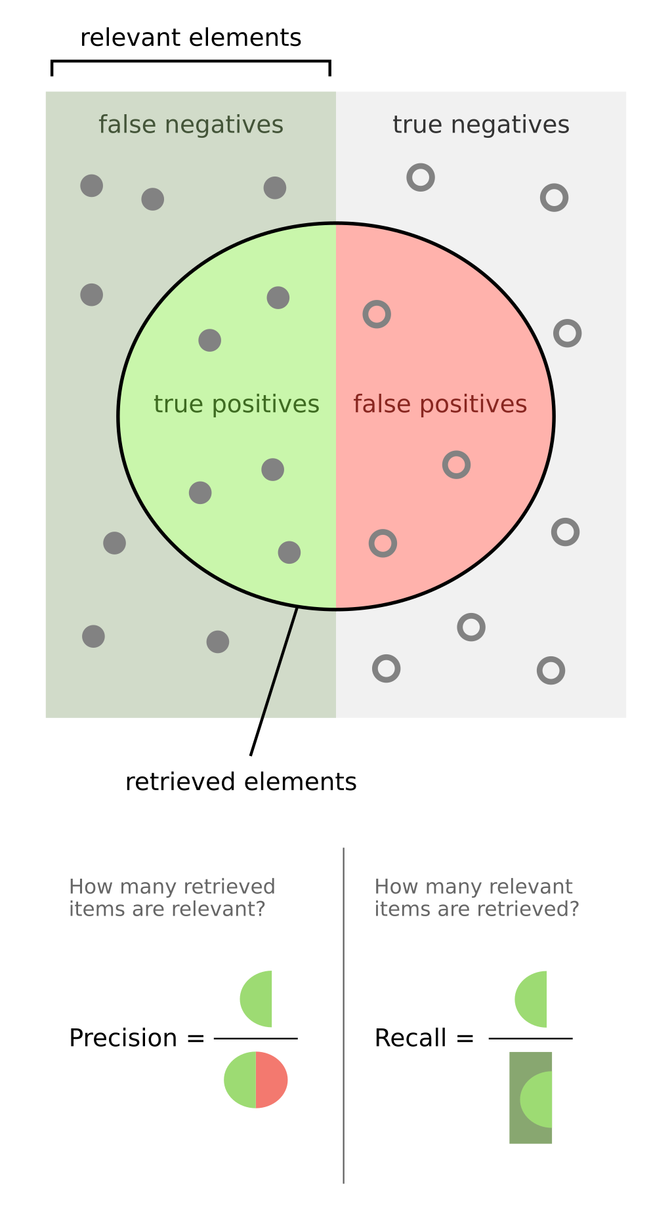
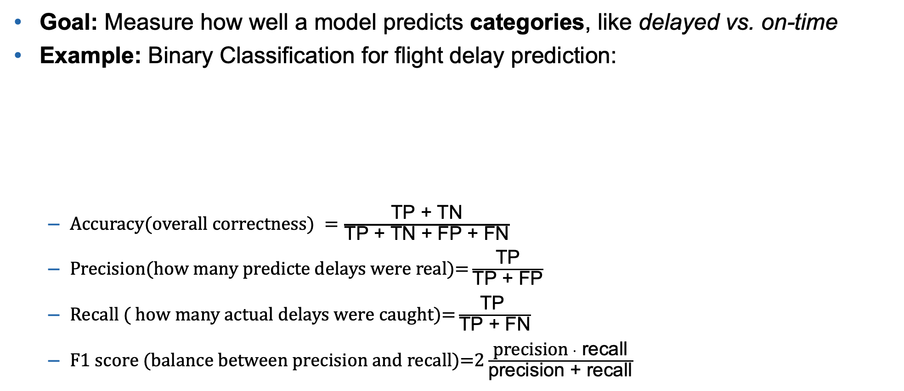
Focus on Binary Classification Metrics
Goal: Measure how well a model predicts categories, like delayed vs. on-time
Example: Binary Classification for flight delay prediction:
$A\text{ccuracy}\text{(}\text{overall} \text{correctness}\text{) }=\frac{\text{TP}\text{ + }\text{TN}}{\text{TP}\text{ + }\text{TN}\text{ + }\text{FP}\text{ + }\text{FN}}$
$\text{P}\text{recision}\text{(}\text{how} \text{many} \text{predicte} \text{delays} \text{were} \text{real}\text{)=}\frac{\text{TP}}{\text{TP}\text{ + }\text{FP}}$
$\text{R}\text{ecall}\text{ ( }\text{how} \text{many} \text{actual} \text{delays} \text{were} \text{caught}\text{)=}\frac{\text{TP} }{\text{TP}\text{ + }\text{FN}}$
$\text{F}\text{1 }\text{score}\text{ (}\text{balance} \text{between} \text{precision} \text{and} \text{recall}\text{)=}2\frac{\text{precision} ⋅ \text{recall}}{\text{precision}\text{ + }\text{recall}}$
 | Predicted: Delay | Predicted: On Time
Actual: Delay | True Positive (TP) | False Negative (FN)
Actual: On Time | False Positive (FP) | True Negative (TN)
Source: Wikipedia
Notes:
• Use Recall when it’s critical not to miss real delays (e.g., for planning gates and crew).
• Use Precision when false alarms (predicting a delay that doesn’t happen) are costly or annoying.

Slide 26
Conclusion
Traffic Systems Operation (TSO)

Slide 27
Conclusion & Takeaways
Now you are able to:
Explain the difference between regression and classification
Describe the typical steps in a machine learning workflow
Understand how decision trees make splits using Gini impurity
Evaluate classification models using metrics like accuracy, precision, recall, and F1 score
Identify real-world applications of ML in aviation (e.g., delay prediction, maintenance, traffic flow)
Notes:
This brings us to the end of this video. I would like to briefly summarise the most important points:

Slide 28

Useful Resources
Python Libraries:
Core Libraries:
Numpy
Pandas
Plotly / Matplotlib
Scipy
Machine Learning
Scikit-learn
XGBoost / LightGBM
Youtube Channel:

