Slide 1

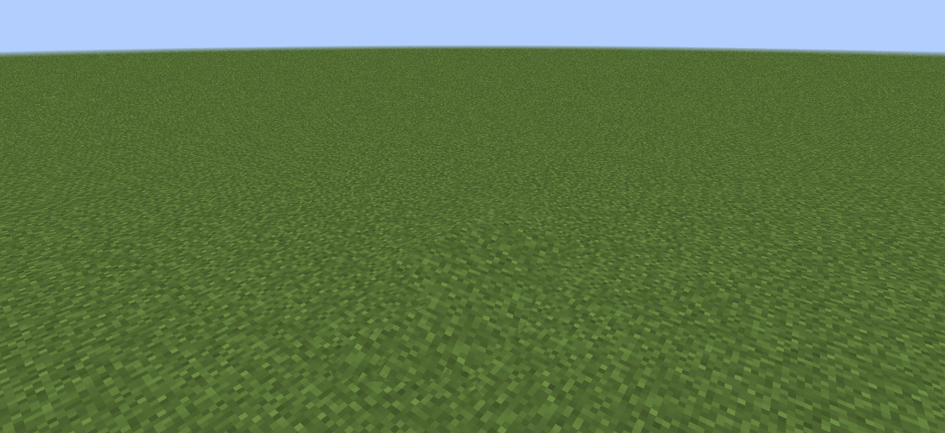


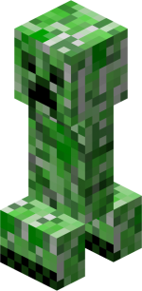
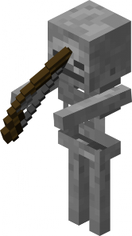
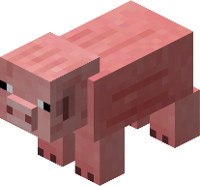
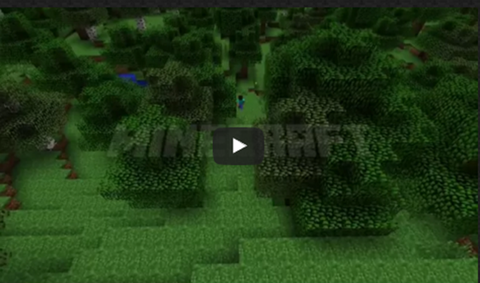
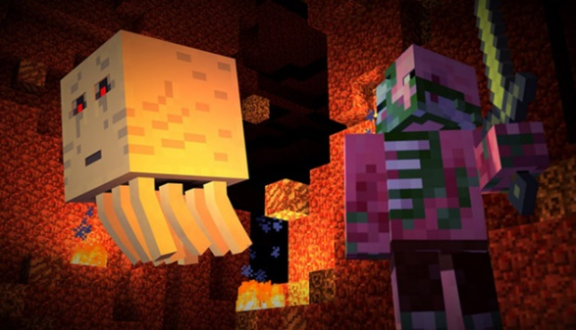
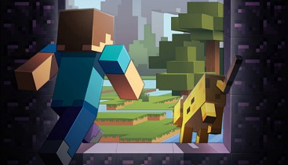
DOWNLOAD STORE REALMS
Buy Minecraft
TWD 800.00
MINECRAFT: STORY MODE
Minecraft: Story Mode is a narrative-driven adventure developed by Telltale Games. The decisions you make influence the adventures of the Order of the Stone in exciting, unexpected ways!
MINECRAFT: REALMS
Minecraft Realms is a simple way to enjoy an online Minecraft world with friends. Realms worlds are always online and can only be accessed by an approved set of friends. Only the owner of a Realm needs to pay.
Learn More
Learn More
Copyright © 2016

