Slide 1

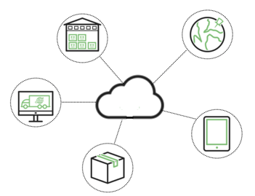
Cloud Computing
Group 4

Slide 2
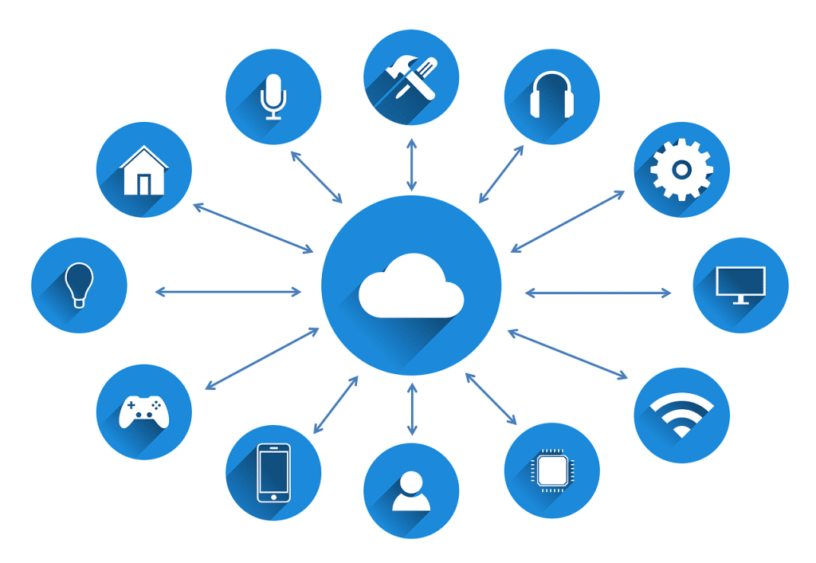
What is Cloud Computing?

Slide 3
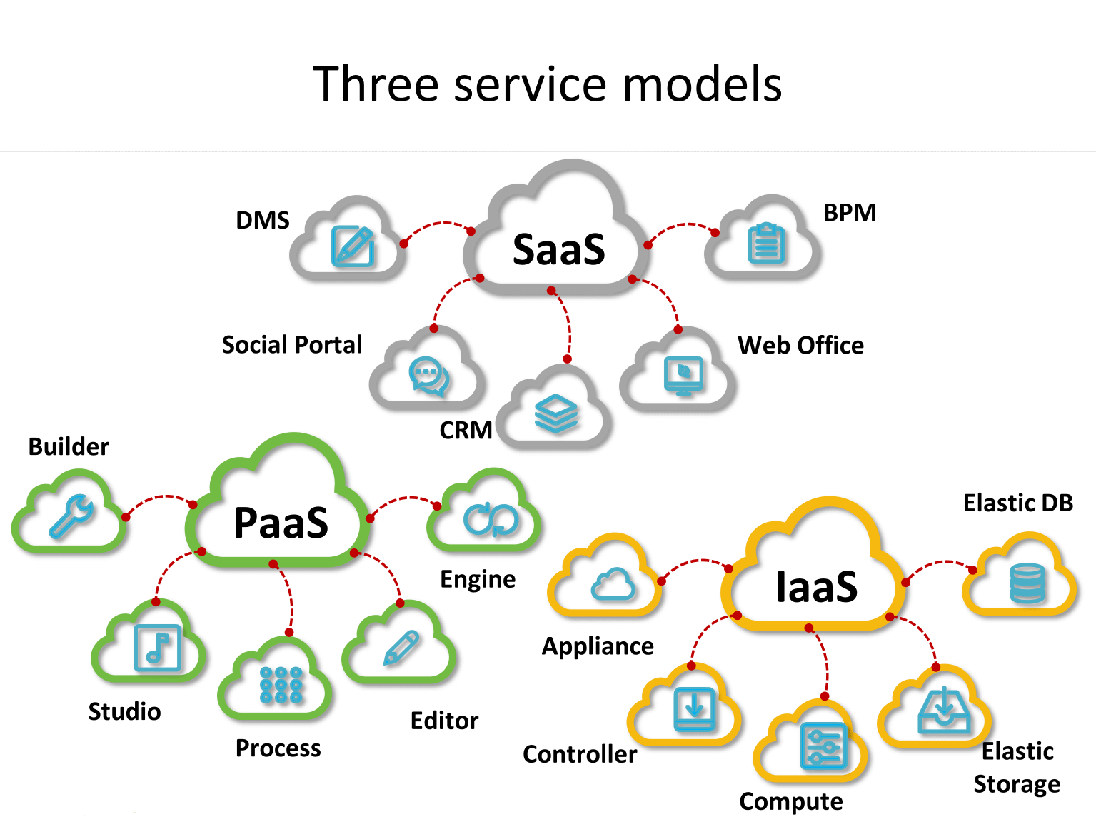
Notes:
Cloud computing is on-demand network access to computing resources, provided by an
outside entity. Common deployment models for cloud computing include platform as a service
(PaaS), software as a service (SaaS), and infrastructure as a service (IaaS.

Slide 4
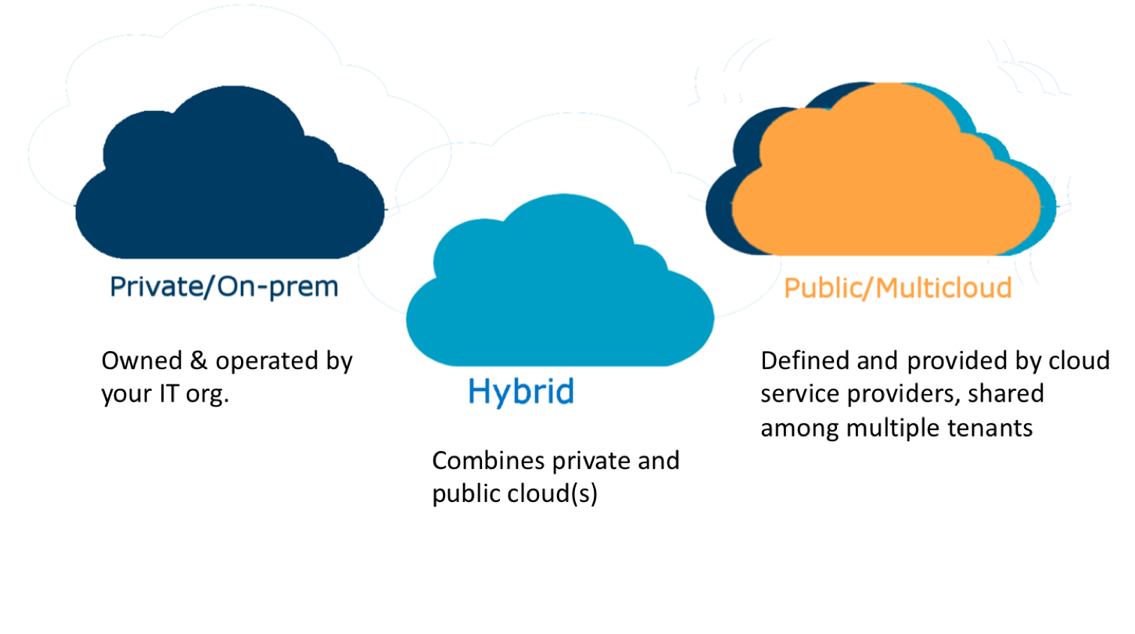
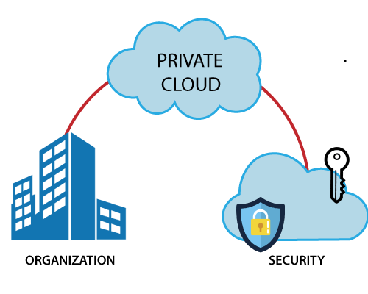
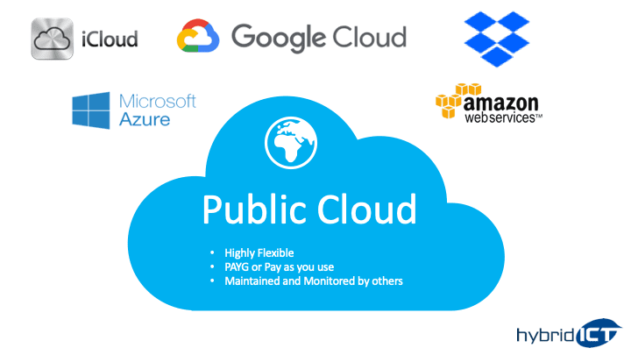
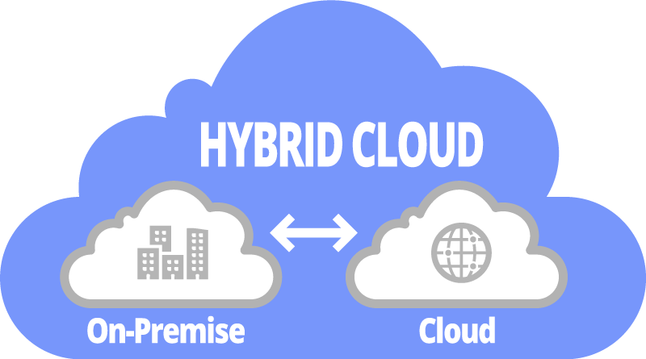
Three types of cloud computing
Notes:
The three types of cloud computing are the public cloud, the private cloud, and the hybrid cloud.
A public cloud is the pay- as-you-go services. A private cloud is internal data center of a business not available to the general public but based on cloud structure.
The hybrid cloud is a combination of the public cloud and private cloud.

Slide 5
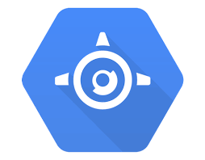
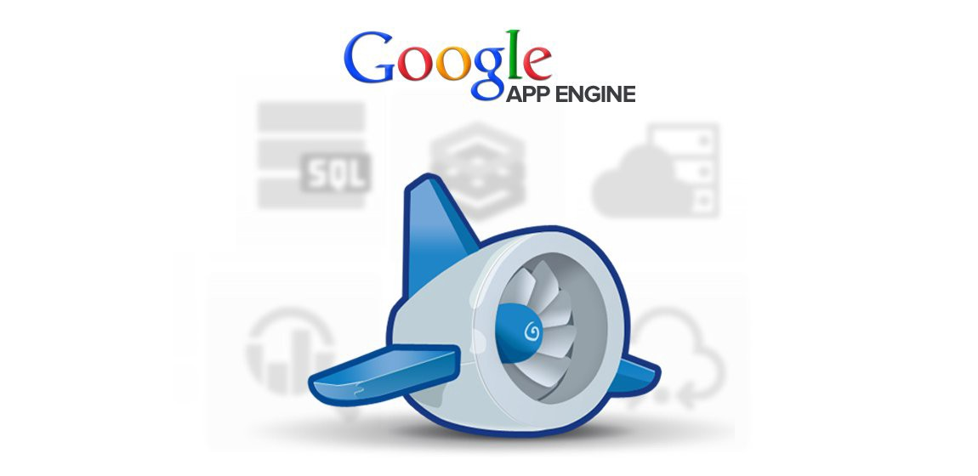
Google App Engine

Slide 6
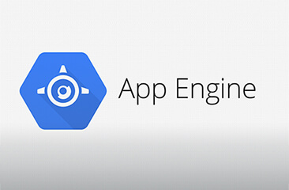
How does GAE work?
The application environment
Sandbox
Storage
The Runtime environment

Slide 7
Thank you

Slide 8
Benefits of cloud computing

Slide 9
Background
Big data entails a huge commitment of hardware and processing resources, making adoption costs of big data technology prohibitive to small and medium sized businesses. Cloud computing offers the promise of big data implementation to small and medium sized businesses.

Slide 10
What can Cloud Computing bring us?
A number of architectures and deployment models exist for cloud computing, and these architectures and models are able to be used with other technologies and design approaches. Owners of small to medium sized businesses who are unable to afford adoption of clustered NAS technology can consider a number of cloud computing models to meet their big data needs. Small to medium sized business owners need to consider the correct cloud computing in order to remain both competitive and profitable.

Slide 11
What can Cloud Computing bring us?
Cloud computing provides an environment for small to medium sized businesses to implement big data technology. Benefits that businesses can realize from big data include performance improvement, decision making support, and innovation in business models, products, and services .Three major reasons for small to medium sized businesses to use cloud computing for big data technology implementation are the ability to reduce hardware costs, reduce processing costs, and to test the value of big data before committing significant company resources. The major concerns regarding cloud computing are security and loss of control.

Slide 12
Future direction of Cloud Computing
While the public cloud provides the greatest costs savings, it also incurs the greatest security risk and loss of control, since all of the company’s big data is transferred to the cloud service provider.
If the data being processed is considered mission critical to the company, the more expensive private cloud, implemented in-house, would provide a more secure environment with the company keeping the mission critical data in-house.

Slide 13
Thank you

