Slide 1
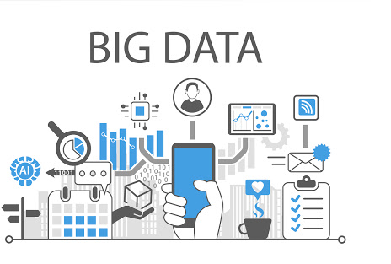

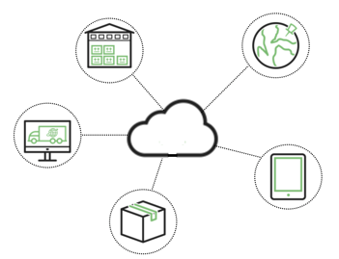
Big data using cloud computing
ZhengTianji
01170227

Slide 2
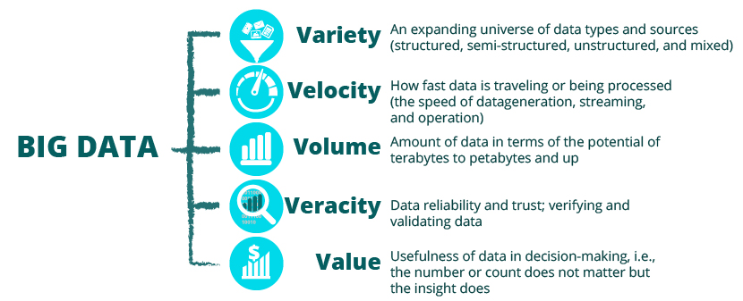
What is Big Data？
Characteristics
1.Volume
2.Variety
3.Velocity
4.Veracity
5.Variability
6.Value
Notes:
Big Data is a data analysis methodology enabled by a new generation of technologies and architecture which support high-velocity data capture, storage, and analysis. Data sources extend beyond the traditional corporate database to include e-mail, mobile device output, sensor-generated data, and social media output . Data are no longer restricted to structured database records but include unstructured data – data having no standard formatting.

Slide 3
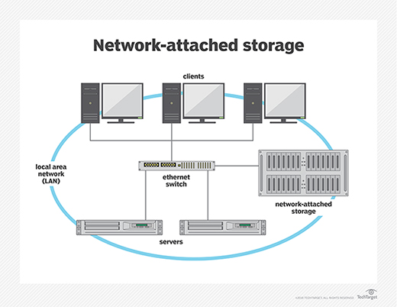
Network-Attached Storage
Notes:
A typical model for in-house storage of big data is clustered Network-Attached Storage .
The configuration would begin with a network-attached storage (NAS) pod consisting of several computers attached to a computer used as the (NAS) device.
Several NAS pods would be attached to each other through the computer used as the NAS device.
Clustered NAS storage is an expensive prospect for a small to medium size business.
A cloud services provider can furnish the necessary storage space for substantially lower costs.

Slide 4
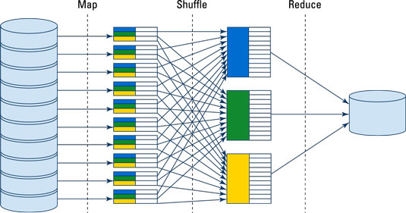
MapReduce Paradigm
Map
Shuffle
Reduce
Notes:
Big Data processing is performed through a programming paradigm known as MapReduce.
MapReduce is a programming model and an associated implementation for processing and generating big data sets with a parallel, distributed algorithm on a cluster.
A MapReduce framework (or system) is usually composed of three operations (or steps):
Map: each worker node applies the map function to the local data, and writes the output to a temporary storage. A master node ensures that only one copy of the redundant input data is processed.
Shuffle: worker nodes redistribute data based on the output keys (produced by the map function), such that all data belonging to one key is located on the same worker node.
Reduce: worker nodes now process each group of output data, per key, in parallel.
The mapping is done concurrently by each separate NAS device; the mapping requires parallel processing.
The parallel processing needs of MapReduce are costly, and require the configuration noted previously for storage.
The processing needs can be met by cloud-service providers.

Slide 5
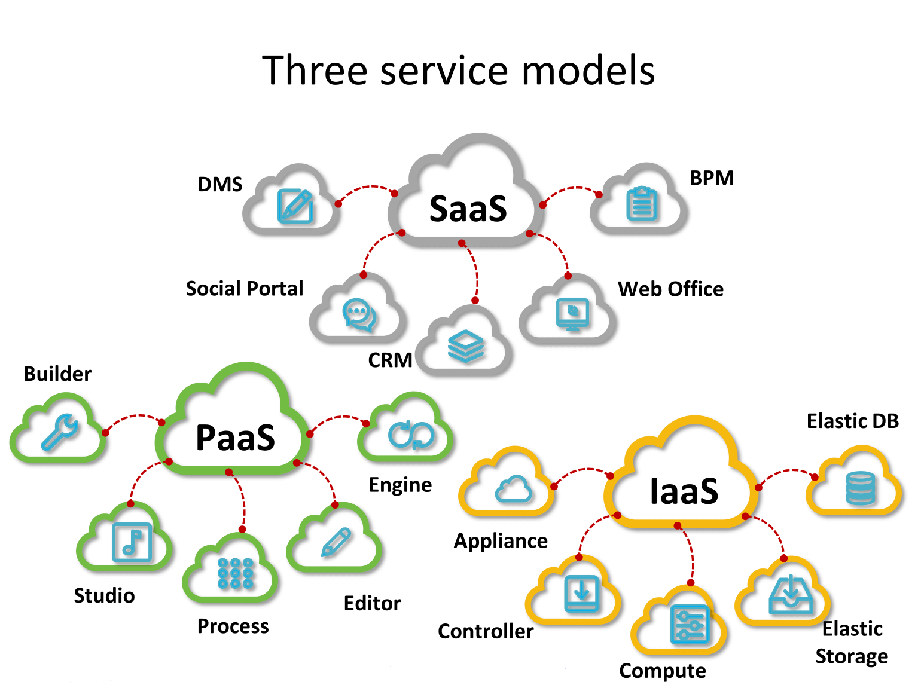
Notes:
Common deployment models for cloud computing include platform as a service (PaaS),
software as a service (SaaS),and infrastructure as a service (IaaS.)
Cloud deployment solutions can provide services that businesses would otherwise not be able to afford.
Businesses can also use cloud deployment solutions as a test measure before adopting a new application or technology company-wide.

Slide 6
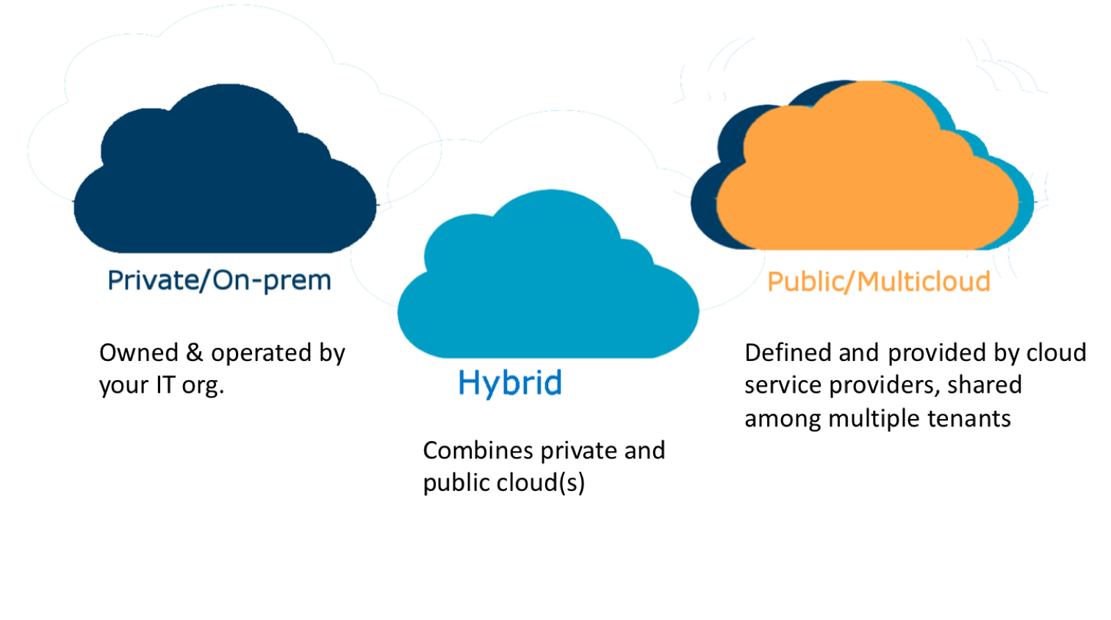
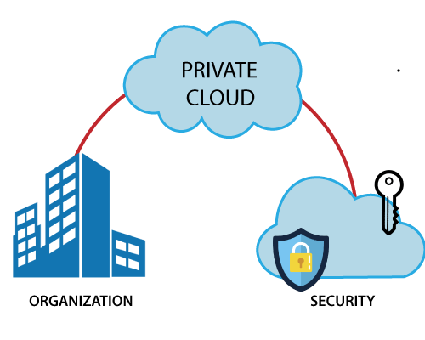
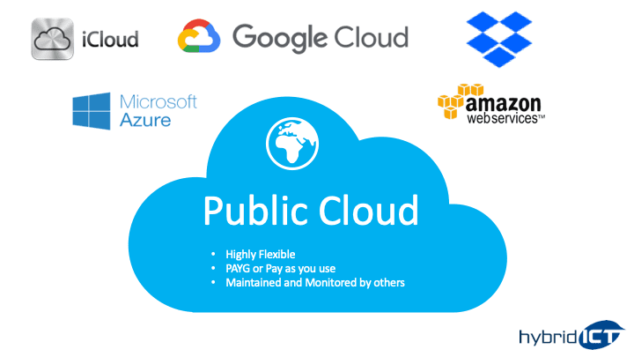
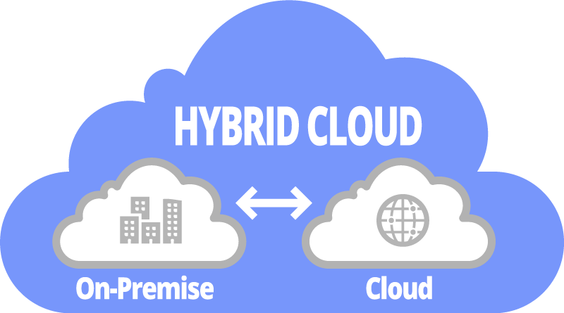
Three types of cloud computing
Notes:
A public cloud is the pay- as-you-go services previously discussed available to the general public.
In a public cloud configuration, a business does not own the core technology resources and services but outsources these .
A public cloud is considered to be an external cloud.
A private cloud is internal data center of a business that is not available to the general public but uses cloud structure .
In a private cloud configuration, resources and services are owned by the business, with the services accessible within the business through the intranet .
When a company uses a hybrid cloud, it uses a public cloud for some tasks and a private cloud for other tasks.
A hybrid cloud allows a company to maintain critical, confidential data and information within it firewall while leveraging the public cloud for non-confidential data .

Slide 7
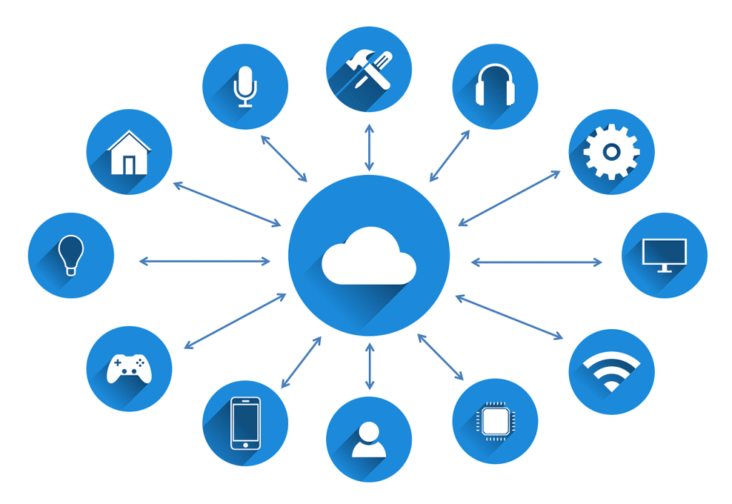
CLOUD COMPUTING FOR BIG DATA IN A SMALL TO MEDIUM SIZED BUSINESS
Advantage
Reduce hardware costs
Reduce processing costs
Test the value of big data before committing significant company resources
Problem
Security and loss of control
Notes:
Cloud computing enables small to medium sized business to implement big data technology with a reduced commitment of company resources.
Three major reasons for small to medium sized businesses to use cloud computing for big data technology implementation are the ability to reduce hardware costs, reduce processing costs, and to test the value of big data before committing significant company resources.
The major concerns regarding cloud computing are security and loss of control.

Slide 8
Thank you

