Slide 1
Python Stock Prediction
Zhichong Li

Slide 2
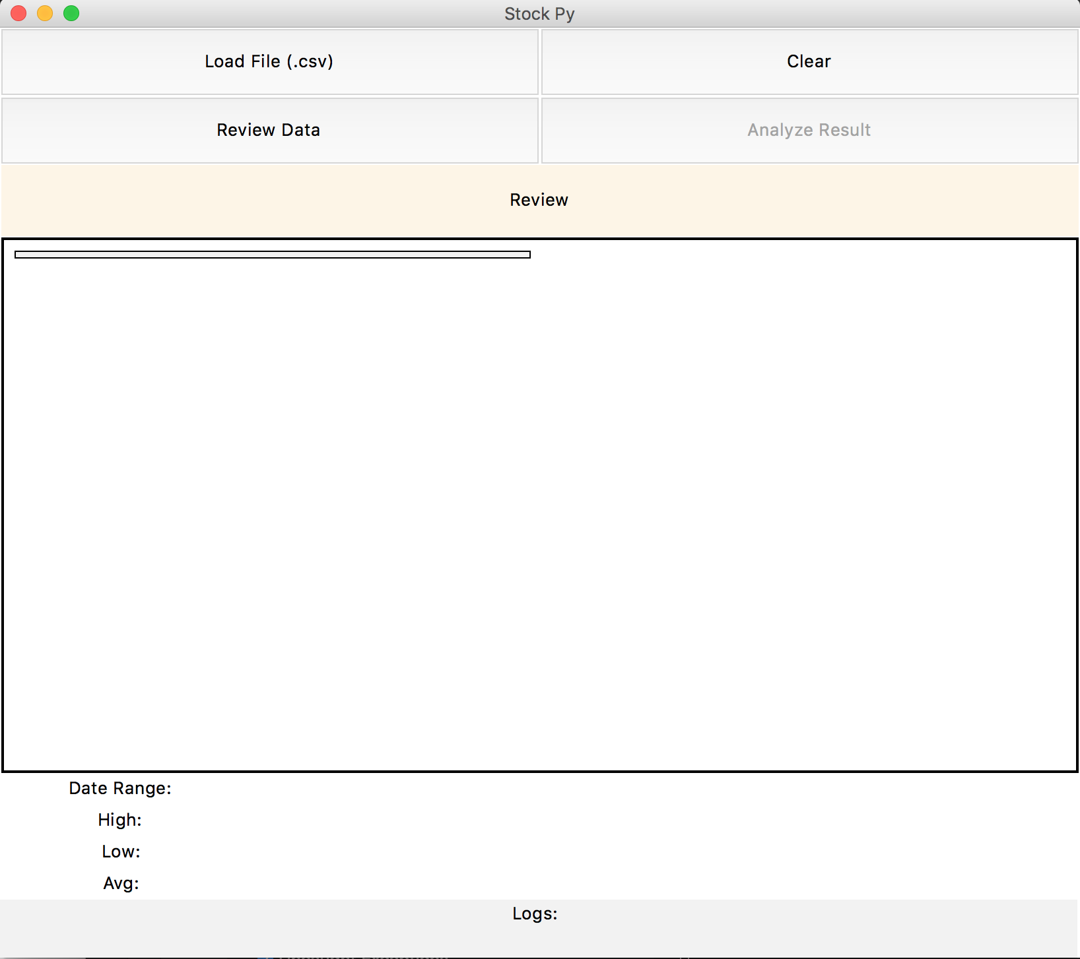
UI Components
Landing Screen
No data loaded
Empty canvas and review data
Analyze button disabled
Type to enter a caption.

Slide 3
UI Sections
Buttons ->
Frame Title ->
Figure Canvas ->
Raw Data ->
Status Bar ->
Type to enter a caption.

Slide 4
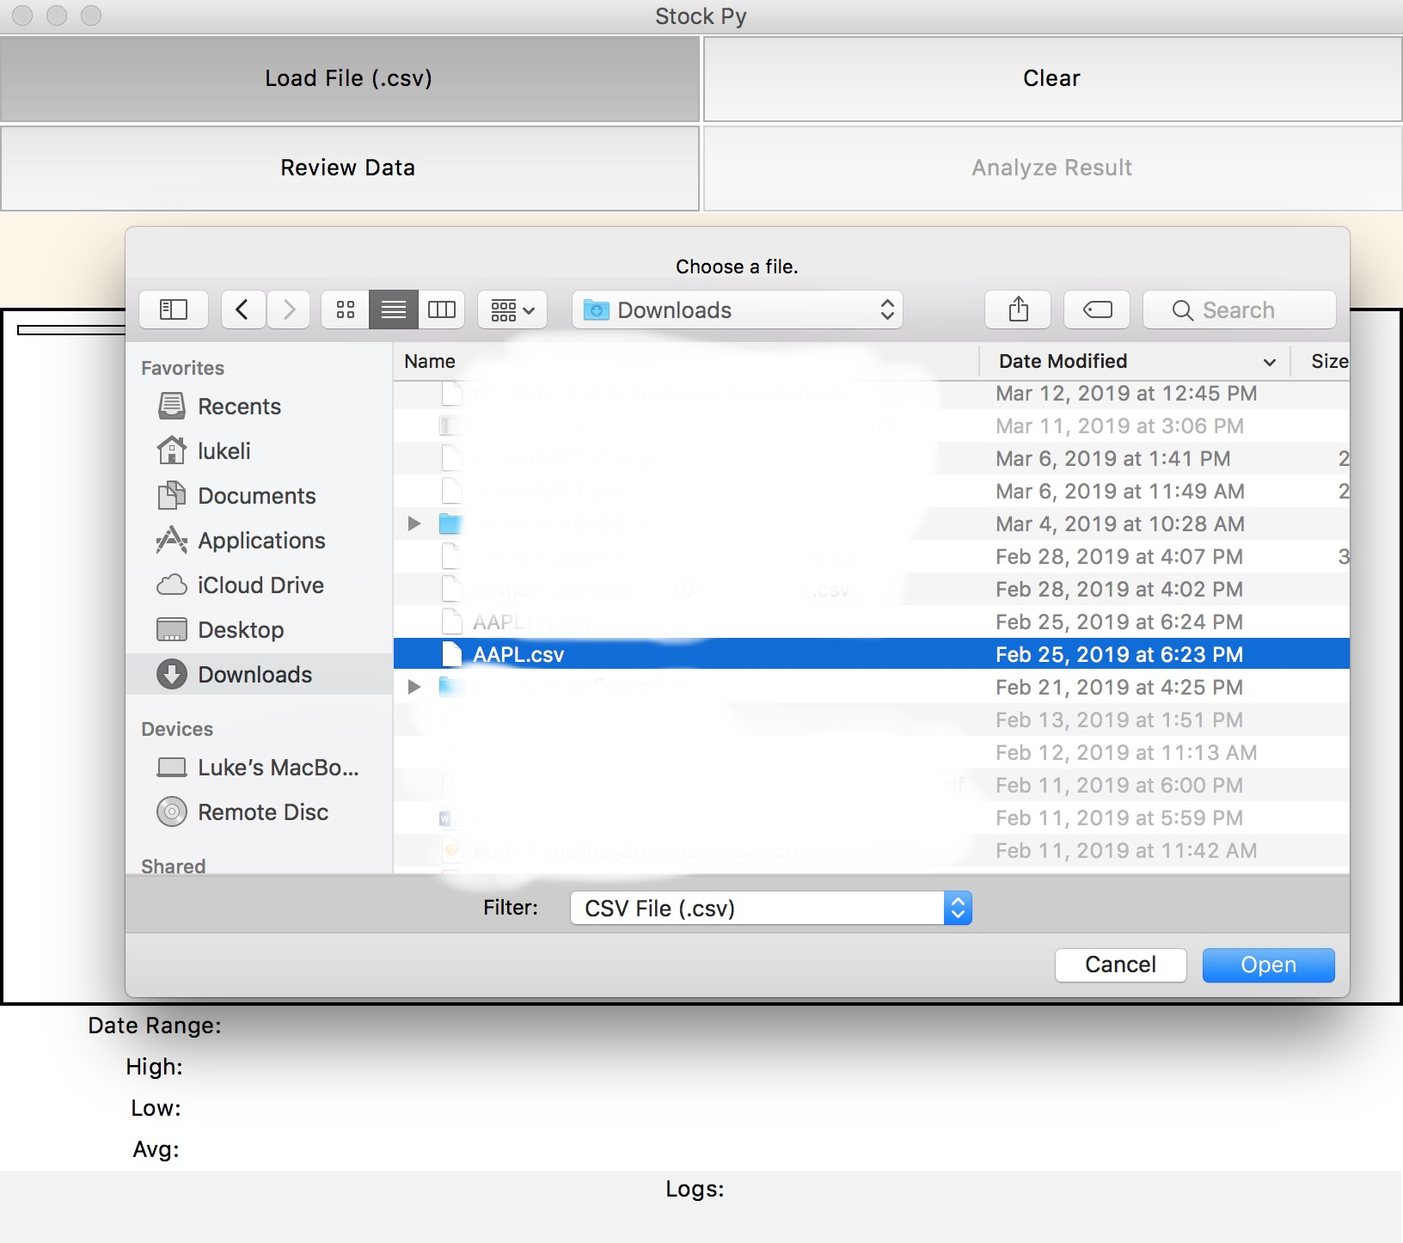
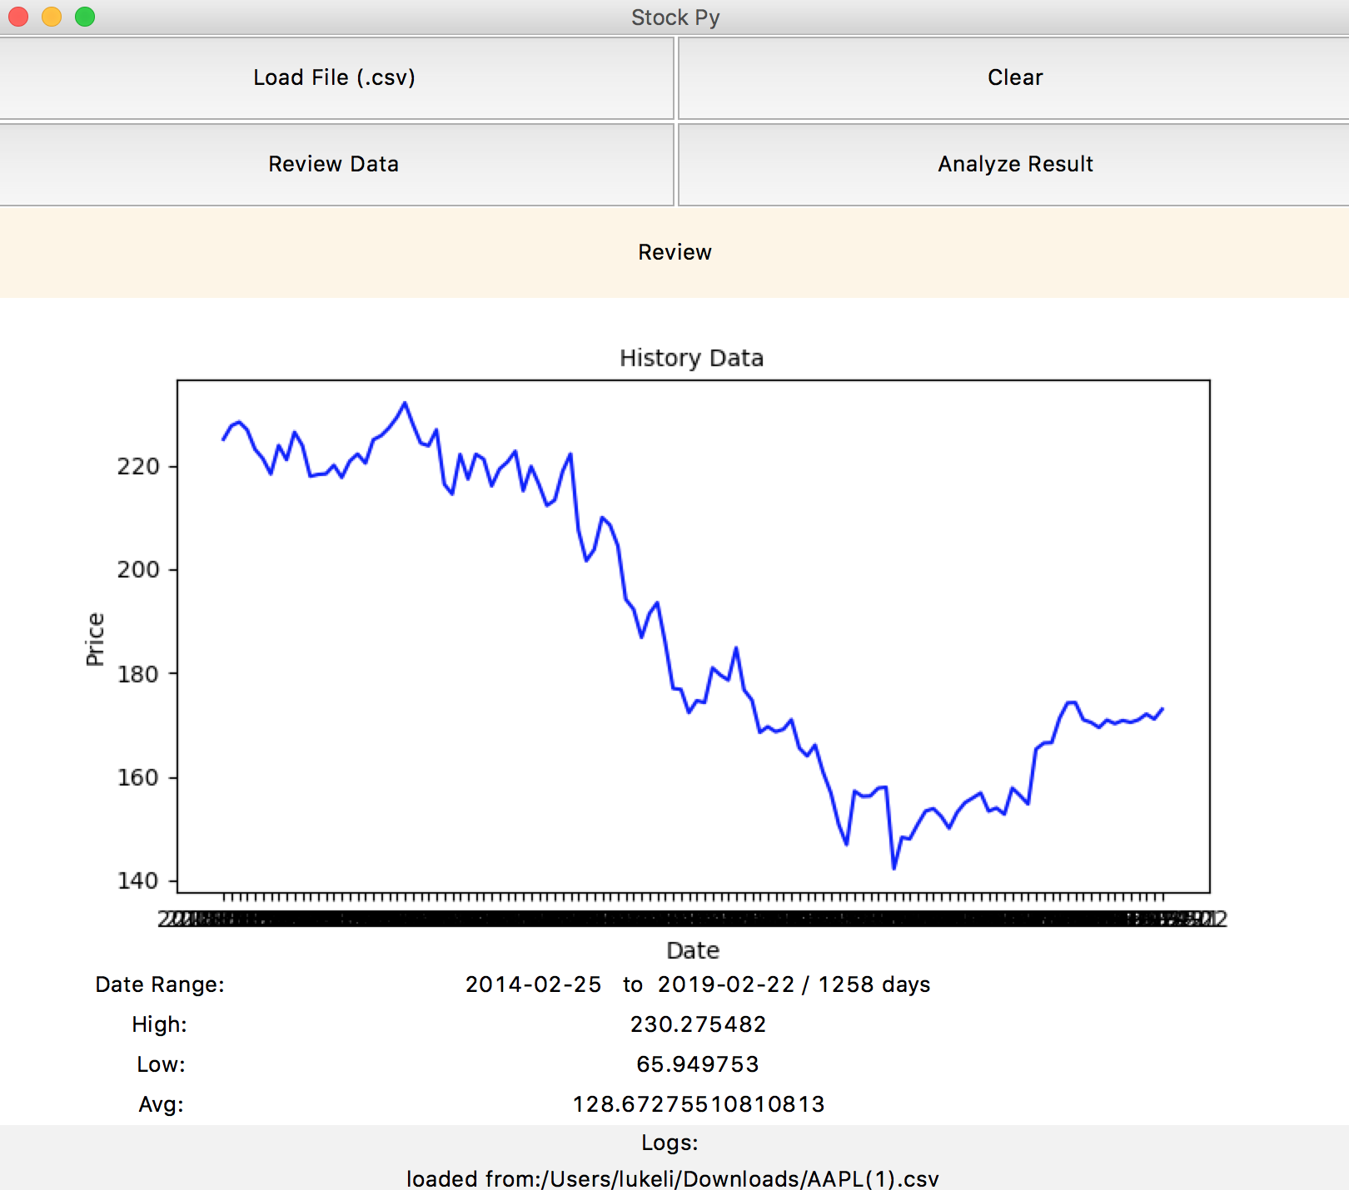
Load Data
Click Load Data
Select .csv file
Show history data figure
Analyze button is enabled
Type to enter a caption.
Review data board and logs updated
Type to enter a caption.

Slide 5
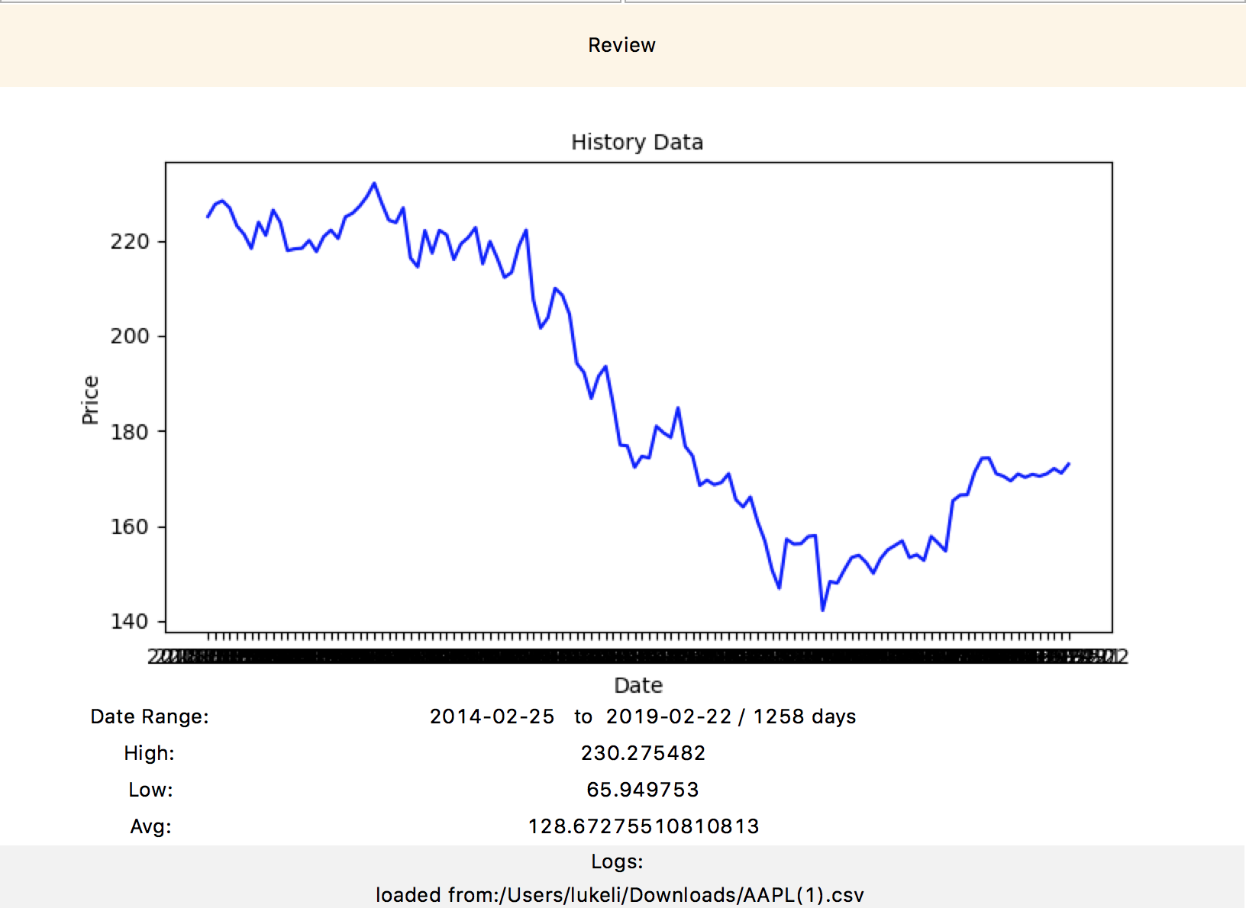
Review Data
Canvas title shows Review
Figure should be History Data
Plotted figure shows price for the past 120 days
Data review board shows raw data date range, high, low and average price
Log status shows the loaded file’s dir and file name
Type to enter a caption.

Slide 6
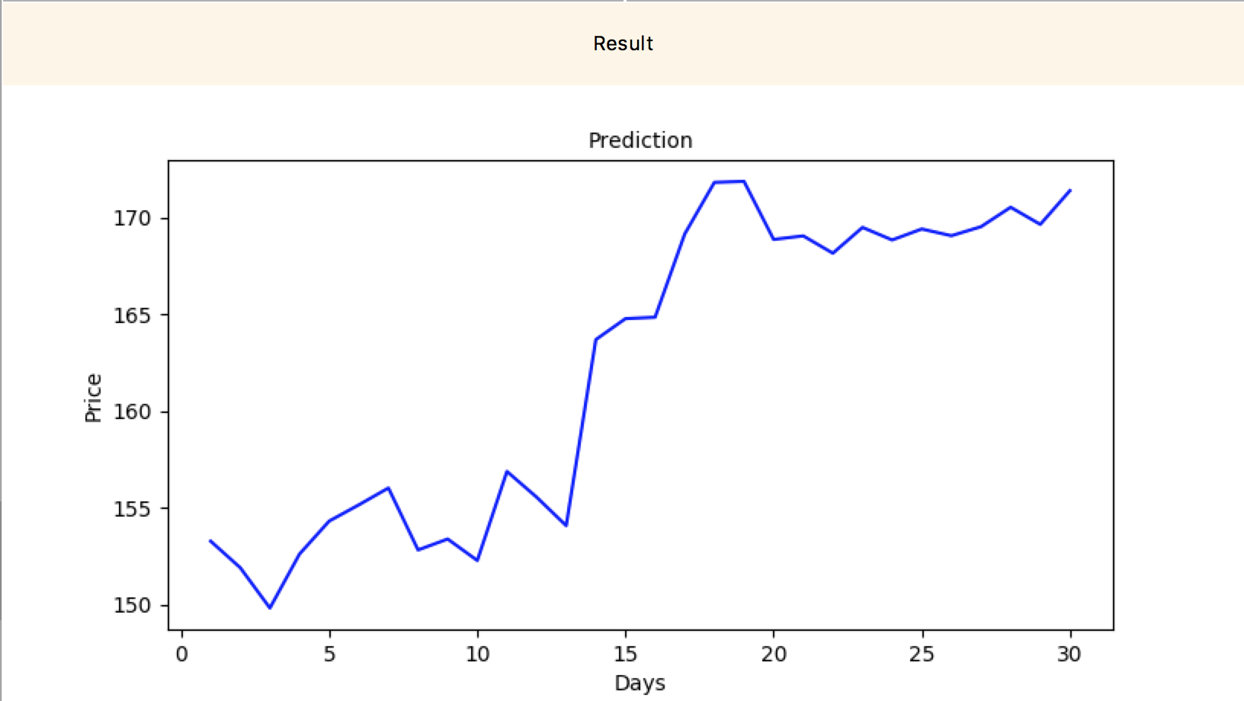
Analyze Result
Type to enter a caption.
Click analyze result
Canvas title shows Result
Canvas figure shows prediction for upcoming 30 days

Slide 7
Analyze Result
Analyze uses historic data for training and using linear regression to build a prediction model
Apply the prediction model to 30 day’s data to predict the trends for the upcoming 30 day
History data should be longer than 120 days and is recommended to be longer as possible

Slide 8
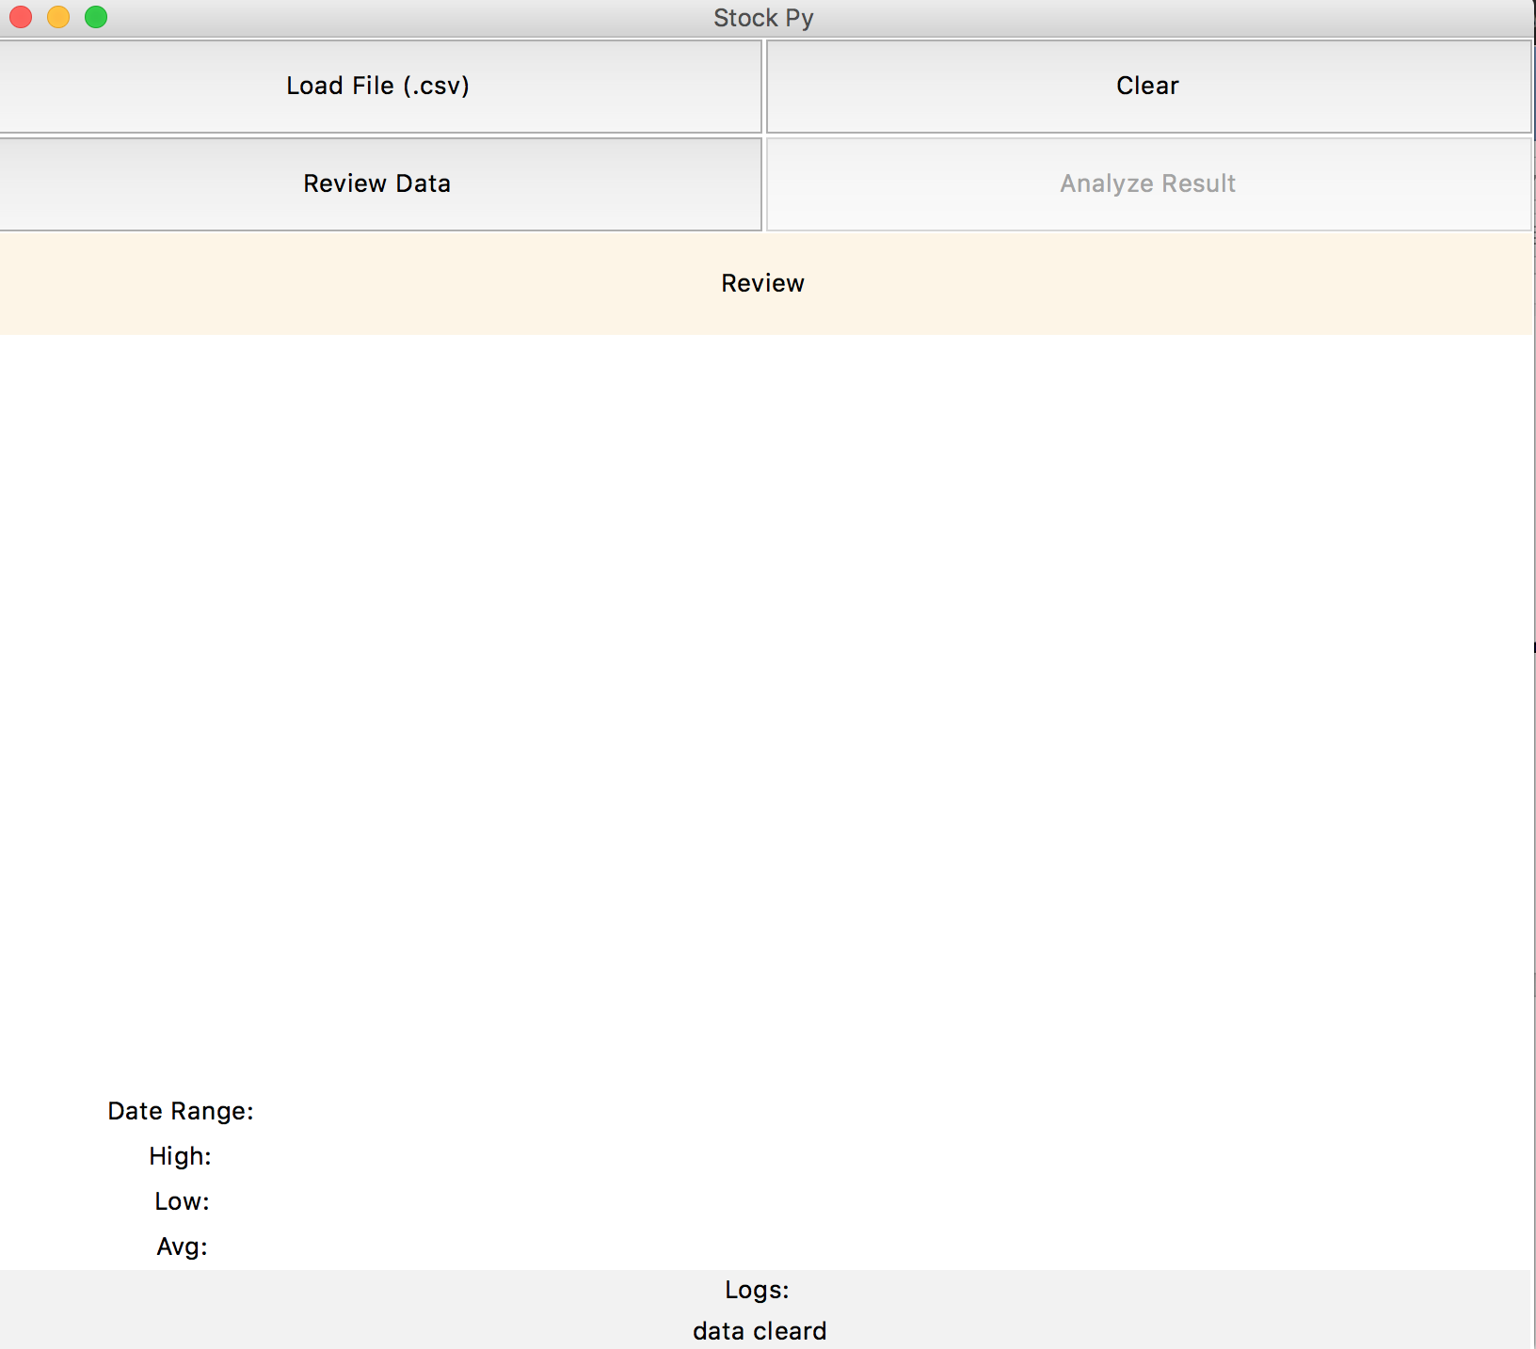
Review Data will switch figure to history data
Clear will clear all loaded data and canvas figure and logs, and since no data cached, analyze button will be disabled.
Type to enter a caption.

Slide 9
Python Modules
The app has two file modules, main file “stock.py” and util file “analyze.py”.
Tkinter is used for UI, buttons, frames, canvas, labels are used for different components. filedialog is used to select file.
“CSV”, “pandas” are used to import data and format to list or data columns.
“numpy” is used for math and array computations
“matplotlib” is used to plot stock figure
“sklearn” is used for data training and linear regression computation for stock prediction

Slide 10
Python Methods Used
OOP is used in this app. Since the app has three methods are used for calculate and switch canvas figure when switch between Review and Result, those methods are grouped into one object class.
Multi modules. “analyze.py” is an util module which can be used to compute prediction result and review data. They are purely functions have no relations with UI components, so they are better to put in a separated module. Main module can import it and use the functions inside.

