Slide 1
Python Stock Prediction
Zhichong Li

Slide 2
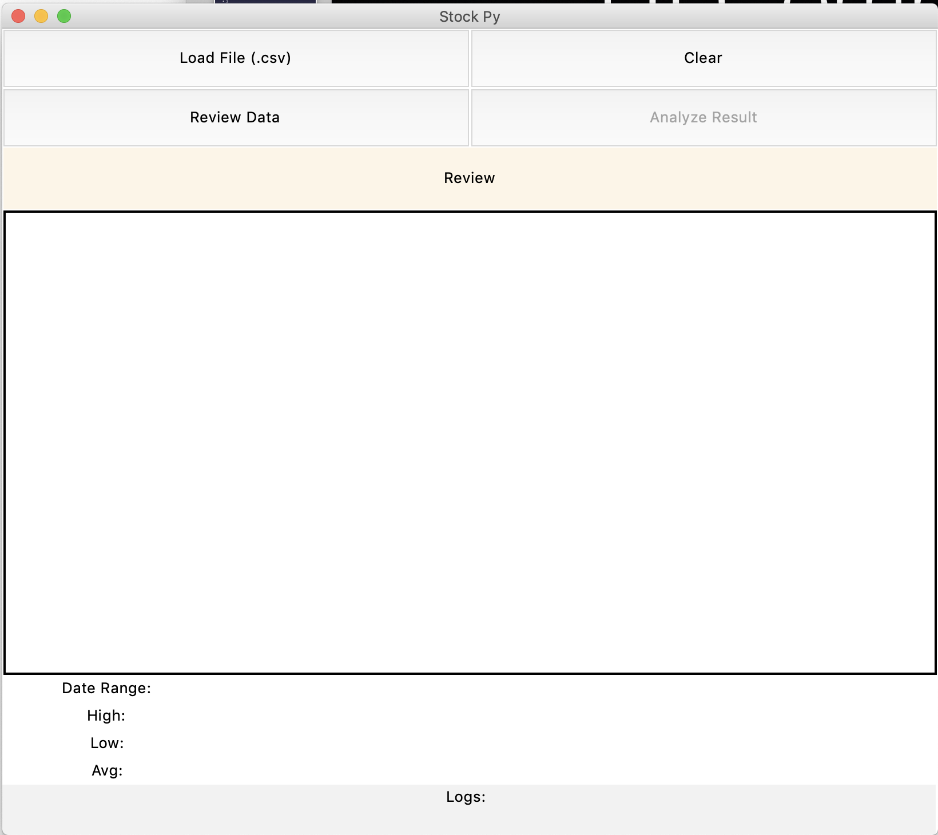
UI Components
Buttons
Frame Title
Figure Canvas
Raw Data
Status Bar
Type to enter a caption.

Slide 3
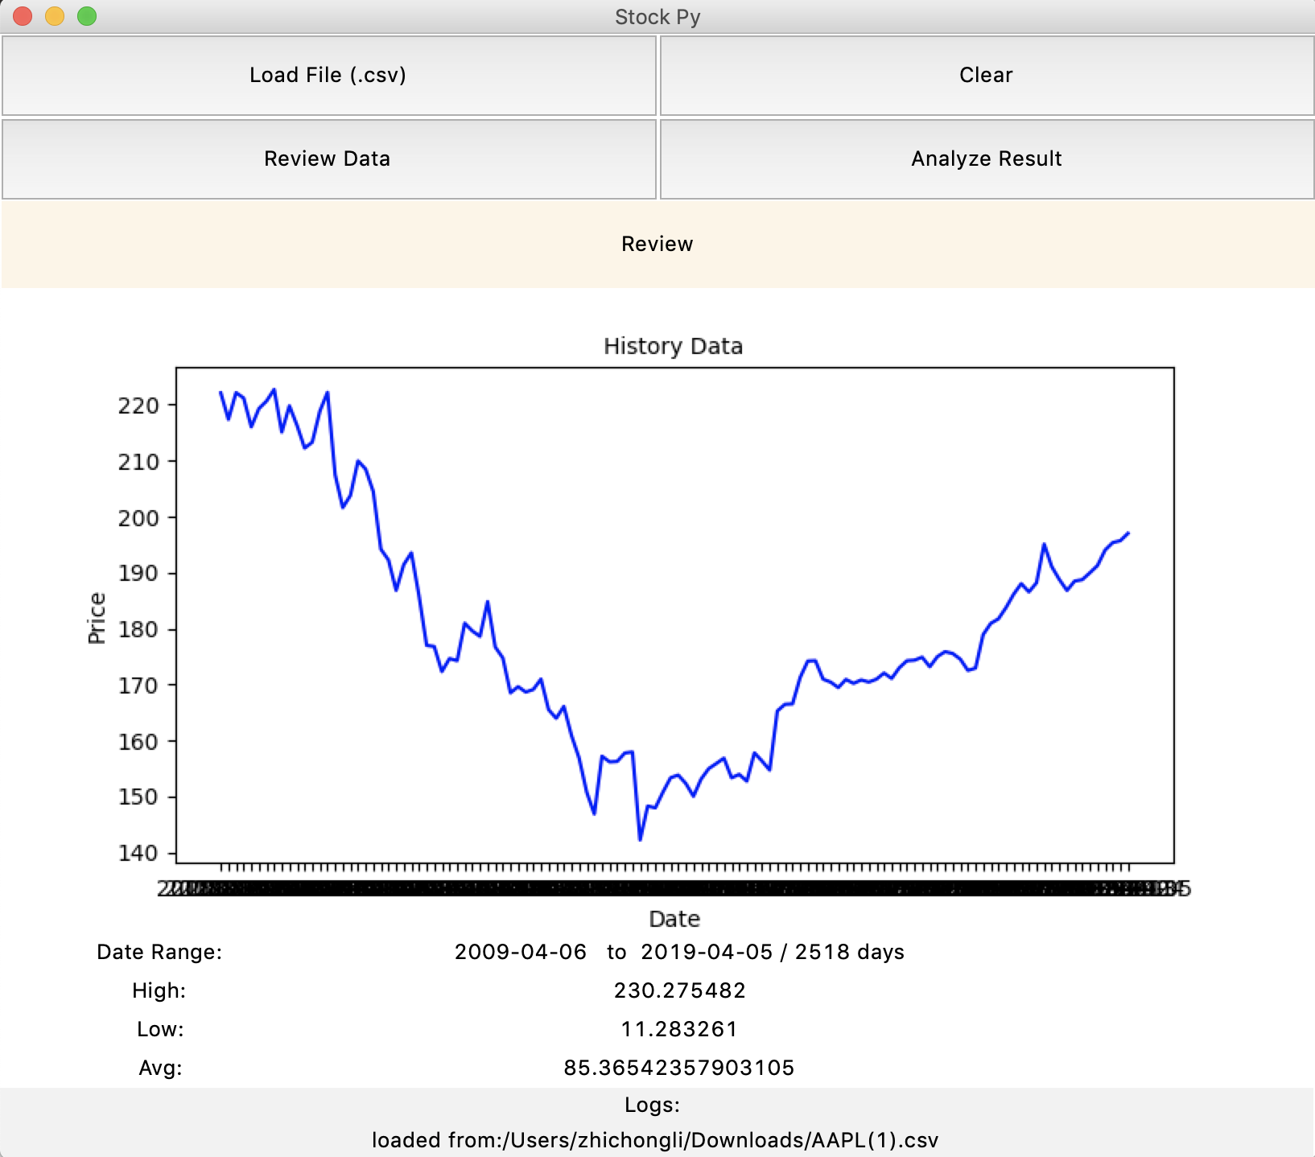
Load Data
Download 10 Yrs raw data .csv
Select .csv file to load
Show History Data figure for the most recent 120 days
Raw data: date ranges, highest point, lowest point and average price
Status bar: shows loaded file’s dir and name
Type to enter a caption.

Slide 4
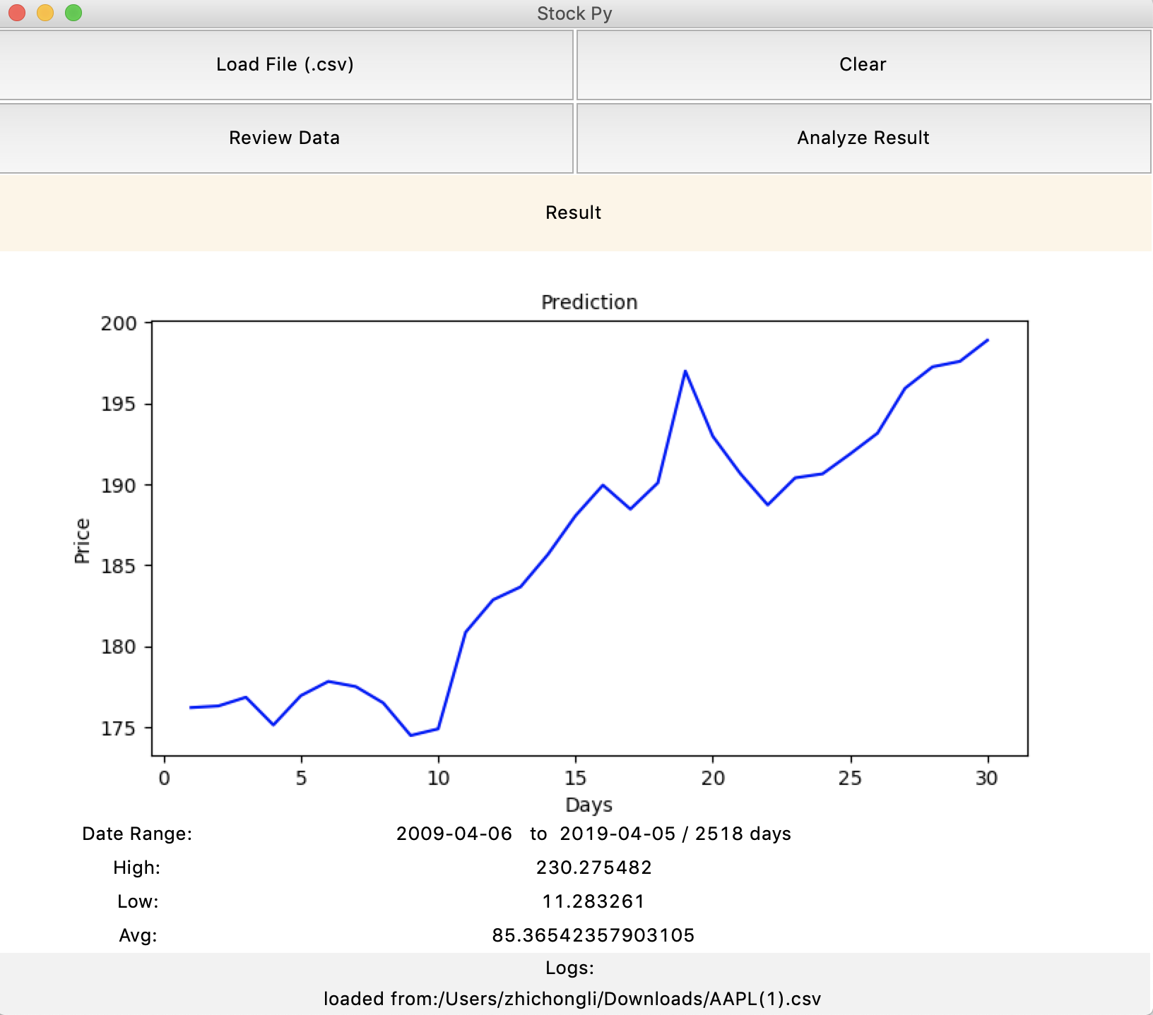
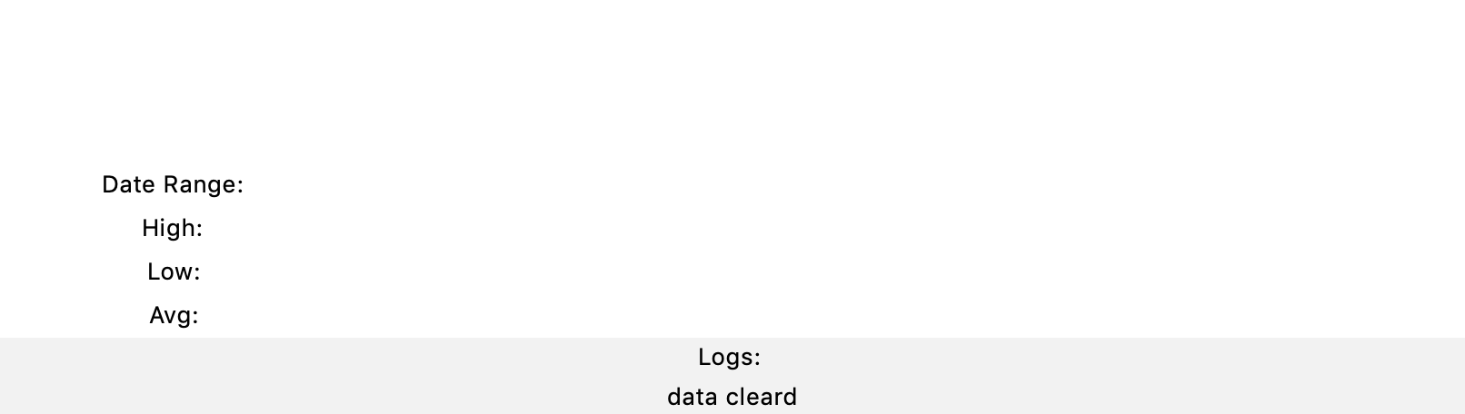
Analyze Result
Click Analyze Result Button
Figure Canvas switches to Prediction figure for upcoming 30 days
Review Data button will switch back to history data
Clear button will clear canvas, raw data and logs
Type to enter a caption.
Type to enter a caption.

