Slide 1

Recommender Systems (CA6124)
NarraCare
Safety-aware rehabilitation recommendations
Group project demonstration
Recommendation, safety and a gentle adventure experience
A supportive companion for a 60-day rehabilitation journey
Notes:
0:00–0:12
NarraCare recommends daily rehabilitation exercises with safety checks and a narrative companion. We combine an inspectable recommendation pipeline with a gentle adventure experience.
Sources: NarraCare_Final_Report_Revised.docx sections 1.3, 8; README.md
Repository: https://github.com/ZHIQIAN-fine/NarraCare/tree/main

Slide 2
Personalised rehabilitation
Changing symptoms meet repetitive daily exercises
Pain and fatigue shape suitability. Small milestones make progress visible
20
100
60
Synthetic personas
Exercise tasks
Days per rollout
ACL reconstruction, rotator-cuff repair and chronic back pain
Synthetic inputs support controlled inspection, with no claim of clinical efficacy
NarraCare CA6124 Group Project
Notes:
0:12–0:35
Rehabilitation can feel repetitive, while pain and fatigue change daily. A useful recommender must respect those constraints and make progress understandable. We explore this with twenty synthetic personas, one hundred exercises and sixty-day rollouts, covering knee, shoulder and back rehabilitation.
Sources: data/user_profiles.json; data/task_library.json; configs/default.yaml
Repository: https://github.com/ZHIQIAN-fine/NarraCare/tree/main

Slide 3
Five components in one daily loop
Daily execution
SAPS selection and feedback
User Simulator supplies state
Safety filters the catalogue
SAPS ranks; Safety checks the shortlist
Narrator presents a task
Choice, Reward Composer and updates
S(a) = r_ucb(a) + 2.0 × s
s ~ Beta(alpha_a, beta_a)
Chosen-task pain_change ≤ 1.0
updates the Beta safety estimate
An internal gate restricts output
IER: ungated proposals. SVR: accepted-task violations
Reward uses LinUCB UCB. Only the safety bonus is Thompson sampled
NarraCare CA6124 Group Project
Notes:
0:35–1:20
Every day, the User Simulator supplies symptoms. Safety filters the catalogue before SAPS ranks candidates and checks the shortlist afterwards. The template Narrator presents a task. Simulated feedback drives the Reward Composer and online learning. SAPS adds a sampled Beta safety bonus to LinUCB's reward estimate. We inspect safety twice: IER measures infeasible ungated proposals, while SVR checks accepted tasks. This separates the learner's proposals from what the filter allows.
Sources: src/pipeline.py run_single_turn/run_simulation; src/policies/saps.py select/update_safety
Repository: https://github.com/ZHIQIAN-fine/NarraCare/tree/main

Slide 4
Reward and proposal feasibility
20 synthetic personas, 60 days, seed 42
Ungated IER
SAPS 0.0223
LinUCB 0.0233
Random 0.4082
LinUCB without Safety: 171 / 772 accepted tasks violate runtime rules
SAPS vs LinUCB reward p = 0.743. No significant advantage
NarraCare CA6124 Group Project
Notes:
1:20–2:00
SAPS scores forty-two point zero two, close to LinUCB, without a significant advantage. Random earns more reward, but its infeasible proposal rate is forty point eight two percent, versus SAPS's two point two three percent. More directly, removing Safety from LinUCB produces one hundred seventy-one violating accepted tasks. These results support runtime filtering within our simulator.
Sources: evaluation/results/saps_60day.json; linucb_60day.json; random_60day.json; posthoc_svr_60day_seed42.json
Repository: https://github.com/ZHIQIAN-fine/NarraCare/tree/main

Slide 5
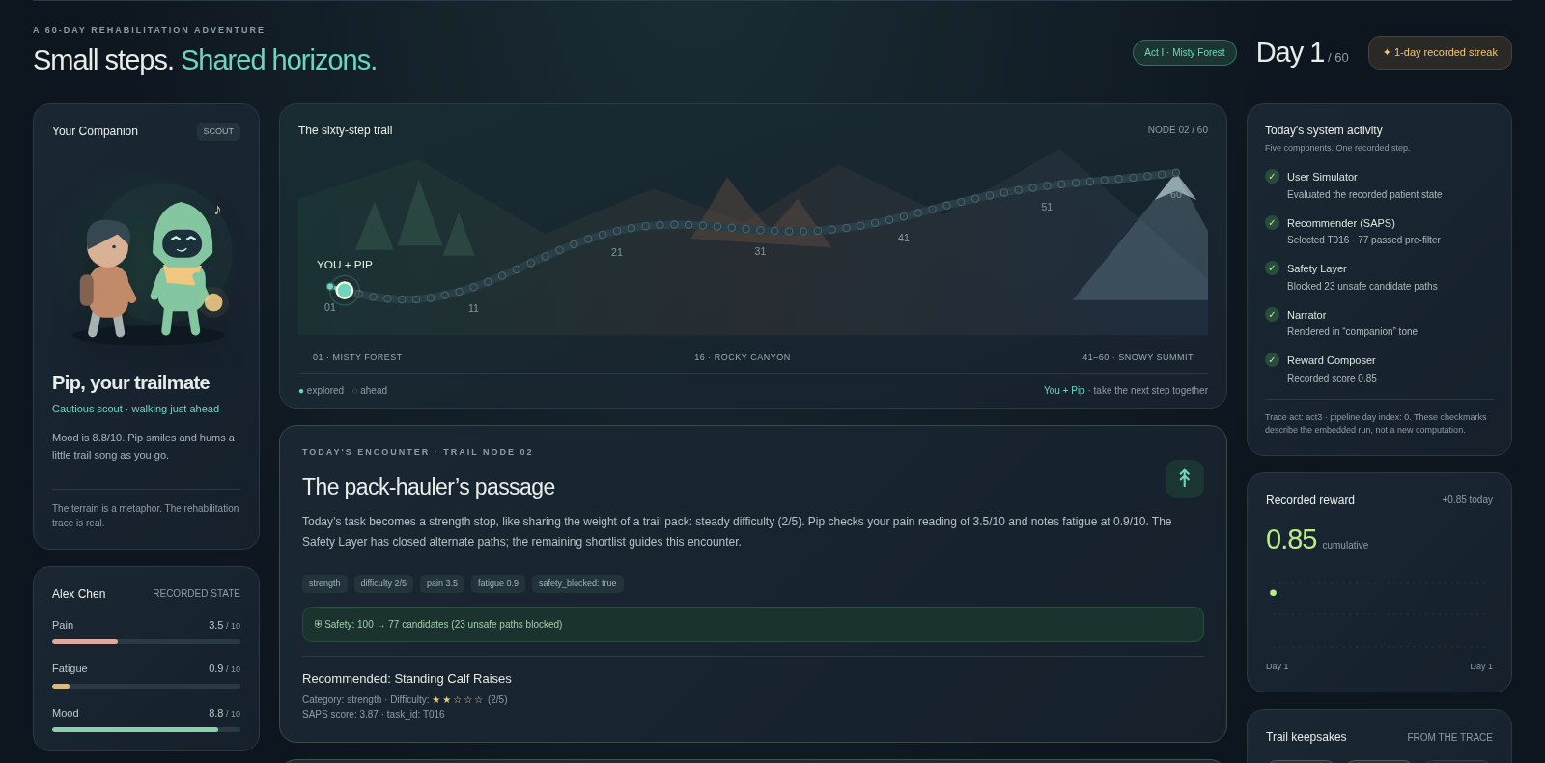
A companion for the rehabilitation journey
Small achievements and permission to rest
Recorded Day 1: Alex and Pip
A supportive companion
Forest, Canyon, Summit
60 days of milestones
Camp when tired
Rest counts as part of the journey
Real tasks and safety counts
remain visible
CLI runs the backend. HTML replies preserve recorded outcomes
NarraCare CA6124 Group Project
Notes:
2:00–2:40
Our demo turns this workflow into a mountain trail with Pip, a supportive companion. Forest, Canyon and Summit mark sixty days of small achievements. Camping makes rest part of the journey, without pressure to push harder. Real task details and safety counts remain visible. The CLI runs the backend; the HTML replays recorded trajectories. Replies change only the presentation. Engagement and adherence benefits still need user evaluation.
Sources: demo/index.html embedded U001/saps Day1 and presentation rules; narracare/demo.py; NarraCare_Final_Report_Revised.docx section 7.1
Repository: https://github.com/ZHIQIAN-fine/NarraCare/tree/main

Slide 6
Conclusion
Contribution and next step
Inspectable architecture for safety-aware recommendations
Proposal and execution safety measured separately
Companion-trail design for manageable achievements
Synthetic prototype. Clinical and engagement benefits need validation
Planned: a bounded agent for clarification, tool calls and preference memory
NarraCare CA6124 Group Project
Notes:
2:40–3:00
Our contribution is an inspectable safety-aware architecture, complementary safety metrics and a companion-based application design. Next, we plan a bounded agent that clarifies symptoms and uses existing tools. That extension remains future work. Thank you.
Sources: README.md; docs/implementation_notes.md
Repository: https://github.com/ZHIQIAN-fine/NarraCare/tree/main

Slide 7
Backup: complete policy comparison
Frozen seed-42 artifacts, 20 personas and 60 days
Policy | Mean cumulative reward | Ungated IER
SAPS | 42.02 | 0.0223
LinUCB | 41.94 | 0.0233
NeuralUCB modified | 38.31 | 0.0022
Random | 45.94 | 0.4082
Popularity | 39.03 | 0.0127
RuleBased | 43.33 | 0.3257
EpsilonGreedy | 40.95 | 0.0503
Raw SAPS IER bypasses its gate. Baseline implementations remain limited
Sources: evaluation/results/*60day*.json and docs/implementation_notes.md
NarraCare CA6124 Group Project
Notes:
Backup for questions. Not part of the three-minute talk. See the separate script and Q&A document for direct answers.
Sources: evaluation/results/saps_60day.json; evaluation/results/linucb_60day.json; evaluation/results/neuralucb_60day.json; evaluation/results/random_60day.json; evaluation/results/popularity_60day_seed42.json; evaluation/results/rule_based_60day_seed42.json; evaluation/results/epsilon_greedy_60day_seed42.json
Repository: https://github.com/ZHIQIAN-fine/NarraCare/tree/main

Slide 8
Backup: safety ablation evidence
LinUCB with Safety
LinUCB without Safety
0 / 743
171 / 772
Violating accepted tasks
Post-hoc SVR: 0.0000
Violating accepted tasks
Post-hoc SVR: 0.2215
Five runtime predicates. This does not establish clinical safety
NarraCare CA6124 Group Project
Notes:
Backup for questions. Not part of the three-minute talk. See the separate script and Q&A document for direct answers.
Sources: evaluation/results/posthoc_svr_60day_seed42.json; nosafety_svr_posthoc_full.json
Repository: https://github.com/ZHIQIAN-fine/NarraCare/tree/main

Slide 9
Backup: proposed agent extension
Current evaluated system
Proposed three-day prototype
Structured simulator state
Contextual ranking and online updates
Template narrator
HTML recorded replay
Day 1: state and clarification
Day 2: tool calls and memory
Day 3: multi-turn tests
Safety remains authoritative
Proposed follow-up. New interaction evidence is required
Legacy free-text path exists, but current results do not validate a dialogue agent
NarraCare CA6124 Group Project
Notes:
Backup for questions. Not part of the three-minute talk. See the separate script and Q&A document for direct answers.
Sources: Proposed plan, not implemented; src/pipeline.py run_single_turn/process_feedback/interactive_session; src/memory.py; report sections 4.1 and 8.2
Repository: https://github.com/ZHIQIAN-fine/NarraCare/tree/main

