Slide 1

Recommender Systems (CA6124)
NarraCare
A conversational rehabilitation recommender
LLM agent and evaluated recommendation pipeline
Recommendation and hard safety with a gentle trail companion
Synthetic benchmark and a live interactive companion
Notes:
0:00–0:12
NarraCare is a conversational rehabilitation recommender with a gentle trail companion. It combines an evaluated recommendation pipeline with a live LLM agent.
Sources: NarraCare_Agent_Report.docx sections 1.3, 8; README.md
Repository: https://github.com/ZHIQIAN-fine/NarraCare/tree/main

Slide 2
Personalised rehabilitation
Changing symptoms meet repetitive daily exercises
Pain and fatigue shape suitability. Small milestones make progress visible
20
100
60
Synthetic personas
Exercise tasks
Days per rollout
ACL reconstruction, rotator-cuff repair and chronic back pain
Synthetic inputs support controlled inspection, with no claim of clinical efficacy
NarraCare CA6124 Group Project
Notes:
0:12–0:35
Home rehabilitation can feel repetitive, while symptoms change daily. We want suitable recommendations and manageable achievements, without pressure to push through discomfort. Our benchmark uses twenty synthetic personas, one hundred exercises and sixty-day rollouts, covering knee, shoulder and chronic back conditions.
Sources: data/user_profiles.json; data/task_library.json; configs/default.yaml
Repository: https://github.com/ZHIQIAN-fine/NarraCare/tree/main

Slide 3
Learning and conversation with hard safety
Benchmark components
Live LLM tool controller
Simulator supplies state
Safety filters; SAPS ranks and checks
Template Narrator presents a task
Simulated feedback supplies reward
Models update; Narrator closes
gpt-4o-mini clarifies and calls tools
User reports replace simulation
Preferences change actual retrieval
Guarded tools enforce safety
Reported outcomes update learning
S(a) = r_ucb(a) + 2.0 × s s ~ Beta(alpha_a, beta_a)
Chosen-task pain_change ≤ 1.0 updates Beta. Narrator stays template-based
NarraCare CA6124 Group Project
Notes:
0:35–1:20
In the benchmark, the Simulator supplies state. Safety filters candidates; SAPS ranks them; Safety checks again. The template Narrator presents a task, and simulated feedback drives reward and learning. SAPS adds a sampled Beta safety bonus to LinUCB's reward score. In the live agent, user reports replace simulated behavior. GPT-four-o-mini interprets requests and selects tools, including clarification and preference revision. Deterministic tools enforce safety. Actual reported outcomes update reward and learning. The LLM cannot award completion from an intention.
Sources: src/pipeline.py; src/policies/saps.py; narracare/conversation/controller.py and tools.py
Repository: https://github.com/ZHIQIAN-fine/NarraCare/tree/main

Slide 4
Reward and proposal feasibility
20 synthetic personas, 60 days, seed 42
Ungated IER
SAPS 0.0223
LinUCB 0.0233
Random 0.4082
LinUCB without Safety: 171 / 772 accepted tasks violate runtime rules
SAPS vs LinUCB reward p = 0.743. No significant advantage
NarraCare CA6124 Group Project
Notes:
1:20–2:00
SAPS earns forty-two point zero two, close to LinUCB, without a significant advantage. Random earns more reward, but its infeasible proposal rate is forty point eight two percent, versus SAPS's two point two three percent. IER checks ungated proposals; SVR checks accepted tasks. Removing Safety from LinUCB produces one hundred seventy-one violating accepted tasks. These are benchmark results, not an evaluation of conversation quality.
Sources: evaluation/results/saps_60day.json; linucb_60day.json; random_60day.json; posthoc_svr_60day_seed42.json
Repository: https://github.com/ZHIQIAN-fine/NarraCare/tree/main

Slide 5
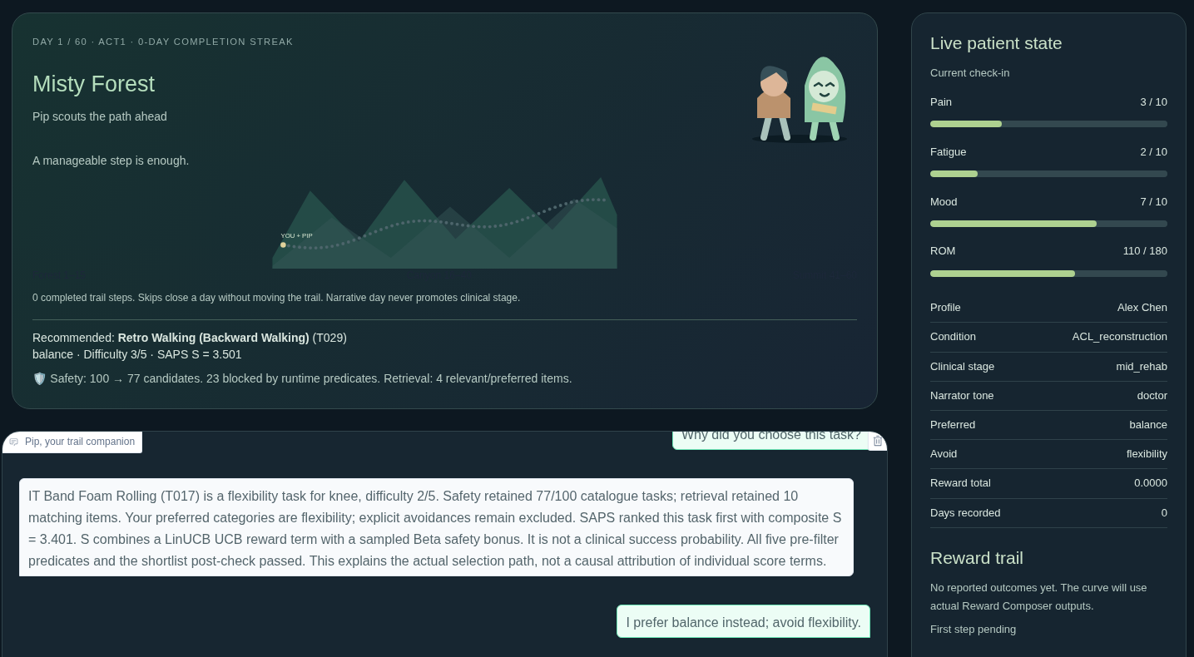
A live companion that responds to you
Real input changes the task, feedback changes learning
Verified live Gradio session
Preference revision
flexibility: T017
10 retrieved candidates
balance: T029
4 retrieved candidates
Safety retained 77 / 100
8/8 real-provider smoke cases. 67 tests. Frozen benchmark unchanged
NarraCare CA6124 Group Project
Notes:
2:00–2:40
Pip turns the workflow into a mountain trail, with small milestones and camp when tired. This is live interaction: changing flexibility to balance changes the actual retrieved set and task. Explicit completion updates reward and progress; skipping creates camp without invented feedback. Real-provider smoke checks passed all eight cases, alongside sixty-seven tests. Those checks verify integration, not improved adherence or clinical outcomes.
Sources: narracare/agent_app.py; real gpt-4o-mini production browser sequence in deliverables/agent/evidence; docs/conversational_agent.md; report section 7.1
Repository: https://github.com/ZHIQIAN-fine/NarraCare/tree/main

Slide 6
Conclusion
Contribution and next evaluation
Inspectable architecture for safety-aware recommendations
Proposal and execution safety measured separately
Live conversational companion with reported feedback
Synthetic prototype. Clinical and engagement benefits need validation
Next: stronger baselines, dialogue evaluation and clinician-reviewed studies
NarraCare CA6124 Group Project
Notes:
2:40–3:00
Our contribution is an inspectable safety-aware architecture, complementary safety diagnostics and a conversational companion design. We preserve the original benchmark and evaluate the agent separately. Next come stronger baselines, dialogue evaluation and clinician-reviewed user studies. Thank you.
Sources: README.md; docs/implementation_notes.md
Repository: https://github.com/ZHIQIAN-fine/NarraCare/tree/main

Slide 7
Backup: complete policy comparison
Frozen seed-42 artifacts, 20 personas and 60 days
Policy | Mean cumulative reward | Ungated IER
SAPS | 42.02 | 0.0223
LinUCB | 41.94 | 0.0233
NeuralUCB modified | 38.31 | 0.0022
Random | 45.94 | 0.4082
Popularity | 39.03 | 0.0127
RuleBased | 43.33 | 0.3257
EpsilonGreedy | 40.95 | 0.0503
Raw SAPS IER bypasses its gate. Baseline implementations remain limited
Sources: evaluation/results/*60day*.json and docs/implementation_notes.md
NarraCare CA6124 Group Project
Notes:
Backup for questions. Not part of the three-minute talk. See the separate script and Q&A document for direct answers.
Sources: evaluation/results/saps_60day.json; evaluation/results/linucb_60day.json; evaluation/results/neuralucb_60day.json; evaluation/results/random_60day.json; evaluation/results/popularity_60day_seed42.json; evaluation/results/rule_based_60day_seed42.json; evaluation/results/epsilon_greedy_60day_seed42.json
Repository: https://github.com/ZHIQIAN-fine/NarraCare/tree/main

Slide 8
Backup: safety ablation evidence
LinUCB with Safety
LinUCB without Safety
0 / 743
171 / 772
Violating accepted tasks
Post-hoc SVR: 0.0000
Violating accepted tasks
Post-hoc SVR: 0.2215
Five runtime predicates. This does not establish clinical safety
NarraCare CA6124 Group Project
Notes:
Backup for questions. Not part of the three-minute talk. See the separate script and Q&A document for direct answers.
Sources: evaluation/results/posthoc_svr_60day_seed42.json; nosafety_svr_posthoc_full.json
Repository: https://github.com/ZHIQIAN-fine/NarraCare/tree/main

Slide 9
Backup: implemented agent and its limits
Observed tool workflow
Engineering evidence
Clarify missing symptoms
Retrieve and rank safe candidates
Explain the actual selection path
Revise preferences before feedback
Record reported outcomes or camp
8 real-provider smoke cases
67 regression tests
Real Gradio preference and feedback
36 frozen result files unchanged
No conversational quality study yet
LLM chooses tools. Safety and feedback guards remain authoritative
Agent needs a key and network. Offline HTML is a separate recorded replay
NarraCare CA6124 Group Project
Notes:
Backup for questions. Not part of the three-minute talk. See the separate script and Q&A document for direct answers.
Sources: narracare/conversation; narracare/agent_check.py; tests/test_conversation.py; tests/test_agent_ui.py; verified real provider and browser logs
Repository: https://github.com/ZHIQIAN-fine/NarraCare/tree/main

