Slide 1
GAME PROJECT
Mini Whisper
A Roguelike Deckbuilder Solved with Action-Masked PPO

Slide 2
Overview
Motivation
Game Design
RL Formulation
01
02
03
Why RL in deckbuilders?
Mini Whisper in 3 minutes
MDP · State · Action · Reward
Training
Results
Findings
04
05
06
MaskablePPO · 300K steps · 4.4 min
Win rate · Floor reach · Strategy
Balance insights · Limitations

Slide 3
Motivation
Fully Observable
TWO RESEARCH QUESTIONS
No hidden information — difficulty comes from combinatorial card choices, not imperfect info.
Can a small PPO agent learn a non-trivial roguelike from scratch?
Long Horizon
Runs span ~16 turns across 10 floors, demanding long-term planning with dense reward shaping.
Can RL serve as a game-design audit tool — surfacing balance problems faster than manual playtesting?
Action Masking
Illegal actions (empty slots, insufficient energy) must be masked — ideal for MaskablePPO.

Slide 4
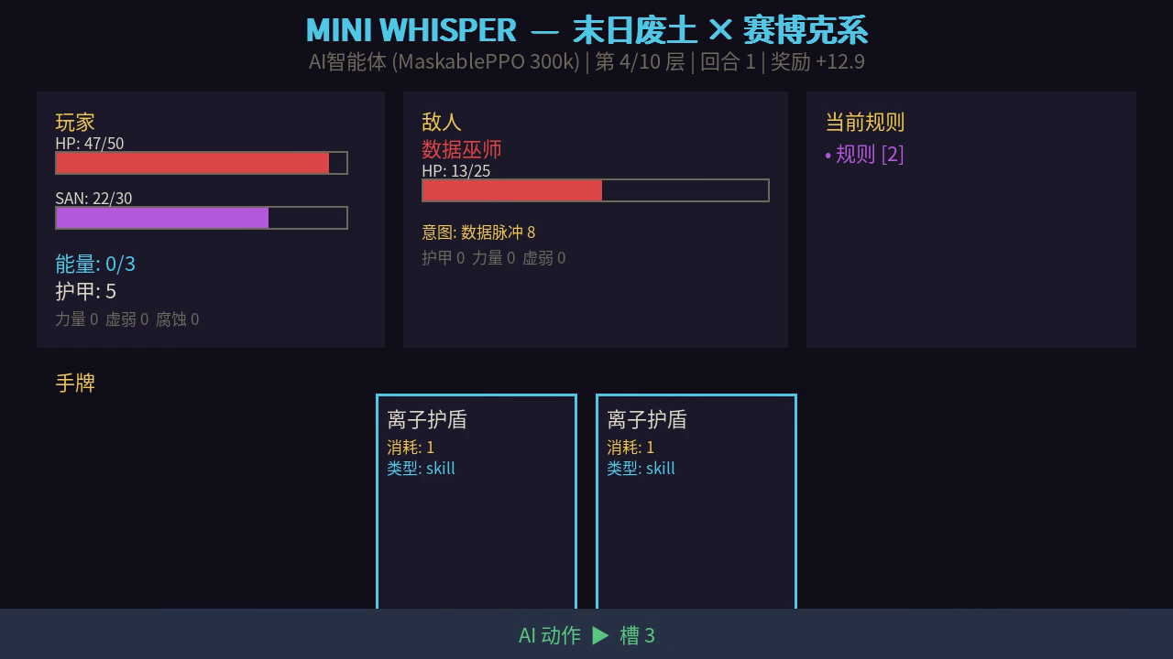
Mini Whisper: The Game
Post-apocalyptic × Cyber-Cthulhu roguelike deckbuilder built in Gymnasium
Core Loop
1
Floor Entry
Restore hand · Roll one rule modifier
2
Enemy Spawn
Stage-specific pool · Intent published
3
Combat
Play cards → spend energy → end turn
4
Advance / End
Kill enemy → next floor · HP=0 → defeat
10 floors
6 enemies
15 cards
6 rules

Slide 5
Formalising Mini Whisper as an MDP
State S
51-dim
Action A
16-way
Reward R
dense
· Player: HP, SAN, energy, buffs
· Slots 0–4: play hand card
· 0.05·Δdamage + 0.02·Δarmor
· Enemy: HP, intent, stage
· Slot 5–14: reserved (future)
· 0.05·Δheal + 0.03·Δsan_gain
· Hand: card IDs + costs (5 slots)
· Slot 15: End Turn
· −0.02·Δsan_loss
· Deck & discard composition
· +5 enemy kill · +20 boss kill
· Floor, turn, active rule
· Slot-based (not card-id based)
· −15 player death
51-dim Box float32 · bounded [-1, 100]
Discrete(16) · action-masked
Dense shaping · mean≈49.5 / 1K eps

Slide 6
Action Masking
Filtering illegal moves at every step keeps training fast and stable
What is Action Masking?
Key code
At each step, env.action_masks() returns a bool[16] vector.
# Wrap env with mask function
env = ActionMasker(
env,
lambda e: e.unwrapped.action_masks()
)
MaskablePPO zeroes out logits for illegal actions before sampling — the policy never 'wastes' gradient on impossible moves.
# MaskablePPO uses masks in:
# · rollout buffer
# · action distribution
# · policy loss term
Typical turn: 3–5 legal actions out of 16.
model = MaskablePPO(
'MlpPolicy', env,
n_steps=2048,
batch_size=64,
Without masking
With masking
...)
Plateaus at ~30 reward Never reliably reaches boss
Converges in 300K steps 56.1% win rate achieved

Slide 7
Training Setup
MaskablePPO · sb3-contrib 2.3.0 · Google Colab T4 · 300K steps
Hyperparameters
Hardware
Total timesteps
300,000
NVIDIA Tesla T4 · 15,360 MiB
Policy network
MLP [64, 64]
PyTorch 2.10.0 / CUDA 13.0
Learning rate
3 × 10⁻⁴
Google Colab free tier
n_steps
2,048
batch_size
64
4.4 min
300K
n_epochs
10
total training time
environment steps
γ (discount)
0.99
λ (GAE)
0.95
4×
0.80–0.86
clip_range
0.2
Parallel envs
4
parallel envs
explained variance

Slide 8
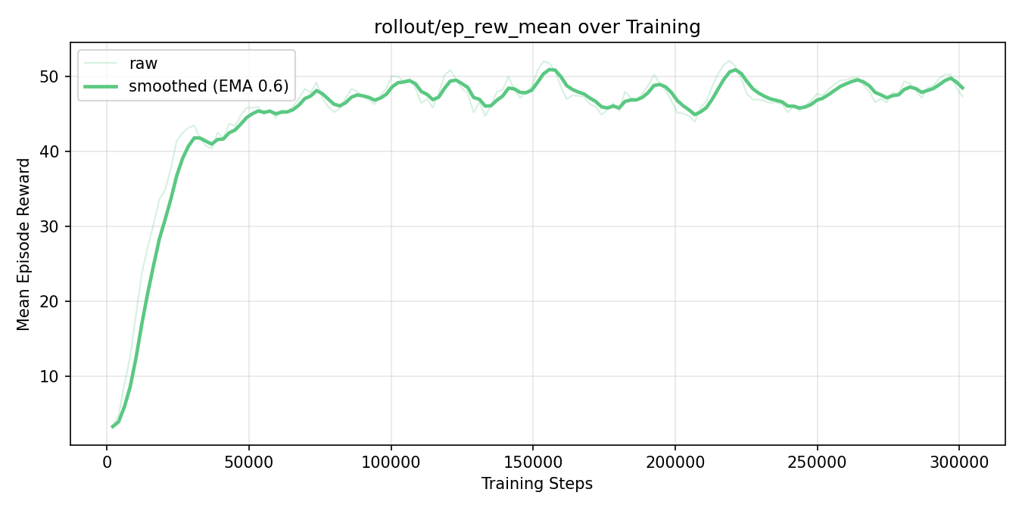
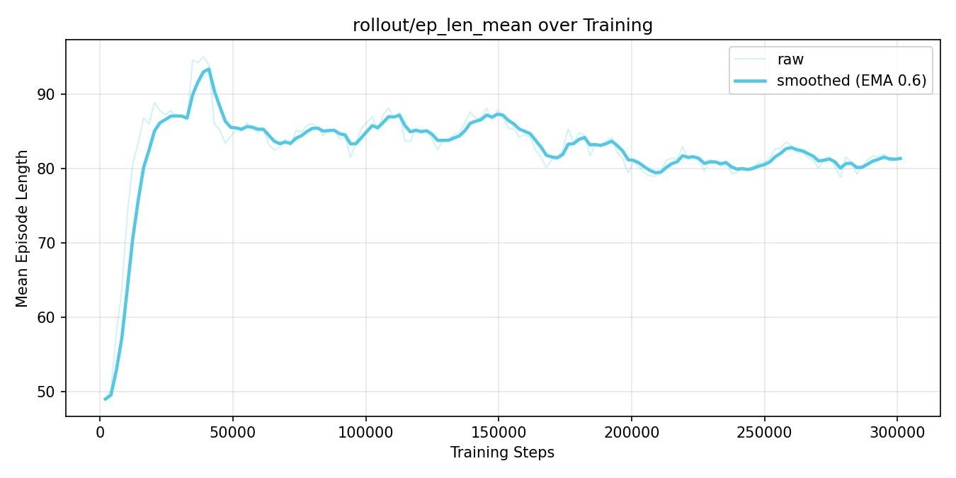
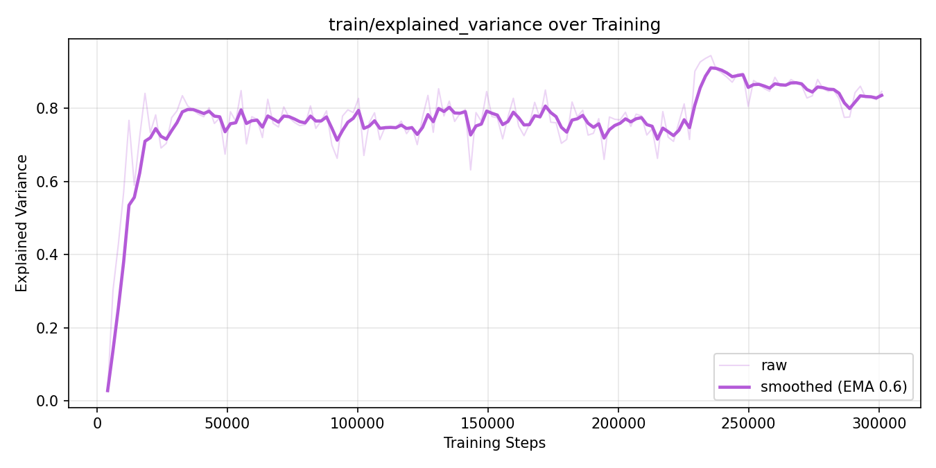
Learning Curves — 300K Steps
Smooth convergence on all three PPO diagnostics: reward · episode length · value fit
ep_rew_mean
ep_len_mean
explained_variance
Reward rises 3.3→50 in 18K steps, then plateaus at 47–50
Episode length stabilises at ~85 steps — policy survives longer
Value-function fit reaches 0.80–0.86 — critic is accurate

Slide 9
Headline Results — 1,000 Evaluation Episodes
Seeds 20,000–20,999 · Deterministic evaluation · None seen during training
56.1%
95.1%
+49.5
16.5
Win Rate
Boss-Reach Rate
Mean Reward
Mean Turns / Run
Human Baseline Comparison
Agent outperforms by ~22%
Lead designer's single playthrough: +40.55 reward · reached boss but did not win
std reward: ±15.7
47,315 total cards played
max reward: 70.1
min reward: 6.1
Bimodal distribution: defeat mode ~+34 (boss reached, lost) · victory mode ~+63 (boss killed)

Slide 10
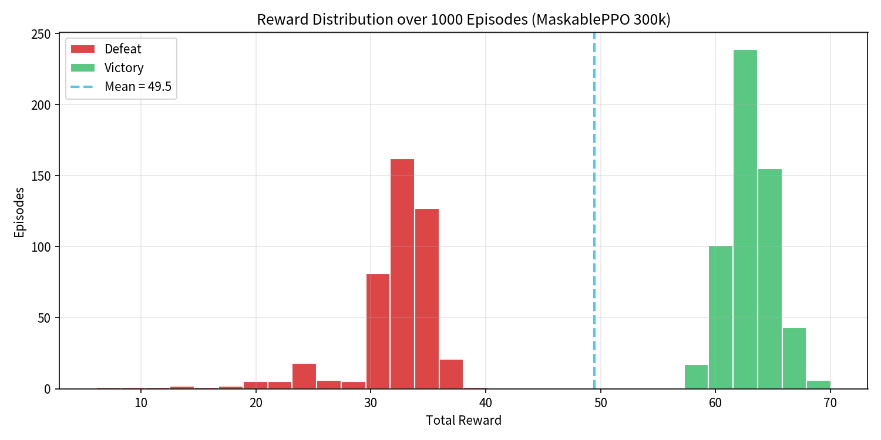
Reward Distribution
Bimodal shape reveals a single critical decision point: the boss fight
Defeat mode ~+34
Floors 1–9 cleared cleanly (~+5 each + dense damage reward). Boss lost — no +20 terminal bonus.
Victory mode ~+63
Same floor rewards + +20 boss-kill bonus + residual HP advantage at run end.
±15.7 std deviation
Dominated by the binary boss outcome. Reducing variance = improving boss win rate specifically.
95.1% reach the boss
Early game is essentially solved (floors 1–6: ≥99% reach rate). The bottleneck is the boss.

Slide 11
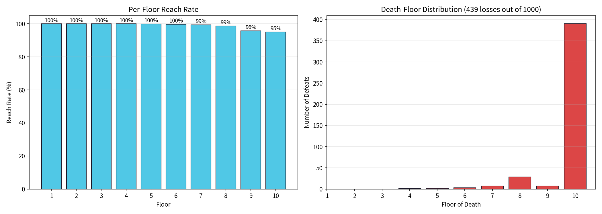
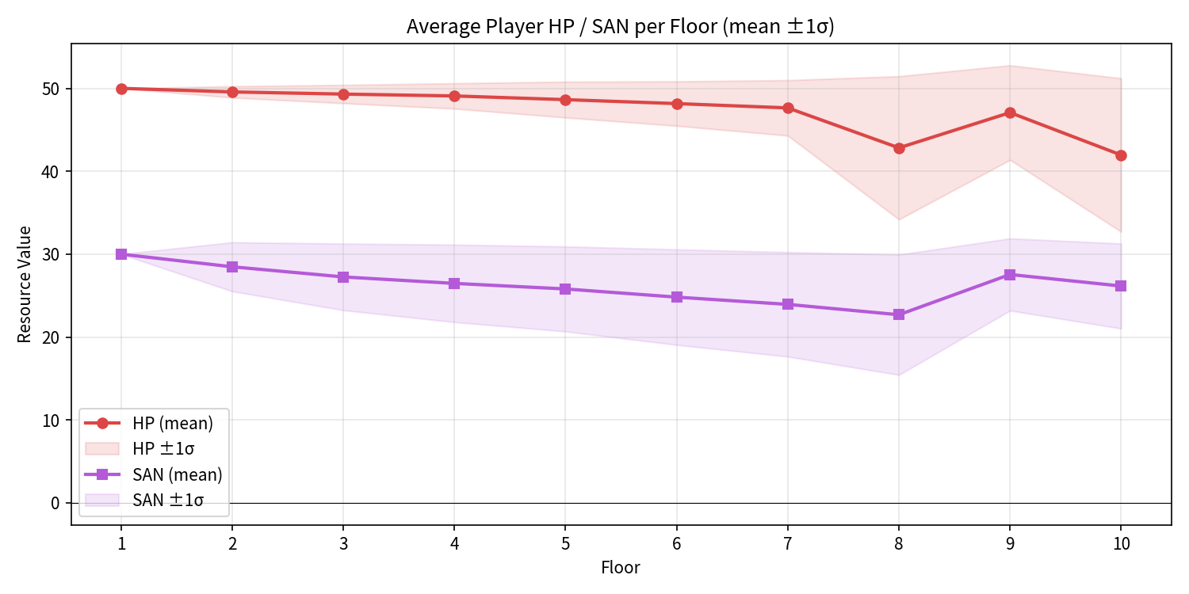
Per-Floor Analysis
Floor reach rate · failure distribution · HP / SAN trajectories across 1,000 episodes
Figure: Per-floor reach rate (left) & failure floor distribution (right)
Figure: Mean HP (red) & SAN (purple) per floor ± 1σ
Floors 1–6 ≥99% reach rate — early game solved
390/439 losses (88.8%) happen on boss floor
HP decays ~2–3 per floor on floors 1–6, accelerates to ~5–7 on floors 7–9
SAN stays high — agent avoids SAN-costly cards (Black Whisper, Nameless Kiss)

Slide 12
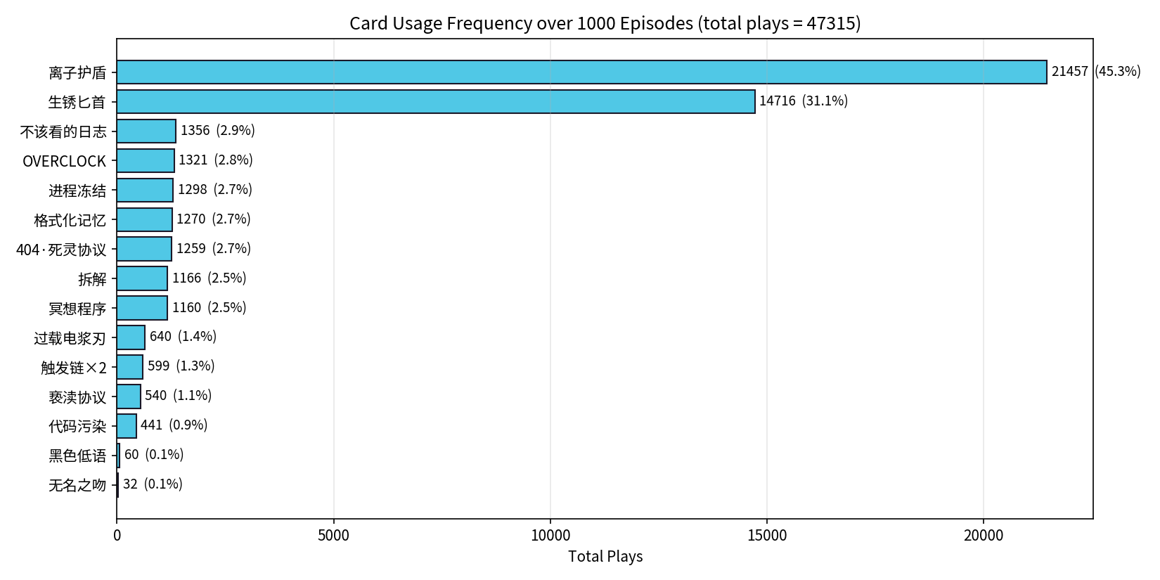
What Did the Agent Learn?
Card usage frequency across 47,315 plays over 1,000 episodes
Dominant Strategy (76.4% of all plays = 2 cards)
Ionic Shield (离子护盾)
45.3%
Cost 1 · Grants scaling armor Cheapest effective defence
Rusty Dagger (生锈匕首)
31.1%
Cost 1 · Direct attack Cheapest effective offence
Dead cards: Black Whisper + Nameless Kiss = 0.2% combined Both trade SAN for damage — the agent avoids them entirely

Slide 13
Design Findings
RL as a playtesting tool — two concrete insights in 138 seconds
Finding 1 · Ionic Shield is over-tuned
Finding 2 · Two cards are effectively dead
45.3% of all plays from a 15-card deck
Black Whisper + Nameless Kiss = 0.2% combined (92/47,315 plays)
Cost-1 armor scales linearly with skill cards played — unmatched efficiency
Both trade SAN for high-damage effects
Signal: dominance this strong implies the card crowds out strategic variety
Agent learned that the SAN loss penalty (−0.02·Δsan) makes the trade-off negative
Fix: reduce armor scaling coefficient, or raise cost to 2 energy
Fix: lower SAN cost by 50%, or add a card-draw side effect
Weeks of human testing to surface → 1,000 episodes took 138 seconds
Conditional on the reward shaping — but the problem is real and measurable

Slide 14
Limitations & Future Work
Limitations
Future Work
Single-seed training
Multi-seed reporting
All numbers from seed 42. Informal re-runs show ±2% variance — but no formal 5-seed mean ± std.
Proper error bars on headline metrics.
Deterministic evaluation
Curriculum difficulty
deterministic=True gives stable numbers but likely overestimates real-world performance.
Gradually raise boss HP — watch policy adapt or collapse.
No comparison baseline
Recurrent policy (LSTM)
No MCTS, random policy, or hand-coded heuristic to benchmark PPO against.
Capture floor-to-floor rule-modifier interactions across turns.
No difficulty scaling
Re-balance & re-train
No Ascension-style tier system — policy's robustness to harder settings is unknown.
Apply the two findings from §7.2 and verify the dominance structure shifts.

Slide 15
Conclusion
56.1% win rate
MaskablePPO + dense reward shaping converges in 4.4 minutes from scratch on a free GPU.
Action masking is the key
Without masking the policy plateaus at ~30 reward and never reliably reaches the boss.
RL as a design tool
1,000-episode evaluation (138 sec) surfaced two balance problems undetected after weeks of manual playtesting.

