Slide 1



Unlocking Airbnb Success: A Data-Driven Analysis
Team 3A
Sophia Park | Pratiksha Gund | Saisreevenkat Pedarla | Mengwei Zhang | Zihao Li

Slide 2
Introduction
Project Objective:
Analyze Airbnb listing data to identify success factors
Examine key elements such as pricing, reviews, and amenities
Significance:
What factors (e.g., price, location, amenities, host reputation) are most associated with successful listings?
How do customer reviews and ratings impact booking rates?
Are there specific amenities that increase booking success? How does seasonality affect pricing and booking rates?

Slide 3
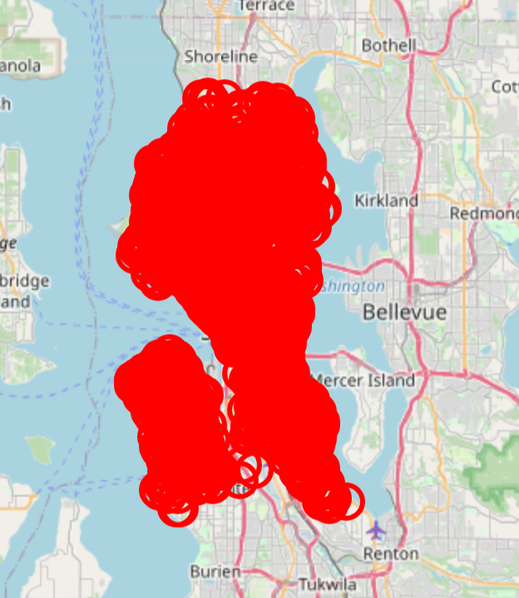
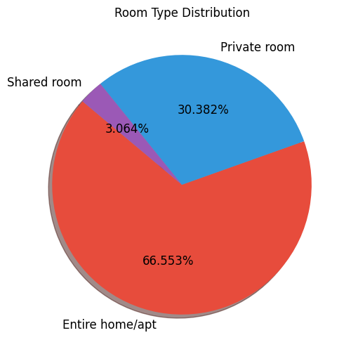
3. Visualizations
Insights from the map:
Prime Location Advantage: High-demand for listings near downtown, airports, and attractions.
Booking & Pricing Trends: High-density areas attract more bookings, higher prices, and better ratings.
Insights From the Pie Chart :
Entire Homes/Apartments (66.55%): Most listings offer full privacy, ideal for families and long-term stays.
Private Rooms (30.38%): Popular among budget travelers seeking affordability with some privacy.
Shared Rooms (3.06%): Least preferred due to limited privacy and lower demand

Slide 4
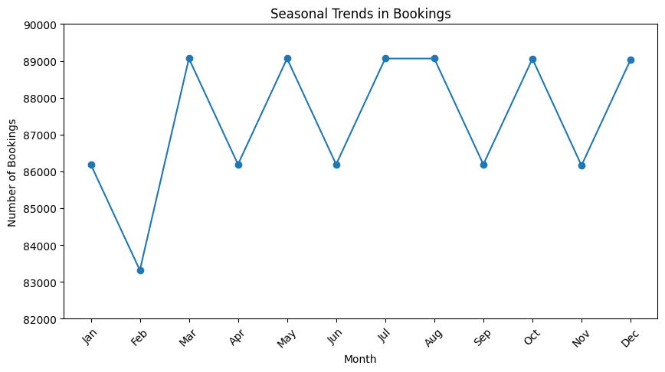
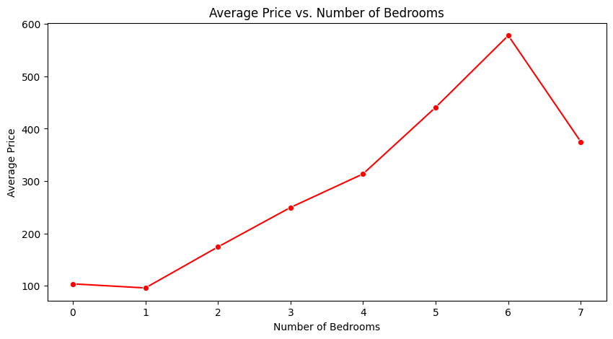
Insights From the Line Chart :
Peak Months: March, May, July-August, and December see the highest bookings.
Low Demand: February, April, June, and September have noticeable drops.
Seasonal Cycle: Bookings align with holidays and vacation trends.
Insights From the Line Chart :
Price Increases with Bedrooms: More bedrooms generally lead to higher prices.
Peak at 6 Bedrooms: The highest average price is at 6 bedrooms.
Drop at 7 Bedrooms: A decline in price after 6 bedrooms suggests lower demand or fewer listings.

Slide 5
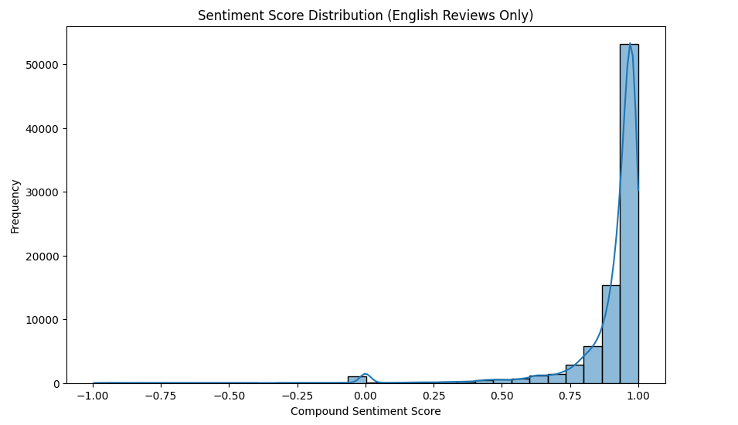
4. Sentimental Analysis
Insights from the map:
After loading the "reviews" sheet and applying NLTK’s VADER, each review was assigned a compound sentiment score (ranging from –1 for extremely negative to +1 for extremely positive).
The histogram shows a concentration of reviews with scores above 0.0. This indicates that, overall, customers tend to leave positive reviews. A noticeable peak around 0.6–0.8 suggests that many reviews are strongly positive.
We filtered the reviews into two groups based on their sentiment:
Positive Reviews: Reviews with a sentiment score greater than 0.3,Words like “great,” “clean,” “friendly,” and “comfortable” reflect a positive customer experience,
Negative Reviews: Reviews with a sentiment score less than –0.3, In contrast, negative reviews often mention “dirty,” “noisy,” “small,” and “expensive.”

Slide 6
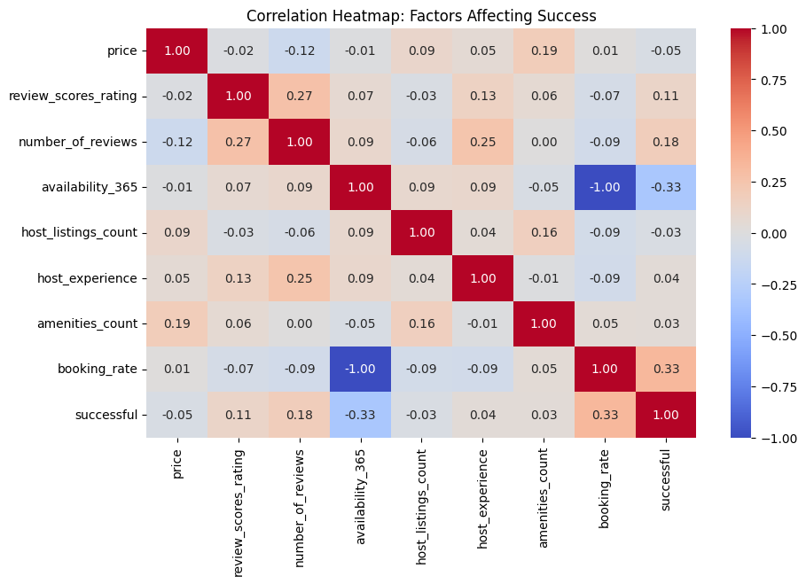
5. Key Factors for Airbnb Success
Top Positive Correlations with Success:
Factor | Impact
Booking Rate | 0.33, Higher booking rates boost success.
Number of Reviews | 0.18, More reviews increase credibility.
Review Scores Rating | 0.11, Higher ratings attract guests.
Factors with Minimal Impact:
Factor | Impact
Price | -0.05, Pricing alone has little effect.
Host Listings Count | -0.03, Managing multiple listings doesn’t ensure success.
Negative Correlation:
Factor | Impact
Availability_365 | -0.33, Year-round availability may reduce exclusivity.

Slide 7
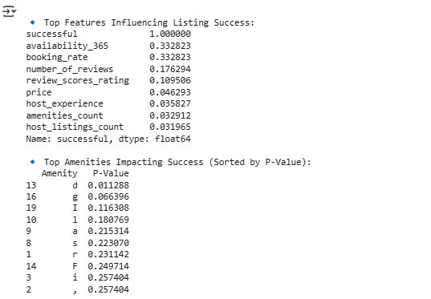
6. Key Drivers of Airbnb Success
Top Features Influencing Success:
Availability (0.33): Year-round listings see a negative trend, but strategic seasonal availability helps.
Booking Rate (0.33): Higher booking rates directly boost success—optimize pricing and appeal.
Reviews (0.18 & 0.19): More and better reviews enhance credibility and visibility. Encourage guest feedback.
Price (0.05): Minimal impact, but competitive pricing with added value can help.
Amenities & Impact (P-Value Analysis)
Certain amenities significantly influence bookings.
Hosts should analyze and prioritize impactful features.

Slide 8
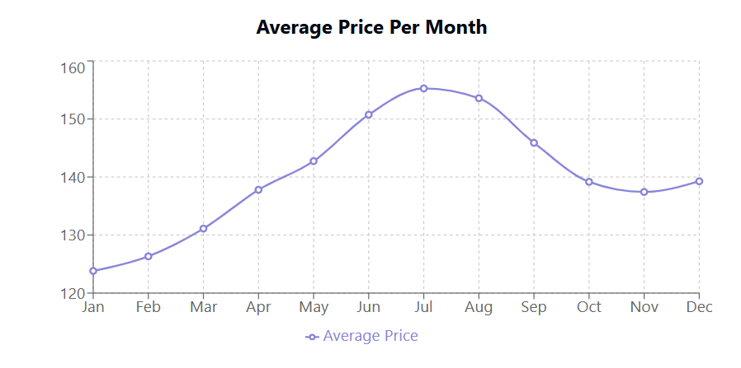
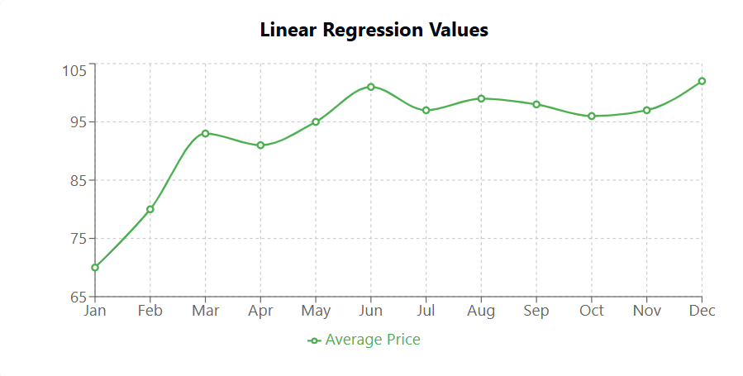
6. Key Drivers of Airbnb Success
Airbnb prices peak in July & August due to high summer demand, while March & December see the lowest prices. Hosts can adjust pricing to maximize bookings and revenue.
Optimized Pricing Strategy: Using these linear regression values as pricing guidelines can maximize profitability for Airbnb hosts.
Seasonal Price Trends: Adjusting prices according to monthly trends ensures higher occupancy rates and revenue optimization.

Slide 9
Thank You!

