Slide 1
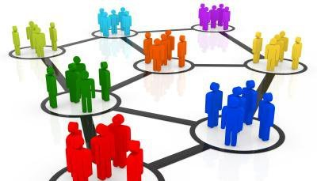
DATA MINING USING NON LINEAR CLUSTERING ALGORITHM

Slide 2
Under The Esteemed Guidance of
Sri P.PENCHALA PRASAD, M.Tech,
Assistant Professor,
Department of CSE.
Prepared by
Batch 2,VII-Semester-Section B
K.HARSHINI :149X1A0591
S.L.ZAHEER HUSSAIN :139X1A05C8
A.VAMSHI KRISHNA :149X1A0506

Slide 3
Contents
Introduction
What is Clustering?
Proposed Method : Kernel Based Clustering
Problem Formulation
K-Means Clustering
Kernel K-means Clustering
Conscience online Learning(COLL)
Software Requirements
Applications
Conclusion

Slide 4
Data Mining
Data mining is the technique that discovers previously unknown relationships in data.
Data mining is the practice of automatically searching large stores of data to discover patterns and trends that go beyond simple analysis.
Data mining is also known as Knowledge Discovery in Data.

Slide 5
What is Clustering??
Clustering is the task of grouping a set of objects in such a way that objects in the same group are more similar to each other than to those in other groups.
It deals with finding a structure in a collection of unlabeled data.

Slide 6
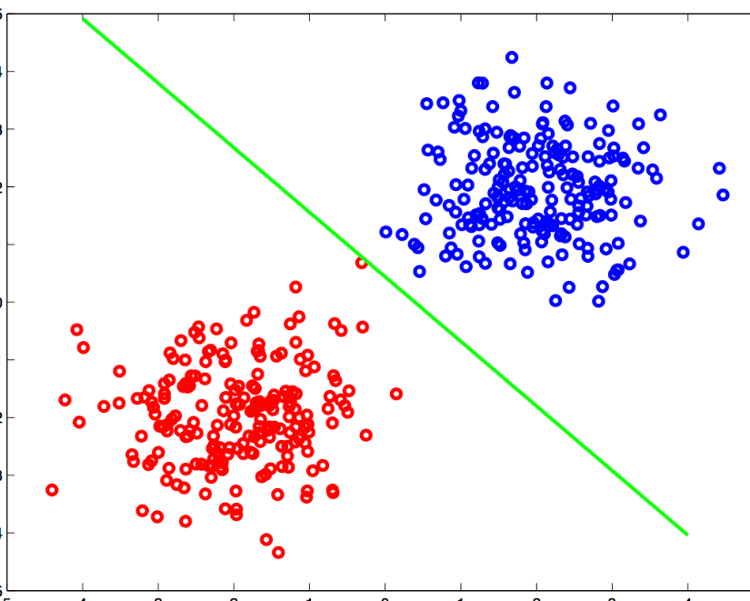
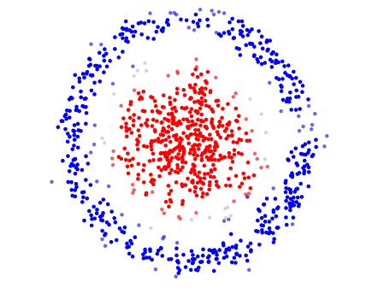
Types of Clustering
Linear Clustering
Non-Linear Clustering

Slide 7
Linear Clustering
Linear Clustering involves linearly partitioning a dataset into homogeneous groups.
Since Linear Clustering can not be applied for non-linear partitions, our project deals with non-linear clustering.

Slide 8
Types of Linear clustering
K-means Clustering
Fuzzy C-means Clustering
Hierarchical Clustering
Gaussian Clustering
Quality Threshold Clustering

Slide 9
Non-Linear Clustering
Non linear clustering means that the data set to be partitioned contains at least one cluster with concave boundaries or arbitrary shapes.
The classical linear clustering algorithms cannot meet the need of identifying nonlinear clusters.

Slide 10
Types of Non-linear Clustering algorithms
Kernel based Clustering
Multi Exemplar Model
Graph Based Model
Support Vector Clustering

Slide 11
Proposed Method : Kernel Based Clustering
This is one of the most widely used non- linear clustering methods.
This makes use of Conscience Online Learning (COLL) mechanism.
COLL method overcomes the ill-initialization problem created in k-means linear clustering algorithm.

Slide 12
Procedure:
Problem Formulation
K-Means Clustering
Kernel K-Means Clustering
Conscience Online Learning

Slide 13
Problem Formulation
Given an unlabelled data set X={x1…xn} of n data points which is projected into a kernel space Y by a mapping , and the number of clusters c, we wish to find an assignment of each data point to one of c clusters, such that in the kernel space Y , the within-cluster similarity is high and the between-cluster one is low.

Slide 14
K-Means Clustering
The k-means algorithm is one of most popular iterative methods for solving the optimization problem . It begins by initializing a random assignment and seeks to minimize the distortion error by iteratively updating the assignment .
Despite great success, k-means has one serious drawback that its performance would easily degenerate in the case of ill-initialization.
This procedure leads to the well-known kernel k-means. Given the appropriate initialization, it can find the sub-optimal solution (local minima).

Slide 15
Kernel K-Means Clustering
The kernel k-means algorithm applies the same trick as k-means but with one difference that here in the calculation of distance, kernel method is used instead of the Euclidean distance.
This can be done by using kernel functions(Radial Basis Function(RBF), Linear, Polynomial, Histogram Intersection, String Kernel.

Slide 16
Kernel K-Means Algorithm
Randomly initialize ‘c’ cluster center.
Compute the distance of each data point and the cluster center in the transformed space.
Assign data point to that cluster center whose distance is minimum.
Until data points are re-assigned repeat from step 2.

Slide 17
Advantages and Disadvantages
Advantages are
Algorithm is able to identify the non-linear structures.
Algorithm is best suited for real life data set.
Disadvantages are
Number of cluster centers need to be predefined.
Algorithm is complex in nature and time complexity is large.

Slide 18
Conscience online Learning
The COLL is performed as follows:
It starts with a random guess of the assignment the same as k- means. However, unlike k-means, in the procedure of each iteration, for each randomly taken data point, the method selects the winning prototype based on the conscience mechanism .
It updates the winner by the online learning rule .The procedure requires only one winning prototype to update slightly toward the new point rather than re-computing the mean of each cluster at each step, hence much faster convergence rate is achieved.

Slide 19
PROCEDURE:
Step l. (Initialization). Having determined the number of clusters ‘n’, k prototypes (sometimes called seeds), are defined by a random initialization of points to each of n clusters. Each prototype is computed as the mean of points randomly assigned to the corresponding cluster. Each prototype constitutes the centre (usually mean of assigned points) of the clusters in the initial partition.
Step 2. (Winner selection). Each data point is assigned to the cluster with the closest centre. For each element of the data set, the distances are calculated between the element and the (centre of) prototype of the cluster to which it has been assigned. In this process, some points get updated into a different position away from the assigned cluster. While few points stay in the same assigned cluster, which are thus selected as “winners” for that iteration.
Step 3. (Update of all cluster centres). Recalculate the centres of the clusters and iteratively update the assignment and the prototypes based on the frequency sensitive (conscience) on-line learning rule. That is, in the t-th iteration, for one randomly taken data point, select the winning prototype guided by the winning frequency.
Step 4. (Stopping criterion). If a convergence criterion is not met, go to step 2. Typical convergence criteria are: no (or minimal) reassignment of records to new cluster centres, or using an epsilon( a very small value used in stopping the iteration).

Slide 20
Flow Chart of Conscience On-Line Learning(COLL)
Start
Get c empty index arrays and a random permutation
Input Kernel Matrix
Until l <n
Randomly initialize assignment,
Initialize the winning frequency,
Initialize prototype descriptor.
FALSE
TRUE
Select the winning prototype,
Update the winning prototype
Compute ephilist
Until
t >tmax
TRUE
FALSE
Assignment of
each point to prototype
Stop

Slide 21
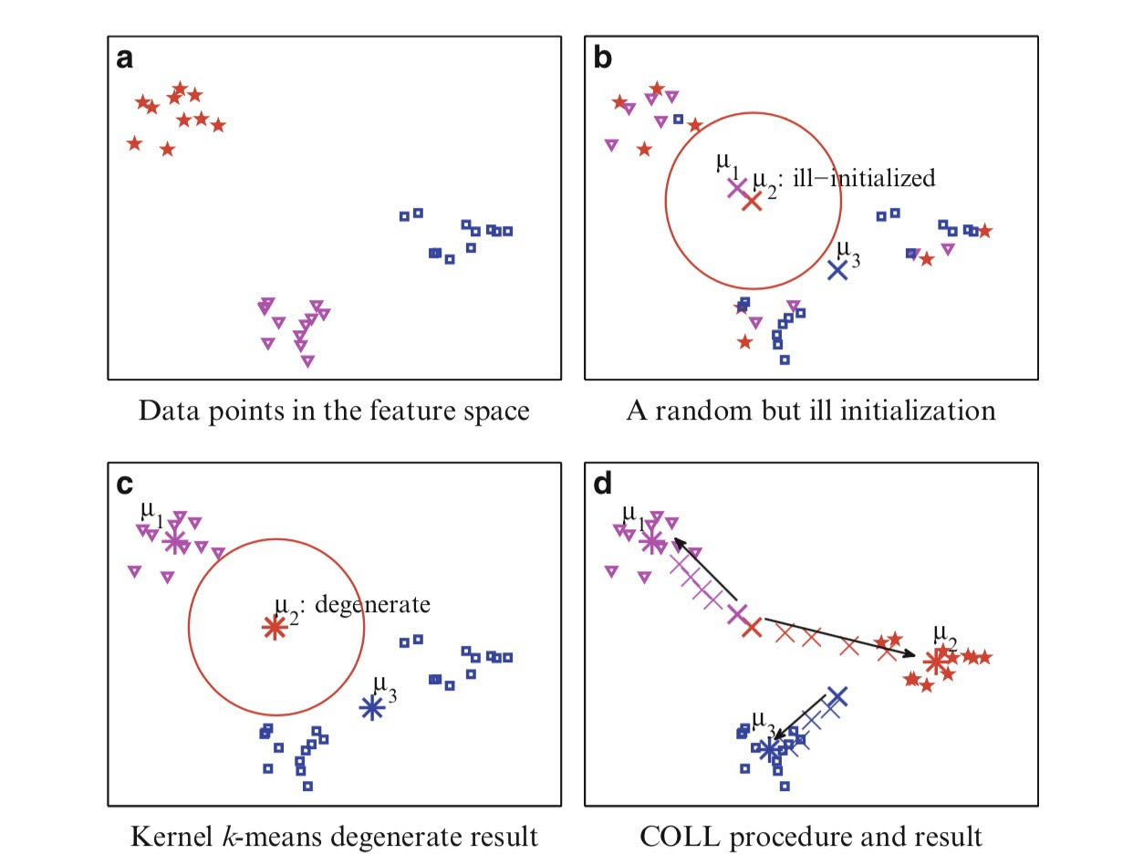
Expected Results
This picture illustrates of ill-initialization and comparison of kernel k-means and COLL.

Slide 22
Software Requirements
To implement this non-linear clustering algorithm we are using python language.
Various inbuilt libraries are used such as numpy , scipy , pandas.

Slide 23
Python
Python is a general-purpose interpreted, interactive, object-oriented, and high-level programming language.
Due to its extended features like Portable , Scalable, Easy-to-learn, Standard library, we have choosen python for our implementation of the project

Slide 24
NumPy
NumPy stands for Numerical python.
It is library consisting of multidimensional array objects and collection of routines for those arrays.
Using this mathematical and logical operations can be performed.
Numpy includes Fourier transforms and routines for shape manipulation.
Inbuilt functions are present for linear algebra and random number generation.

Slide 25
Scipy
Scipy : high level scientific computing.
This is meant to operate efficiently on numpy arrays. Both the libraries work hand in hand.
Many modules can be accessed by importing module import scipy
This saves tremendous amount of time in scientific computing applications.
These sub modules are used in interpolation , integration , optimization , image processing , statistics.

Slide 26
Other Requirements
Ubuntu operating system, 8 Intel, 2.00GHz Processor, 4gb RAM.
Python with Numpy , Scipy , Panda modules installed.
Clustering Datasets
test1_data.txt
This dataset contains 2 attributes, 400 instances.
test2_data.txt
This dataset contains 2 attributes, 400 instances.
quiz_A.data
This dataset contains 2 attributes, 400 instances.
self_test.data
This dataset contains 2 attributes, 300 instances.
xclara.txt
This dataset contains 2 attributes, 3000 instances.

Slide 27
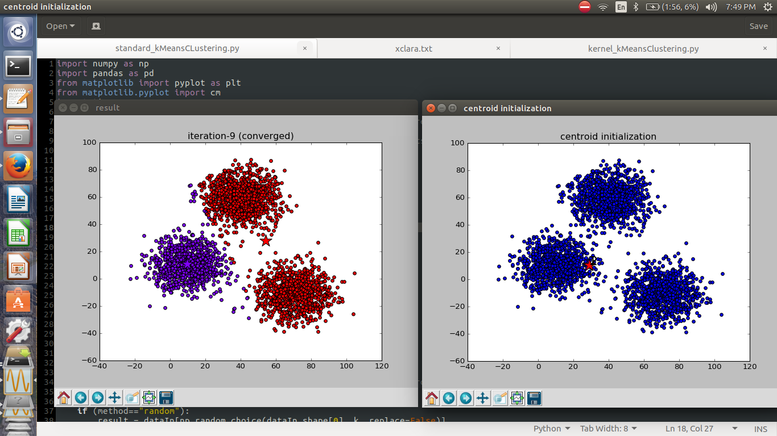
Final Results
This figure shows the result when k-means is applied over xclara dataset.

Slide 28
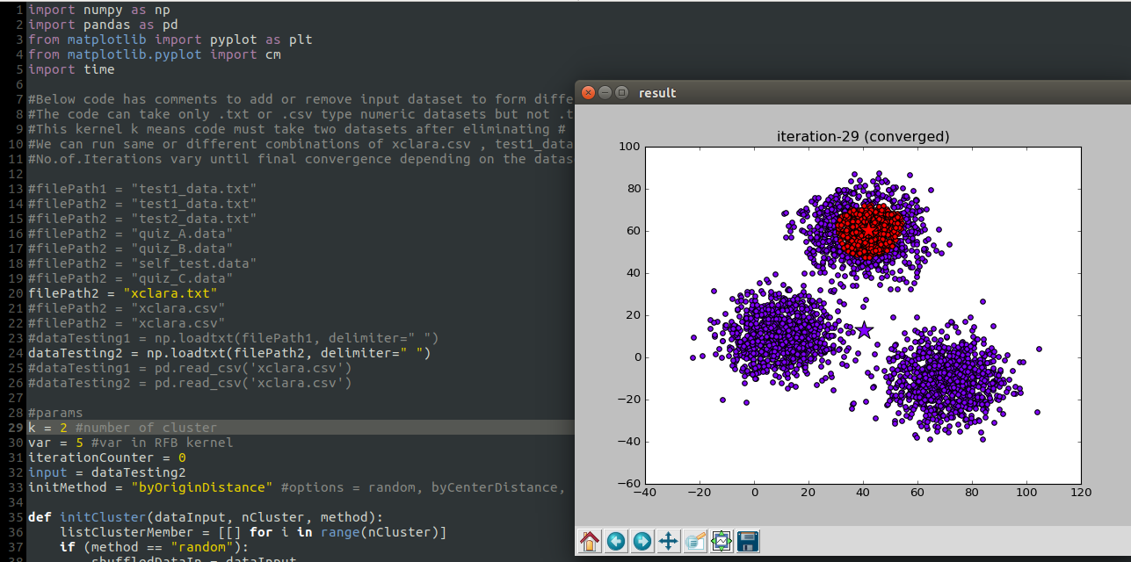
This figure shows the result when kernel k-means is applied over xclara dataset

Slide 29
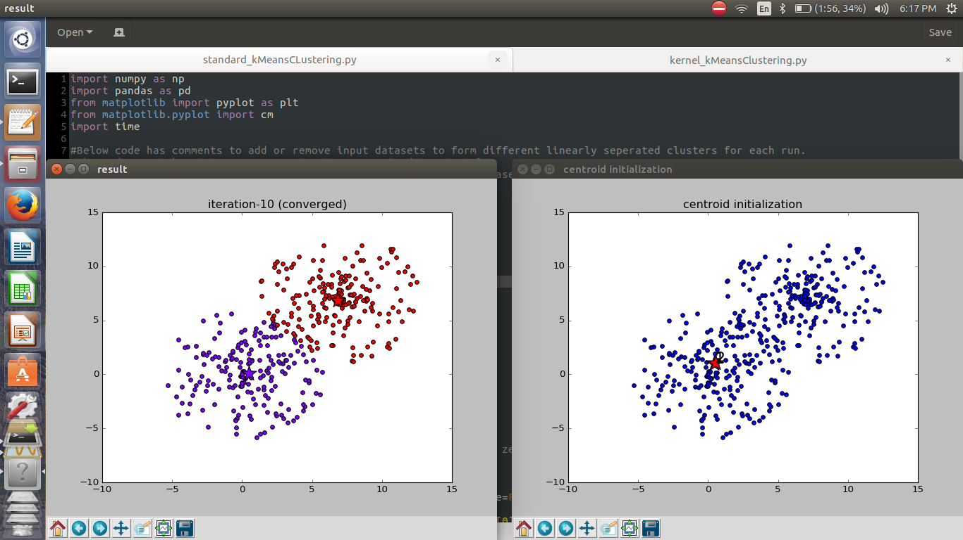
This figure shows the result when k-means is applied over quiz_A dataset

Slide 30
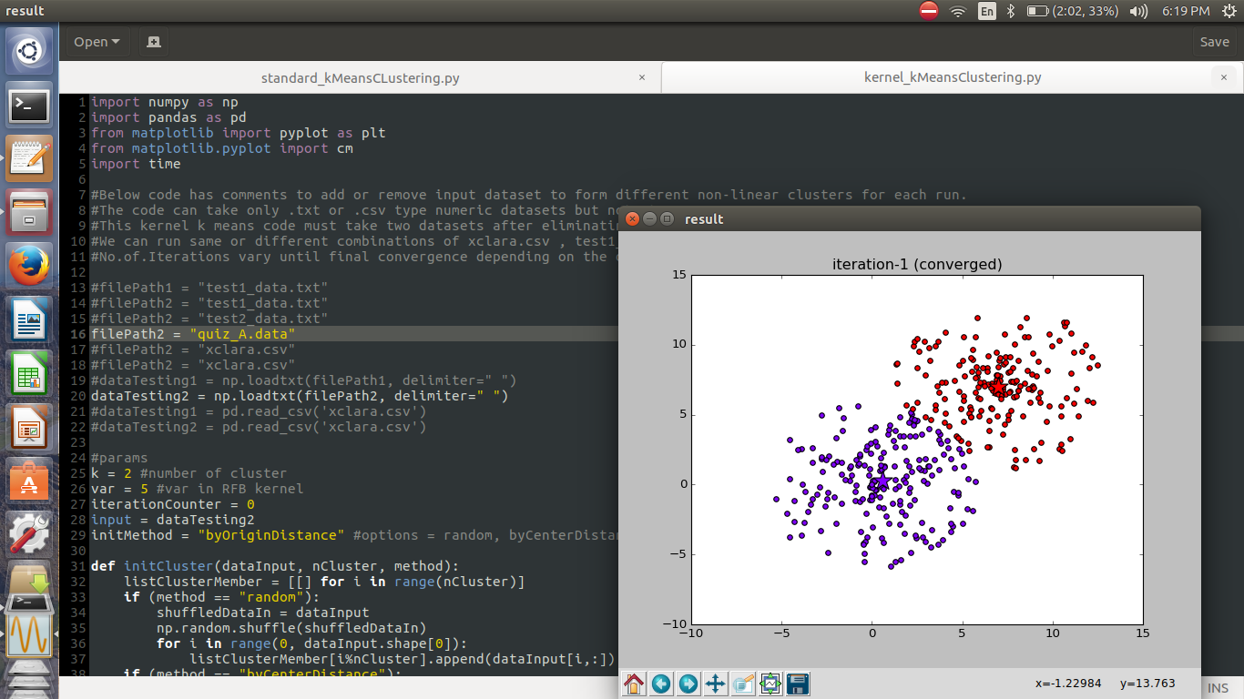
This figure shows the result when kernel k-means is applied over quiz_A dataset

Slide 31
Applications
Video Clustering- video clips have been segmented into shots which are further represented by a set of keyframes. Video clustering is thus reduced to a clustering of still keyframe images.
Digital Image Clustering- Digital images account for huge data in any industrial field such as Internet search, finance, etc. But in research area such as meteorology, genomics digital images play a crucial role, classification such of the images which grows rapidly in terms of peta-bytes is a challenging task. Classifying the images against a category and processing those using clusters of computers will be designed and implemented.
Color Image Segmentation- Face recognition, Fingerprint recognition, Iris recognition, Medical imaging (Measure tissue volumes Diagnosis, study of anatomical structure, Surgery planning) , Object detection (Pedestrian detection Face detection, Brake light detection).
Clustering algorithm in identifying cancerous data.
Clustering algorithm in search engines.
Clustering algorithm in academics.

Slide 32
Conclusion and Discussion
Data clustering plays an indispensable role in various fields such as computer science, medical science, computational biology, mobile communication and economics.
Its application in computer vision such as digital image clustering, video segmentation, and color image segmentation is wide.
Due to its well found usage in various fields, it is clear that nonlinear clustering has been and will continue to be a hot research topic.

Slide 33
THANK YOU!

