Slide 1
CC
CLAIMCOURT
TRACK 2 SUBMISSION
01
PRIVATE / LOCAL / EVIDENCE-GROUNDED
ClaimCourt
TEAM
ZI FEI YU
A Private Local AI Evidence Court
AMD AI DevMaster Hackathon 2026
Turns fuzzy human recollections and disputed commitments into cited local evidence, contradiction timelines, and approval-gated briefs.
Track 2
Development & Local Deployment
of Private AI Agents
0 CLOSED MODEL APIs
RADEON + ROCm + vLLM

Slide 2
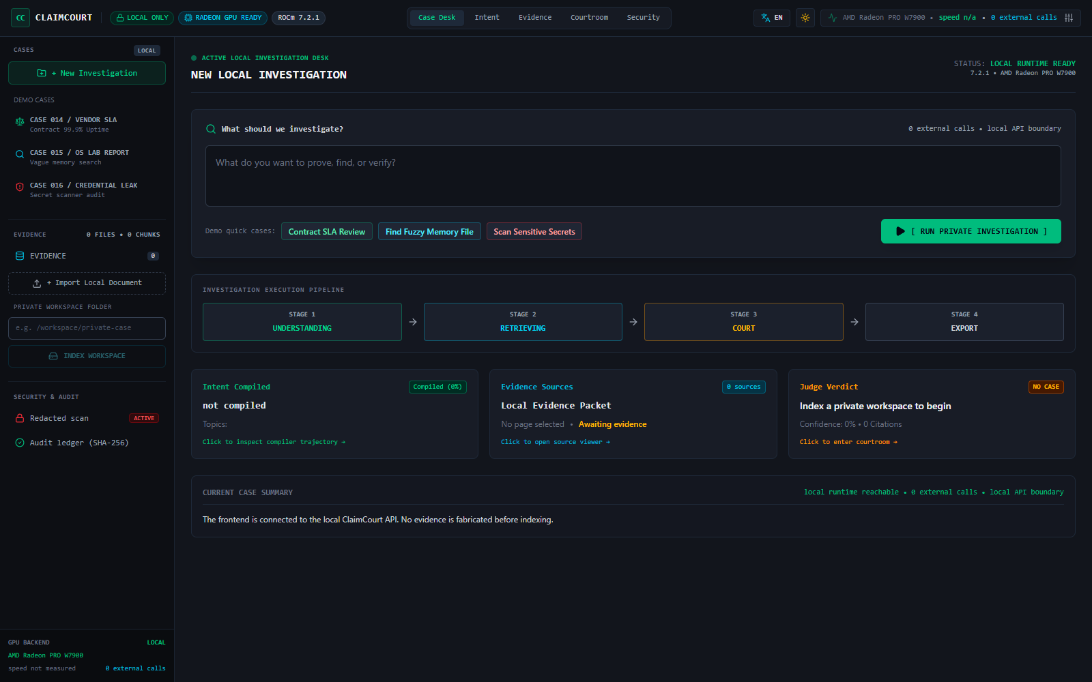
CC
CLAIMCOURT
THE PRODUCT
02
A REAL WORKSPACE PROBLEM
People remember meaning, not filenames
ClaimCourt combines fuzzy private memory retrieval with an evidence-grounded decision workflow.
01
Find the right private file from an incomplete recollection.
02
Challenge disputed claims with cited supporting and opposing evidence.
03
Locate sensitive records without revealing the secret value.

Slide 3
CC
CLAIMCOURT
CORE INNOVATION
03
FUZZY INTENT COMPILER
Do not send vague language directly to a vector store
Compile human memory into explicit constraints, relations, exclusions, and clarification policy first.
HUMAN RECOLLECTION
LOCAL INTENT PLAN
RETRIEVAL DECISION
"Find the deck I wrote after the customer launch slipped - it mentioned Q4 risk."
artifact: PPTX
topics: customer delay, delivery risk
time: Q4
relation: causal_after
mode: single
clarify: false
Final version selected
Draft grouped as alternate
Page / slide evidence retained
Low confidence -> clarify
320 / 320
100%
100%
0
frozen live queries passed
single-target Top-1
clarification accuracy
unsafe wrong auto-selections

Slide 4
CC
CLAIMCOURT
CONTROLLED AGENTS
04
EVIDENCE COURT
One local model. Three constrained roles. One citation boundary.
The workflow is auditable orchestration, not performative multi-agent autonomy.
STAGE 1
STAGE 2
STAGE 3
PROSECUTOR
DEFENSE
JUDGE
Strongest supporting evidence
Counter-evidence, exceptions and contradictions
Schema-valid verdict using allowed citation IDs only
HARD OUTPUT CONTRACT
claim / supported | contradicted | insufficient_evidence / confidence / citations / contradictions / timeline / missing evidence / next action

Slide 5
CC
CLAIMCOURT
SYSTEM ARCHITECTURE
05
PRIVATE LOCAL ARCHITECTURE
Every sensitive component stays inside the selected host
Evidence is retrieved before inference, and every downstream action is permission- and citation-gated.
PRIVATE
FILES
LOCAL
MEMORY
INTENT
COMPILER
HYBRID
RETRIEVAL
EVIDENCE
COURT
APPROVED
BRIEF
PDF / DOCX / PPTX / EML / OCR
chunks / SHA-256 / FTS5 / versions
Qwen3-14B + ClaimCourt LoRA
BM25 / BGE / metadata / reranker
prosecutor / defense / judge
local write only after consent
LOOPBACK MODEL ENDPOINTS
127.0.0.1:8000/v1 judge + LoRA router
127.0.0.1:8001/v1 BGE embeddings
0 external model calls

Slide 6
CC
CLAIMCOURT
PRIVACY
06
PRIVACY IS A CONTROL PLANE
ClaimCourt does not rely on a privacy promise alone
The architecture blocks unsafe endpoints, raw-secret disclosure, invented citations, silent fallback and unapproved writes.
LOCAL ENDPOINT POLICY
Loopback-only by default; private hosts require explicit owner allow-listing.
SECRET REDACTION
Raw credentials are removed before model, UI, history and export paths.
CITATION ALLOW-LIST
The judge may cite only evidence IDs from the current retrieved packet.
FAIL CLOSED
Real workspaces never receive a fabricated deterministic answer when vLLM fails.
APPROVAL GATE
No local decision brief is written until the user approves the operation.
AUDIT LEDGER
Source, evidence and report identities use SHA-256 for later verification.

Slide 7
CC
CLAIMCOURT
AMD RADEON
07
VERIFIED RADEON STACK
Qwen3-14B + LoRA + BGE + reranker on one W7900-class GPU
The complete local stack peaked at approximately 45.3 GB of 51.52 GB VRAM.
Qwen3-14B
gfx1100
45.3 GB
8,192
BF16 judge and controlled roles
AMD Radeon PRO W7900 class
observed peak stack VRAM
judge context tokens
WHY THIS FITS
VERIFIED LOCAL ENDPOINTS
• One shared judge service for all three roles
• Small dedicated BGE pooling runner
• Shortlist-only cross-encoder reranking
• Evidence packet instead of full-workspace context
8000 / Qwen3-14B + ClaimCourt LoRA
8001 / BGE-small pooling runner
8503 / local ClaimCourt API
8502 / private browser interface

Slide 8
CC
CLAIMCOURT
MEASURED EVIDENCE
08
LIVE, NO-FALLBACK RESULTS
The quality gate requires the complete local stack
A component that fails or silently falls back causes the Radeon holdout to fail.
0.27 s
14.3
126.44 s
1,778
first-token latency
generation tokens / second
complete three-role latency
completion tokens
320 / 320
100%
0
LIVE
frozen fuzzy-intent holdout
Top-1 / coverage / no-match / clarification
unsafe wrong auto-selections
Router + BGE + reranker

Slide 9
CC
CLAIMCOURT
DEMO
09
FOUR-MINUTE JUDGE JOURNEY
Show the dispute, the evidence, the permission gate and the GPU proof
Use only the synthetic championship workspace during public recording.
0:00
DISPUTE
Sales promise vs signed contract
RECORDING RULES
0:20
RADEON
rocminfo / vLLM / local endpoints
Use synthetic files only
Warm the model once
Show local vLLM, never fallback
Hide keys, tokens and shell history
Do not expose a real workspace publicly
End on the measured evidence
0:45
INTENT
Compile the vague claim
1:10
EVIDENCE
Retrieve signed, draft and contradictory records
1:45
COURT
Prosecute, defend and judge
3:05
APPROVE
Permission-gated local brief
3:30
PROOF
Latency, throughput, VRAM and 320/320

Slide 10
CC
CLAIMCOURT
CLOSING
10
CLAIMCOURT
Private evidence
before confident answers.
WHY IT MATTERS
LOCAL
AUDITABLE
CITED
PRIVACY-GATED
RADEON-OPTIMIZED
ClaimCourt understands fuzzy human memory, retrieves the right private records, exposes contradictions, and asks permission before it acts.
TEAM ZI FEI YU / TRACK 2

