Slide 1
SentinelX
Intrusion Detection System
Using Honey Pot
In A
Cloud Environment
By,
Mohammed Shidhan N O(21BCS0024)
Abhay V(21BCS0041)
Guided By,
Prof. Gundala Swathi

Slide 2
ABSTRACT
Cloud services are increasingly targeted by cyber intruders due to their delivery as utility computing over the Internet.
Protecting network accessible Cloud resources from growing cyber threats is a significant concern.
Most Network based Intrusion Detection Systems (NIDS) rely on rule based mechanisms, limiting their ability to identify known attacks through pattern matching.
Traditional Anomaly Detection based IDS may yield a higher number of false positives.
This paper proposes amalgamating IDS with Cloud computing to bolster security measures.
The introduction of Honeypots in Cloud IDS design can aid in detecting potential attacks with fewer false positives.
This research aims to strengthen network security aspects related to Cloud computing, enhancing its trustworthiness.

Slide 3
INTRODUCTION
Cloud computing provides convenient, ondemand network access to a shared pool of configurable computing resources, including servers, storage, applications, and services.
Resources can be rapidly provisioned and released with minimal management effort or service provider interaction.
It serves as a significant asset for startups, allowing them to offer online applications and services without significant investments in storage, web, or computing infrastructure.
Utilizing established Internet protocols, standards, and formats, Cloud computing offers a range of consumable services to endusers and consumers.
These services encompass computing utilities and platforms for application development.

Slide 4
PROBLEM DEFINITION
Lack of anomaly signatures within the IDS Database can significantly impact detection effectiveness.
Regular maintenance and updates are essential to ensure the database is equipped with the latest signatures.
Data collection entails gathering log data from the Intrusion Detection System, such as Snort, and reports from Packet Sniffing storage.
Evaluation measures detection rates and conducts manual deep analysis of log files and reports.
Alert generation enables real time updates on detected anomalies.
Challenges like false alarms from signature faults and database errors must be mitigated.
Integration challenges include compatibility issues with various operating systems and versions of network hardware and software.

Slide 5
OBJECTIVES
Scalability: Adapting IDS with honeypots to fluctuating resource demands in cloud environments.
Integration Complexity: Configuring IDS with honeypots to seamlessly integrate with existing cloud infrastructure.
Resource Constraints: Allocating resources efficiently to maintain IDS performance without affecting critical services.
Network Visibility: Overcoming challenges in monitoring and analyzing network activity across diverse cloud instances.
Data Volume: Handling large data volumes generated in cloud environments for effective threat analysis.
Compliance Concerns: Addressing privacy and regulatory compliance issues when implementing IDS with honeypots in cloud settings.

Slide 6
CHALLENGES
Scalability: Adapting IDS with honeypots to fluctuating resource demands in cloud environments.
Integration Complexity: Configuring IDS with honeypots to seamlessly integrate with existing cloud infrastructure.
Resource Constraints: Allocating resources efficiently to maintain IDS performance without affecting critical services.
Network Visibility: Overcoming challenges in monitoring and analyzing network activity across diverse cloud instances.
Data Volume: Handling large data volumes generated in cloud environments for effective threat analysis.
Compliance Concerns: Addressing privacy and regulatory compliance issues when implementing IDS with honeypots in cloud settings.

Slide 7
SCOPE
Deployment Strategy: Define deployment approaches and integration methods for IDS with honeypots in the cloud.
Technology Selection: Evaluate and choose scalable and compatible IDS and honeypot solutions suitable for cloud environments.
Configuration and Optimization: Develop guidelines for configuring IDS and honeypots to optimize performance and resource utilization.
Incident Response Planning: Establish protocols for responding to security incidents detected by IDS with honeypots.
Compliance and Governance: Ensure compliance with data privacy regulations and internal governance policies in the cloud environment.
Training and Improvement: Provide training for personnel and implement mechanisms for continuous enhancement of IDS and honeypot capabilities.

Slide 8
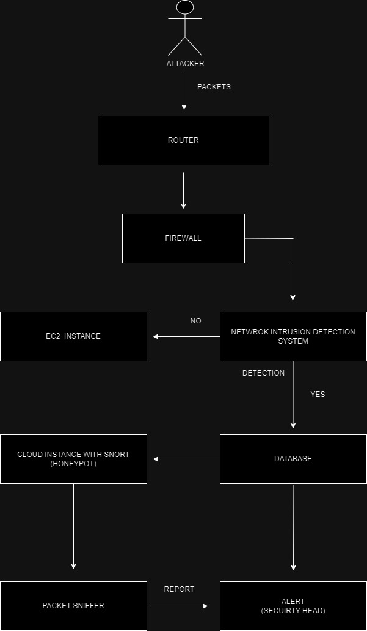
ARCHITECTURE

Slide 9
MODULE DESCRIPTION
Packet Sniffer
SNORT Honey Pot
Network Intrusion Detection System(NIDS)
AWS EC2 Instance with Linux
IDS Alert System

Slide 10
PACKET SNIFFER
Packet sniffer: Monitors network traffic in real-time
Captures and logs packets traversing the network
Identifies anomalies and potential security threats
Key functionalities: packet capture, protocol analysis, traffic filtering, intrusion detection, alerting mechanism
Integrates with honeypot sensors and centralized logging systems
Vital for detecting and responding to security incidents within the network environment.

Slide 11
SNORT HONEY POT
Snort Honeypot: Intrusion detection system (IDS) using honeypots
Based on Snort, an open-source network intrusion detection system
Emulates vulnerable systems or services to attract attackers
Monitors and analyzes network traffic for suspicious activity
Provides real-time alerts and logs for potential security threats
Integrated with centralized logging systems for comprehensive analysis
Effective for detecting and mitigating various cyber threats within the network environment.

Slide 12
NETWORK INTRSUION DETECTION SYSTEM
NIDS: Monitors network traffic for suspicious activities
Analyzes incoming and outgoing packets for signs of intrusion
Utilizes signatures, anomaly detection, or behavioral analysis
Provides alerts for potential security threats in real-time
Helps in identifying unauthorized access attempts or malicious activities
Integrates with other security measures for comprehensive defense
Essential for maintaining network security and preventing cyber attacks.

Slide 13
AWS EC2 INSTANCE
AWS EC2: Elastic Compute Cloud service for scalable computing
Linux-based operating system deployed on EC2 instance
Provides flexible and scalable infrastructure for hosting applications
Offers security features like firewalls, security groups, and encryption
Enables customization and configuration for specific use cases
Supports various workloads, including web hosting, data processing, and machine learning
Integrates with AWS services for seamless deployment and management.

Slide 14
IDS ALERT SYSTEM
IDS Alert System: Monitors network traffic for potential security threats
Detects suspicious activities and anomalies in real-time
Generates alerts based on predefined rules or signatures
Provides detailed information on detected threats, including source and severity
Offers customizable alert notifications for security personnel
Integrates with centralized logging systems for comprehensive analysis
Facilitates prompt response to security incidents, enhancing network defense capabilities.

Slide 15
LITERATURE REVIEW
An IoT Honeynet Based on Multiport Honeypots for Capturing IoT Attacks
Authors: Weizhe Zhang , Bin Zhang
Ying Zhou , Hui He, Zeyu Ding
The article presents a honeynet system tailored for IoT devices to combat their susceptibility to attacks. It features three types of honeypots: emulating router UPnP services, utilizing real IoT device firmware, and targeting exposed SOAP service ports. Docker simplifies deployment, and a centralized control center aids management. In practice, the system efficiently detects new malicious attacks, surpassing traditional security measures like Virus Total.

Slide 16
Tracing MIRAI Malware in Networked System
Authors: Yao Xu , Hiroshi Koide
Danillo Vasconcellos , Kouichi Sakurai
The paper examines the Mirai malware's threat in light of the growing number of IoT devices, expected to reach 30 billion by 2021. Mirai's exploitation of vulnerable IoT devices using default credentials for launching DDoS attacks highlights the pressing need for enhanced IoT security. To effectively understand and counter Mirai, the paper conducts static and dynamic analyses of the malware. It introduces Threat Tracer, initially developed to combat APTs, to simulate Mirai's operations. This simulation aims to offer insights into Mirai's behavior and vulnerabilities, aiding in predicting future variants and proactive threat mitigation.

Slide 17
Design of Intrusion Detection Honeypot Using Social Leopard Algorithm to Detect IoT Ransomware Attacks
Authors: S.Sibi Chakkaravarthy ,
D.Sangeetha , Meenalosini Vimal Cruz,
V.Vaidehi , Balasubramanian Raman
Ransomware has become a major cyber threat affecting various sectors, including individuals, enterprises, healthcare, and IoT. Traditional security measures often struggle to detect ransomware efficiently due to complexity and time constraints. To address this, an Intrusion Detection Honeypot (IDH) is proposed, comprising Honeyfolder, Audit Watch, and Complex Event Processing (CEP). Honeyfolder acts as a decoy folder using the Social Leopard Algorithm (SoLA) to detect suspicious file activities. AuditWatch assesses file entropy for anomalies, while the CEP engine consolidates data for prompt response. Experimental testing with over 20 ransomware variants confirms IDH's efficacy in detection time, rate, and accuracy, surpassing existing models.

Slide 18
A honeypot for arbitrary malware on USB storage devices
Authors: Sebastian Poeplau , Jan Gassen
Malware poses a significant threat to modern information technology, necessitating effective detection and analysis for developing countermeasures. While honeypots aid in collecting malware samples, existing ones focus on network-propagated malware, overlooking those spread through USB flash drives. This article introduces Ghost, a novel honeypot designed for USB malware. Ghost simulates a removable device in software, enticing malware to copy itself onto the virtual device. We detail the concept and assess its effectiveness using widespread malware samples. Our findings demonstrate Ghost's reliability, even against sophisticated malware, making it a promising new approach in malware detection.

Slide 19
Early detection of DDoS attacks against SDN controllers
Authors: Seyed Mohammad Mousavi ,
Marc St-Hilarie
A Software Defined Network (SDN) is a new network architecture that provides central control over the network. Although central control is the major advantage of SDN, it is also a single point of failure if it is made unreachable by a Distributed Denial of Service (DDoS) Attack. To mitigate this threat, this paper proposes to use the central control of SDN for attack detection and introduces a solution that is effective and lightweight in terms of the resources that it uses. More precisely, this paper shows how DDoS attacks can exhaust controller resources and provides a solution to detect such attacks based on the entropy variation of the destination IP address. This method is able to detect DDoS within the first five hundred packets of the attack traffic.

Slide 20
IMPLEMENTATION
1.Create an AWS Account
2. Setup a root account and a new IAM User
(For Security Access)
3.Provide role, Permissions, accessibilities,
User group.
4.Setup Network configuration
5.Add and update Security policies for
User/Group/Roles.
6.Create a Virtual Private Cloud(VPC).
7. Setup an S3 Bucket ad database for the
Machine

Slide 21
8. Launch an Instance in EC2 Dashboard
9. Give the Machine a name
10. Select the Operating Server(Linux)
11. Select the machine hardware configuration
12. Configuring Network setting for the Machine
13. Generating a key pair value(RSA) in .ppk
14. Assigning the AIM User and Permissions to the Instance.
15. Initializing the Instance.
16. Wait for the Instance to be running after verification.
17. Connect to the EC2 Linux Machine

Slide 22
18. Give the System update and update in Shell.
19. Understanding the distros filesystem.
20. Installed necessary dependencies for snort
and other software.
21. Installed Snort 3.0 and generated its rule sets
and inserted a custom rule set plugin.
22. A UFW Firewall(FIREWALLD) was installed and Verified that
its in running status.
23. Made a python script for Packet Sniffer and Network Analayzer.
24. Giving system a final update and upgrade to make sure every process and
daemons works perfectly.

Slide 23
CONCLUSION
Incorporating Honeypots: The proposed IDS for Cloud integrates honeypots to alert users about potential network attacks and enables Cloud administrators to monitor unknown attacks, enhancing the overall Intrusion Prevention Strategy.
Enhanced Trustworthiness: Implementation of the proposed system in a Cloud environment aims to bolster trust by providing an intrusion alert mechanism for attacks against the Cloud.
Core Benefits:
1. Detection of Known and Unknown Attacks: The system can effectively detect both known and potential unknown attacks.
2. Reduced False Alarms: Controlled use of honeypots results in fewer false alarms for unknown attacks, offering an efficient solution for intrusion detection, particularly in private Cloud environments.
Platform Flexibility: Although implemented with an AWS EC2 Instance, the proposed scheme may be adaptable to other Cloud platforms, serving as a model for studying NIDS behavior in distributed environments.

Slide 24
THANK YOU!

