Slide 1



Data Science Roadmap: A Comprehensive Guide
This presentation provides a roadmap to the exciting field of data science, exploring its fundamental concepts, methods, and applications across various industries. Data science is revolutionizing how we understand and leverage information, driving innovation and progress in many sectors.
by Nsisong Akpaikpe

Slide 2

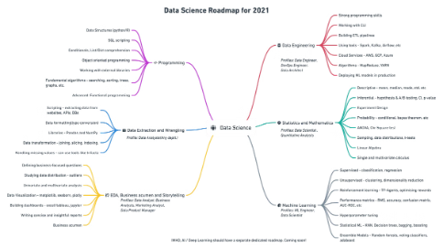
Fundamentals of Data Science
1
Data Collection
2
Data Cleaning and Preparation
The process of gathering raw data from different sources. This can be structured or unstructured data, and it forms the foundation of data science.
Transforming raw data into a usable format for analysis, involving tasks like handling missing values, outliers, and inconsistencies.
3
Data Analysis
4
Data Interpretation and Communication
Extracting meaningful insights and patterns from cleaned data through statistical techniques, exploratory analysis, and modeling.
Presenting findings clearly and effectively to stakeholders, enabling informed decision-making based on data-driven insights.

Slide 3
Data Collection Methods and Techniques
Surveys
Web Scraping
Sensor Data
Collecting data through questionnaires or interviews to gather opinions, preferences, and demographics.
Extracting data from websites using automated tools to gather information about products, services, or trends.
Gathering real-time data from sensors that monitor physical conditions like temperature, pressure, or motion.

Slide 4

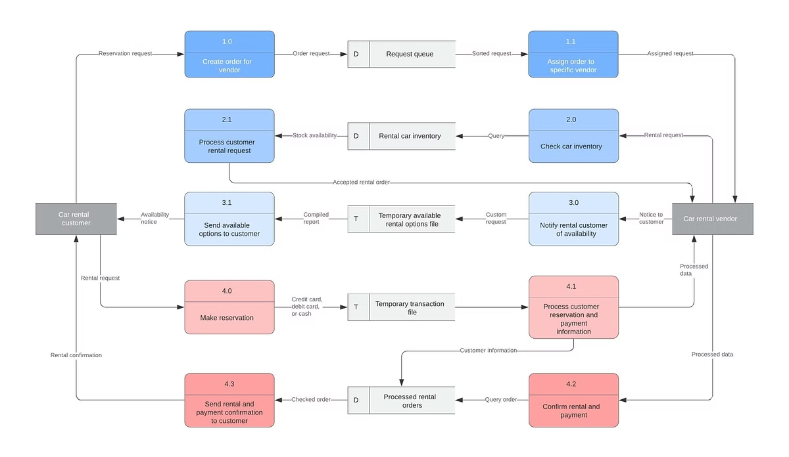
Big Data Technologies: Hadoop, Spark, and Beyond
Hadoop
Spark
A distributed file system and processing framework designed for handling large datasets. It breaks data into smaller chunks, processing them in parallel across multiple nodes.
A general-purpose cluster computing framework that is faster than Hadoop for many operations. It uses in-memory computing for faster data processing.
NoSQL Databases
Non-relational databases designed for scalability and flexibility, handling diverse data structures and large volumes of information.

Slide 5

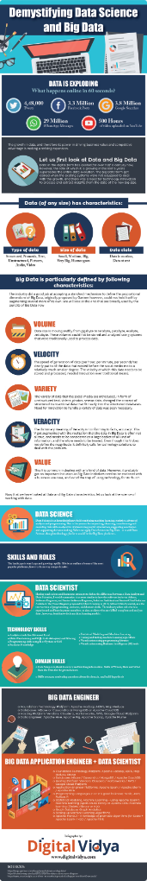




Applications of Data Science Across Industries
Healthcare
Personalized medicine, disease prediction, and drug discovery.
Finance
Fraud detection, risk assessment, and algorithmic trading.
Retail
Personalized recommendations, inventory management, and customer segmentation.
Marketing
Targeted advertising, customer behavior analysis, and campaign optimization.

Slide 6

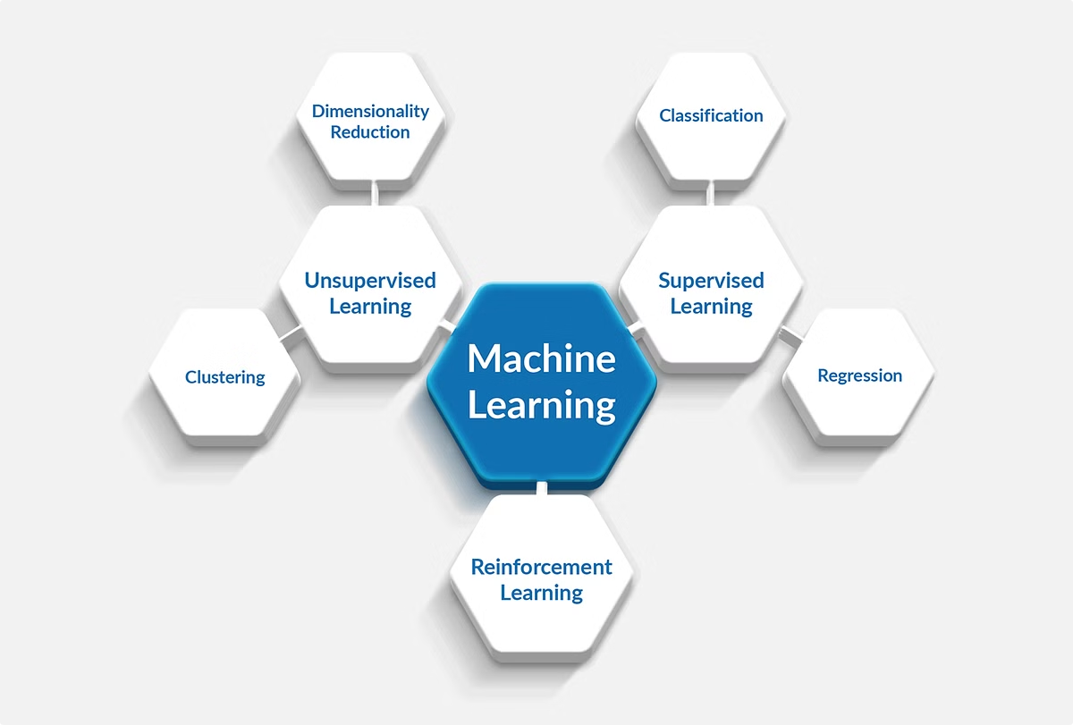
Predictive Analytics and Machine Learning
Supervised Learning
Regression
Classification
Unsupervised Learning
Clustering
Dimensionality Reduction
Reinforcement Learning
Q-learning
Deep Reinforcement Learning

Slide 7

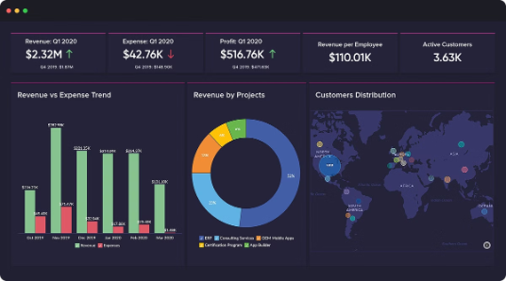



Data Visualization and Storytelling
Charts and Graphs
Maps
Infographics
Visual representations of data, helping to identify patterns and trends.
Visualizing data geographically, highlighting spatial relationships and distributions.
Combining visuals and text to present data in an engaging and easily understandable format.

Slide 8

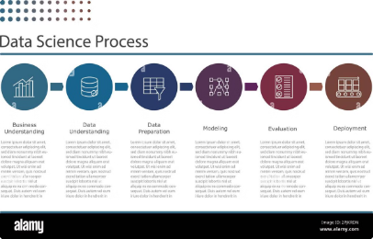
The Future of Data Science: Trends and Opportunities
Artificial Intelligence
1
AI and deep learning algorithms are becoming more sophisticated, enabling more complex data analysis and decision-making.
2
Internet of Things (IoT)
The proliferation of connected devices generates massive amounts of data, creating opportunities for real-time analysis and insights.
Data Ethics and Privacy
3
Growing concerns about data privacy and responsible use drive the need for ethical frameworks and regulations in data science.

