Slide 1

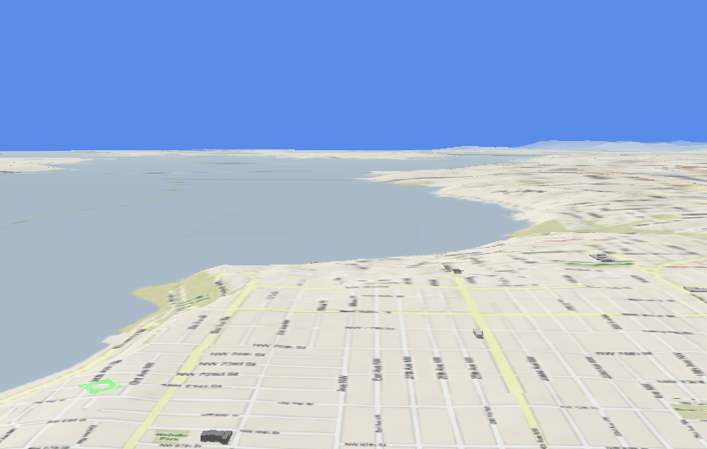





Trajectory Data Mining
Dr. Yu Zheng
Lead Researcher, Microsoft Research
Chair Professor at Shanghai Jiao Tong University
Editor-in-Chief of ACM Trans. Intelligent Systems and Technology
http://research.microsoft.com/en-us/people/yuzheng/
Notes:
A Location trajectory is a geospatial trail generated by a moving object. Typically, this trail is represented by of a set of time-ordered points.
The advance of location-acquisition technologies has boosted the increase of location trajectories, which record the trails of a variety of moving objects, such as people, vehicles, animals and nature phenomena.
These trajectories have not only enabled many applications significantly changing the way we live but also provided us with the scientific observations to understand the objects creating the trajectory.
As a result, the location trajectory has become the foundation a lot of research and attracted intensive attentions from a multitude of areas including computer sciences, biology, sociology, geography, and climatology, etc.

Slide 2
Paradigm of Trajectory Data Mining
Yu Zheng. Trajectory Data Mining: An Overview. ACM Transactions on Intelligent Systems and Technology. 2015, vol. 6, issue 3.

Slide 3

Trajectory Data Management
Spatial Databases
Queries
Range queries
KNN queries
Distance metrics
The distance between a point $q$ and a trajectory
The Distance between two trajectories
The distance between two trajectory segments
Indexing structures
Retrieval algorithms

Slide 4
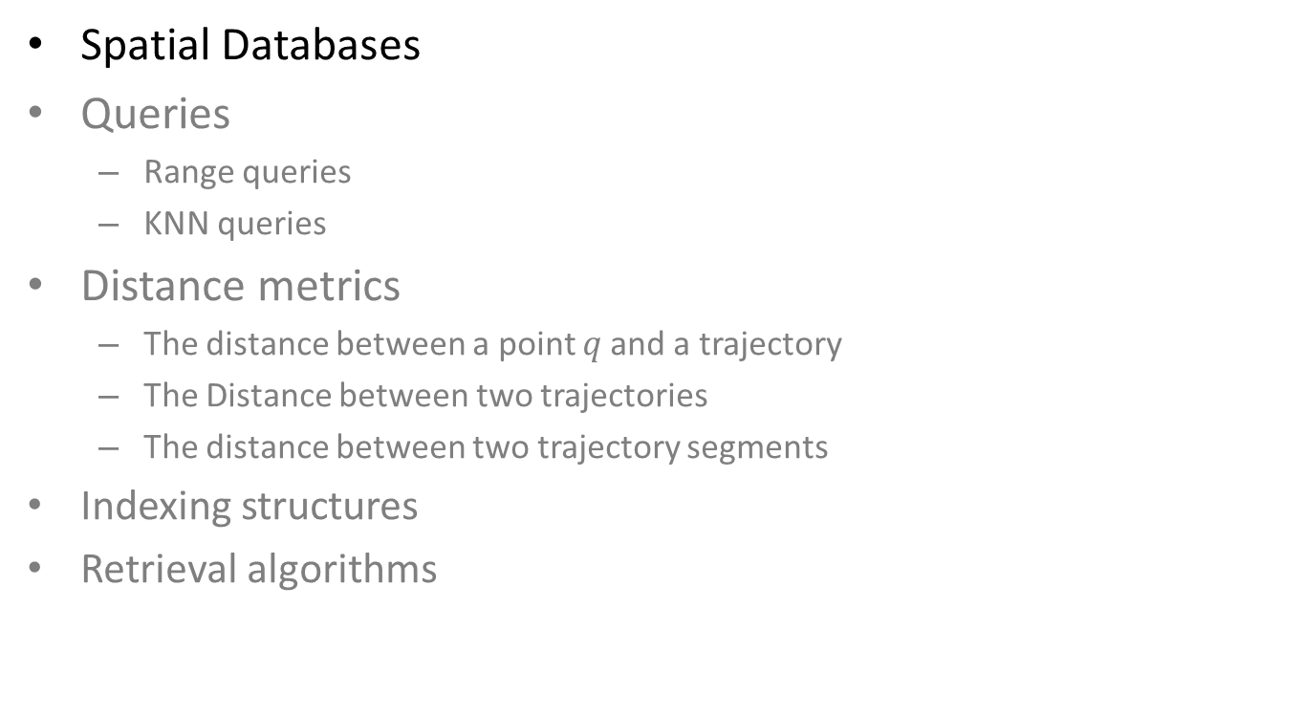
Trajectory Data Management
Spatial Databases
Queries
Range queries
KNN queries
Distance metrics
The distance between a point $q$ and a trajectory
The Distance between two trajectories
The distance between two trajectory segments
Indexing structures
Retrieval algorithms

Slide 5
Spatial Queries
Nearest Neighbour Queries
Region (Range) Query
Given a point or an object, find the nearest object that satisfies given conditions
Ask for objects that lie partially or fully inside a specified region.

Slide 6
Spatial Indexing Structures
Space Partition-Based Indexing Structures
Grid-based
Quad-tree
k-D tree
Data-Driven Indexing Structures
R-Tree

Slide 7
Spatial Indexing Structures
Space Partition-Based Indexing Structures
Grid-based
Quad-tree
k-D tree
Data-Driven Indexing Structures
R-Tree

Slide 8
Grid-based Spatial Indexing
Indexing
Partition the space into disjoint and uniform grids
Build inverted index between each grid and the points in the grid
g1
p1
p3
p1
g1
g2
p4
p3
g2
p4

Slide 9
Grid-based Spatial Indexing
Range Query
Find the girds intersecting the range query
Retrieve the points from the grids and identify the points in the range
g1
p2
p4
p4
g2
p3
p2
g3
p1
p3
g4
p1

Slide 10
Grid-based Spatial Indexing
Nearest neighbor query
Euclidian distance
Road network distance is quite different
The nearest object is within the grid
The nearest object is outside the grid
Fast approximation
p2
p1
p2
p1
p1

Slide 11
Grid-based Spatial Indexing
Advantages
Easy to implement and understand
Very efficient for processing range and nearest queries
Disadvantages
Index size could be big
Difficult to deal with unbalanced data

Slide 12
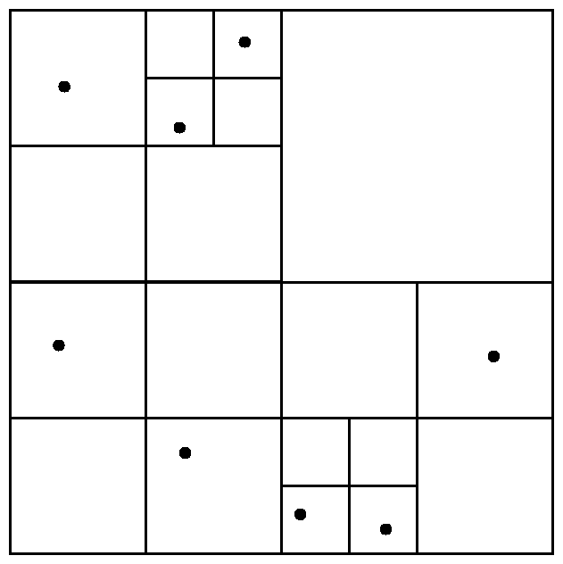
Quad-Tree
Indexing
Each node of a quad-tree is associated with a rectangular region of space; the top node is associated with the entire target space.
Each non-leaf node divides its region into four equal sized quadrants
Leaf nodes have between zero and some fixed maximum number of points (set to 1 in example).
00
0
1
0
1
2
3
03
02
00
30
30
31
3
2
33
32

Slide 13
Quad-Tree
Range query
00
0
1
0
1
2
3
03
02
20
23
30
31
3
2
33
32

Slide 14
Quad-Tree
Nearest Neighbour Query (hard)
00
0
1
0
1
2
3
03
02
20
23
30
31
3
2
33
32

Slide 15
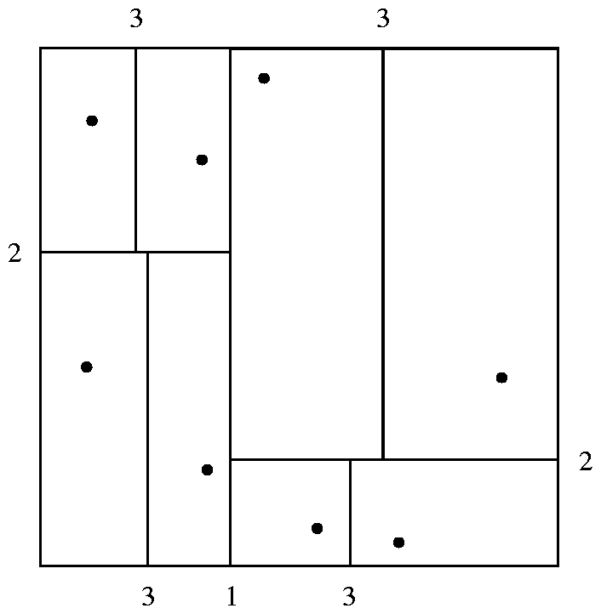
K-D-Tree
Each line in the figure (other than the outside box) corresponds to a node in the k-d tree
the maximum number of points in a leaf node has been set to 1.
The numbering of the lines in the figure indicates the level of the tree at which the corresponding node appears.

Slide 16
K-D-Tree Example
X=7
X=5
y=6
y=5
Y=6
x=8
x=7
x=3
Y=5
y=2
Y=2
X=3
X=5
X=8

Slide 17
K-D-Tree Example
Range query
X=5
X=3
X=7
Q=(4,7), (7,5)
y=6
y=5
x=8
x=7
x=3
Y=6
Y=5
y=2
Y=2
X=5
X=8

Slide 18
K-D-Tree
Nearest neighbor query

Slide 19
Spatial Indexing Structures
Space Partition-Based Indexing Structures
Grid-based
Quad-tree
k-D tree
Data-Driven Indexing Structures
R-Tree

Slide 20
R-Trees
Build a Minimum Bounding Rectangle (MBR)
MBR = {(L.x,L.y)(U.x,U.y)}
Note that we only need two points to describe an MBR, we typically use lower left, and upper right.

Slide 21
R-Trees
We can group clusters of data points into MBRs
Can also handle line-segments, rectangles, polygons, in addition to points
We can further recursively group MBRs into larger MBRs….
R1
R4
R2
R5
R3
R6
R9
R7
R8

Slide 22
R-Tree Structure
Nested MBRs are organized as a tree
R10
R11
R10 R11 R12
R1 R2 R3
R4 R5 R6
R7 R8 R9
R12
Data nodes containing points

Slide 23
Nearest Neighbour Search
Given an MBR, we can compute lower bounds on nearest object
Once we know there IS an item within some distance d, we can prune away all items/MBRs at distance > d
Even if we haven’t actually found the nearest item yet
Similar technique possible for k-d trees and quad-trees as well
Q
R10
R11
R10 R11 R12
R1 R2 R3
R4 R5 R6
R7 R8 R9
R12
Data nodes containing points

Slide 24
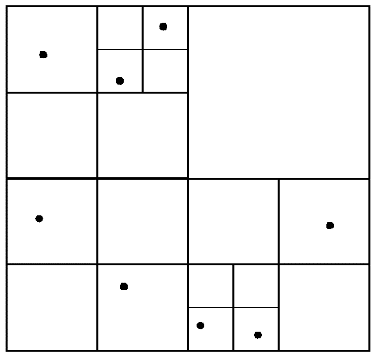
Comparison among Spatial Indices
 | Unbalanced data | Range query | Nearest neighbor | Construction | Balanced structure | Storage
Grid-based | Poor | Good | Nomal | Easy | Yes | Big
Quad-Tree | Good | Best | Poor | Easy | No | Median
KD-Tree | Good | Normal | Good | Easy | Almost | Median
R-Tree | Good | Normal | Best | Difficult | Yes | Small

Slide 25

Trajectory Data Management
Spatial Databases
Queries
Range queries
KNN queries
Distance metrics
The distance between a point $q$ and a trajectory
The Distance between two trajectories
The distance between two trajectory segments
Indexing structures
Retrieval algorithms

Slide 26
Trajectory Data Management
Range queries
E.g. Retrieve the trajectories of vehicles passing a given rectangular region R between 2pm-4pm in the past month
KNN queries
E.g. Retrieve the trajectories of people with the minimum aggregated distance to a set of query points
Publications: [1][2] for a single point query, [3] for multiple query points
E.g. Retrieve the trajectories of people with the minimum aggregated distance to a query trajectory
Publications: Chen et al, SIGMOD05; Vlachos et al, ICDE02; Yi et al, ICDE98.
[1] E. Frentzos, et al. Algorithms for nearest neighbor search on moving object trajectories. Geoinformatica, 2007
[2] D. Pfoser, et al. Novel approaches in query processing for moving object trajectories. VLDB, 2000.
[3] Zaiben Chen, et al. Searching Trajectories by Locations: An Efficiency Study, SIGMOD 2010

Slide 27

Trajectory Data Management
Spatial Databases
Queries
Range queries
KNN queries
Distance metrics
The distance between a point $q$ and a trajectory
The Distance between two trajectories
The distance between two trajectory segments
Indexing structures
Retrieval algorithms

Slide 28


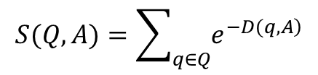
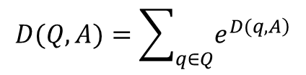
Trajectory Data Management
Distance metrics
The distance between a point $q$ and a trajectory
using an exponential function to assign a larger contribution to a closer matched pair of points while giving much lower value to those far-away pairs
$$D\left(q,A\right)=\min_{p∈A}D\left(p,q\right)$$
$$D(Q,A)=\sum_{q∈Q}{e^{\left.D(q,A\right)}}$$
$$S(Q,A)=\sum_{q∈Q}{e^{\left.−D(q,A\right)}}$$
Zaiben Chen, et al. Searching Trajectories by Locations: An Efficiency Study, SIGMOD 2010

Slide 29
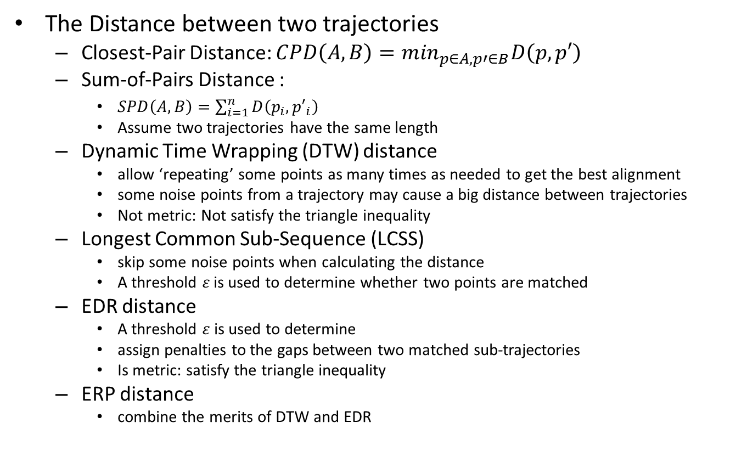
Trajectory Data Management
The Distance between two trajectories
Closest-Pair Distance: $CPD\left(A,B\right)=\min_{p∈A,p′∈B}D\left(p,p′\right)$
Sum-of-Pairs Distance :
$SPD\left(A,B\right)=\sum_{i=1}^{n}{D\left(p_{i},{p′}_{i}\right)}$
Assume two trajectories have the same length
Dynamic Time Wrapping (DTW) distance
allow ‘repeating’ some points as many times as needed to get the best alignment
some noise points from a trajectory may cause a big distance between trajectories
Not metric: Not satisfy the triangle inequality
Longest Common Sub-Sequence (LCSS)
skip some noise points when calculating the distance
A threshold $ε$ is used to determine whether two points are matched
EDR distance
A threshold $ε$ is used to determine
assign penalties to the gaps between two matched sub-trajectories
Is metric: satisfy the triangle inequality
ERP distance
combine the merits of DTW and EDR

Slide 30
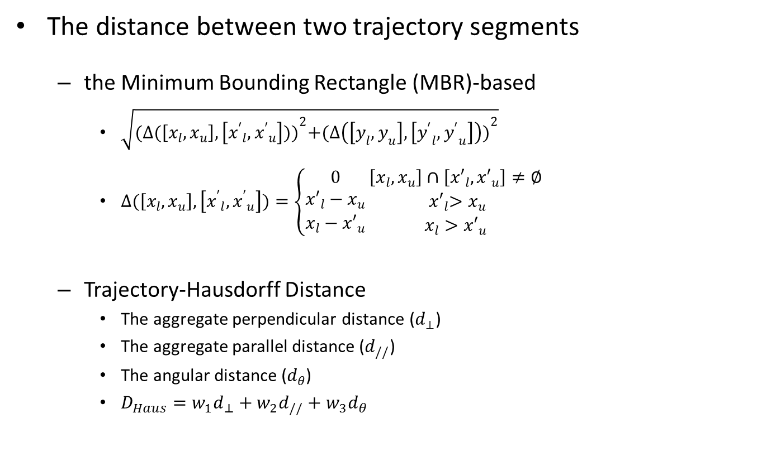
Trajectory Data Management
The distance between two trajectory segments
the Minimum Bounding Rectangle (MBR)-based
$\sqrt{{(∆(\left[x_{l},x_{u}\right],\left[{x^{′}}_{l},{x^{′}}_{u}\right]))}^{2}+{(∆\left(\left[y_{l},y_{u}\right],\left[{y^{′}}_{l},{y^{′}}_{u}\right]\right))}^{2}}$
$∆(\left[x_{l},x_{u}\right],\left[{x^{′}}_{l},{x^{′}}_{u}\right])=\left\{\begin{matrix}0 \\ {x′}_{l}−x_{u} \\ x_{l}−{x′}_{u}\end{matrix}\right.\begin{matrix}\left[x_{l},x_{u}\right]∩\left[{x′}_{l},{x′}_{u}\right]≠∅ \\ { x′}_{l}>x_{u} \\ x_{l}>{x′}_{u}\end{matrix}$
Trajectory-Hausdorff Distance
The aggregate perpendicular distance ($d_{⊥}$)
The aggregate parallel distance ($d_{//}$)
The angular distance ($d_{θ}$)
$D_{Haus}={w_{1}d}_{⊥}+w_{2}d_{//}+w_{3}d_{θ}$

Slide 31

Trajectory Data Management
Spatial Databases
Queries
Range queries
KNN queries
Distance metrics
The distance between a point $q$ and a trajectory
The Distance between two trajectories
The distance between two trajectory segments
Indexing structures
Retrieval algorithms

Slide 32
Trajectory Data Management
Indexing structures
View temporal as an additional dimension
3D R-Tree
ST R-Tree
TB-Tree
Divides a time period into multiple time intervals → a spatial index in each interval
HR-tree
MR-tree
HR+-tree
MV3R-tree
Partition a geographical space into grids → a temporal index in each grid
CSE-Tree

Slide 33
Trajectory Data Management
R-Tree
R10
R11
R10 R11 R12
R1 R2 R3
R4 R5 R6
R7 R8 R9
R12
Data nodes containing points

Slide 34
Trajectory Data Management
3D R-tree
Time
y
x
Notes:
The straightforward way to index trajectory data is to augment temporal dimension to the traditional spatial index
Along with the time, when a piece of recently collected trajectory data is coming, that is, M line segment, it is inserted into 3D R-tree according to its position in the 3D space. As a result, in many cases when we need to retrieve a long trajectory, we have to visit many different paths in 3D R-tree.
To avoid this situation, ST-R-tree and TB-tree have been proposed.

Slide 35
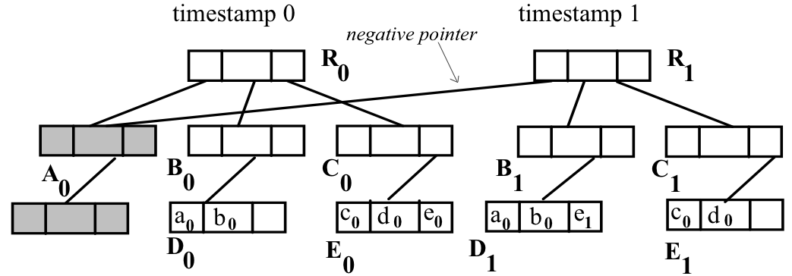
Trajectory Data Management
Multi-version R-tree (HR-tree [Tao2001a], HR+-tree[Tao2001b], MR-tree[Xu2005])
For each timestamp, an R-tree is created. So, there are many R-trees. These R-trees are indexed.
HR-tree [Tao2001]
Query for trajectories in a given region and in a given time interval:
The R-tree at the timestamp is found first
The trajectories in the specified region are retrieved from the R-tree.
Notes:
3D R-tree may have significant overlap between non-leaf nodes. When processing query, this may lead to visit much more irrelevant nodes. To overcome this problem,

Slide 36
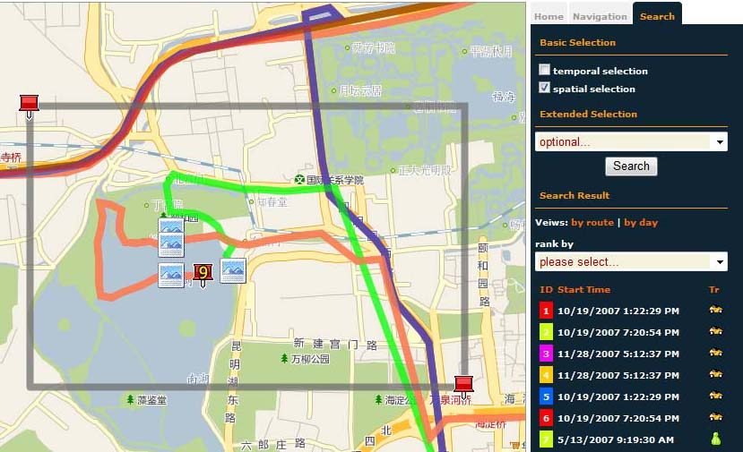
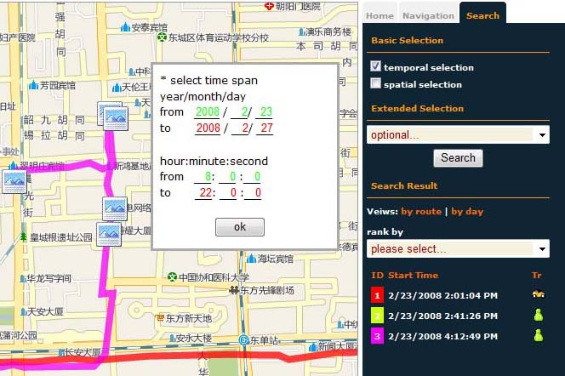
CSE-Tree
Problem Definition
Retrieve the GPS trajectories across a given region and intersecting a given time span
Present techniques are not optimized to these applications
Spatial query
Temporal query

Slide 37
Index Design
Architecture
Partition space into disjoint grids
Maintain a temporal index for each grid
The temporal index (CSE-Tree) is special
Longhao Wang, Yu Zheng, et al. A FLEXIBLE SPATIO-TEMPORAL INDEXING SCHEME FOR LARGE-SCALE GPS TRACK RETRIEVAL. MDM 2009

Slide 38
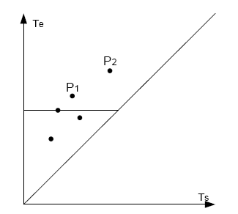
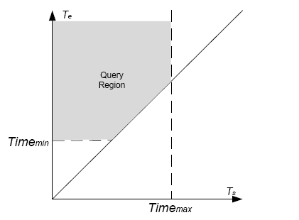

Temporal Index (CSE-Tree)
A GPS segment can be represented by a pair (Ts, Te)
A point on two dimensional plane
A temporal query is a time span (Timemin , Timemax)
Timemin
Timemax
Ts
Te
Ts
Te
Ts
Te

Slide 39
Temporal index
Structure
Partition the points into groups by Te
Build a start time index (B+ Tree) to index points of each group
Build a end time index (B+ Tree) to index groups
Te
ti+1
ti
t2
t1
Ts

Slide 40
Temporal Index (CSE-Tree)
Search operation
Te> Timemin: Search End Time index to get the corresponding start time indexes
Ts< Timemax: Look up each start time index candidate to find the correct points

Slide 41
Temporal Index (CSE-Tree)
Compress operation
Occur when update frequency drops to some extent
Convert B+ tree to dynamic array
B+ Tree
dynamic array

Slide 42
More Elegant
1
3
4
7
11
6
Traj ID1
i1, j1
Traj ID1
p1, p2, … pk
Traj ID2
i2, j2
Traj ID2
p1, p2, … pk
Traj IDn
in, jn
Traj IDn
p1, p2, … pk

Slide 43
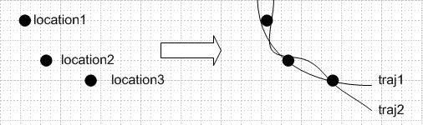
KNN Point Queries
The problem we study: Searching by multiple locations
To find trajectories that are ‘close’ to all the locations
Technically, it is an extension of the single-location based query. But more complicated.
Practically, it produces a more general way to search trajectories.
Two extreme cases (one location, many locations)
Zaiben Chen, et al. Searching Trajectories by Locations: An Efficiency Study, SIGMOD 2010

Slide 44





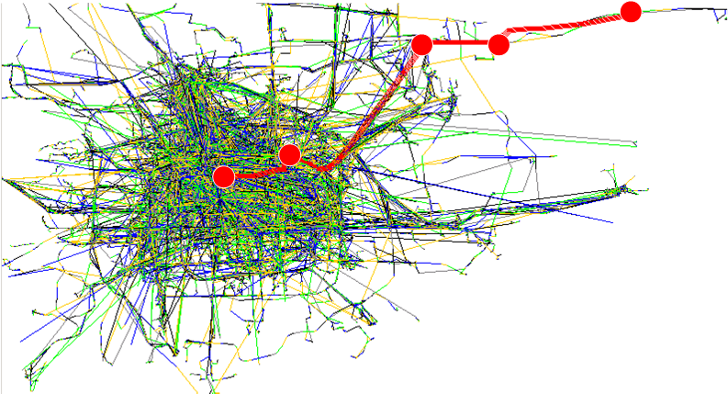
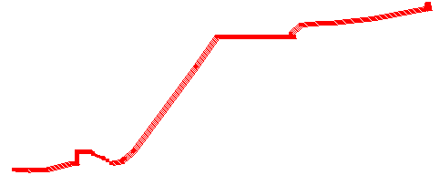
KNN Point Queries
The recommended route

Slide 45
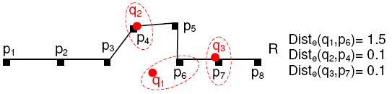
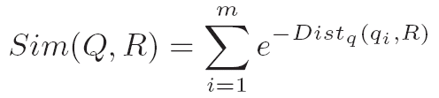
Similarity Function
The similarity function reflects how close a trajectory is to the given locations, and we call the most similar trajectory the best-connected trajectory.
Step 1. find out the closest trajectory point on R to each location q_{i}
Step 2. sum up the contribution of each matched pair. (unordered query)
Dist_{q}(q_{i}, R) is the shortest distance from q_{i} to R
Q={q_{1,} q_{2,} … q_{m}}, R={p_{1,} p_{2,} … p_{n}}
Zaiben Chen, et al. Searching Trajectories by Locations: An Efficiency Study, SIGMOD 2010

Slide 46
KNN Point Queries
k-Best Connected Trajectory (k-BCT) query
Given a set of trajectories T = {R₁, R₂, … , R_{n}}, a set of query locations
Q = {q₁, q_{2, … ,}q_{m}}, and the similarity function Sim(Q, R), the k-BCT query is to find the k trajectories among T that have the highest similarity.
Assumption:
The number of query locations is small. (m is a small constant)
Intuition:
The k-BCT result is the JOIN of m single-location based queries.

Slide 47
Basic ideas
Incremental k-NN Algorithm (IKNN)
Step 1. Index all the trajectory points by one single R-tree
Get the shortest distance from a query location to the trajectories
Step 2. Search for the λ-nearest neighbor (λ-NN) of each query location
using any traditional k-nearest neighbor algorithm over R-tree
Candidate set C = {all scanned trajectories}
Zaiben Chen, et al. Searching Trajectories by Locations: An Efficiency Study, SIGMOD 2010

Slide 48

IKNN algorithm
Step 3. Construct lower bounds of similarity.
For a trajectory R1 in C, assume it got 3 points p1, p2 and p3 scanned by the λ-NN search of q1, q2.
p5
R1
p1
p2
p3
q1
q2
q3
Sim(Q, R1) = e^{-|q1, p1|} + e^{-|q2, p2|} + e^{-|q3, p5|}
≥ e^{-|q1, p1|} + e^{-|q2, p2|}

Slide 49

The Incremental k-NN algorithm
Step 4. Construct upper bound of similarity.
For any trajectory that is not covered by the λ-NN search, e.g. R5
it’s distance to q_{i} must be larger than the radius of q_{i}
R1
radius1
radius2
radius3
q1
q2
q3
R5
Sim(Q, R5) = e^{-|q1, R5|} + e^{-|q2, R5|} + e^{-|q3, R5|}
≤ e^{-radius1}+ e^{-radius2} + e^{-radius3}

Slide 50
The Incremental k-NN algorithm
Step 5. Check the STOP condition (pruning condition)
For a k-BCT query, if we can get k candidate trajectories whose lower bounds are not less than the upper bound of similarity for all un-scanned trajectories, then the k best-connected trajectories must be included in the candidate set.
if the condition is satisfied
go to the refinement step
else
increase λ by some Δ
repeat the search process
With the search region of the λ-NN search enlarges, eventually k best-connected trajectories will be found
Zaiben Chen, et al. Searching Trajectories by Locations: An Efficiency Study, SIGMOD 2010

Slide 51
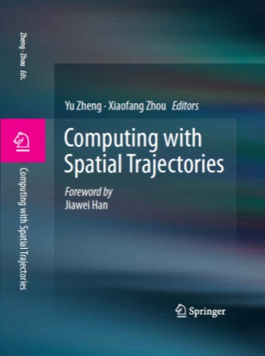

Thanks!
Yu Zheng
yuzheng@microsoft.com
Homepage
Yu Zheng. Trajectory Data Mining: An Overview.
ACM Transactions on Intelligent Systems and Technology. 2015, vol. 6, issue 3.

