Slide 1

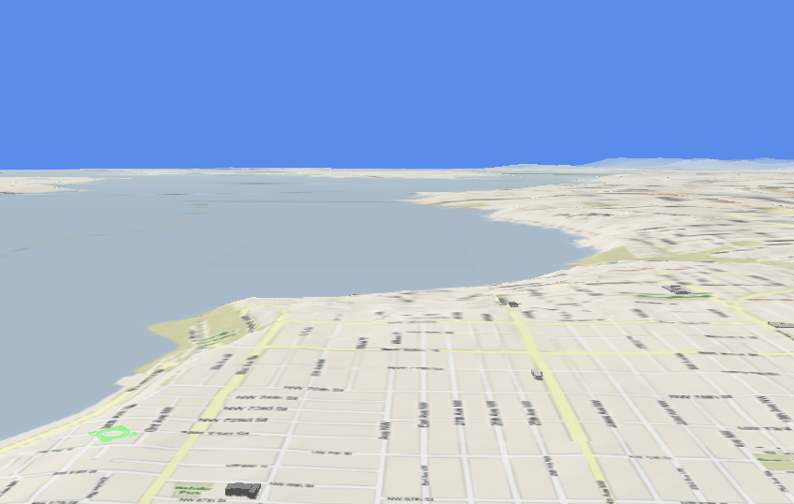





Trajectory Data Mining
Dr. Yu Zheng
Lead Researcher, Microsoft Research
Chair Professor at Shanghai Jiao Tong University
Editor-in-Chief of ACM Trans. Intelligent Systems and Technology
http://research.microsoft.com/en-us/people/yuzheng/
Notes:
A Location trajectory is a geospatial trail generated by a moving object. Typically, this trail is represented by of a set of time-ordered points.
The advance of location-acquisition technologies has boosted the increase of location trajectories, which record the trails of a variety of moving objects, such as people, vehicles, animals and nature phenomena.
These trajectories have not only enabled many applications significantly changing the way we live but also provided us with the scientific observations to understand the objects creating the trajectory.
As a result, the location trajectory has become the foundation a lot of research and attracted intensive attentions from a multitude of areas including computer sciences, biology, sociology, geography, and climatology, etc.

Slide 2
Paradigm of Trajectory Data Mining
Yu Zheng. Trajectory Data Mining: An Overview. ACM Transactions on Intelligent Systems and Technology. 2015, vol. 6, issue 3.

Slide 3
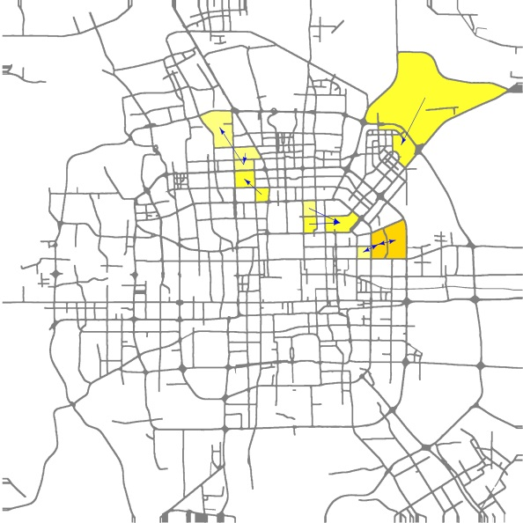
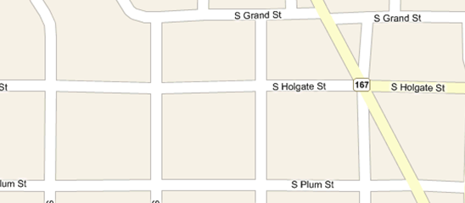
Uncertain trajectories
check-ins or geo-tagged photos
Taxi trajectories, trails of migratory birds
...
...
...

Slide 4
Trajectory Uncertainty
Reducing Uncertainty from Trajectory Data → Enhance its utility
Modeling Uncertainty of a Trajectory for Queries
Path Inference from Uncertain Trajectories
Make a trajectory even more uncertain → Protect a user’s privacy

Slide 5
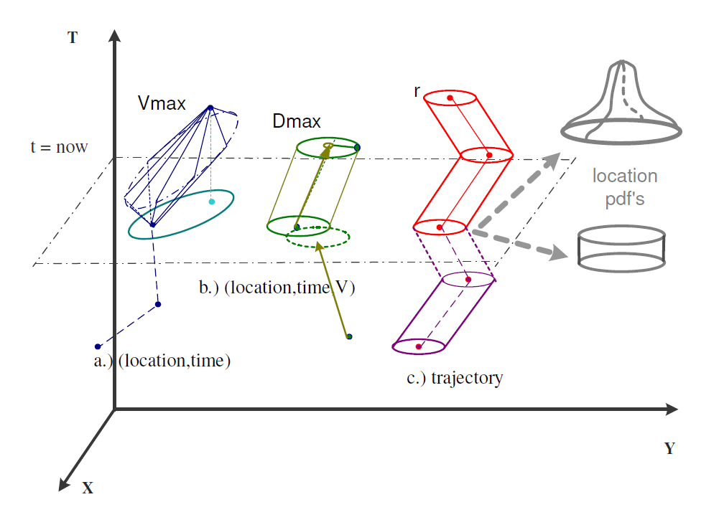
Trajectory Uncertainty
Modeling Uncertainty of a Trajectory for Queries

Slide 6
Trajectory Uncertainty
Path Inference from Uncertain Trajectories
In a road network
In a free space

Slide 7
Constructing Popular Routes from Uncertain Trajectories in Free Space
In KDD 2012
.
Ling-Yin Wei, Yu Zheng, Wen-Chih Peng, Constructing Popular Routes from Uncertain Trajectories. KDD 2012.

Slide 8
Constructing Popular Routes from Uncertain Trajectories
Goal: Using collective knowledge: The route may not exist in the dataset
Mutual reinforcement learning (uncertain + uncertain → certain)
...
...
...
...
...
...
...
...
...
...
Ling-Yin Wei, Yu Zheng, Wen-Chih Peng, Constructing Popular Routes from Uncertain Trajectories. KDD 2012.

Slide 9
...
Concatenation
...
...
...
...
...
...
...
Mutual reinforcement construction
...
...
...
...
...
...
...
...

Slide 10
Constructing Popular Routes from Uncertain Trajectories
Problem
Given a corpus of uncertain trajectories and
a user query: some point locations and a time constraint
Suggest the top k most popular routes
...
...
...
...
...
...
...
...
...
...
...
...
...
...
...

Slide 11
Framework Overview
Routable graph construction (off-line)
Region: Connected geographical area
Edges in each region
Edges between regions
Routable Graph

Slide 12
Framework Overview
Routable graph construction (off-line)
Route inference (on-line)
q₁
Local Route Search
Global Route Search
q₂
q₃
Popular Route
Routable Graph

Slide 13
Region Construction (1/3)
Space partition
Divide a space into non-overlapping cells with a given cell length
Trajectory indexing

Slide 14
Region Construction (2/3)
Region
A connected geographical area
Idea
Merge connected cells to form a region
Observation
Tra₁ and Tra₂ follow the same route but have different sampled geo-locations
Spatially close
Temporal constraint

Slide 15

Region Construction (3/3)
Spatio-temporally correlated relation between trajectories
Spatially close
Temporal constraint
Connection support of a cell pair
Minimum connection support C
Rule1
Rule2
Ling-Yin Wei, Yu Zheng, Wen-Chih Peng, Constructing Popular Routes from Uncertain Trajectories. KDD 2012.

Slide 16
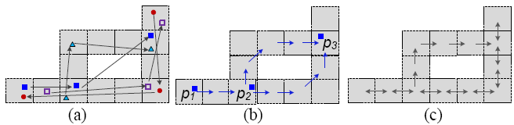
Edge Inference
[Edges in a region]
Step 1: Let a region be a bidirectional graph first
Step 2: Trajectories + Shortest path based inference
Infer the direction, travel time and support between each two consecutive cells
[Edges between regions]
Build edges between two cells in different regions by trajectories
Ling-Yin Wei, Yu Zheng, Wen-Chih Peng, Constructing Popular Routes from Uncertain Trajectories. KDD 2012.

Slide 17


Local Route Search
Goal
Top K local routes between two consecutive geo-locations q_{i}, q_{i+1}
Approach
Determine qualified visiting sequences of regions by travel times
A*-like routing algorithm
where a route
q₁
R₅
Sequences of Regions from q₁ to q₂:
R₁
q₂
R₁→ R₂ → R₃
R₁→ R₃
R₃
R₂
R₄

Slide 18
Global Route Search
Input
Local routes between any two consecutive geo-locations
Output
Top K global routes
Branch-and-bound search approach
E.g., Top 1 global route
q₁
R₅
R₁
q₂
R₃
R₄
R₂
q₃

Slide 19
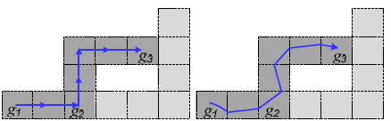
Route Refinement
Input
Top K global routes: sequences of cells
Output
Top K routes: sequences of segments
Approach
Select GPS track logs for each grid
Adopt linear regression to derive regression lines

Slide 20
Route Inference from Uncertain Trajectories in a Road Network
ICDE 2012
Kai Zheng, Yu Zheng, Xing Xie, Xiaofang Zhou. Reducing Uncertainty of Low-Sampling-Rate Trajectories. ICDE 2012.

Slide 21
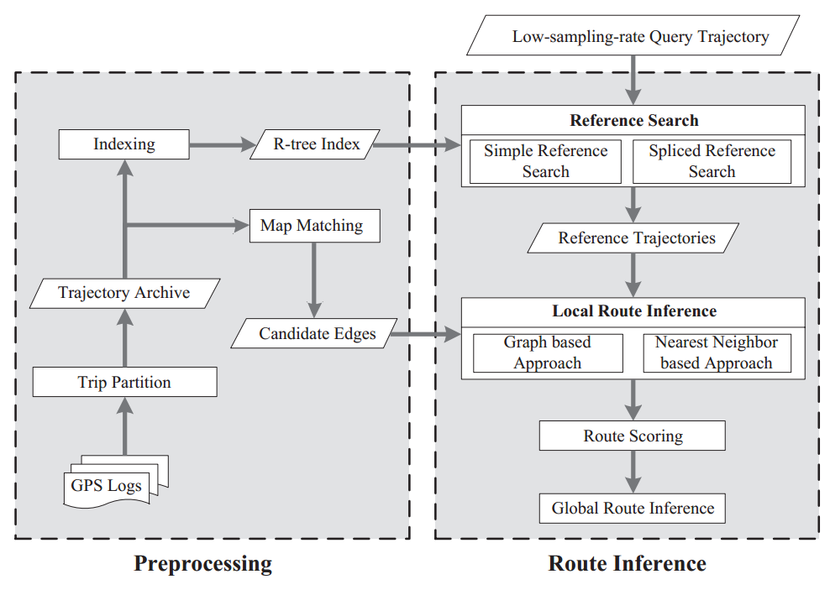
Methodology
Search for reference trajectories
Select the relevant historical trajectories that may be helpful in inferring the route of the query
Local route inference
Inferring the routes between consecutive samples of query
Global route inference
Inferring the whole routes by connecting the local routes
Kai Zheng, Yu Zheng, Xing Xie, Xiaofang Zhou. Reducing Uncertainty of Low-Sampling-Rate Trajectories. ICDE 2012.

Slide 22
Reference Trajectory Search
Simple reference based on eclipse
T1, T2 – yes; T3, T4 – no
Sliced reference based on cascading
T1, T2, T4 – not simple reference trajectory
Parts of T1 and T2 can form a reference trajectory

Slide 23

Local Route Inference
Reference trajectories
Check the density of reference points around the query points
> $τ$
Yes
No
For sparse points
For high density points
Traverse Graph-Based Approach
Nearest neighbor based approach

Slide 24
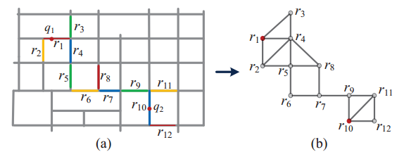


Traverse Graph-Based Approach
Graph augmentation
A special case of the k-connectivity graph augmentation problem [1]
i.e., add a minimum number (cost) of edges to a graph so as to satisfy a given connectivity condition
transformed to the min-cost spanning tree problem when k = 1
Graph reduction
Remove redundant edges to save computational loads for the k-shortest path search in a graph
Solved by transitive reduction algorithms [2]
e.g., $r_{3}→r_{5}$ is redundant, $r_{4}→r_{2}$ is not
$λ=2$, i.e. one hop
Use the k shortest paths of this graph as the candidate local possible route of the query
[1] A. Frank, “Augmenting graphs to meet edge-connectivity requirements,” in Foundations of Computer Science. 2002
[2] A. Aho, M. Garey, and J. Ullman, “The transitive reduction of a directed graph,” SIAM Journal on Computing, 1972.

Slide 25
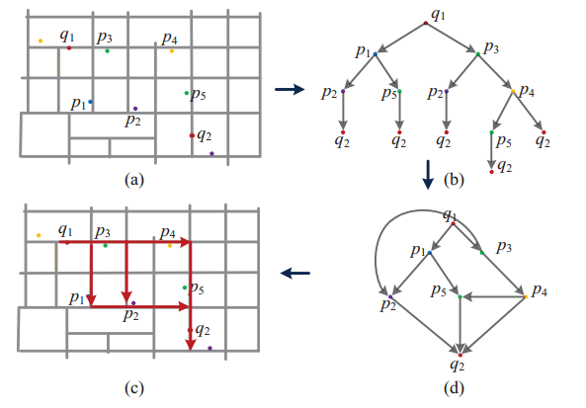
Nearest Neighbor-Based Approach
1. Find the top-k nearest nodes to a query point
2. Keep extending the nearest neighbours until reach the destination query point
Search for the top k most possible paths
re-use the shares structure

Slide 26
Global Route Inference

Slide 27
Privacy of Trajectories
Protect a user from the privacy leak caused by the disclosure of the user’s trajectories
Real-time continuous location-based services
Spatial cloaking
Mix-zones
Path confusion
Euler histogram-based on short IDs
Dummy trajectories
Publication of historical trajectories
Clustering-based generalization-based
Suppression-based
Grid-based approach

Slide 28
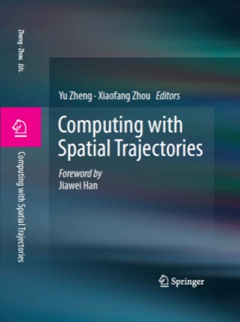

Thanks!
Yu Zheng
yuzheng@microsoft.com
Homepage
Yu Zheng. Trajectory Data Mining: An Overview.
ACM Transactions on Intelligent Systems and Technology. 2015, vol. 6, issue 3.

