Slide 1

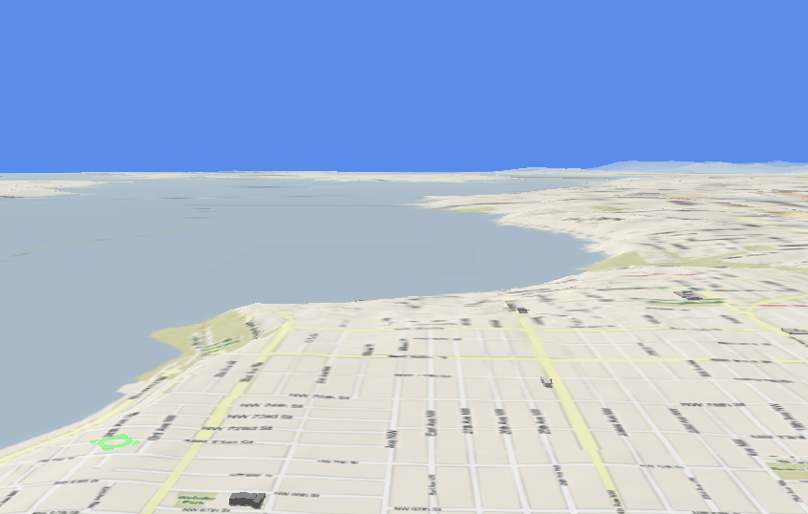





Trajectory Data Mining
Dr. Yu Zheng
Lead Researcher, Microsoft Research
Chair Professor at Shanghai Jiao Tong University
Editor-in-Chief of ACM Trans. Intelligent Systems and Technology
http://research.microsoft.com/en-us/people/yuzheng/
Notes:
A Location trajectory is a geospatial trail generated by a moving object. Typically, this trail is represented by of a set of time-ordered points.
The advance of location-acquisition technologies has boosted the increase of location trajectories, which record the trails of a variety of moving objects, such as people, vehicles, animals and nature phenomena.
These trajectories have not only enabled many applications significantly changing the way we live but also provided us with the scientific observations to understand the objects creating the trajectory.
As a result, the location trajectory has become the foundation a lot of research and attracted intensive attentions from a multitude of areas including computer sciences, biology, sociology, geography, and climatology, etc.

Slide 2
Paradigm of Trajectory Data Mining
Yu Zheng. Trajectory Data Mining: An Overview. ACM Transactions on Intelligent Systems and Technology. 2015, vol. 6, issue 3.

Slide 3
Trajectory Classification
Differentiate between trajectories (or its segments) of different status:
motions
transportation modes
human activities
……
Applications
trip recommendation
life experiences sharing
context-aware computing
……

Slide 4
Trajectory Classification
General Steps:
Divide a trajectory into segments using segmentation methods.
Sometimes, each single point is regarded as a minimum inference unit
Extract features from each segment (or point)
Build a model to classify each segment (or point)
Some models
Dynamic Bayesian Network (DBN)
HMM and Conditional Random Field (CRF)

Slide 5
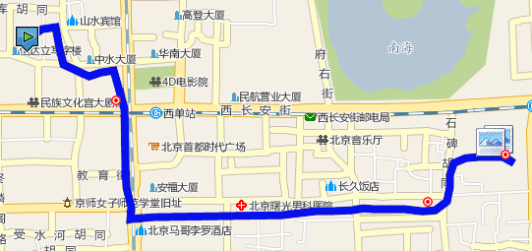
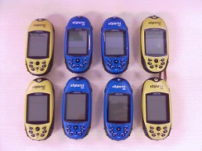
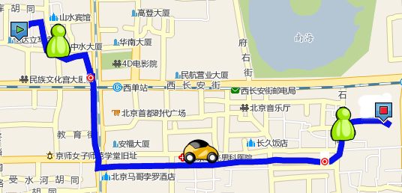
Learning Transportation Modes Based on GPS Trajectories
Goal & Results: Inferring transportation modes from raw GPS data
Differentiate driving, riding a bike, taking a bus and walking
Achieve a 0.75 inference accuracy (independent of other sensor data)
GPS log
Infer model

Slide 6
Learning Transportation Modes Based on GPS Trajectories
Motivation
For users:
Reflect on past events and understand their own life pattern
Obtain more reference knowledge from others’ experiences
For service provider:
Classify trajectories of different transportation modes
Enable smart-route design and recommendation
Difficulty
Velocity-based method cannot handle this problem well (<0.5 accuracy)
People usually transfer their transportation modes in a trip
The observation of a mode is vulnerable to traffic condition and weather
Yu Zheng, et al. Understanding Mobility Based on GPS Data. UbiComp 2008

Slide 7
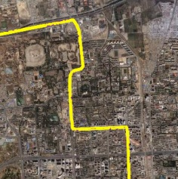
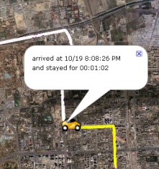
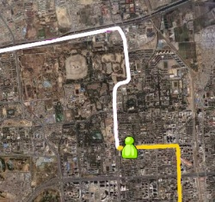
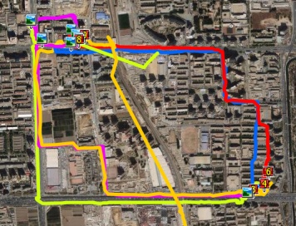
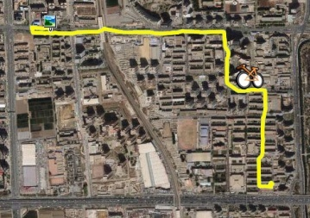
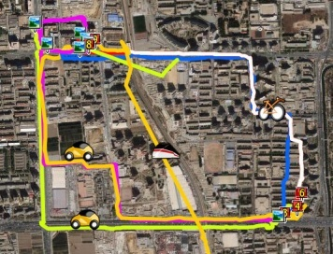
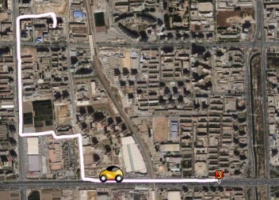

Slide 8
Learning Transportation Modes Based on GPS Trajectories
Contributions and insights
A change point-based segmentation method
Walk is a transition between different transportation modes
Handle congestions to some extent
A set of sophisticated features
Robust to traffic condition
Feed into a supervise learning-based inference model
A graph-based post-processing
Considering typical user behavior
Employing location constrains of the real world
WWW 2008 (first version)
Yu Zheng, et al. Understanding Mobility Based on GPS Data. UbiComp 2008

Slide 9
Architecture

Slide 10
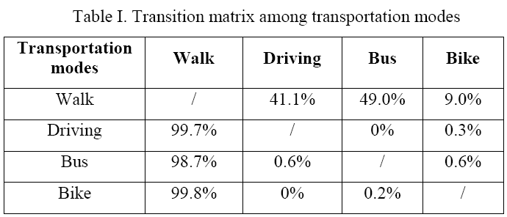
Walk-Based Segmentation
Commonsense knowledge from the real world
Typically, people need to walk before transferring transportation modes
Typically, people need to stop and then go when transferring modes
Yu Zheng, et al. Understanding Mobility Based on GPS Data. UbiComp 2008

Slide 11
Walk-Based Segmentation
Change point-based Segmentation Algorithm
Step 1: distinguish all possible Walk Points, non-Walk Points.
Step 2: merge short segment composed by consecutive Walk Points or non-Walk points
Step 3: merge consecutive Uncertain Segment to non-Walk Segment.
Step 4: end point of each Walk Segment are potential change points

Slide 12
Feature Extraction (1)
Features
Category | Features | Significance
Basic Features | Dist | Distance of a segment
 | MaxVi | The ith maximal velocity of a segment
 | MaxAi | The ith maximal acceleration of a segment
 | AV | Average velocity of a segment
 | EV | Expectation of velocity of GPS points in a segment
 | DV | Variance of velocity of GPS points in a segment
Advanced Features | HCR | Heading Change Rate
 | SR | Stop Rate
 | VCR | Velocity Change Rate
Yu Zheng, et al. Understanding Mobility Based on GPS Data. UbiComp 2008

Slide 13
Feature Extraction (2)
Our features are more discriminative than velocity
Heading Change Rate (HCR)
Stop Rate (SR)
Velocity change rate (VCR)
>65 accuracy

Slide 14
Graph-Based Post-Processing (1)
Using location-constraints to improve the inference performance??
Yu Zheng, et al. Understanding Mobility Based on GPS Data. UbiComp 2008

Slide 15
Graph-Based Post-Processing (2)
Transition probability between different transportation modes
P(Bike|Walk) and P(Bike|Driving)
Segment[i].P(Bike) = Segment[i].P(Bike) * P(Bike|Car)
Segment[i].P(Walk) = Segment[i].P(Walk) * P(Walk|Car)

Slide 16
Graph-Based Post-Processing (3)
Mine a implied road network from users’ GPS logs
Use the location constraints and typical user behaviors as probabilistic cues
Being independent of the map information
Yu Zheng, et al. Understanding Mobility Based on GPS Data. UbiComp 2008

Slide 17
Graph-Based Post-Processing (4)
Yu Zheng, et al. Understanding Mobility Based on GPS Data. UbiComp 2008

Slide 18
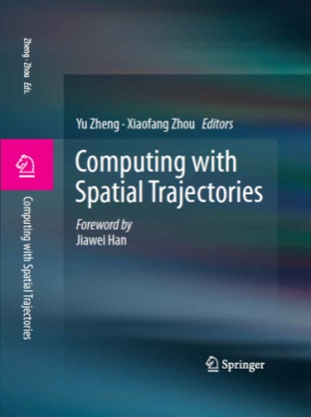

Thanks!
Yu Zheng
yuzheng@microsoft.com
Homepage
Yu Zheng. Trajectory Data Mining: An Overview.
ACM Transactions on Intelligent Systems and Technology. 2015, vol. 6, issue 3.

