Slide 1
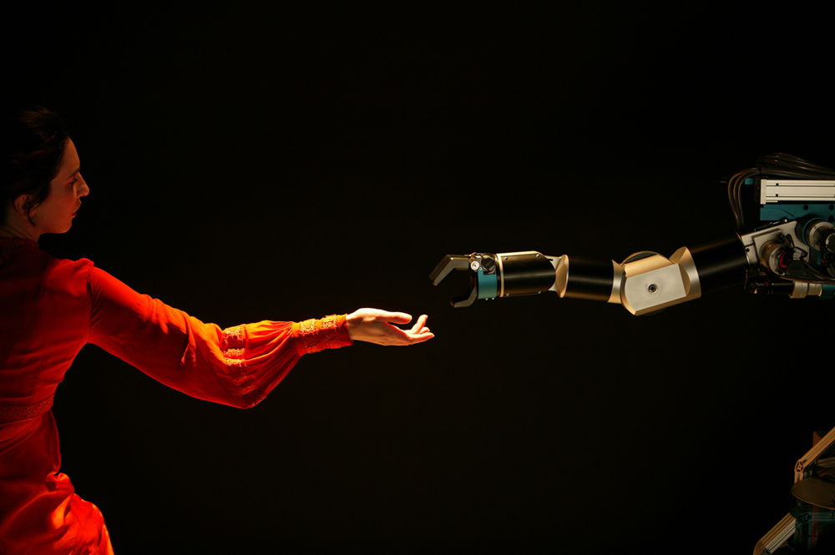
Trajectory Pattern Mining
Hoyoung Jeung† Man Lung Yiu‡ Christian S. Jensen*
† Ecole Polytechnique F´ed´erale de Lausanne (EPFL)
‡ Hong Kong Polytechnic University
* Aarhus University
ACMGIS’2011

Slide 2



Introduction & Overview
Relative Motion Patterns
Disc-Based Trajectory Patterns
Density-Based Trajectory Patterns
Conclusion

Slide 3
Introduction
Increasing location-awareness
  Drowning in trajectory data, but starving for knowledge.
Trajectory pattern mining
  An emerging and rapidly developing topic in data mining.
  Concerns the grouping of similar trajectories.
Applications and uses
  Transportation optimization
  Prediction
  Animal movement analyses, social analyses
  Team sports events analyses
  Traffic analyses

Slide 4
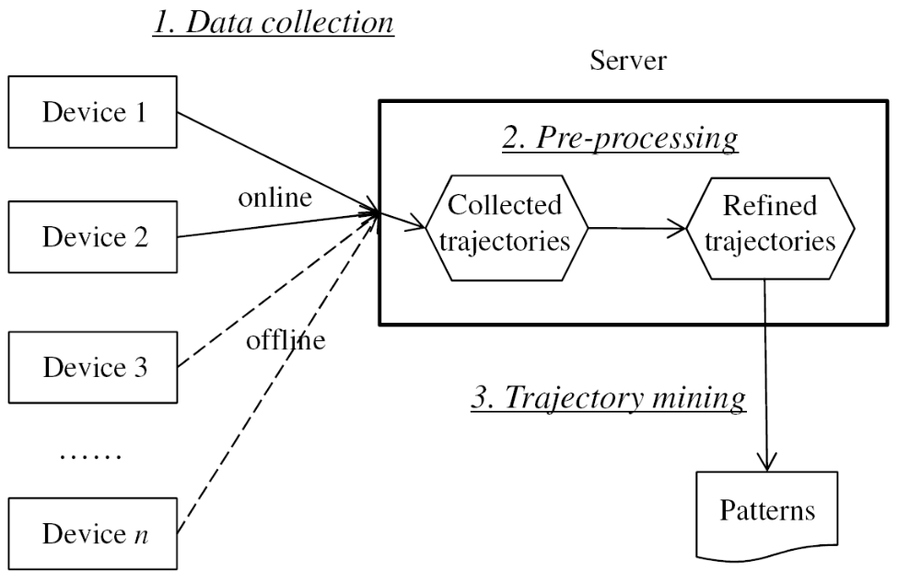
Pattern Discovery Process

Slide 5
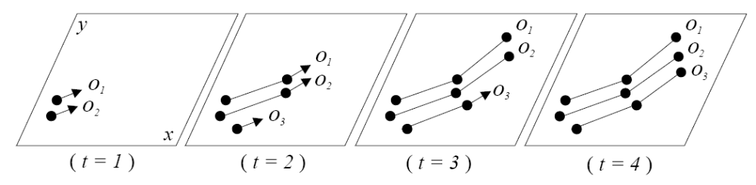
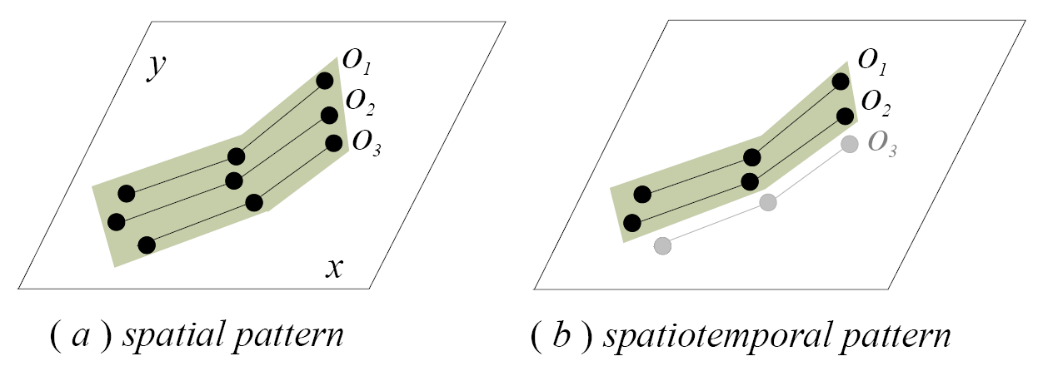
Classifying Trajectory Patterns
Mining tasks on trajectories
  Clustering of trajectories
    Group trajectories based on geometric proximity in spatial/spatiotemporal space.
  Trajectory join
    Given two trajectory datasets, retrieve all pairs of similar trajectories.
Spatial and spatiotemporal patterns

Slide 6
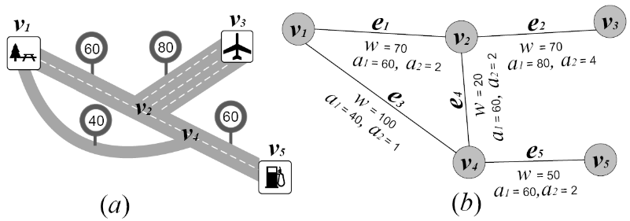
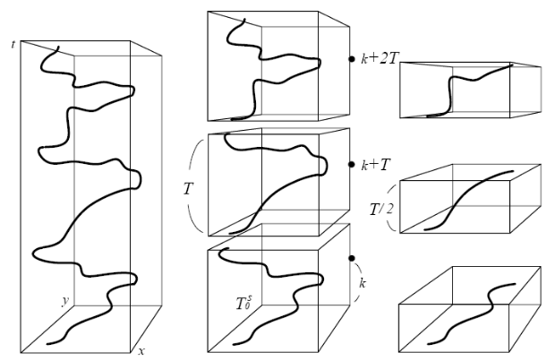
Classifying Trajectory Patterns
Granularity of trajectory patterns
  Global vs. partial patterns.
    Global: basic unit of pattern discovery is a whole trajectory.
    Partial: concerns sub-trajectories to discover patterns of some duration.
  Individual vs. group patterns.
    Individual: regular patterns of an individual.
    Group: common patterns of different objects.
Constrained trajectory patterns
  Spatial constraints: movement on spatial networks.
  Temporal constrains: periodicity.

Slide 7



Introduction & Overview
Relative Motion Patterns
Disc-Based Trajectory Patterns
Density-Based Trajectory Patterns
Conclusion
Relative Motion Patterns

Slide 8
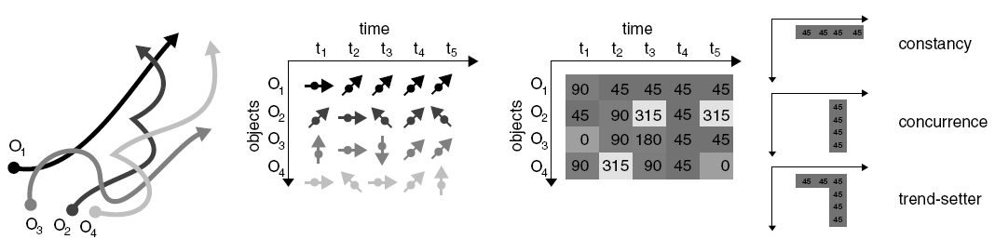
Overview
Key features
  Identify similar movements in a collection of moving-object trajectories.
  REMO (RElative MOtion): analysis concept.
    Transform raw trajectories into motion attributes (speed, motion azimuth).
Pattern types
  Basic motions: constance, concurrence, trendsetter.
  Spatial motions: track, flock, leadership.
  Aggregate/segregate motions: convergence, encounter, divergence, breakup.
[GIScience'02, IJGIS'05,SDH'04,CEUS'06]

Slide 9
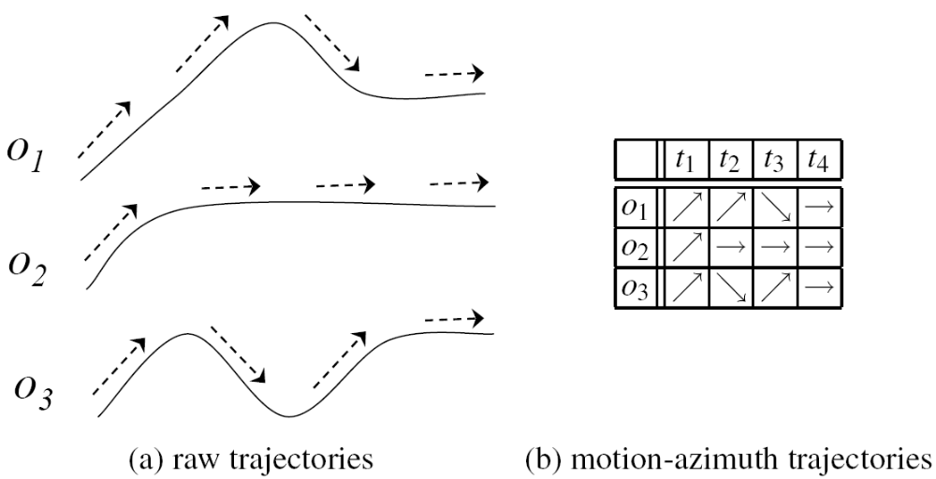
Basic Motion Patterns
Concept
  Describing motion events, disregarding absolute positions.
Definitions
  Constance: a sequence of equal motion attributes for consecutive times.
  Concurrence: the incidence of multiple objects with the same motion attributes.
  Trendsetter: a certain motion pattern that is shared by a set of other objects in the future. E.g., “constance” + “concurrence.”
constance
concurrence
trendsetter

Slide 10
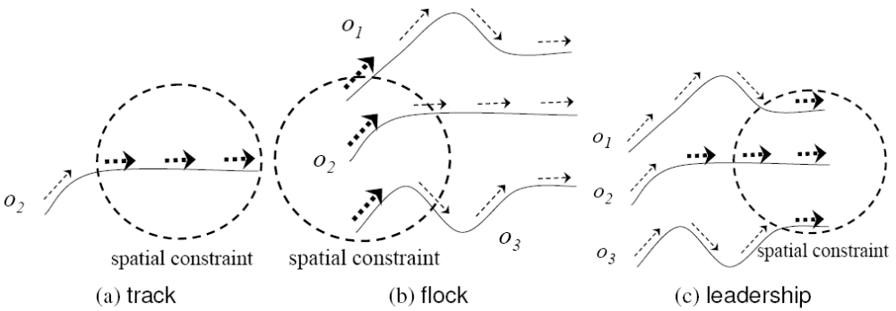
Spatial Motion Patterns
Concept
  Basic motion patterns + spatial constraint (region)
Definitions
  Track: individual objects, each travels within a range while keeping the same motion. “constance” + a spatial constraint.
  Flock: a set of objects who travel within a range while keeping the same motion. “concurrence” + a spatial constraint.
  Leadership: one leader followed by a set of objects with the same motion. “trendsetter” + a spatial constraint.

Slide 11
Aggregate/Segregate Motion Patterns
Concept
  Describing aggregation and segregation of objects’ movements.
Definitions
  Convergence
    A set of objects during a time interval that share motion azimuth vectors intersecting within a given spatial range.
    Captures the behavior of a group of objects that converge in a certain region.
  Encounter
    A set of objects that will arrive in a given spatial range concurrently some time points later.
    Captures an extrapolated (future) meeting of a set of objects within a spatial range.
  Divergence
    Opposite concept of “convergence.”
    Heading backwards instead of forwards.
  Breakup
    Opposite concept of “encounter.”
    E.g., departing from a meeting point.

Slide 12
Discussion
Significance
  Conceptual foundation for many subsequent studies on trajectory pattern discovery.
Drawbacks
  Difficult to define an absolute distance between two objects.
  Mainly deals with motion azimuths, consisting of a certain number of angles (typically 8). Finding an appropriate number of angles is important, but non-trivial.
  Missing data points in trajectories substantially decrease the accuracy and effectiveness of pattern discovery.

Slide 13
Introduction & Overview
Relative Motion Patterns
Disc-Based Trajectory Patterns
Density-Based Trajectory Patterns
Conclusion
Disc-Based Trajectory Patterns

Slide 14
Overview
Key features
  Extend the relative motion patterns.
  Instead of motion attributes, Euclidean distances are used for pattern definition.
  Basic relative motion patterns are no longer considered.
  Circular spatial constraint are used only.
  Integration of time constraints in pattern definitions.
Pattern types
  Prospective patterns: encounter, convergence.
  Flock-driven patterns: flock, meet, leadership.
[SAC'07, GeoInformatica'08, CG'08, GIS'04, GIS'09]

Slide 15
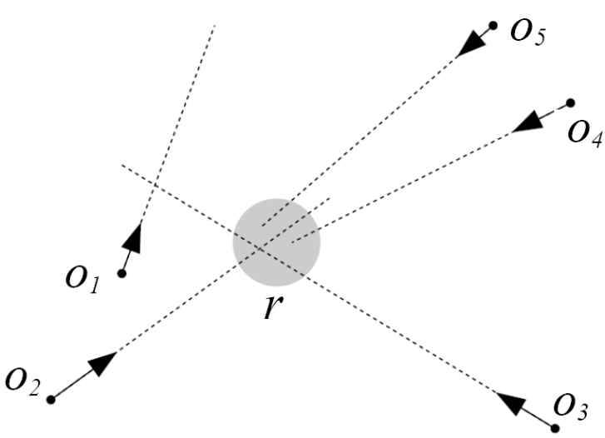
Prospective Patterns
Concept
  Patterns on future trajectories of objects, assuming that the objects keep their current speeds and directions.
Definitions
  Encounter (m,r) : a group of at least m objects that will arrive simultaneously in a disc with radius r
  Convergence (m,r): a group of at least m objects that will pass through a disc with radius r (not necessarily at the same time).

Slide 16
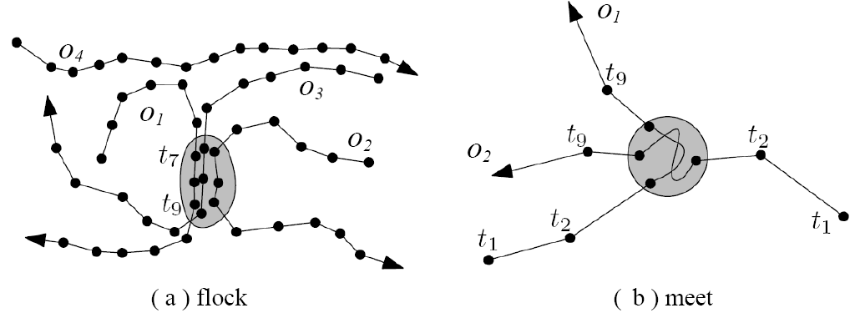
Flock-Driven Patterns
Concept
  Extending “Flock” in the relative motion patterns using Euclidean distance.
Definitions
  Flock (m,k,r): a group of at least m objects that move together for at least k consecutive time points, while staying within a disc with radius r.
  Meet (m,k,r): a group of at least m objects that stay together in a stationary disc with radius r for at least k consecutive time points.

Slide 17
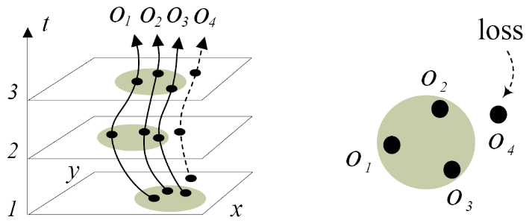
Discussion
Significance
  A large number of subsequent studies extend the relative motion patterns.
  Considerable advances in both concepts and discovery techniques.
Drawbacks
  The selection of a proper disc size r is difficult.
    A large r may capture objects that are intuitively not in the same group.
    A small r may miss some objects that are intuitively in the same group.
  A single value for r may be inappropriate.
    The geographical size of a group typically varies in practice.
  E.g., lossy-flock problem:

Slide 18
Introduction & Overview
Relative Motion Patterns
Disc-Based Trajectory Patterns
Density-Based Trajectory Patterns
Conclusion
Density-Based Trajectory Patterns

Slide 19
Overview
Key features
  Address drawbacks of disc-based patterns.
  Employ density concepts.
    Allow the capture of generic trajectory patterns of arbitrary shape and extent.
Pattern types
  TRACLUS: trajectory clustering.
  Moving cluster: a sequence of spatial clusters.
  Convoy: density-based flock.
    Variants: dynamic/evolving/valid concoys
  Swarm: time-relaxed convoy.
    Variants: closed swarm, follower

Slide 20
Density Notions
Given e and m
Directly Density-Reachable
Density-Reachable
Density-Connected
e
p
q
m = 3
p’
p
q
q
p
o
[KDD’96]

Slide 21
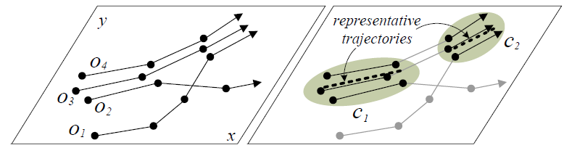
TRACLUS
Concept
  Clustering of density-connected trajectory segments.
  Time is not considered.
Procedure
  Partition a trajectory into sub-trajectories.
  DBSCAN clustering is done on the sub-trajectories.
  Represent a cluster by a representative (sub-)trajectory
[SIGMOD’07]

Slide 22
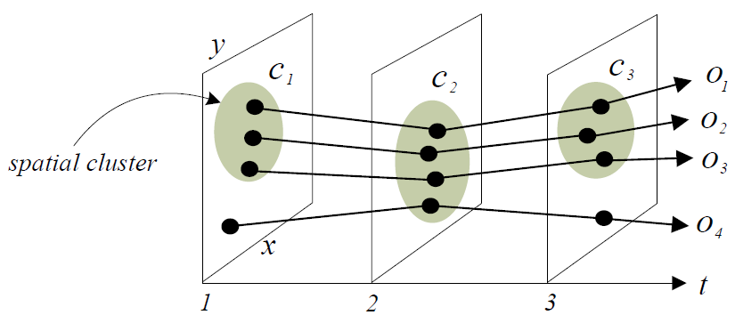

Moving Cluster
Concept
  A set of objects that move close to each other for a time duration.
Definition
  A sequence of consecutive snapshot clusters that share at least given θ of common objects.
[SSTD’05]

Slide 23
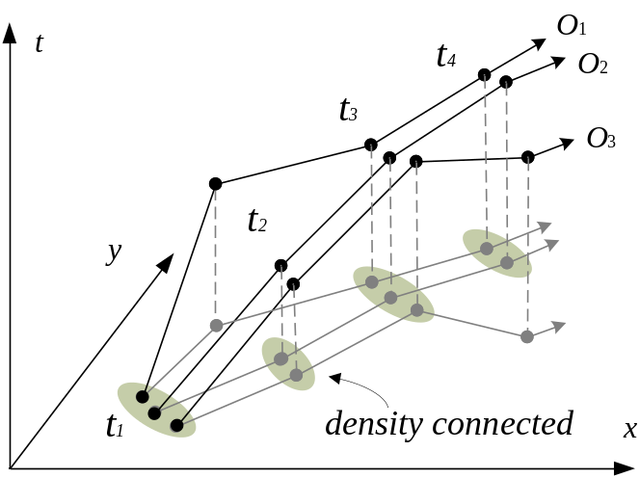
Convoy
Concept
  Density-connected “Flock (m,k,r).”
Definition
  Given e, m, and k, find all groups of objects so that each group consists of density-connected objects w.r.t. e and m during at least k consecutive time points.
[PVLDB’08]

Slide 24
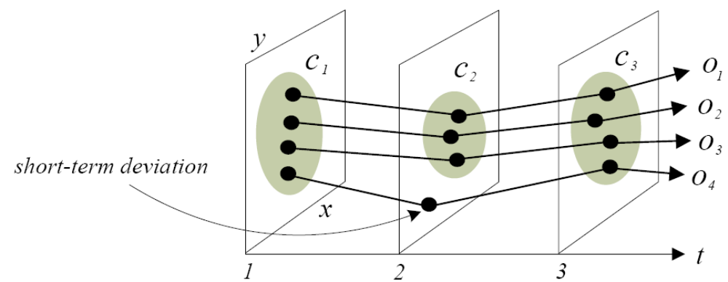
Swarm
Concept
  Time-relaxed convoy.
    Accepting short-term deviations of objects.
Definition
  Given e, m, and k_{min}, find all groups of objects so that each group consists of density-connected objects w.r.t. e and m during at least k_{min} time points (not necessarily consecutive times).
[PVLDB’10]

Slide 25
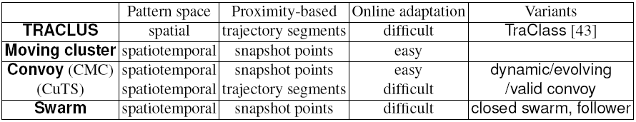
Discussion
Significance
  Main stream in the current research on trajectory pattern mining.
Summary

Slide 26
Introduction & Overview
Relative Motion Patterns
Disc-Based Trajectory Patterns
Density-Based Trajectory Patterns
Conclusion
Conclusion

Slide 27
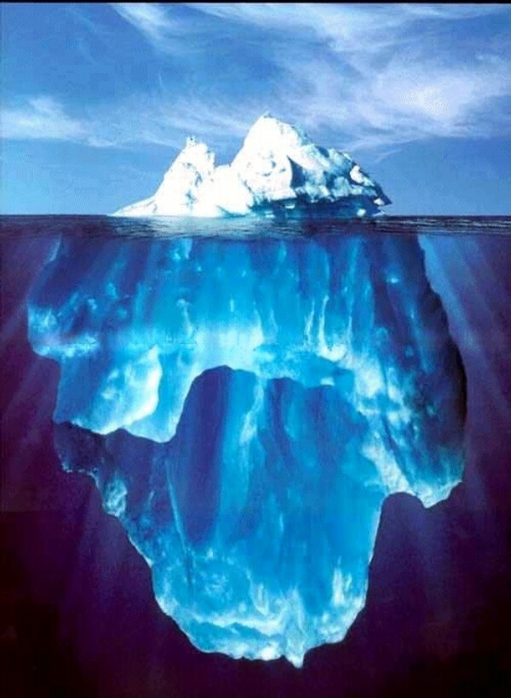
Conclusion
wide
Overview of Trajectory Patterns
glance
Relative Motion
Patterns
Disc-Based Trajectory Patterns
Density-Based Trajectory Patterns
Notes:
Conceptual foundation
DB talk

Slide 28
References
[GIScience'02] Laube, P., Imfeld, S.: Analyzing relative motion within groups of trackable moving point objects. In: GIScience, pp. 132–144 (2002)
[IJGIS'05] Laube, P., Imfeld, S., Weibel, R.: Discovering relative motion patterns in groups of moving point objects. International Journal of Geographical Information Science 19(6), 639–668 (2005)
[SDH'04] Laube, P., van Kreveld, M., Imfeld, S.: Finding remo - detecting relative motion patterns in geospatial lifelines. In: Proceedings of the International Symposium on Spatial Data Handling, pp. 201–214 (2004)
[CEUS'06] Laube, P., Purves, R.S.: An approach to evaluating motion pattern detection techniques in spatio-temporal data. Computers, Environment and Urban Systems 30(3), 347–374 (2006)
[GIS’06] Gudmundsson et al., Computing longest duration flocks in trajectory data, 2006
[PVLDB’08] Jeung et al., Discovery of Convoys in Trajectory Databases, 2008
[PVLDB'10] Li, Z., Ding, B., Han, J., Kays, R.: Swarm: mining relaxed temporal moving object clusters. PVLDB 3, 723–734 (2010)
[SAC'07] Andersson, M., Gudmundsson, J., Laube, P., Wolle, T.: Reporting leadership patterns among trajectories. In: SAC, pp. 3–7 (2007)
[GeoInformatica'08] Andersson, M., Gudmundsson, J., Laube, P.,Wolle, T.: Reporting leaders and followers among trajectories of moving point objects. GeoInformatica 12(4), 497–528 (2008)
[CG'08] Benkert, M., Gudmundsson, J., Hbner, F., Wolle, T.: Reporting flock patterns. Computational Geometry 41(1), 111125 (2008)
[GIS'04] Gudmundsson, J., van Kreveld, M., Speckmann, B.: Efficient detection of motion patterns in spatio-temporal data sets. In: Proceedings of the ACM international symposium on Advances in geographic information systems, pp. 250–257 (2004)
[GIS'09] Vieira, M.R., Bakalov, P., Tsotras, V.J.: On-line discovery of flock patterns in spatio-temporal data. In: Proceedings of the 17th ACM SIGSPATIAL International Conference on Advances in Geographic Information Systems, pp. 286–295 (2009)
[KDD'96] Ester, M., Kriegel, H.P., Sander, J., Xu, X.: A density-based algorithm for discovering clusters in large spatial databases with noise. In: Proceedings of the ACM SIGKDD International Conference on Knowledge Discovery and Data Mining, pp. 226–231 (1996)
[SSTD'05] Kalnis, P., Mamoulis, N., Bakiras, S.: On discovering moving clusters in spatio-temporal data. In: Proceedings of the International Symposium on Spatial and Temporal Databases, pp. 364–381 (2005)

