Slide 1
Machine learning for Pairs Trading in Utilities
Group 9: Chenyang Que, Haoxuan Su, Hongyang Lu, Runyao Tang, Jiahao Zhang

Slide 2

TABLE OF CONTENTS
01
02
03
04
05
06
07
08
Motivation
Data
Trading Execution
Pairs trading
Cointegration
Machine Learning
Result
Future development

Slide 3
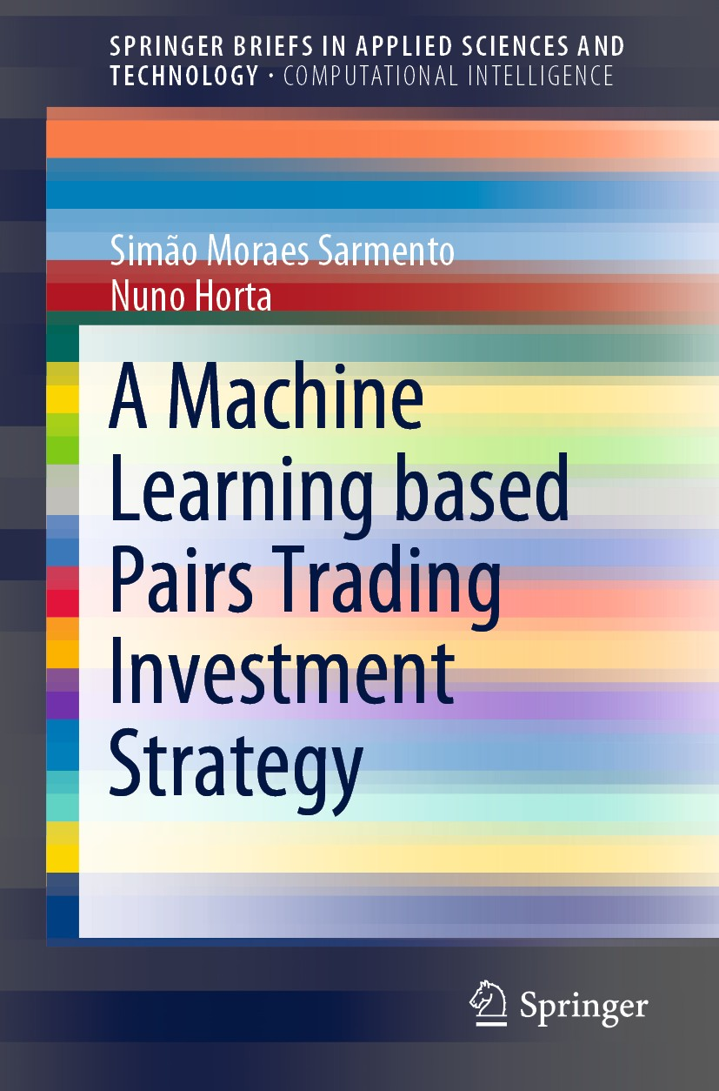
Motivation
Machine learning for pairs trading
Assets Price & Return
High dimensional
Non-linear
Can Unsupervised Learning find more promising pairs?
Purpose:
finding the appropriate candidate pairs
selecting the most promising ones.
Compare with traditional method
OPTICS
Correlation
Sarmento, Simão Moraes, and Nuno Horta. A machine learning based pairs trading investment strategy. Springer, 2020.

Slide 4
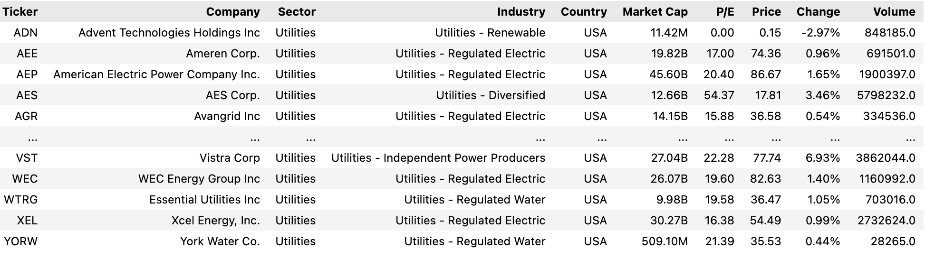
Data
Data: Yahoo finance API (yahooquery)
US market: 9502 asset
Stock: 6010 (exclude ETF)
Sector Utilities: 82 stocks
Pairs: (82*81)/2 = 3321
Daily data
Train period 2023/03 - 2023/12
Test period 2023/01-2023/04

Slide 5
Trading Execution Threshold-Based Trading Model
Calculate the spread’s (St = Yt − Xt ) mean μ, and standard deviation σ during the pair’s formation period.
Define the model thresholds: the threshold that triggers a long position L ,the threshold that triggers a short position S, and the exit threshold exit that defines the level at which a position should be exited.
Monitor the evolution of the spread, St and control if any threshold is crossed.
In case L is crossed, go long the spread by buying Y and selling X .If S is triggered, short the spread by selling Y and buying X . Exit position when exit is triggered and a position was being held.

Slide 6
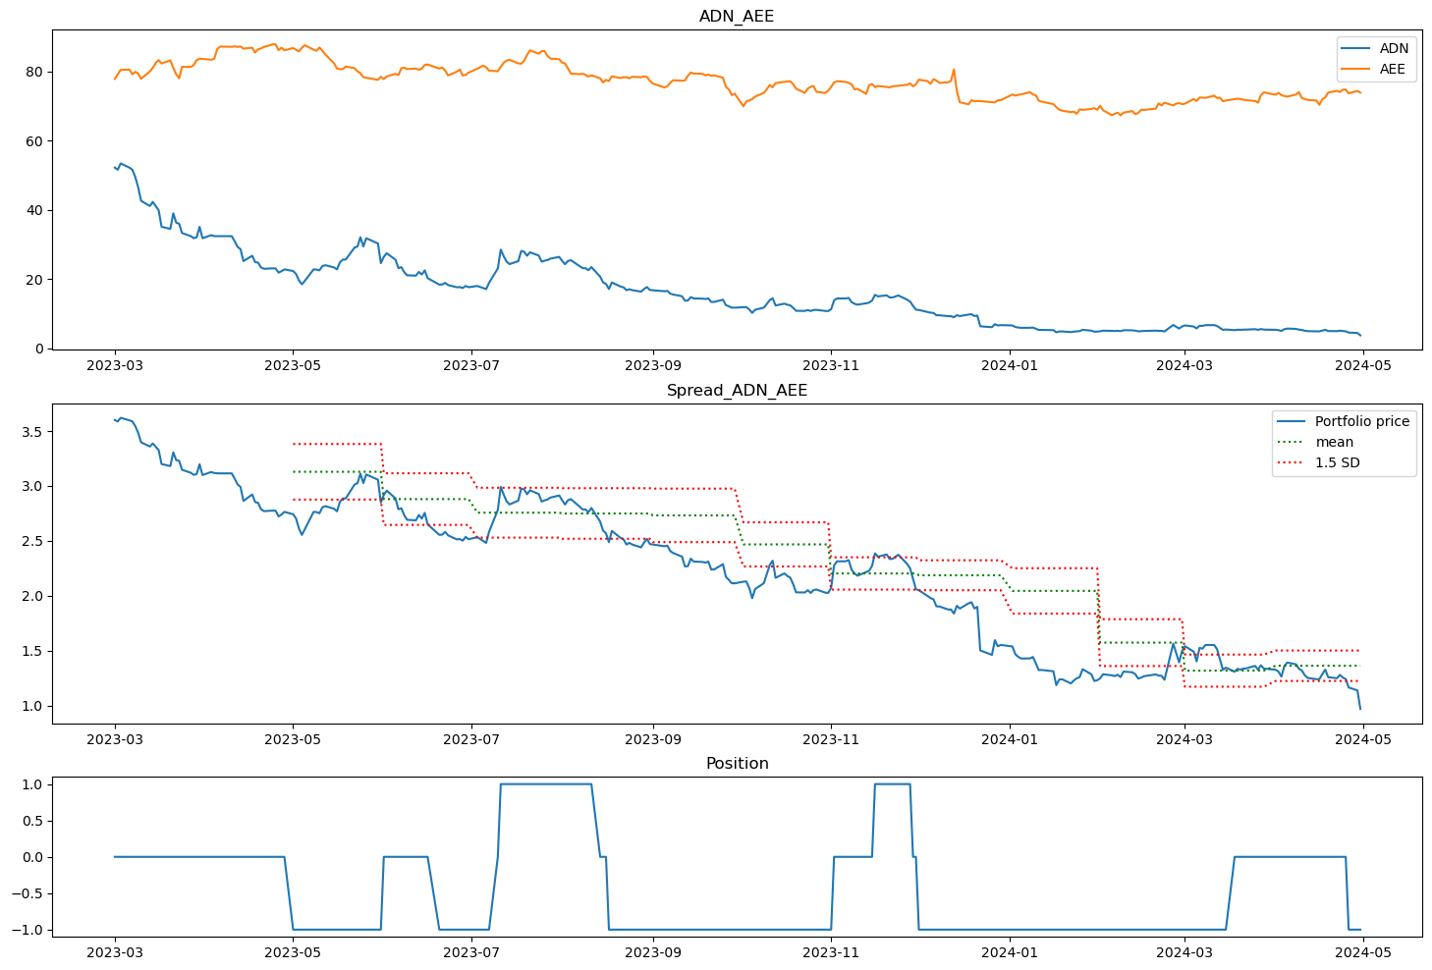
Pairs

Slide 7
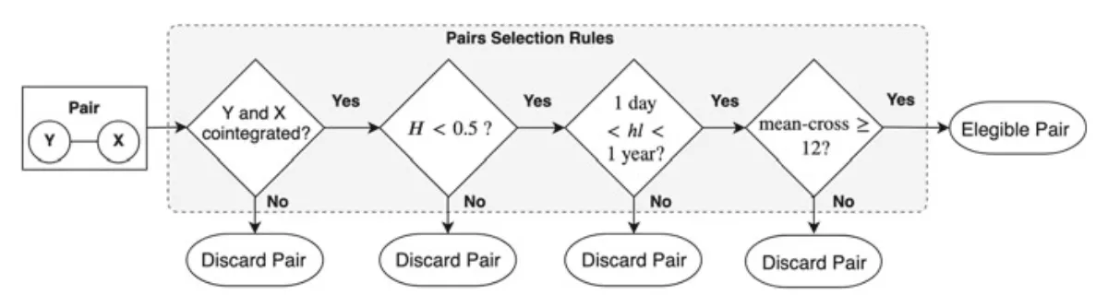
Cointegration
Mean-Reversion and Stationarity
Mean-reversion is the tendency of a time series to return to its historical average over time.
Stationarity implies that the statistical properties of a time series, such as mean and variance, do not change over time.
Cointegration Test p-value < 0.05: Ensures a stable long-term relationship between the pair.
Hurst Exponent < 0.5: Confirms mean-reverting behavior.
1 < Half-Life < 365: Validates that the mean reversion occurs at a reasonable pace.
Mean-Cross >=12: Ensures sufficient trading opportunities through frequent mean reversion.
Sarmento, Simão Moraes, and Nuno Horta. A machine learning based pairs trading investment strategy. Springer, 2020.

Slide 8
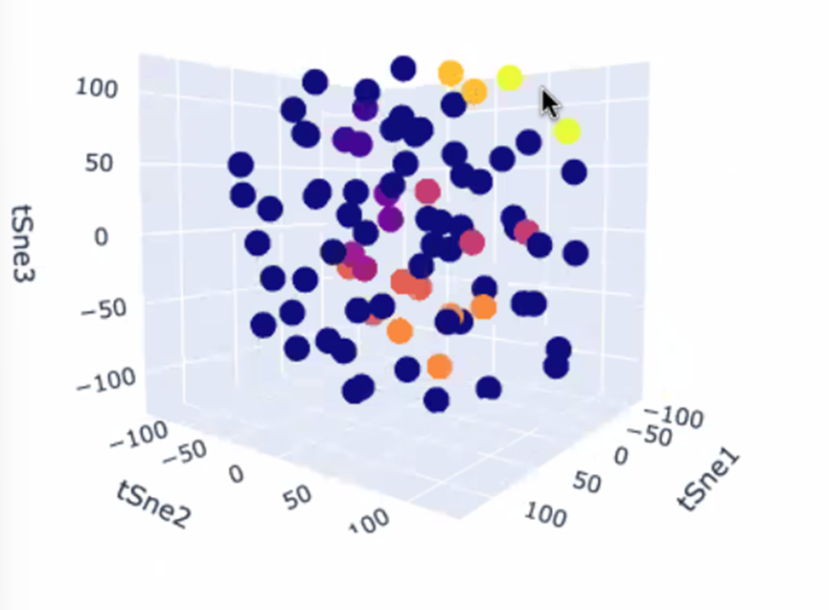
Machine Learning
Identification of two securities, for example two stocks, for which the corresponding prices series display a similar behaviour, or simply seem to be linked to each other.
Normalization & Dimensionality reduction
We imported,adjusted, standardized these data and find a compact representation for each security
T-SNE:Non-linear method.
Unsupervised Learning—apply an appropriate clustering algorithm;
OPTICS：A density-based algorith
Handles Varying Densities
Effectively with Noise
Flexible Clustering
Select pairs—define a set of rules to select pairs for trading.
Combined with Cointegration, we finally came up with 4 pairs that can meet all our requirements.

Slide 9
Result & Beaktest
1. Correlation
Pair | correlation | pvalue | hurst_exponent | half_life | crossovers | Return | Std Dev | Max Drawdown | Sharpe Ratio | Omega
AGR_ES | 0.977222 | 0.014088 | 0.371316 | 6.513701 | 26 | -0.199022 | 0.084834 | -0.075814 | -2.346009 | 1.316523
BKH_POR | 0.975519 | 0.03509 | 0.230085 | 36.62348 | 33 | -0.047788 | 0.049497 | -0.023879 | -0.965465 | 1.186399
ES_WTRG | 0.974181 | 0.021631 | 0.412536 | 38.71063 | 26 | -0.136136 | 0.087945 | -0.090848 | -1.547979 | 1.34521
CPK_ORA | 0.973617 | 0.001601 | 0.14878 | 7.060058 | 46 | 0.155662 | 0.101842 | -0.026966 | 1.52847 | 1.443658
2. OPTICS
Pair | OPTICS | pvalue | hurst_exponent | half_life | crossovers | Return | Std Dev | Max Drawdown | Sharpe Ratio | Omega
AMPS_SWX | 74.49906 | 0.001184 | 0.390763 | 319.1302 | 24 | 2.384911 | 0.286012 | -0.049647 | 8.338499 | 2.583018
AES_D | 44.41755 | 0.010932 | 0.361442 | 265.1005 | 26 | -0.049624 | 0.154581 | -0.105985 | -0.321022 | 1.627348
ARTNA_NWN | 49.96095 | 0.004631 | 0.349361 | 49.28517 | 34 | 0.093354 | 0.135373 | -0.047971 | 0.689605 | 1.455371
NWN_UGI | 58.28693 | 0.040827 | 0.326623 | 172.0943 | 18 | -0.192875 | 0.103003 | -0.068142 | -1.872517 | 1.339657

Slide 10
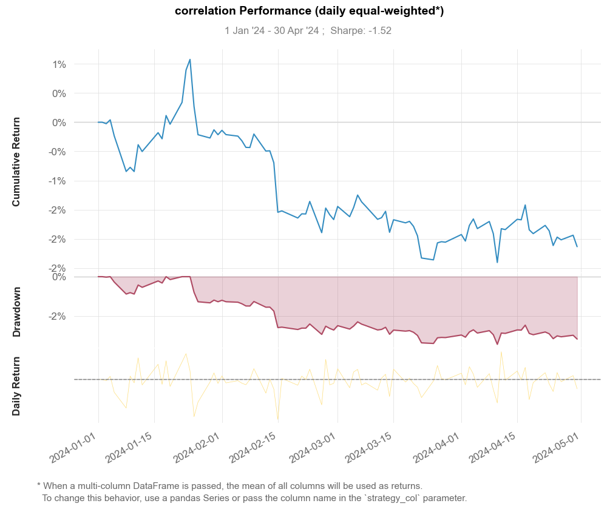
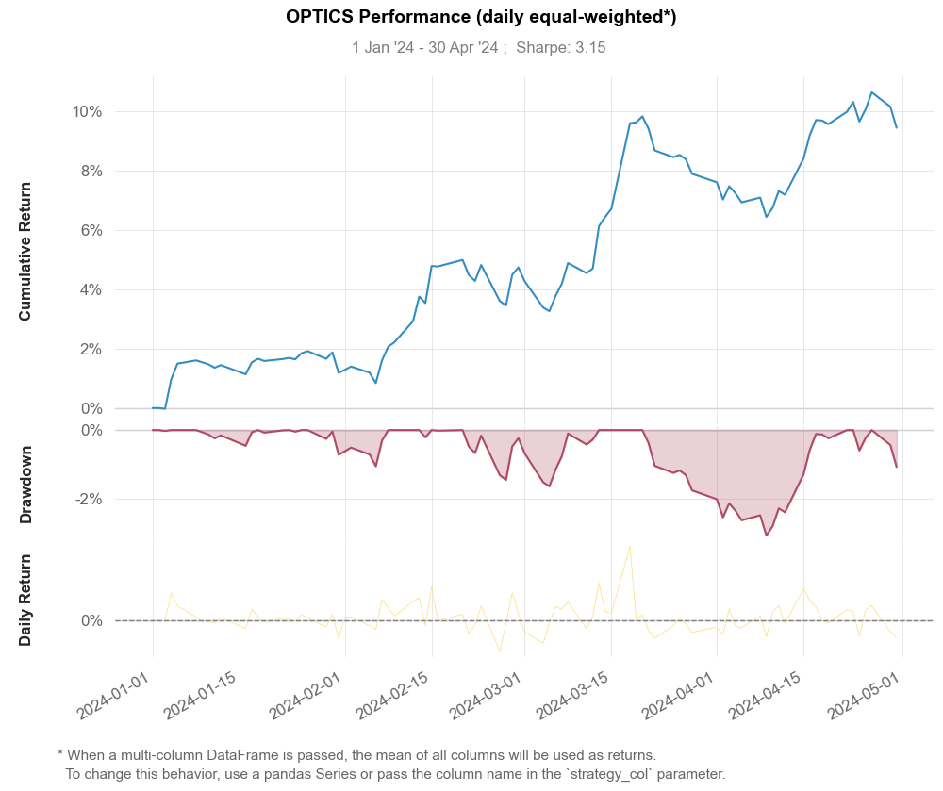
Result & Performance

Slide 11
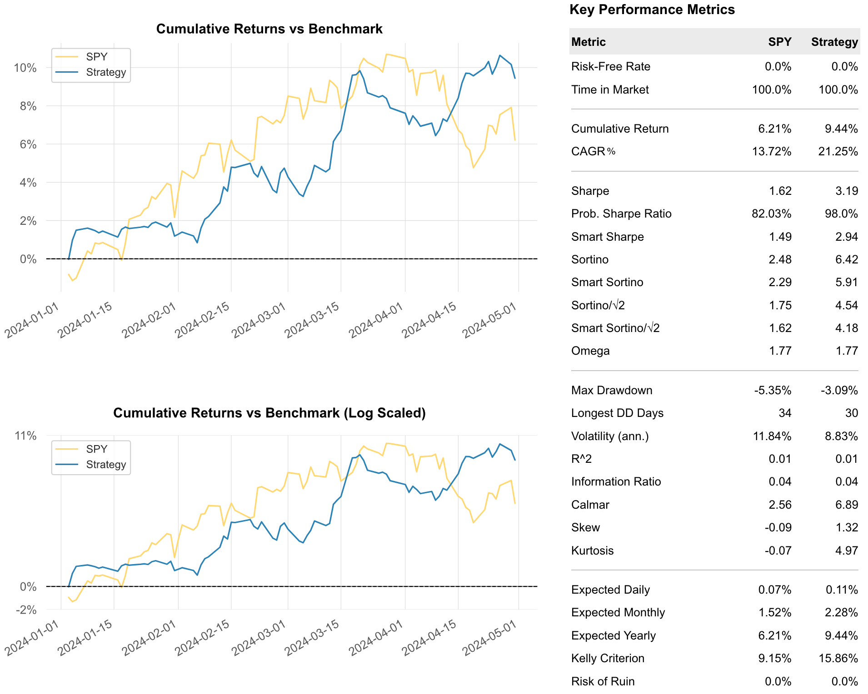
Result & Performance

Slide 12
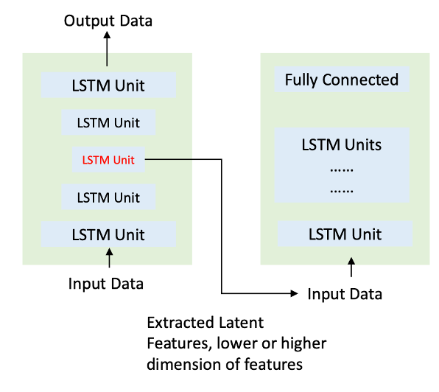
Future development
Refining Entry Points
Threshold-Based Trading Model: One limitation is the lack of precision in defining entry points.
Deep Learning Model: Implementing Autoencoder LSTM for Time Series Forecasting could achieve more robust performance.
Sentiment and Event Analysis
News Impact: Analyzing how news events cause price jumps.
Pair Selection: Selecting pairs based on mean-reversion speed and jump behavior to enhance performance.
Empirical Research
Sector and Asset Variability: Conducting research across different sectors and asset classes.
Frequency Analysis: Investigating from different frequencies, including microstructure market data
Sarmento, Simão Moraes, and Nuno Horta. A machine learning based pairs trading investment strategy. Springer, 2020.
Gu, Shihao, Bryan Kelly, and Dacheng Xiu. "Autoencoder asset pricing models." Journal of Econometrics 222, no. 1 (2021): 429-450.
Stübinger, Johannes, and Sylvia Endres. "Pairs trading with a mean-reverting jump–diffusion model on high-frequency data." Quantitative Finance 18, no. 10 (2018): 1735-1751.

Slide 13
Thanks!
Q&A

