Slide 1
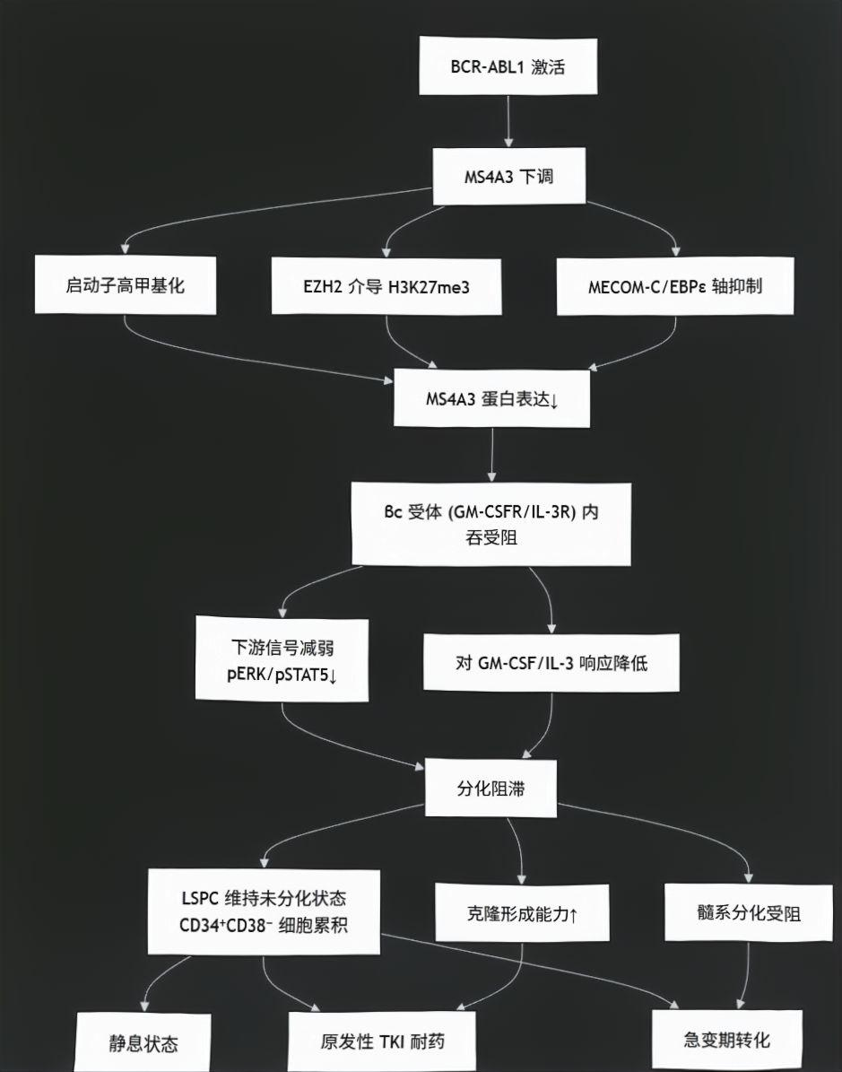
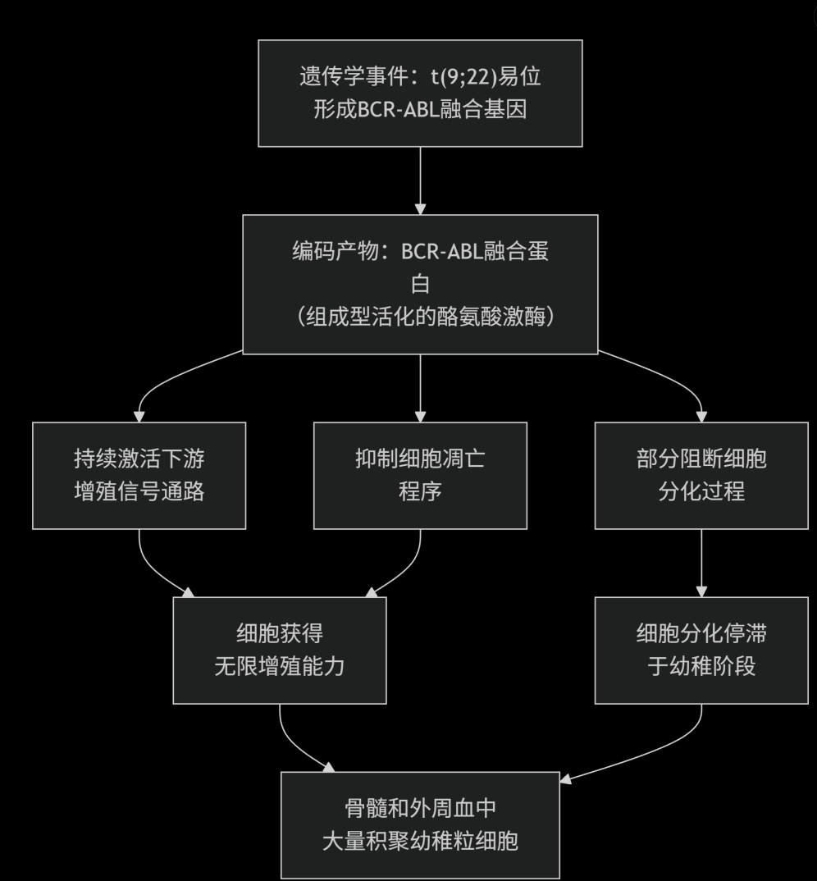
CML产生幼稚WBC的机制是什么？ 李宗垚
MS4A3 在 CML CD34⁺ 细胞中显著降低，尤其是在急变期和 TKI 耐药患者中，且低表达与患者总生存期缩短相关。MS4A3 通过促进 βc 受体内吞与信号传导，驱动 CML 细胞髓系分化，维持对 TKI 的敏感性。
Citation
Helong Zhao, Anthony D. Pomicter, Anna M. Eiring, Anca Franzini, Jonathan Ahmann, Jae-Yeon Hwang, Anna Senina, Bret Helton, Siddharth Iyer, Dongqing Yan, Jamshid S. Khorashad, Matthew S. Zabriskie, Anupriya Agarwal, Hannah M. Redwine, Amber D. Bowler, Phillip M. Clair, Shannon K. McWeeney, Brian J. Druker, Jeffrey W. Tyner, Derek L. Stirewalt, Vivian G. Oehler, Sooryanarayana Varambally, Kristofer C. Berrett, Jeffery M. Vahrenkamp, Jason Gertz, Katherine E. Varley, Jerald P. Radich, Michael W. Deininger; MS4A3 promotes differentiation in chronic myeloid leukemia by enhancing common β-chain cytokine receptor endocytosis. Blood 2022; 139 (5): 761–778. doi: https://doi.org/10.1182/blood.2021011802

