Slide 1
MA4705 Aircraft Navigation & Flight Computers
6 Continual Assessment
Ed Ang
School of Mechanical and Aerospace Engineering
Nanyang Technological University

Slide 2
Overview
CA structure
FIR filter
FFT filter
Introduction to Python & Kaggle

Slide 3
CA1 Structure
CA1 involves a group project involving a python programming project – application of DSP theoretical concepts.
20% of the entire course.
Conducted in groups of two, group name 'DSP X'.
One week to complete the project - Deadline of submission is 21 September 1159.
There will be 2 questions – Q1 and Q2 (contained in a zipped folders). For Group X where X is an odd number, please complete Q1. If X is even, please complete Q2.

Slide 4
CA1 Structure
Each zipped folder will consist of a uncompleted python notebook (.ipynb file extension) and some data.
The deliverable is the completed python notebook, which each team should email to sushin.ang@ntu.edu.sg using the template.
The Kaggle environment is recommended as a means of completing the project.
The same marks will be given to each member of the team.

Slide 5
CA1 Structure – Email template
Please copy in all of your team members.
Subject: MA4705 CA1 (DSP <X>)
Attachment: <Your project notebook>
Hello,
We belong to DSP <X>, and we attach our completed CA project deliverable.

Slide 6
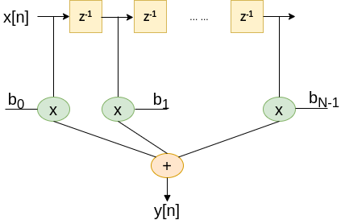
FIR filter implementation
y[n] = b₀x[n] + b₁x[n-1] + … + b_{N-1}x[n-(N-1)]

Slide 7
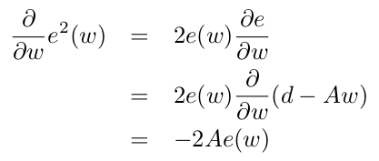

Least Mean Square Minimisation
As an alternative, we reframe cost function as random variables rather than vectors. Recall that A refers to the noise input.
Using gradient descent, we obtain the filter coefficient update equation. This is also known as Least Mean Square (LMS) minimisation.
The learning rate 'u' here refers to the step size that is taken during each update, which occurs for every new sample that is input to the filter.

Slide 8
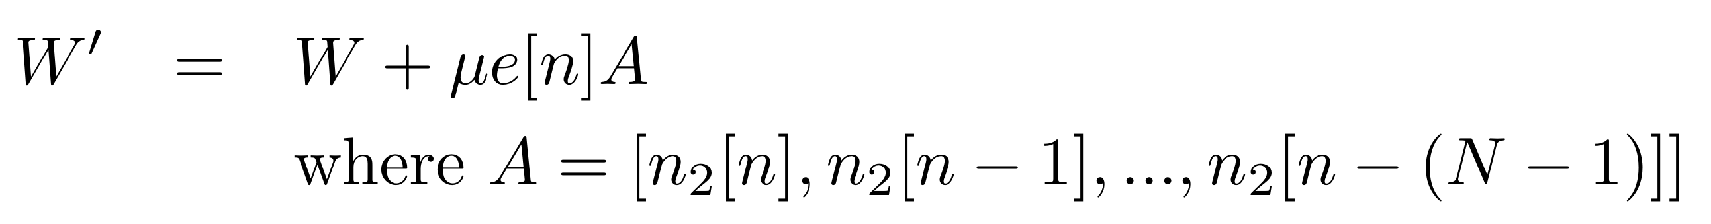
Weight Update equation
Updating a single FIR filter coefficient.
How do we update of the filter coefficients W'?

Slide 9
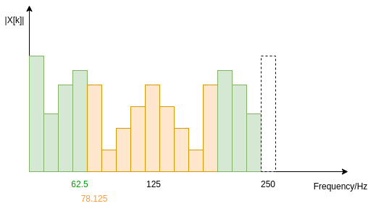
FFT Filter
Low pass filter a signal x[n], removing high frequency components above 60 Hz.

