Slide 1
76540 hospitalization with ICU stay records in database
(8822 death, 67718 censored)
200859 hospitalization with ICU stay records in database
(10941 death, 189918 censored)
7361 excluded:
7329 duplicated records;
32 records without first diagnosis
Exclude 62164 records without ‘Primary’ diagnosis in database
69179 records remained
(7354 death, 61825 censored)
138695 records remained
(8028 death, 130667 censored)
10 top-ranked death causes (recorded as the first diagnosis, exclude fractured or injured)
Diagnosis in 10 top-ranked disease combination pairs (for each pair, at least one is from 10 top-ranked death causes)
10 top-ranked death causes (recorded as the first diagnosis)
Diagnosis in 10 top-ranked disease combination pairs (for each pair, at least one is from 10 top-ranked death causes)
20349 records with the 10 top-ranked death causes remained (3761 death, 16588 censored)
13517 records of combination pairs with first diagnosis in 10 top-ranked disease (2524 death, 10993 censored)
53161 records with the 10 top-ranked death causes remained (5250 death, 47911 censored)
31836 records with first diagnosis in 10 top-ranked disease combination pairs (4163 death, 27673 censored)
18048 excluded:
12793 duplicated records
5255 records with only one diagnosis of interest
59490 excluded:
29924 duplicated records
29566 records with only one diagnosis of interest
15818 records with at least two competing risks remained in the study
(3418 death, 12400 censored)
25507 records with at least two competing risks remained in the study
(3561 death, 21946 censored)
Exclude 6461 records with more than 40 missing features
9776 excluded:
1228 records with no time to event
8548 records with more than 28 missing features
9357 records remained in the study
(2528 death, 6836 censored)
15731 records remained in the study
(2,487 death, 13244 censored)
(A)
(B)
5530535 records in the SEER Research Data (1975-2018)
( 3538006 death, 1992529 censored)
209819 records with three competing risk remained
(34439 death, 175380 censored)
122815 records remained in the study
(18788 death, 104027 censored)
Filter:
1. Patients with breast cancer
2. Year of diagnosis: 2004-2015
3. COD (cause of death): Breast cancer, cardiovascular disease, Cerebrovascular Diseases and censored
4. Ages between 20 and 85
5. Survival months is not unknown
6.Diagnostic confirmation: positive histology (Make sure the diagnosis is correct)
7. survival month flag is complete.
8. Type of reporting source: exclude sources from autopsy and death certificate.
9. Type of follow-up is active to make sure follow-up effective
Exclude:
55588 Survival months = 0 or survival months > 120.
660 with unknown race
104 with unknown household income
8288 with unknown grade
5924 with cs tumor size > 150
494 with unknown cs tumor extension
889 with unknown cs lymph nodes
2 with unknown summary stage
1100 with unknown derived AJCC Stage Group
2639 with unspecific (>89) Regional nodes examined
11698 with unspecific (>89) Regional nodes positive
(C)

Slide 2


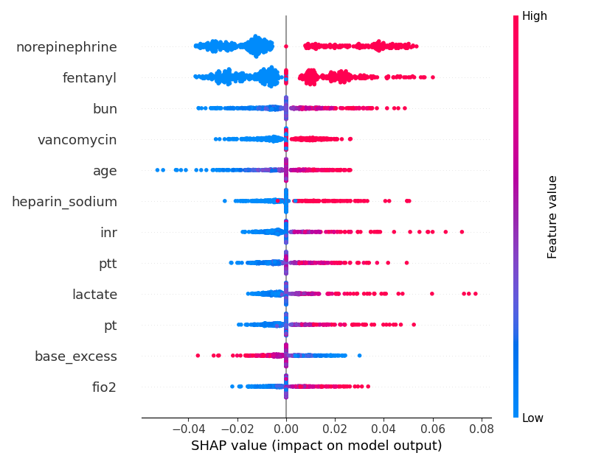
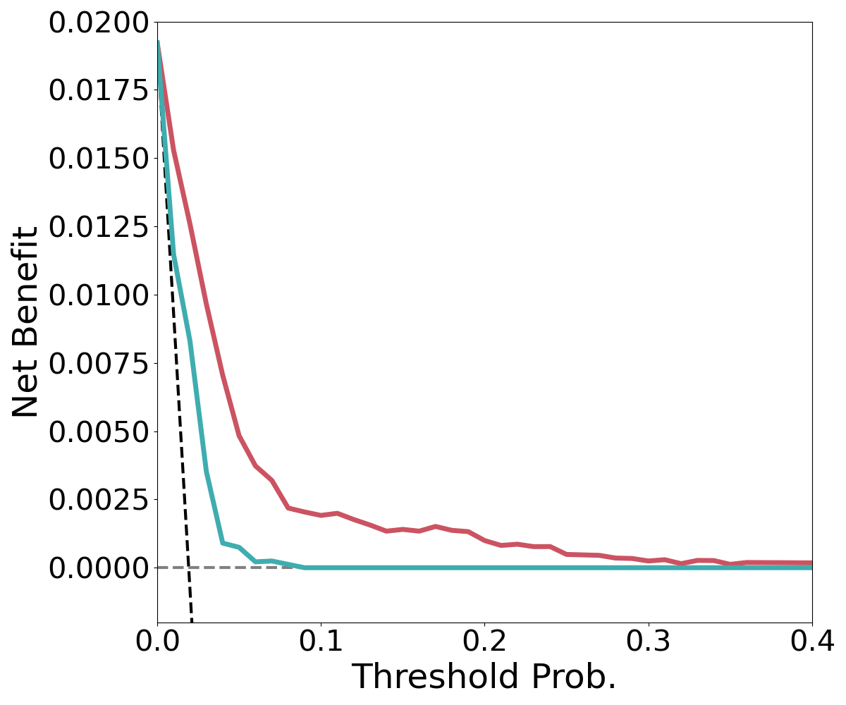
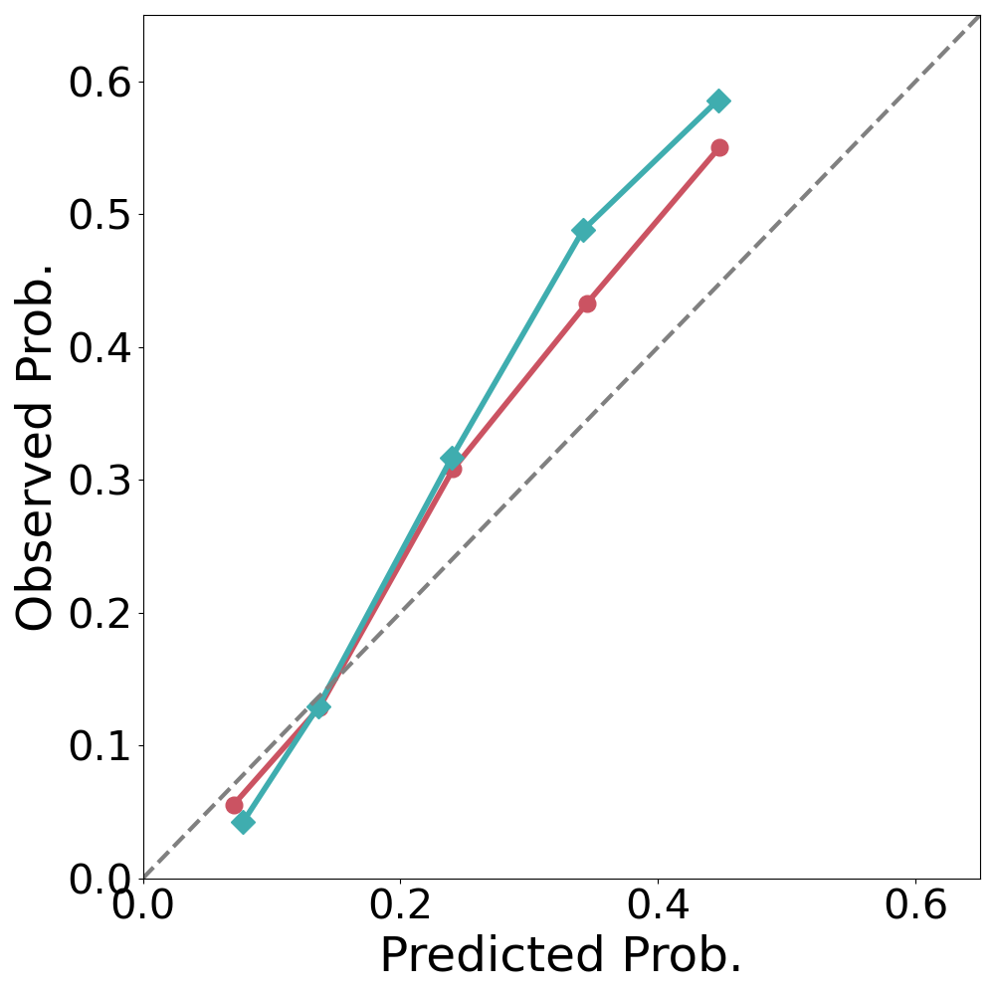
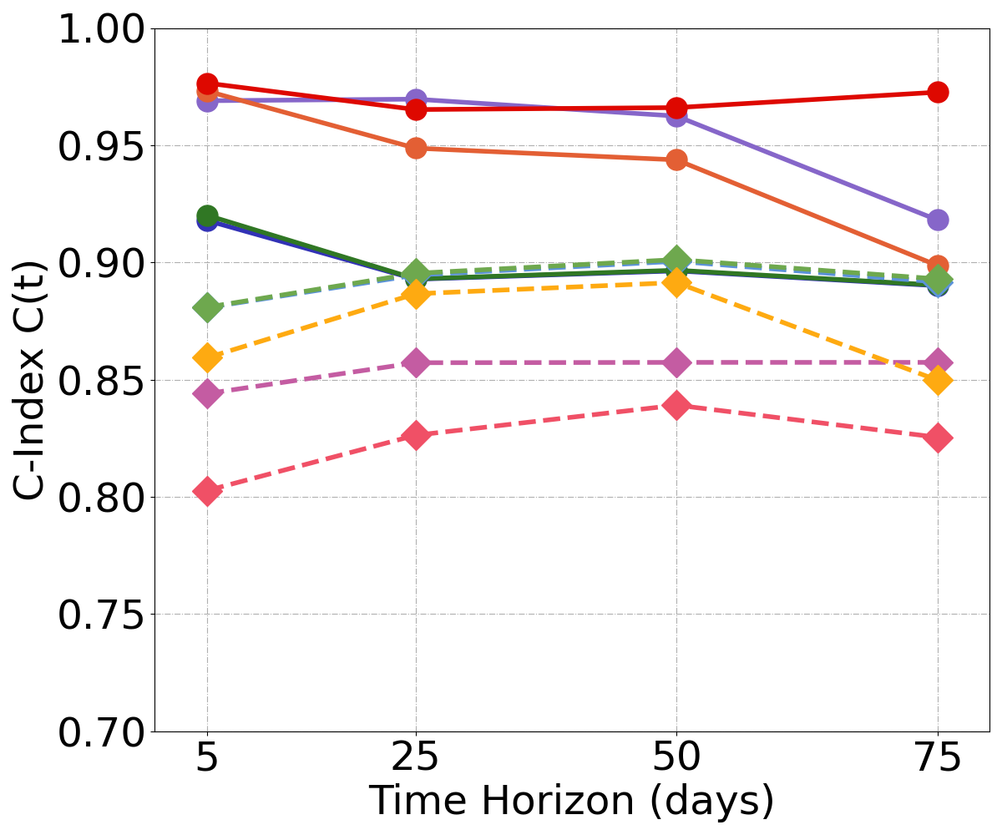
SCM
R
R
X
X
Y
T
X
Y
T
Backdoor Adjustment
(A)
(B)
Patient cohort
9357 patients with 11 competing risks, 2526 death
Fine-Gray
MIMIC-IV
cs-Cox
Stratified Shuffled 5-Fold cross validation
Patient cohort
15731 patients with 11 competing risks, 2487 death
Semi-Parametric Models
eICU-CRD
DSM
DeepHit
Training Fold
Validation Fold
Patient cohort
122815 patients with 3 competing risks, 18788 death
Dynamic-DeepHit
Full Parametric Models
SEER
SHAP Value
Decision Curve Analysis
Net Reclassification Index
Calibration
C-Index
Evaluation

