Slide 1
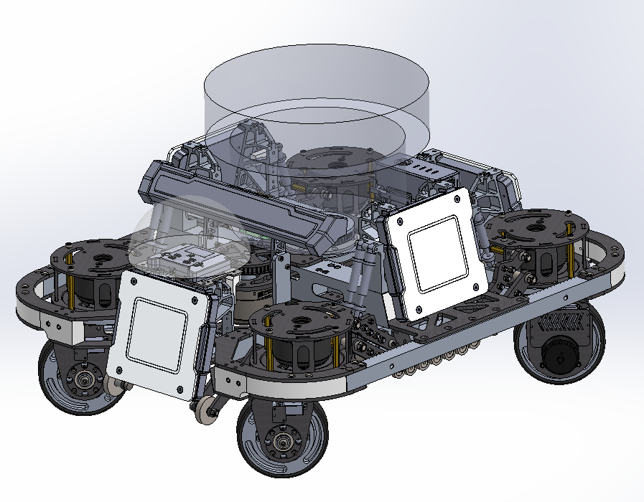
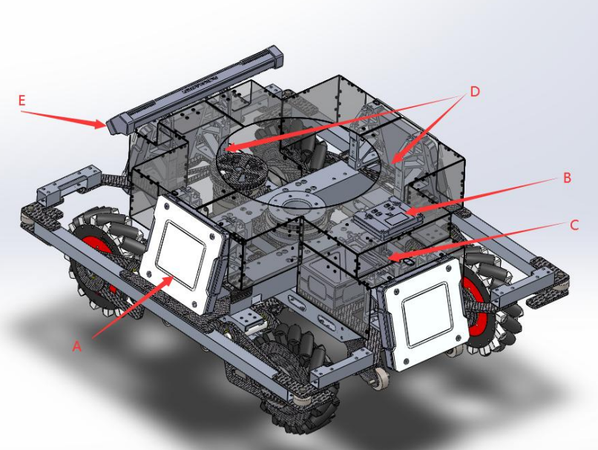






$$z_{o}$$
z
$$x_{m_{0}}$$
$$y_{o}$$
$$x_{o}$$
y
$$y_{m_{0}}$$
x
$$z_{m_{0}}$$

Slide 2
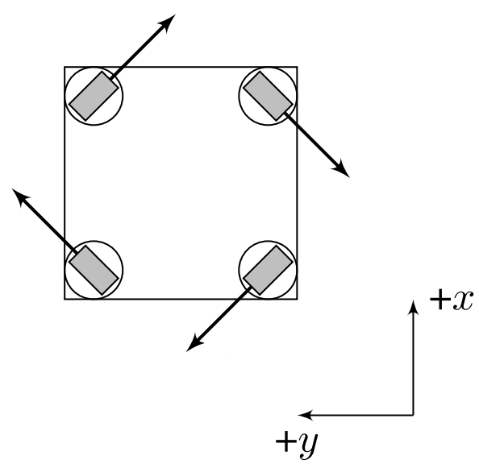














$$v_{1}$$
$$v_{1}$$
$$d_{4}$$
$$d_{1}$$
$$v_{4}$$
$$v_{4}$$
$$r_{1}$$
l
$$r_{1}$$
$$d_{2}$$
$$v_{2}$$
$$v_{2}$$
$$d_{3}$$
$$v_{3}$$
$$v_{3}$$
w

Slide 3
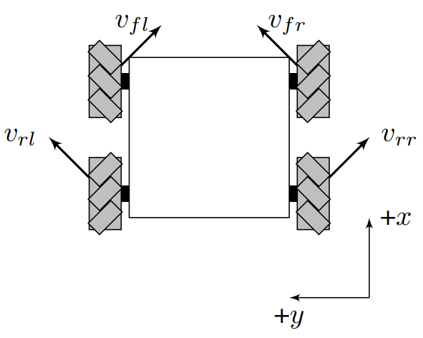
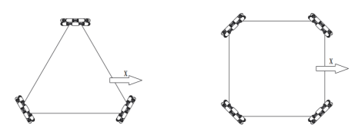



















$$v_{s1}$$
$$v_{1}$$
$$v_{4}$$
$$v_{1}$$
$$v_{4}$$
$$r_{1}$$
$$v_{s1}$$
$$v_{s4}$$
l
$$v_{2}$$
$$v_{3}$$
$$r_{1}$$
l
$$v_{s2}$$
$$v_{2}$$
$$v_{3}$$
$$v_{s3}$$
w
$$v_{3}$$
$$v_{1}$$
$$r$$
w
$$v_{2}$$

Slide 4
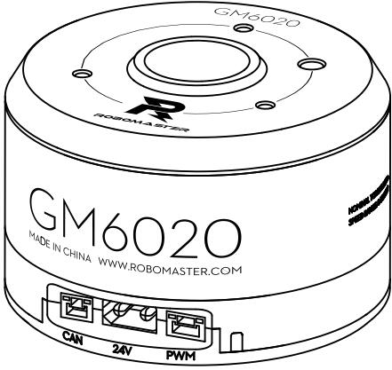
z
direction
✔
✔
y
x
angle = 0

