Slide 1
python interpreter implemented in javascript
组员：蒋铠嵘 何淂劲 尹艳玲 胡笛

Slide 2
语法树生成
遍历执行语法树
符号表和类型检查

Slide 3
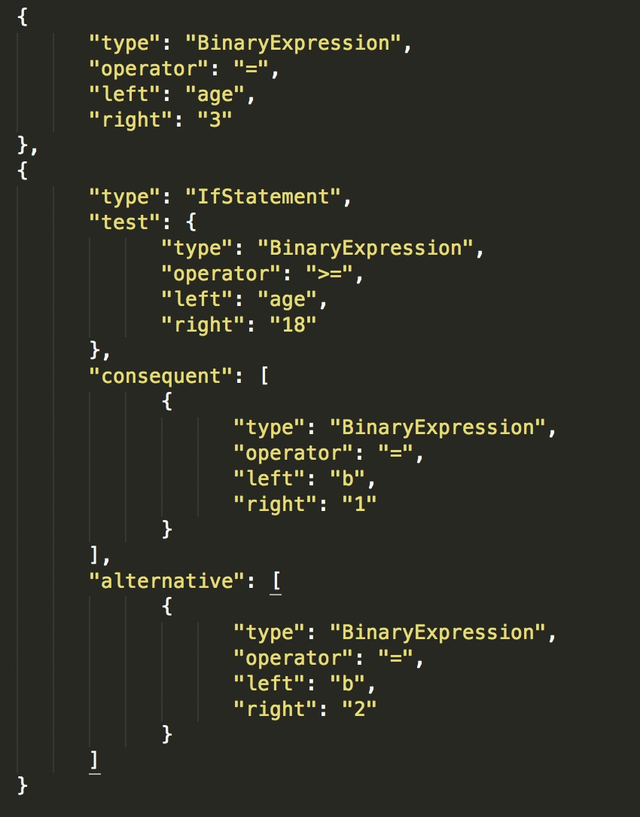
语法树生成
age = 3
if age >= 18:
b=1
else:
b=2

Slide 4
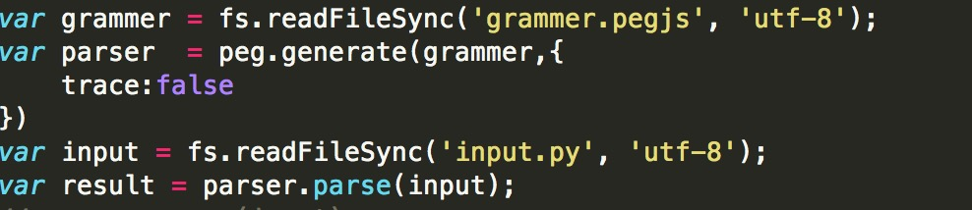
语法树生成
使用了pegjs开源库辅助完成词法分析任务: Github/pegjs
PEG.js is a simple parser generator for JavaScript that produces fast parsers with excellent error reporting.

Slide 5
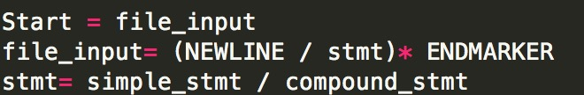
语法树生成
age = 3
if age >= 18:
b=1
else:
b=2

Slide 6
语法树生成
if age >= 18:
b=1
else:
b=2

Slide 7
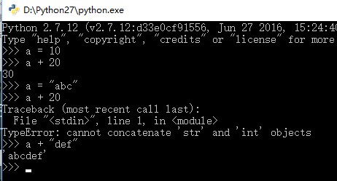
符号表和类型检查
一些Python特性：
动态类型检查
Object

Slide 8
符号表和类型检查
一些Python特性：
Scoping Rule: LEGB Rule.
L, Local — Names assigned in any way within a function (def or lambda)), and not declared global in that function.
E, Enclosing-function locals — Name in the local scope of any and all statically enclosing functions (def or lambda), from inner to outer.
G, Global (module) — Names assigned at the top-level of a module file, or by executing a global statement in a def within the file.
B, Built-in (Python) — Names preassigned in the built-in names module : open, range, SyntaxError, ... Object

Slide 9
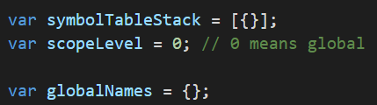
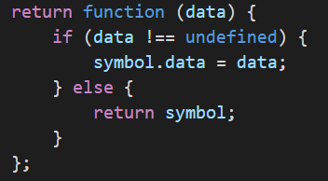
符号表和类型检查
符号表数据结构：

Slide 10
遍历执行语法树
switch case

