Slide 1

Task 1
Web scraping to gain company insights

Slide 2
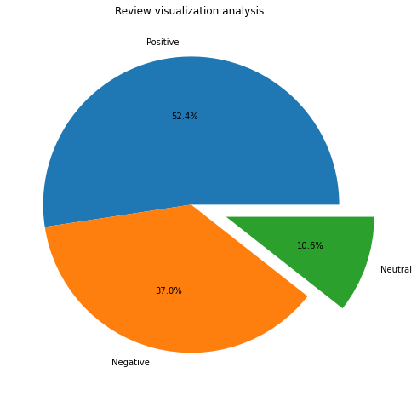
Based on rule-based sentimental analysis from 1000 reviews from customers , our conclusions of reviews are:
Positive reviews: 524
Negative reviews: 370
Neutral reviews: 106

Slide 3
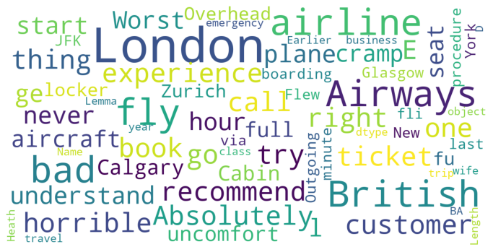
WordCloud

