Slide 1

Task 2
Predicting customer buying behaviour

Slide 2
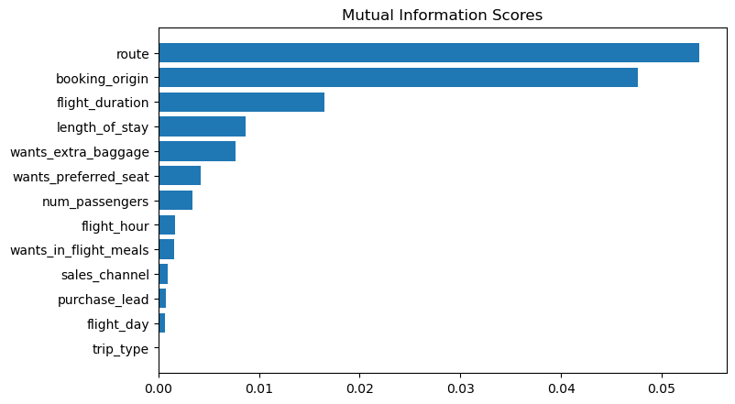
Based on mutual information scores, we found that route and booking_origin are the top 2 features that have affect on customer buying behaviors.

Slide 3
We trained the dataset with Random forest classifier with top 5 and all features, XGB classifier with top 5 and all features. The results are：
 | Random forest with top 5 features | Random forest with all features | XGB classifier with top 5 features | XGB classifier with all features
Accuracy | 83.26 | 84.84 | 84.69 | 84.87
AUC score | 0.5554 | 0.5527 | 0.5214 | 0.5358

