Slide 1
Chapter 4
The Medium Access Control (MAC) Sublayer
介质访问控制子层
The MAC Sublayer

Slide 2
The Data Link Layer
LOGICAL LINK CONTROL sublayer
OSI
Application
Framing (Bit Stuffing)
Error control (CRC)
Flow control
  Stop and Wait
  Sliding Window
  Go Back n
  Selective Repeat
Presentation
Session
Transport
Network
Data Link
Physical
MEDIA ACCESS CONTROL sublayer
Shared channel
competition/access
The MAC Sublayer

Slide 3
Network topology
网络拓扑结构
Network topology is the study of the arrangement or mapping of the elements of a network, such as links, nodes, etc.;
Network topology involves the physical (real) and logical (virtual) interconnections between nodes;
The MAC Sublayer

Slide 4
Network topology
Physical Topology物理拓扑结构 can be described by the way the computers are physically connected to the network.
Logical Topology逻辑拓扑结构 defines how the data flow through the network.
The MAC Sublayer

Slide 5

LAN topology: Bus总线网
  A physical bus topology connects all networked devices to a single continuous cable. Data may pass directly from one station to another.
  In a logical bus topology all network communications are broadcast to the entire network.
A
B
C
Bus
The MAC Sublayer

Slide 6

LAN topology: Star星形网
  All stations are connected by cable (or wireless) to a central point, such as hub集线器 or a switch交换机
A
A
B
C
Star
The MAC Sublayer

Slide 7
LAN topology: Star星形网
  If the central node is operating in a broadcast fashion such as a Hub, transmission of a frame from one station to the node is retransmitted on all of the outgoing links. In this case, although the arrangement is physically a star, it is logically a bus.
A
A
B
C
Star
The MAC Sublayer

Slide 8
LAN topology: Star星形网
  In the case of the central node acting as switch, an incoming frame is processed in the node and then retransmitted on an outgoing link to the destination station.
A
A
B
C
Star
The MAC Sublayer

Slide 9
LAN topology: Ring环形网
  A physical ring topology is one in which all branches of the network are connected to a loop. In a logical ring, data flow from one node to the next in an ordered sequence. When the data reach the last node, they are returned to the originating node.
D
A
Ring
T
C
B
The MAC Sublayer

Slide 10
The MAC Sublayer
Broadcast channels: a number of stations that share the same “wire”. If one station sends, all the others get to hear it.
The MAC Sublayer

Slide 11
The MAC Sublayer
Problem: if you’re sharing a channel, then two or more stations may decide to start frame transmission at the same time, it will lead to frame collision(碰撞、冲突), which means rubbish on the wire.
The MAC Sublayer

Slide 12
The MAC Sublayer
Medium Access Control: allocates the broadcast channel to one of the competing stations分配广播信道给参与竞争的站点之一。
The MAC Sublayer

Slide 13
Broadcast Networks
广播式网络
Single communication channel that is shared by all the machines on the network
computer
1
2
3
4
5
cable
General Rule:
Smaller, geographically localized networks
The MAC Sublayer

Slide 14
Broadcast Networks
广播式网络
Single communication channel that is shared by all the machines on the network
computer
1
2
3
4
5
cable
Frames sent by any machine are received by all others
The MAC Sublayer

Slide 15
Broadcast Networks
广播式网络
Any machine sends frames based on CSMA；
ALL machines receive it, but only one processes it
A
B
C
A
B
C
终端电阻
C 发现网络空闲
A
C 发送帧，目的地址为A
A
B
C
A
B
C
A
A
B 忽略该帧
A 接收该帧
信号由终端电阻吸收
The MAC Sublayer

Slide 16




Broadcast Networks
The MAC Sublayer

Slide 17
Broadcast Networks
广播式网络
Also possible to address a frame to ALL machines (special code in the address field) --- Broadcasting广播
Also possible to address a frame to a SUBSET of machines (group number code in the address field) ---Multicasting组播
The MAC Sublayer

Slide 18
Chapter 4
The Medium Access Control Sublayer(contd.)
介质访问控制子层
The MAC Sublayer

Slide 19
The Medium Access Sublayer (ch 4)
deals with
BROADCAST NETWORKS AND THEIR PROTOCOLS

Slide 20
The Medium Access Sublayer (ch 4)
THE CHANNEL ALLOCATION PROBLEM 信道分配问题
MULTIPLE ACCESS PROTOCOLS多路存取访问协议
IEEE 802 STANDARD FOR LANs
VLANs虚拟局域网
Wireless LAN 无线局域网

Slide 21

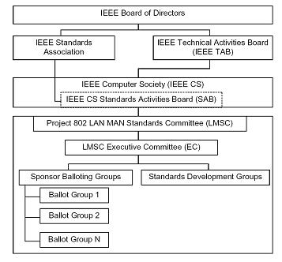
Institute of Electrical and Electronics Engineers
IEEE 802又称为LMSC (LAN/ MAN Standards Committee局域网/城域网标准委员会)，致力于研究局域网和城域网的物理层和MAC层规范，对应OSI参考模型的第1层和第2层。
LMSC执行委员会：
  工作组(Working Group)
  研究组(Study Group)
  技术顾问组(Technical Advisory Group)。
IEEE802的从属关系
The MAC Sublayer

Slide 22
Institute of Electrical and Electronics Engineers
802.1 ：高层局域网协议Higher Layer LAN Protocols
802.2 ：逻辑链路控制Logical Link Control
802.3 ：以太网Ethernet
802.4 ：令牌总线Token Bus
802.5 ：令牌环Token Ring
802.11：无线局域网Wireless LAN
802.15：无线个域网 Wireless Personal Area Network
802.16：宽带无线接入 Broadband Wireless Access
The MAC Sublayer

Slide 23
Institute of Electrical and Electronics Engineers
802.17：弹性分组环 Resilient Packet Ring
802.18：无线管制 Radio Regulatory TAG
802.19：共存 Coexistence TAG
802.20：移动宽带无线接入 Mobile Broadband Wireless Access (MBWA)
802.21：介质无关切换 Media Independent Handoff
The MAC Sublayer

Slide 24
The Channel Allocation Problem
Static Allocation静态分配
Example:
FDM频分多路复用
4 users
frequency
time
TDM时分多路复用
frequency
time
The MAC Sublayer

Slide 25
The Channel Allocation Problem
Static Allocation静态分配
  FDM /TDM (Frequency/Time Division Multiplexing)
    FDM : Radio/TV broadcasts
    TDM : POTS (Plain Old Telephone System)
The MAC Sublayer

Slide 26
The Channel Allocation Problem
FDM/TDM with each user allocated equal-sized frequency/ time portion is simple and efficient only when
  the number of users is small
  the number of users is constant,
  each user has a heavy traffic.

Slide 27
The Channel Allocation Problem
It is inefficient
  if the number of user is variable
  or when the traffic is bursty.
In this case, the performance will be very poor!

Slide 28
The Channel Allocation Problem
If the spectrum频谱 is cut up into N regions and fewer than N users are currently interested in communicating, a large piece of valuable spectrum will be wasted (Wasteful of bandwidth)

Slide 29
The Channel Allocation Problem
If more than N users want to communicate, some of them will be denied permission for lack of bandwidth, even if some of the users who have been assigned a frequency band hardly ever transmit or receive anything.

Slide 30
Multiple Access Methods
Three strategies for channel allocation
Let a station place a reservation for the channel. Used in slotted systems. The problem is how to make a reservation.
Employ a round-robin technique: each station in turn is allowed to use the channel. Applied in token-based systems –the station that has the token令牌 may use the channel.
The MAC Sublayer

Slide 31
Multiple Access Methods
Three strategies for channel allocation
Exercise no control at all: simply let a station try to use the channel, and do something when a collision happens. Applied in contention systems.
The MAC Sublayer

Slide 32
The Channel Allocation Problem
Dynamic Allocation动态分配
  Five key assumptions
  五个关键性假设
    1. Station Model站模型
    2. Single Channel Assumption单信道假设
    3.Collision Assumption冲突假设
    4a. Continuous Time 连续时间
    4b. Slotted Time 时隙
    5a. Carrier Sense 载波侦听
    5b. No Carrier Sense 非载波侦听
The MAC Sublayer

Slide 33

The Channel Allocation Problem
1. Station Model
The model consists of N in-dependent stations, each with a program or user that generates frames for transmission.
The probability of a frame being generated in an interval of length ∆t is λ∆t, where λ is a constant (the arrival rate of new frames).
Once a frame has been generated, the station is blocked阻塞 and does nothing until the frame has been successfully transmitted.
The MAC Sublayer

Slide 34
The Channel Allocation Problem
2. Single Channel Assumption
A single channel is available for all communication.
Any station can transmit on the channel and all can receive from it.
As far as the hardware is concerned, all stations are equivalent, although protocol software may assign priorities to them.
The MAC Sublayer
尽管从协议软件的角度可以给站点分配优先级，但从硬件的角度说，所有站点是平等的。

Slide 35
The Channel Allocation Problem
3. Collision Assumption
If two frames are transmitted simultaneously, they overlap in time and the resulting signal is garbled. This event is called a collision.
All stations can detect collisions.
A collided frame must be transmitted again later.
The MAC Sublayer

Slide 36
The Channel Allocation Problem
4. Time Assumption
Continuous Time. Frame transmission can begin at any instant. There is no master clock dividing time into discrete intervals.
Slotted Time. Time is divided into discrete intervals (slots时隙). Frame transmissions always begin at the start of a slot.
The MAC Sublayer

Slide 37
The Channel Allocation Problem
5. Carrier Sense Assumption
Carrier Sense. Stations can tell if the channel is in use before trying to use it. If the channel is sensed as busy, no station will attempt to use it until it goes idle.
No Carrier Sense. Stations cannot sense the channel before trying to use it. They just go ahead and transmit盲目发送. Only later can they determine whether the transmission was successful.
The MAC Sublayer

Slide 38
Dynamic Channel Allocation Technologies
Pure ALOHA
Slotted ALOHA
CSMA (Carrier Sense Multiple Access载波侦听, 多路存取协议)
CSMA/CD (ETHERNET以太网)
Switching (Fast ETHERNET)
Token passing (Token Ring )
* ALOHA:夏威夷人问候语，欢迎。

Slide 39

Pure ALOHA
Norman Abramson at the University of Hawaii proposed a solution for the channel allocation, so called ALOHA

Slide 40
Pure ALOHA
Although Abramson’s work used ground-based radio broadcasting, the basic idea is applicable to any system in which uncoordinated users are competing for the use of a single shared channel
尽管当时Abramson的系统是用于基于地面的无线广播通信，但其基本思想适用于任何无协调关系的多用户竞争单信道使用权的系统。

Slide 41
Pure ALOHA
Basic Idea:
Anyone may transmit data whenever they want.

Slide 42
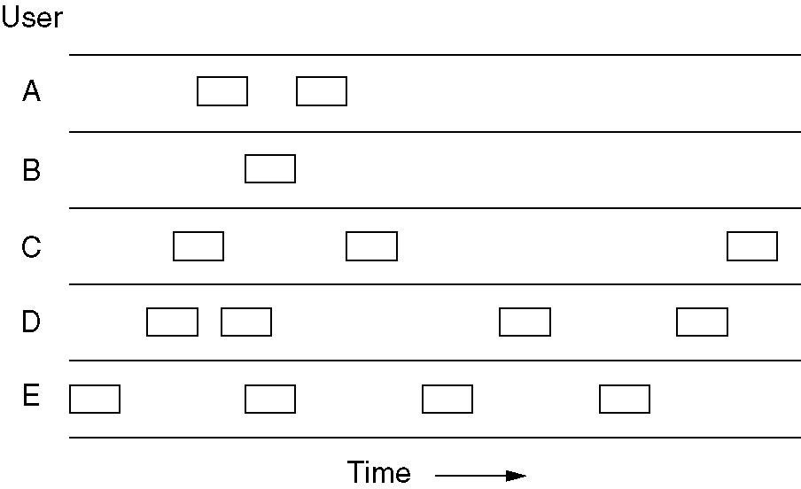
Pure ALOHA
collision
In pure ALOHA, frames are transmitted at completely arbitrary times完全任意的时间
The MAC Sublayer

Slide 43
Pure ALOHA
Basic Idea(contd.):
Each station detects collisions探测冲突 by listening to its own signal.
A collision occurs when a sender doesn't receive the signal that it just sent.
After a collision, sender waits a random amount of time and transmits the same frame again.
This technique is known as backoff退避

Slide 44
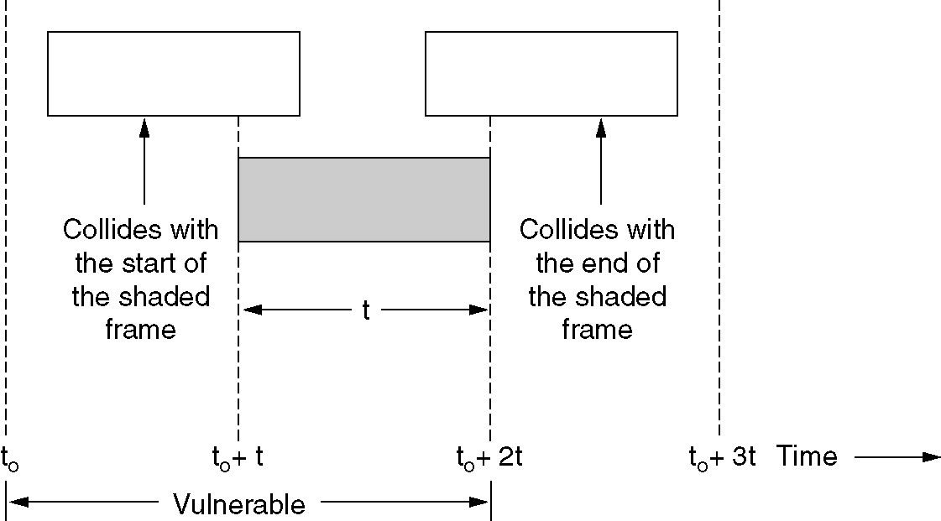
Pure ALOHA
What is the efficiency of an ALOHA channel?
Research shows that the best channel utilization of Pure ALOHA reaches about 18%.
The MAC Sublayer

Slide 45
Slotted分时隙 ALOHA
In 1972, Roberts published a method for doubling the capacity of an ALOHA system, i.e. slotted ALOHA
ROBERTS, L.G.: "Extensions of Packet Communication Technology to a Hand Held Personal Terminal," Proc. Spring Joint Computer Conference, AFIPS, pp. 295-298, 1972.

Slide 46
Slotted分时隙 ALOHA
Principle:
His proposal was to divide time into discrete intervals, each interval corresponding to one frame.
data are always sent at the beginning of a time slot.
This approach requires the users to agree on slot boundaries.

Slide 47
Slotted分时隙 ALOHA
If a collision occurs, finish the current transmission and retry after a random amount of time slots.
A frame will not suffer a collision if no other frames are sent at the beginning of the same frame time(time slots).

Slide 48
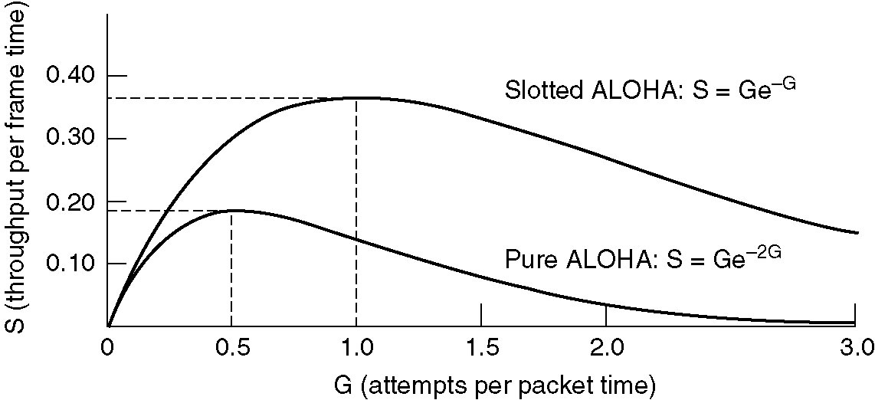
Slotted分时隙 ALOHA
Vulnerable period halved冲突危险区减半，i.e. the maximum efficiency is doubled
Requires synchronization of clocks
Still poor at high loads
(Attempts per frame time)

Slide 49
Carrier Sense, Multiple Access (CSMA)载波侦听、多路存取
Communication Link
We can improve the performance of our simple network greatly if we introduce carrier sensing载波侦听(CS).
With CS, each host listens to the data being transmitted over the cable.

Slide 50
Carrier Sense, Multiple Access (CSMA)载波侦听、多路存取
Communication Link
A host will only transmit its own frames when it cannot hear any data being transmitted by other hosts.
Is it still possible that a collision occurs?

Slide 51



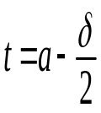


距离L
站点1
站点2
站点2
发送帧
站点1在t＝0时发送帧
传播时延
碰撞
t
站点2
停止发送
The MAC Sublayer

Slide 52
Carrier Sense, Multiple Access (CSMA)载波侦听、多路存取
Communication Link
If a collision occurs, the station waits a random amount of time and starts all over again.

Slide 53
Carrier Sense, Multiple Access (CSMA)载波侦听、多路存取
Communication Link
When a frame finishes, an interframe gap 帧间间隙of about 9.6μsec is allowed to pass before another host starts transmitting its frame.

Slide 54
Persistent持续 and
Nonpersistent非持续 CSMA
1-persistent CSMA
When a station has data to send, it first listens to the channel to see if anyone else is transmitting at that moment.
  If not, it transmits a frame.
  If yes, that means that the channel is busy, the station waits until it becomes idle.
The MAC Sublayer

Slide 55
Persistent持续 and
Nonpersistent非持续 CSMA
  If a collision occurs, the station waits a random amount of time and starts all over again.
The MAC Sublayer

Slide 56
With 1-persistent CSMA, the propagation delay has an important effect on the performance of the protocol.
距离L
站点1
站点2
站点2
发送帧
站点1在t＝0时发送帧
传播时延
碰撞
t
站点2
停止发送
The MAC Sublayer

Slide 57
Persistent持续 and
Nonpersistent非持续 CSMA
Nonpersistent CSMA
Before sending, a station senses the channel.
  If no one else is sending, the station begins doing so itself.
The MAC Sublayer

Slide 58
Persistent持续 and
Nonpersistent非持续 CSMA
Nonpersistent CSMA
Before sending, a station senses the channel.
  if the channel is already in use, the station does not continually sense it for the purpose of seizing it immediately upon detecting the end of the previous transmission. Instead, it waits a random period of time and then repeats the algorithm.
The MAC Sublayer

Slide 59
Persistent持续 and
Nonpersistent非持续 CSMA
Consequently,
the Non-persistent CSMA algorithm leads to better channel utilization
but longer delays than 1-persistent CSMA.
The MAC Sublayer

Slide 60
Persistent CSMA
p-persistent CSMA
When a station becomes ready to send, it senses the channel. If it is idle,
  it transmits with a probability p.
  With a probability q = 1-p, it defers推迟 until the next slot. If that slot is also idle, it either transmits or defers again, with probabilities p and q.
The MAC Sublayer

Slide 61
Persistent CSMA
  This process is repeated until either the frame has been transmitted or another station has begun transmitting.
  In the latter case, the unlucky station acts as if there had been a collision.
  If the station initially senses the channel busy, it waits until the next slot and applies the above algorithm
The MAC Sublayer

Slide 62
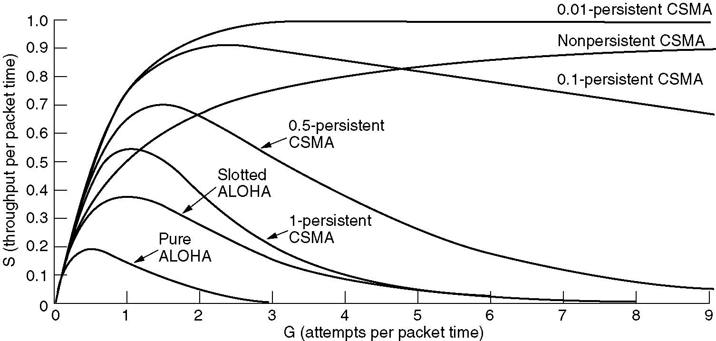
Persistent持续 and
Nonpersistent非持续 CSMA
Comparison of the channel utilization versus load for various random access protocols.
Comparison of the channel utilization versus load for various random access protocols.
The MAC Sublayer

Slide 63
CSMA/CD
载波侦听多路存取/冲突检测
CSMA with Collision Detection
When a station has data to send, it first listens to the channel.
If the channel is busy, the station waits until it becomes idle.
When the station detects an idle channel, it begins to transmit frame, meanwhile listens to the channel in all time
The MAC Sublayer

Slide 64
CSMA/CD
载波侦听多路存取/冲突检测
CSMA with Collision Detection
距离L
站点1
站点2
站点2
发送帧
站点1在t＝0时发送帧
传播时延
碰撞
t
站点2
停止发送
The MAC Sublayer

Slide 65
CSMA/CD
载波侦听多路存取/冲突检测
CSMA with Collision Detection
Collision Detection: The station's hardware must listen to the cable while it is transmitting. If what it reads back is different from what it is putting out, it knows that a collision is occurring.
It aborts transmission as soon as it detects a collision rather than finish transmitting it’s frames.
The MAC Sublayer

Slide 66
CSMA/CD
载波侦听多路存取/冲突检测
CSMA with Collision Detection
Quiz: How long will it take them to realize that there has been a collision?
It depends.
In the worst case it is 2τ, the round-trip propagation time. Why?
The MAC Sublayer

Slide 67
CSMA/CD
载波侦听多路存取/冲突检测
CSMA with Collision Detection
距离L
站点1
站点2
站点2
发送帧
站点1在t＝0时发送帧
传播时延
碰撞
t
站点2
停止发送
The MAC Sublayer

Slide 68
例题：某局域网采用CSMA/CD协议实现介质访问控制，数据传输速率为10Mbps，主机A和主机B之间的距离为2000m，信号传播速度是2x10⁸m/s。若主机A和主机B发送数据时发生冲突，则从开始发送数据时刻起，到两台主机均检测到冲突止，最短需经过多长时间？最长需经过多长时间？
The MAC Sublayer

Slide 69
主机A和主机B之间单项传播时延=2000m/(2x10⁸km/s)=10x10⁻⁶s =10μs
两台主机检测到冲突时，最短所需时间：
(1) 主机A和主机B同时各发送一个数据帧，信号在信道中间发生冲突后，冲突信号继续向两个方向传播。因此，双方检测到冲突需要1个单向传播时延，即10μs。
因此，两台主机均检测到冲突时，最短需经过10μs。
The MAC Sublayer

Slide 70
(2) 两台主机均检测到冲突时，最长所需时间：主机A先发送一个数据帧，当该数据帧即将到达主机B时，主机B也开始发送一个数据帧。这是主机B将立即检测到冲突，而主机A要检测到冲突，冲突信号还需要从主机B传播到主机A，因此，主机A检测到冲突需要2个单向传播时延，即20μs。因此，两台主机均检测到冲突时，最长需经过20μs。
The MAC Sublayer

Slide 71
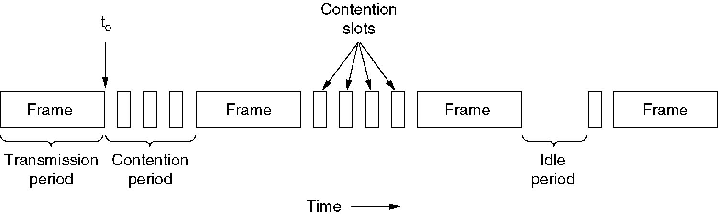
CSMA/CD
载波侦听多路存取/冲突检测
CSMA with Collision Detection
CSMA/CD mechanism can be in one of three states: contention竞争, transmission发送, or idle空闲.
The MAC Sublayer

Slide 72
Chapter 4
The Medium Access Control Sublayer(contd.)
介质访问控制子层（续）
The MAC Sublayer

Slide 73
CSMA载波侦听、多路存取
Carrier Sense: With carrier sensing, A host will only transmit its own frames when it cannot hear any data being transmitted by other hosts.
Multiple Access: Multiple hosts share a single channel
载波侦听: 每个主机在发送数据之前首先监听信道，只有当信道空闲时才发送数据帧；如果信道忙，暂不发送（退避一个随机的时间），以免发生碰撞；
多路存取: 多个主机共享信道。
REVIEW
The MAC Sublayer

Slide 74
CSMA/CD
载波侦听多路存取/冲突检测
CSMA with Collision Detection
  The host always listens to the cable while it is transmitting data.
  It aborts transmission as soon as it detects a collision
  It tries later again, with a “binary exponential back-off algorithm”
冲突检测:在发送数据的过程中始终监听信道，一旦冲突立即中止发送，退避一个随机时间(二进制指数退避算法)，再重新发送。
REVIEW
The MAC Sublayer

Slide 75
CSMA/CD
载波侦听多路存取/冲突检测
CSMA with Collision Detection
距离L
站点1
站点2
站点2
发送帧
站点1在t＝0时发送帧
传播时延
碰撞
t
站点2
停止发送
The MAC Sublayer

Slide 76
IEEE 802.3: CSMA/CD Bus LAN
The IEEE802.3 standard describes the operation of the MAC sublayer in a bus LAN that uses CSMA/CD.
The CSMA/CD Bus LAN is also widely called Ethernet以太网.

Slide 77
IEEE 802.3: CSMA/CD Bus LAN
a station, as soon as detecting a collision, aborts transmission, waits a random amount of time, and then retransmits the same frame.
The purpose is to reduce the probability that collision occurs again.
The random amount of time is determined by the binary exponential back-off algorithm 二进制指数随机退避算法.
The MAC Sublayer

Slide 78
二进制指数随机退避算法
Binary exponential back-off algorithm
让发生碰撞的站在停止发送数据后，不是立即再发送数据，而是推迟(退避)一个随机的时间，以减少再次发生碰撞的概率。
确定基本退避时间，一般取为争用期2τ。
定义一个参数k，它等于重传的次数，但不超过10。
即 k = min[重传次数，10]。
The MAC Sublayer

Slide 79
二进制指数随机退避算法
Binary exponential back-off algorithm
从离散的整数集合[0,1,2,…,2^{k-1}]中随机取出一个数，记为r。重传需要推迟的时间t = r× 2τ 。
设置一个最大重传次数，一般为16次。若重传达16次仍不能成功,则丢弃该数据帧, 并向高层报告
The MAC Sublayer

Slide 80
CSMA/CD
载波侦听多路存取/冲突检测
CSMA with Collision Detection
发送帧
Yes
信道忙？
延迟随机时间
No
No
发送
Yes
N≥16?
No
No
发送完？
碰撞？
发送失败
Yes
Yes
☹
碰撞次数N+1
发送成功
发送Jam
☺
The MAC Sublayer

Slide 81
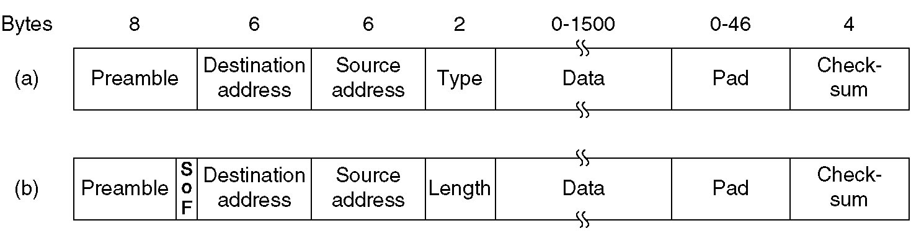
IEEE 802.3: CSMA/CD Bus LAN
the standard also describes the format of the frames
Frame formats. (a) DIX Ethernet,
(b) IEEE 802.3.
DIX: DEC, Intel, Xerox
DEC: DigitalEquipmentCorporation数字设备公司
Xerox: Xerox Corporation施乐公司,
（PARC: Palo Alto Research Center, Inc）

Slide 82
Palo Alto
located in the San Francisco, California, US.
The city includes portions of Stanford University斯坦福大学
Headquarters to a number of Silicon Valley硅谷 high-tech companies, including HP, Facebook, Google, Apple Inc., Cisco Systems, Inc.
The MAC Sublayer

Slide 83

PARC: Palo Alto Research Center, Inc
帕洛阿尔托研究中心
拥有许多高科技成果和产品:
  以太网；
  激光打印机；
  图形用户界面；
  鼠标。
The MAC Sublayer

Slide 84
IEEE 802.3: CSMA/CD Bus LAN
The IEEE 802.3 standard describes the format of the frames
Frame formats. (a) DIX Ethernet,
(b) IEEE 802.3.
The MAC Sublayer

Slide 85
IEEE 802.3: CSMA/CD Bus LAN
Preamble先导码: Each frame starts with a Preamble of 8 bytes, each containing the bit pattern 10101010.
The Manchester encoding of this pattern produces a 10-MHz square wave for 6.4 µsec to allow the receiver's clock to synchronize with the sender's.
SOF: Just a delimiter to tell that the real info is now coming.
The MAC Sublayer

Slide 86
IEEE 802.3: CSMA/CD Bus LAN
Type field tells the receiver what to do with the frame.
Data Length: Ranges from 0-1500.
Checksum: Calculated over the data field. CRC-based.
The MAC Sublayer

Slide 87
IEEE 802.3: CSMA/CD Bus LAN
Address: Generally 48-bit fields. Leftmost bit indicates ordinary or group addresses.
One to More:
Multicast & Broadcast
  The address consisting of all 1 bits is reserved for broadcast.
  When a frame is sent to a group address, all the stations in the group receive it.
The MAC Sublayer

Slide 88
IEEE 802.3: MAC Addresses
  The most significant bit最高位 is set to
    0 to indicate an ordinary address;
    1 to indicate a group address (this is for multicasting, which means that frames are sent to several hosts).

Slide 89
IEEE 802.3: MAC Addresses
  If all 48 bits are set to 1 then frames are broadcast to all the hosts.
  If the two most significant bits are both zero then the 46 least significant bits contain the MAC addresses of the source and destination hosts.

Slide 90
IEEE 802.3: MAC Addresses
Every network card in the world has a unique 46-bit serial number called a MAC address.
The IEEE allocates these numbers to network card manufacturers who encode them into the firmware固件 of their cards.
  The destination and source address fields of the MAC frame have 48 bits set aside

Slide 91
IEEE 802.3: CSMA/CD Bus LAN
Data Length: Ranges from 0-1500.
Ethernet Frames should always be at least 64 bytes.
The MAC Sublayer

Slide 92
IEEE 802.3: CSMA/CD Bus LAN
The minimum length of frames can be varied from network to network.
Depending on the size of the network, the frames must be of a suitable minimum length.

Slide 93
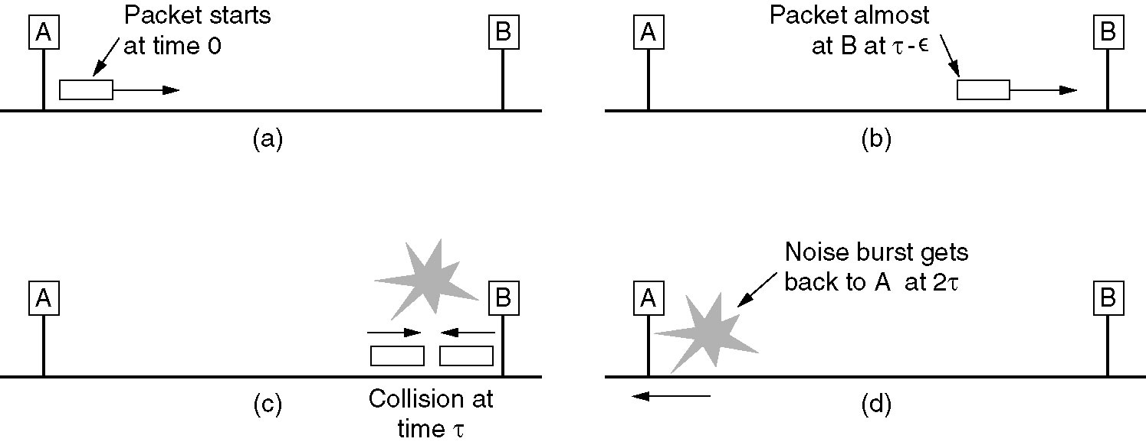
Ethernet: Non-Deterministic 不确定性
when a station transmits a frame, there is a small chance that a collision will occur, although it didn’t hear anything from the channel before transmitting.
The MAC Sublayer

Slide 94
Ethernet: Non-Deterministic 不确定性
the signal travels along the cable at a limited speed
the time period for collision
detection indicates contention period
The MAC Sublayer

Slide 95
Ethernet: Non-Deterministic 不确定性
When the network is quite busy, the number of collisions rises dramatically and it may become very difficult for any hosts to transmit their frames.
“non-deterministic when sending” means that no station is guaranteed to be able to send its frame successfully;
It is just a good probability of doing so!

Slide 96
Ethernet: Non-Deterministic 不确定性
The worse case scenario is if the two hosts are at far ends of the cable.
If host A’s frame is just reaching host B when B begins transmitting, host B will detect the collision first

Slide 97
Ethernet: Non-Deterministic 不确定性
The first host to detect a collision transmits a 48-bit jam sequence, to ensure that any hosts involved with the collision realise意识到 that the jam sequence is associate with their frame

Slide 98
Ethernet: Non-Deterministic 不确定性
The host must still be transmitting when the jam sequence arrives.
This means that the frame must be of a minimum length.

Slide 99
Ethernet: Non-Deterministic 不确定性
The host must still be transmitting when the jam sequence arrives.
This means that the frame must be of a minimum length.
The Ethernet standard defines a minimum frame size as 64 bytes, i.e. no frame may have less than 46 bytes of payload数据载荷.

Slide 100
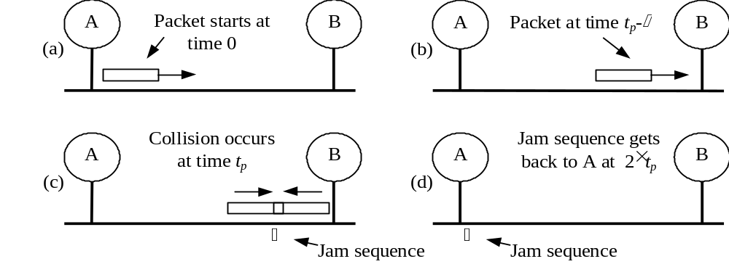
IEEE 802.3: Minimum Frame Length
The longest time between starting to transmit a frame and receiving the first bit of a jam sequence is twice the propagation delay from one end of the cable to the other.

Slide 101
IEEE 802.3: Minimum Frame Length
This means that a frame must have enough bits to last twice the propagation delay.

Slide 102
IEEE 802.3: Minimum Frame Length
The standard also makes some suggestions about the type of cabling that should be used for CSMA/CD bus LANs.

Slide 103
IEEE 802.3: Minimum Frame Length
  The 802.3 CSMA/CD Bus LAN transmits data at the standard rate of r = 10Mbps.
  The speed of signal propagation is v = 2×10⁸m/s.

Slide 104
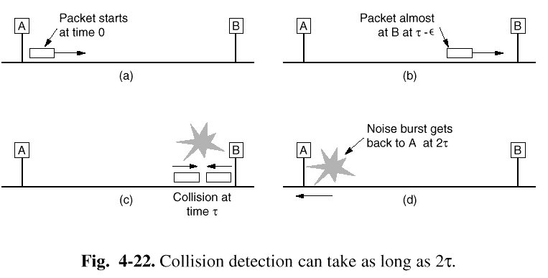
IEEE 802.3: Minimum Frame Length
In order to calculate the minimum frame length, we must first work out the propagation delay from one end of the cable to the other.

Slide 105
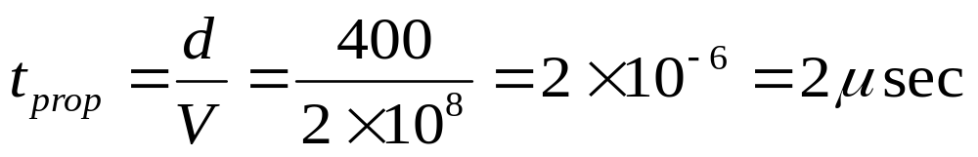
IEEE 802.3: Minimum Frame Length
Example #1:
Cable length d= 400m,
Data rate R = 10 Mbits/sec,
Propagation speed V= 2x10⁸ m/sec
The End-to-end propagation delay time t_{prop}=?

Slide 106
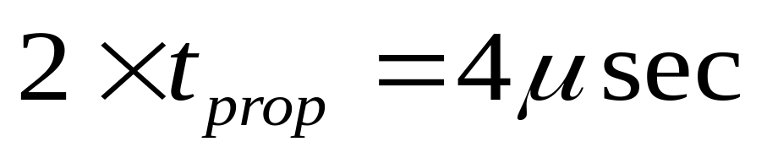
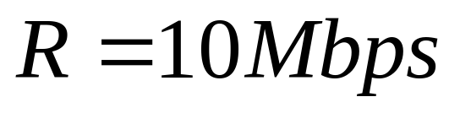
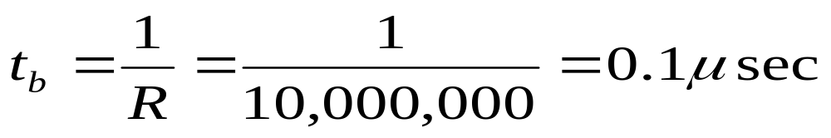
IEEE 802.3: Minimum Frame Length
Example #1 – cont.
The round-trip propagation delay is, of course, twice the end-to-end delay.
Thus the round trip delay is
With a data rate of
each bit has
duration

Slide 107
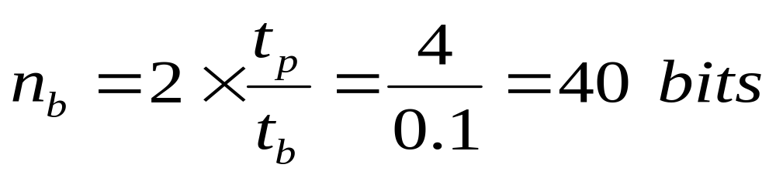
IEEE 802.3: Minimum Frame Length
Example #1 – cont.
The number of bits we can fit into a round-trip propagation delay is
  The minimum frame length is thus 40 bits (5 bytes).

Slide 108
IEEE 802.3: Minimum Frame Length
The 802.3 standard frame length is at least 64 bytes (512 bits) long, which is much longer than our minimum requirement of 40 bits (5 bytes).

Slide 109
IEEE 802.3: Minimum Frame Length
The minimum frame size is related to the follows:
the distance which the network spans跨度,
the type of media being used
the number of repeaters中继器 which the signal may have to pass through to reach the furthest part of the LAN.
The MAC Sublayer

Slide 110

Repeaters中继器
  Run at the Physical Layer
  Connect together one or more Ethernet cable segments of any media type
  Extend the distance over which a signal may travel down a cable
  Provide more flexibility灵活性 in network design
The MAC Sublayer

Slide 111
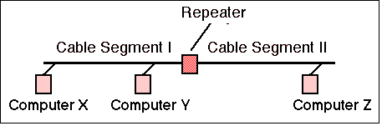
Repeaters中继器
Provide signal amplification信号放大 and regeneration信号再生 to restore恢复 a good signal level before sending it from one cable segment to another
The MAC Sublayer

Slide 112
Repeaters中继器
802.3 CSMA/CD bus LANs longer than 500m are usually composed of multiple segments joined by repeaters中继器
The MAC Sublayer

Slide 113
Repeaters中继器
If an Ethernet segment were allowed to exceed the maximum length, the signal quality would deteriorate信号质量变坏.
The MAC Sublayer

Slide 114

Repeaters中继器
注意：利用中继器扩展局域网时，从理论上讲，中继器的使用个数可以不受限制，网络可以达到无限远的距离。但实际上很多网络都限制了中继器的数目。
Ethernet的5-4-3规则：一个Ethernet最多只能有4个中继器,连接5个线缆段，而其中只有3段缆线可以连接计算机
The MAC Sublayer

Slide 115
IEEE 802.3: Minimum Frame Length
When we work out the minimum frame length for these longer LANs, we also have to take the delays caused by the repeaters (about 2.5μsec each) into account as well.
Together these define a value known as the Ethernet Slot Time, corresponding to 512 bit times at 10 Mbps.
The MAC Sublayer

Slide 116
Shortest Ethernet Frame
Quiz: A Ethernet consists of 5 segments connected by 4 repeaters.
Each segment is 500 meter long.
The signal propagation speed is
2x10⁸ m/sec.
The delay caused by each repeater is
2.5 µsec.
There are two hosts, A and B, which are located at far ends of the LAN.
Let’s calculate the signal propagation delay from host A to B.
The MAC Sublayer

Slide 117
Shortest Ethernet Frame
Why specify a shortest frame of 64byte?
500m/segment, 4 repeaters between nodes ⇒2500m, 2x10⁸m/sec, 4X2.5 μsec ⇒25 μsec propagation delay
The frame should be longer enough for sender to detect the collision(2x25 or about 50 μsec )
64 bytes sent at 10Mbps ⇒ 51.2μsec
Node A
R1
R2
R3
R4
Node B
500m ⇒25 μsec propagation delay

Slide 118
Shortest Ethernet Frame
Why specify a shortest frame of 64byte?
500m/segment, 4 repeaters between nodes ⇒2500m, 2x10⁸m/sec, 4X2.5 μsec ⇒25 μsec propagation delay
The frame should be longer enough for sender to detect the collision(2x25 or about 50 μsec )
64 bytes sent at 10Mbps ⇒ 51.2μsec
Node A
R1
R2
R3
R4
Node B
500m ⇒25 μsec propagation delay

Slide 119
Shortest Ethernet Frame
Why specify a shortest frame of 64byte?
  We only have to start worrying when the LAN reaches lengths of more than 2.5km.
Node A
R1
R2
R3
R4
Node B
500m ⇒25 μsec propagation delay

Slide 120
EEE 802.3: Minimum Frame Length
Example # 2
Two nodes are communicating using CSMA/CD protocol.
  Transmission rate is 100 Mbits/sec
  Frame size is 1500 bytes.
  The propagation speed is 3x10⁸ m/sec.
Calculate the distance between the nodes such that the time to transmit the frame = time to recognize that the collision have occurred at any time.
The MAC Sublayer

Slide 121
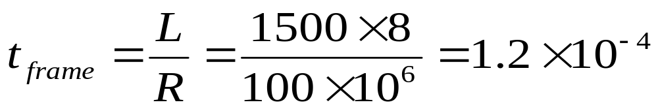
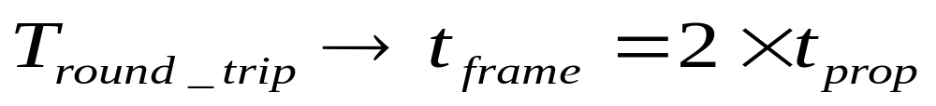
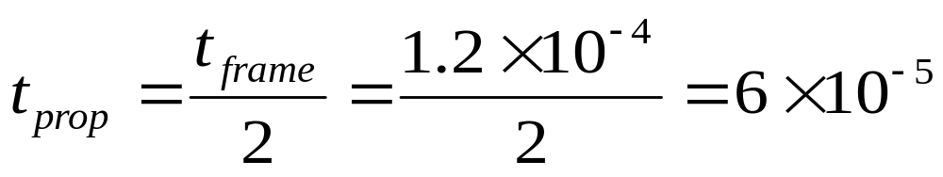
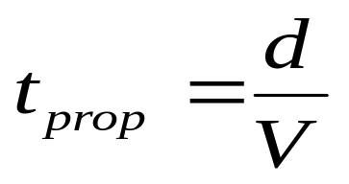
EEE 802.3: Minimum Frame Length
Example # 2
Two nodes are communicating using CSMA/CD protocol.
Transmission rate is 100 Mbits/sec and frame size is 1500 bytes. The propagation speed is 3*10⁸ m/sec.
Calculate the distance between the nodes such that the
time to transmit the frame = time to recognize that the collision have occurred.
The MAC Sublayer

Slide 122
Ethernet的信道利用率
总线上共有N个站，每个站发送数据帧的概率是p。
争用期长度为2τ，即端到端的信号传播时延的两倍。(假定检测到碰撞后不发送干扰信号)
数据帧长度为L (bit)，发送速率为C (bit/s), 因而帧的发送时间为L/C =T₀
争用期的平均个数NR
占用期
……
发送成功
争用期
争用期
争用期
2τ
2τ
2τ
T₀
τ
The MAC Sublayer
发送一个帧所需的平均时间TAV

Slide 123
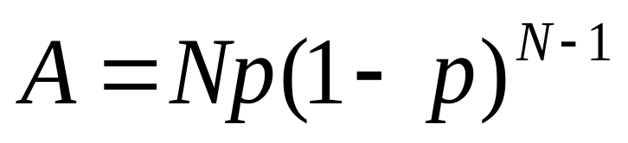
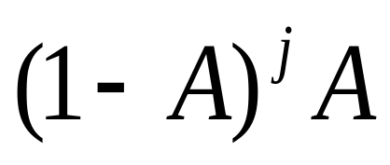
Ethernet的信道利用率
令A为某个站发送成功的概率，则
P[争用期为j个]
= P[发送j次失败但下一次成功]
=
争用期的平均个数NR
占用期
……
发送成功
争用期
争用期
争用期
2τ
2τ
2τ
T₀
τ
The MAC Sublayer
发送一个帧所需的平均时间TAV

Slide 124
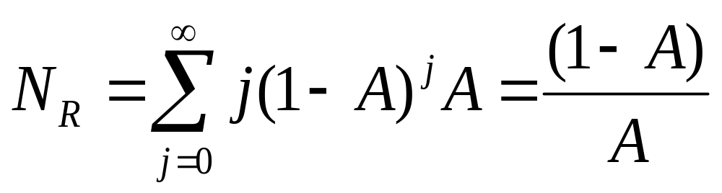
Ethernet的信道利用率
争用期的平均个数，即帧重发的次数NR：
争用期的平均个数NR
占用期
……
发送成功
争用期
争用期
争用期
2τ
2τ
2τ
T₀
τ
The MAC Sublayer
发送一个帧所需的平均时间TAV

Slide 125
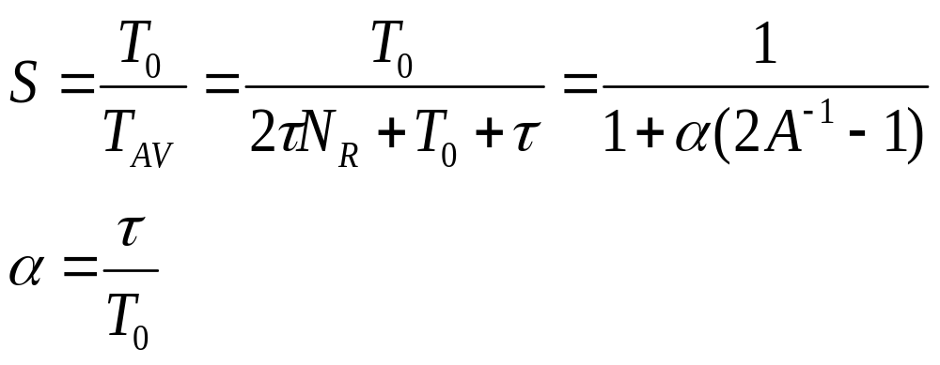
Ethernet的信道利用率
由此求出Ethernet的信道利用率：
是信号单程传播时延与
帧的发送时延之比。
争用期的平均个数NR
占用期
……
发送成功
争用期
争用期
争用期
2τ
2τ
2τ
T₀
τ
The MAC Sublayer
发送一个帧所需的平均时间TAV

Slide 126
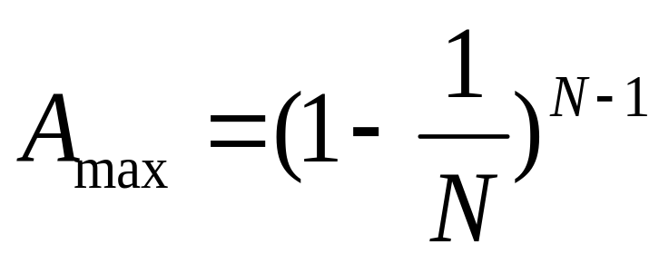
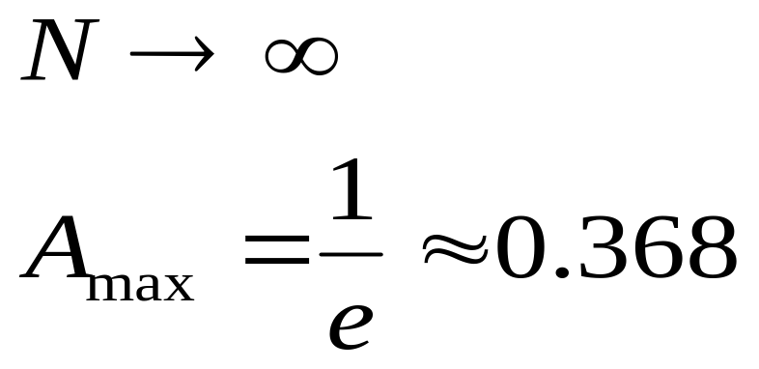
Ethernet的信道利用率
当A取最大值
时
即得出信道利用率最大值Smax。
当
N | 2 | 4 | 8 | 16 | 32 | 64 | 128 | 256
Amax | 0.5 | 0.42 | 0.39 | 0.38 | 0.37 | 0.37 | 0.37 | 0.37
The MAC Sublayer

Slide 127
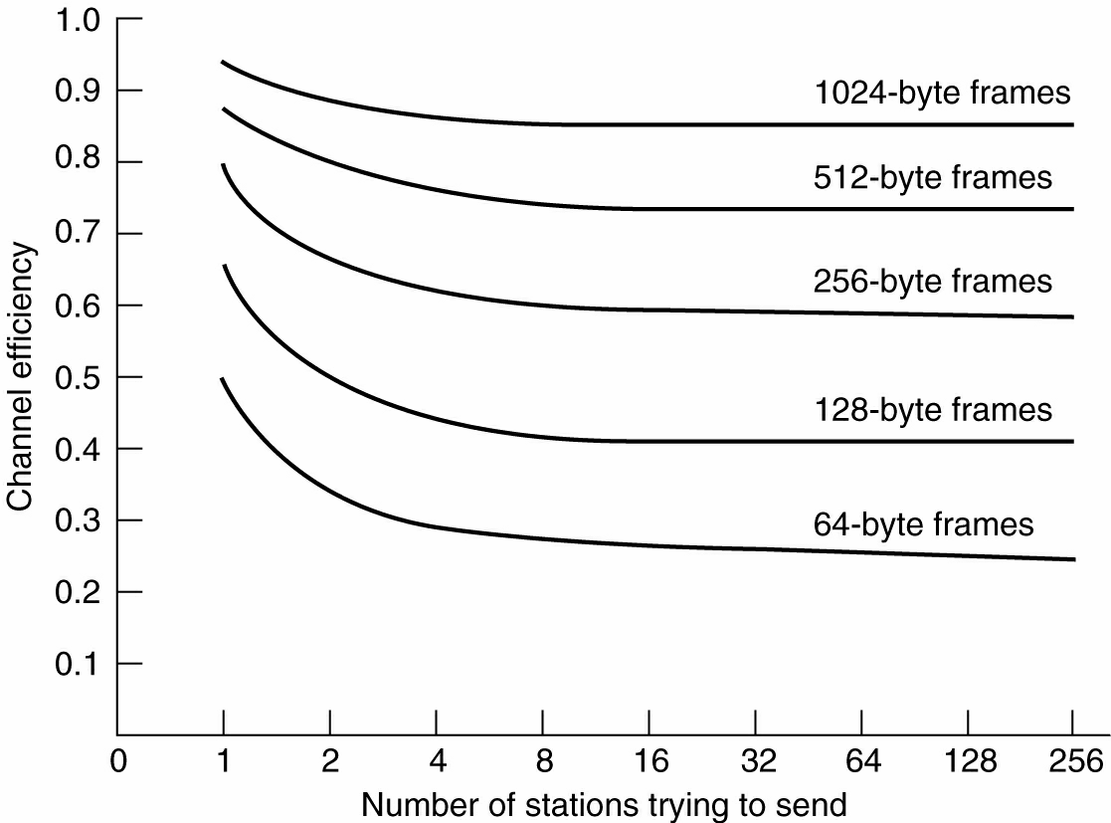
Ethernet Performance
Smax
N
The MAC Sublayer
Effect of frame size on the channel efficiency

Slide 128
Ethernet传输速率
10BASE-T
  Ethernet: 10Mbps
100BASE-FX/TX/T4
  FastEthernet: 100Mbps
1000BASE-T/CX/LX/SX
  Gigabit Ethernet: 1Gbps
The MAC Sublayer

Slide 129
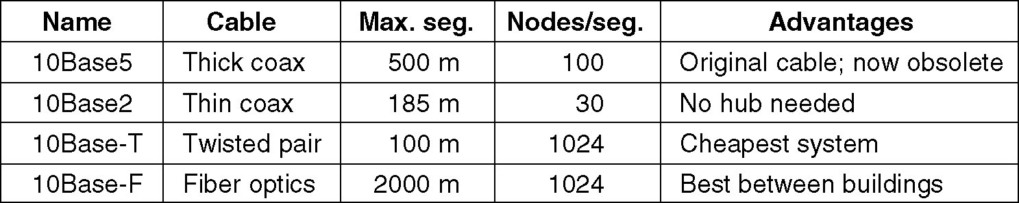
Ethernet Cabling
10Base5
“10”--10 Mbps,
“Base”--Baseband transmission,
“5”--500m cable length
The MAC Sublayer

Slide 130
Ethernet Cabling
10Base2
  10 Mbps,
  Baseband transmission,
  ~200m cable length
The MAC Sublayer

Slide 131
Ethernet Cabling
10Base-T
10 Mbps,
Baseband transmission,
“T”--UTP Unshielded Twisted
Pair
The MAC Sublayer

Slide 132
Ethernet Cabling
10Base-F
10 Mbps,
Baseband transmission,
“F”--fiber optics
The MAC Sublayer

Slide 133
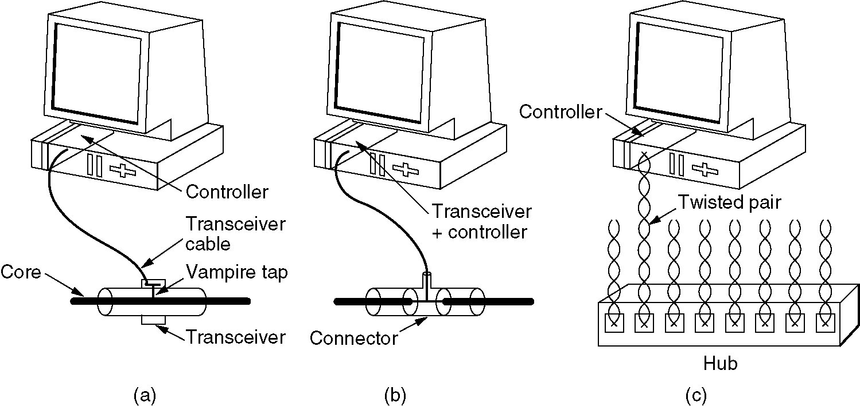
Ethernet Cabling
10Base5 10Base2 10Base-T
粗缆 细缆 双绞线
The MAC Sublayer

Slide 134
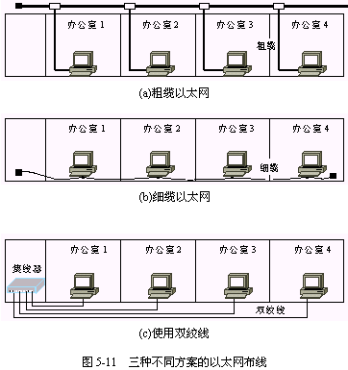
The MAC Sublayer

Slide 135
Ethernet Cabling
In option of 10Base-T Ethernet Cabling, all stations have a cable running to a central hub in which they are all connected electrically.
In this case, the physical topology of the LAN is star, however, the logical topology is still bus.
The MAC Sublayer

Slide 136
Ethernet Cabling
Stations must compete the shared channel using CSMA/CD before transmit frames.
Only one station can transmit at a time, otherwise, a collision will occur!
The MAC Sublayer

Slide 137
10Base-T Ethernet Cabling
“10”：10Mbit/s的数据率
“T”：双绞线星型网。
双绞线Ethernet总是和集线器配合使用。
用集线器Hub来连接站点。物理上是星型网，但逻辑上是总线网. 各站仍使用CSMA/CD协议，并共享逻辑上的总线。
各站必须竞争公共信道，并在任何时刻只有一个站可以发送数据。否则发生碰撞。
The MAC Sublayer

Slide 138
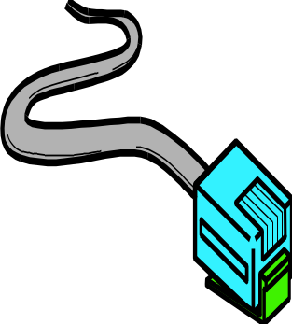

Ethernet 10Base-T & 100Base-TX
Wiring
  Unshielded Twisted Pair (UTP)
  Category 5 wiring is best
    Cat 3 and Cat 4 in some older installations
  Bundle of eight wires (only uses four)
  Terminates in RJ-45 connector
The MAC Sublayer

Slide 139
Chapter 4
The Medium Access Control (MAC) Sublayer
(contd.)
The MAC Sublayer

Slide 140
Ethernet Extension
扩展的局域网
At the Physical Layer
  Hub(集线器)
  Repeater(转发器/中继器)
At the Data Link Layer
  Bridge(网桥)
  Switch(交换机)
The MAC Sublayer

Slide 141
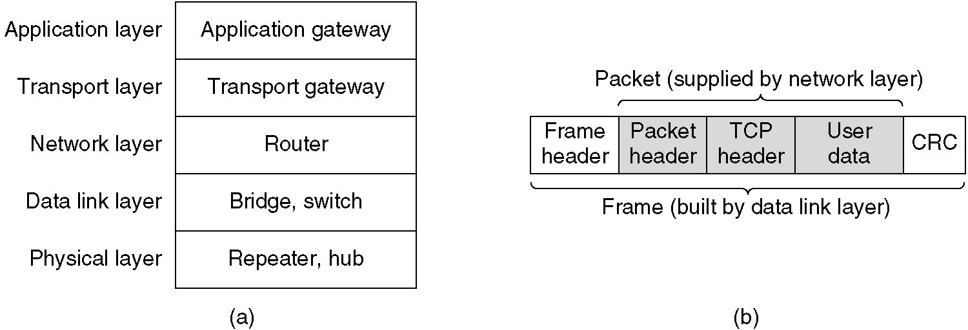
Repeaters, Hubs, Bridges, Switches, Routers and Gateways
(a) Which device is in which layer.
(b) Frames, packets, and headers.
The MAC Sublayer

Slide 142
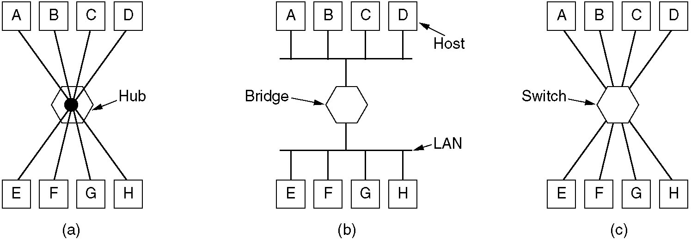
Repeaters, Hubs, Bridges, Switches, Routers and Gateways
(a) A hub. (b) A bridge. (c) A switch.
The MAC Sublayer

Slide 143
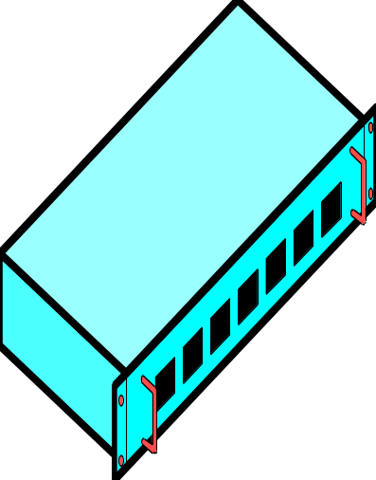

10Base-T & 100Base-TX hubs网络集线器
UTP-based networks use hubs to interconnect NICs
  each UTP cable runs directly from a NIC to a hub
The MAC Sublayer

Slide 144
10Base-T & 100Base-TX hubs网络集线器
Hubs have many ports, each of which
has one incoming network cable
Hubs are usually located in computer
rooms, or network distribution
cupboards网络配电箱
  a patch panel (or patch bay插线架) is used to connect between hubs and the wall sockets throughout a building
The MAC Sublayer

Slide 145
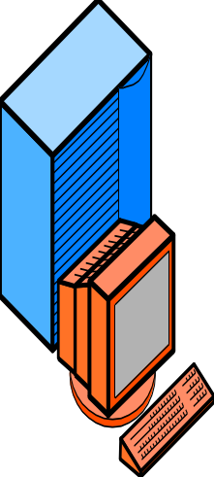
10Base-T & 100Base-TX wiring
Wiring配线
  100 meters maximum distance hub-to-station
200 m
100 m
100 m
The MAC Sublayer

Slide 146
Multiple Hubs in 10Base-T
  Can use multiple hubs to increase the distance between any two stations, but max. 4
100m
100m
10Base-T hubs
100m
500m, 4 hubs
100m
100m
The MAC Sublayer

Slide 147
Multiple Hubs in 10Base-T
Farthest stations in 10Base-T can be five segments (500 m apart)
  100m per segment
  Separated by 4 hubs
100m
100m
10Base-T hubs
100m
500m, 4 hubs
100m
100m
The MAC Sublayer

Slide 148
10Base-T to 100Base-TX
Upgrading
from 10Base-T to 100Base-TX
  Need new hub
    May have some 10 Mbps ports to handle 10Base-T NICs
    May have autosensing 10/100 ports that handle either
  Need new NICs
    Only for stations that need more speed
  No need to rewire
    This would be expensive
The MAC Sublayer

Slide 149
Multiple Hubs in 100Base-TX
Limit of Two Hubs in 100Base-TX
  Must be within a few metres of each other
  Maximum span ~200 metres
  Shorter distance span than 10Base-T
2 Co-located
Hubs
100m
100Base-TX
Hubs
100m
The MAC Sublayer

Slide 150
Latency延迟&Congestion拥塞 with hubs
Ethernet is a shared media LAN
  Only one station can transmit at a time, even in multi-hub LANs, others must wait
  This causes delay
All Other
Stations
Must Wait
One Station Sends
The MAC Sublayer

Slide 151
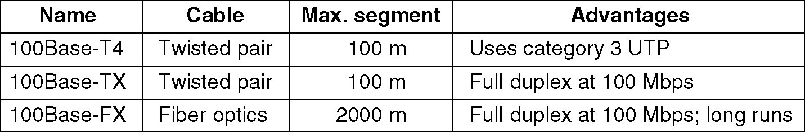
Fast Ethernet
The original fast Ethernet cabling.
The MAC Sublayer

Slide 152
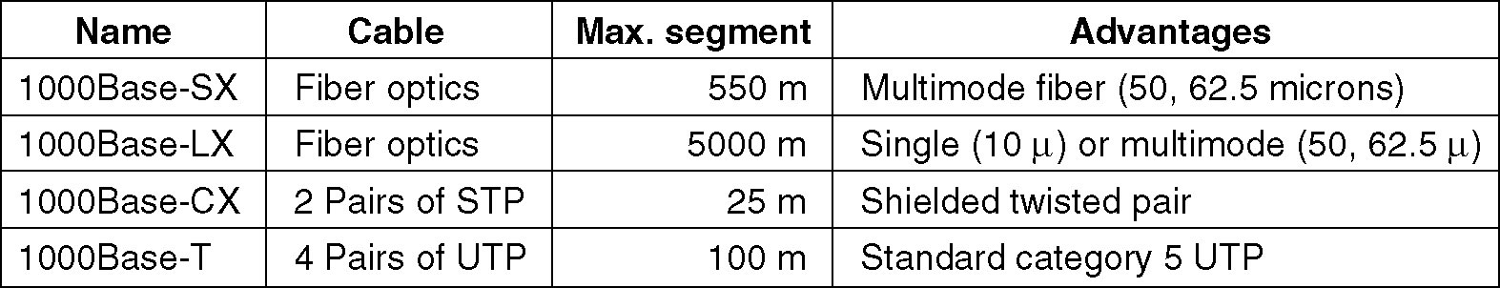
Gigabit Ethernet
Gigabit Ethernet cabling.
The MAC Sublayer

Slide 153
Chapter 4
The Medium Access Control Sublayer(contd.)
介质访问控制子层
The MAC Sublayer

Slide 154
Repeaters中继器
  Run at the Physical Layer
  Connect together one or more Ethernet cable segments of any media type
  Extend the distance扩大距离 over which a signal may travel down a cable
  Provide signal amplification信号放大
  Regenerate the signal信号再生
  Provide more flexibility灵活性 in network design

Slide 155
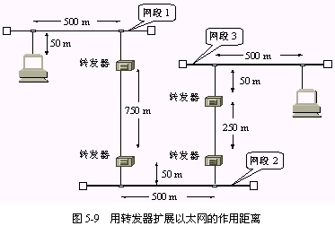
Repeaters中继器
实例：三段电缆连接成一个Ethernet。网段1和网段2各通过一个中继器经过750m的点到点链路相连,而网段2和网段3各通过一个中继器经过250m的点到点链路相连。
中继器
中继器
中继器
中继器

Slide 156
Ethernet Bridge网桥
  Run at the Data Link Layer
  Join two LAN segments (A,B), constructing a larger LAN
  Filter traffic passing between the two LANs
  may enforce a security policy安全机制 separating different work groups located on each of the LANs.

Slide 157
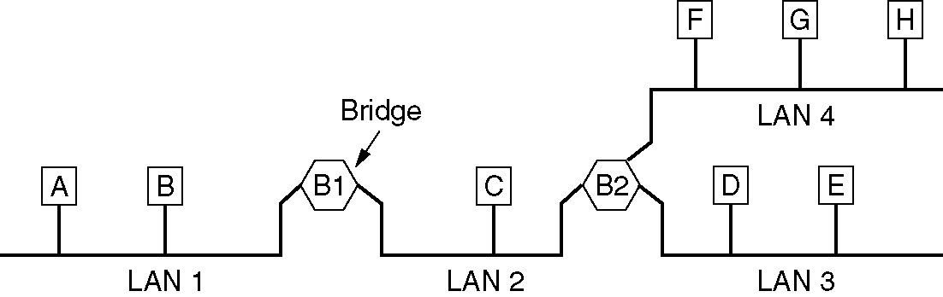
Local Internetworking
Ethernet Bridge网桥
网桥的应用环境举例：
如果某单位的下属部门各自根据需要将自己部门的服务器、工作站与微机互联成网,但不同部门可能选用了不同的局域网。当这些部门之间需要交换信息，共享资源时,就可以用网桥将各个部门的局域网互联起来。
The MAC Sublayer

Slide 158
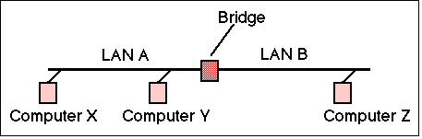
Ethernet Bridge网桥
Simplest and most frequently used → Transparent Bridge透明网桥 (meaning that the nodes using a bridge are unaware of its presence).
Bridge could forward all frames, but then it would behave rather like a repeater
Bridges are smarter than repeaters!

Slide 159
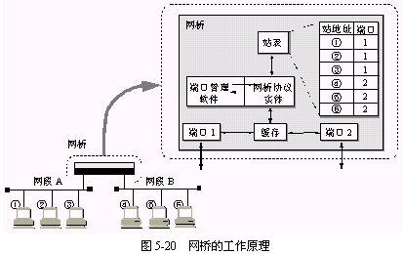
Ethernet Bridge网桥
A bridge stores the MAC addresses observed from frames received by each interface and uses this info to learn which frames need to be forwarded by the bridge.

Slide 160
Ethernet Bridge网桥
网桥具有寻址和路径选择的逻辑功能
它通过检查数据帧的源地址和目的地址以决定数据帧的去向；

Slide 161
Ethernet Switch交换机 → Modern LANs
  Runs at the Data Link Layer
  Fundamentally similar to a bridge
  Supports a larger number of connected LAN segments
  Richer management capability.

Slide 162
Ethernet Switch → Benefits
Ethernet Switch交换机 → Modern LANs
  Improved security
    users are less able to tap-in into other user's data
  Better management
    control who receives what information (i.e. Virtual LANs虚拟局域网)
    limit the impact of network problems
  Full duplex
    rather than half duplex required for shared access

Slide 163
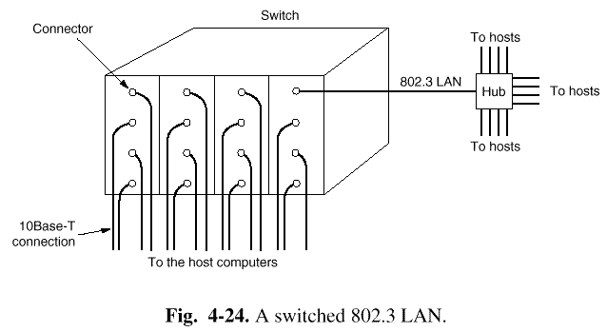
Switched LAN
Hub and Switched LAN
  Hub simulates a single shared medium
  Switch simulates a bridged LAN with one computer per segment

Slide 164
当主机需要通信时，交换机能同时连通许多对的端口，使每一对相互通信的主机都占有整个信道带宽，例如10Mbps，100Mbps， … 大大提高了整个LAN的可用带宽。
Ethernet Switch
10Mbps
10Mbps
Host1
Host2
Host3
Host4
The MAC Sublayer

Slide 165
对于普通10 Mbit/s的共享式以太网，若共有N个用户，则每个用户占有的平均带宽只有总带宽(10 Mbit/s)的N分之一。
在使用以太网交换机时，虽然在每个端口到主机的数据率还是10 Mbit/s，但由于一个用户在通信时是独占而不是和其它网络用户共享传输媒体的带宽，因此拥有N个端口的交换机的总容量为N*10 Mbit/s。
The MAC Sublayer

Slide 166
Ethernet Switch
100Mbps
10Base-T
Hub
Web
Server
Mail
Server
The MAC Sublayer

Slide 167
Ethernet Switches
Highly Scalable
10Base-T switches
  competitive with 100Base-TX hubs in both cost and throughput
100Base-TX switches
  Higher performance (and price)
Gigabit Ethernet switches
  Very expensive

Slide 168
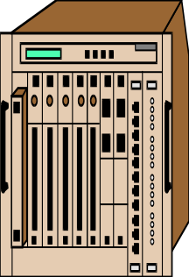
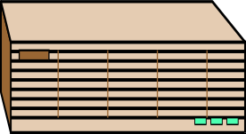
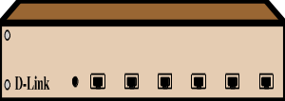
Ethernet Switches
No limit on number of Ethernet switches between farthest stations
  So no distance limit on size of switched networks

Slide 169
Ethernet Switches
Ethernet Switches must be arranged in a Hierarchy
  Only one possible path between any two stations, switches
1
Path=4,5,2,1,3
2
3
4
5
6

Slide 170
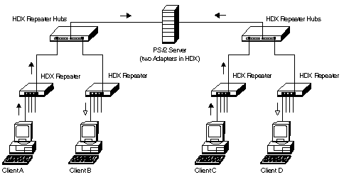

Repeater HUBs

Slide 171
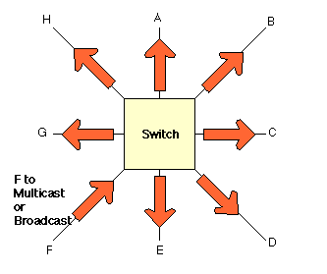
Ethernet Switches and Multicast Traffic
Multicast Traffic from F is delivered to all output interfaces (ports) which asks for it

Slide 172
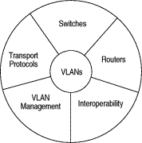
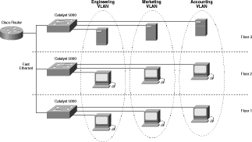
Virtual LANs
(VLANs)
虚拟局域网
Cisco Systems

Slide 173
Virtual LANs
(VLANs)
虚拟局域网
虚拟局域网其实只是交换局域网给用户提供的一种服务，而并不是一种新型局域网。
虚拟局域网VLAN 是建立在网络交换技术上的，用软件方式实现的逻辑工作组的划分和管理。
The MAC Sublayer

Slide 174

虚拟局域网是由一些局域网网段构成的与物理位置无关的逻辑组，而这些网段具有某些共同的需求。每一个VLAN的帧都有一个明确的标识符，指明发送这个帧的工作站是属于哪一个VLAN。
The MAC Sublayer

Slide 175
Virtual LANs
(VLANs)
虚拟局域网
虚拟局域网的站点不受物理位置的束缚和限制。同一虚拟局域网上的站点可以分布在不同的物理网段上，也可以建立在不同的交换机上。
The MAC Sublayer

Slide 176


Cisco Systems

Slide 177
You are now
an Ethernet expert !
Congratulations !
The MAC Sublayer

