Slide 1
Chapter 3
The Data Link Layer
数据链路层

Slide 2
Why Data Link Layer?
The data link layer is responsible for efficient and reliable communication across a physical link.
数据链路层在物理层连接上提供一条高效可靠的逻辑连接，为网络层提供服务。
The data link layer provides services to the network layer
OSI
Application
Presentation
Session
Transport
Network
Data link
Physical

Slide 3
Why Data Link Layer?
The data link layer describes
  how a data frame数据帧 can be reliably transmitted;
  how a shared communication channel should be accessed.
Two sublayers:
  LLC: Logical Link Control sublayer逻辑链路控制子层
  MAC: Media Access Control sublayer介质访问控制子层

Slide 4
Services Provided to Network Layer
Unacknowledged connectionless
  • No attempt to recover lost frame
  • Suited for low error rate networks or for fault tolerant applications such as voice
Acknowledged connectionless
  • Each frame is acknowledged by the receiver
  • Suited for unreliable channels

Slide 5
Services Provided to Network Layer
Acknowledged connection-oriented
  • Ensures that
    – All frames are received
    – Each is received exactly once
The service is accomplished using SIMPLEX, HALF DUPLEX OR FULL DUPLEX channels.

Slide 6
Responsibility of Data Link Layer:
PROVIDE SERVICE TO NETWORK LAYER
OSI
LOGICAL LINK CONTROL sublayer
Application
Presentation
Framing
Flow control
Error control
Session
Transport
Network
Data Link
Physical
MEDIA ACCESS CONTROL sublayer
Shared channel
competition/access

Slide 7
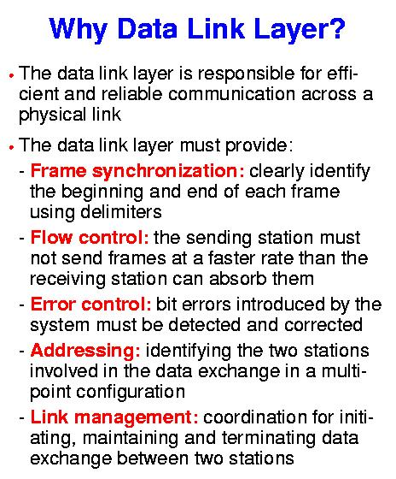
The Data Link Layer (DLL)
OSI
Application
Presentation
Session
Transport
Network
Data link
Physical

Slide 8
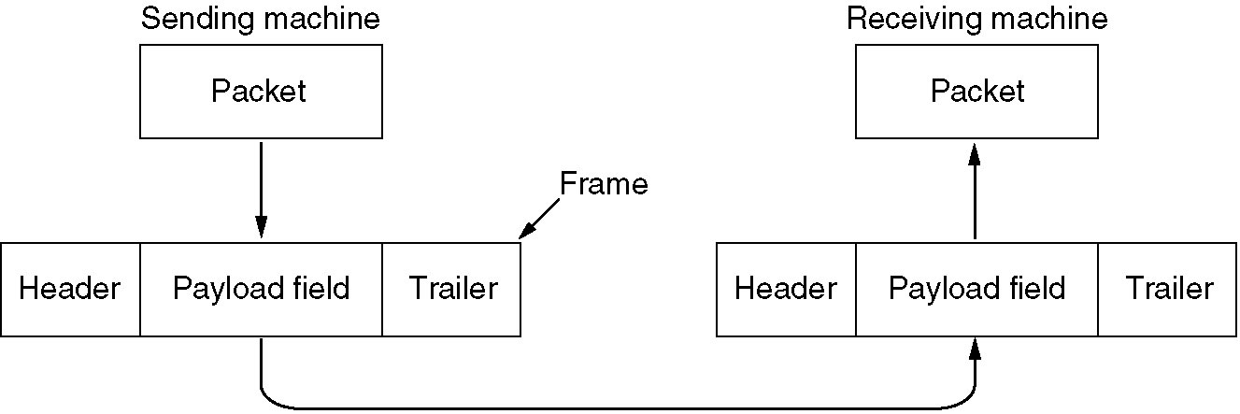
Framing帧的形成
The DLL takes packets from the Network Layer, and then
  adds header/trailer info to create new data unit ⇨ Frame数据帧
  passes frames to layer below
……101011100010101
Relationship between packets and frames

Slide 9
理想条件下不需要协议
A
B
假定一：不论发送方发送速率有多快，接收主机每收到一个帧, 都可以及时处理。
假定二：理想信道，没有传输差错，没有数据丢失。

Slide 10
讨论：
理想情况是不存在的！
由于各种原因，接收方不能保证永远能及时处理收到的数据。当接收方缓冲区添满时，就会溢出，发生数据丢失。
数据帧在物理层传输线路上可能出错,丢失。

Slide 11
The Data Link Layer (DLL)
Flow Control
流量控制
OSI
Application
Prevent a fast sender from overwhelming a slower receiver.
e.g., a supercomputer can easily generate data faster than a PC can consume it.
Presentation
Session
Transport
Network
Data Link
Physical

Slide 12
The Data Link Layer (DLL)
Error Control
差错控制
OSI
When data is transmitted across a physical link, there is always a chance that some of the bits will be corrupted (changed) due to noise噪音, signal distortion失真 or attenuation衰减.
Application
Presentation
Session
Transport
Network
Data Link
Physical

Slide 13
The Data Link Layer (DLL)
Error Control
差错控制
OSI
Application
Presentation
If errors do occur, then some of the transmitted bits will either change from 0 to 1 or from 1 to 0.
Session
Transport
Network
Data Link
Physical

Slide 14
What is QoS服务质量 ?
the collective effect of service performance which determines the degree of satisfaction of a user of a network service.
What effect of transmission error on the Quality of Service (QoS) ???

Slide 15

Errors and Error Effect
Original Waterfall Image:

Slide 16

Errors and Error Effect
Waterfall Image: every tenth bit in error.
bit error rate=10%

Slide 17

Errors and Error Effect
Waterfall Image: every other bit in error
bit error rate =50%

Slide 18
Data Link Layer (DLL)
Error Control
差错控制
OSI
Application
Presentation
Sender checksums the frame and sends checksum校验和together with data.
Session
Transport
Network
Data Link
Physical

Slide 19
Data Link Layer (DLL)
Error Control
差错控制
OSI
Application
Presentation
The checksum allows the receiver to determine when a frame has been damaged in transit.
Session
Transport
Network
Data Link
Physical

Slide 20
Data Link Layer (DLL)
Error Control
差错控制
OSI
Application
Presentation
Receiver recomputes the checksum and compares it with the received value. If they differ, an error has occurred and the frame is discarded.
Session
Transport
Network
Data Link
Physical

Slide 21
Framing数据帧的形成
The physical layer doesn’t do too much: it just pumps bits from one end to the other.
But things may go wrong;
The data link layer needs a means to do retransmissions.
The unit of retransmission is a frame. So it must recognize the start and end of a frame.

Slide 22
Chapter 3
The Data Link Layer
(contd.)

Slide 23
Responsibility of Data Link Layer:
PROVIDE SERVICE TO NETWORK LAYER
OSI
LOGICAL LINK CONTROL sublayer
Application
Presentation
Framing
Flow control
Error control
Session
Transport
Network
Data Link
Physical
MEDIA ACCESS CONTROL sublayer
Shared channel
competition/access

Slide 24
Framing数据帧的形成
Translates the physical layer‘s raw bit stream into discrete units called frames数据帧
SENDER
RECEIVER
Frame #n
Frame #2
Frame #1
…
How can the receiver detect frame boundaries?
That is, how can the receiver recognize the start and end of a frame?
Four methods:
Length Count
Bit Stuffing
Character stuffing
Pulse encoding

Slide 25
Framing → Bit Stuffing位填充
Use reserved bit patterns to indicate the start and end of a frame. 使用特定的位模式来表示一个数据帧的开始和结束。
  For instance, use the 4-bit sequence of 0111 to delimit consecutive frames界定相邻数据帧. A frame consists of everything between two delimiters定界符.
0111
frame
0111

Slide 26
Framing → Bit Stuffing
位填充
Use reserved bit patterns to indicate the start and end of a frame.
  Problem: What happens if the reserved delimiter happens to appear in the frame itself? If we don't remove it from the data, the receiver will think that the incoming frame is actually two smaller frames!
Solution:
Within the frame, after every occurrence of two consecutive 1's insert 0.
0111
frame
0111

Slide 27
Framing → Bit Stuffing
位填充
Use reserved bit patterns to indicate the start and end of a frame.
e.g., append a zero bit after each pair of 1's in the data.
This prevents 3 consecutive 1's from ever appearing in the frame.
Likewise, the receiver converts two consecutive 1's followed by a 0 into two 1's, but recognizes the 0111 sequence as the end of the frame.

Slide 28
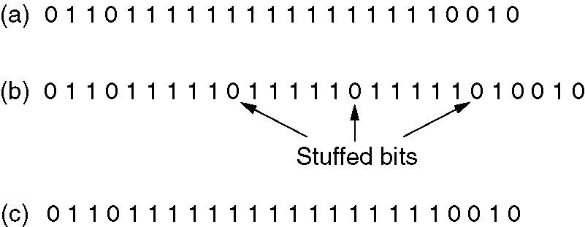
Framing – bit stuffing
e.g.: Reserved bit pattern 01111110
Bit stuffing
(a) The original data.
(b) The data as they appear on the line.
(c) The data as they are stored in receiver’s memory after destuffing.

Slide 29
Flow Control流量控制
SENDER
RECEIVER
Frame #n
…
Frame #2
Frame #1
Buffer
A receiver reserves some buffer space for storing data from a sender, while the data is being processed;
If the sender sends data faster than the receiver can process it, then buffer overflow will occur!

Slide 30
Flow Control流量控制
SENDER
RECEIVER
Frame #n
…
Frame #2
Frame #1
Buffer
The main problem we have to deal with here is how to prevent the sender from flooding the receiver with data faster than the latter is able to process them.
Flow control protocols enable the receiver to inform the sender when it is able to receive data.

Slide 31
Stop and Wait Protocols
停止等待协议
Sender: A
frame1
frame2
frame2
Retrans.
frame3
……
ack
nak
ack
Receiver: B
Protocols in which the sender sends one frame and then waits for an acknowledgement before proceeding are called stop-and-wait.

Slide 32
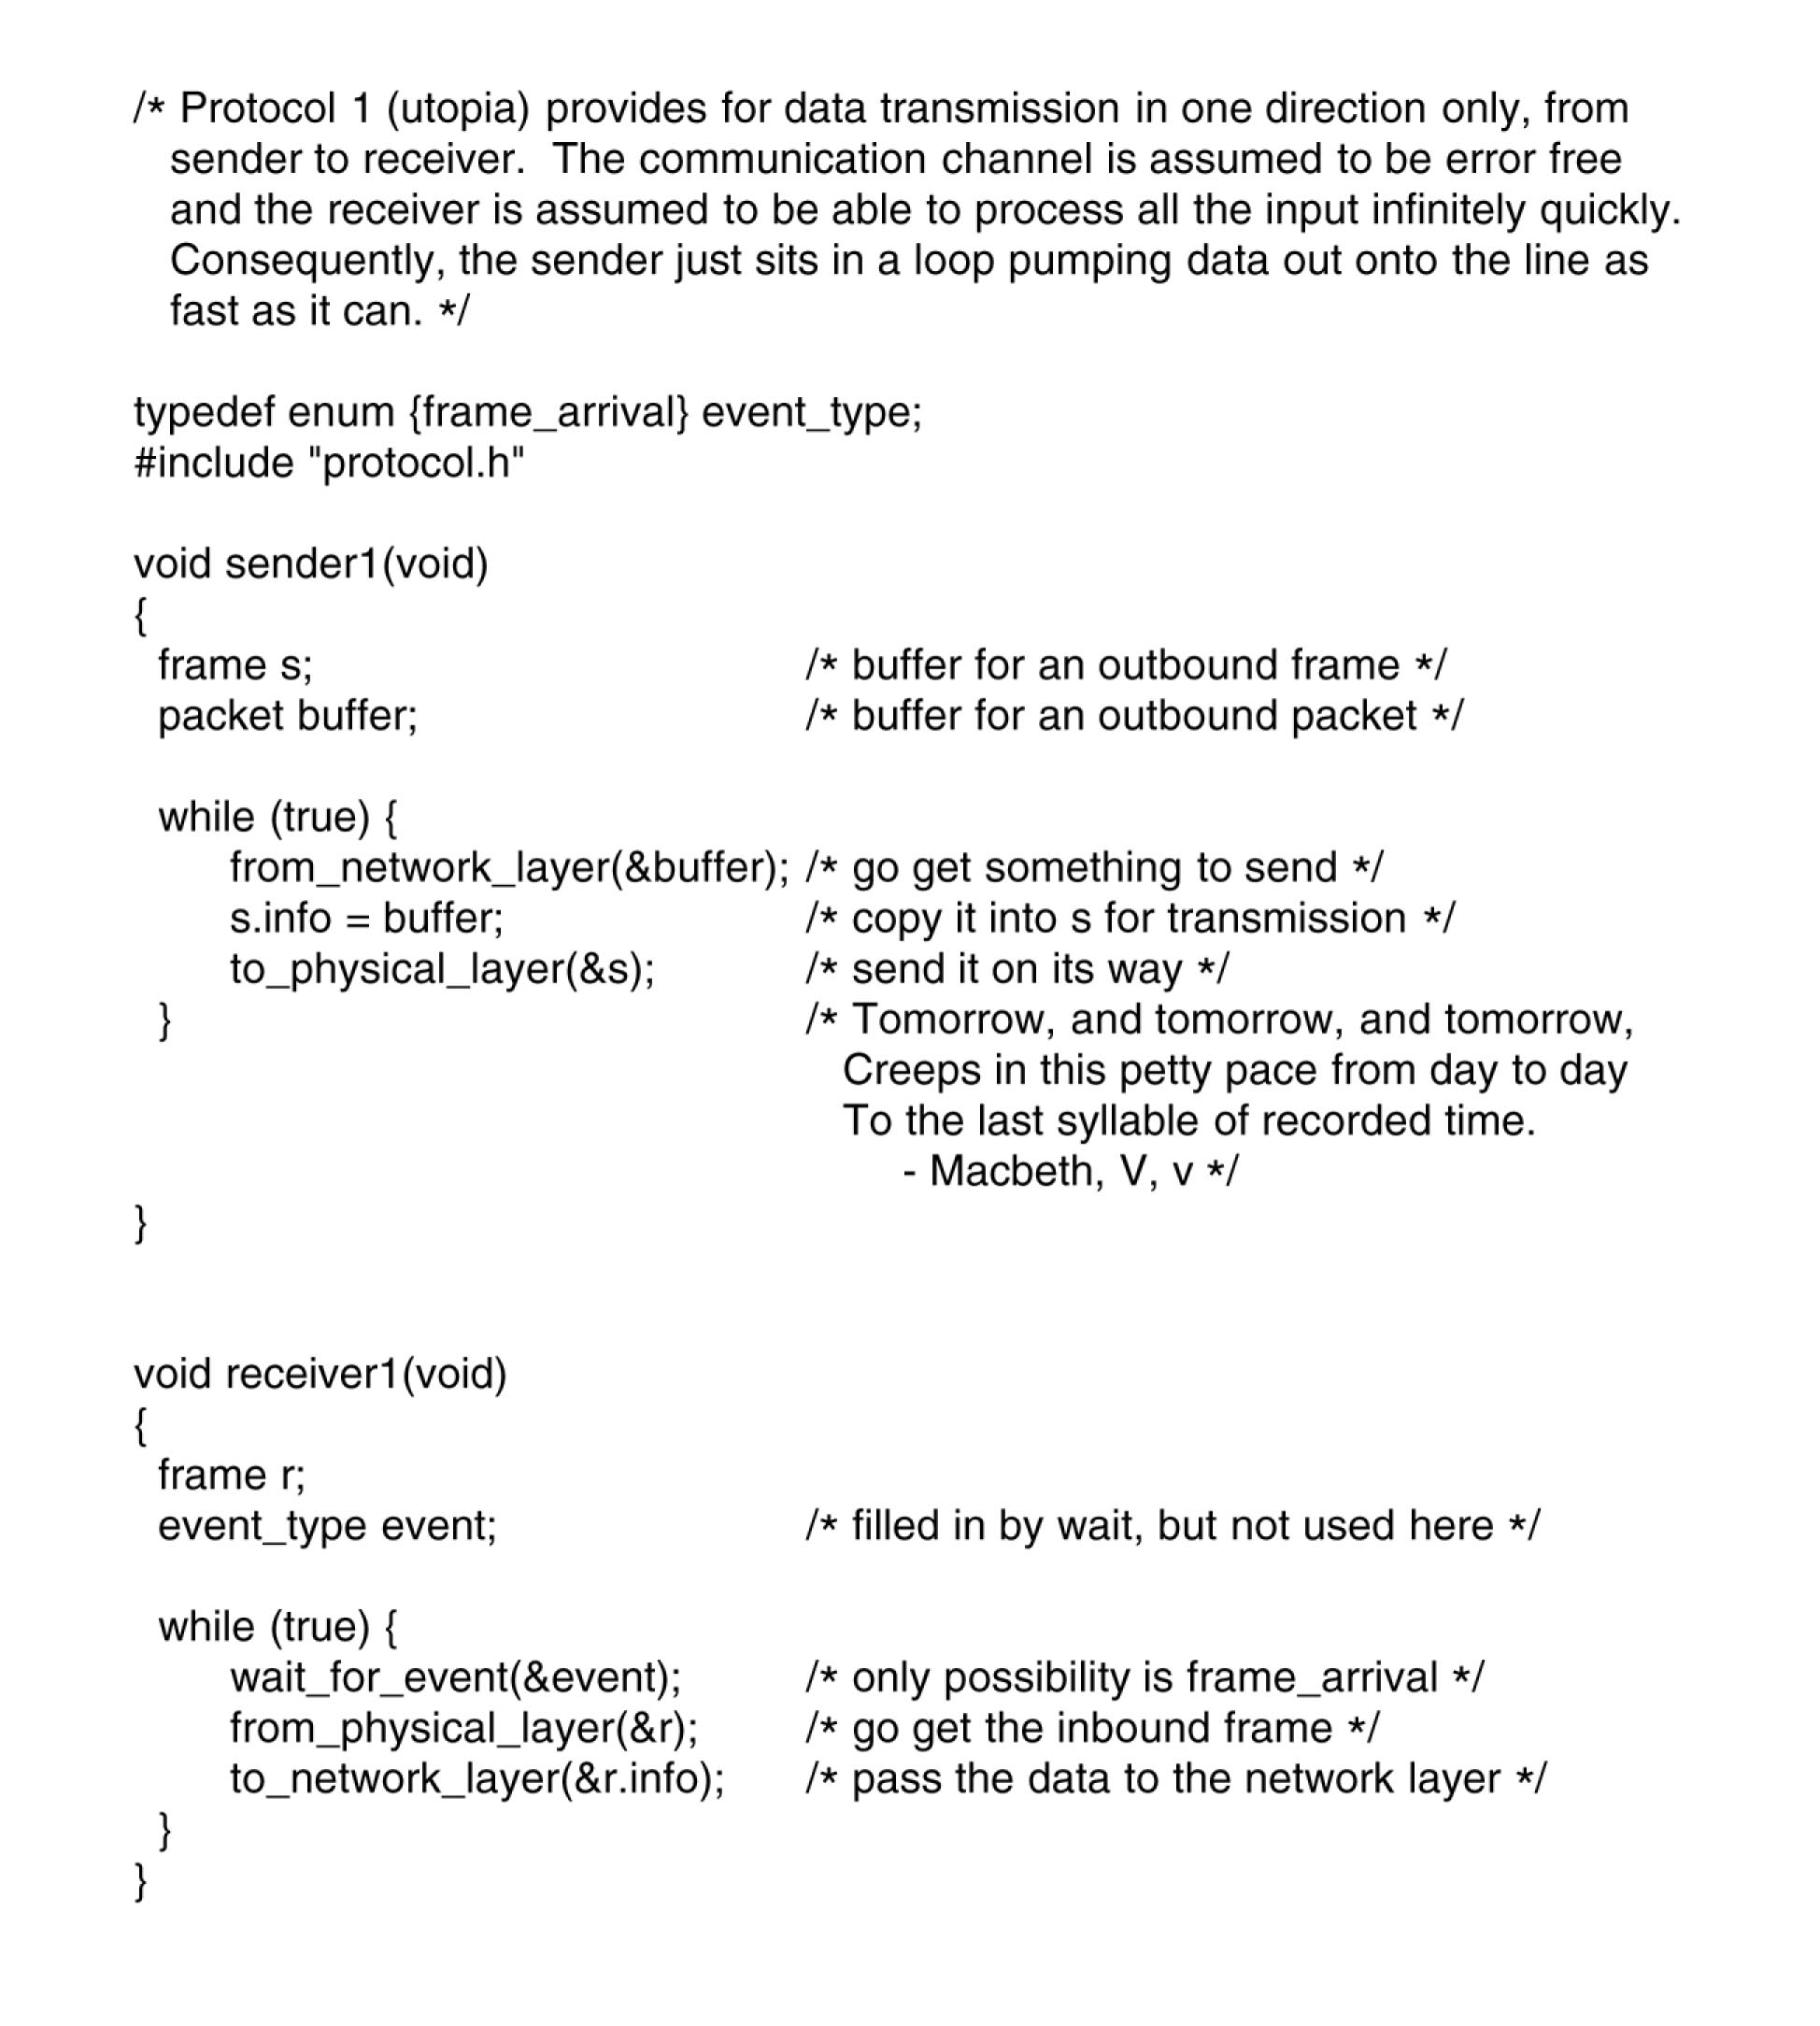
Stop and Wait Protocols
停止等待协议

Slide 33
Stop and Wait Protocols
停止等待协议
Problem: B sends a NAK frame back to A, after having received a data frame with errors. What happens if A always gets NAK frames.
A
frame1
frame2
frame2
Retrans.
frame2
Retrans.
……
ack
nak
nak
B

Slide 34
Stop and Wait Protocols
停止等待协议
Problem: B sends a NAK frame back to A, after having received a data frame with errors. What happens if A always gets NAK frames.
Solution: set a max. number for retransmission times, e.g. 8. If not successful, gives an error report to the above layer.

Slide 35
Stop and Wait Protocols
停止等待协议
Problem: Due to poor link conditions, the frame sent by A doesn't get B at all. It gets lost ! In this case, A will never get any response from the peer.
Solution: schedule a timeout timer超时计时器 to expire at some time after the ACK should have been returned. If the timer goes off, A retransmits the frame.

Slide 36
Stop and Wait Protocols
停止等待协议
Problem: Retransmissions may introduce duplicate frames received by B
Solution: assign sequence numbers序号 for every frame, so that B can distinguish between new frames and old copies. However, an ACK for the duplicated frame is still necessary! Why?

Slide 37
Stop and Wait Protocols
停止等待协议
A protocol, in which the sender waits for a positive acknowledgement before advancing to the next data item, are often called ARQ (Automatic Repeat reQuest).

Slide 38
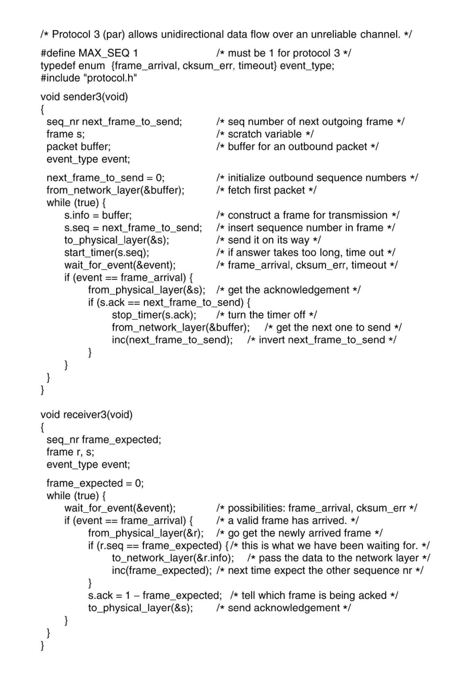
Stop and Wait Protocols
停止等待协议

Slide 39
Stop and Wait Protocols
停止等待协议
The ARQ protocol is very simple；
Unfortunately, it gives poor link utilization链路利用率.

Slide 40
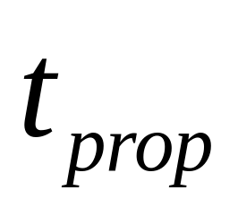
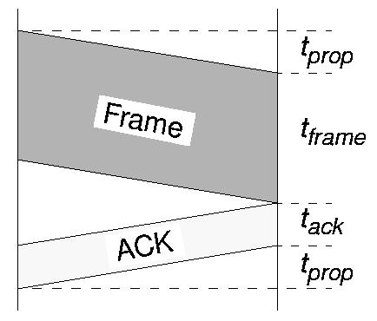
Stop-and-Wait Protocol Performance
Propagation delay:
defined as the delay between transmission and receipt of frames between hosts
can be used to estimate timeout period
A
B

Slide 41
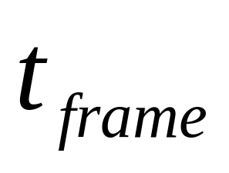
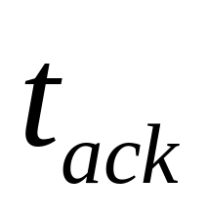
Stop-and-Wait Protocol Performance
→ Frame transmission time
→ Acknowledgment transmission time
A
B

Slide 42
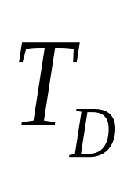
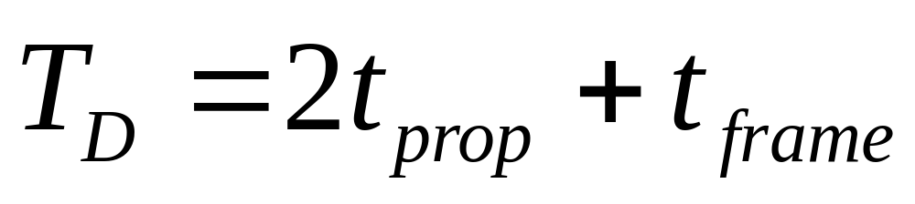
Stop-and-Wait Protocol Performance
Total delay
(ignoring ACK transmission time)
A
B

Slide 43
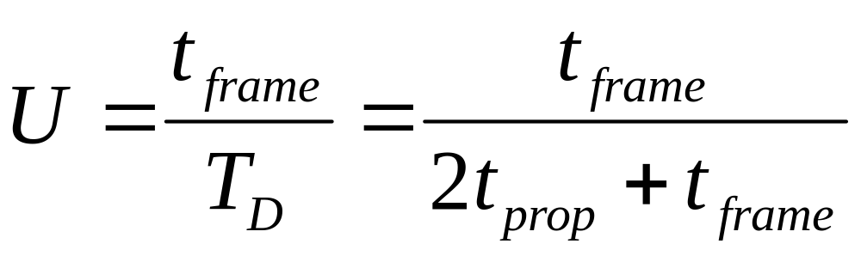
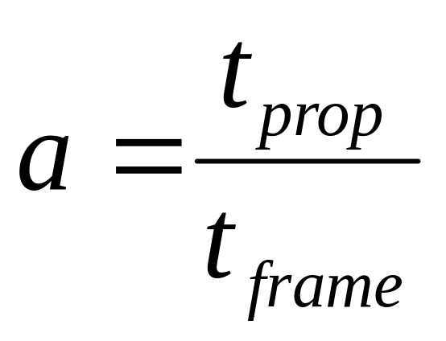
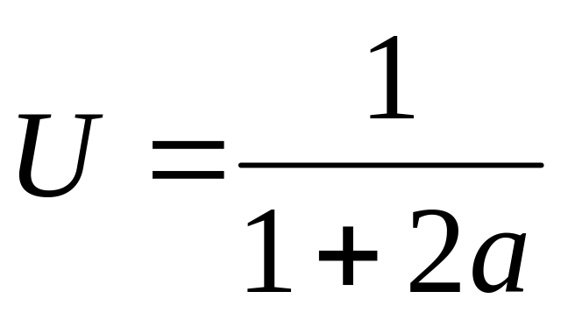
Stop-and-Wait Protocol Performance
Of this time, only t_{frame} is actually spent transmitting data. Therefore, the efficiency or utilization is:
If we define a:
then

Slide 44
Example #1
A channel has a bit rate of 4 Kbps and a propagation delay of 20 ms.
Question: For what range of frame sizes does the stop-­and-­ wait protocol give an efficiency of 50%?

Slide 45
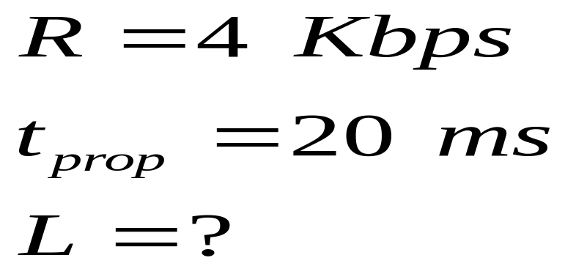
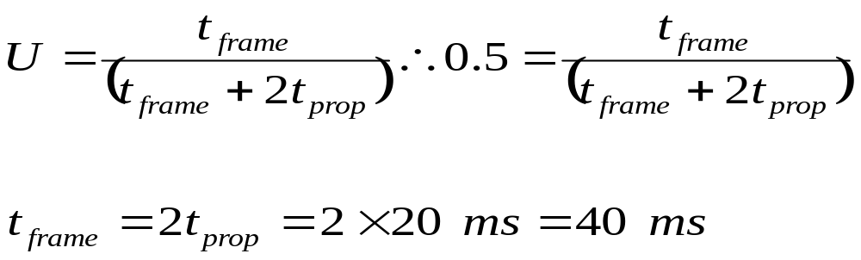
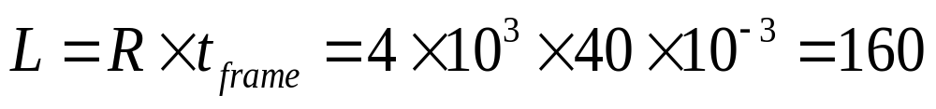
Example #1
A channel has a bit rate of 4 Kbps and a propagation delay of 20 ms. For what range of frame sizes does the stop­and­ wait protocol give an efficiency of 50 %?
Solution:
Thus for frame sizes L 160 bits, the stop­and­wait protocol gives an efficiency of 50 %

Slide 46
Example #1
A channel has a bit rate of 4 Kbps and a propagation delay of 20 ms. For what range of frame sizes does the stop­and­ wait protocol give an efficiency of 50 %?
Solution:
Thus for frame sizes L 160 bits, the stop­and­wait protocol gives an efficiency of 50 %

Slide 47
Example #1
A channel has a bit rate of 4 Kbps and a propagation delay of 20 ms. For what range of frame sizes does the stop­and­ wait protocol give an efficiency of 50 %?
Solution:
Thus for frame sizes L=160 bits, the stop-­and­-wait protocol gives an efficiency of 50%

Slide 48
Example #2
Two computers, A and B, are located at far ends of the network with
  rate R = 10 Mbps,
  max. distance d = 1500 m.
The propagation speed is V = 2 x 10⁸ m/sec
Now A wants to send a series of frames to B, with a fixed size of 800 bits. How many frames can it send per second actually?

Slide 49
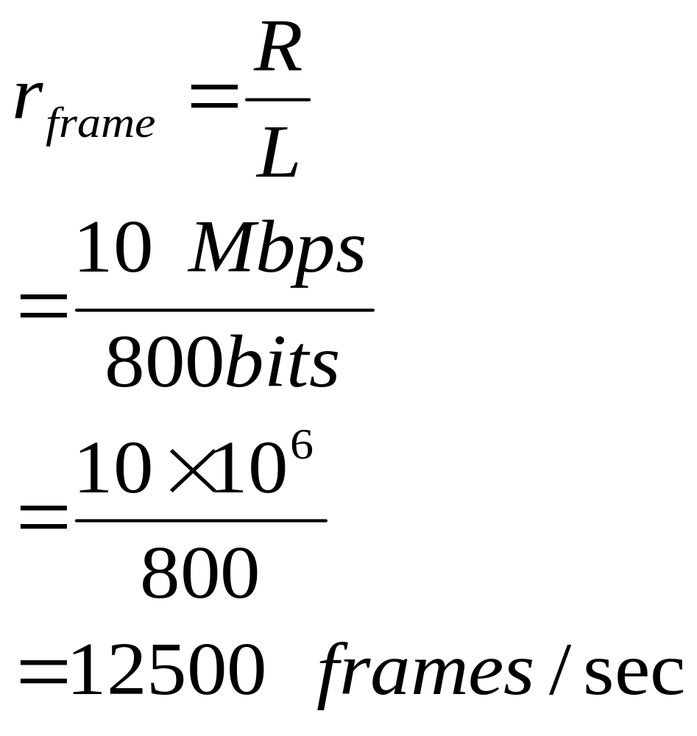
Example #2
Solution:
It is easy:
Data Rate R=10Mbps;
Frame Size= 800 Bits

Slide 50
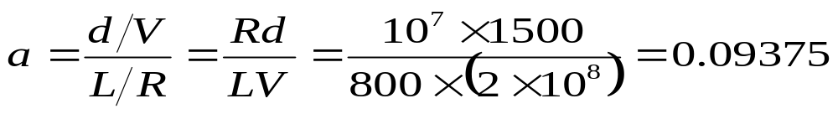
Example #2
Solution:

Slide 51
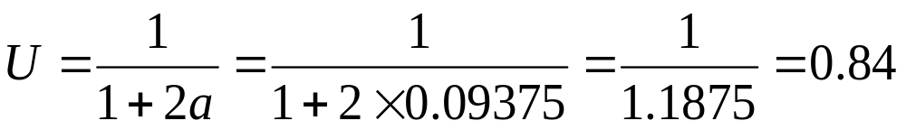
Example #2
Solution:

Slide 52
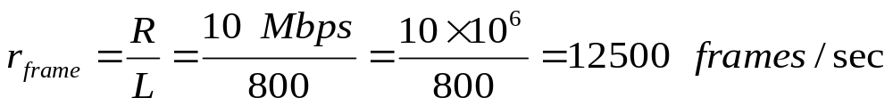
Example #2
Solution:

Slide 53
Example #2
Solution:

Slide 54
Stop and Wait Protocols
停止等待协议
Sender: A
frame1
frame2
frame2
Retrans.
frame3
……
ack
nak
ack
Receiver: B
Protocols in which the sender sends one frame and then waits for an acknowledgement before proceeding are called stop-and-wait.
REVIEW

Slide 55
Stop and Wait Protocols
停止等待协议
The ARQ protocol is very simple；
Unfortunately, it gives poor link utilization链路利用率.

Slide 56
Stop and Wait Protocols
停止等待协议
Sender: A
frame1
frame2
frame2
Retrans.
frame3
……
ack
nak
ack
Receiver: B
The stop-and-wait protocol is inefficient when the propagation delay is large compared to the transmission time;

Slide 57
Quiz
Imagine a link that uses a geo-stationary satellite地球同步卫星:
Satellite
Up link
Antenna
Down Link
Ground Station
Notes:
In order to implement this algorithm we had to address these six issues.

Slide 58
Quiz
Imagine a link that uses a geo-stationary satellite地球同步卫星:
  The data rate is 50-kbps.
  The round-trip delay is 500ms.
  What is the link utilization, if you use stop-­and­-wait protocol to send 1000-bit frames?
Satellite
Up link
Antenna
Down Link
Ground Station
Notes:
In order to implement this algorithm we had to address these six issues.

Slide 59
Long Transit Delays
Imagine a link that uses a geo-stationary satellite地球同步卫星:
  The data rate is 50-kbps.
  The round-trip delay is 500 msec.
  If we use stop-­and­-wait protocol to send a 1000-bit frame, the receiver will get
  the whole frame 270msec later.
Satellite
Up link
Antenna
Down Link
Ground Station
Notes:
In order to implement this algorithm we had to address these six issues.

Slide 60
Long Transit Delays
Imagine a link that uses a geo-stationary satellite地球同步卫星:
  The data rate is 50-kbps.
  The round-trip delay is 500 msec.
  If we use stop-­and­-wait protocol to send a 1000-bit frame, the receiver will get
  the whole frame 270msec later.
Satellite
Up link
Antenna
Down Link
Ground Station
Notes:
In order to implement this algorithm we had to address these six issues.

Slide 61
Long Transit Delays
Imagine a link that uses a geo-stationary satellite地球同步卫星:
  The acknowledgement will take a further 250msec to get back.
Satellite
Up link
Antenna
Down Link
Ground Station
Notes:
In order to implement this algorithm we had to address these six issues.

Slide 62
Long Transit Delays
Imagine a link that uses a geo-stationary satellite地球同步卫星:
  Out of 520msec, data is only being sent for 20msec.
  Only 20/520 ≈ 4% of the link’s capacity is being utilised.
Satellite
Up link
Antenna
Down Link
Ground Station
Notes:
In order to implement this algorithm we had to address these six issues.

Slide 63
Sliding Window Protocols
(滑动窗口协议)
Rather than wasting so much channel capacity, a protocol can be designed to send enough frames to keep the link busy.
A Sliding Window Protocol is introduced.
0
1
2
3
4
5
6
7
8
9
10

Slide 64
Sliding Window Protocols
(滑动窗口协议)
0
1
2
3
4
5
6
7
8
9
10
N=5
Sender
……
Receiver

Slide 65
Sliding Window Protocols
(滑动窗口协议)
Purpose: to limit the maximum number of frames sent by sender without waiting for acknowledgement.
A sending window is used to control the data delivery speed from sender.
0
1
2
3
4
5
6
7
8
9
10

Slide 66
Sliding Window Protocols
(滑动窗口协议)
目的：限制发送方已经发出，但未被确认的数据帧的最大数目。
发送窗口用来控制发送方的流量。发送窗口内的帧是允许发送的帧，而不考虑有没有收到接收方的确认
0
1
2
3
4
5
6
7
8
9
10

Slide 67
Sliding Window Protocols
(滑动窗口协议)
The essence of all sliding window protocols is that at any instant of time, the sender maintains a set of sequence numbers corresponding to frames it is permitted to send. These frames are said to fall within the sending window.
0
1
2
3
4
5
6
7
8
9
10

Slide 68
Stop and Wait Protocols
停止等待协议
Sender: A
frame1
frame2
frame2
Retrans.
frame3
……
ack
nak
ack
Receiver: B
Protocols in which the sender sends one frame and then waits for an acknowledgement before proceeding are called stop-and-wait.

Slide 69
Sliding Window Protocols
(滑动窗口协议)
Quiz: What is the size of the sending window for a simple Stop-and-Wait Protocol?
✓
Congratulations! ☺☺☺
Answer: one.

Slide 70
Sliding Window Protocols
(滑动窗口协议)
N=5
Sender
Receiver
0
1
2
3
4
5
6
7
8
9
10

Slide 71
Sliding Window Protocols
(滑动窗口协议)
N=5
Sender
Receiver
0
1
2
3
4
5
6
7
8
9
10

Slide 72
Sliding Window Protocols
(滑动窗口协议)
N=5
Sender
Receiver
0
1
2
3
4
5
6
7
8
9
10

Slide 73
Summary
The Sliding window protocol overcomes this inefficiency by allowing multiple frames to be in transit at one time;
The receiver allocates buffer space for n frames;

Slide 74
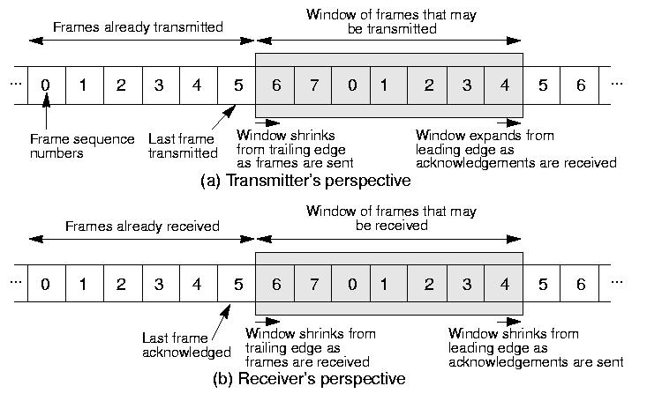
Sliding Window Protocol
Notes:
In order to implement this algorithm we had to address these six issues.

Slide 75
Summary
The sender can send upto n frames without waiting for any ack;
Each of n frames contains an unique sequence number;
The sender maintains a list of sequence number it is allowed to send;
The receiver maintains a list of sequence number it is prepared to receive (window) ;

Slide 76
Sequence numbers usually occupy a field with a limited number of bits in the frame header.
  We don’t want to have sequence numbers that are too large because that would waste valuable bandwidth.
  Sequence numbers occupy a whole number of bits, the range of sequence numbers is usually 0 to 2^{k}-1 where k is the number of bits used.
  For example, we could have a 1-bit sequence number. This will be enough for a sliding window protocol with window size 1.

Slide 77
Sliding Windows Protocol
Here is what happens if we have a 3-bit sequence number and a window size of 1 on both sender and receiver:
No Frame to send
Got Frame 0 to send
Waiting for Frame 0 ACK
Got ACK for Frame 0
7
0
7
0
7
0
7
0
6
1
6
1
6
1
6
1
5
2
5
2
5
2
5
2
4
3
4
3
4
3
4
3
Sending Frame
Sending ACK
7
0
7
0
7
0
7
0
6
1
6
1
6
1
6
1
5
2
5
2
5
2
5
2
4
3
4
3
4
3
4
3
Waiting for Frame 0
Getting
Frame 0
Got Frame 0,
Waiting for Frame 1
Waiting for Frame 1
Notes:
In order to implement this algorithm we had to address these six issues.

Slide 78
Sliding Window Protocol
Sliding window is best known algorithm in networking
First role is to enable reliable delivery of frames
  Timeouts and acknowledgements
Second role is to enable in order delivery of frames
  Receiver doesn’t pass data up to the upper layer until it has frames in order
Third role is to enable flow control
  Prevents sender from overflowing receiver’s buffer

Slide 79
Stop and Wait Protocols
停止等待协议
Sender: A
frame1
frame2
frame2
Retrans.
frame3
……
ack
nak
ack
Receiver: B
The stop-and-wait protocol is inefficient when the propagation delay is large compared to the transmission time;

Slide 80
Quiz
Imagine a link that uses a geo-stationary satellite地球同步卫星:
Satellite
Up link
Antenna
Down Link
Ground Station
Notes:
In order to implement this algorithm we had to address these six issues.

Slide 81
Quiz
Imagine a link that uses a geo-stationary satellite地球同步卫星:
  The data rate is 50-kbps.
  The round-trip delay is 500ms.
  What is the link utilization, if you use stop-­and­-wait protocol to send 1000-bit frames?
Satellite
Up link
Antenna
Down Link
Ground Station
Notes:
In order to implement this algorithm we had to address these six issues.

Slide 82
Long Transit Delays
Imagine a link that uses a geo-stationary satellite地球同步卫星:
  Out of 520msec, data is only being sent for 20msec.
  Only 20/520 ≈ 4% of the link’s capacity is being utilised.
Satellite
Up link
Antenna
Down Link
Ground Station
Notes:
In order to implement this algorithm we had to address these six issues.

Slide 83
Pipelining流水线
Rather than wasting so much channel capacity, a protocol can be designed to send enough frames to keep the link working at full capacity.
  we can allow up to 26 outstanding frames (enough to fill the 520msec round-trip delay period).
Notes:
In order to implement this algorithm we had to address these six issues.

Slide 84
Pipelining流水线
Rather than wasting so much channel capacity, a protocol can be designed to send enough frames to keep the link working at full capacity.
  we can allow up to 26 outstanding frames (enough to fill the 520msec round-trip delay period).
Notes:
In order to implement this algorithm we had to address these six issues.

Slide 85
Pipelining流水线
Rather than wasting so much channel capacity, a protocol can be designed to send enough frames to keep the link working at full capacity.
  we can allow up to 26 outstanding frames (enough to fill the 520msec round-trip delay period).
Notes:
In order to implement this algorithm we had to address these six issues.

Slide 86
Pipelining
  The sliding window of the sender need only be enlarged to 26 frames.
  So, a 5-bit (0-31) sequence number would be most suitable.
  With a sliding window size of 26, up to 26 frames and acknowledgements can be in transit at any time.
Notes:
In order to implement this algorithm we had to address these six issues.

Slide 87
Sliding Window Protocols
(滑动窗口协议)
In order to improve the link utilization, we can allow up to n outstanding frames in transit at any time.
REVIEW

Slide 88
Sliding Window Protocols
(滑动窗口协议)
The real question is: “What happens when one of the frames is damaged during transit?”

Slide 89
Go Back n 后退n帧协议
One approach is to discard the damage frame and all the frames that follow it.
  Eventually the sender will realise it has not received an ACK for the damage frame within the timeout period.
  The sender will then retransmit the damage frame and all the frames that follow it.

Slide 90
Go Back n 后退N帧协议
  This time sequence diagram shows what happens when an erroneous frame (E) is received.
  All following frames are discarded (D) until the new copy of the erroneous frame is received.
Timeout interval
0
1
2
3
4
5
2
3
4
5
6
7
Ack 0
Ack 1
Ack 2
Ack 3
Ack 4
0
1
E
D
D
D
2
3
4
time

Slide 91
Go Back n
The main advantage of go back n is that the receiver only needs to maintain enough buffer space for one frame at a time.
  Frames must be passed up to the Network Layer in the order in which they were sent by the Network Layer in the source host.
  Only one frame needs to be stored at a time since the frames will always arrive in the correct order.

Slide 92
Go Back n
To implement the go back n, the sliding window of the receiver is set to 1 (i.e., different from the sliding window of the sender).
  With a sliding window size of 1, the receiver will only accept the frame with the next expected frame sequence number.
  When a frame is damaged, the next expected frame sequence number remains the same.

Slide 93
Go Back n
Go back n can waste a lot of link capacity by re-sending frames that arrived perfectly the first time.
If a link is particularly noisy, this waste can significantly reduce the link’s throughput链路的吞吐量.

Slide 94
数据链路层协议
Summary
Go Back n后退n帧协议：to discard the damage frame and all the frames that follow it, then retransmit all of them.

Slide 95
Selective Repeat选择性重传
With selective repeat, only those frames that are damaged are re-sent. Undamaged frames are stored until they can be passed (in the correct order) to the Network Layer.
  The receiver must have enough buffer space available to potentially store all the outstanding frames from the sender.
  Much less of the link’s capacity is wasted since only the damaged frames are retransmitted and the rest of the time the link can carry useful data.

Slide 96
Selective Repeat
  Frames may arrive at the destination out of order. This means that the Data Link Layer is responsible for ordering them before sending the packets they contain to the Network Layer.
Timeout interval
0
1
2
3
4
5
2
6
7
8
9
10
Ack 0
Ack 1
Ack 1
Ack 1
Ack 1
Ack 5
Ack 6
Ack 7
0
1
E
3
4
5
2
6
7
time

Slide 97
Selective Repeat
  The selective repeat protocol can be implemented by setting the receiver sliding window size to more than 1 (usually it is set to the same size as the sender’s sliding window).
Timeout interval
0
1
2
3
4
5
2
6
7
8
9
10
Ack 0
Ack 1
Ack 1
Ack 1
Ack 1
Ack 5
Ack 6
Ack 7
0
1
E
3
4
5
2
6
7
time

Slide 98
Chapter 3
The Data Link Layer
(contd.)

Slide 99
Sliding Window Protocols
(滑动窗口协议)
N=5
Sender
Receiver
0
1
2
3
4
5
6
7
8
9
10

Slide 100
Sliding Window Protocols
(滑动窗口协议)
N=5
Sender
Receiver
0
1
2
3
4
5
6
7
8
9
10

Slide 101
Sliding Window Protocols
(滑动窗口协议)
N=5
Sender
Receiver
0
1
2
3
4
5
6
7
8
9
10

Slide 102
Sliding Window Protocols
(滑动窗口协议)
Purpose: to limit the maximum number of frames sent by sender without waiting for acknowledgement.
A sending window is used to control the data delivery speed from sender.
0
1
2
3
4
5
6
7
8
9
10

Slide 103
Sliding Window Protocols
(滑动窗口协议)
The real question is: “What happens when one of the frames is damaged during transit?”

Slide 104
数据链路层协议
Summary
Go Back n后退n帧协议：to discard the damage frame and all the frames that follow it, then retransmit all of them.
Selective Repeat选择性重传：With selective repeat, only those frames that are damaged are re-sent.

Slide 105
例题：
两台主机之间的数据链路层采用后退N帧协议(GBN)传输数据，数据传输速率为16kbps，单向传播时延为270ms，数据帧长度范围是128~512字节，接收方总是以与数据帧等长的帧进行确认。为使信道利用率达到最高，帧序号的比特数至少应取多少？
2012年全国硕士研究生入学统一考试：计算机学科专业基础综合

Slide 106
2012年全国硕士研究生入学统一考试
计算机学科专业基础综合
36. 答案：
数据帧长度：128~512 B
数据帧发送时间
最短(128*8)/16=64ms
最长(512*8)/16=256ms
从发出数据帧第1位开始，到收到来自接收方的ACK的时间：
最短(64+270)*2=668ms
最长(256+270)*2=1052ms
要使得信道利用率达到最高，则落入发送窗口的数据帧数为:
668/64=10.4375 ~
1052/256=4.109375
帧序号的比特数至少应为4

Slide 107
Duplex Communication双向通信
The protocols we have seen so far just send data in one direction. Of course, data will usually flow in both directions.
  it makes sense to piggyback acknowledgements on these frames.
Header
Data
Host A
Host B
Header
ACK
Data

Slide 108
Duplex Communication双向通信
The protocols we have seen so far just send data in one direction. Of course, data will usually flow in both directions.
  This saves the overhead involved in sending a separate frame just to carry an ACK.
Header
Data
Host A
Host B
Header
ACK
Data
Notes:
In order to implement this algorithm we had to address these six issues.

Slide 109
Duplex Communication双向通信
The protocols we have seen so far just send data in one direction. Of course, data will usually flow in both directions.
  Of course, if no frames are due to be sent back, we will have no choice but to send back a separate ACK frame.
Header
Data
Host A
Host B
Header
ACK
Data
Notes:
In order to implement this algorithm we had to address these six issues.

Slide 110
Error Control差错控制
SENDER
RECEIVER
Frame #n
…
Frame #2
Frame #1
Suppose something went wrong during frame transmission.
Notes:
In order to implement this algorithm we had to address these six issues.

Slide 111
Error Control差错控制
SENDER
RECEIVER
Frame #n
…
Frame #2
Frame #1
When data is sent as a sequence of frames, two types of error can occur:
  Lost frame: the frame fails to arrive at the receiver. This may be due to a noise burst destroying the frame beyond recognition面目全非
  Damaged frame: A recognizable frame arrives at the receiver but some bits are in error
★
★
Notes:
In order to implement this algorithm we had to address these six issues.

Slide 112
Error Control差错控制
SENDER
RECEIVER
Frame #n
…
Frame #2
Frame #1
How do we actually notice that something’s wrong, and can it be corrected by the receiver?
  Error Detection检错
  Acknowledgment确认
  Error Correction纠错
Notes:
In order to implement this algorithm we had to address these six issues.

Slide 113
Error Control差错控制
SENDER
RECEIVER
Frame #n
…
Frame #2
Frame #1
Error Detection/Retransmission
检错/重传机制:
The sender includes only enough redundancy to allow the receiver to deduce that an error occurred, but not which error (error-detecting codes);
The receiver have it request a retransmission.
Notes:
In order to implement this algorithm we had to address these six issues.

Slide 114
Error Control差错控制
SENDER
RECEIVER
Frame #n
…
Frame #2
Frame #1
Forward Error Correction (FEC):
前向纠错机制:
The sender includes enough redundant information along with each block of data sent (error-correcting codes), to enable the receiver to deduce what the transmitted data must have been.
Notes:
In order to implement this algorithm we had to address these six issues.

Slide 115
Error Control差错控制
SENDER
RECEIVER
Frame #n
…
Frame #2
Frame #1
Suppose the frame was lost on the way. How do the sender notice it, and how to deal with it?
What if a frame was transmitted multiple times?
Notes:
In order to implement this algorithm we had to address these six issues.

Slide 116
Error Control差错控制
SENDER
RECEIVER
Frame #n
…
Frame #2
Frame #1
Suppose the frame was lost on the way. How do the sender notice it, and how to deal with it?
Timers and Retransmission
What if a frame was transmitted multiple times?
Sequence Numbers for every
frame.
Notes:
In order to implement this algorithm we had to address these six issues.

Slide 117
Error Control差错控制
Typically, reliable delivery is achieved using the “acknowledgments with retransmission” paradigm
Notes:
In order to implement this algorithm we had to address these six issues.

Slide 118
Error Control
Error control is concerned with insuring that all frames are eventually delivered (possibly in order) to a destination.
How? Three items are required:
(1) Acknowledgements确认
the receiver returns a special acknowledgment (ACK) frame to the sender indicating the correct receipt of a frame, or
the receiver sends a negative acknowledgment (NACK) frame back, indicating that something has gone wrong during transmission.
Notes:
In order to implement this algorithm we had to address these six issues.

Slide 119
Error Control
Error control is concerned with insuring that all frames are eventually delivered (possibly in order) to a destination.
How? Three items are required:
(2) Timers计时器
when the sender transmits a frame, it generally starts a timer.
The timer is set to expire after an interval long enough for
  the frame to reach the destination,
  be processed there
  have the ack frame propagate back
  to the sender.
Notes:
In order to implement this algorithm we had to address these six issues.

Slide 120
Error Control
Error control is concerned with insuring that all frames are eventually delivered (possibly in order) to a destination.
How? Three items are required:
(2) Timers计时器
If either the data frame or the acknowledgement is lost, the timer will go off, alerting the sender to retransmission.
Notes:
In order to implement this algorithm we had to address these six issues.

Slide 121
Error Control
Error control is concerned with insuring that all frames are eventually delivered (possibly in order) to a destination.
How? Three items are required:
Negative Acknowledgements
In some systems, the receiver returns a NACK for incorrectly-received frames.
But this is nothing more than a hint to the sender so that it can retransmit a frame right away without waiting for a timer to expire.
Notes:
In order to implement this algorithm we had to address these six issues.

Slide 122
Error Control
Error control is concerned with insuring that all frames are eventually delivered (possibly in order) to a destination.
How? Three items are required:
(3) Sequence Numbers序列号
Retransmissions introduce the possibility of duplicate frames.
To suppress duplicates, add
sequence numbers to each
frame, so that a receiver can
distinguish between new
frames and old copies.
Notes:
In order to implement this algorithm we had to address these six issues.

Slide 123
Cyclic Redundancy Code
A Cyclic Redundancy Code (CRC) 循环冗余校验 is a more sophisticated type of checksum.
If a CRC is used, it is extremely unlikely that any errors will go undetected.
Although the technique may sound a little complicated, in practice calculating a CRC is easy and can be implemented in hardware.
CRC

Slide 124
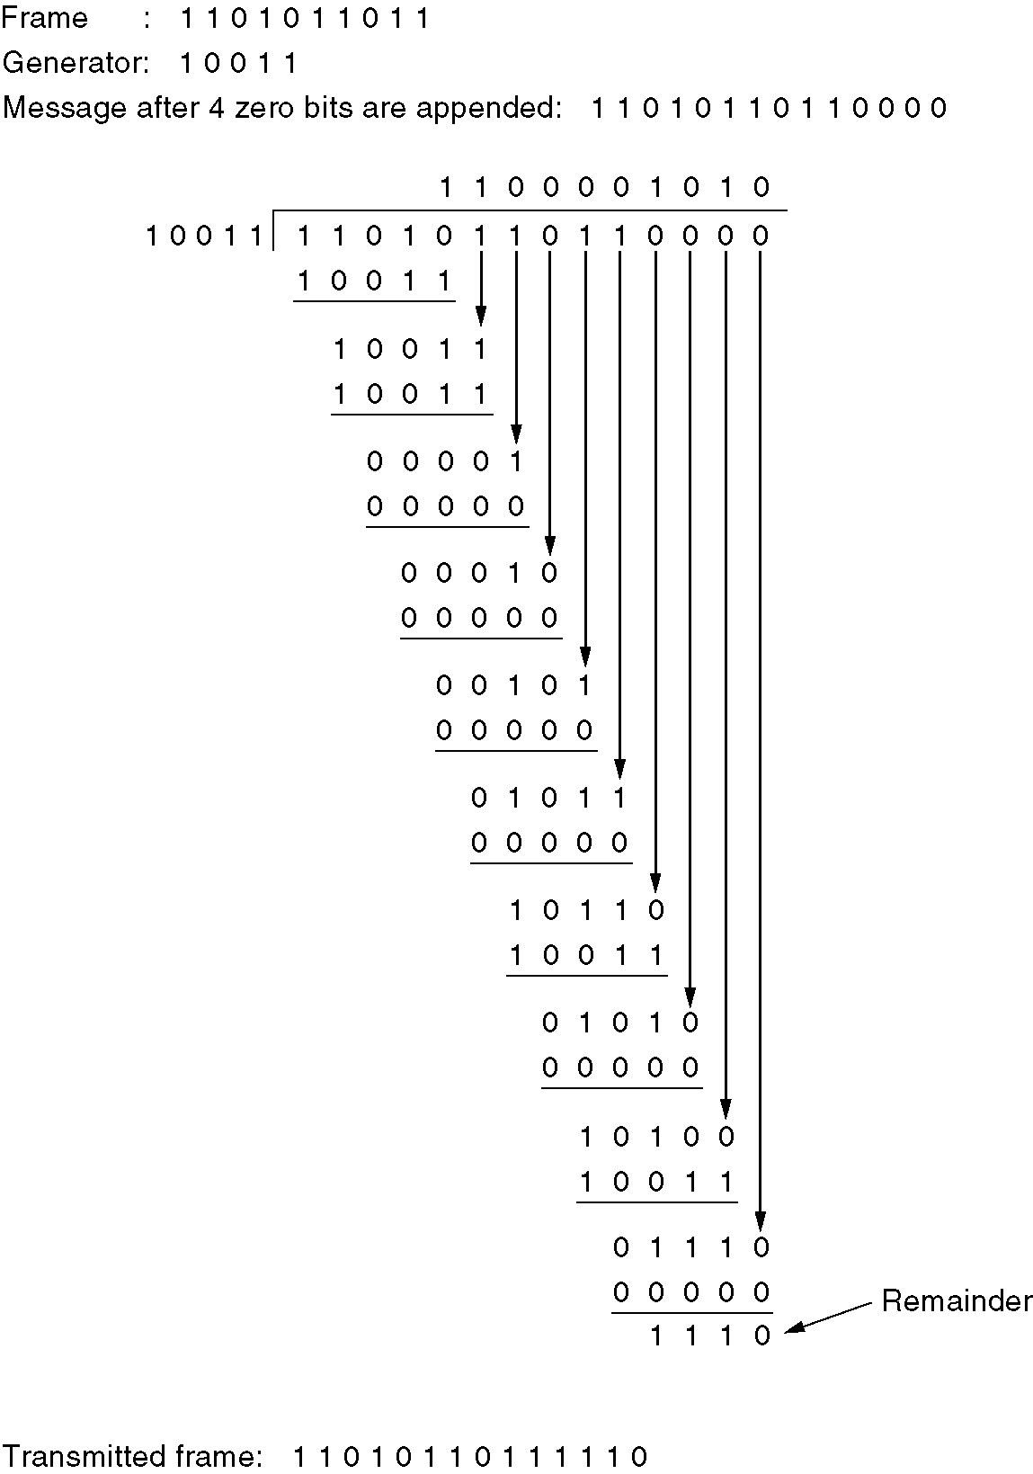
Calculation of the polynomial code checksum

Slide 125
Data Link Protocols： Example
HDLC – High-Level Data Link Control高级数据链路控制
PPP--Point-to-Point Protocol--The Data Link Layer protocol in the Internet

Slide 126
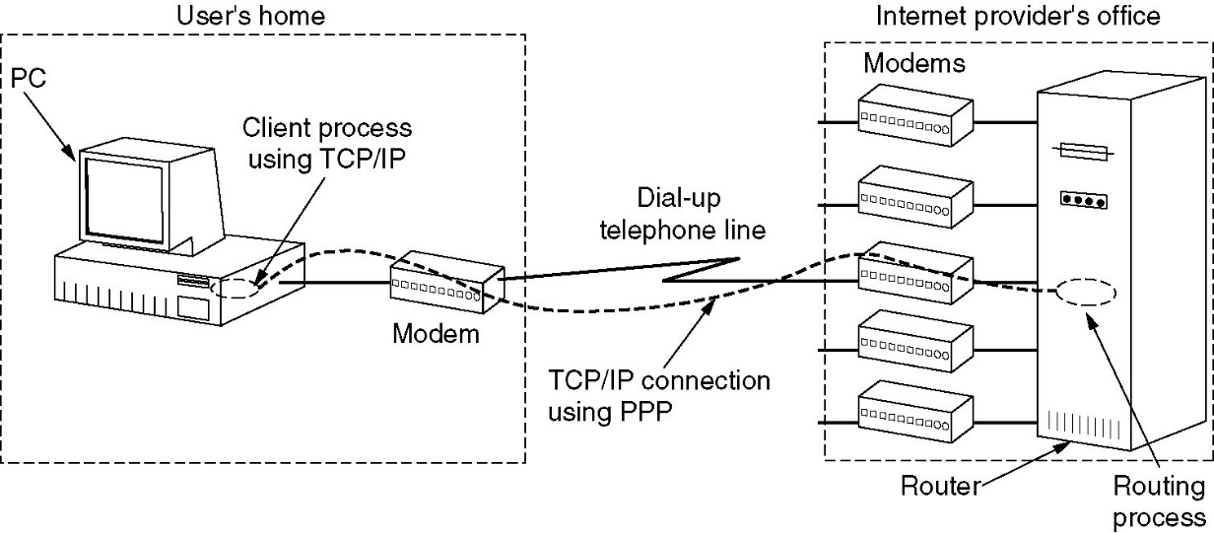
Point-to-Point Protocol
The Point-to-Point Protocol (PPP) is used in the Internet for a variety of purposes,
  router-to-router traffic
  home user-to-ISP traffic.

Slide 127

Point-to-Point Protocol
Step 1: Call the ISP’s router through a modem to setup a physical connection.
Step 4: Client process using TCP/IP.
Step 2: Sending a number of LCP to negotiate what kind of PPP connection you want.
Step 3: Using NCP to negotiate network layer stuff, like getting an IP address.

Slide 128
Point-to-Point Protocol
PPP handles error detection,
PPP supports multiple protocols,
PPP allows IP addresses to be negotiated at connection time,
PPP permits authentication身份验证
PPP has many other features.

Slide 129
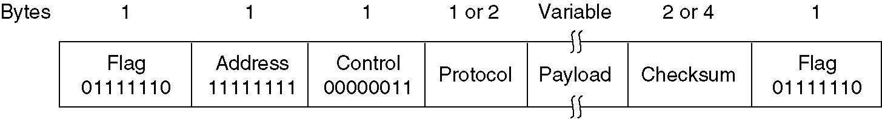
Point-to-Point Protocol
A framing method that unambiguously delineates 精确描绘 the end of one frame and the start of the next one. The frame format also handles error detection.
The PPP frame format is closely resemble the HDLC frame format. The major difference between PPP and HDLC is that PPP is character oriented rather than bit oriented.

Slide 130
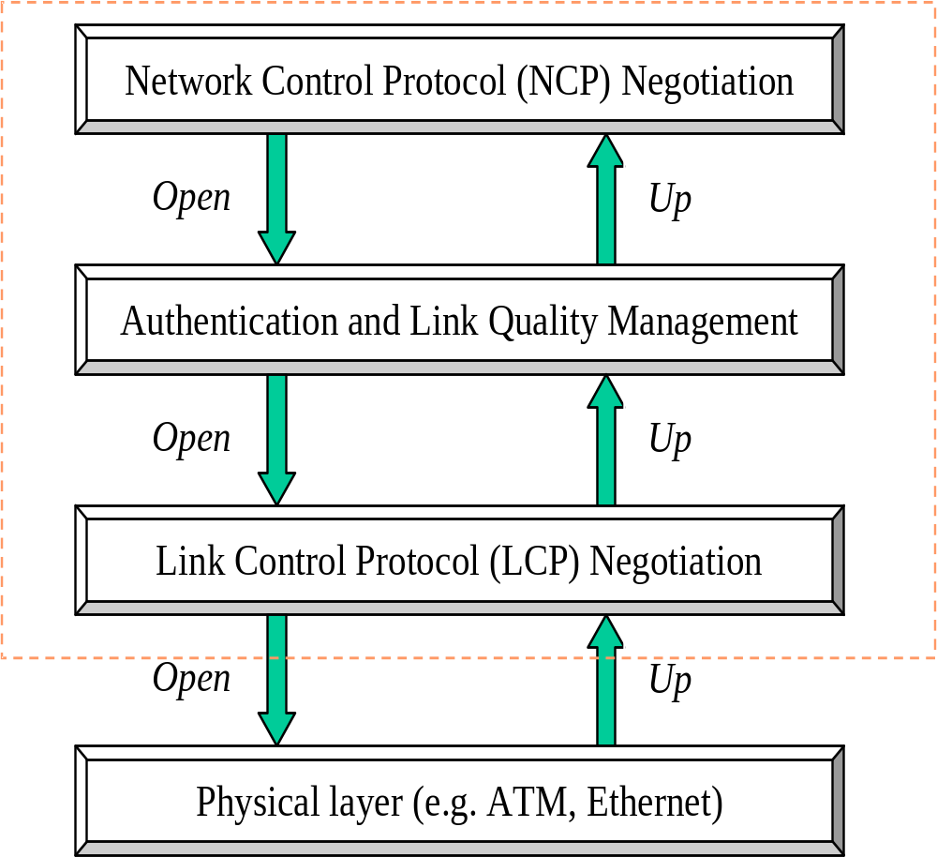
点对点协议PPP
PPP协议族的层次结构

Slide 131
点对点协议PPP
当外部事件指示物理层准备就绪(Up)时，PPP进入链接建立阶段：
PPP经历的三个阶段：
  “Establish”，
  “Authenticate”
  “Network”
使某一层准备就绪的条件：
  来自上一层的OPEN请求(requests)；
  来自下一层的UP事件(events)；
  本层内成功的参数协商。

Slide 132
Point-to-Point Protocol
LCP (Link Control Protocol)-- A link control protocol for
  bringing lines up,
  testing them,
  negotiating options, and
  bringing them down again gracefully when they are no longer needed.

Slide 133
Point-to-Point Protocol
LCP supports synchronous and asynchronous circuits同步/异步电路
LCP supports byte-oriented and bit-oriented encodings.

Slide 134
Point-to-Point Protocol
The different NCP (Network Control Protocol) for each network layer supported to negotiate network-layer options in a way that is independent of the network layer protocol to be used.

Slide 135
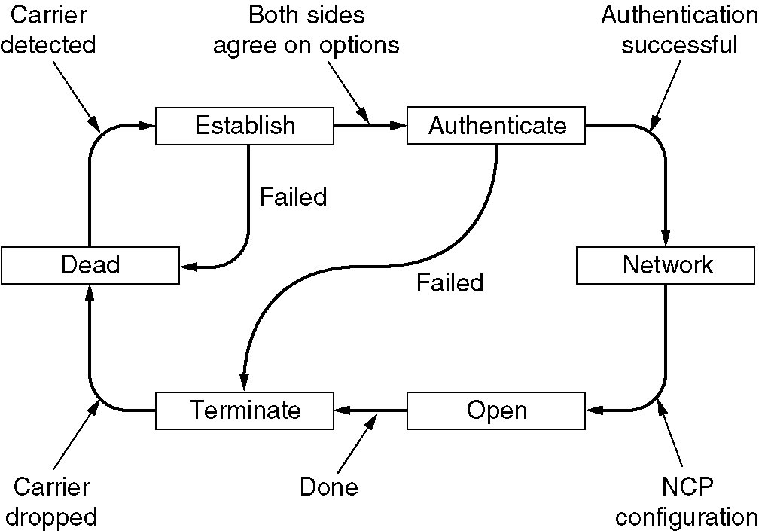
PPP – Point to Point Protocol

Slide 136
Link Dead (静止状态)：物理层没有准备就绪；
Link Establishment(链接建立状态)：通过交换一系列的数据帧，双方协商配置选项(Configuration Options) ；
Authentication(鉴别状态)：
Network-Layer Protocol (网络状态)：通过网络控制协议配置网络层协议，例如IP.

Slide 137
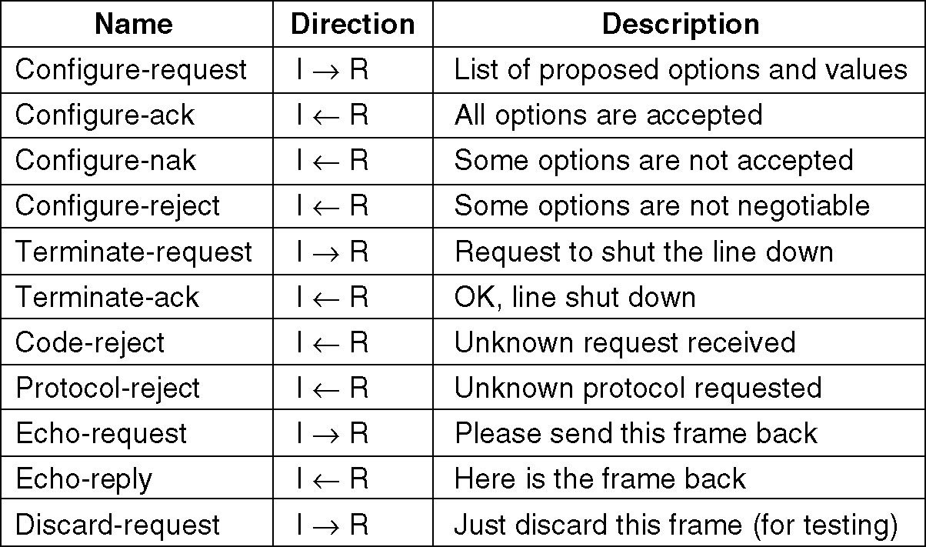
PPP – Point to Point Protocol
The LCP frame types.
The LCP frame types

