Slide 1
Chapter 2
The Physical Layer
物理层

Slide 2
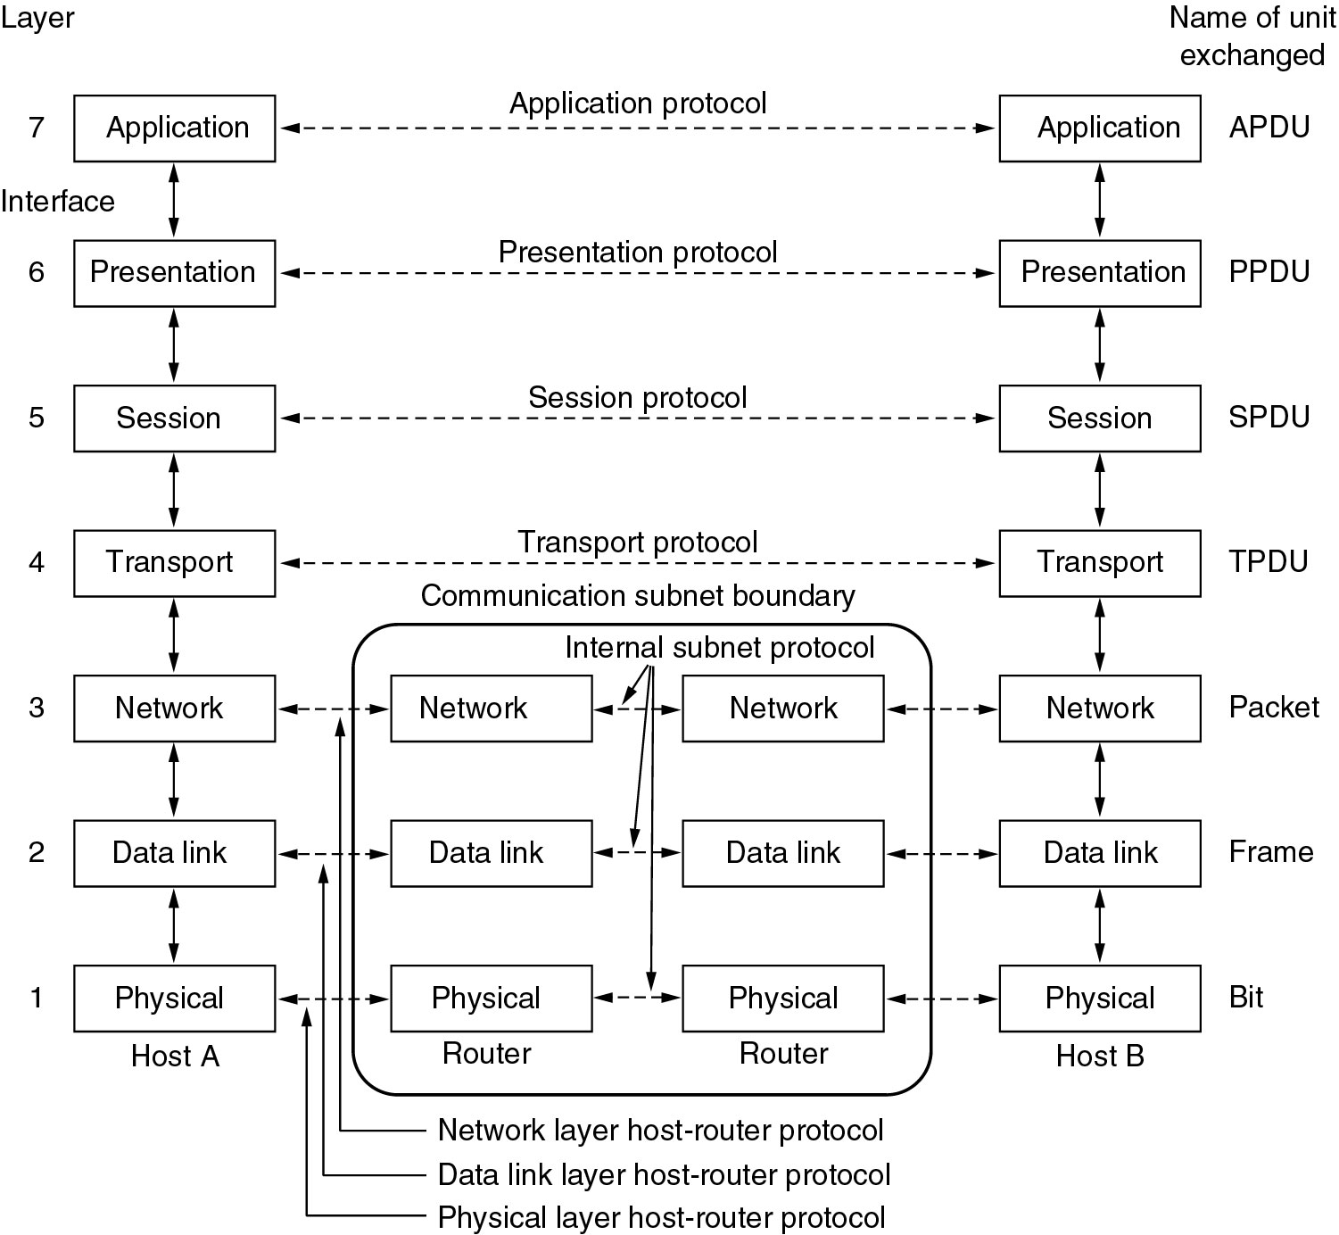
Data Transmission from one host to another one across the network
The Physical Layer performs
bit by bit transmission
010111110000110101…

Slide 3
The Physical Layer
The specifications技术规范 of the Physical Layer include:
  Mechanical and electrical interfaces (机械和电气接口)
  Sockets and wires used to connect the host to the network
  Voltage levels uses (e.g. -5V and +5V)

Slide 4
The Physical Layer
The specifications技术规范 of the Physical Layer include:
  Encoding techniques (编码技术), e.g. Manchester encoding
  Modulation techniques used (调制技术)
  The bit rate(比特率) and the baud rate (波特率).

Slide 5
Signal Transmission (信号传输)
Electronic energy to send signals that communicate from one node to another
Two methods of transmitting data
  Digital signaling数字信号
  Analog signaling模拟信号

Slide 6
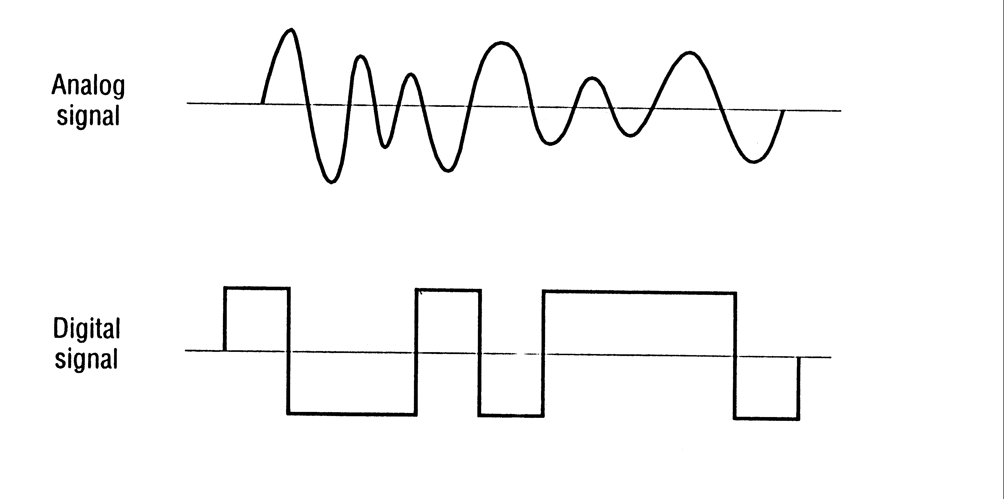
Comparison of Digital and Analog (数字信号和模拟信号)

Slide 7
Digital Signaling 数字信号编码
Digital signal represents discrete state (离散状态): on or off
Practically instantaneous change(瞬间变化)

Slide 8
Digital Signaling
Current State Encoding
Data is encoding by the presence or absence of a signal数据按信号的有或无来编码
A positive voltage might represent a binary one or binary zero
The current state indicates the value of the data

Slide 9
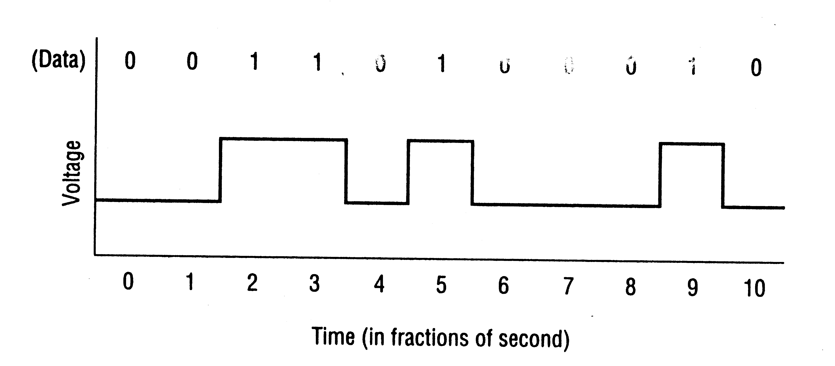
Digital Signaling
Current State当前状态

Slide 10
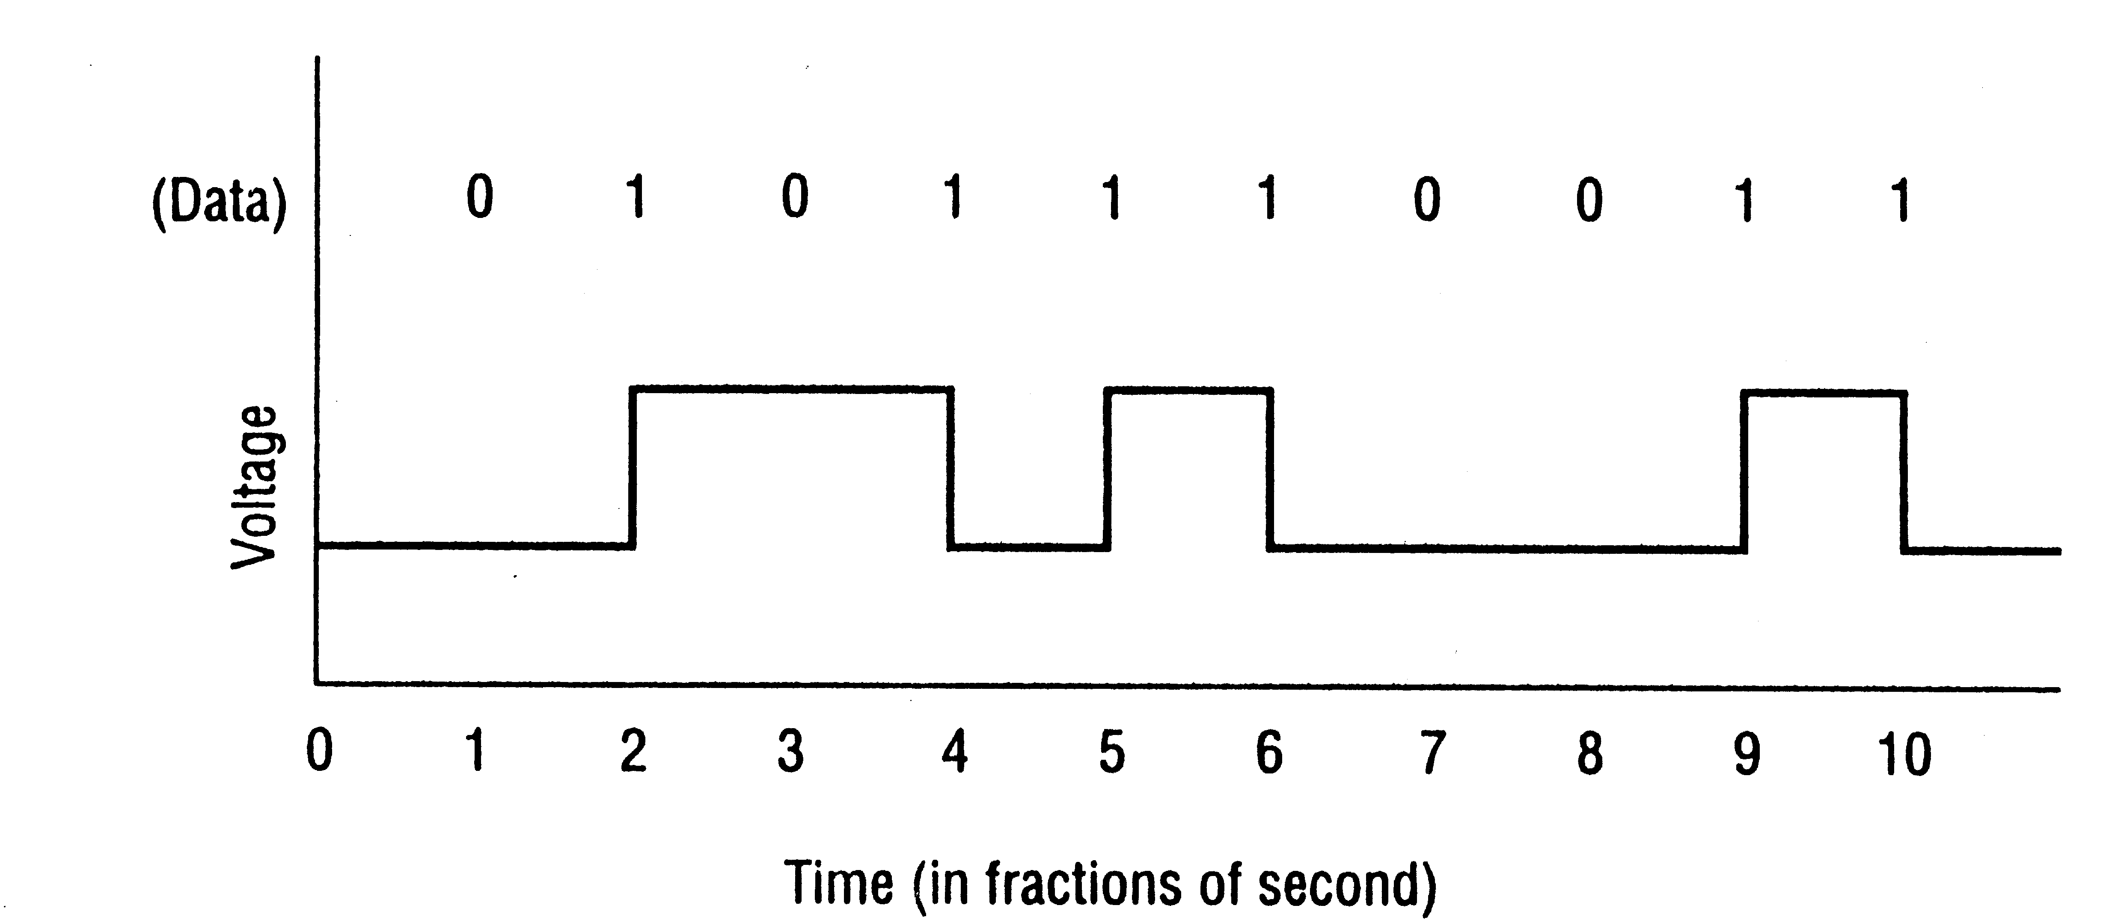
Digital Signaling
State Transition状态变迁

Slide 11
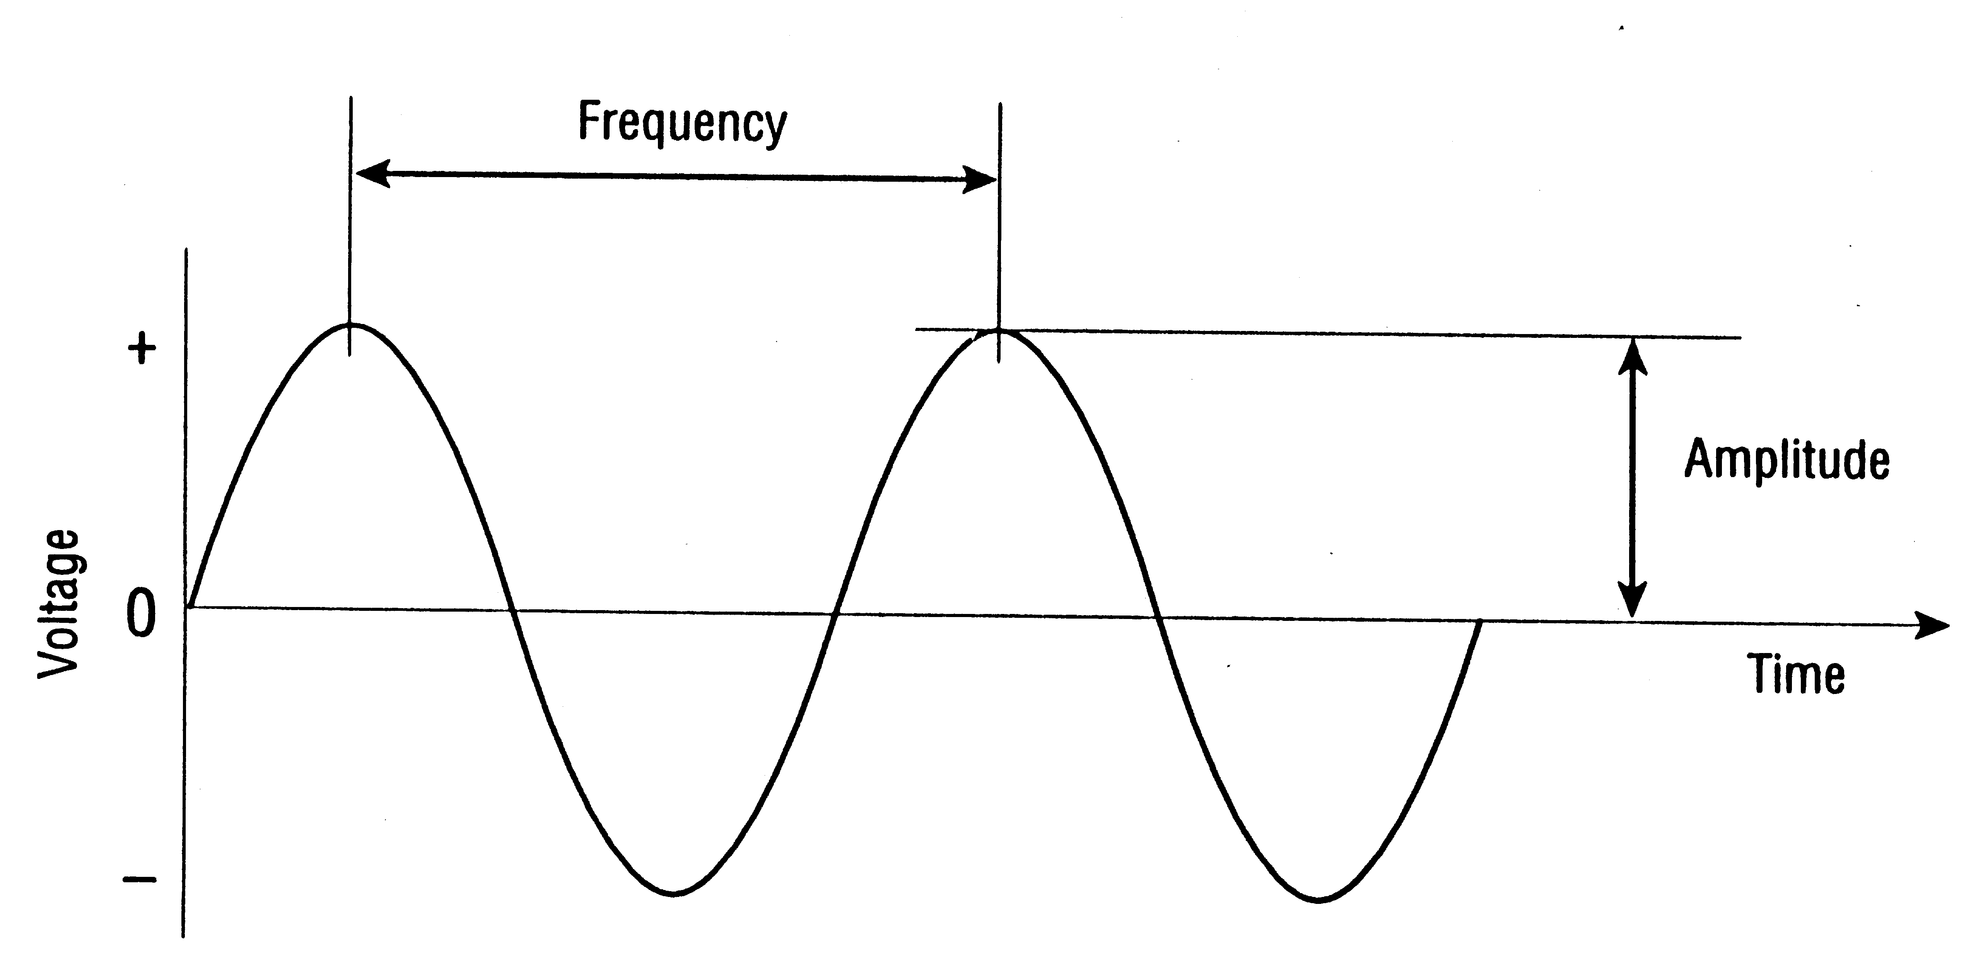
Analog Signaling 模拟信号编码
Signals represented by an electromagnetic wave电磁波
Signal is continuous and represents values in a range

Slide 12
Analog Signaling 模拟信号编码
Uses one or more of the characteristics of an analog wave to represent ones and zeros

Slide 13
Parts of a Wave波的组成
The number of complete wave cycles every second is the frequency频率.
The maximum intensity of a wave is called the amplitude振幅.

Slide 14
Parts of a Wave波的组成
The distance between two crests is the wavelength波长.
The phase difference相位差 measures (as an angle) how far ahead one wave is when compared to another wave.
Phase
相位:
Relative state of one wave to another in regards to timing
Wavelength (λ)
or period
Amplitude (a)
Phase difference (φ)
Notes:
In order to implement this algorithm we had to address these six issues.

Slide 15
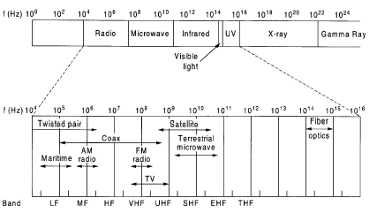
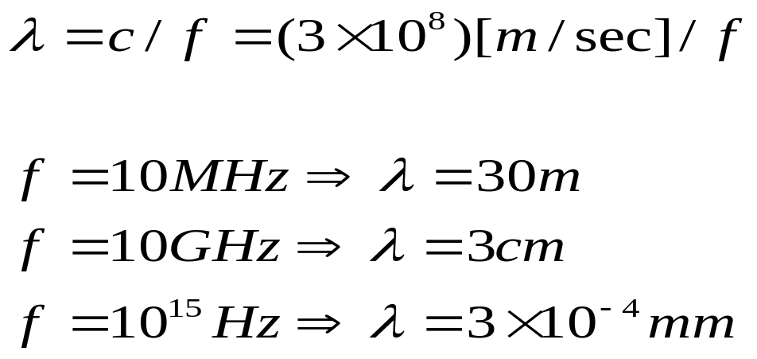
ELECTROMAGNETIC SPECTRUM
电磁波频谱
Wavelength
Frequency

Slide 16
ELECTROMAGNETIC SPECTRUM
电磁波频谱
f(Hz)
10⁰ 10² 10⁴ 10⁶ 10⁸ 10¹⁰ 10¹² 10¹⁴ 10¹⁶ 10¹⁸ 10²⁰ 10²² 10²⁴
无线电
微波
红外线
X射线
γ
射线
f (Hz)
可见光
紫外线
10⁴ 10⁵ 10⁶ 10⁷ 10⁸ 10⁹ 10¹⁰ 10¹¹ 10¹² 10¹³ 10¹⁴ 10¹⁵ 10¹⁶
双绞线
卫星
光纤
同轴电缆
地面微波
海事
无线电
调幅
无线电
调频
无线电
移动
无线电
电视
LF
MF
HF
VHF
UHF
SHF
EHF
THF
波段
波长
频率

Slide 17
Wire Propagation Effects传播效应
Propagation Effects
    Signal changes as it travels
    Receiver may not be able to recognise it
Original
Signal
Final
Signal
Distance

Slide 18
Propagation Effects: Attenuation衰减
Attenuation: signal gets weaker as it propagates
  Attenuation becomes greater with distance
  May become too weak to recognise
Signal
Strength
Distance

Slide 19
Propagation Effects: Distortion失真
Distortion: signal changes shape as it propagates
  Adjacent bits may overlap相邻位重叠
  May make recognition impossible for receiver
Distance

Slide 20
Propagation Effects: Noise噪音
Noise: thermal energy热能 in wire adds to signal
  Noise floor is average noise energy
  Random signal随机信号, so spikes sometimes occur
Signal
Strength
信号强度
Spike
Signal
Noise
Noise Floor
Time

Slide 21
Propagation Effects: SNR(Signal-to-Noise Ratio)
We want a high SNR (信噪比)
  Signal strength divided by average noise strength（SNR=信号强度/平均噪音强度）
  As SNR falls, errors increase
Signal
Strength
Signal
SNR
Noise Floor
Distance

Slide 22
Propagation Effects: Interference干扰
Interference: energy from outside the wire
  Adds to signal, like noise
  Often intermittent间歇的, so hard to diagnose诊断
Signal
Strength
Signal
Interference
Time

Slide 23
Theoretical Basis
Information can be transmitted on wires by varying some physical property, such as voltage or current电压或电流.

Slide 24
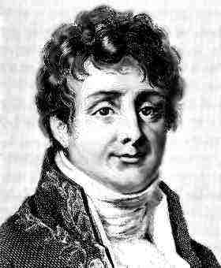
Fourier Analysis 傅立叶分析
让·巴普蒂斯·约瑟夫·傅立叶(Baron Jean Baptiste Joseph Fourier，1768-1830)，法国数学家、物理学家。主要贡献是在研究《热的传播》和《热的分析理论》时创立了一套数学理论，对19世纪的数学和物理学的发展都产生了深远影响。

Slide 25
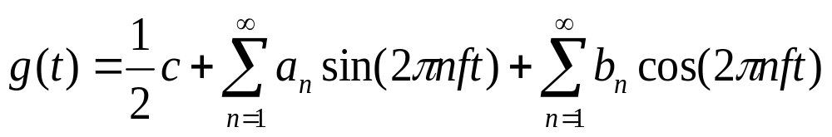
Fourier Analysis 傅立叶分析
Fourier proved that any reasonably behaved periodic function, g(t) with period T can be constructed as the sum of a (possibly infinite) number of sines and cosines:
Joseph Fourier
(1768--1830)

Slide 26
Fourier Analysis 傅立叶分析
Fourier proved that any reasonably behaved periodic function, g(t) with period T can be constructed as the sum of a (possibly infinite) number of sines and cosines:
傅立叶证明：任何正常的周期为T的函数g(t)，都可以由（可能无限个）正弦和余弦函数合成。

Slide 27
Fourier Analysis 傅立叶分析
Fourier proved that any reasonably behaved periodic function, g(t) with period T can be constructed as the sum of a (possibly infinite) number of sines and cosines:
where
f = 1/T is the fundamental frequency基频,
a_{n} and b_{n} are the sine and cosine
amplitudes振幅 of the n^{th} harmonics谐波
c is a constant.

Slide 28
Fourier Analysis 傅立叶分析
From the Fourier series, the function can be reconstructed, i.e. the original function of time can be found, if
  the period, T, is known and
  the amplitudes are given

Slide 29
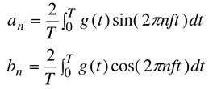
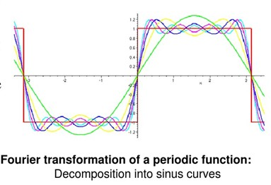
Fourier Analysis 傅立叶分析

Slide 30
Chapter 2
The Physical Layer
(contd.)

Slide 31
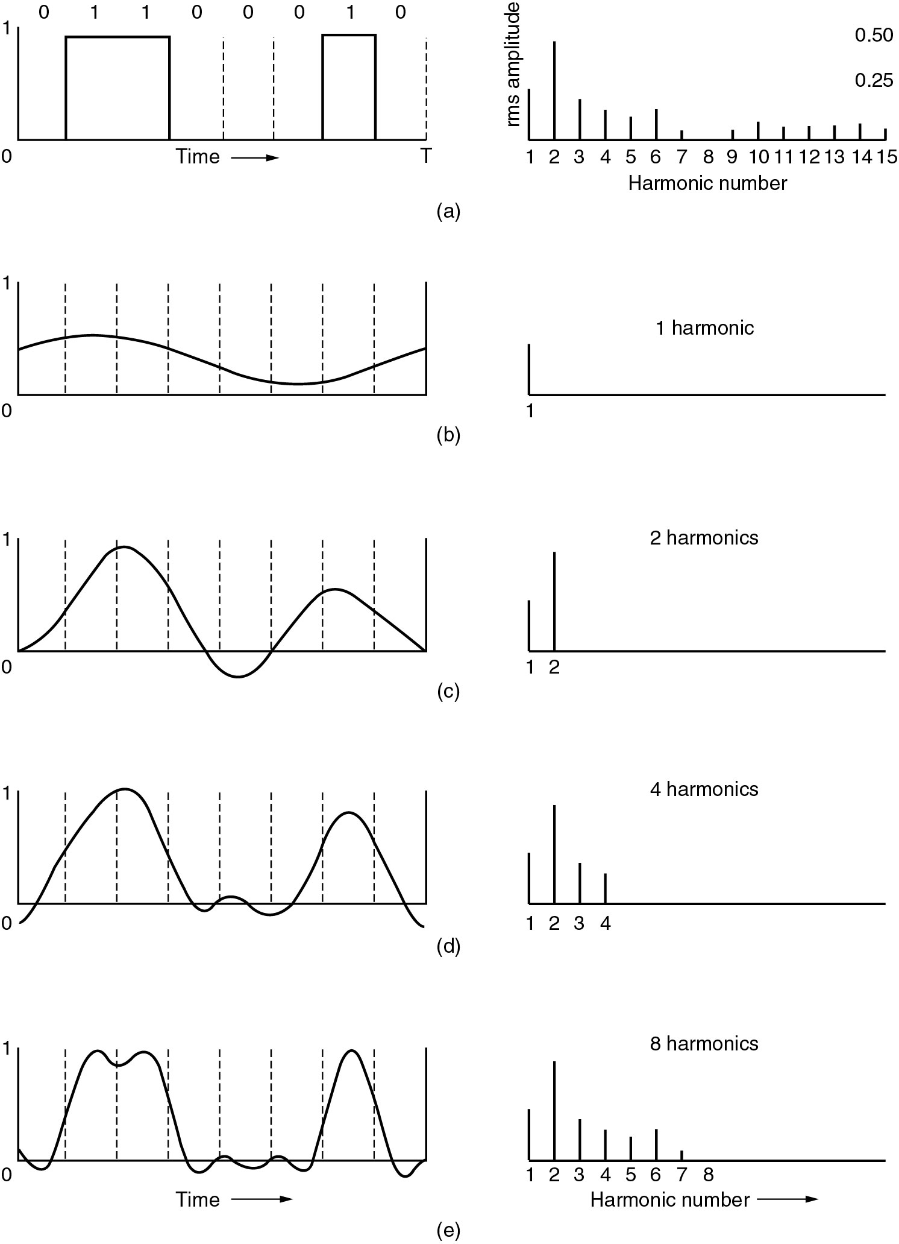
Bandwidth-Limited Signals
有限带宽信号
振幅
谐波数
The bit pattern that is to be transmitted is 01100010 (left-hand part of the figure)
A specific example:

Slide 32
Fourier Analysis 傅立叶分析
Fourier proved that any reasonably behaved periodic function, g(t) with period T can be constructed as the sum of a (possibly infinite) number of sines and cosines:
傅立叶证明：任何正常的周期为T的函数g(t)，都可以由（可能无限个）正弦和余弦函数合成。

Slide 33
Bandwidth-Limited Signals
有限带宽信号
振幅
谐波数
No transmission facility can transmit signals without losing some power in the process.

Slide 34
Bandwidth-Limited Signals
有限带宽信号
振幅
谐波数
No transmission facility can transmit signals without losing some power in the process.所有的传输线路在传输信号的过程中都要损失一些能量。

Slide 35
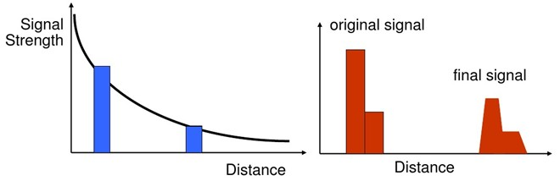
Bandwidth-Limited Signals
有限带宽信号
If all the Fourier components were equally diminished, the resulting signal would be reduced in amplitude but not distorted.如果所有傅立叶分量都等量衰减的话，。。。。。。This is ideal!

Slide 36
Bandwidth-Limited Signals
有限带宽信号
Unfortunately, all transmission facilities diminish different Fourier components by different amounts(对不同傅立叶分量的衰减不同), thus introducing distortions(失真)。

Slide 37
Bandwidth-Limited Signals
有限带宽信号
振幅
谐波数
Usually, the amplitudes are transmitted undiminished from 0 up to some frequency f_{c} with all frequencies above this cutoff frequency截至频率 attenuated.

Slide 38
Bandwidth-Limited Signals
有限带宽信号
振幅
谐波数
The range of frequencies transmitted without being strongly attenuated is called the bandwidth带宽.
The bandwidth: capacity of a media to carry information.

Slide 39
Bandwidth-Limited Signals
有限带宽信号
振幅
谐波数
In practice, the cutoff is not really sharp, so often the quoted bandwidth is from 0 to the frequency at which half the power gets through.

Slide 40
Bandwidth-Limited Signals
有限带宽信号
振幅
谐波数
Now let us consider how the signal of Fig.(a) would look if the bandwidth were so low that only the lowest frequencies were transmitted
(a) A binary signal and its root-mean-square Fourier amplitudes.
(b) – (c) Successive approximations连续逼近 to the original signal.

Slide 41
Bandwidth-Limited Signals
有限带宽信号
振幅
谐波数
(a) A binary signal and its root-mean-square Fourier amplitudes.
(b) – (c) Successive approximations连续逼近 to the original signal.

Slide 42
Bandwidth-Limited Signals
有限带宽信号

Slide 43
Bandwidth-Limited Signals
有限带宽信号
Successive approximations连续逼近 to the original signal.

Slide 44
Baud Rate波特率
Bit Rate比特率
The maximum number of times a signal can change in a second is called the baud rate.波特率是单位时间(每秒)传输波形的个数。
The number of bits (1s and 0s) transmitted in a second is called the bit rate.比特率是单位时间(每秒)传输的比特数。
Notes:
In order to implement this algorithm we had to address these six issues.

Slide 45
Baud Rate波特率
Bit Rate比特率
波特率与比特率是两个完全不同的概念，但二者在数量上却有一定的关系。
若一个波形(码元)只携带1bit的信息量，则二者在数值上是相等的。
Notes:
In order to implement this algorithm we had to address these six issues.

Slide 46
Baud Rate / Bit Rate
In the examples we have seen so far, the bit rate and the baud rate are the same.
This is not always the case！
The bit rate can be higher than the baud rate if we use more than two signal levels (more later on…).
Notes:
In order to implement this algorithm we had to address these six issues.

Slide 47
Baud Rate波特率
Bit Rate比特率
在数字信道中，比特率是数字信号的传输速率，它用单位时间内传输的二进制代码的有效位(bit)数来表示。
单位：bps、Kbps或Mbps (此处K和M分别为10³和10⁶，而不是涉及计算机存储器容量时的1024和1048576)。
Notes:
In order to implement this algorithm we had to address these six issues.

Slide 48
Baud Rate波特率
Bit Rate比特率
在数字信道中，波特率指数据信号对载波的调制速率，它用单位时间内载波调制状态改变次数来表示，其单位为波特(Baud)。
波特率与比特率的关系为：
比特率=波特率 × 单个调制状态对应的二进制位数。
Notes:
In order to implement this algorithm we had to address these six issues.

Slide 49
Baud Rate波特率
Bit Rate比特率
例如：
2相位调制(单个调制状态对应1个二进制位)的比特率等于波特率；
4相位调制(单个调制状态对应2个二进制位)的比特率为波特率的两倍；
8相位调制(单个调制状态对应3个二进制位)的比特率为波特率的三倍；
…… 依次类推。
Notes:
In order to implement this algorithm we had to address these six issues.

Slide 50
2011年全国硕士研究生入学统一考试
计算机学科专业基础综合
例题
34. 若某通信链路的数据传输速率为2400 bps，采用4相位调制，则该链路的波特率是
A. 600波特 B. 1200波特
C 4800波特 D 9600波特

Slide 51
Analog vs. Digital
Analog
  Old technology
  Little control over the signal distortion
Digital
  Is less error prone
  Distortion of the signal between the source and destination is eliminated

Slide 52
Analog versus Digital
In digital communication, it is often possible to reconstruct the original signal even after it has been effected by noise
voltage
voltage
time
time
voltage
analogue signal
voltage
digital signal
time
time
analogue signal + noise
digital signal + noise
When noise effects an analogue signal, it is hard to deduce the original signal.
  The original digital signal can be deduced推断 despite the noise.
Notes:
In order to implement this algorithm we had to address these six issues.

Slide 53
Benefits of
Digital Transmission
Reliability可靠性
  Can regenerate slightly damaged signals信号再生
  There are only two states. Change to closest
  e.g., if two states are voltages +10v (1) and -10v (0) and the signal is +8v, the signal is a 1
Original
Received
Regenerated

Slide 54
Benefits of
Digital Transmission
Error detection and correction
    检错与纠错
Can detect errors in transmission
    Add a few bytes of error-checking information
    Can ask for retransmission if an error is detected

Slide 55
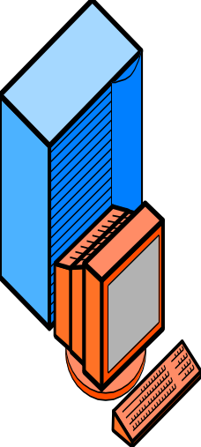


Benefits of
Digital Transmission
Encryption加密
  Encrypt (scramble) messages so that someone intercepting 截取them cannot read them

Slide 56
Benefits of
Digital Transmission
Compression压缩
  Compress message before transmission
  Decompress at other end
  Compressed message places lighter load on transmission line, so less expensive to send
  Not always used
10101001
1010
Original
Signal
Compressed
Signal

Slide 57
Bandwidth带宽
Bandwidth denotes the capacity of media to carry information
Total capacity may be divided into channels信道
A channel is a portion of the total bandwidth used for a specific purpose

Slide 58

Channel Types
A channel is any conduit管道 for sending information between devices.
Basic types of channel:
  Simplex channel 单工信道
  Half-duplex channel 半双工信道
  Full-duplex channel 全双工信道
Notes:
In order to implement this algorithm we had to address these six issues.

Slide 59
Channel Types
A simplex channel is unidirectional, which means data can only be sent in one direction.
For example, a TV channel only carries data from the transmitter to your TV set. Your TV set cannot send information back.
Notes:
In order to implement this algorithm we had to address these six issues.

Slide 60
Channel Types
A half-duplex channel allows information to flow in either direction (but not simultaneously不是同时的！).
Devices at either end of the channel must take it in turns to transmit information whilst the other listens.
For example, a walky-talky步话机 either transmits or receives but not both at the same time.
Notes:
In order to implement this algorithm we had to address these six issues.

Slide 61
Channel Types
A full-duplex channel allows data to be sent in both directions simultaneously.
A full-duplex channel can be formed from two simplex channels carrying data in opposite directions. This may make it more expensive than a half-duplex channel.
There is no waiting for turns. This means full-duplex can be faster and more efficient.
Notes:
In order to implement this algorithm we had to address these six issues.

Slide 62
Channel Types
单工信道：只能有一个方向的通信而没有反方向的交互。无线电广播或有线电广播以及电视广播就属于这种类型。
半双工信道：即通信的双方都可以发送信息，但不能双方同时发送。这种通信方式是一方发送另一方接收，过一段时间后再反过来。
全双工信道：即通信的双方可以同时发送和接收信息。
Notes:
In order to implement this algorithm we had to address these six issues.

Slide 63
Data Transmission from one host to another one across the network
Two methods of transmitting data: Digital and Analog
Digital Transmission improves reliability significantly by means of signal regeneration信号再生
Bandwidth indicates the capacity of media to carry information
A channel is a portion of the total bandwidth used for a specific purpose
summary

Slide 64
Baseband & Broadband
Baseband基带
  The total capacity of the media is used for one channel
  Most LANs use baseband
Broadband宽带
  Divides the total bandwidth into many channels
  Each channel can carry a different signal
  Broadband carries many simultaneous transmissions

Slide 65
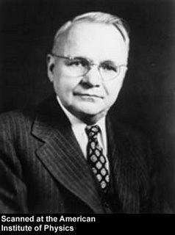
The Maximum Data Rate of a Channel: Nyquist’s theorem尼奎斯特定理
Harry Nyquist (1889--1976), an important contributor to information theory.
奈奎斯特，美国物理学家。
1917年获得耶鲁大学博士学位。曾在美国AT&T公司与贝尔实验室任职。奈奎斯特为近代信息理论做出了突出贡献。他总结的奈奎斯特采样定理是信息论、特别是通讯与信号处理学科中的一个重要基本结论。
Notes:
In order to implement this algorithm we had to address these six issues.

Slide 66
The Maximum Data Rate of a Channel: Nyquist’s theorem尼奎斯特定理
Harry Nyquist (1889--1976), an important contributor to information theory.
if an arbitrary signal has been run through a low-pass filter of bandwidth H, the filtered signal can be completely reconstructed by making only 2H (exact) samples per second. 如果一个任意信号通过带宽为H的低通滤波器，那么只需要每秒采样2H次就能完全地重现被滤波的信号。
Notes:
In order to implement this algorithm we had to address these six issues.

Slide 67
The Maximum Data Rate of a Channel: Nyquist’s theorem尼奎斯特定理
Harry Nyquist (1889--1976), an important contributor to information theory.
如果一个任意信号通过带宽为H的低通滤波器，那么只需要每秒采样2H次就能完全地重现被滤波的信号。
Notes:
In order to implement this algorithm we had to address these six issues.

Slide 68
The Maximum Data Rate of a Channel: Nyquist’s theorem尼奎斯特定理
Sampling the line faster than 2H times per second is pointless because the higher frequency components that such sampling could recover have already been filtered out. 以每秒高于2H次的采样是无意义的，因为高频分量已经被滤波器滤掉无法再恢复了。
Notes:
In order to implement this algorithm we had to address these six issues.

Slide 69
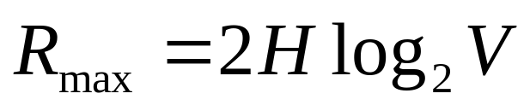
The Maximum Data Rate of a Channel: Nyquist’s theorem尼奎斯特定理
Suppose we know the bandwidth (H) of a channel and the number of signal levels (V) being used. What is the maximum number of bit we could transmit?
Nyquist’s theorem says:
Max data rate
For example, if the bandwidth is 3100Hz and we are using 16 level modulation then the maximum number of bits per second is:
max data rate = 2 × 3100 × log₂(16)
= 24800 bps
bits/sec
Notes:
In order to implement this algorithm we had to address these six issues.

Slide 70
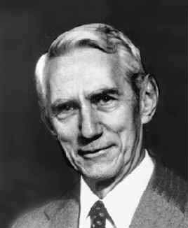
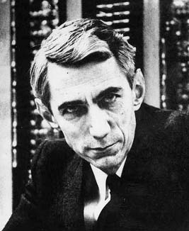
The Maximum Data Rate of a Channel: Shannon’s theorem香农定理
Claude Elwood Shannon
1916 - 2001
克劳德·艾尔伍德·香农，美国数学家、信息论的创始人，贝尔实验科学家。香农的工作为信息论和数字通信奠定了基础。
Notes:
In order to implement this algorithm we had to address these six issues.

Slide 71
The Maximum Data Rate of a Channel: Shannon’s theorem香农定理
Claude Elwood Shannon
1916 - 2001
Shannon was educated at Michigan University in 1936, where he earned his B.S. degree.
Notes:
In order to implement this algorithm we had to address these six issues.

Slide 72
The Maximum Data Rate of a Channel: Shannon’s theorem香农定理
Claude Elwood Shannon
1916 - 2001
Later he went to MIT, where he studied both electrical engineering and mathematics. Shannon received both his M.S. degree and his PhD in 1940.
Notes:
In order to implement this algorithm we had to address these six issues.

Slide 73
The Maximum Data Rate of a Channel: Shannon’s theorem香农定理
Claude Elwood Shannon
1916 - 2001
In 1948, he published a research paper at Bell System Technical Journal , i.e. “A Mathematical Theory of Communication”.
Notes:
In order to implement this algorithm we had to address these six issues.

Slide 74
The Maximum Data Rate of a Channel: Shannon’s theorem香农定理
Claude Elwood Shannon
1916 - 2001
In 1948, he published a research paper at Bell System Technical Journal ：“通信中的数学原理”.
Notes:
In order to implement this algorithm we had to address these six issues.

Slide 75
The Maximum Data Rate of a Channel: Shannon’s theorem香农定理
Claude Elwood Shannon
1916 - 2001
香农定理描述了有限带宽、带有随机热噪声信道的最大传输速率与“信道带宽H”和“信噪比S/N”之间的关系.
Notes:
In order to implement this algorithm we had to address these six issues.

Slide 76
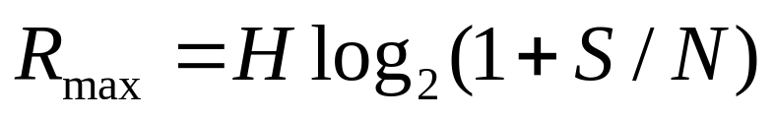
The Maximum Data Rate of a Channel: Shannon’s theorem香农定理
Shannon's major result is that the maximum data rate of a noisy channel whose bandwidth is H Hz, and whose signal-to-noise ratio is S/N, is given by
Shannon’s result applies to any channel subject to thermal noise香农的结论适用于任何带有热噪声信道.
bits/sec
Notes:
In order to implement this algorithm we had to address these six issues.

Slide 77

The Maximum Data Rate of a Channel: Shannon’s theorem香农定理
Counterexamples should be treated in the same category as perpetual motion machines.如果你试图找到反例，那么无异于是想要发明永动机
It should be noted that this is only an upper bound and real systems rarely achieve it.
Notes:
In order to implement this algorithm we had to address these six issues.

Slide 78
Modems调制解调器
Modulation&Demodulation
Used to connect a digital computer to an analog phone system
Can be installed internally a card inserted into the motherboard
Can be connected to the serial port (external modem)

Slide 79
Modulation调制
modems use a sine wave carrier of a particular frequency and then modulate that frequency.调制解调器使用一个特定频率的正弦波载体, 然后调制它的频率。
Notes:
In order to implement this algorithm we had to address these six issues.

Slide 80
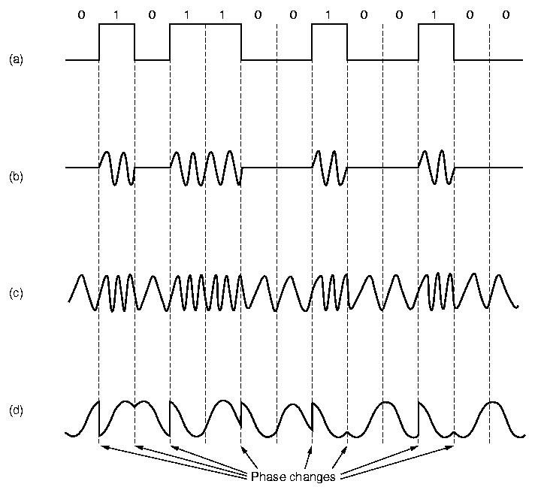
Modulation调制
Various modulations include:
Frequency modulation调频： Two different frequencies, close to the carrier frequency, are used.
Binary Signal
Notes:
In order to implement this algorithm we had to address these six issues.

Slide 81
Modulation调制
Various modulations include:
Amplitude modulation调幅： Two different amplitudes of sine wave are used to represent 1's and 0's.
Binary Signal
Notes:
In order to implement this algorithm we had to address these six issues.

Slide 82
Modulation调制
Various modulations include:
Binary Signal
Phase modulation调相: The phase of the sine wave is changed by some fixed amount.
Notes:
In order to implement this algorithm we had to address these six issues.

Slide 83
Network Media Types
网络介质类型
Types of Media
  Cable Media导向传输介质
  Radiated非导向传输介质

Slide 84
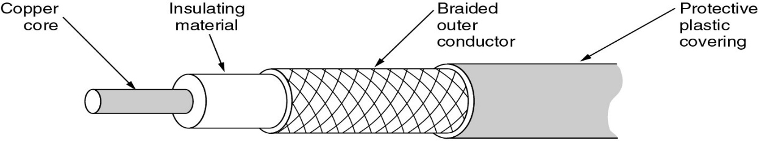
Network Media Types
网络介质类型
Cable Media导向传输介质
  Coaxial同轴电缆
  Twisted pair (UTP)双绞线
  Shielded twisted pair (STP) 屏蔽双绞线
  Fiber optic光纤

Slide 85
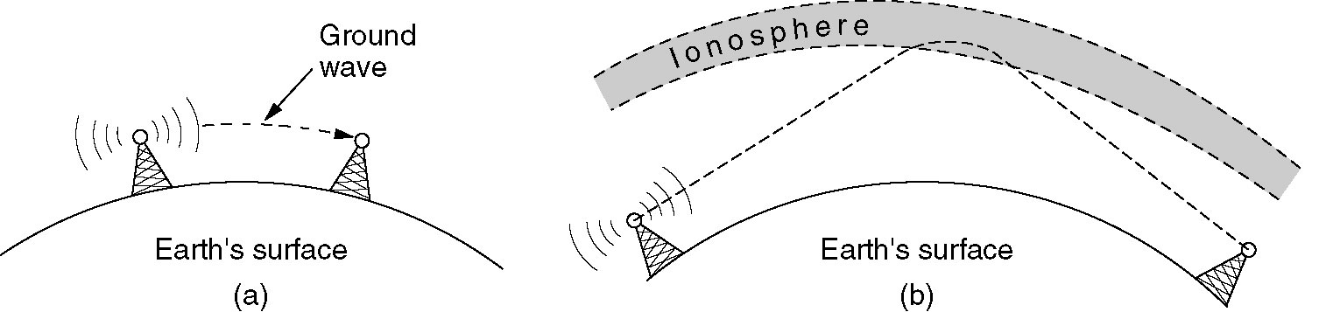
Network Media Types
网络介质类型
Radiated非导向传输介质
  Infrared红外线
  Microwave微波
  Radio无线电
  Satellite卫星

Slide 86
Media Selection Criteria
Cost
  For actual media and connecting devices, such as NICs, hubs, etc.
Installation
  Difficulty to work with media
  Special tools, training

Slide 87
Media Selection Criteria
Capacity
  The amount of information that can be transmitted in a giving period of time
  Measured as
    Bits per second: bps (preferred)
    Baud (discrete signals per second)
    Bandwidth (range of frequencies)

Slide 88
Media Selection Criteria
Node Capacity
  Number of network devices that can be connected to the media
Attenuation
  Weakening of the signal over distance

Slide 89
Media Selection Criteria
Electromagnetic Interference (EMI)
  Distortion of signal caused by outside electromagnetic fields
  Caused by large motors, proximity to power sources
Other noise sources
  White (Gaussian) noise
  Impulse noise
  Crosstalk
  Echo

Slide 90
Cable Media
Unshielded Twisted Pair UTP
Shielded Twisted Pair STP
Coaxial
Fiber optic

Slide 91
Unshielded Twisted Pair (UTP)非屏蔽双绞线
One or more pairs of twisted copper wires insulated and contained in a plastic sheath
Twisted to reduce crosstalk*
串扰(crosstalk)是两条信号线之间的耦合，信号线之间的互感和互容引起线上的噪声.容性耦合引发耦合电流，而感性耦合引发耦合电压。

Slide 92
Unshielded Twisted Pair (UTP)非屏蔽双绞线
Categories种类
  categories 1 and 2
    voice grade
    low data rates up to 4 Mbps
  category 3
    suitable for most LANs
    up to 16 Mbps
  category 4
    up to 20 Mbps

Slide 93
Unshielded Twisted Pair (UTP)非屏蔽双绞线
Categories种类
  category 5
    supports fast Ethernet
    more twists per foot
    more stringent standards on connectors对连接器要求更高

Slide 94
Twisted Pair
(a) Category 3 UTP.
(b) Category 5 UTP.

Slide 95
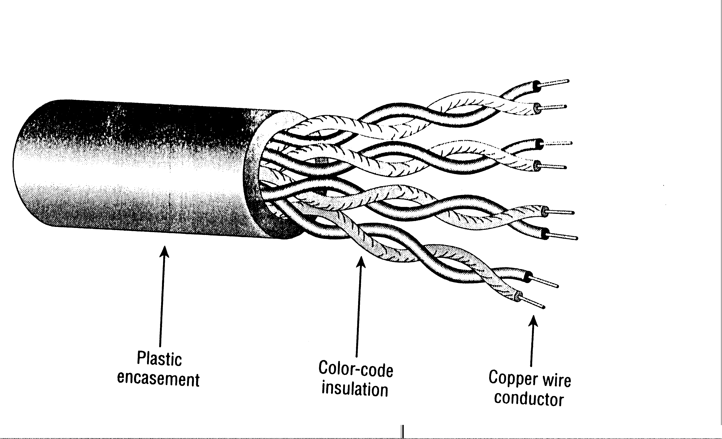
Unshielded Twisted Pair (UTP)非屏蔽双绞线
Data grade UTP cable usually consists of either 4 or 8 wires, two or four pair

Slide 96
Shielded Twisted Pair (STP)屏蔽双绞线
Same as UTP but with a aluminum/polyester shield铝/聚酯防护罩
Different standards for IBM and Apple

Slide 97
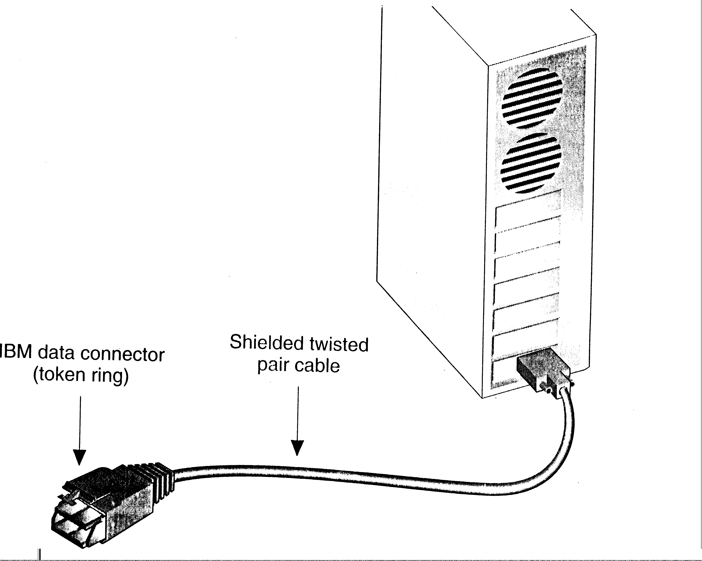
Shielded Twisted Pair (STP)屏蔽双绞线
Connectors are more awkward笨拙 to work with
Usually comes in pre made lengths

Slide 98
Chapter 2
The Physical Layer
(contd.)

Slide 99
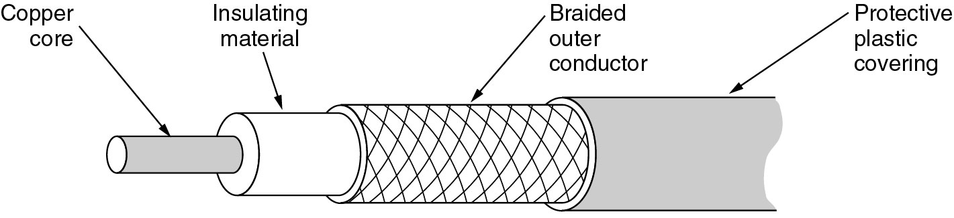
Coaxial Cable
同轴电缆
外导体
屏蔽层
绝缘保
护套层
内导体
绝缘层
Two conductors sharing the same axis
A solid center wire surrounded insulation and a second conductor

Slide 100
Coaxial Cable
同轴电缆
外导体
屏蔽层
绝缘保
护套层
内导体
绝缘层
同轴电缆由内导体铜质芯线(单股实心线或多股绞合线)、绝缘层、网状编织的外导体屏蔽层(也可以是单股的)以及保护塑料外层所组成

Slide 101
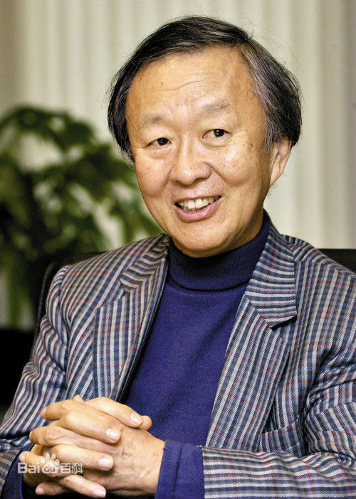
光纤通信
高锟，华裔物理学家，生于中国上海，祖籍江苏金山。“光纤通讯之父”(Father of Fiber Optic Communications)，曾任香港中文大学校长。2009年获得诺贝尔物理学奖。

Slide 102
Fiber-optic communication
1966年高锟教授提出“光通讯”基础理论，以一条比头发丝还要细的光纤传送容量几近无限的信息。

Slide 103
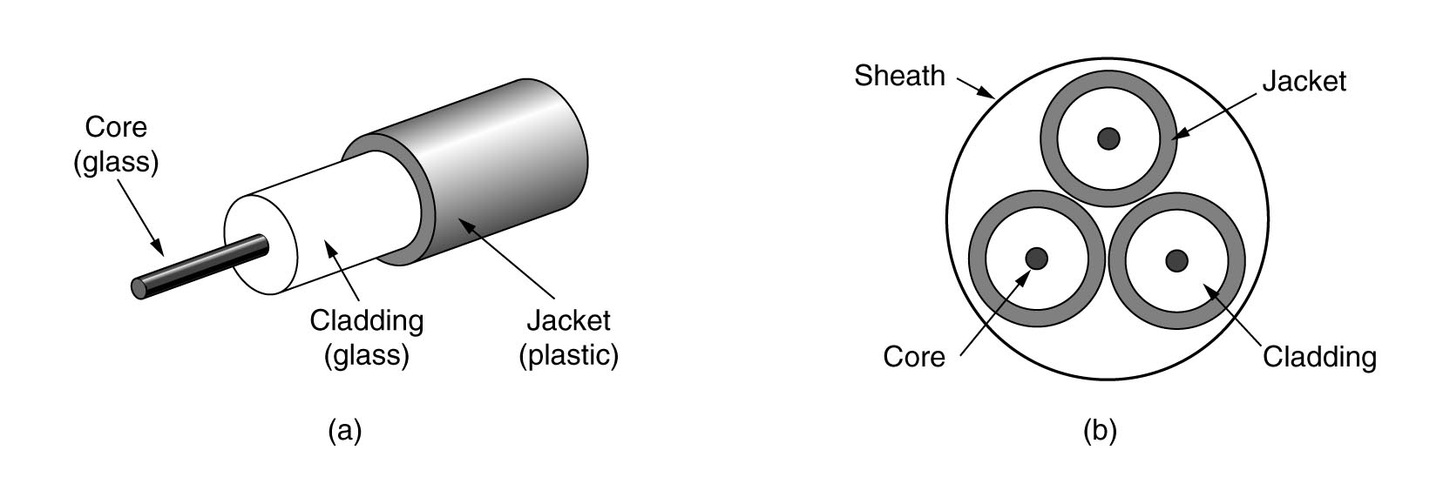
Fiber Optic Cable光缆
光纤通常由完全透明的石英玻璃拉成细丝，主要由纤芯和包层构成双层通信圆柱体。
纤芯很细，其直径只有8 ~ 100 μm。这个纤芯用来传导光波。
芯(玻璃)
覆层(玻璃)
外罩(塑料)

Slide 104
Optical Fibers
At the center is the glass core through which the light propagates.
芯(玻璃)
覆层(玻璃)
外罩(塑料)

Slide 105
Fiber Optic Cable光缆
SPEED: Fiber optic networks operate at high speeds - up into the gigabits
BANDWIDTH: large carrying capacity
DISTANCE: Signals can be transmitted further without needing to be "refreshed" or strengthened.

Slide 106
Fiber Optic Cable光缆
RESISTANCE抗干扰: Greater resistance to electromagnetic noise such as radios, motors or other nearby cables.
MAINTENANCE: Fiber optic cables costs much less to maintain.

Slide 107
Fiber Optic Cable光缆
The main advantage of optical fiber is the great bandwidth it can carry.
Each light ray is said to have a different mode:
  Single-mode单模光纤
  Multi-mode多模光纤
Single mode is more expensive, but can handle longer distances

Slide 108
Fiber Optic Cable光缆
与纤芯相比，包层具有较低的折射率。
当光线从高折射率的媒体射向低折射率的媒体时，其折射角将大于入射角。

Slide 109
Optical Fibers
One problem with optical fibers is that the light pulses become distorted over distance due to dispersion光纤传输的一个问题是经过长距离传播后由于散射，光脉冲会变形.
Notes:
In order to implement this algorithm we had to address these six issues.

Slide 110
Optical Fibers
Dispersion occurs when photons光子 from the same light pulse take slight different paths along the optical fiber. Because some paths will be longer or shorter than other paths the photons will arrive at different times thus smearingthe shape of the pulse光脉冲拖尾效应.
Notes:
In order to implement this algorithm we had to address these six issues.

Slide 111
Optical Fibers
Over long distances, one pulse may merge合并 with another pulse.
When this happens, the receiving device will not be able to distinguish between pulses.
Notes:
In order to implement this algorithm we had to address these six issues.

Slide 112
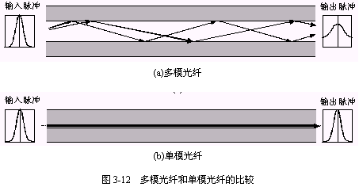
Single-mode & Multi-mode
只要从纤芯中射到纤芯表面的光线的入射角大于某一个临界角度，就可产生全反射。因此，可以存在许多条不同角度入射的光线在一条光纤中传输。这种光纤就称为多模光纤。

Slide 113
Single-mode & Multi-mode
若光纤的直径减小到只有一个光的波长，则光纤就像一根波导那样，它可使光线一直向前传播，而不会产生多次反射。这样的光纤就称为单模光纤。

Slide 114
Overcoming Dispersion
Normal fiber optic cable is called multimode多模光纤 because photons can take different paths along it.
The more expensive monomode单模光纤 fibre optic overcomes dispersion by having a core so thin that the light can only take one path along it.
Notes:
In order to implement this algorithm we had to address these six issues.

Slide 115
Optical Fibers
In multimode fibers, the core is typically 50 μm in diameter, about the thickness of a human hair.
In single-mode fibers, the core is 8 to 10 μm.

Slide 116
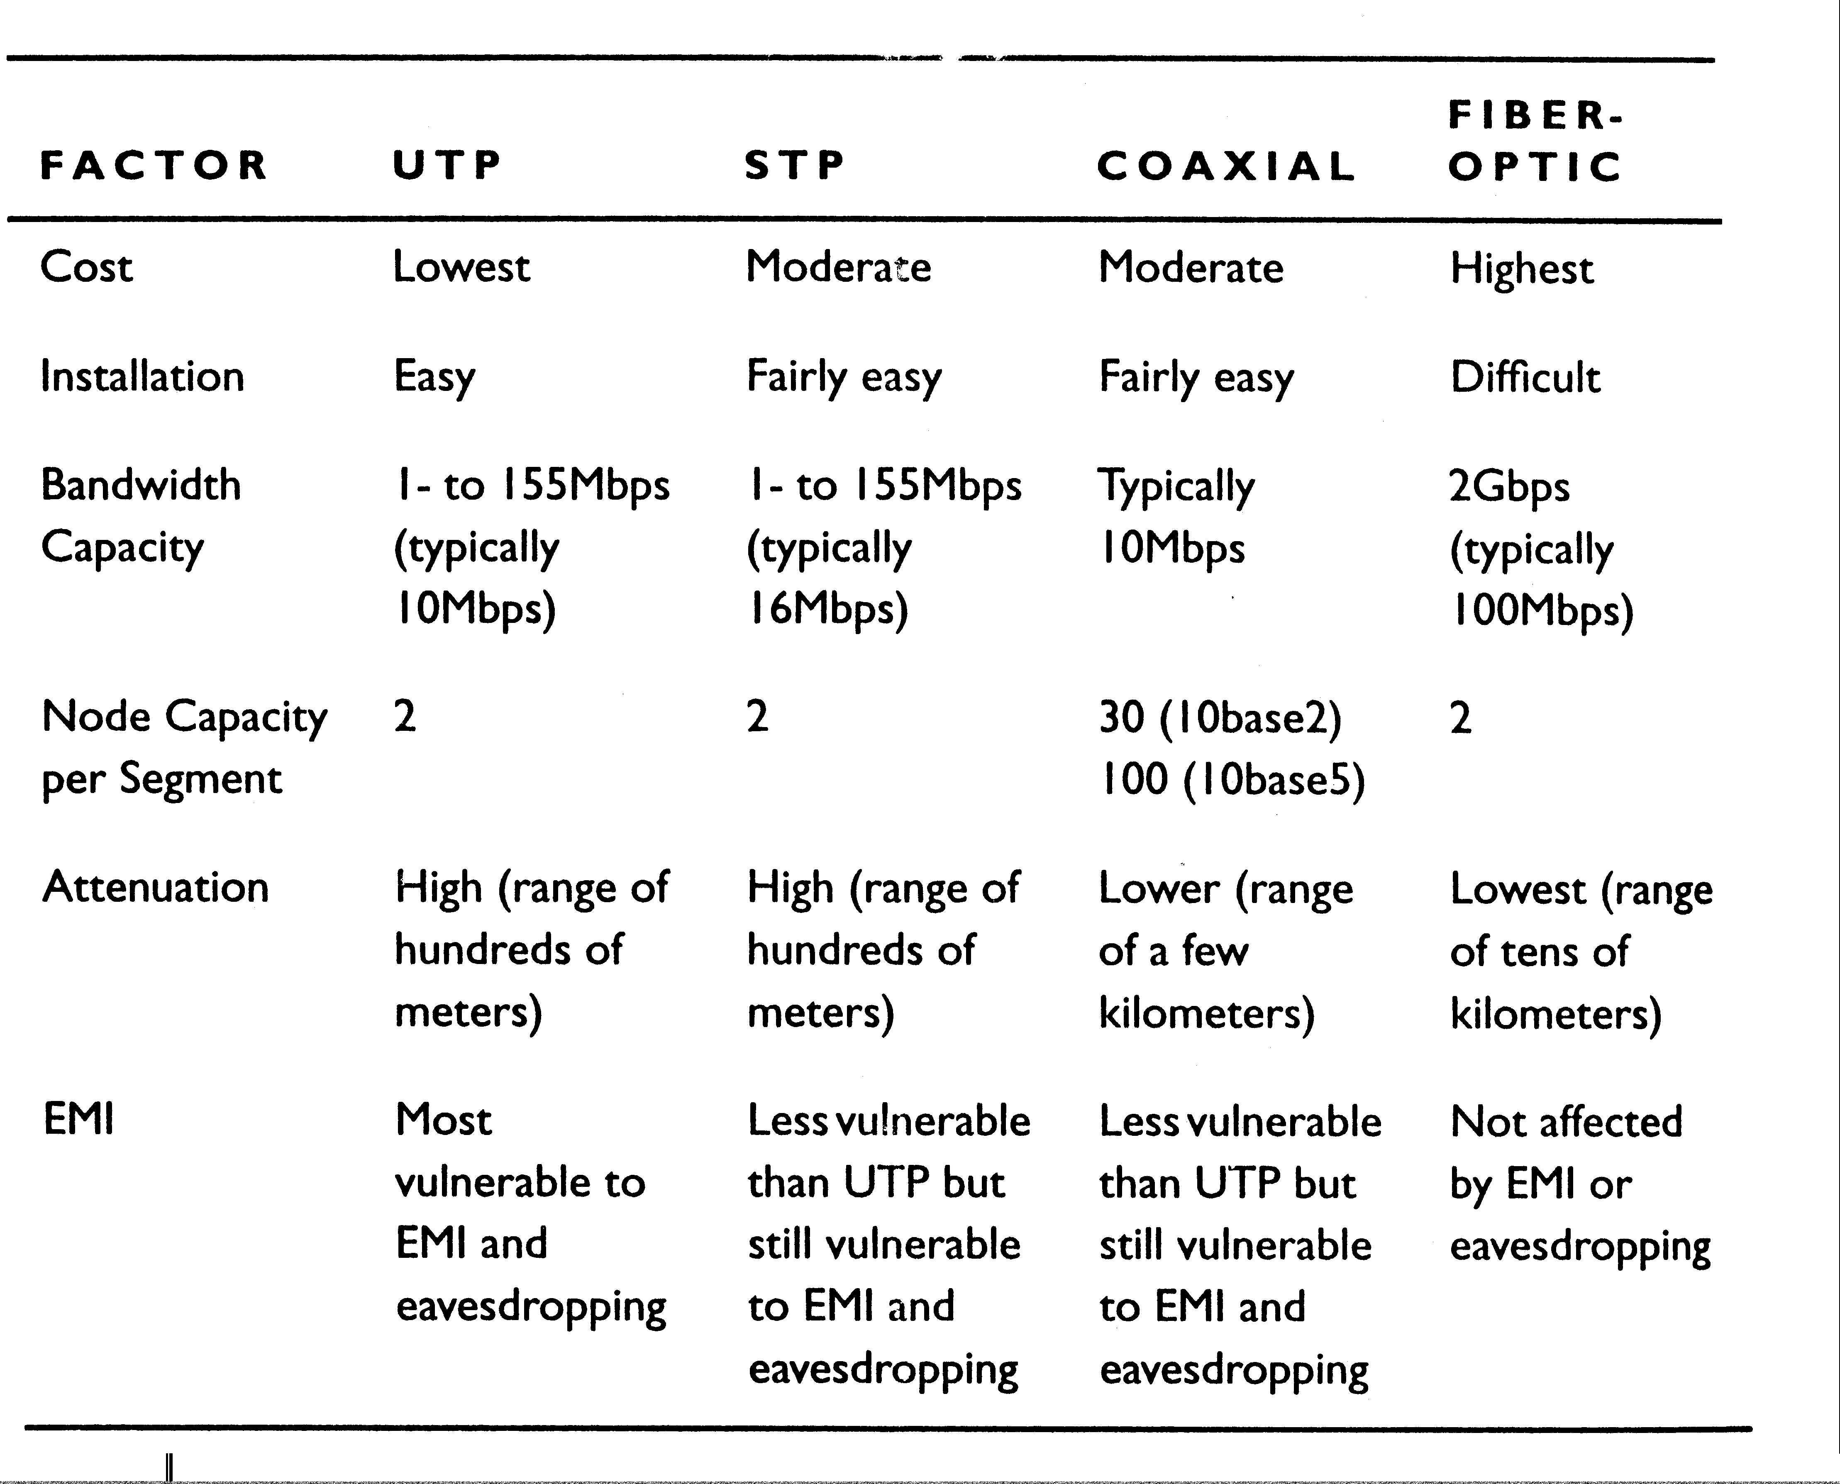
Characteristics of Cable Media

Slide 117
Wireless Media
无线传输介质
Uses the earth’s atmosphere as a conducting media以大气层作为传输导体
Main types:
  radio wave无线电波
  microwave (including satellite)微波(包括卫星)
  infrared红外线

Slide 118
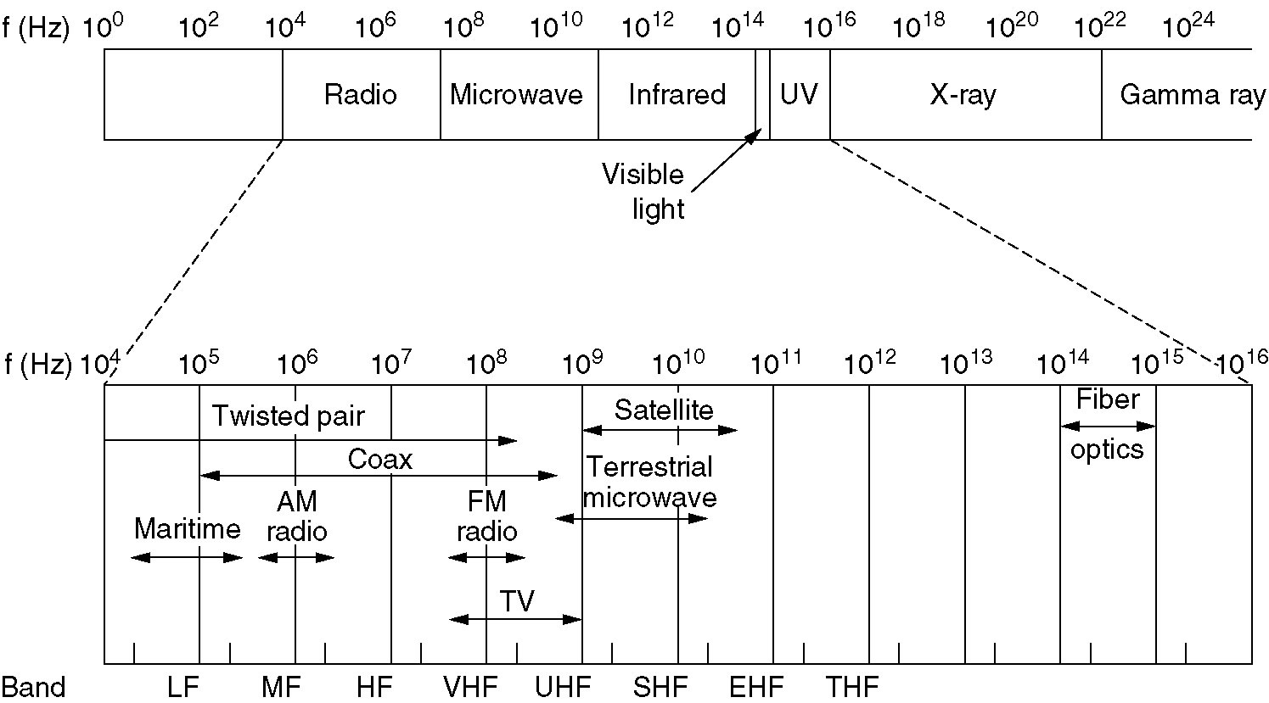
The Electromagnetic Spectrum电磁波频谱
The electromagnetic spectrum and its uses for communication.

Slide 119
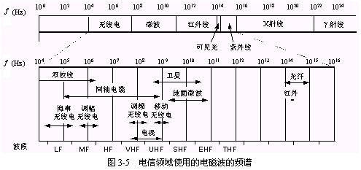

Slide 120
Radio Transmission
(a) In the VLF, LF and MF bands, radio waves follow the curvature of the earth,在超低频、低频和中频波段，无线电波沿地球表面传播.

Slide 121
Microwave微波
Terrestrial 陆地
  line of sight视线
  use relay towers中继塔
  uses license frequencies

Slide 122
Radio Transmission
(b) In the HF and VHF bands, the ground waves tend to be absorbed by the earth.

Slide 123
Radio Transmission
(b) However, the waves that reach the ionosphere are refracted by it and sent back to earth 电波到达电离层再被折射返回地面

Slide 124
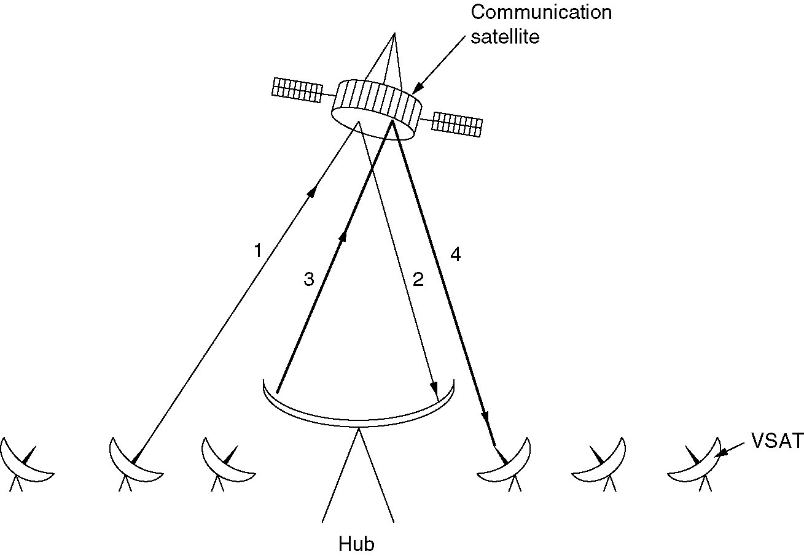
Communication Satellites
通信卫星
VSATs using a hub.

Slide 125
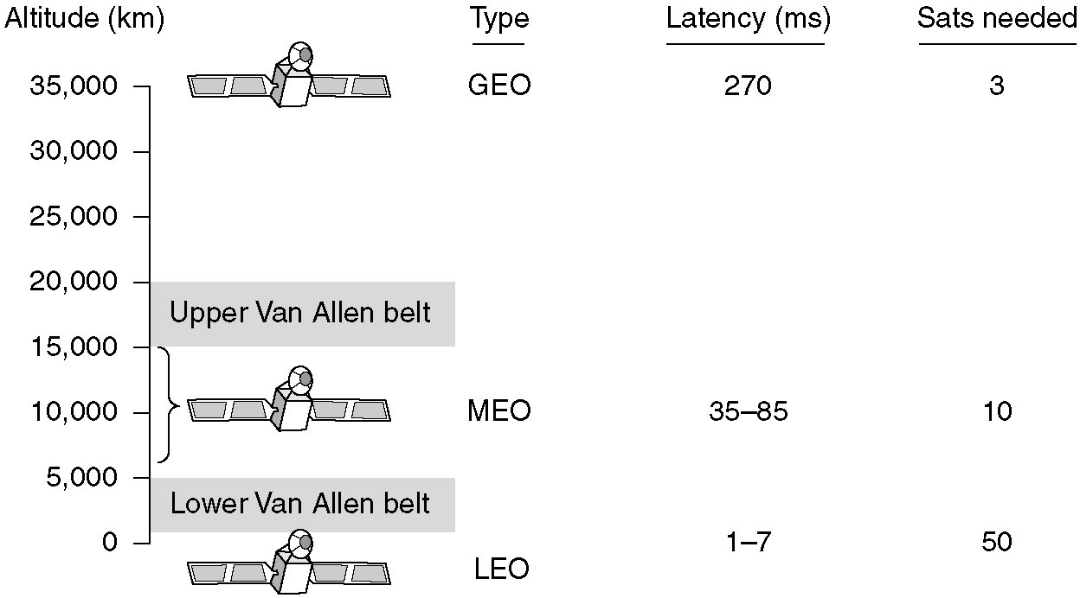
Communication Satellites
通信卫星
GEO (Geostationary Earth Orbit环地轨道) satellites
MEO (Medium-Earth Orbit) satellites
LEO (Low-Earth Orbit) satellites

Slide 126
Infrared红外线
Uses same technology as remotes for T.V.
signals can not penetrate objects不能穿透物体
Can be point to point or broadcast
Pointless immune to eavesdropping容易被偷听

Slide 127
The Public Switched Telephone Network (PSTN)
公共电话交换网
Structure of the Telephone System
The Local Loop: Modems, ADSL, and Wireless
Trunks and Multiplexing中继线和多路复用技术
Switching

Slide 128
Structure of the Telephone System





For a full-interconnection with 5 telephone sets, we need 10 pairs of lines
How many pairs of lines for N telephone sets ?
=N(N – 1)/2

Slide 129
Structure of the Telephone System
With a large number of telephone sets, a switch is used to connect all.


…


switching
office






Slide 130
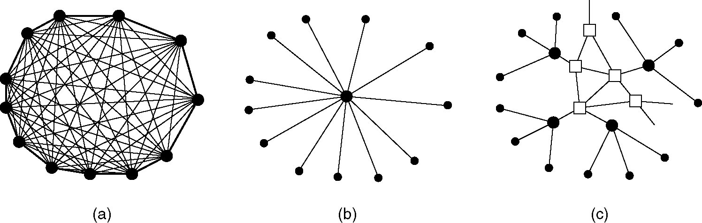
Structure of the Telephone System
(a) Fully-interconnected network.
(b) Centralized switch.
(c) Two-level hierarchy.

Slide 131
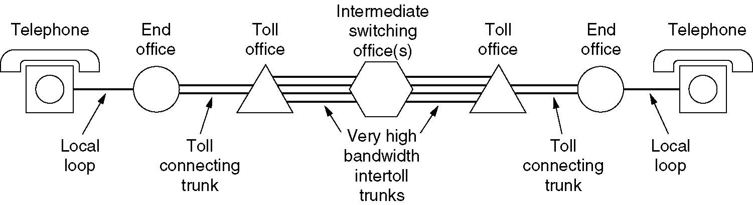
A typical circuit route for a medium-distance call.
End office端局: Each telephone has two copper wires coming out of it that go directly to the telephone company's nearest end office. The distance is typically 1 to 10 km.

Slide 132
A typical circuit route for a medium-distance call.
Local loop本地回路: The two-wire connections between each subscriber's telephone and the end office are known in the trade as the local loop.

Slide 133
A typical circuit route for a medium-distance call.
Toll offices长途局: Each end office has a number of outgoing lines to one or more nearby switching centers, called toll offices.

Slide 134
Major Components of the Telephone System
Local loops本地回路
  Analog twisted pairs going to houses and businesses
Trunks中继干线
  Digital fiber optics connecting the switching offices
Switching offices交换局
  Where calls are moved from one trunk to another

Slide 135
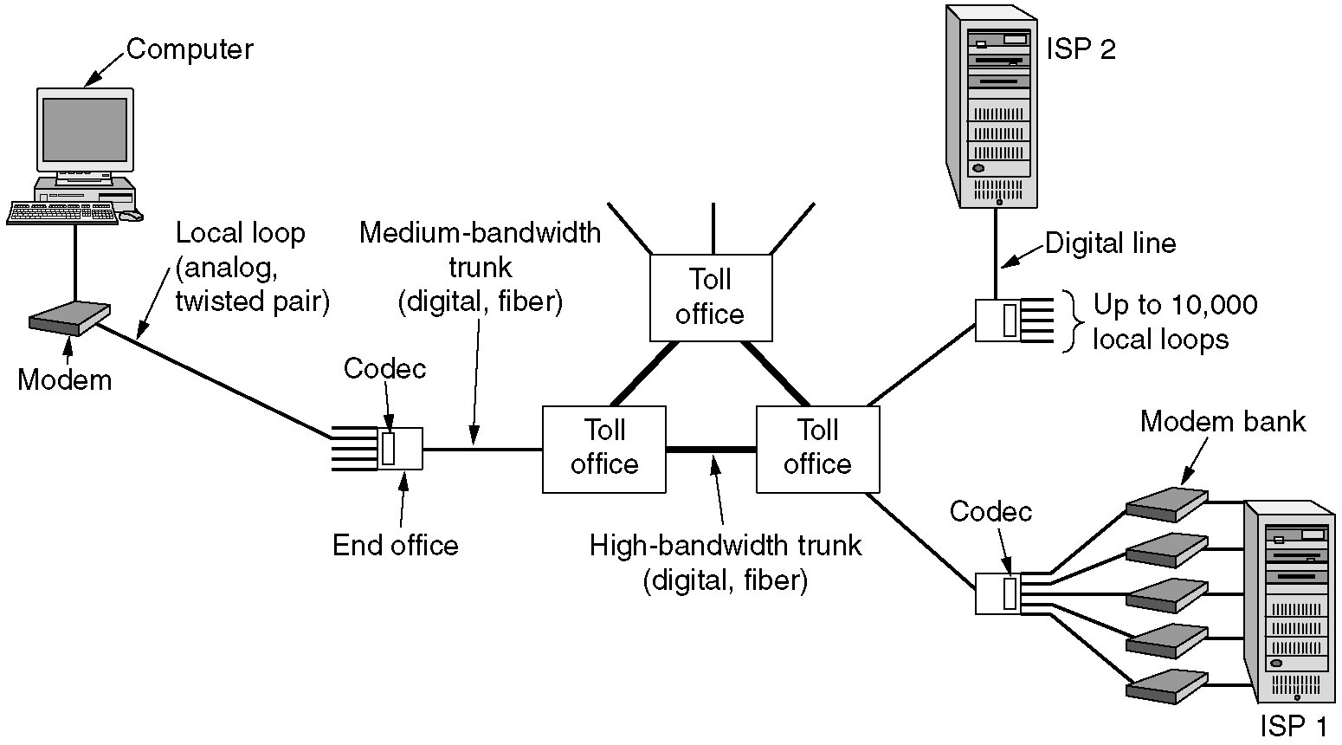
The Local Loop: Modems, ADSL, and Wireless
Modems调制解调器: convert the digital data to analog form for transmission over the local loop or the reverse conversion (at computer side)
The use of both analog and digital transmissions for a computer to computer call. Conversion is done by the modems and codecs.

Slide 136
The Local Loop: Modems, ADSL, and Wireless
Codecs编解码器: convert the analog to digital for transmission over long-haul fiber trunks or the reverse conversion (at the end office)
The use of both analog and digital transmissions for a computer to computer call. Conversion is done by the modems and codecs.

Slide 137
DSL: Digital Subscriber Lines数字用户线路
DSL or xDSL, is a family of technologies that provide digital data transmission over the wires of a local telephone network.
DSL technology transmits data over phone lines without interfering with voice service.

Slide 138
ADSL: Asymmetric
Digital Subscriber Line
非对称数字用户线路
ADSL is a new technology that allows more data to be sent over existing copper telephone lines, using a special ADSL modem.
ADSL supports data rates
  Downstream: 1.5 to 9 Mbps
  Upstream: up to 1Mbps.

Slide 139
ADSL: Asymmetric
Digital Subscriber Line
非对称数字用户线路
ADSL的原理：
传统的电话系统使用的是铜线的低频部分(4kHz以下频段)。

Slide 140
ADSL: Asymmetric
Digital Subscriber Line
非对称数字用户线路
ADSL的原理：
ADSL采用DMT(离散多音频)技术，将原先电话线路0 Hz到1.1 MHz频段划分成256个频宽为4.3kHz的子频带。其中，
  4kHz以下频段仍用于传送传统电话业务，
  20kHz到138kHz的频段用来传送上行信号，
  138kHz到1.1MHz的频段用来传送下行信号。

Slide 141
Trunks and Multiplexing
主干与多路复用
High-bandwidth trunks中继干线 in telephone systems always transport many conversations over a single physical trunk with multiplexing techniques.

Slide 142
Multiplexing
多路复用技术
several lines (one for each device) enter a multiplexer多路复用器 (mux) at the host side
the host side mux combines all incoming signals
combined signals are transmitted to a mux on the receiving side

Slide 143
Types of Multiplexers
Frequency Division Multiplexing (FDM)
Time Division Multiplexing (TDM)
Wavelength Division Multiplexing (WDM)
Statistical Time Division Multiplexing (STDM)

Slide 144
Multiplexing 多路复用
FDM: used over copper wires or microwave channels, it requires analog circuitry and is not amenable to being done by a computer.
TDM can be handled entirely by digital electronics
WDM : fiber optic channels
Notes:
In order to implement this algorithm we had to address these six issues.

Slide 145
FDMA and TDMA
Example:
FDMA频分多路复用
4 users
F
time
TDMA时分多路复用
F
time
Notes:
Two simple multiple access control techniques.
Each mobile’s share of the bandwidth is divided into portions for the uplink and the downlink. Also, possibly, out of band signaling.
As we will see, used in AMPS, GSM, IS-54/136

Slide 146
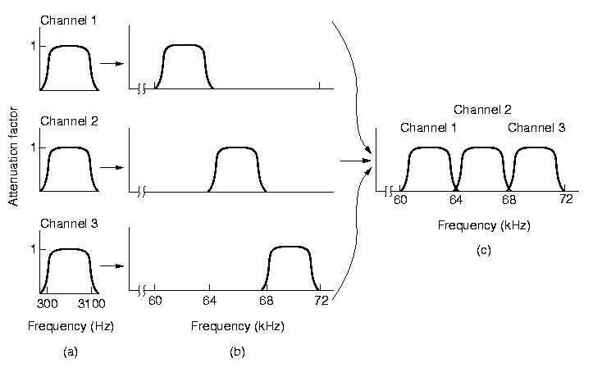
Frequency Division Multiplexing
频分多路复用
The frequency spectrum频谱 is divided up among the logical channels - each user hangs on to a particular frequency.
Notes:
In order to implement this algorithm we had to address these six issues.

Slide 147
Frequency Division Multiplexing
频分多路复用
One problem with FDM is that it cannot utilise the full capacity of the cable.
It is important that the frequency bands do not overlap重叠.
Indeed, there must be a considerable gap间隙 between the frequency bands in order to ensure that signals from one band do not affect signals in another band.
Notes:
In order to implement this algorithm we had to address these six issues.

Slide 148
Frequency Division Multiplexing
频分多路复用
how three voice-grade telephone channels are multiplexed using FDM?
Notes:
In order to implement this algorithm we had to address these six issues.

Slide 149
Frequency Division Multiplexing
频分多路复用
Filters limit the usable bandwidth to about 3100 Hz per voice-grade channel.
Notes:
In order to implement this algorithm we had to address these six issues.

Slide 150
Frequency Division Multiplexing
频分多路复用
When many channels are multiplexed together, 4000 Hz is allocated to each channel to keep them well separated.
Notes:
In order to implement this algorithm we had to address these six issues.

Slide 151
Frequency Division Multiplexing
频分多路复用
Notice that even though there are gaps (guard bands) between the channels, there is some overlap between adjacent channels because the filters do not have sharp edges.
Notes:
In order to implement this algorithm we had to address these six issues.

Slide 152
Time Division Multiplexing (TDM)
时分多路复用
The use of both analog and digital transmissions for a computer to computer call. Conversion is done by the modems and codecs.

Slide 153
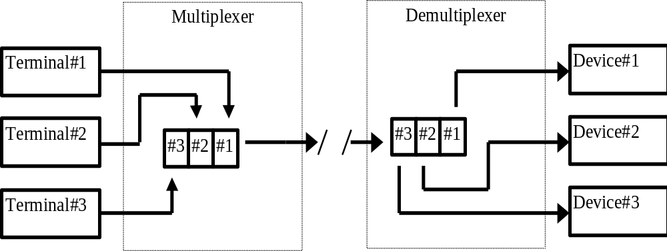
Time Division Multiplexing (TDM)
时分多路复用
TDM splits cable usage into time slots时隙. Each channel is given a regular time slot in which to send a PCM signal
PCM: Pulse Code Modulation脉冲编码调制.
Notes:
In order to implement this algorithm we had to address these six issues.

Slide 154
Time Division Multiplexing (TDM)
时分多路复用
In TDM, the users take turns(轮流、依次), each one having exclusive use专用 of the medium in a round robin循环赛 fashion.
Notes:
In order to implement this algorithm we had to address these six issues.

Slide 155
The Maximum Data Rate of a Channel: Nyquist’s theorem尼奎斯特定理
Harry Nyquist (1889--1976), an important contributor to information theory.
如果一个任意信号通过带宽为H的低通滤波器，那么只需要每秒采样2H次就能完全地重现被滤波的信号。
REVIEW
Notes:
In order to implement this algorithm we had to address these six issues.

Slide 156
Time Division Multiplexing (TDM)
时分多路复用
The analog signals are digitized in the end office by a device called a codec (coder-decoder), producing a series of 8-bit numbers.
The codec makes 8000 samples per second (125 µsec/sample)
The use of both analog and digital transmissions for a computer to computer call. Conversion is done by the modems and codecs.

Slide 157
Time Division Multiplexing (TDM)
时分多路复用
Nyquist theorem says that this is sufficient to capture all the information from the 4-kHz telephone channel bandwidth.
Pulse Code Modulation (PCM)
The use of both analog and digital transmissions for a computer to computer call. Conversion is done by the modems and codecs.

Slide 158
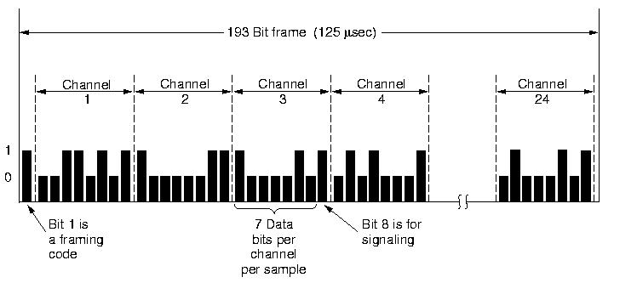
Time Division Multiplexing (TDM)
时分多路复用
The method used in North America and Japan is the T1 carrier (T1载波)
T1 carrier consists of 24 voice channels multiplexed together.
Notes:
In order to implement this algorithm we had to address these six issues.

Slide 159
Time Division Multiplexing (TDM)
时分多路复用
Each of the 24 channels, in turn, gets to insert 8 bits into the output stream.
Notes:
In order to implement this algorithm we had to address these six issues.

Slide 160
Time Division Multiplexing (TDM)
时分多路复用
Seven bits are data and one is for control per channel
  data: 7 x 8000 = 56,000 bps,
  signaling: 1 x 8000 = 8000 bps
Notes:
In order to implement this algorithm we had to address these six issues.

Slide 161
Time Division Multiplexing (TDM)
时分多路复用
A frame consists of 24 x 8 = 192 bits plus one extra bit for framing, yielding 193 bits every 125 µsec.
T：a gross data rate of 1.544 Mbps
Notes:
In order to implement this algorithm we had to address these six issues.

Slide 162
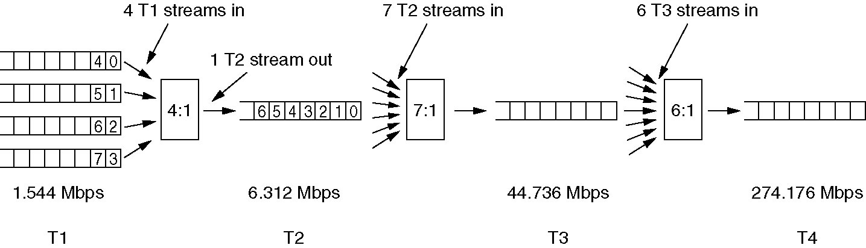
Time Division Multiplexing (TDM)
时分多路复用

Slide 163
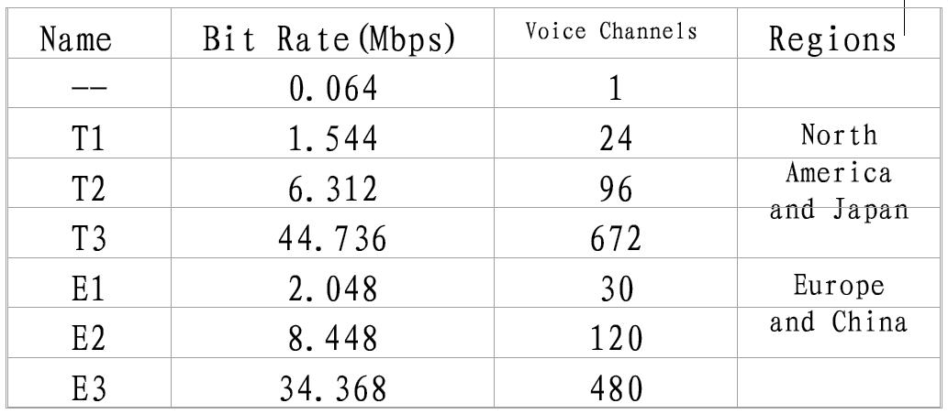
T and E series Carriers
Bit Rate Computing：64Kbps*Voice Channels+extra bits used for framing and recovery

Slide 164
Statistical Time Division Multiplexing (STDM)统计时分多路复用
allows connection of more nodes to the circuit than the circuit capacity;
works on the premise前提 that not all nodes will transmit at full capacity at all times;
must transmit a terminal identification;
may require storage;

Slide 165
Switching交换
Switching send data across different routes
Three types of switching
  Circuit switching电路交换
  Message switching报文交换
  Packet switching分组交换

Slide 166
Circuit Switching
电路交换:
Before transmission a dedicated circuit must be established
A connection (electrical, optical, radio) is established from the caller phone主叫 to the callee phone被叫.

Slide 167
Circuit Switching
Connects the sender and receiver by a single physical path for the duration of the session
PSTN uses circuit switching

Slide 168
Circuit Switching
Advantages
  guaranteed data rate
  once connected no channel access delay
Disadvantages
  inefficient use of the transmission media (idle time)
  long connection delays (first time)

Slide 169
Packet Switching
分组交换:
The connection is determined only when there is actual data (a message) ready to be sent.
The whole message is recollected at each switch and then forwarded on to the next switch.
→ store-and-forward存储转发.

Slide 170
Packet Switching
分组交换:
Divides the message up into blocks, i.e. packets.
Therefore packets use the transmission lines for only a short time period
allows for interactive traffic.

Slide 171
H4
H2
H6
D
B
A
E
H1
C
H5
H3
分组交换网示意图

Slide 172
Packet Switching
Packet switching breaks messages into packets
Packets travel different routes (independent routing)
Each packet has its own header information
Packets small enough to be stored in RAM thus quicker than message switching

Slide 173
Packet Switching
Advantages
  improves the use of bandwidth over circuit switching
  can adjust routes to reflect network conditions
  shorter transmission delays than message switching
  smaller packets to retransmit

Slide 174
Packet Switching
Disadvantages
  More complex protocols
  more processing power for switching device
  The greater number of packets, the greater chance for packet loss or damage

Slide 175
Packet Switching
Two methods of packet switching
  Datagram packet switching数据报分组交换
  Virtual circuit packet switching虚电路分组交换

Slide 176
Datagram Packet Switching数据报分组交换
Message divided into a stream of packets
Each packet has it’s own control instructions
Switching devices route each packet independently

Slide 177
H4
H2
H6
D
B
A
E
H1
C
H5
H3
分组交换网示意图

Slide 178
Datagram Packet Switching数据报分组交换
Switching devices can route packets around busy network links
Require sequence numbers to reassemble
Small packet size facilitates retransmission due to errors

Slide 179
Virtual Circuit Packet Switching虚电路分组交换
Similar to circuit switching
Before transmission of the sending and receiving device agree on:
  network path
  maximum message size
  establish a logical connection (virtual circuit)
All packets travel on the same virtual path

Slide 180
Data Transmission from one host to another one across the network

Slide 181
Data Transmission from one host to another one across the network

