Slide 1
Chapter 4
The MAC Sublayer (cont'd)
介质访问控制子层(续)

Slide 2


Classification of Networks
by transmission media传输介质:
  Wireless networks / Wired networks
REVIEW

Slide 3
Wireless Networking Technologies
Wireless LANs (无线局域网):
  IEEE 802.11--The Working Group Setting the Standards for Wireless LANs
Wireless network access无线网络访问技术
  IEEE 802.11b/g
  -- an enhanced version of 802.11b
  Bluetooth蓝牙技术

Slide 4
Radio Technologies & Frequency Band
802.11b and g equipment, operating at 2.4 GHz, may occasionally suffer interference from microwave ovens, cordless telephones and Bluetooth devices.
Both 802.11 and Bluetooth control their interference by using spread spectrum modulation扩频调制技术.

Slide 5
Radio Technologies & Frequency Band
Bluetooth uses a FHSS (Frequency Hopping Spread Spectrum跳频扩频) signaling method
802.11b/g (WiFi) use
  DSSS (Direct Sequence Spread Spectrum直接序列扩频) signaling;
  OFDM (orthogonal frequency division multiplexing正交频分复用) methods.

Slide 6
The IEEE 802.11 Wireless LAN Architecture
A wireless LAN station could be a laptop or a PDA (Personal Digital Assistant个人数字助理), Smartphone, etc.
Stations may be mobile, portable, or stationary.
Mobility of wireless stations may be the most important feature of a wireless LAN.

Slide 7
The IEEE 802.11 Wireless LAN Architecture
802.11 defines the BSS(Basic Service Set基本服务集) as the basic building block of an 802.11 WLAN.
The BSS consists of a group of any number of stations.
The BSS is not a very interesting topic until we take the topology of the WLAN into consideration.

Slide 8
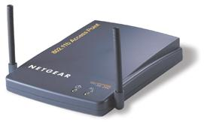
WLAN Configurations
BSS: Basic Service Set
Access Point
(AP)
Internet
Independent BSS
(Ad Hoc Mode)
Infrastructure BSS
(Infrastructure Mode)

Slide 9
Ad hoc mode
BSS: Basic Service Set
ad-hoc mode
(自组网络)由一组带
有无线收发装置的移
动站组成的一个多跳
的、临时性自治系统。
每个移动站兼备路由
器和主机的功能。
Independent BSS
(Ad Hoc Mode)

Slide 10
802.11 Topologies
Infrastructure Basic Service Set
Access Point
(AP)
Internet
BSS
BSS: Basic Service Set
基本服务集

Slide 11
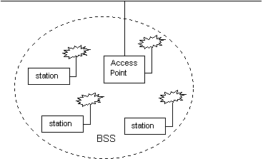
802.11 Topologies
Infrastructure Basic Service Set
An Infrastructure Basic Service Set is a BSS with an Access Point (AP).
Infrastructure Basic Service Set

Slide 12
802.11 Topologies
Infrastructure Basic Service Set
The AP may also provide connection to the outside.
Infrastructure Basic Service Set

Slide 13
Infrastructure mode
Infrastructure mode(有固定基础设施的)网络由带有无线收发装置的移动站和预先建立起来的、能覆盖一定地理范围的一批固定基站AP组成。
每个BSS包括一个AP以及该AP覆盖范围内的若干移动站。
AP用于连接BSS以外的世界，例如有线网络(Internet, Ethernet, etc)，或其他BSS。

Slide 14


Wireless Cells
Each AP coverage area (覆盖区域) is called a “cell”
Wireless nodes can roam (漫游) between cells
Channel 1
Channel 11
Channel 1
AP
AP
AP
AP
AP
Channel 1
AP
Channel 6
Channel 6

Slide 15

Example: Infrastructure Mode
www.xinhua.org
Internet
AP
BSS
User

Slide 16
Where does 802.11 live in the OSI?
Telnet, FTP, Email, Web, etc.
Application
Presentation
Session
TCP, UDP
Transport
IP, ICMP, IPX
Network
Logical Link Control - 802.2
(Interface to the upper layer protocols)
MAC
Data Link
Wireless lives at
Layers 1 & 2
only!
802.3, 802.5, 802.11
Physical Layer Convergence Protocol
Physical
LAN: 10BaseT, 10Base2, 10BaseFL
WLAN: FHSS, DSSS, IR

Slide 17
The 802.11 Physical Layer (PHY)
The IEEE 802.11 standard defines the media access control (MAC) and physical (PHY) layers for a LAN with wireless connectivity.
It addresses local area networking where the connected devices communicate over the air to other devices.

Slide 18
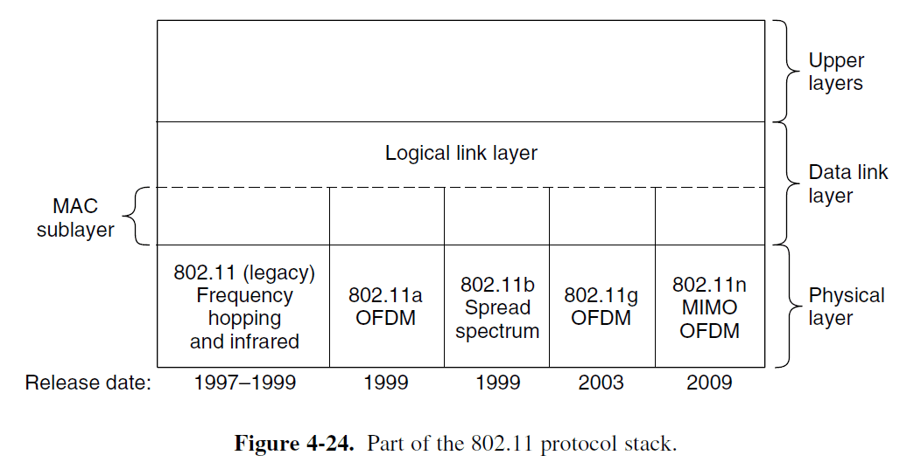
Introduction to IEEE 802.11
IEEE 802.11 standards mapped to the OSI reference model

Slide 19
The 802.11 Physical Layer (PHY)
The PHY provides three functions:
  the PHY provides an interface to exchange frames with the upper MAC layer for transmission and reception of data.
  the PHY uses signal carrier and spread spectrum modulation信号载波和扩展频谱调制to transmit data frames over the media.
  the PHY provides a carrier sense indication back to the MAC to verify activity on the media.

Slide 20
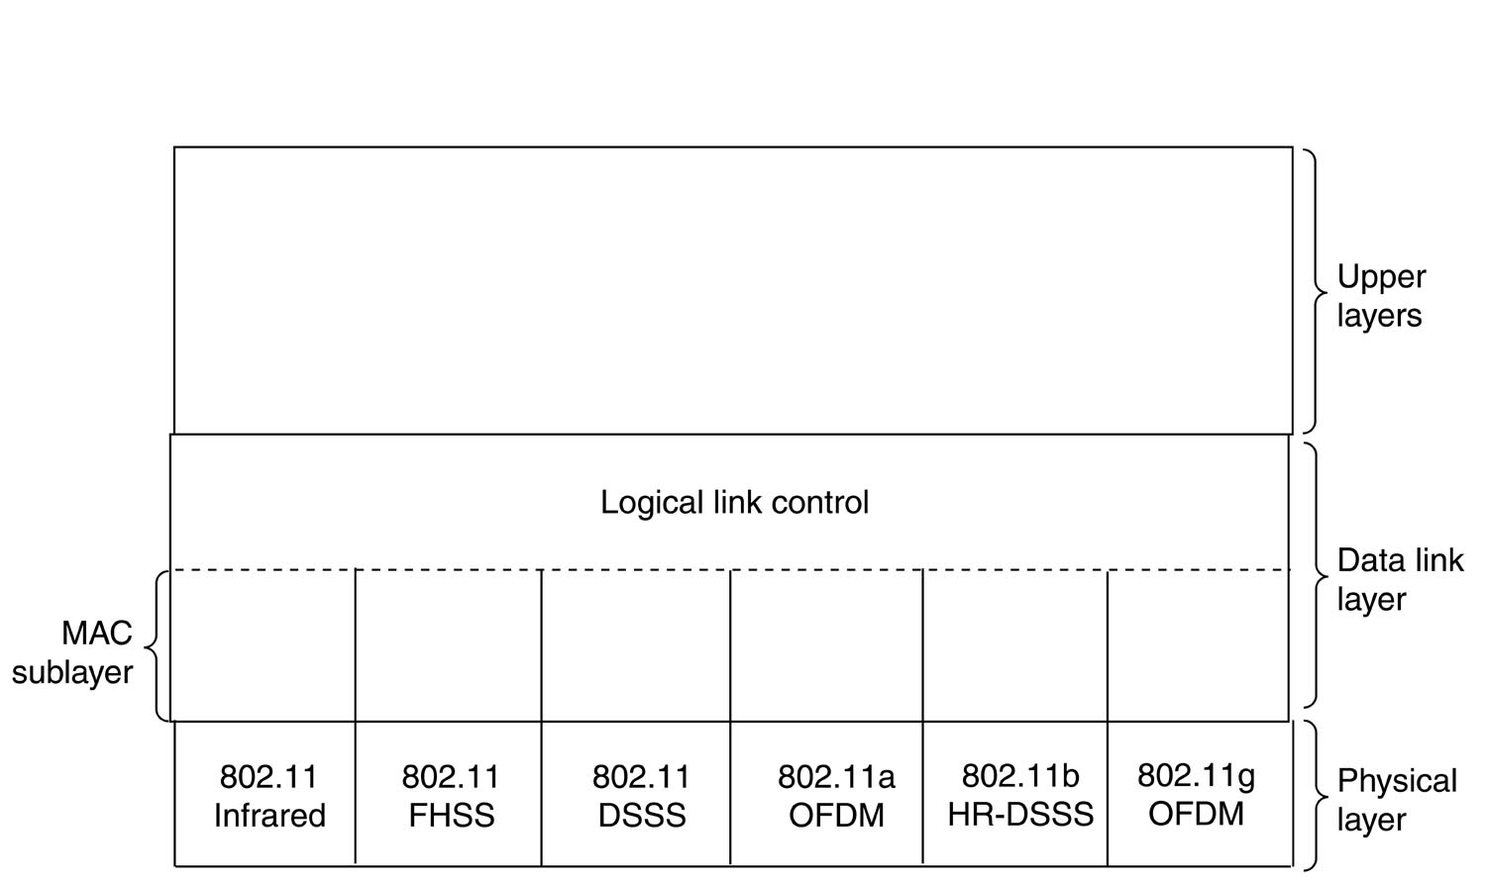
Introduction to IEEE 802.11
Part of the 802.11 protocol stack

Slide 21
The 802.11 Physical Layer (PHY)
The 802.11 physical layer (PHY) is the interface between the MAC and the wireless media where frames are transmitted and received.
Part of the 802.11 protocol stack

Slide 22
The 802.11 Physical Layer (PHY)
The 1997 802.11 standard specifies three transmission techniques:
  Infrared红外线
  FHSS (Frequency Hopping Spread Spectrum跳频扩频)
  DSSS (Direct Sequence Spread Spectrum直接序列扩频)
They use the 2.4 GHz radio frequency band, operating with at 1 or 2 Mbps data rate.

Slide 23
The 802.11 Physical Layer (PHY)
In 1999, two new techniques were introduced to achieve higher bandwidth, i.e.
  OFDM (Orthogonal Frequency Division Multiplexing正交频分复用)
  HR-DSSS (High Rate Direct Sequence Spread Spectrum高速直接序列扩频)
They operate at up to 54 Mbps and 11 Mbps, respectively.

Slide 24
几种常用的 802.11 无线局域网
标准 | 频段 | 数据 速率 | 物理层 | 优缺点
802.11b | 2.4 GHz | 最高为 11 Mb/s | HR-DSSS | 最高数据率较低，价格最低，信 号传播距离最远，且不易受阻碍
802.11a | 5 GHz | 最高为 54 Mb/s | OFDM | 最高数据率较高，支持更多用户 同时上网，价格最高，信号传播 距离较短，且易受阻碍
802.11g | 2.4 GHz | 最高为 54 Mb/s | OFDM | 最高数据率较高，支持更多用户 同时上网，信号传播距离最远， 且不易受阻碍，价格比 802.11b 贵

Slide 25
The 802.11 Media Access Control
Before transmitting frames, a station must first gain access to the medium, which is a radio channel that stations share.
The 802.11 standard defines two forms of medium access,
  Distributed coordination function (DCF)分布协调功能
  Point coordination function (PCF)点协调功能

Slide 26
The 802.11 Media Access Control
Distributed coordination function (DCF)分布协调功能 is mandatory
uses a CSMA/CA (Collision Avoidance) protocol, together with a positive ACK scheme;

Slide 27
The 802.11 Media Access Control
With DCF, 802.11 stations contend for access and attempt to send frames when there is no other station transmitting.
If another station is sending a frame, stations are polite and wait until the channel is free.

Slide 28
The 802.11 Media Access Control
The 802.11 MAC layer provides functionality to allow reliable data delivery for the upper layers over the wireless PHY media.
The data delivery itself is based on an asynchronous, best-effort, connectionless delivery of MAC layer data.
There is no guarantee that the frames will be delivered successfully.

Slide 29
The 802.11 Media Access Control
The 802.11 MAC provides a controlled access method to the shared wireless media called Carrier-Sense Multiple Access with Collision Avoidance (CSMA/CA).
CSMA/CA is similar to the collision detection access method deployed by 802.3 Ethernet LANs.

Slide 30
The 802.11 Media Access Control
CSMA/CD is a good idea on a wired LAN (e.g. Ethernet). However it cannot be used on a wireless LAN environment, because
  Implementing a Collision Detection Mechanism would require the implementation of a Full Duplex radio, an approach that would increase the price significantly;
  We cannot assume that all stations hear each other (which is the basic assumption of the Collision Detection scheme)

Slide 31
Wired and Wireless, What Difference ?
Ethernet LAN
Wireless LAN
B
A
B
C
A
C
If both A and C sense the channel to be idle at the same time, they send at the same time;
Collision can be detected at sender in Ethernet;
Half-duplex radios in wireless cannot detect collision at sender.

Slide 32
IEEE 802.11 MAC Protocol:
CSMA/CA载波监听多点接入/冲突避免
avoid collisions: 2⁺ nodes transmitting at same time
802.11: CSMA – sense(监听) before transmitting
  don’t collide with ongoing transmission by other nodes

Slide 33
IEEE 802.11 MAC Protocol:
CSMA/CA载波监听多点接入/冲突避免
802.11: no collision detection(没有冲突检测)!
  can’t sense all collisions in any case: fading, hidden station
A
B
C
C
A’s signal
strength
C’s signal
strength
B
A
space

Slide 34
IEEE 802.11 MAC Protocol:
CSMA/CA载波监听多点接入/冲突避免
802.11: no collision detection(没有冲突检测)!
  goal: avoid collisions: CSMA/ C(ollision) A(voidance)
A
B
C
C
A’s signal
strength
C’s signal
strength
B
A
space

Slide 35
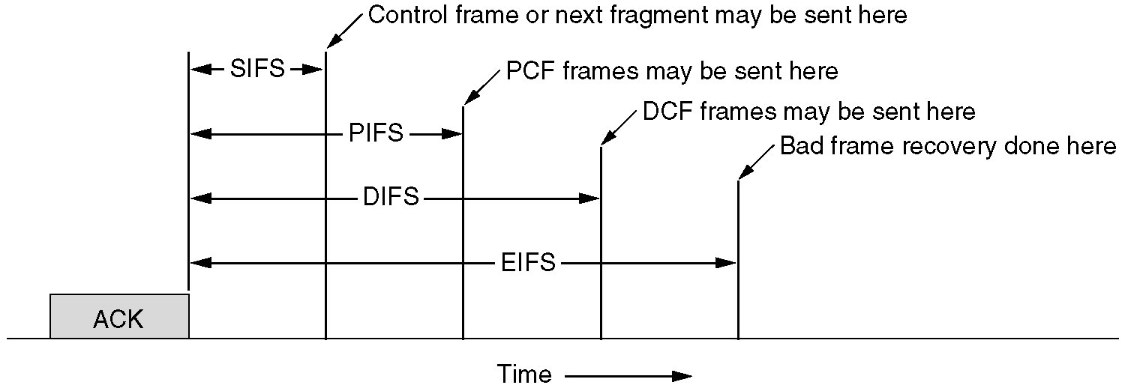
CSMA/CA协议的原理
为了尽量避免碰撞，每个站检测到信道空闲后，
必须等一段时间(帧间间隔IFS)才能发送数据帧。
Interframe spacing in 802.11.

Slide 36
CSMA/CA协议的原理
帧间间隔IFS (Inter-Frame Space)。其长短取决于打算发送的帧的类型。高优先级的帧需要等待的时间较短。
SIFS=28µs，PIFS= 78µs，DIFS=128µs

Slide 37
DIFS
PIFS
SIFS
信道闲
发送第一帧
源站
SIFS
时间
有帧要发送
ACK
目的站
时间
DIFS
争用窗口
PIFS
SIFS
NAV（信道忙）
发送下一帧
其他站
时间
推迟接入
等待重试时间
有帧要发送

Slide 38
The 802.11 Media Access Control
The 802.11 MAC provides a controlled access method to the shared wireless media called Carrier-Sense Multiple Access with Collision Avoidance (CSMA/CA).
CSMA/CA is similar to the collision detection access method deployed by 802.3 Ethernet LANs.

Slide 39
IEEE802.11 MAC Protocol: CSMA/CA 载波监听多点接入/冲突避免
802.11 sender
1 if sense channel idle for DIFS then
  transmit entire frame (no CD)
sender
receiver
DIFS
data
SIFS
ACK
Notes:
Distributed Inter-frame Space (DIFS):

Slide 40
IEEE802.11 MAC Protocol: CSMA/CA 载波监听多点接入/冲突避免
802.11 sender
2 if sense channel busy then
  - start random backoff time(随机退避时间)
  timer that counts down倒计时.
  try again when timer expires
sender
receiver
DIFS
data
SIFS
ACK
Notes:
Distributed Inter-frame Space (DIFS):

Slide 41
IEEE802.11 MAC Protocol: CSMA/CA 载波监听多点接入/冲突避免
802.11 sender
3 if no ACK, increase random backoff interval, repeat 2
802.11 receiver
- if frame received OK
return ACK after SIFS (ACK needed due to hidden terminal problem)
sender
receiver
DIFS
data
SIFS
ACK
Notes:
Distributed Inter-frame Space (DIFS):

Slide 42
SUMMARY
CSMA-CA + Acknowledgement
Carrier Sense Multiple Access with Collision Avoidance
source
destination
others
“Air” is free
for DIFS time period
DIFS
send frame
data
All other devices
must defer while “air” is busy
NAV: defer access
SIFS
Receive ACK back
that frame was
received intact!
ack
Every frame is ack’ed - except broadcast and multicast!
SIFS - Short Inter-Frame Space (approx 28 µs)

Slide 43
Hidden station & exposed station
隐蔽站与暴露站问题
Multiple wireless senders and receivers create additional problems (beyond multiple access):
Hidden station problem
(隐蔽站问题)
B, A hear each other
B, C hear each other
A, C can not hear each other
C
B
A
means A, C unaware of their interference at B

Slide 44
Hidden station & exposed station
隐蔽站与暴露站问题
Signal fading(信号衰减):
B, A hear each other
B, C hear each other
A
B
C
A’s signal
strength
C’s signal
strength
space
A, C can not hear each other interfering at B

Slide 45
Wired and Wireless, What Difference ?
Ethernet LAN
Wireless LAN
B
A
B
C
A
C
If both A and C sense the channel to be idle at the same time, they send at the same time;
Collision can be detected at sender in Ethernet;
Half-duplex radios in wireless cannot detect collision at sender.

Slide 46
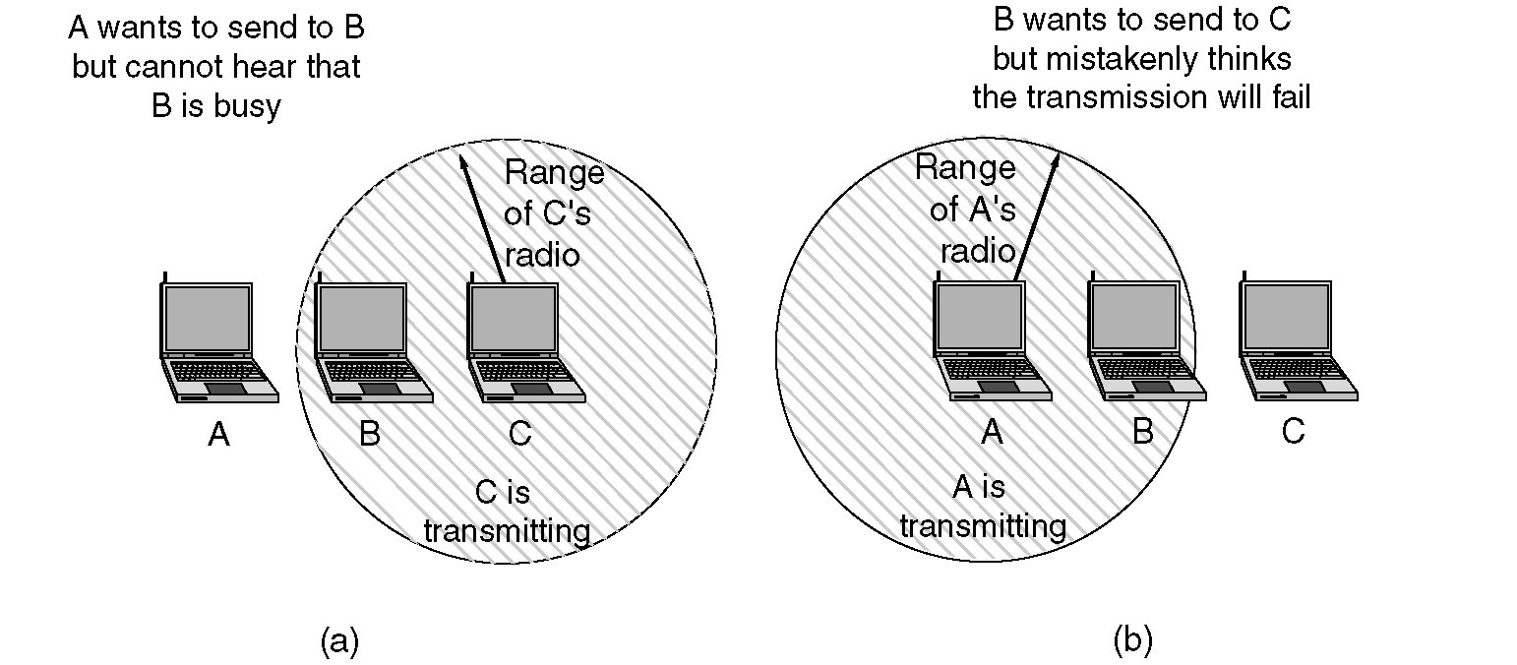
Hidden Station & Exposed Station
隐蔽站与暴露站问题
(a) The hidden station problem.
(b) The exposed station problem.

Slide 47
The hidden station problem
隐蔽站问题
隐蔽站是指在接收结点的覆盖范围内而在发送结点的覆盖范围外的结点。
隐蔽站因听不到发送结点的发送而可能向同样的接收结点发送数据，造成数据包在接收结点处冲突。
冲突后发送结点要重发冲突的数据包，从而降低了信道的利用率。

Slide 48
Channel Reservation 信道预约机制
RTS/CTS
idea: allow sender to “reserve” channel rather than random access of data frames: avoid collisions of long data frames 允许发送站采用预约信道的方式代替随机访问
sender first transmits small RTS (request-to-send) packets to receiver using CSMA
  RTSs may still collide with each other (but they’re short!)

Slide 49
Channel Reservation 信道预约机制
RTS/CTS
A
B
C
RTS(C)
RTS(A)
reservation collision
RTS(A)
CTS(A)
CTS(A)
DATA (A)
defer
time
ACK(A)
ACK(A)

Slide 50
Channel Reservation 信道预约机制
RTS/CTS
The receiver broadcasts CTS (clear-to-send) in response to RTS
CTS heard by all nodes
  sender transmits data frame
  other stations defer transmissions其它站推迟发送
A
B
C
RTS(B)
RTS(A)
reservation collision
RTS(A)
CTS(A)
CTS(A)
DATA (A)
defer
Avoid data frame collisions completely
using small reservation packets!
time
ACK(A)
ACK(A)

Slide 51
Channel Reservation 信道预约机制
RTS/CTS
The receiver broadcasts CTS (clear-to-send) in response to RTS
CTS heard by all nodes
  sender transmits data frame
  other stations defer transmissions其它站推迟发送
Avoid data frame collisions completely
using small reservation packets!

Slide 52
Channel reservation 信道预约机制
RTS/CTS
Request-To-Send/Clear-To-Send
  reservation-based approach (ask permission);
  useful for very large frames;
  useful for solving the “hidden node” problem;
  request asks for clearance (permission) to send;
  request also indicates time required for transmit.

Slide 53


隐蔽发送站
当A向B发送数据时，C也要向B发送信息。但A和C相距太远，C因检测不到A的信号而认为自己可以发送。C是A的隐蔽发送站。
A
B
C
D

Slide 54


隐蔽发送站问题的解决办法：信道预约
A向B发送数据帧之前，先发一个控制帧RTS (Request To Send请求发送)。C收不到此帧；
如果B处信道空闲，则回答一个控制帧CTS(Clear To Send允许发送). A和C均可收到.
A收到CTS后，开始发送数据帧，C回避。
RTS
A
CTS
CTS
B
C
D

Slide 55
SUMMARY
CSMA-CA + Acknowledgement
Carrier Sense Multiple Access with Collision Avoidance
source
destination
others
“Air” is free
for DIFS time period
DIFS
send frame
data
All other devices
must defer while “air” is busy
NAV: defer access
SIFS
Receive ACK back
that frame was
received intact!
ack
Every frame is ack’ed - except broadcast and multicast!
SIFS - Short Inter-Frame Space (approx 28 µs)

Slide 56
虚拟载波监听(Virtual Carrier Sense)
In order to reduce the probability of two stations colliding because they cannot hear each other, the standard defines a Virtual Carrier Sense mechanism.
  A station willing to transmit a data frame will first transmit a short RTS with the duration of the following transaction (i.e. the data frame and respective ACK)

Slide 57
虚拟载波监听(Virtual Carrier Sense)
In order to reduce the probability of two stations colliding because they cannot hear each other, the standard defines a Virtual Carrier Sense mechanism.
  The destination station will respond with a CTS with the same duration info

Slide 58
虚拟载波监听(Virtual Carrier Sense)
All stations receiving either the RTS and/or the CTS, will set their Virtual Carrier Sense indicator (called NAV, for Network Allocation Vector), for a given duration;
NAV is a counter resident at each station that represents the amount of time that the previous station needs to send its frame.

Slide 59
Channel reservation 信道预约机制
RTS/CTS
As a condition to accessing the medium, the MAC Layer checks the value of its network allocation vector (NAV)
The NAV must be zero before another station can attempt to send a frame.

Slide 60
Channel reservation 信道预约机制
RTS/CTS
Prior to transmitting a frame, a station calculates the amount of time necessary to send the frame based on the frame's length and data rate.

Slide 61
Channel reservation 信道预约机制
RTS/CTS
The station places a value representing this time in the duration field in the header of the frame.
When stations receive the frame, they examine this duration field value and use it as the basis for setting their corresponding NAVs.
This process reserves the medium for the sending station.

Slide 62
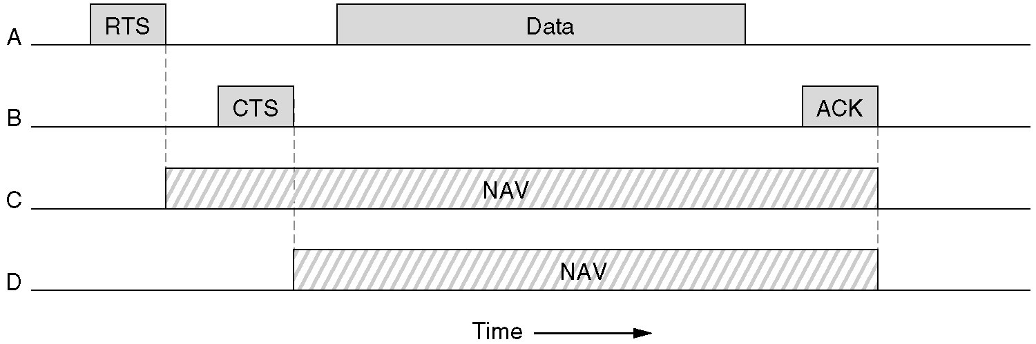
Channel Reservation 信道预约机制
RTS/CTS
RTS: Request To Send
CTS: Clear To Send

Slide 63
CSMA/CA协议的原理
虚拟载波监听(Virtual Carrier Sense)：源站将它要占用信道的时间(以微秒为单位)通知所有其它站，以便使其它站在这一段时间停止发送数据。这样就大大减少了碰撞的机会。

Slide 64
隐蔽接收站
当A向B发送数据时，C不能发送任何信息。如果这时D向C发来RTS，C收到了，却不能回答。D无法判断原因(RTS冲突？C没开机？C是隐蔽站？)
RTS
隐蔽接收站问题在单信道条件下无法解决。
A
B
C
D

