Slide 1
Babel
Upgrade or Downgrade

Slide 2
private scope
/01
babel-cli -> @babel/cli
babel-core -> @babel/core
babel-preset-env -> @babel/preset-env

Slide 3
Deprecated Yearly Presets
/02
e.g. babel-preset-es20xx => babel-preset-env

Slide 4

Renames:
/03
Proposal
e.g. @babel/plugin-transform-class-properties => @babel/plugin-proposal-class-properties
Drop the year from the plugin name
e.g. @babel/plugin-transform-es2015-classes => @babel/plugin-transform-classes

Slide 5
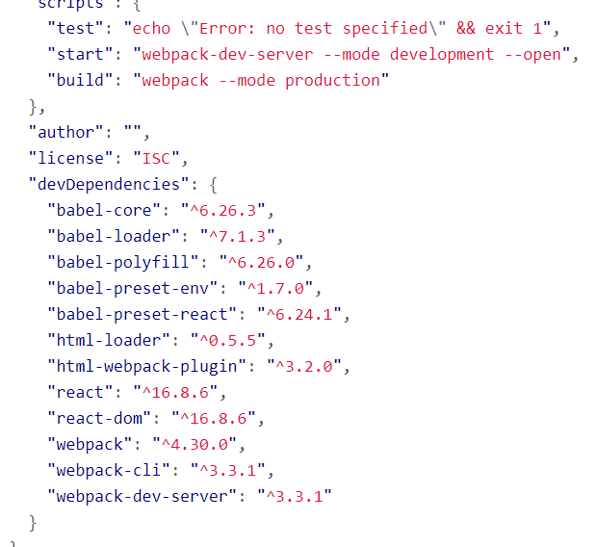
Upgrade
npm install babel-core babel-preset-env babel-preset-react babel-loader --save-dev
Previous:

Slide 6
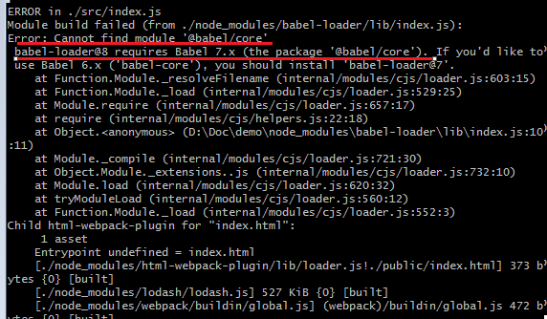
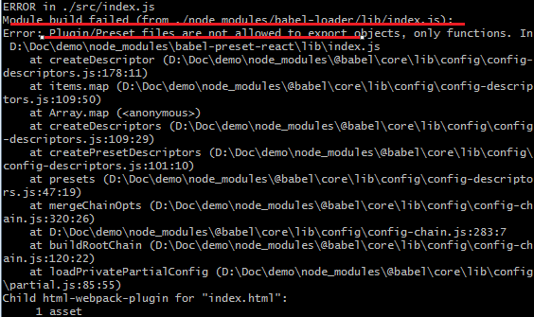
Upgrade
Compiles failed:

Slide 7
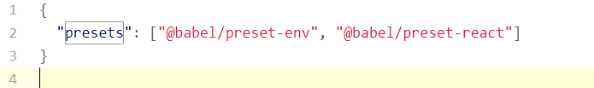
Upgrade
Now:
babel-preset-react => @babel/preset-react

Slide 8
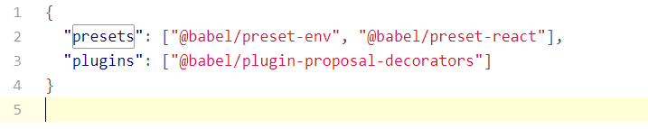
Decorator @ => hoc
/01
@babel/plugin-proposal-decorators

Slide 9
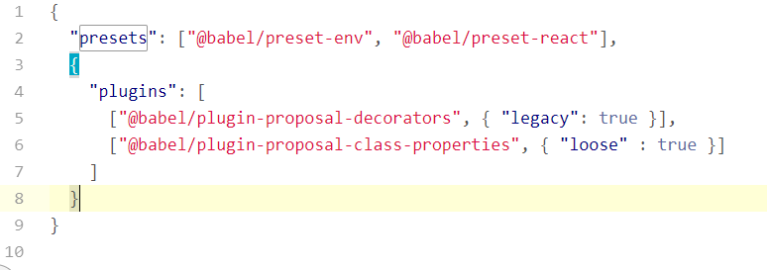
Decorator
Options:
decoratorsBeforeExport boolean
legacy boolean

Slide 10
Thanks.

Slide 11
Note:
本页为主题使用说明页，使用时请删除本页内容。
This is a instruction for theme, please delete this slide before presentaion.
主题模板的标准 How to use this template
主题色彩 THEME COLORS
预设参考线（2013版本及以上） GUIDES
文字/背景 Text/Background
填充色 Accents
*可以通过iSlide 【色彩库】功能，快速应用更多色彩
Use Color Library to apply theme colors.
主题字体 THEME FONTS
中文字体：微软雅黑 Asian Font: Microsoft Yahei
英文字体：Arial Lation Font: Arial
ALT+F9 开启和查看本主题预设的参考线
Use Alt + F9 to display/hidden guides.
*可以在【设计】菜单【字体】中改变，或应用iSlide【统一字体】功能改变设置。
Use Design, Variants, Fonts to change theme fonts, or just use Uniform Fonts in iSlide.
*可以通过iSlide 【一键优化】（智能参考线）功能，应用更多预设参考线。
Use Uniform Guides in iSlide to apply guides with presets.
Notes:
iSlide，让PPT设计简单起来！
iSlide, Make PowerPoint Design Simple!

Slide 12
快速设计页面 Quick design slides
Note:
本页为主题使用说明页，使用时请删除本页内容。
This is a instruction for theme, please delete this slide before presentaion.
1
使用【图示库】筛选图示
Use Diagram Library to search diagram
2
选择图示插入当前PPT主题，编辑修改文字，替换图标或填充图片
Click to insert diagram into current presentation, edit text, replace icon or fill pictures.
图示库/Diagram Library
?
获取更多帮助
Get more help
Notes:
iSlide，让PPT设计简单起来！
iSlide, Make PowerPoint Design Simple!

Slide 13

PPT“一键”美化神器
160K+专业PPT素材资源下载
让PPT设计简单起来！
All-In-One PowerPoint Design Add-in
160K+ Professional PowerPoint Resources
®
www.islide.cc
关注官方微信公众号 Follow us on WeChat
iSlide® 版权声明 COPYRIGHT NOTICE
本素材由iSlide® 提供
iSlide®尊重知识产权并注重保护用户享有的各项权利。郑重提醒您：
iSlide®插件中提供的任何信息内容的所有权、知识产权归其原始权利人或权利受让人所有，您免费/购买获得的是信息内容的使用权，并受下述条款的约束；
1. 您仅可以个人非商业用途使用该等信息内容，不可将信息内容的全部或部分用于出售，或以出租、出借、转让、分销、发布等其他任何方式供他人使用；
2. 禁止在接入互联网或移动互联网的任何网站、平台、应用或程序上以任何方式为他人提供iSlide®插件资源内容的下载。
The resource is supplied by iSlide®.
iSlide® respects all intellectual property rights and protects all the rights its users acquired. Solemnly remind you:
The ownership and intellectual property of the resources supplied in iSlide Add-in belongs to its owner or the assignee of this ownership. you only acquired the usage of the resources supplied in iSlide Add-in, as well as respected the following restrain terms:
1.You are only allowed to use such resource for personal and non-commercial aim, not allowed to use such resource or part of it for the sale; or rent, lend, transfer to others; or distribution or release it in any way.
2.You are not permitted to provide the resource of iSlide Add-in in any website, platform, application access to the Internet or mobile Internet.
Notes:
本素材由iSlide® 提供
iSlide®尊重知识产权并注重保护用户享有的各项权利。郑重提醒您：
iSlide®插件中提供的任何信息内容的所有权、知识产权归其原始权利人或权利受让人所有，您免费/购买获得的是信息内容的使用权，并受下述条款的约束；
1. 您仅可以个人非商业用途使用该等信息内容，不可将信息内容的全部或部分用于出售，或以出租、出借、转让、分销、发布等其他任何方式供他人使用；
2. 禁止在接入互联网或移动互联网的任何网站、平台、应用或程序上以任何方式为他人提供iSlide®插件资源内容的下载。
The resource is supplied by iSlide® .
iSlide® respects all intellectual property rights and protects all the rights its users acquired. Solemnly remind you:
The ownership and intellectual property of the resources supplied in iSlide Add-in belongs to its owner or the assignee of this ownership. you only acquired the usage of the resources supplied in iSlide Add-in, as well as respected the following restrain terms:
1.You are only allowed to use such resource for personal and non-commercial aim, not allowed to use such resource or part of it for the sale; or rent, lend, transfer to others; or distribution or release it in any way.
2.You are not permitted to provide the resource of iSlide Add-in in any website, platform, application access to the Internet or mobile Internet.

