Slide 1
Controlled-U gate

Slide 2
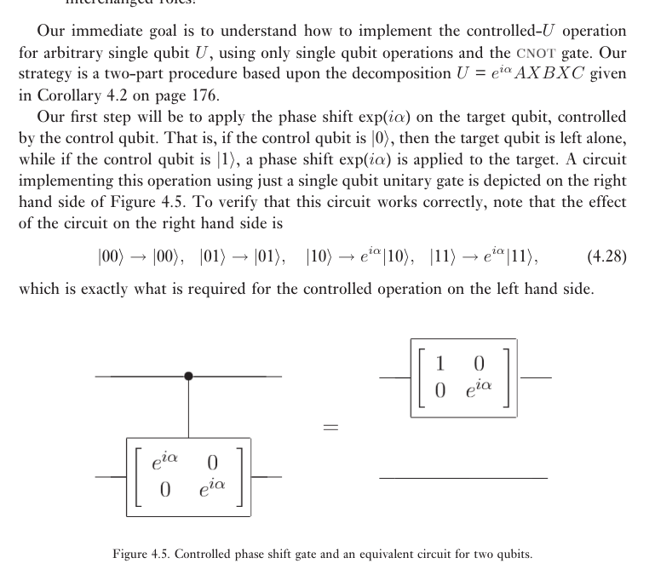
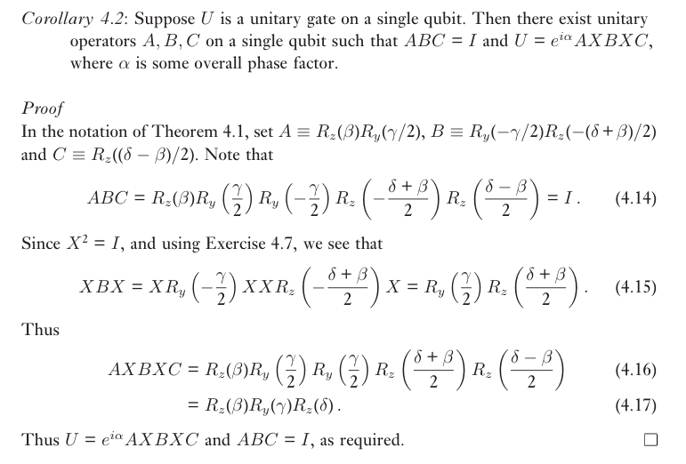

Slide 3



Slide 4



Slide 5



Slide 6
