Slide 1
Quantum random walk search algorithm

Slide 2
Overview
Classical random walk search algorithm
Use of Markov Chain in random walk + cost estimation
Quantum circuit introduction
Quantum random walk search algorithm
Cost for quantum random walk algorithms
Comparing quantum walk with Grover’s algorithm

Slide 3
Classical random walk search algorithm
Input: x ∈ {0, 1} ^{N}
Output: A string 𝑥 ∈{0, 1} ^{N} for which 𝑓(𝑥)=1 (marked state)

Slide 4
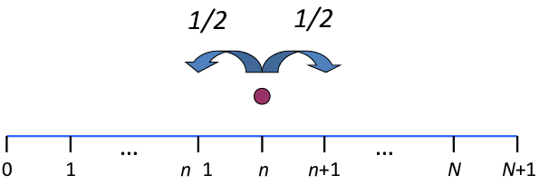
Classical random walk search algorithm
Start at some specific vertex x of the graph.
Repeat the following a number of times:
Check if x is marked, if it is marked, stop the walk and output x.
If not, select one of its neighbors y at random and set x to be that neighbor.

Slide 5
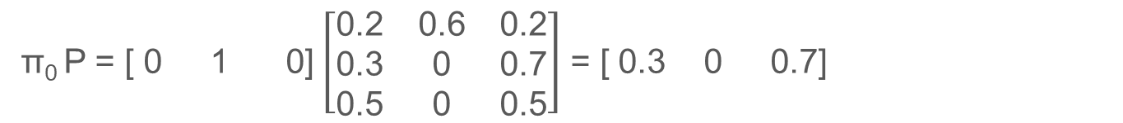
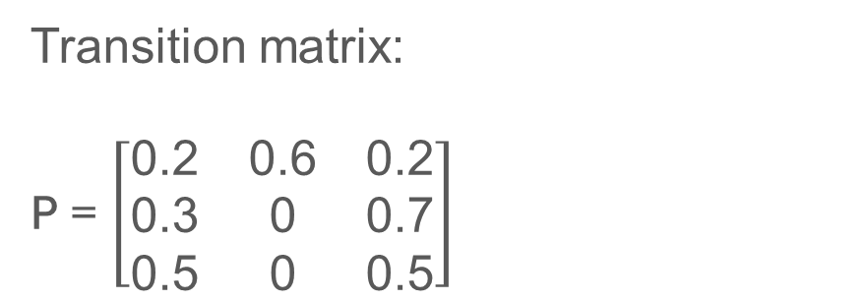
Use of Markov Chain in random walk
Transition matrix:
P = $\left[\begin{matrix}\text{0}\text{.2} & \text{0.6} & \text{0.2} \\ \text{0.3} & \text{0} & \text{0.7} \\ \text{0.5} & \text{0} & \text{0.5}\end{matrix}\right]$
0.2
A
0.2
0.5
C
0.5
0.3
π₀ = [ 0 1 0]
0.6
B
0.7
π₀ P = [ 0 1 0] $\left[\begin{matrix}\text{0}\text{.2} & \text{0.6} & \text{0.2} \\ \text{0.3} & \text{0} & \text{0.7} \\ \text{0.5} & \text{0} & \text{0.5}\end{matrix}\right]$ = [ 0.3 0 0.7]

Slide 6
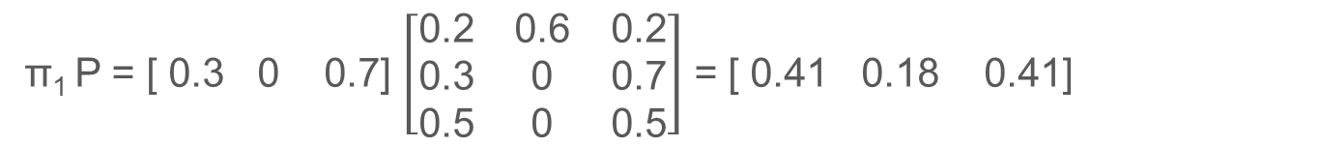
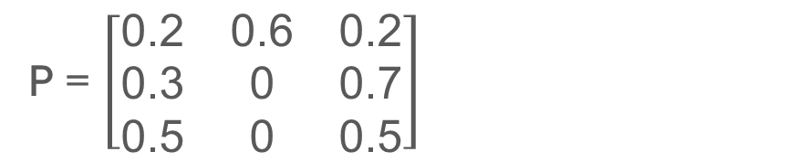
Use of Markov Chain in random walk
P = $\left[\begin{matrix}\text{0}\text{.2} & \text{0.6} & \text{0.2} \\ \text{0.3} & \text{0} & \text{0.7} \\ \text{0.5} & \text{0} & \text{0.5}\end{matrix}\right]$
0.2
A
0.2
0.5
π₀ = [ 0 1 0]
C
0.5
0.3
0.6
B
0.7
π₁ P = [ 0.3 0 0.7] $\left[\begin{matrix}\text{0}\text{.2} & \text{0.6} & \text{0.2} \\ \text{0.3} & \text{0} & \text{0.7} \\ \text{0.5} & \text{0} & \text{0.5}\end{matrix}\right]$ = [ 0.41 0.18 0.41]

Slide 7
Use of Markov Chain in random walk
P = $\left[\begin{matrix}\text{0}\text{.2} & \text{0.6} & \text{0.2} \\ \text{0.3} & \text{0} & \text{0.7} \\ \text{0.5} & \text{0} & \text{0.5}\end{matrix}\right]$
0.2
A
0.2
0.5
π₀ = [ 0 1 0]
C
0.5
0.3
0.6
π P = π
B
0.7
Pπ = λπ
λ = 1

Slide 8
Use of Markov Chain in random walk
P = $\left[\begin{matrix}\text{0}\text{.2} & \text{0.6} & \text{0.2} \\ \text{0.3} & \text{0} & \text{0.7} \\ \text{0.5} & \text{0} & \text{0.5}\end{matrix}\right]$
0.2
A
0.2
0.5
π₀ = [ 0 1 0]
C
0.5
0.3
0.6
π P = π
B
0.7
Pπ = λπ
π = [ 0.35211 0.21127 0.43662]

Slide 9
Cost estimation
Start at some specific vertex x of the graph.
Repeat the following a number of times:
Check if n is marked, if it is marked, stop the walk and output x.
If not, select one of its neighbors y at random and set x to be that neighbor.

Slide 10
Cost estimation
Start at some specific vertex n of the graph. (S: the cost of setting up the initial state)
Repeat the following 1/ϵ times:
Check if n is marked, if it is marked, stop the walk and output n. (C: the cost to check if a given vertex is marked)
If not, select one of its neighbors at random and set n to be that neighbor. (U: the cost to update the current vertex)
(1/δ​ represents the mixing time, which is the number of steps required for the random walk to approach its stationary distribution)

Slide 11

Cost estimation
S + ​$\frac{\text{1}}{\text{ϵ}}$ (C + $\frac{\text{1}}{\text{δ}}$ ​U)

Slide 12
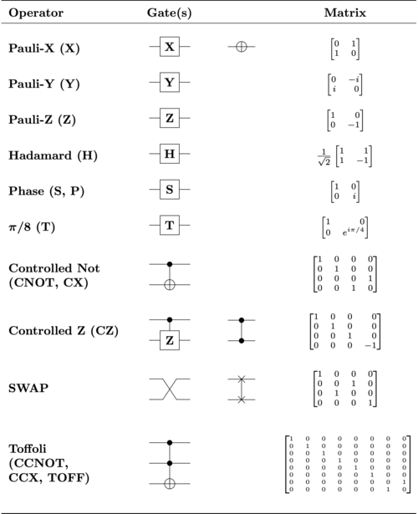
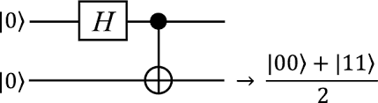
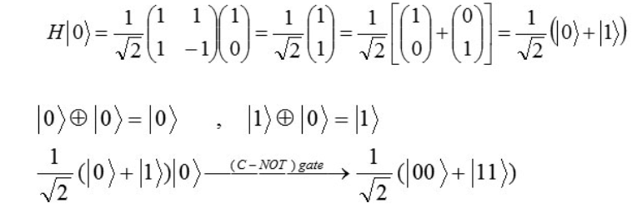
Quantum circuit introduction

Slide 13
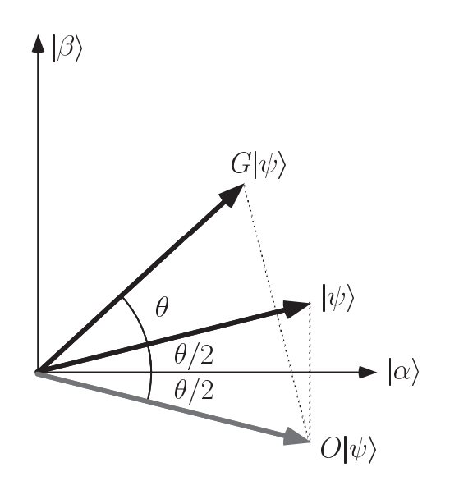
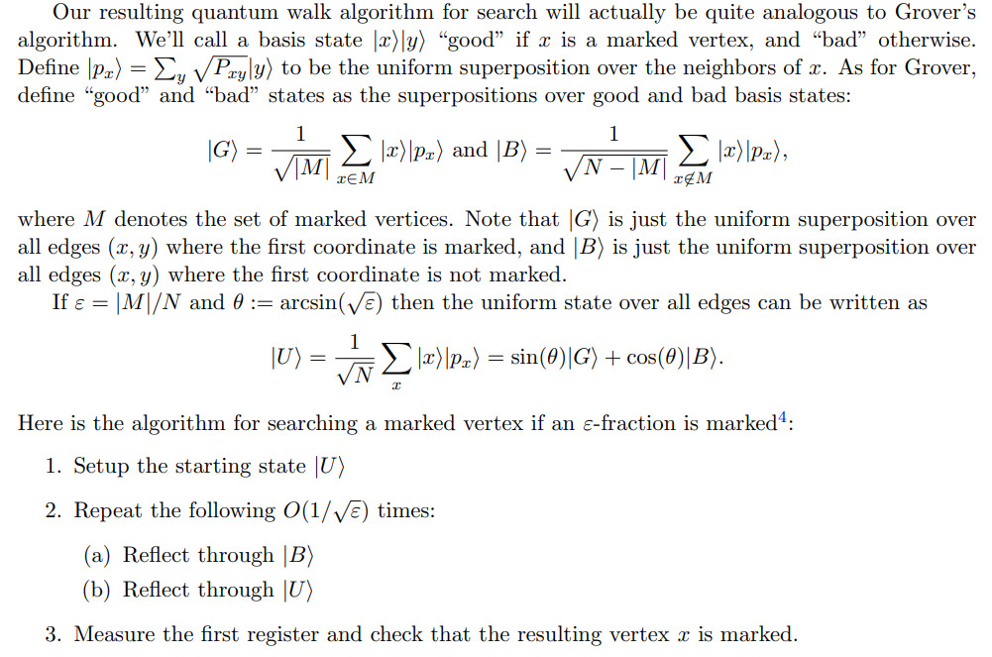
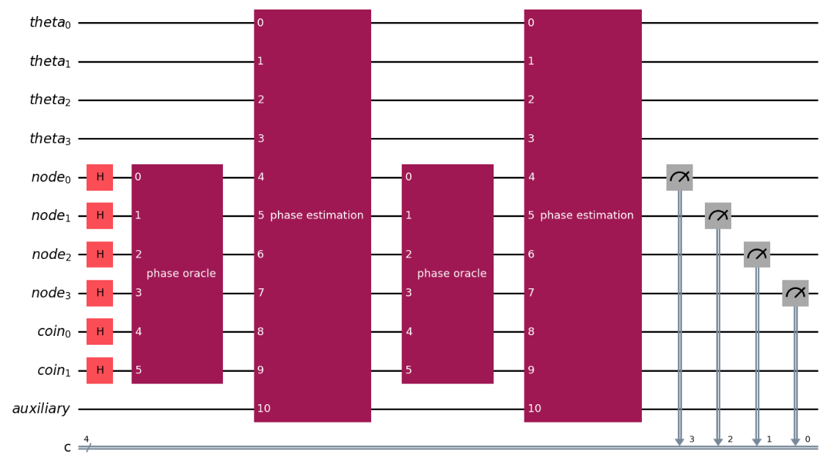

Quantum random walk search algorithm
∣G⟩
R(P)$O$(U)
∣U⟩
∣B⟩
O∣G⟩

Slide 14


Quantum random walk search algorithm (Final output)
11
01
∣G⟩
10
00
Final state
∣B⟩

Slide 15
Quantum random walk search algorithm (Final output)
11
01
∣G⟩
10
00
Final state
∣B⟩

Slide 16
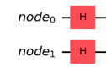

Quantum random walk search algorithm (1st step)
0.5∣00⟩+0.5∣01⟩+0.5∣10⟩+0.5∣11⟩
11
01
∣G⟩
10
00
$\text{∣}\text{U}\text{⟩}= \frac{1}{2}$ ∣G⟩ + $\frac{\sqrt{3}}{2}$ ∣B⟩
30°
∣B⟩

Slide 17
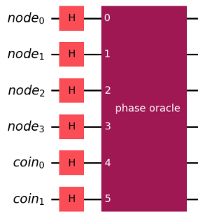
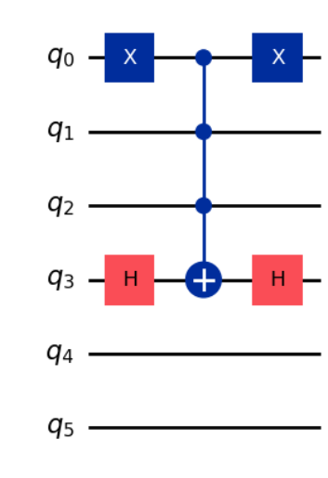
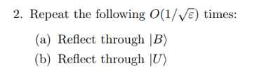
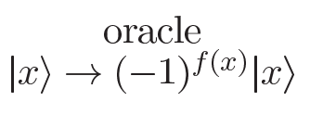


Quantum random walk search algorithm (2nd step (a))
Oracle (Mark 0111)
∣G⟩
H^{⊗6}∣0000⟩
$$\text{∣}\text{U}\text{⟩}$$
∣B⟩
O$\text{∣}\text{U}\text{⟩}$

Slide 18
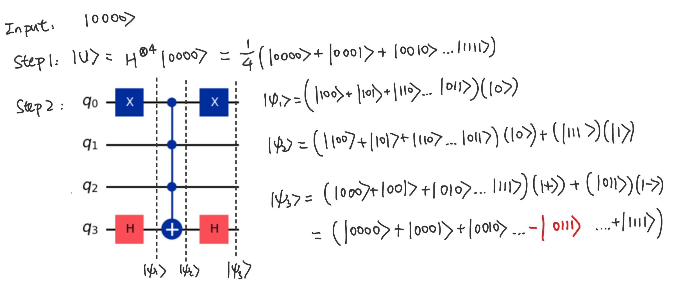
Quantum random walk search algorithm (2nd step (a))
Oracle (Mark 0111)

Slide 19
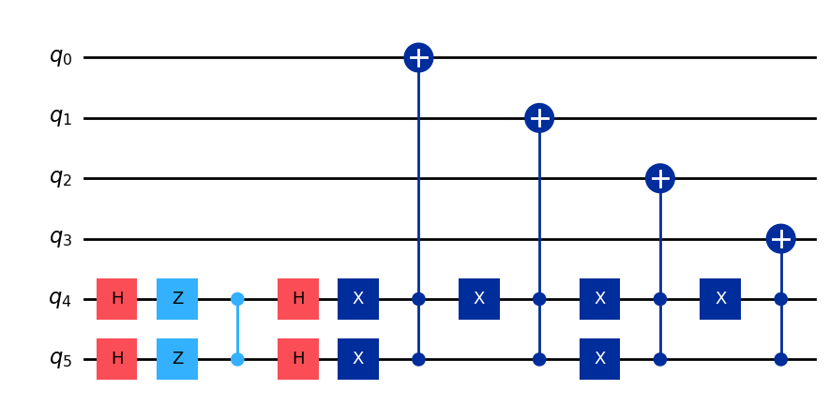
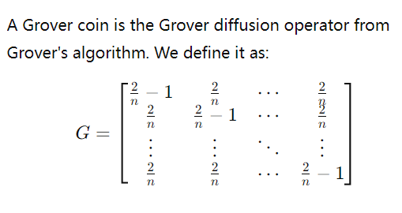
Quantum random walk search algorithm (2nd step (b))
For the walk on the integer line, the shift operator moves the walker to the left if the coin is ∣0⟩∣0⟩ and to the right if the coin is ∣1⟩:
𝑆∣0⟩∣𝑗⟩=∣0⟩∣𝑗+1⟩
𝑆∣1⟩∣𝑗⟩=∣1⟩∣𝑗−1⟩
With the shift operator defined as above, we can represent one step of the coined quantum walk as the unitary operator 𝑈 given by
𝑈=𝑆𝐶,
where 𝐶 is the coin operator. For the quantum walk on the integer line, we use the Hadamard coin, but 𝐶C can be either Hadamard coin, Grover coin, or any other coin operator. We can also look several steps ahead. We can express the quantum state ∣𝜓⟩ after 𝑡 time steps as
∣𝜓(𝑡)⟩=𝑈^{𝑡}∣𝜓(0)⟩,
where ∣𝜓(0)⟩ is the initial state and 𝑈 is the operator for one step of the walk. Coined quantum walks are most suitable for regular graphs, graphs where all nodes have the same number of neighbors.
Coin Operator
Shift Operator

Slide 20
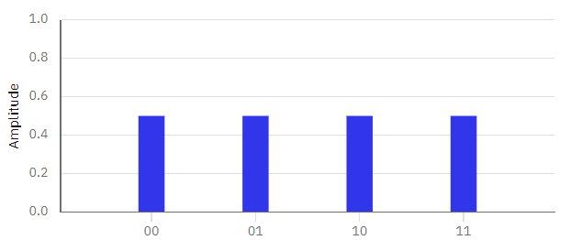
Quantum random walk search algorithm (2nd step (b))
For the walk on the integer line, the shift operator moves the walker to the left if the coin is ∣0⟩∣0⟩ and to the right if the coin is ∣1⟩:
𝑆∣0⟩∣𝑗⟩=∣0⟩∣𝑗+1⟩
𝑆∣1⟩∣𝑗⟩=∣1⟩∣𝑗−1⟩
With the shift operator defined as above, we can represent one step of the coined quantum walk as the unitary operator 𝑈 given by
𝑈=𝑆𝐶,
where 𝐶 is the coin operator. For the quantum walk on the integer line, we use the Hadamard coin, but 𝐶 can be either Hadamard coin, Grover coin, or any other coin operator. We can also look several steps ahead. We can express the quantum state ∣𝜓⟩ after 𝑡 time steps as
∣𝜓(𝑡)⟩=𝑈^{𝑡}∣𝜓(0)⟩,
where ∣𝜓(0)⟩ is the initial state and 𝑈 is the operator for one step of the walk. Coined quantum walks are most suitable for regular graphs, graphs where all nodes have the same number of neighbors.
Coin Operator
Shift Operator

Slide 21
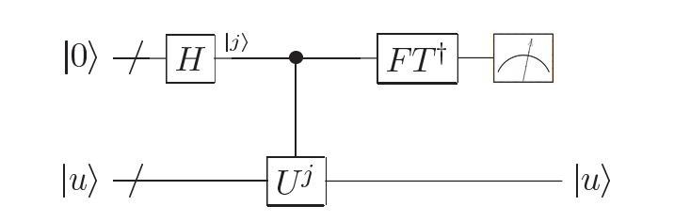
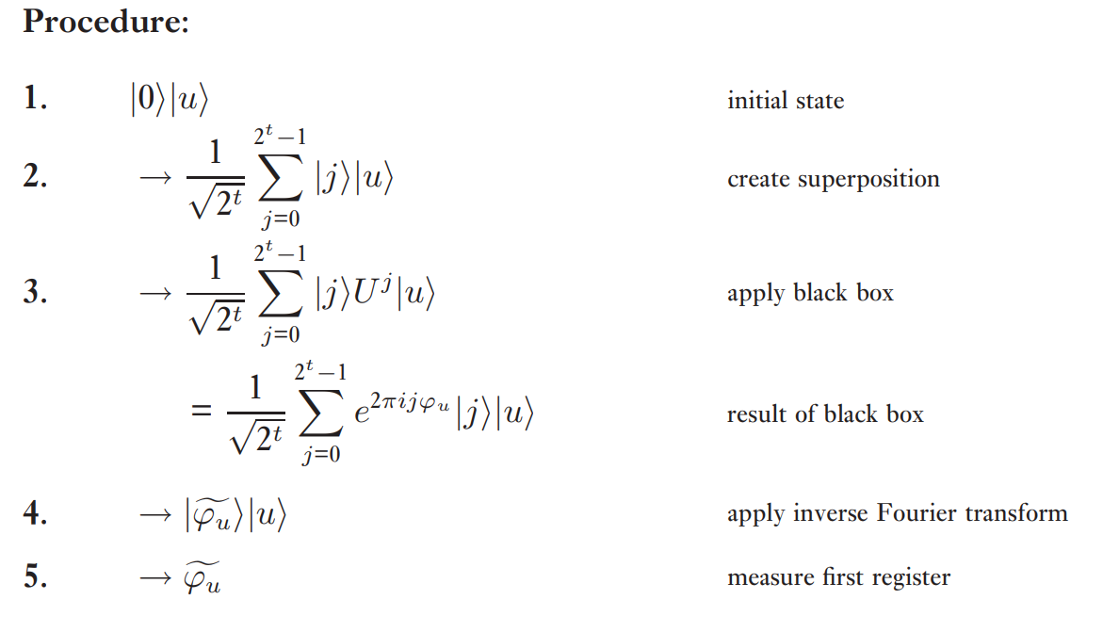
Quantum random walk search algorithm (2nd step (b))

Slide 22
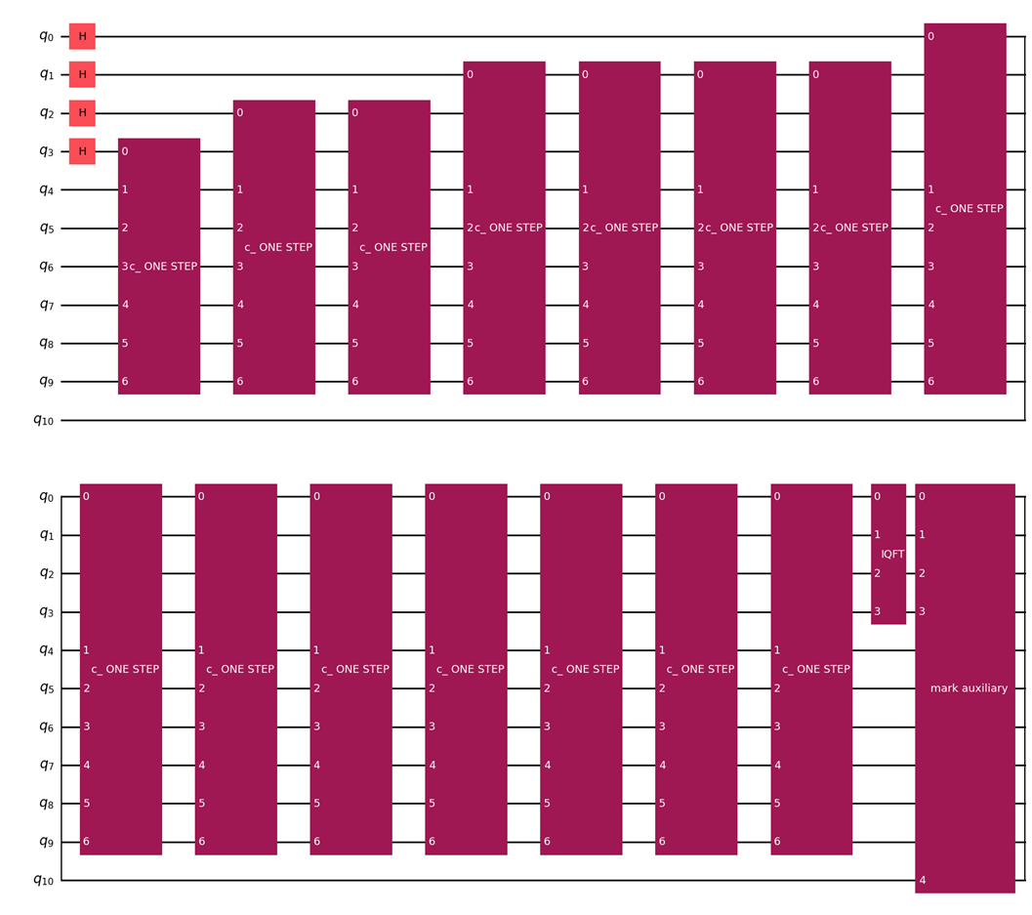
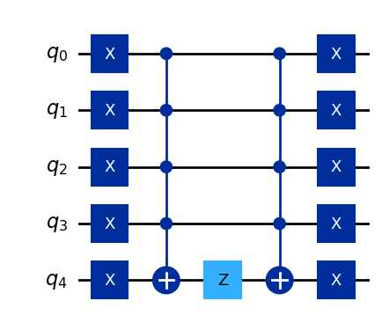
Quantum random walk search algorithm (2nd step (b))

Slide 23
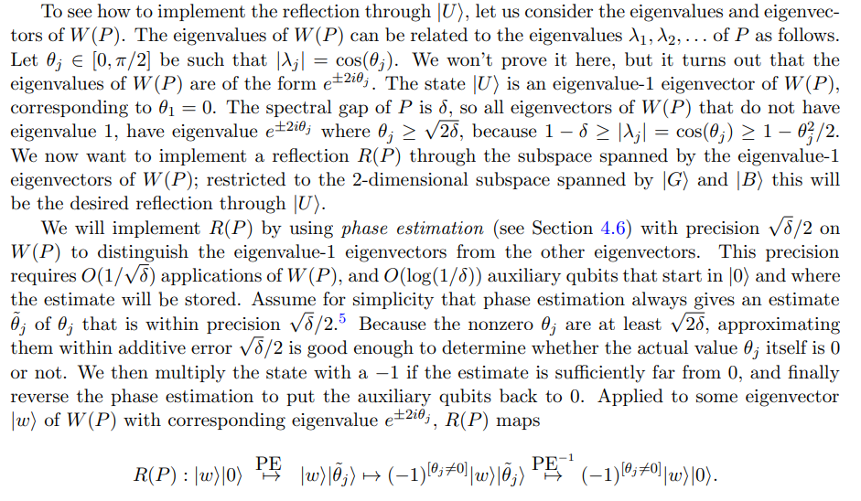
Quantum random walk search algorithm (2nd step (b))

Slide 24
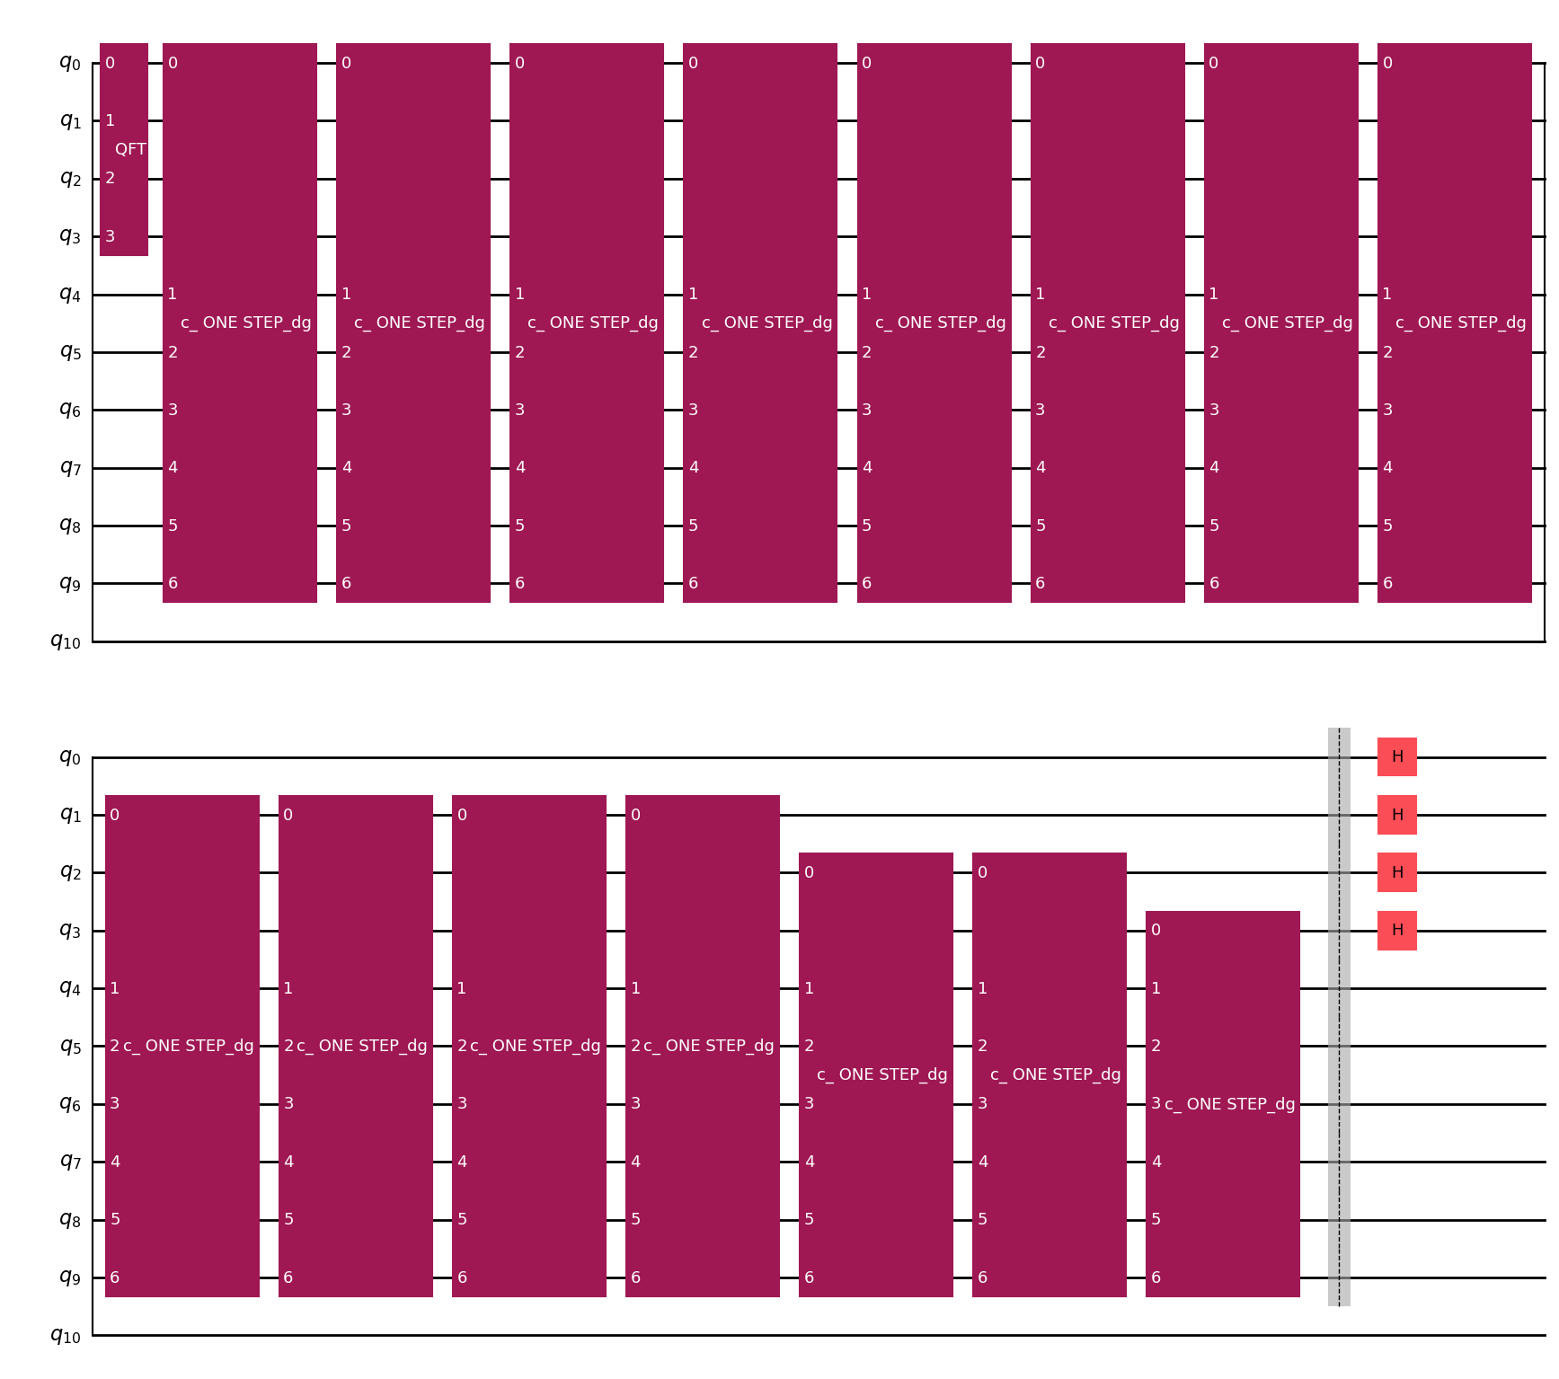
Quantum random walk search algorithm (2nd step (b))

Slide 25


Quantum random walk search algorithm (2nd step (b))
∣G⟩
$$\text{∣}\text{U}\text{⟩}$$
∣B⟩
O$\text{∣}\text{U}\text{⟩}$

Slide 26

Quantum random walk search algorithm (2nd step (b))
∣G⟩
R(P)$O\text{∣}\text{U}\text{⟩}$
$$\text{∣}\text{U}\text{⟩}$$
∣B⟩

Slide 27
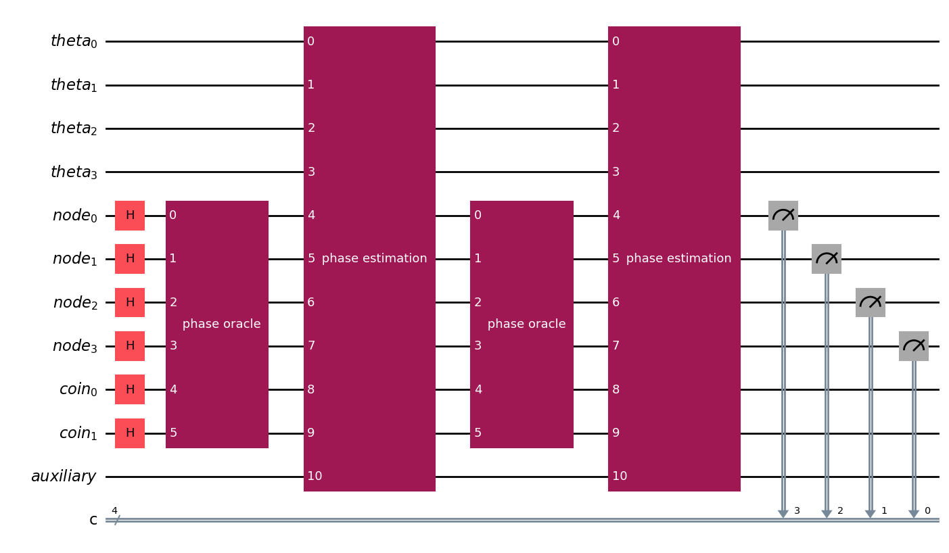
Quantum random walk search algorithm (2nd step (b))

Slide 28
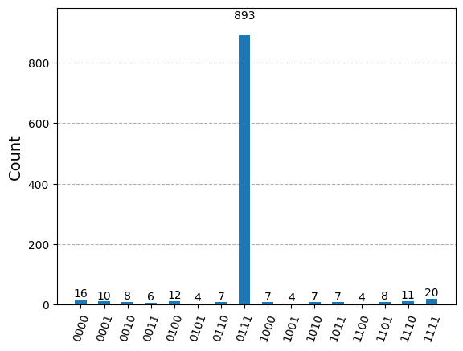
Quantum random walk search algorithm (2nd step (b))

Slide 29
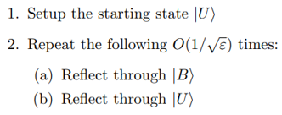
Cost for quantum random walk algorithms
Quantum random walk:
Setup Cost 𝑆
Definition: The cost of constructing the initial state ∣𝑈⟩.
Checking Cost 𝐶
Definition: The cost of the unitary map ∣𝑥⟩∣𝑦⟩↦𝑚_{𝑥}∣𝑥⟩∣𝑦⟩, where: 𝑚_{𝑥}=−1 if 𝑥 is a marked state.
𝑚_{𝑥}=1 otherwise.
Quantum: S + ​$\frac{\text{1}}{\sqrt{\text{ϵ}}}$ (C + $\frac{\text{1}}{\sqrt{\text{δ}}}$ ​U)
Update Cost 𝑈
Definition: The cost of one step of the quantum walk, i.e., of 𝑊(𝑃).
Classical: S + ​$\frac{\text{1}}{\text{ϵ}}$ (C + $\frac{\text{1}}{\text{δ}}$ ​U)
The cost of part (a) of the algorithm is 𝐶. Since 𝑅(𝑃) uses 𝑂(1/√𝛿) applications of 𝑊(𝑃), and a few other gates, the cost of part (b) of the algorithm is essentially 𝑂(1/√𝛿).

Slide 30
Comparing quantum walk with Grover’s algorithm
Similarities:
Initial State: Both algorithms begin in the equal superposition state over all bit strings.
Use of Grover Diffusion Operator: Both algorithms make use of the Grover diffusion operator 𝐺, also known as the Grover iterate.
Conceptual Framework: Both can be viewed as rotations in a two-dimensional subspace.
Oracle Marking: Both use an oracle that marks the target state with a phase of -1.
Running Time: Both algorithms have a running time of 𝑂(√𝑁).
Measurement: Both require measurement at a specific time to obtain the maximum probability of success.
Differences:
Mapping to Two-Dimensional Subspace: Grover's algorithm can be exactly mapped to a two-dimensional subspace, whereas the random walk search algorithm can only be approximately mapped.
Spanned Subspace: In Grover's algorithm, the two-dimensional subspace is spanned by ∣𝜓0⟩ and ∣0⟩.In the random walk search algorithm, it is spanned by ∣𝜓0⟩ and ∣𝜓1⟩.
Final State: The final state of Grover's algorithm is exactly the pure marked state ∣0⟩.The random walk search algorithm’s final state is a linear combination of the marked state and its neighbors, reflecting the underlying topology of the hypercube.
Application of the Grover Diffusion Operator: In Grover's algorithm, 𝐺 is applied to the entire 2^{𝑛} -dimensional search space. In the random walk algorithm, 𝐺 acts on the 𝑛-dimensional coin space.
Physical Implementation: The random walk search algorithm can use different types of qubits (quantum coins) due to varying gate sets in physical quantum computers, while Grover’s diffusion operator typically acts on a uniform space.

Slide 31
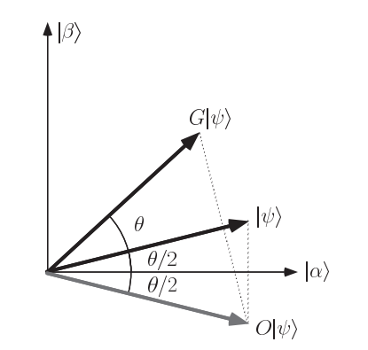
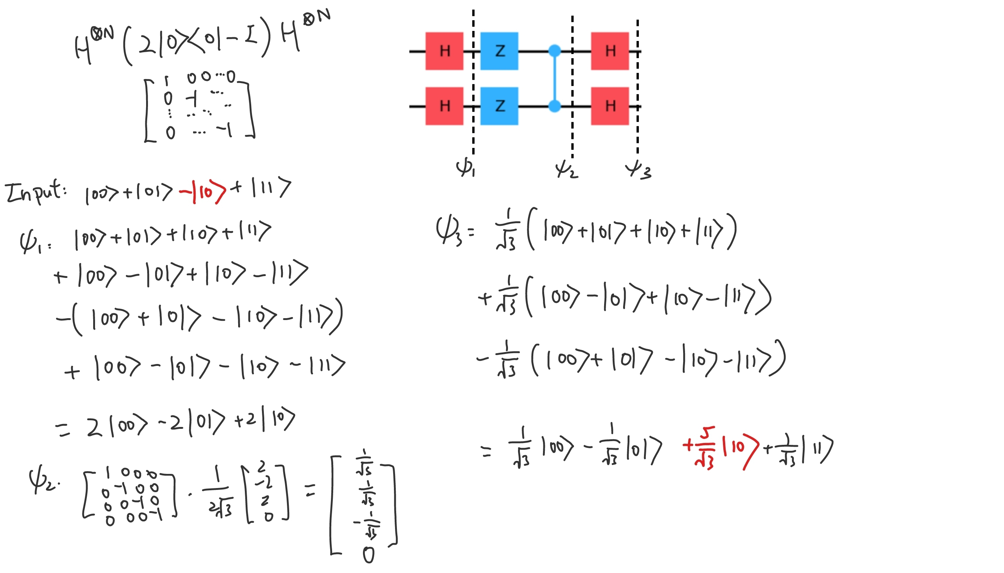
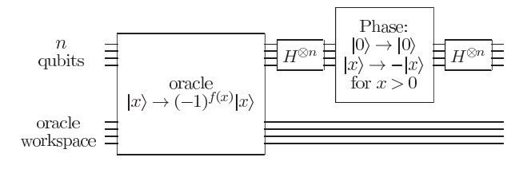
Grover diffusor

