Slide 1
Notes for Class 6
The phonological status of morphologically complex words.
July 2007, Stanford

Slide 2

Case study: Tagalog tapping
d vs. r ([ɾ])
In native words, there’s (near-)complementary distribution, with r between vowels and d elsewhere
  V__V elsewhere
  araw ‘sun’ dapat ‘should’ (#__)
  likod ‘back’ (__#)
  ganda ‘beauty’ (C__)
  (na-)idlip ‘nap(ped)’ (__C)
Spanish and English loans have introduced lots of exceptions:
  barkada ‘group’ (VdV) radyo ‘radio’ (#r)
  ambasador ‘embassador’ (r#)
  (often approximant)
  sobra-ng ‘too much’ (Cr)
  barkada ‘group’ (rC)
  All sound clips taken from Guevara et al. audio corpus

Slide 3
Tapping background, continued
d → r / V__V
d optionally becomes r between vowels
  lakad ‘walk’ lakar-an ‘to be walked on’
  bayad ‘fee’ b<in>a-bayar-an ‘payment’

Slide 4
Environments for tapping
(Schachter & Otanes 1973)
Stem+suffix: obligatory tapping
  lakad ‘walk’ lakar-an ‘be walked on’
  tamad ‘lazy’ tamar-in ‘be lazy about’
Prefix+stem: varies
  dumi ‘dirt’ ma-rumi ‘dirty’
  dahon ‘leaf’ ma-dahon ‘leafy’
  including for CV reduplication
  dambong ‘plunder’ man-da-rambong ‘plunderer’
  dula ‘drama’ man-du-dula ‘dramatist’
Stem+stem reduplication: tapping is rare
  dala-dala ‘load carried’
  agad-[ʔ]agad ‘at once’

Slide 5
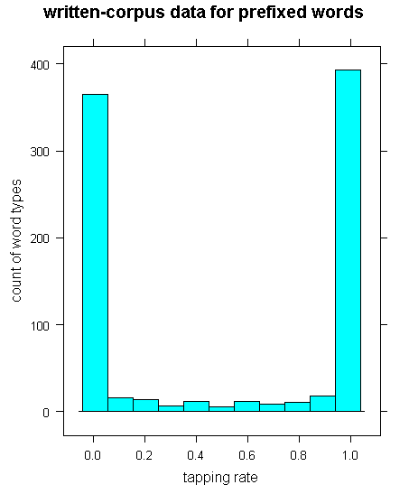
Variation in prefixed words
Polarized:
some word types do it
some word types don’t
Data source:
~ 20-million word corpus of written Tagalog, created from web pages
Morphological segmenter identifies potentially prefixed forms of known roots
Only items with corpus frequency > 10 shown here
Thanks to Ivan Tam for programming and Rosie Jones for sharing data from her corpus project
Notes:
> histogram(~ tapping_rate, matcheckPrefixes, type="count",main="written-corpus data for prefixed words", xlab="tapping rate",ylab="count of word types")

Slide 6
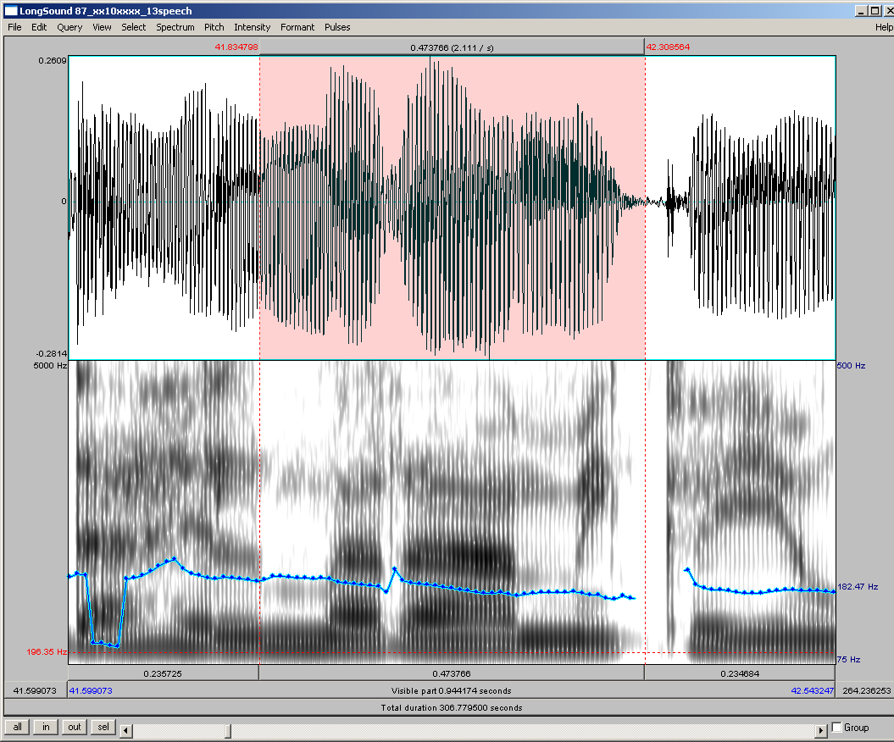
Typical r token (ma+rami)
m a ɾ aː m i
Thanks, Praat! (Boersma & Weenink 2006)

Slide 7
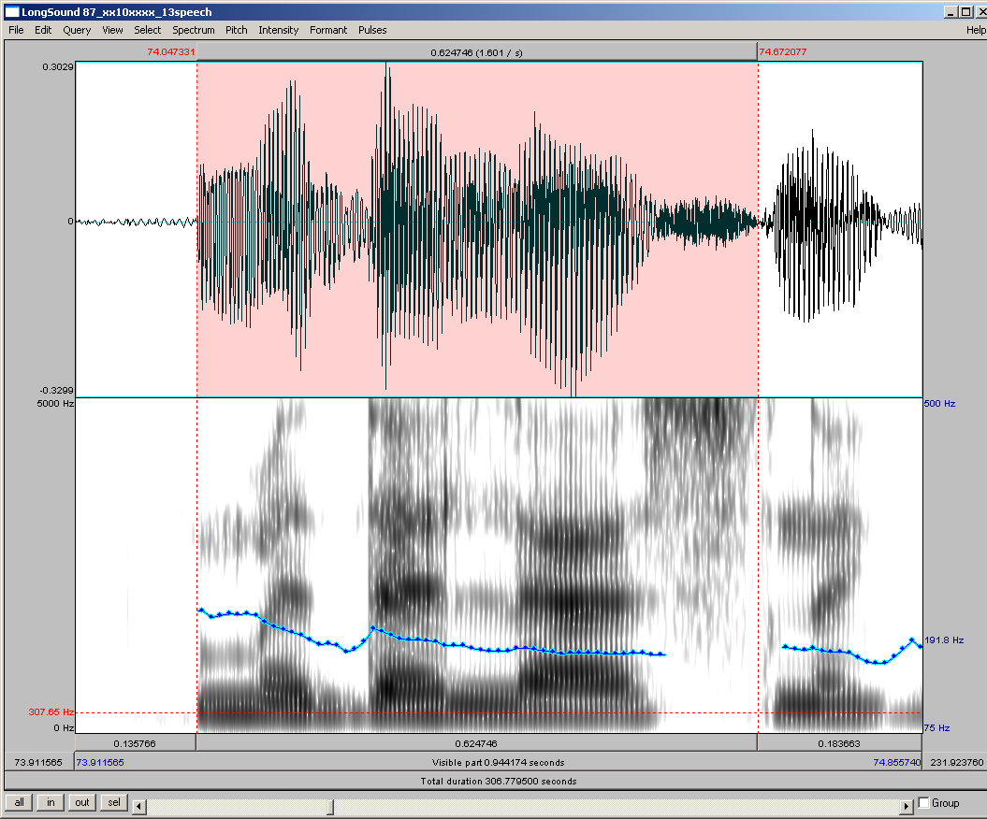
Typical d token (ma+dalas)
m a d a l a s

Slide 8
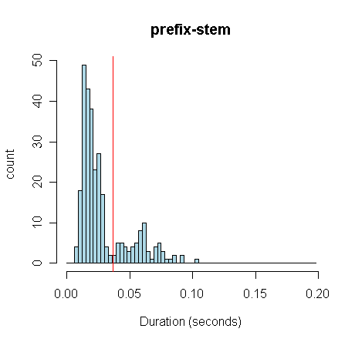
Corroboration from Guevara et al.’s audio corpus (Kevin Ryan’s work)
Bimodal distribution
some tokens have short duration ([ɾ])
some tokens have long duration ([d])
Data source:
Kevin measured duration of all V_{prefix}]+[_{stem}__V “r”s and “d”s in transcript
Item selection:
Loans and approximant realizations excluded
Notes:
> histogram(~ tapping_rate, matcheckPrefixes, type="count",main="written-corpus data for prefixed words", xlab="tapping rate",ylab="count of word types")

Slide 9
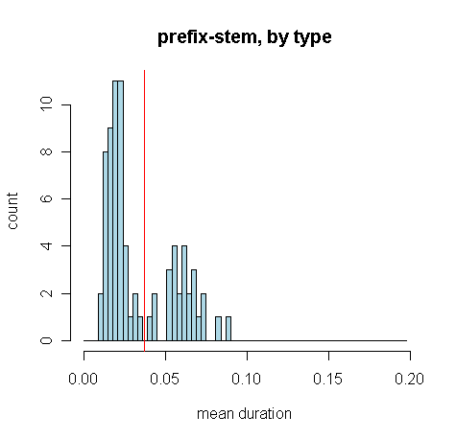
Same thing with types instead of tokens
some word types have short mean duration ([ɾ])
some word types have long mean duration ([d])
Overall, Ryan’s phonetic analyses show that the spellings are pretty reliable—words’ spellings in the written corpus correlate strongly with their behavior in the audio corpus.
Notes:
> histogram(~ tapping_rate, matcheckPrefixes, type="count",main="written-corpus data for prefixed words", xlab="tapping rate",ylab="count of word types")

Slide 10
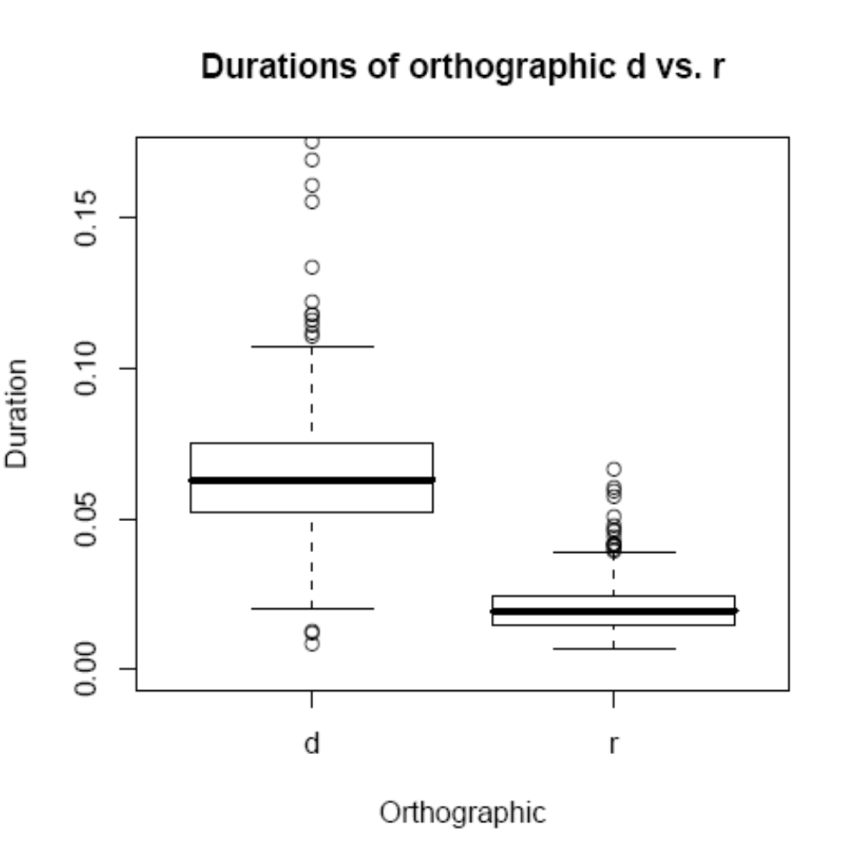
Relationship to written-corpus spelling (all words?)

Slide 11
What determines which category a word falls into?
Suppose that d→r/V_V is blocked if VdV is spread over two accessed units
direct route: d→r OK
Dunong (902)
ma
maDunong (9,164)
decomposed route: no d→r
Dahon (1,947)
ma
maDahon (9)

Slide 12
Predictions
more-frequent words more likely to tap (← whole-word parse more likely when word is frequent)
words that are frequent relative to their bases more likely to tap—hard to disentangle from whole-word frequency, though
words with more-frequent affixes less likely to tap (← broken-down parse more likely when affix is frequent)

Slide 13
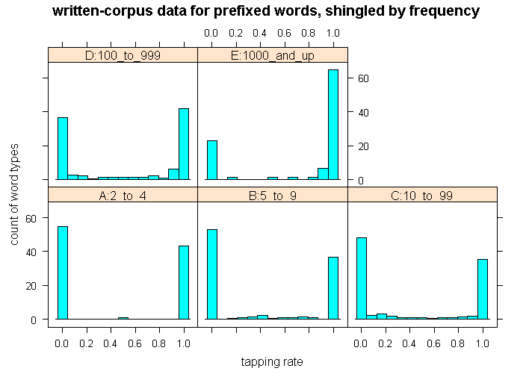
Effect of word frequency
frequency of 100 to 999: about equal
grouped
frequency of 1000 or greater: tapping predominates
frequency under 100: nontapping predominates
Notes:
> histogram(~ tapping_rate | freq_bin, allDPrefixed, main="written-corpus data for prefixed words, shingled by frequency", xlab="tapping rate",ylab="count of word types")

Slide 14
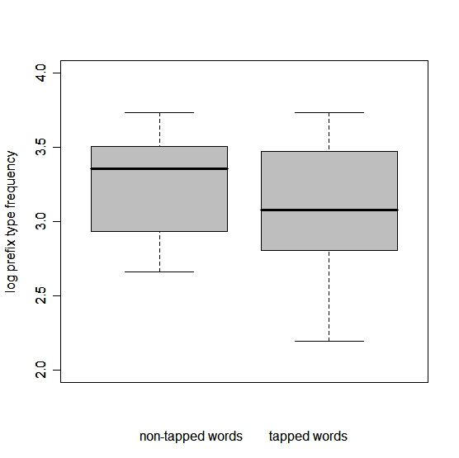
Effect of prefix frequency
(caution: this graph is from an older, dirtier version of the corpus)
words that tap: prefix has lower median frequency

Slide 15
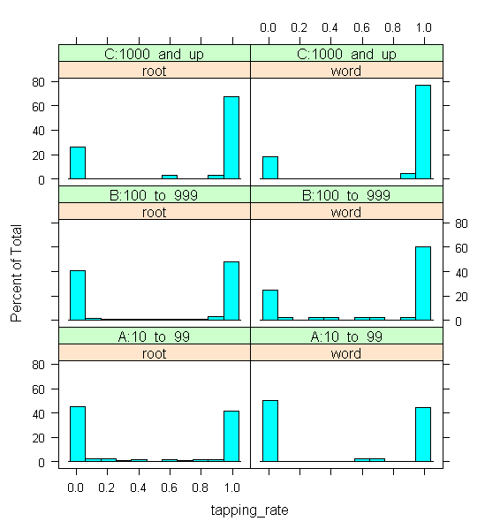
Effect of word-base freq. ratio
This is confounded with whole-word frequency, but may be an effect.
Split by which is more frequent, root or word.
Within two top word-frequency categories, higher rates of tapping when word is more frequent than root. (flattish for lower-frequency group)
Notes:
> histogram(~tapping_rate | which_more_freq*other_freq_bin, subset(prefix_with_roots,prefix_with_roots$which_more_freq!="tie"))

Slide 16
Summary
There are frequency effects on whether a prefixed word undergoes the rule.
These effects might suggest a model in which lexical access mode → phonological behavior.
(And of course, factors besides frequency should matter: transitional probability, semantic relationship...)
The model’s predictions might be more complicated—we really need to implement it...

Slide 17
Model is based on Matcheck
Baayen et al. 2000, Baayen & Schreuder 2000
a model of morphological segmentation in word recognition.
  (originally, visual word recognition; used more generally in Hay & Baayen 2002)

Slide 18
Tagalog simulation details
Lexicon = all words in corpus with at least one “good” structure identified by morphological segmenter.
Lexicon also includes all affixes and affix combinations found in these words.
Targets = all words identified by morphological segmenter as potentially prefixed forms of known non-loan roots, with frequency ≥ 10

Slide 19
Modifications made to Matcheck
Undo allophony: in both lexicon and targets, all d,r → D, all u,o → U, all i,e → I
Undo nonconcatenative morphology: from each target are made multiple clones
  DUmaDatIng → {DUmaDatIng, Um+DaDatIng, Um+CV+DatIng, DUmaDatI+ng, ...}
  A lexical item remains “active” if aligned with or sufficiently similar to any of the clones
  (a version is also implemented in which each clone is parsed separately, but it runs too slowly!)

Slide 20
Assumed link to production
When whole-word parse wins...
  Resting activation of whole-word lexical entry is strengthened (maDumi gets strong relative to ma, Dumi).
  In production, word will therefore tend to get accessed as a single unit (maDumi).
  The VDV sequence is contained in within a single unit, so tapping applies: marumi.
When broken-down parse wins...
  Resting activations of prefix and stem entries are strengthened (ma, Dahon get strong relative to maDahon)
  In production, word will therefore tend to get accessed concatenatively (ma+Dahon)
  The VDV sequence is spread across two different units, so tapping doesn’t apply: madahon
So for now, how a word tends to be recognized will stand in for how it tends to be retrieved. This loop will be closed in a toy-language simulation (today or next time).

Slide 21
Example of results
maykaDapatan (= may-ka-dapat-an):
  may+kaDapatan at timestep 10
    first “simple” parse
  maykaDapatan at timestep 11
  mayka+Dapatan at timestep 12
    first “complex” parse
  → Simple parse wins (by 2 timesteps)

Slide 22
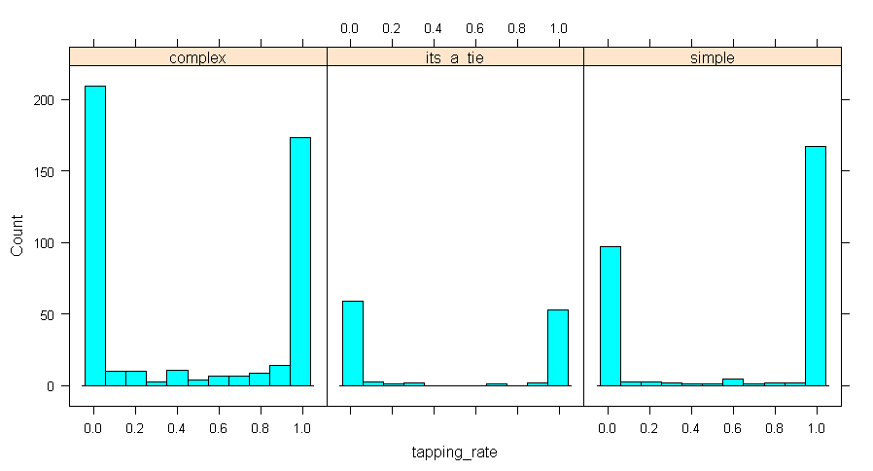
Tapping rate, grouped by winning parse
When complex parse wins, most words don’t tap
When simple parse wins, most words do tap
Notes:
> library(lattice)
> histogram(~ tapping_rate | simple_advantage_binned, matcheckPrefixes, type="count")

Slide 23
Discussion
Results are in the expected direction.
It’s not perfect—not every simply-parsed word has >95% tapping, and not every complexly-parsed word has <5% tapping.
  lexical access involves other factors
  many sources of noise in the lexicon
  free parameters of model not tuned

Slide 24
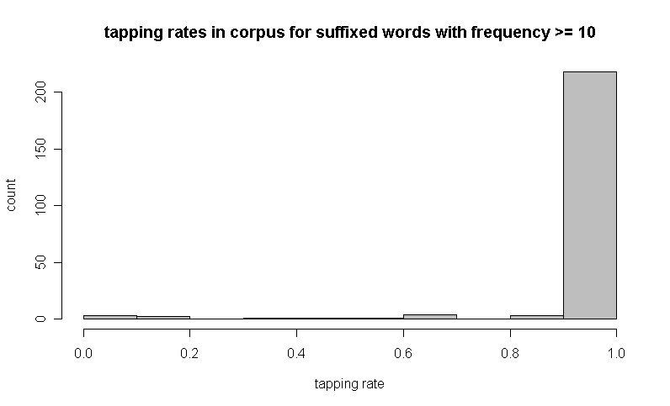
Stem-suffix boundary (lakar-an): recall that tapping is obligatory
nearly all suffixed words in written corpus tap
Notes:
> hist(matcheckSuffixs$tapping_rate,col="gray",xlab="tapping rate",main="tapping rates in corpus for suffixed words with frequency >= 10",ylab="count")

Slide 25
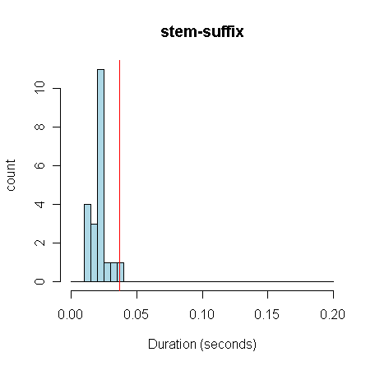
Acoustic data agree
nearly all tokens fall on “tap” side of the duration line
Notes:
> hist(tapLogStemSuffix$Duration,xlab="Duration (seconds)",ylab="count",main="stem-suffix",seq(0.00,0.2,0.005),col="light blue")
> abline(v=.037,lwd=1,col="red")

Slide 26
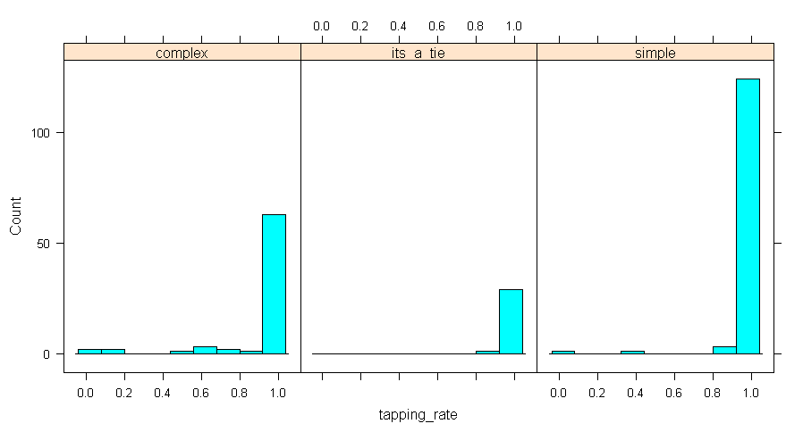
Is this because suffixed words always get a whole-word parse?
No! Lots of suffixed words get a complex parse in Matcheck simulation, but they still undergo tapping.

Slide 27
So morphology matters
Prefix+stem: variation allowed, frequency-influenced
Stem+suffix: tapping required (frequency doesn’t matter)
(Actually, if we examine the residue of suffixed words that are, at least sometimes, non-tapped, there is a frequency effect.)

Slide 28
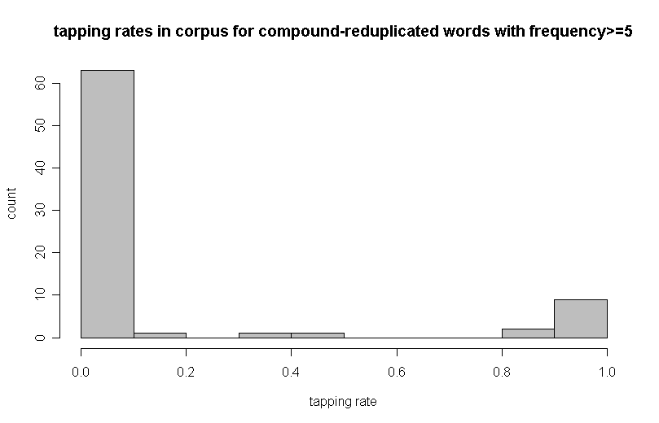
Stem+stem reduplication (dala-dala): recall that tapping is rare
most words in written corpus do not tap
Notes:
> hist(tapCompounds$tapping_rate,col="gray",
+ main="tapping rates in corpus for compound-reduplicated words with frequency>=5",
+ xlab="tapping rate",ylab="count")

Slide 29
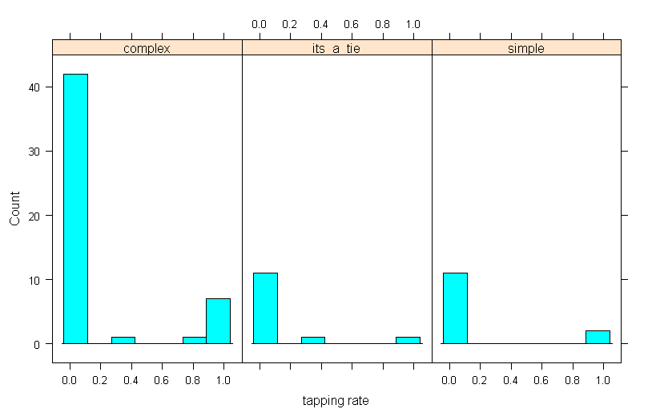
Is this because stem+stem-reduplicated words tend to get a complex parse?
Probably not—most words do get a complex parse, but even those where the simple parse wins don’t show much tapping (still, data are sparse)
Notes:
> histogram(~tapping_rate|winning_parse,tapCompounds,type="count",xlab="tapping rate")

Slide 30
Is it base-reduplicant identity?
B-R identity (McCarthy & Prince 1995) may be at work, but it seems to act by preventing the first copy from tapping when there’s a V-final prefix (i.e., non-tapping of the second copy is required, and controls the first copy):
  ka-daki-dakil-an-g
  ka-dulu-dulu-han
  ka-dusta-dusta cf. pan-du-dusta ~ pan-du-rusta

Slide 31
Summary: effect of morphology
Prefixed words: predicted parsing route correlates with tapping behavior
Suffixed words: tapping happens regardless of model’s prediction
Stem-stem reduplicated words: tapping is rare regardless of model’s prediction
Model doesn’t explain away morphological differences: they’re not due to accidental frequency properties (at least, not properties that are relevant to this model).

Slide 32
Grammar—see handout for tableaux
requires (stem+suffix) to be in the same constraint domain [they also form a single domain for stress]
requires (stem)+(stem) to form two separate domains [they also form two domains for stress]
allows two options for prefix+stem

Slide 33
Proposed analysis: prosodic domains
Selkirk 1980, Nespor & Vogel 1986, Hayes 1989, and many others.
Domain of tapping is the prosodic word (ω): VdV → VrV only if no ω-boundary intervenes
(prefix+stem)ω (tapping) or (prefix+(stem)ω)ω (no tapping)
(stem+suffix)ω only
(stem)ω+(stem)ω only
(similar to Nespor & Vogel 1986, Peperkamp 1997 for Italian)

Slide 34
Deriving prosodic domains—prefixed words
Alignment constraint: accessed lexical unit initiates prosodic word:Align(AccessedUnit,L,PWd,L)
  (cf. Prince & Smolensky’s 1993/2004 Align(LexWd,PrWd))
Otherwise, constraint against recursion prefers simple structure.
p-word
p-word p-word
prefix stem prefix stem
ma rumi ma dahon
single unit: two units:
tapping applies tapping doesn’t apply
Two choices for prefixed word, depending on lexical-access outcome:

Slide 35
Suffixed words
Minimality constraint: p-word must dominate at least one foot, and foot must dominate at least two syllables
Suffixes are monosyllabic and so can’t head a p-word
Adjoining the suffix is no help
p-word
p-word
Only one choice for suffixed word, regardless of outcome of lexical access:
p-word
p-word
p-word
stem
suffix
stem
suffix
stem
suffix

Slide 36
Stem+stem reduplication
Heading constraint: each stem must head a p-word
p-word p-word
stem stem
dala dala
tapping doesn’t apply
Only one choice for compounding reduplication, regardless of outcome of lexical access:

Slide 37
Relationship to lexical retrieval
Standard model
Proposed modification
lexical access
lexical access
/ morpheme + morpheme /
or
/ morpheme + morpheme /
/morpheme+morpheme/
grammar
grammar

Slide 38
Enclitics
One more environment for tapping:
Enclitics daw, din can be raw, rin after vowel-final words (and, less frequently, after consonant-final words)
  ako rin ~ ako din ‘me too’
  ako raw ~ ako daw ‘me, reportedly’

Slide 39
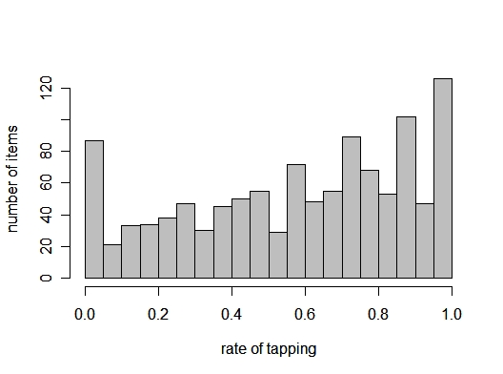
Word + enclitic
We see the full range of behaviors:
(warning—these are data from the earlier, dirtier version of the corpus)
Suggests that choice between din/rin and between daw/raw is made online (at least in a lot of cases).

Slide 40
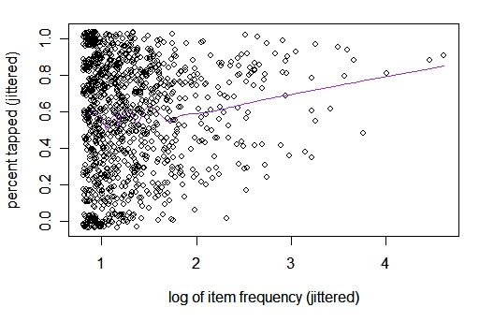
Distributional effects apply
Higher item frequency → higher tapping rate

Slide 41
Enclitic + enclitic
Enclitics can combine:
  bakit pa rin ‘why still also’

Slide 42
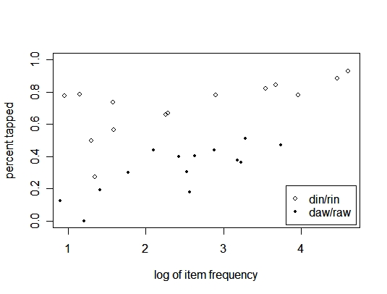
Enclitic + enclitic
Higher item frequency → higher tapping rate

Slide 43
Interpretation
Frequency influences are also active online, not just in possibly-lexicalized items (like the prefixed words).

Slide 44
Questions raised by words vs. clitics
Is there something special about syntactic words (in general or in this case), or can we get the prefix+stem (polarized) vs. word+enclitic (continuous) difference to fall out from frequency?
Can the behavior of particular prefix+stem be determined directly by parsing route, or must it be lexicalized, to account for each word’s relative stability?
Will try to address these with a toy simulation.

Slide 45
Mini-lexicon simulation
Model run above was a model of word recognition.
But the applicability of optional phonology should depend on retrieval for production.
Also determining frequencies for Matcheck was problematic: how frequent a morpheme is should depend on how often it’s recognized as a separate morpheme (but determining that requires running the model, which requires frequencies...)

Slide 46
Overview
SOCRATES
“concepticon”: {dark, ADJ} 50
{dark} 10
lexicon: buqiw ‘dark’
ma ‘ADJ’
Socrates chooses a concept according to its frequency, and produces it, with no phonological cues as to its structure: mabuqiw
Plato parses it (mabuqiw, ma+buqiw), using its own lexicon (initially all with same frequency) and increments the frequencies of the parts of the winning parse
PLATO
lexicon: buqiw ‘dark’ 4
ma ‘ADJ’ 2
mabuqiw ‘dark,ADJ’ 8
afterwards, test Plato’s productions

Slide 47
Retrieval for production
Works just like recognition, except...
the target is a feature set: {dark, ADJ}
an item’s similarity to the target is evaluated on features rather than phones: ‘dark’ vs. {dark, ADJ}
the clock is slowed so that items have more time to reach threshold
Missing: competition between form-similar entries

Slide 48
Mini-language
10 randomly-generated CVCVC roots, with frequencies distributed Gaussianly
  wimiw ‘dark’ 10.9 sumin ‘salt’ 2.8
  nikil ‘light’ 2.2 gikuh ‘bitter’ 18.4
  yilan ‘heavy’ 6.9 gipas ‘sweet’ 8.2
  luday ‘cold’ 13.0 gapah ‘tall’ 20.1
  watuk ‘hot’ 6.2 witan ‘short’ 19.0
5 “inner” prefixes, each with its own characteristic frequency. To get frequency of the prefix+stem combination, add Gaussian noise to stem frequency, add Gaussian noise to prefix frequency, and multiply
  mawimiw A,dark 0.9 magwimiw V,dark 8.4
  manikil A,light 0.9 magnikil V,light 2.0
  ... ...
  pawimiw V,CAUS,dark 1.5 pagwimiw N,ACT,dark 32.5
  panikil V,CAUS,light 0.3 pagnikil N,ACT,light 1.7
  ... ...
  kawimiw N,dark 0.0
  kanikil N,light 0.8
  ...
2 “outer” prefixes—meant to be clitic-like—that work the same way
  dimawimiw ALSO,A,dark 0.1 duwimiw REPORT,dark 0.5
  dikaluday ALSO,N,cold 3.3 dumaggikuh REPORT,V,bitter 2.4

Slide 49
Simulation details
Socrates produces 1,000 word tokens for Plato to learn from.
Process is repeated for 100 Plato “clones”
In testing phase, each Plato produces each possible word once—record whether winning retrieval is simple or complex (in case of tie, one is selected at random)

Slide 50
Check: effect of base frequency
We expect that words with frequent bases will be retrieved complexly (prefix+base) more often

Slide 51
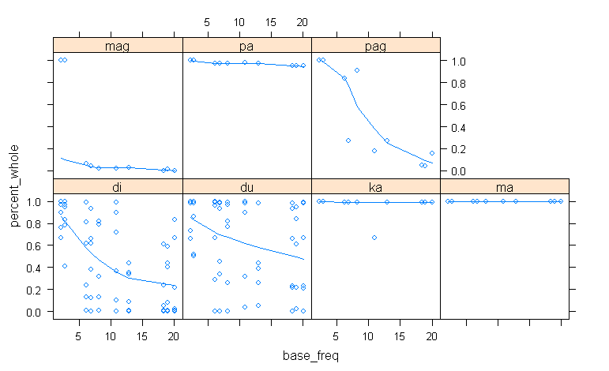
Effect of base frequency
As expected, within each prefix, more-frequent base correlates with less whole-word retrieval.
(Except for ka- and ma-, where almost every item gets a whole-word parse)
Notes:
> xyplot(percent_whole~base_freq | prefix, data=simulation,panel=panel.plsmo,method="lowess")

Slide 52
Check: effect of prefix frequency
Similarly, we expect that a more-frequent prefix should facilitate retrieval as separate morphemes (di+luday)

Slide 53
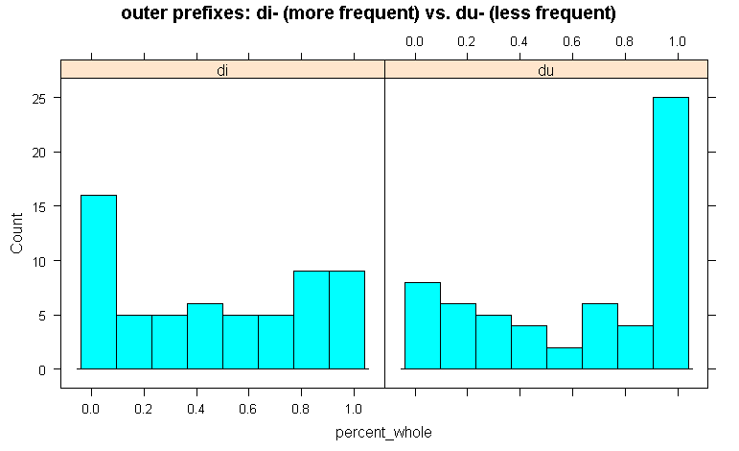
Outer prefixes
The more-frequent prefix produces more complex productions (di+luday)
The less-frequent prefix produces more whole-word productions (duluday)

Slide 54
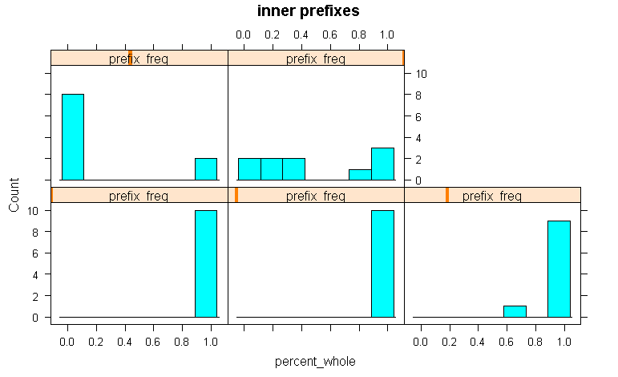
Inner prefixes
Messier here: because the lexicon is small, the prefixes’ frequencies are closely tied to the word frequencies
medium-frequency prefix: mostly prefix+stem
highest-frequency prefix: flat
lowest-frequency prefixes: mostly whole-word

Slide 55
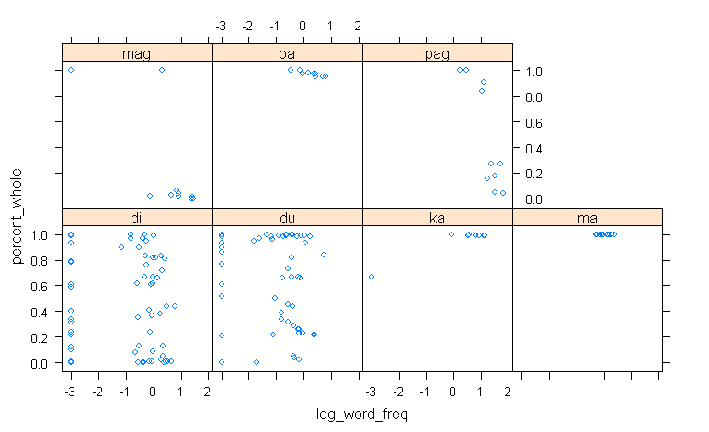
Effect of whole-word frequency?
Unfortunately, this is so confounded with prefix and base frequency that the data are a mess (plan to address this in future simulations—but will require a bigger lexicon)
Notes:
> xyplot(percent_whole~log_word_freq | prefix, data=simulation)

Slide 56
Polarized vs. continuous variation
In the Tagalog data, we saw a contrast between the distribution of tapping in prefixed words (polarized) and in word+clitic combinations (more continuous)
written-corpus data for word+clitic

Slide 57
Polarized vs. continuous variation
Can this be produced by distributional differences alone?
Lexicon was set up to address this
Inner prefixes: each occurs with at most 10 stems → self-reinforcing word behavior could be more important than behavior of affix overall
Outer prefixes (clitic-like): each occurs with lots of different stems (can combine with the 10 roots plus all the inner_prefix+root words) → affixes themselves can have high frequency, interfering with lexicalization

Slide 58
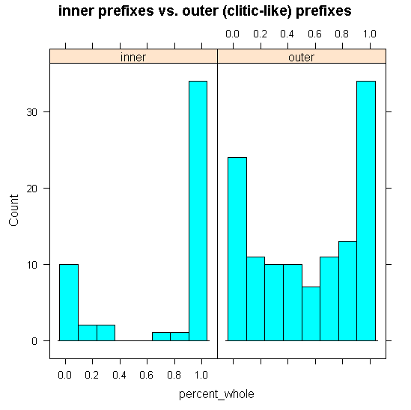
Polarized vs. continuous variation
Notes:
> histogram(~ percent_whole | prefix_type, simulation, type="count",
+ x_lab="percent of Cain clones who produce the word as a single unit",
+ main="inner prefixes vs. outer (clitic-like) prefixes")

Slide 59
“Priming”
How robust is the learned lexicon to perturbations of resting activation caused by recent experience (e.g., priming)?
Predictions
  inner prefixes: priming should have little effect, mimicking the stable behavior of prefixed words in Tagalog
  outer prefixes (du-, di-): priming could have an effect (in Tagalog word+clitic cases, there is intra-item variation—many possible causes, but priming is one)

Slide 60
Modelling priming
After learning is complete...
...for each possible word:
  present word to learner
  learner performs recognition
  for winning parse(s), learner increments strength of each lexical entry recognized
  test learner’s output, using updated lexicon, for any word that shares a morpheme with the word just presented

Slide 61
Results (increment value 2, learner chosen at random)—changes only
before priming | after priming | number of primes that affect
dikasumin | di+kasumin | 3
dikawitan | di+kawitan | 1
dikayilan | di+kayilan | 2
dimagapah | di+magapah | 1
dimagipas | di+magipas | 2
dimanikil | di+manikil | 3
dimayilan | di+mayilan | 1
dipanikil | di+panikil | 3
dipasumin | di+pasumin | 3
dipawitan | di+pawitan | 3
no output | du+gipas | 38
dumasumin | du+masumin | 32
dumawimiw | du+mawimiw | 1
no output | kawimiw | 1
no output | mag+gipas | 8
no output | magnikil | 1
only words with “outer” prefixes undergo a change

Slide 62
Conjectures from toy model
Apparent qualitative difference between prefix+stem (most items are stable) and word+clitic (many items vary) could plausibly result from distribution alone.
Stable behavior of certain individual items may not require lexicalization.

Slide 63
Prosody?
Don’t (yet) know whether there’s any detectable prosodic difference between X+daw/din and X+raw/rin.

Slide 64
Case study II: o/u alternations
In native words, [o] occurs in final syllables and [u] in nonfinal syllables
  nag+lu+luto ‘cooking’
  tapos ‘afterwards’
  naka+sulat ‘written’
  (I suspect that spelling is less reliable here than it is with tapping!!)

Slide 65
Alternations
We see an alternation with suffixation:
  kwento ‘story’ nag-kwentuh-an ‘told e.o. stories’
  t<in>apos ‘finished’ ka+tapus+an ‘last’
And with stem-stem reduplication:
  halo ‘mixture’ halu-halo (dessert)
  ~ halo-halo
  (not very many tokens in the corpus—here’s one with [o]: sulok-sulok )

Slide 66
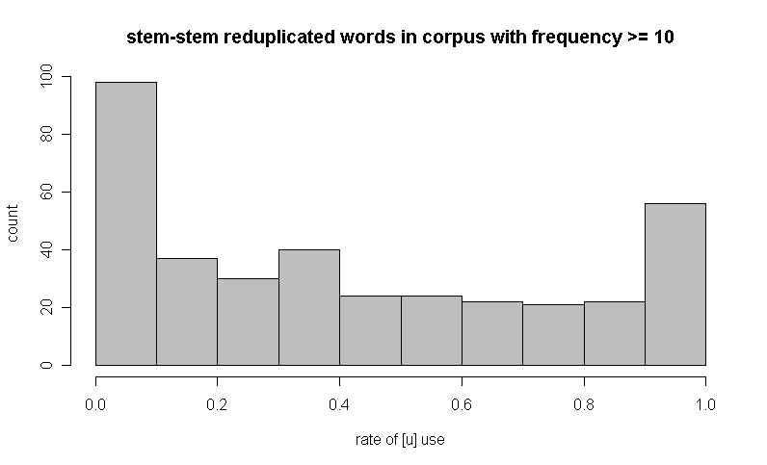
Variation in written corpus for stem-stem reduplication
Not very lexicalized—lots of words show variation.
Notes:
> hist(raising$raising_rate,col="gray",xlab="rate of [u] use",ylab="count",main="stem-stem reduplicated words in corpus with frequency >= 10")

Slide 67
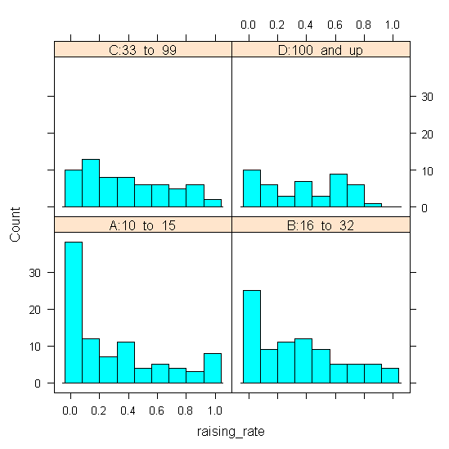
Frequency effect
[o] is concentrated in lower-frequency words

Slide 68
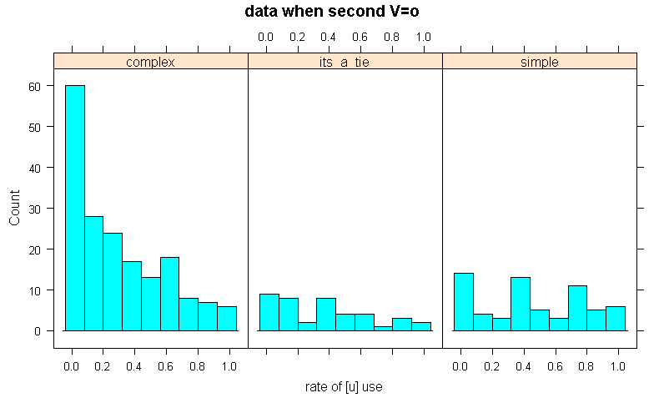
Parsing simulation results
When the complex parse wins, mostly o (halo-halo)
When the simple parse wins, mix of o (halo-halo) and u (halu-halo)
Notes:
> histogram(~ raising_rate | winning_parse, subset(raising,raising$second_V=="o"),type="count",
+ xlab="rate of [u] use",main="data when second V=o")

Slide 69
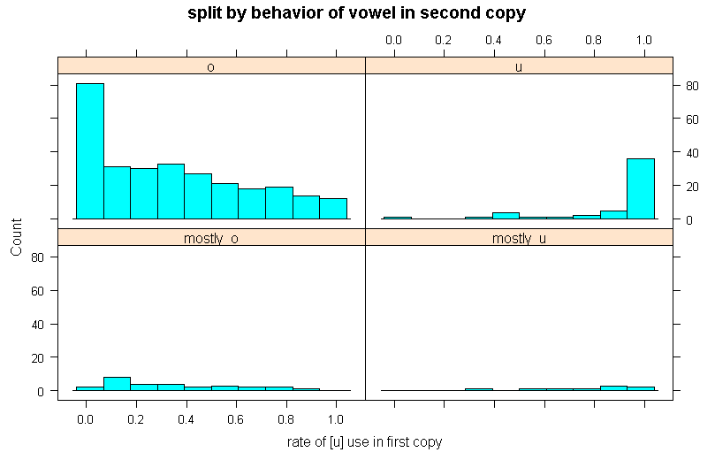
Phonological effect
When the second copy’s vowel is [u] (because of suffixation) the first copy’s vowel is very likely to be [u] too (ka-tapus-tapus-an ‘very last’).
Notes:
> histogram(~raising_rate|second_V,raising,type="count",xlab="rate of [u] use in first copy",
+ main="split by behavior of vowel in second copy")

Slide 70
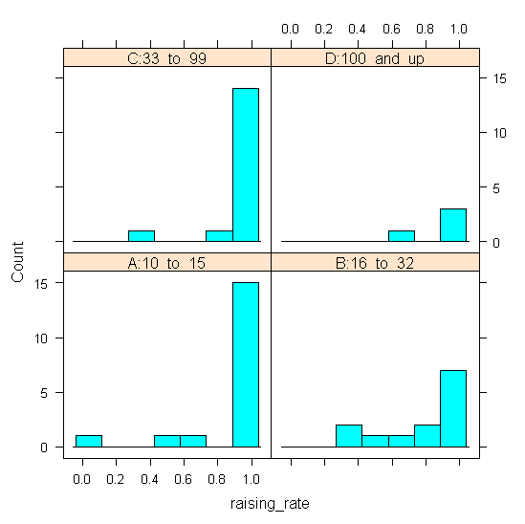
No frequency effect when second V is [u]
Notes:
> histogram(~raising_rate | freq_bin, subset(raising,raising$second_V=="u"),type="count"

Slide 71
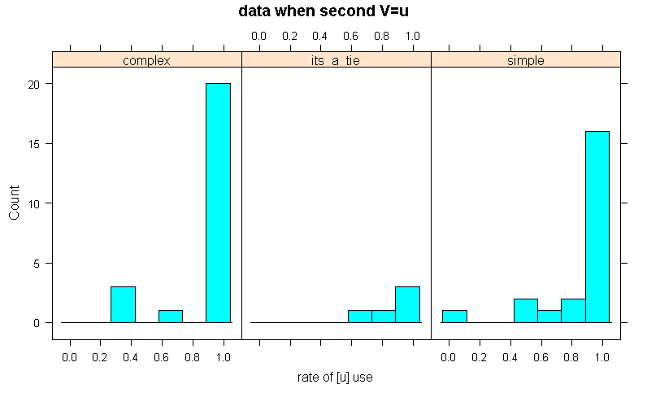
No parsing effect, either
Notes:
> histogram(~ raising_rate | winning_parse, subset(raising,raising$second_V=="u"),type="count",
+ xlab="rate of [u] use",main="data when second V=u")

Slide 72
Grammar
The domain of raising/lowering seems to be bigger than that of tapping—call it the minor phrase.
  *o/non-MPh-final, *u/__C*]_{MPh} >> Ident-IO(hi)
An accessed unit initiates a Minor Phrase:
        or
MPh
MPh
MPh
p-word p-word
p-word p-word
halo
halo
halu
halo

Slide 73
More grammar
Ident-BR(hi)>> *u/__C*]_{MPh}
→ even when there are two separate minor phrases, the first copy shows [u] if the second does
MPh
MPh
p-word p-word
suntuk
suntuk+in
base-reduplicant correspondence

Slide 74
Asymmetric Corr-BR
We can’t just say Id-BR(hi)>>*u/__C*]_{MPh}
(Can you think of the problematic candidate?)
I’ve made Id-BR(hi) asymmetric by splitting it into Max-BR(hi) and Dep-BR(hi), but maybe something cyclic is really going on?

Slide 75
More grammar
A minor phrase can’t be dominated by a p-word, so a suffixed word has to be a single MPh, and the vowel must be [u]:
MPh
p-word
stem
tapus
suffix
in

Slide 76
Phonological effects in loans
Zuraw (2002): among loans, o-to-u raising under suffixation tends to be blocked when the preceding syllable has o or e (and more so if the two syllables are similar):
  todo ‘all’ todo-hin ‘include all’
  vs.
  gwapo ‘attractive’ gwapu-hin

Slide 77
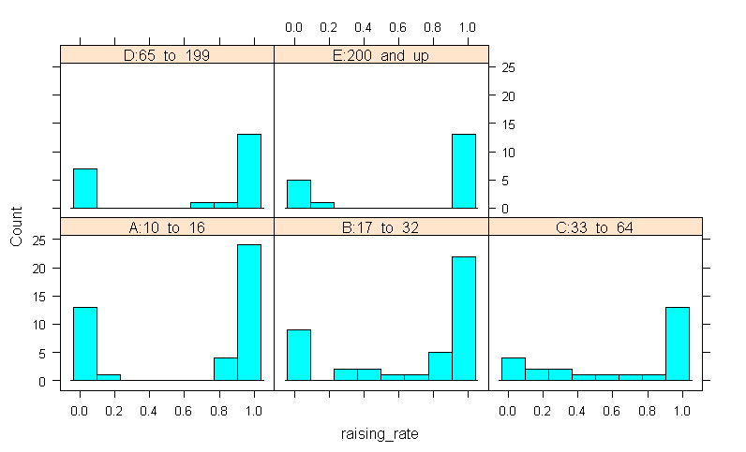
No apparent frequency effect in suffixed loans
Notes:
> histogram(~raising_rate|freq_bin,subset(ouSuffixed,ouSuffixed$origin=="spanish"),type="count")

Slide 78
Consistent with grammar
Grammar forces stem+suffix always to form one p-word, and thus one Minor Phrase, so lexical access/parsing doesn’t matter.

Slide 79
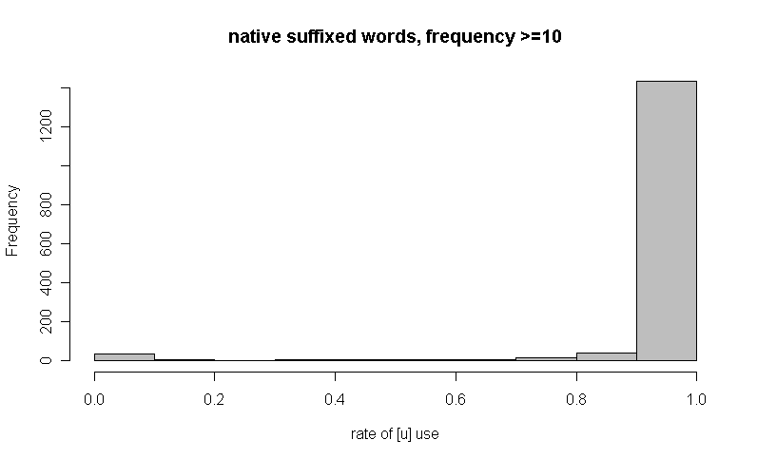
Suffixation
Raising is basically obligatory in native words under suffixation
Notes:
> hist(subset(ouSuffixed$raising_rate,ouSuffixed$origin=="native"),col="gray",xlab="rate of [u] use",main="native suffixed words, frequency >=10")

Slide 80
Phonological effects in loans
Zuraw (2002): among loans, o-to-u raising under suffixation tends to be blocked when the preceding syllable has o or e (and more so when the two syllables are similar):
  todo ‘all’ todo-hin ‘include all’
  vs.
  gwapo ‘attractive’ gwapu-hin

Slide 81
But no apparent frequency effect in suffixed loans
Notes:
> histogram(~raising_rate|freq_bin,subset(ouSuffixed,ouSuffixed$origin=="spanish"),type="count")

Slide 82
Case study 3: nasal substitution
Suffixes that end in /N/ can do nothing...
  pang-pasko ‘for Christmas’ pang-pito ‘7th’
...or assimilate to a following obstruent (or l)
  pam-pasko ‘for Christmas’ pam-publiko ‘public’
...or fuse with the following obstruent (“nasal substitution”):
  pamasko ‘for Christmas’ pamasahe ‘fare’ (<pasahe)
  (In ‘for Christmas’, the third option is by far the most frequent.)

Slide 83
Phonological effect
Zuraw (2000): Rate of nasal substitution depends on stem-initial consonant: p,t,s,k substitute the most, then b, then d, then g.

Slide 84
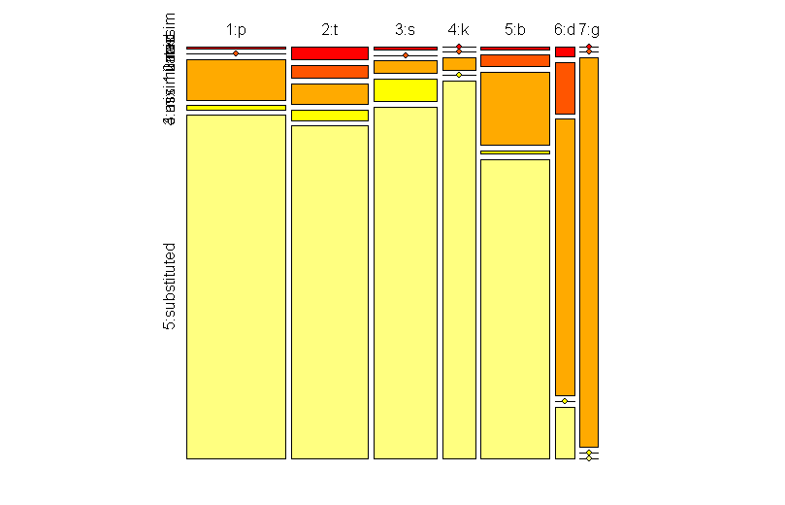
Consonant effects
red: unassimilated
b-initial under-go a bit less
d-initial mostly assimilates without nasal substitution (orange)
p-, t-, s-, k-initial words mostly undergo the rule (pale yellow)
g-initial never undergoes (vacuous assimilation)
Notes:
Fix: get rid of V (artefact)
> cols=heat.colors(5)
> mytable=table(nasSubMini$initial_c,nasSubMini$behavior)
> mosaic(mytable,direction="v",pop=FALSE,gp=gpar(fill=cols))

Slide 85
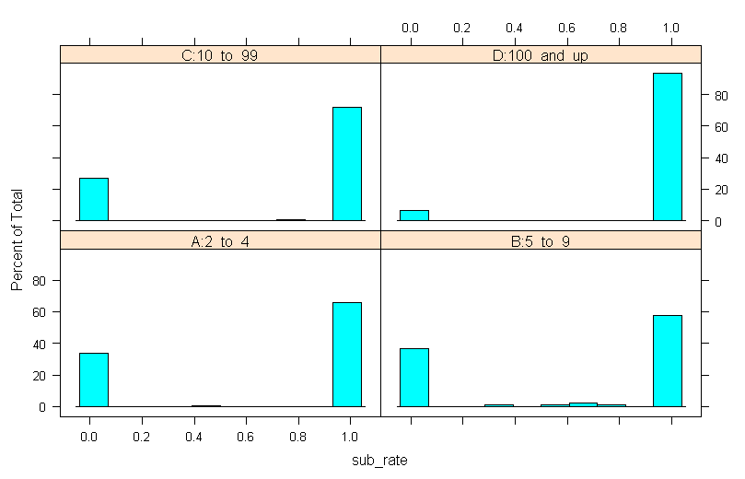
Frequency effect—data for /b/s
highest-frequency words have the most nasal substitution
Notes:
> histogram(~sub_rate | freq_bin, b)

Slide 86
Grammar—speculative
As with tappng, the grammar allows prefix+stem to form a single domain for nas. sub., or to remain aloof from each other (choice influenced by frequency)
When the prefix+stem form a single domain for nas. sub...
  For g-initial stems, the grammar essentially forbids nas. sub.
  For p-, t-, s-, and k-initial stems, the grammar essentially requires nas. sub.
  For b- and d-initial stems, the grammar allows variation
(See Zuraw 2000 for constraints)

Slide 87
Morpheme boundaries?
What’s interesting about nasal substitution is that it wouldn’t be explained under a model where rules are blocked by morpheme boundaries, and apply when boundaries have been erased (because of high frequency, etc.).
Nas. sub. is restricted to the prefix-stem boundary—there are plenty of NC sequences within roots (they don’t vary with N)
  lampas ‘past’
The rule/constraint driving nas. sub. must refer to the morpheme boundary—it can’t be erased.

Slide 88
Conclusion
The application of phonological processes is partly sensitive to factors like frequency, partly governed by grammar.
3 case studies from Tagalog
Tapping: morphology can override frequency
  prefixed words show frequency-influenced variation, but suffixed words must undergo, and stem+stem reduplicated words rarely do.
Vowel height: B-R identity, morphology can override frequency
  stem+stem reduplicated words show frequency-influenced variation, but base-reduplicant identity can override. (No frequency effects in suffixed words—there is variation, but it seems to be conditioned by phonological factors only.)
Nasal substitution: phonological factors can make frequency effects invisible
  prefixed words show frequency-influenced variation, but heavily restricted by stem-initial consonant.

Slide 89
Conclusions
The application of phonological processes can be sensitive to frequency...
...and morphology can override frequency
(other two case studies: phonology can also override frequency)
Polarized variation in words and continuous variation in larger units could result from distributional differences.
Apparent lexicalization could result from frequencies that just happen to be robust to small perturbations.

Slide 90
References
Bybee, Joan (2001). Phonology and Language Use. Cambridge: Cambridge University Press.
Christophe, Anne, Sharon Peperkamp, Christophe Pallier, Eliza Block, Jacques Mehler (2004). Phonological phrase boundaries constrain lexical access. Journal of Memory and Language 51: 523-547.
Davis, Matthew H. & William Marslen-Wilson (2002). Leading up the lexical garden path: segmentation and ambiguity in spoken word recognition. Journal of Experimental Psychology: Human Perception and Performance 28: 218-244.
Ghani, Rayid, Rosie Jones & Dunja Mladenić (2004). Building minority language corpora by learning to generate Web search queries. Knowledge and Information Systems 7: 56-83.
Guevara, Rowena Cristina, Melvin Co, Evan Espina, Ian Dexter Garcia, Emerson Tan, Ryan Ensomo, & Ramil Sagum (2002). Development of a Filipino Speech Corpus. In Proc. 3rd National ECE Conference.
Hay, Jennifer (2003). Causes and Consequences of Word Structure. New York & London: Routledge.
Hay, Jennifer & Harald Baayen (2002). Parsing and productivity. In Geert Booij & Jap van Marle (eds.) Yearbook of Morphology 2001. Kluwer Academic Publishers. Pp. 203-235.
Hayes, Bruce (1989). The Prosodic Hierarchy in meter. In Paul Kiparsky & Gilbert Youmans (eds.) Rhythm and Meter. Orlando, FL: Academic Press. Pp. 201-260.

Slide 91
References
Kiparsky, Paul. (1982). Lexical morphology and phonology. In Yang, I.-S. (ed.), Linguistics in the Morning Calm. Seoul: Hanshin. 3–91.
Martin, Andrew 2005. Loanwords as pseudo-compounds in Malagasy. In Proceedings of the Twelfth Annual Conference of the Austronesian Formal Linguistics Association.
McCarthy, John & Alan Prince (1995). Faithfulness and reduplicative identity. Papers in Optimality Theory, UMass Occasional Papers in Linguistics 18: 249-348.
Munro, Pamela & Jason Riggle (to appear). Productivity and lexicalization in Pima compounds. Proceedings of BLS 13.
Marina Nespor & Irene Vogel (1986). Prosodic Phonology. Dordrecht: Foris.
Discusses each level of the prosodic hierarchy as a source of rule domains. Emphasis on Italian, Spanish, English, Greek
Peperkamp, Sharon (1997). Prosodic Words. Den Haag: Holland Academic Graphics.
Prince, Alan and Paul Smolensky (1993/2004). Optimality Theory: Constraint Interaction in Generative Grammar. Blackwell.

Slide 92
References
Raffelsiefen, Renate (1999a). Diagnostics for prosodic words revisited: the case of historically prefixed words in English. In T. Alan Hall & Ursula Kleinhenz (eds.) Studies on the Phonological Word. Amsterdam: Benjamins.
Raffelsiefen, Renate 1999b. Phonological constraints on English word formation. In Yearbook of Morphology 1998, G. Booij & J. van Marle (eds.) 225-287. Dordrecht : Kluwer.
Salverda, Anne Pier, Delphine Dahan, Michael K. Tanenhaus, Katherine Crosswhite, Mikhail Masharov & Joyce McDonough (2006). Effects of prosodically modulated sub-phonetic variation on lexical competition. Cognition.
Schachter, Paul and Fe Otanes (1972) Tagalog Reference Grammar. University of California Press, Berkeley.
Elizabeth Selkirk (1980). Prosodic domains in phonology: Sanskrit revisited. In Mark Aronoff & Mary-Louise Kean (eds.) Juncture. Saratoga, CA: Anma Libri.
Trubetzkoy, Nikolai (1939). Grundzüge der Phonologie. Göttingen: Vandenhoek & Ruprecht.
Zuraw, Kie (2000). Patterned Exceptions in Phonology. Ph.D. dissertation, UCLA.
Zuraw, Kie (2002). Aggressive reduplication. Phonology 19: 395-439.

