Slide 1
Predicting Korean sai-siot
Kie Zuraw
Nov. 2011

Slide 2
Acknowledgements
Korea National Research Resource Center’s Bank of Resource for Language and Annotation (www.bora.or.kr) for allowing me to use their ED3 database
Prof. Eun-Jung Yoon for helping me obtain the database.
UCLA students Jinni Kang and Paul Shin for recently getting involved—Kang has coded spelled s’s as underlying or not and Shin has helped me with Korean-language literature
Mira Oh, Bruce Hayes, Robert Daland, Laura McPherson, Jaehoon Choi, Donca Steriade, Russ Schuh, Kristine Yu, Dustin Bowers, Rachel Walker, Eric Baković, Morgan Sonderegger, Marc Brunelle, Ewa Tchaikowska-Higgins, Joe Pater, Hijo Kang, Lev Blumenfeld, Peter Avery, Sam Steddy, Suyeon Yun, Norvin Richards, Young Ah Do, and Peter Graff, for discussion

Slide 3
Introduction
How do factors from various modules affect a word’s phonological behavior?
Processing factors (e.g., word frequency) expected to have variable effect
Morphological factors (e.g., branching structure) might be expected to carve words into separate categories
Phonological factors (e.g., features) might be expected to interact variably, depending on your model of phonological grammar
Can one module override another?
E.g., even if branching structure puts a word in one category, can its phonological properties move it into another category?

Slide 4
Overview
Korean sai-siot, affected by different types of factors
Different conceptions of how these factors might interact
Effects of factors
  one by one
  together in regression model
Back to how the factors interact

Slide 5
Korean sai-siot
sai ‘between, relationship, gap’
siot ‘the letter ㅅ (/s/)’
(roughly synonymous with sai-sori ‘between sound’)
a process that can occur in noun+noun compounds
looks like insertion of /s/, followed by automatic rules of Korean
  diachronically, originates from genitive marker /-s/
  synchronically, also analyzed as...
    insert [s] (Choy 1959, He 1965, S Kim 1953, S K Yun 2006)
    insert [t] (C-W Kim 1970b, Kim-Renaud 1974)
    insert [Ɂ] (Martin 1954, S-b Cho 1967)
    insert coronal noncontinuant (Ahn 1985)
    insert empty C slot (Chang 2004)
    insert empty X slot (S-h Kim 1990, Lee 1994)
    insert X slot with [+constricted glottis] feature (G-R Kim 2001)
    geminate (E-D Cook 1987)
    insert mora (J Yoon 2008)
    ... and probably more

Slide 6
...nasal__lenis... → tensification
sai-siot case non-sai-siot
‘mountain’+‘fire’ ‘snow’+‘rain’
/san/+/s/+/pul/ /nun/+/pi/
lenis → tense(C’) / obstruent __ san+s+[p’]ul ---
cluster simplification san+[p’]ul ---
lenis→[+voice]/[+voice]__[+voice] --- nun+[b]i
‘wildfire’ ‘snow and rain’
산+불 눈+비

Slide 7
...liquid__lenis... →tensification
sai-siot case non-sai-siot
‘winter’+‘wind’ ‘one’+‘minute’
/kjʌul/+/s/+/palam/ /il/+/pun/
lenis → tense / obstruent __ kjʌul+s+[p’]alam ---
cluster simplification kjʌul+[p’]alam ---
lenis→[+voice]/[+voice]__[+voice] --- il+[b]un
‘winter wind’ ‘one minute’
겨울+바람 일+분

Slide 8
...V__lenis... → tensification
sai-siot case non-sai-siot ‘back’+‘room’ ‘wood’+‘boat’
/twi/+/s/+/paŋ/ /namu/+/pɛ/
lenis → tense / obstruent __ twi+s+[p’]aŋ ---
coda obstruent → lenis stop twi+t+[p’]aŋ ---
coronal obstr. coda totally assimilates
(see Jun 1995): optional? twi+[p’]aŋ ~ ?twi+[t+p’]aŋ ---
lenis → [+voice] /[+voice]__[+voice] --- namu+[b]ɛ
‘back room’ ‘wooden boat’
뒷+방 나무+배
Existence of twi+[t+p’]aŋ variant is disputed (S-b Cho 1967, C-W Kim 1970, K. Chung 1980, Ahn 1985, Cook 1984, E-D Cook 1987, S-h Kim 1990, J-y Tak 1997, S K Yun 2006, J Yoon 2008)

Slide 9
...obstruent__lenis... → no effect
Sai-siot or not? No way to tell
‘rice’+‘bowl’
/pap/+/s/+/kɨlɨs/ /pap/+/kɨlɨs/
lenis → tense / obstruent __ pap+s+[k’]ɨlɨs pap+[k’]ɨlɨs
cluster simplification pap+[k’]ɨlɨs ---
‘rice bowl’
밥+그릇

Slide 10
...V__nasal... → nasal lengthens
sai-siot case sai-siot case non-sai-siot case
‘boat’+‘singing’ ‘back’+‘door’ ‘acorn’+‘jelly’
/pɛ/+/s/+/nolɛ/ /twi/+/s/+/mun/ /tot^{h}oli/+/muk/
obstruent→nasal/___nasal pɛ+[n+n]olɛ twi+[m+m]un ---
place assimilation (optional?) --- ~ ?twi+[n+m]un ---
‘sailor’s song’ ‘back door’ ‘acorn jelly’
뱃+노래 뒷+문 도토리+묵
Existence of twi+[n+m]un variant controversial too

Slide 11
...V__V... → C inserted but sai-siot very rare
sai-siot case non-sai-siot case
rare
‘upper’+‘elders’ ‘electronic’+‘arcade’
/u/+/s/+/ʌlɨn/ /t͡ɕʌnt͡ɕa/+/olaksil/
coda obstruent → lenis stop u+[t]+ʌlɨn ---
lenis → [+voice] /[+voice]__[+voice] u+[d]+ʌlɨn ---
‘seniors’ ‘video arcade’
웃+어른 전자+오락실
Only about 6 examples of sai-siot cited in literature
When second word begins with [i] or [j], something else happens (we’ll get to it later)

Slide 12
Variation
within-item (see C-W Kim 1970, Kim-Renaud 1974, Ahn 1985, E-D Cook 1987, E Han 1991, P-h Lee 1996)
/sai/+/sios/ → sai-[ɕ’]_{yes}ios ~ sai-[ɕ]_{no}ios ‘linking s’ (also palatalization)
across-item
/il/+/pun/ → il-[b]_{no}un ‘1 minute’ (1+minute)
/il/+/to/ → il-[t’]_{yes}o ‘1 degree’ (1+degree)
/il/+/kwa/ → il-[ɡ]_{no}wa ‘lesson 1’ (1+lesson)
/il/+/t͡ɕaŋ/ → il-[t͡ɕ’]_{yes}aŋ ‘chapter 1’ (1+chapter) (C-W Kim 1970; H Sohn 1978)
across-item, even with same stems (but different meaning/structure)
/namu/+/pɛ/ → namu-[b]_{no}ɛ ‘wooden boat’ (wood+boat)
/namu/+/pɛ/ → namu-[p’]_{yes}ɛ ‘boat laden with wood’ (Yun 2006)
/tol/+/tali/ → tol-[d]_{no}ali ‘stone bridge’ (stone+bridge)
/tol/+/tali/ → tol-[t’]_{yes}ali ‘stepping stones’
/moki/+/soli/ → moki-[s]_{no}oli ‘whispering sound’ (mosquito+sound)
/moki/+/soli/ → moki-[s’]_{yes}oli ‘mosquito buzz’ (HY Kim 1990, p. 162)

Slide 13
What is it for?
Seems to mark boundaries of intermediate strength (K. Chung 1980, Ahn 1985):
On the one hand, doesn’t occur within monomorphemes
On the other hand, as we’ll see, more likely to occur when the compound looks like a tight unit

Slide 14
What is it for?
Makes it look as though a boundary might be there
nun+[b]_{no}i must be a single accentual phrase, because inter-sonorant voicing applied (Jun 1993)
san+[p’]_{yes}ul is ambiguous: a tense C onset can occur anywhere in an accentual phrase
Native speaker linguists repeatedly express intuition that sai-siot somehow helps a compound be perceived as consisting of two parts, and isn’t “needed” when the presence of two separate parts is clear
  Kim-Renaud 1974, K. Chung 1980, Ahn 1985, G-R Kim 2001

Slide 15
Factors influencing sai-siot
Etymology: Sino-Korean vs. native Korean
Length of stems
Branching structure of compound
Word and stem frequency
Bound vs. free stems
Features of segments involved
Presence of tense Cs elsewhere in word

Slide 16
Method for investigating variation
List of >26,000 compound nouns: Korea National Research Resource Center, Bank of Resource for Language and Annotation (www.bora.or.kr), item ED3 (2000).
  compound w/ boundaries semantic 2+2 sylls? can be written w/ space? morph? >2 words?
  가가대소 가가//대소 FEW1 P B N S
  가가붓자식 가가붓//자식 FEW1 Q B N S
  가감순서 가감//순서 ABSb P B N S
  가감승합제 가감승//합제 FEW1 Q B N S
  가감저항기 가감//저항/기 ABS6 Q B N S
  가감축전기 가감//축전/기 ABS6 Q B N S
  가갸날 가갸/날 FEW1 Q E N S
  가갸뒤풀이 가갸//뒤풀이 FEW1 Q B N S
  가격경기 가격//경기 ABSb P B N S
Pronunciations and etymologies (looked up by hand): National Institute of Korean Language/국립국어원’s 표준국어대사전 (Standard Language Dictionary), stdweb2.korean.go.kr
Word frequencies: National Institute of Korean Language/국립국어원 (http://www.korean.go.kr/09_new/data/etc_view.jsp?idx=60)
  compounds and stems not in this list given frequency of 0

Slide 17
Method for investigating variation
Some compounds have >2 sites for sai-siot, but some words aren’t in dictionary and some sites aren’t possible targets
⇒ 15,917 crucial items
I’ll call a pair of adjacent stems Word_{A} and Word_{B} (might be 1st & 2nd stems in compound, 2nd & 3rd, etc...)

Slide 18
Modular decision-tree model (partial)
morphological structure: categorical
words that can undergo
words that can’t undergo
phonological grammar: probabilistic
no sai-siot
plus some probabilistic role for lexical access/processing
yes sai-siot
no sai-siot
Factors that categorically divide up the data
Vs. factors that act (maybe probabilistically) within the set of possible undergoers—can’t override higher-up factors

Slide 19
Additive model (partial)
undergoability score i
yes sai-siot
morphological structure
undergoability score j
phonological property 1
undergoability score k
phonological property 2
no sai-siot
...
...
plus some probabilistic role for lexical access/processing
Each factor contributes to an item’s overall propensity to undergo the rule (according to some function)
A high score on one factor can make up for a low score on another
Can be modeled as constraints competing within a single grammar

Slide 20
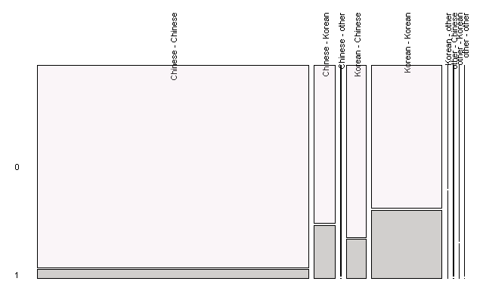
Etymology
As often noted in literature, sai-siot is less frequent in Sino-Korean words (“Chinese” in graph)
Grey = items with sai-siot
Mixed-etymology compounds have an intermediate rate of sai-siot
(Worried about confounds?
We’ll put all these factors into a regression model at the end.)

Slide 21
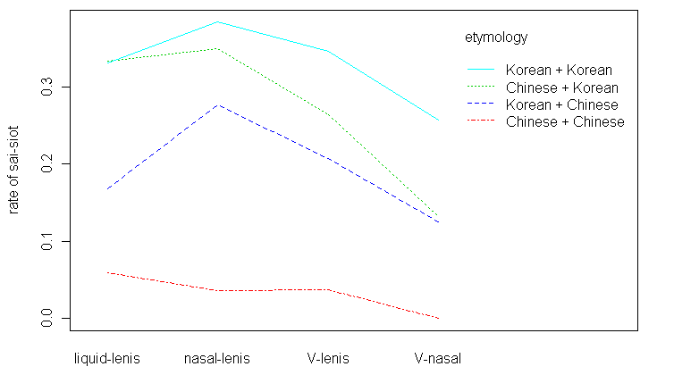
Etymology
Etymology effect is similar across phonological environments:

Slide 22
Etymology
More recent loans?
Few in corpus, but there some examples in the literature that do show sai-siot:
  Korean+English /pata/+ /pɨllausɨ/ → pata-[p’]_{yes}ɨllausɨ ‘sea+blouse’
  English+Korean /ɾadio/+/sok/ → ɾadio-[s’]_{yes}ok ‘radio+inside’
  Japanese+Korean /oteŋ/+/t͡ɕip/ → oteŋ+[t͡ɕ’]_{yes}ip ‘oden+house’
(Kim-Renaud 1974 p. 168, S-b Cho 1967)

Slide 23
Etymology
What does this effect mean?
Could be that words are tagged for etymology and grammar is sensitive to those tags
  see Choi 2010, accounting for prosodic restrictions on Sino-Korean compounds: “Korean needs two n⁰’s: n_{SK}⁰ [Sino-Korean] and n_{NK}⁰ [Native Korean]”
  the extent to which W_{A} or W_{B} looks, phonotactically, native Korean vs. Sino-Korean didn’t have a consistent effect
Could be that many native-Korean compounds once had the /s/ morpheme and so inherited apparent sai-siot
  if extension of sai-siot to newly-borrowed or –coined words is slow, Sino-Korean compounds will lag

Slide 24
More environments—requires a digression
morpheme | initial: deleted | medial: restored | cf. (from en.wiktionary.org)
年 /njʌn/ ‘year’ | [jʌn]-kɨm 연금 年金 ‘pension’ year+money | nɛ-[njʌn] 내년 來年 ‘next year’ coming+year | Cantonese: nin4 Mandarin: nián Sino-Japanese: nen (& den) Sino-Vietnamese: niên, nên, năm
鍊 /ljʌn/ ‘practice’ | [jʌn]-sɨp 연습 練習 ‘practice’ practice+practice | kjo-[ɾjʌn] 교련, 敎鍊 ‘military drill’ teach+practice | Cantonese: lin6 Mandarin: liàn Sino-Jp: ren Sino-Vt: luyện (& rèn, rén)
演 /jʌn/ ‘perform’ | [jʌn]-ki 연기, 演技 ‘performance’ perform+skill | t͡ɕo-[jʌn] 조연, 助演 ‘supporting role’ assist+perform | Cantonese: yin2 Mandarin: yǎn Sino-Jp: en
*#{n,l}{i,j} (except for some mimetics, swear words, English loans)
fossilized alternations in Sino-Korean words (these examples don’t qualify as N+N compounds—they don’t appear in corpus)

Slide 25
{n,l}{i,j} digression, cont’d
Got partially reanalyzed (Y Cho 1995/1998) so that /n/ can now be inserted /+__{i,j}, regardless of historical/underlying initial C
obstruent+__{i,j} /saŋʌp/+/jʌŋʌ/ → saŋʌp-[nj]ʌŋʌ
상업영어 商業英語
business+English ‘business English’
  英 ‘England’ has no etymological l/n, no l/n within non-compounds
liquid+__{i,j} /t͡ɕumal/+/jʌhɛŋ/ → t͡ɕumal-[lj]ʌhɛŋ
주말여행 週末旅行
  weekend+trip ‘weekend trip’
  旅 ‘travel’ happens to have etymological l
nasal+__{i,j} /kɨm/+/jakkwan/ → kɨm-[nj]akkwan
금약관 金約款
  gold+clause ‘gold clause’
  約 ‘agreement’ has no etymological l/n
Productivity: heard example in podcast
핫-요가 ha[tjo]ga ~ ha[nnjo]ga ‘hot yoga’

Slide 26
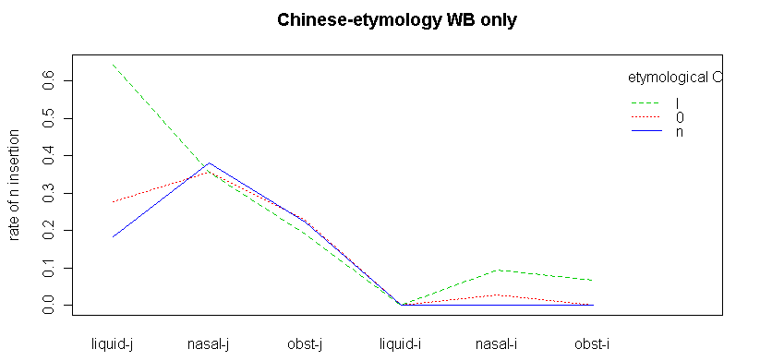
{n,l}{i,j} digression, cont’d
No consistent effect of whether there’s an etymological l/n → really looks like insertion (see also Han 1994)
Sino-Korean rarely inserts __i (E Han 1995)

Slide 27
{n,l}{i,j} digression, cont’d
How about V+__{i,j}?
Only if W_{B} is native Korean
Always accompanied by sai-siot
V+__{i,j} /alɛ+s+ismom/ → alɛ[n-n]ismom 아랫+잇몸
below+gums ‘lower gums’
  note that in the C+__{i,j} cases, we can’t tell whether sai-siot occurred—would have no phonological effect C__n

Slide 28
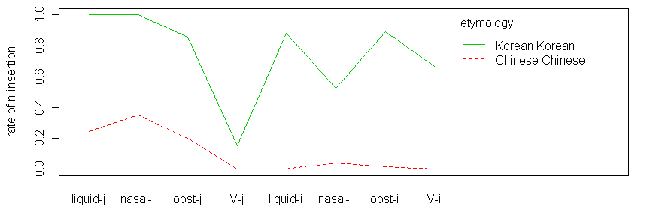
n-insertion affected by similar factors as sai-siot
Etymology: as with regular sai-siot, Sino-Korean (“Chinese”) has lower rate, in all environments
  mixed-etymology cases too sparse to graph
  few loan examples in literature (kokɨp-iŋkɨ ~ kokɨp-[n]_{yes}iŋkɨ ‘high-quality ink’, Kim-Renaud 1974)
I’ll group n-insertion and sai-siot together in graphs below, except where otherwise indicated.

Slide 29
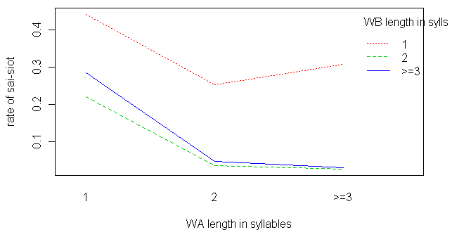
Length
Sai-siot is less probable when W_{A} and W_{B} are both >1 syllable:
  (C-M Lee 1972, Kim-Renaud 1974, K. Chung 1980, Ahn 1985; but see C-B Kim 1974)
Some analyses prevent a monosyllable from forming a prosodic constituent that can trigger sai-siot (E Han 1995, P-h Lee 1996)

Slide 30
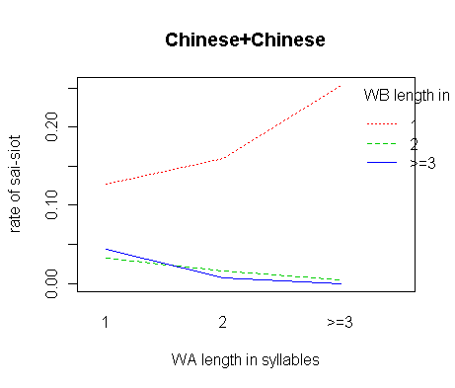
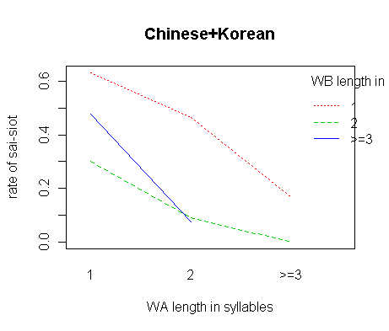
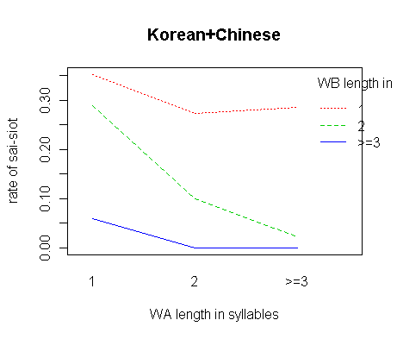
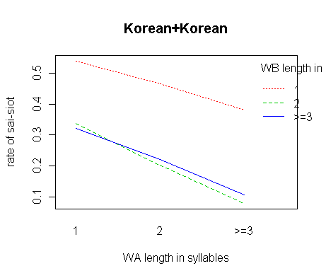
Length
Holds across etymologies:

Slide 31
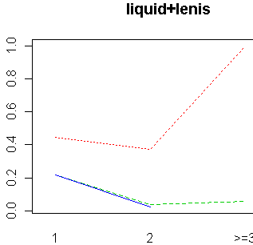
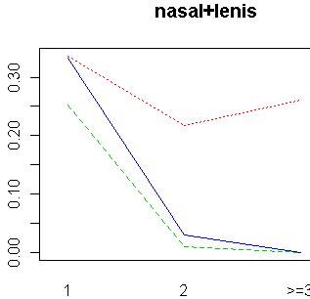
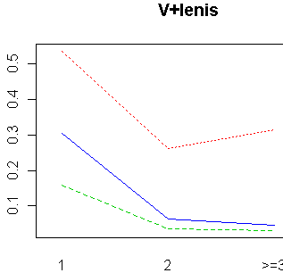
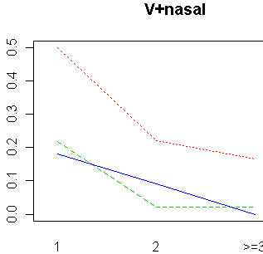
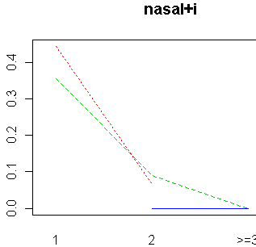
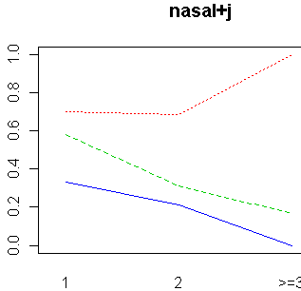
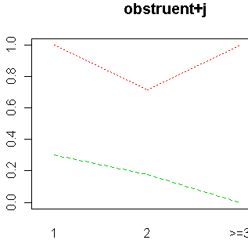
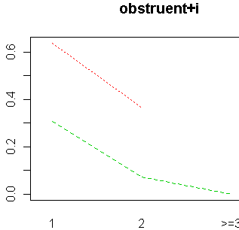
Length
Holds across environments (4 overly sparse cases omitted):
only partial exception is nasal+i

Slide 32
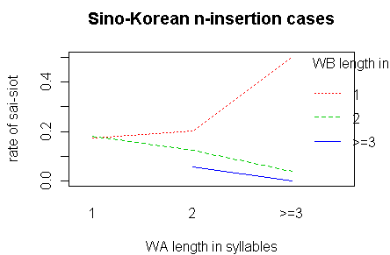
Length
S Hong 1997: no n-insertion in Sino-Korean unless W_{A} > 1 syll (i.e., W_{A} is bimorphemic)
  Unlike the overall trend, we do see less n-insertion when W_{A} is 1 syll:
  15 exceptions, though
    → this restriction can be overridden

Slide 33
Branching structure
(Cook 1991, Hong 1997, but Han 1994)
Can use the corpus’s spelling coding to approximate branching structure in some cases
  베틀//뒷/기둥: can be spelled 베틀 뒷기둥
  loom//back/column
  petʰɨl//twi-s/kituŋ
  베틀//뒷/기둥
Expect: following word branching → no sai-siot, no n-insertion
  E-D Cook 1991, Y Lee & M Lee 2006

Slide 34
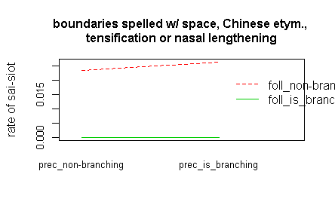
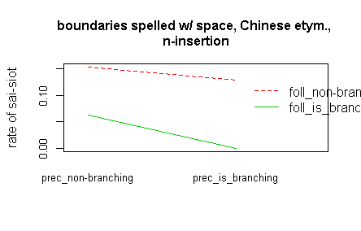
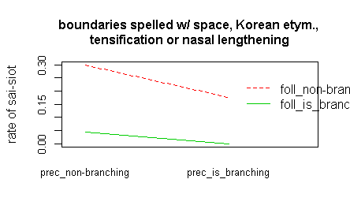
Branching structure
(not enough branching items for Korean-etymology n-insertion)
Consistent trend for less sai-siot if following word is branching (green lines)
Yet there are about 16 exceptions
  This restriction too can be overridden

Slide 35
Branching structure
Similar to a categorical restriction in Japanese rendaku, forbidden [stem₁__[stem₂ stem₃]]
Itô & Mester 2003 analyze this in terms of prosodic structure
  [[12]3] forms a single prosodic constituent, across which rendaku can apply
  stem₂ in [1[23]] begins two different morphological words, and thus must project a prosodic boundary
    this boundary blocks rendaku
  supporting evidence from pitch-accent (Standard Korean doesn’t seem to have a similar diagnostic, unfortunately)

Slide 36
Branching structure
Some examples where sai-siot does occur in [stem₁__[stem₂ stem₃]]
가운뎃//발/가락 kaunte//[p’]_{yes}al/kalak
middle//foot/finger ‘middle toe’
발//뒤/꿈치 pal//[t’]_{yes}ui/k’umt͡ɕ_{h}i
foot//back/heel ‘upper rear portion of heel’
산업//예비/군 sanʌp//[n]_{yes}jepi/kun
industry//reserve/military ‘industrial reserve army’

Slide 37
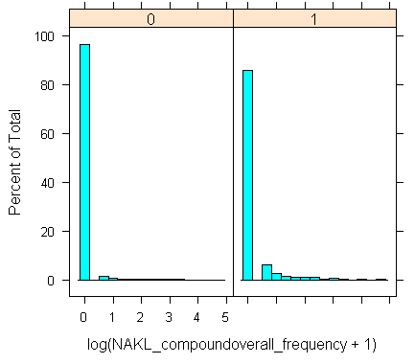
Frequency
Compounds that don’t have sai-siot nearly all have lowest frequency (i.e., not even found in frequency database):
Among compounds that do have sai-siot , a larger minority have non-zero frequencies

Slide 38
Lexicalization
K. Chung 1980: lack of sai-siot in these items indicates that they’ve come to be treated as monomorphemic (or not compounds, anyway):
  sin-[b]_{no}al ‘shoe’ (< ‘footwear+foot’)
  kol-[b]_{no}aŋ ‘closet’ (<‘hole’?+’room’)
So low compound frequency tends to suppress sai-siot, but very high frequency could also suppress it.

Slide 39
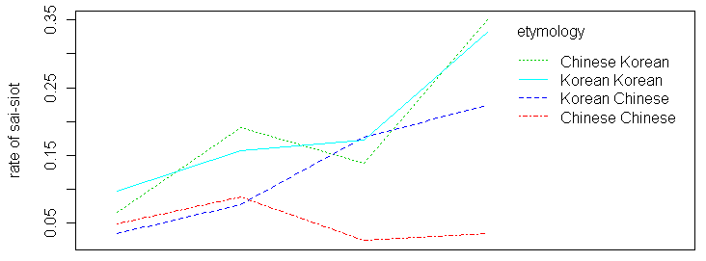
Relative frequency
Hay 2003: if one or both parts of a word is more frequent than the whole, expect non-monomorphemic-like treatment
  --> expect more sai-siot
whole>W_{A},W_{B}
W_{A} > whole
W_{B} > whole
W_{A},W_{B} > whole

Slide 40
Regression models including one new factor
Logistic regression (bayesGLM(arm) function, Gelman & al. 2010, in R, R Development Core Team 2011)
Dependent variable is binary: sai-siot/n-insertion or not

Slide 41
Overall regression model
Estimate Std. Error z value Pr(>|z|)
(Intercept) -0.95476 0.15562 -6.135 8.51e-10 ***
WA is native Korean? 0.87232 0.10255 8.506 < 2e-16 ***
WB is native Korean? 1.37516 0.09871 13.932 < 2e-16 ***
WA_> 1 syll? -1.00357 0.09124 -11.000 < 2e-16 ***
WB > 1 syll? -1.88198 0.07422 -25.358 < 2e-16 ***
log(compound freq + 1) 0.60771 0.07620 7.975 1.52e-15 ***
log(WA freq + 1) 0.14662 0.02351 6.237 4.47e-10 ***
log(WB freq + 1) 0.34745 0.02261 15.367 < 2e-16 ***
WA freq > compound freq? -0.86813 0.11892 -7.300 2.87e-13 ***
WB freq > compound freq? -0.83866 0.13505 -6.210 5.30e-10 ***
WA ends with ...
nasal (vs. V)? 0.49031 0.07910 6.199 5.68e-10 ***
liquid (vs. nasal)? 0.06157 0.12583 0.489 0.625
obstruent (vs. liquid)? 0.15198 0.23000 0.661 0.509
WB begins with ...
lenis (vs. nasal) 0.80386 0.19546 4.113 3.91e-05 ***
i (vs. lenis) 0.31820 0.20393 1.560 0.119
j (vs. i) 1.96199 0.21915 8.953 < 2e-16 ***

Slide 42
To find out model’s estimated probability that a word undergoes sai-siot/n-insertion...
Estimate Std. Error z value Pr(>|z|)
(Intercept) -0.95476 0.15562 -6.135 8.51e-10 ***
WA is native Korean? 0.87232 0.10255 8.506 < 2e-16 ***
WB is native Korean? 1.37516 0.09871 13.932 < 2e-16 ***
WA > 1 syll? -1.00357 0.09124 -11.000 < 2e-16 ***
WB > 1 syll? -1.88198 0.07422 -25.358 < 2e-16 ***
log(compound freq + 1) 0.60771 0.07620 7.975 1.52e-15 ***
log(WA freq + 1) 0.14662 0.02351 6.237 4.47e-10 ***
log(WB freq + 1) 0.34745 0.02261 15.367 < 2e-16 ***
WA freq > compound freq? -0.86813 0.11892 -7.300 2.87e-13 ***
WB freq > compound freq? -0.83866 0.13505 -6.210 5.30e-10 ***
WA ends with ...
nasal (vs. V)? 0.49031 0.07910 6.199 5.68e-10 ***
liquid (vs. nasal)? 0.06157 0.12583 0.489 0.625
obstruent (vs. liquid)? 0.15198 0.23000 0.661 0.509
WB begins with ...
lenis (vs. nasal) 0.80386 0.19546 4.113 3.91e-05 ***
i (vs. lenis) 0.31820 0.20393 1.560 0.119
j (vs. i) 1.96199 0.21915 8.953 < 2e-16 ***
Start with -0.95476s
If W_{A} is native Korean, add 0.87232; if W_{B} is native Korean, add 1.37516
Add in these numbers if W_{A} or W_{B} is > 1 syllable
Add 0.60771 times log frequency of compound, 0.14662 times log freq of W_{A}, etc.
Add these negative numbers if either part is more frequent than the whole compound
Add nothing if W_{A} ends with V, 0.49031 if it ends with nasal, (0.49031+0.061570) if it ends with liquid, (0.49031+0.061570+0.15198) if it ends with obstruent
Similarly for W_{B}’s beginning sound
probability = 1/(1+e^(resulting_number))
→ negative number means a factor discourages sai-siot; positive number means it encourages sai-siot

Slide 43
Estimate Std. Error z value Pr(>|z|)
(Intercept) -0.95476 0.15562 -6.135 8.51e-10 ***
WA is native Korean? 0.87232 0.10255 8.506 < 2e-16 ***
WB is native Korean? 1.37516 0.09871 13.932 < 2e-16 ***
WA > 1 syll? -1.00357 0.09124 -11.000 < 2e-16 ***
WB > 1 syll? -1.88198 0.07422 -25.358 < 2e-16 ***
log(compound freq + 1) 0.60771 0.07620 7.975 1.52e-15 ***
log(WA freq + 1) 0.14662 0.02351 6.237 4.47e-10 ***
log(WB freq + 1) 0.34745 0.02261 15.367 < 2e-16 ***
WA freq > compound freq? -0.86813 0.11892 -7.300 2.87e-13 ***
WB freq > compound freq? -0.83866 0.13505 -6.210 5.30e-10 ***
WA ends with ...
nasal (vs. V)? 0.49031 0.07910 6.199 5.68e-10 ***
liquid (vs. nasal)? 0.06157 0.12583 0.489 0.625
obstruent (vs. liquid)? 0.15198 0.23000 0.661 0.509
WB begins with ...
lenis (vs. nasal) 0.80386 0.19546 4.113 3.91e-05 ***
i (vs. lenis) 0.31820 0.20393 1.560 0.119
j (vs. i) 1.96199 0.21915 8.953 < 2e-16 ***
Korean etymology → more sai-siot
Long W_{A}, W_{B} → less sai-siot
Frequent whole or parts → more sai-siot
Contrary to expectation, once W_{A}, W_{B} freq accounted for, part > whole doesn’t encourage sai-siot
nasal, liquid, and obstruent-final W_{A} → more sai-siot than V-final W_{A}
nasal < lenis, i < j
negative number means a factor discourages sai-siot; positive number means it encourages sai-siot
Overall fit is decent: with cut-off of predicted_probability=0.1, 84% of items that do undergo sai-siot are predicted to, and 82% of items that don’t undergo sai-siot are predicted not to (d’=1.9).

Slide 44
Tense Cs
In Rendaku, a similar compound phenomenon in Japanese, voicing of a consonant is blocked if the stem already contains a voiced obstruent.
Sai-siot produces tensing in most environments. Will it be blocked if stem already contains tense C?
To keep things clean, let’s restrict to cases where...
  W_{B} is >1 syll (otherwise, nowhere for a tense C to occur except site of sai-siot)
  /__lenis cases, which is where sai-siot produces tensing
  W_{A} and W_{B} are native Korean, so they can have underlying (and derived) tense Cs

Slide 45
Regression: tense Cs
Estimate Std. Error z value Pr(>|z|)
(Intercept) -3.995e+00 2.558e+00 -1.562 0.11832
WA is native Korean? 5.788e-02 1.965e-01 0.295 0.76836
WA > 1 syll? -7.806e-01 1.786e-01 -4.370 1.25e-05 ***
WB > 1 syll 4.131e-17 2.500e+00 0.000 1.00000
log(compound freq + 1) 6.185e-01 1.564e-01 3.955 7.64e-05 ***
log(WA freq + 1) 3.132e-01 5.016e-02 6.243 4.28e-10 ***
log(WB freq + 1) 2.263e-01 5.376e-02 4.209 2.56e-05 ***
WA freq > compound freq? -4.392e-01 2.996e-01 -1.466 0.14265
WB freq > compound freq? 1.760e-01 2.861e-01 0.615 0.53838
WA ends with...
nasal (vs. V)? 6.157e-02 1.836e-01 0.335 0.73741
liquid (vs. nasal)? -3.364e-01 2.477e-01 -1.358 0.17435
WA free of tense Cs? 6.742e-01 2.322e-01 2.904 0.00369 **
WB free of tense Cs (after 1st)? 8.491e-01 3.751e-01 2.264 0.02359 *
Weak effect: having a tense C in W_{B} prevents tensing under sai-siot (similar to rendaku)
More reliable effect: having a tense C in W_{A} also suppresses tensing under sai-siot
However, there are still some examples of sai-siot when W_{A} or W_{B} contains a tense C.
Accuracy: 70% of sai-siot words correctly classified; 72% of non-sai-siot cases correctly classified (cut-off of 0.2; d’=1.0)

Slide 46
Branching structure
Need to restrict data to subset:
compound contains 3 or more parts
junctures coded as “//” (i.e., can be spelled with space)
  these are the only cases where we can infer branching structure

Slide 47
Regression: branching structure
Estimate Std. Error z value Pr(>|z|)
(Intercept) -3.5788 0.6535 -5.476 4.34e-08 ***
WA is native Korean? 0.7038 0.3942 1.786 0.074170 .
WB is native Korean? 1.5259 0.3952 3.861 0.000113 ***
WA > 1 syll? -0.4625 0.3007 -1.538 0.124092
WB > 1 syll? -2.3211 0.2866 -8.099 5.52e-16 ***
log(compound freq + 1) 0.1027 0.4860 0.211 0.832644
WA ends with...
nasal (vs. V) 0.3340 0.3322 1.005 0.314710
liquid (vs. nasal) -0.3615 0.3901 -0.927 0.354087
obstruent (vs. liquid) -0.3960 0.7417 -0.534 0.593356
WB starts with...
lenis (vs. nasal) 0.5692 0.7290 0.781 0.434925
i (vs. lenis) 1.6282 0.5742 2.835 0.004576 **
j (vs. i) 0.8743 0.6253 1.398 0.162093
only prec. word branches? 2.1180 0.5094 4.158 3.21e-05 ***
Much more sai-siot if preceding word branches than if following word branches.
Accuracy: 81% of sai-siot words correctly classified, 88% of non-sai-siot words correctly classified (cut-off=0.075, d’=2.1)

Slide 48
Summary of factors
factor | type | effect
branching structure | morphology | variable
etymology | ? | variable
frequency | processing | variable
stem length | processing or phonological | variable
features of segments involved | phonological | variable
presence of tense Cs | phonological | variable

Slide 49
Discussion
None of these factors slice up the compounds into those that can or can’t undergo sai-siot
Rather, each factor seems to contribute to the overall probability of sai-siot (probably with lexicalization of accreted individual outcomes)

Slide 50
Discussion
Doesn’t rule out a decision-tree model where each step is probabilistic

Slide 51
Discussion
Doesn’t rule out a decision-tree model where each step is probabilistic—but this model yields same results as additive/interacting model
morphological structure
p(sai-siot)=0.6
p(sai-siot)=0.3
phonological property 1
phonological property 1
p(sai-siot)=0.7
p(sai-siot)=0.7
p(sai-siot)=0.4
p(sai-siot)=0.4
p(sai-siot)=0.6*0.7
p(sai-siot)=0.6*0.4
p(sai-siot)=0.3*0.7
p(sai-siot)=0.3*0.4
Same results regardless of which factor is on top
How would probability from top factors work?
  A diacritic—e.g. /s/ morpheme—more likely to be applied to right-branching compounds, but able to be applied to either type?
  A (probabilistic) phonological constraint that refers to morphological structure? (similar to Ito & Mester)

Slide 52
Factor we haven’t been able to look at yet: syntactic/semantic structure
See also K. Chung 1980, Ahn 1985, Chang 2004, Yun 2006; G-R Kim 2001 for comparison to Japanese and Malayalam
Ha & Moon 2005
Coordinative compounds never undergo sai-siot
/nun/ +/ pi/ → nun-[b]_{no}i ‘snow and rain’ (snow + rain)
H-Y Kim 1990’s analysis
  p-word is domain of tensification (including sai-siot)
  co-compounds can’t be p-words because they lack a unique head

Slide 53
Factor we haven’t been able to look at yet: syntactic/semantic structure
Ha & Moon 2005
“Non-genitive” compounds tend not to undergo, but there are exceptions
apposition 누이+동생 nui+[d]_{no}oŋsɛŋ sister+younger sibling ‘younger sister’
form 고추+잠자리 kot͡ɕʰu+[d͡ʑ]_{no}amt͡ɕaɾi red pepper+dragonfly ‘red dragonfly’
material 금+반지 kɨm+[b]_{no}ant͡ɕi gold+ring ‘gold ring’
method 칼+국수 kʰal+[g]_{no}uksu knife+noodles ‘knife-cut noodles’
  paraphrasable as Ain B or A(ɨ)ro mandɨn/ mandɨɾʌd͡ʑin B
  In Ha 2002’s database, only 11% undergo sai-siot
  Ahn 1985’s analysis: W_{A} in these cases becomes an adjective (with null morphology) before compounding
Are the exceptional cases those where phonological factors strongly promote sai-siot?
That is, can phonological factors override structural ones? Or is there simply noise?

Slide 54
Factor we haven’t been able to look at yet: syntactic/semantic structure
Ha & Moon 2005; see also K. Chung 1980
“Genitive” compounds tend to undergo, but there are exceptions
possessor 안경+다리 ankjʌŋ+[t’]_{yes}aɾi glasses+leg ‘sides of glasses’
time 봄+비 pom+[p’]_{yes}i spring+rain ‘spring rain’
place 들+짐승 tɨl+[t͡ɕ’]_{yes}imsɨŋ field+animal ‘wild animal’
source 햇+빛 hɛ(s)+[p’]_{yes}it͡ɕʰ sun+shine ‘sunshine’
part 발+바닥 pal+[p’]_{yes}atak foot+bottom ‘sole’
purpose 고깃+배 koki(s)+[p’]_{yes}ɛ fish+boat ‘fishing boat’
  sometimes no clear paraphrase
  In Ha 2002’s database, 74% undergo sai-siot
But sai-siot can be blocked if W_{A} is animate (K. Chung 1980, Yun 2006)
/mal/+/tali/ → mal-[d]_{no}ali ‘legs of horse’ (horse+leg)
/saŋ/+/tali/ → saŋ-[t’]_{yes}aɾi ‘legs of table’ (table+leg)
  suffix */-s/ applied only to inanimate and honorific (H-min Sohn 1994, p. 3)
Again, we’d like to know about exceptions and whether they’re phonologically motivated.

Slide 55
Categorical factors
Whether a word is noun-noun compound
Another phonological factor (items excluded from data set above)
  no sai-siot V__h
  딸기+혀 t’alk[i+h]jʌ ‘raspberry tongue’
  If a /s/ were inserted, we’d expect it to maybe neturalize to [t], then merge with /h/ into an aspirated consonant
  but no examples like * t’alk[i+t^{h}]jʌ, *t’alk[i+t͡ɕ^{h}]jʌ
  cf. examples where W_{B} ends in underlying coronal obstruent
  낮+후 /nat͡ɕ+hu/ → na[t^{h}]u
  can be analyzed in terms of alignment: surface initial segment of W_{B} has to correspond to underlying initial segment of W_{B}
  (Some other environments are categorically lacking sai-siot too, but it’s less clear that it would have an effect)
Maybe surprising that this constraint is unviolated, while seemingly higher-order constraints are violable
  supports grammar in which different types of constraints compete (phonological, morphological, etc.), and it’s possible for phonological constraints to outrank non-phonological
the end

Slide 56
References (sorry, some are missing; you can e-mail me)
Ahn, Sang-cheol. 1985. The interplay of phonology and morphology in Korean.. University of Illinois ph.d. dissertation.
Baek, Eung-Jin. 1993. A Historical Study of Korean Noun Compounds. Korean Studies 17. 105-116. (2 May, 2011).
Cho, Seung-bog. 1967. A Phonological Study of Korean. With a Historical Analysis. (Acta Universitatis Upsaliensis 2). Uppsala: Universitetet.
Choi, Jaehoon. 2010. Disyllabicity of Sino-Korean compounds: evidence from Ca-compounding.. In , University of Southern California.
Hay, Jennifer. 2003. Causes and consequences of word structure.. Routledge.
Hong, Soonhyun. 2002. A conspiracy in Native Korean [n]-insertion. Studies in Modern Grammar 28. 1-16.
Jun, Jongho. 1995. Perceptual and Articulatory Factors in Place Assimilation: An Optimality Theoretic Approach.. University of California, Los Angeles.
Kim, Chin-Wu. 1970. Boundary phenomena in Korean. Papers in Linguistics 2. 1-26.
Kim, Gyung-Ran. 2001. Obstruent alternations in sub-compounds. Studies in Phonetics, Phonology and Morphology 7(2). 315-331.
Kim, Hyoung Youb. 1990. Voicing and tensification in Korean: a multi-face approach.. University of Illinois at Urbana-Champaign ph.d. dissertation.
Kim, Sun-hee. 1990. Phonologie des consonnes en coréen.. Hanshin Publishing Co.
Kim-Renaud, Young-Key. 1974. Korean consonantal phonology.. University of Hawaii, Honolulu.

Slide 57
References (sorry, some are missing; you can e-mail me)
Labrune, Laurence. 1999. Variation intra et inter-langue: morpho-phonologie du rendaku en japonais et du sai-sios en coreen. Cahiers de Grammaire 24. 117-152.
Lee, Chungmin. 1972. Boundary phenomena in Korean revisited. Papers in Linguistics 5(3). 454-474.
Lee, Pong-hyung. 1996. Constraints on sonorant alternations and the feature [sonorant]. The New Studies of English Language and Literature 12. 1-33.
Lee, Yongsung & Minkyung Lee. 2006. n-insertion as y-devocalization in Korean. Korean Journal of Linguistics 31(3). 413-440.
Sohn, Han. 1978. Tensification in compound boundaries in Korean.. In Chin-Wu Kim (ed.), Papers in Korean Linguistics, 113-117. Columbia, SC: Hornbeam Press.
Sohn, Ho-min. 1994. Korean.. Taylor & Francis.
Song, Ki Joong. 1986. Remarks on modern Sino-Korean. Language Research 22(4). 469-501.
Yoon, Junghyoe. 2008. Mora augmentation in Korean noun subcompounding. Indiana University Linguistics Circle Working Papers 8.
Yun, Sung Kyu. 2006. Epenthetic s in compound nouns. English Linguistic Science. Journal of the English Linguistic Science Association of Korea 16.

