Slide 1
AI in Modern Healthcare
September 18th, 2024
Zachary Morrison

Slide 2
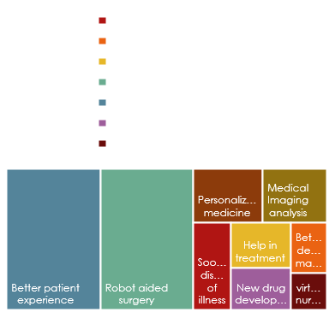
AI Healthcare topics
Early illness prevention
AI Supported surgery
Enhanced diagnostics
Proactive analytics
Sooner discovery of illness | Better decision making | Improved help in treatment
Enhanced access to medical services | Improved patient experience | Customized medicine
New Drug revelations | Virtual nursing aids | Robot aided surgery

Slide 3

AI in surgery AI supported surgery will support data driven decision through improved decision and intelligent robotic aid.AI will come as a support system for workflow analysis providing correct aid in the right context Artificial Intelligence-Assisted Surgery: Potential and Challenges - PMC (nih.gov) Benefits 1.Object detection 2.Speech recognition 3.Natural language processing AI in Surgery: Innovations and Advancements | by Seekmeai | Medium

Slide 4

Enhanced Diagnostics
AI improves the diagnosis of illness for patients, leading to better treatment for the individual. Due to the fairly recent presence of AI in healthcare, medical prediction accuracy, speed, and effectiveness of patient diagnosis. The algorithms can inspect medical images such as x rays, MRIs, ultra sounds, CT scans and DXAs Artificial Intelligence for Medical Diagnostics—Existing and Future AI Technology! - PMC (nih.gov)
AI in medical imaging will help in enhanced diagnosis and personalized treatment (asianmeditour.com)

Slide 5

Predictive Analysis
Predictive AI: Key Applications, Benefits, and Future Trends (aisera.com)
In the center of AI are machine learning models that deal with data. The models are schooled on past data through data analysis to locate connections, tendencies, anomalies,. When the model has been made to anticipate future practices by functioning new data against studied patterns
Data
Reporting analysis
Monitoring
Predictive analytics
Action

Slide 6
References
Artificial Intelligence-Assisted Surgery: Potential and Challenges - PMC (nih.gov)
Artificial Intelligence for Medical Diagnostics—Existing and Future AI Technology! - PMC (nih.gov)
Predictive AI: Key Applications, Benefits, and Future Trends (aisera.com)
AI in medical imaging will help in enhanced diagnosis and personalized treatment (asianmeditour.com)

Slide 7
Effective delivery techniques
This is a powerful tool in public speaking. It involves varying pitch, tone, and volume to convey emotion, emphasize points, and maintain interest.
Pitch variation
Tone inflection
Volume control
Effective body language enhances your message, making it more impactful and memorable.
Meaningful eye contact
Purposeful gestures
Maintain good posture
Control your expressions

Slide 8
Navigating Q&A sessions
Know your material in advance
Anticipate common questions
Rehearse your responses
Maintaining composure during the Q&A session is essential for projecting confidence and authority. Consider the following tips for staying composed:
Stay calm
Actively listen
Pause and reflect
Maintain eye contact

Slide 9

Speaking impact
Your ability to communicate effectively will leave a lasting impact on your audience
Effectively communicating involves not only delivering a message but also resonating with the experiences, values, and emotions of those listening

Slide 10
Dynamic delivery
Learn to infuse energy into your delivery to leave a lasting impression
One of the goals of effective communication is to motivate your audience
Metric | Measurement | Target | Actual
Audience attendance | # of attendees | 150 | 120
Engagement duration | Minutes | 60 | 75
Q&A interaction | # of questions | 10 | 15
Positive feedback | Percentage (%) | 90 | 95
Rate of information retention | Percentage (%) | 80 | 85

Slide 11
Final tips & takeaways
Consistent rehearsal
Strengthen your familiarity
Refine delivery style
Pacing, tone, and emphasis
Timing and transitions
Aim for seamless, professional delivery
Practice audience
Enlist colleagues to listen & provide feedback
Seek feedback
Reflect on performance
Explore new techniques
Set personal goals
Iterate and adapt

Slide 12
Speaking engagement metrics
Impact factor | Measurement | Target | Achieved
Audience interaction | Percentage (%) | 85 | 88
Knowledge retention | Percentage (%) | 75 | 80
Post-presentation surveys | Average rating | 4.2 | 4.5
Referral rate | Percentage (%) | 10 | 12
Collaboration opportunities | # of opportunities | 8 | 10

Slide 13

Thank you
Brita Tamm
502-555-0152
brita@firstupconsultants.com
www.firstupconsultants.com

