Slide 1
AGENTIC AI CAPSTONE
Research Assistant
A Multi-Agent Intelligence System on Google ADK
RAG over AI/ML papers + live web search, with grounded review, observability, and a live Cloud Run deployment.
3 agents
4 patterns
RAG + web
Evaluated
Cloud Run
Zaid Malick
Synapse “Master Agentic AI” certification capstone
github.com/ZMalick/multi-agent-research-assistant · research-assistant-969189630215.us-central1.run.app

Slide 2
The problem
LLMs hallucinate and go stale — research answers need sources and freshness
Why this matters
The goal
Language models invent plausible-but-wrong facts.
Their knowledge is frozen at training cutoff — no “latest”.
Research answers are only useful if they cite sources.
One prompt can’t decide when to retrieve vs. search the web.
Route intelligently
between a paper corpus (RAG) and the live web.
Verify groundedness
before any answer reaches the user.
Measure quality
with an eval harness, and ship it live.
Done = cited answers · smart routing · measured quality · deployed
Research Assistant · Multi-Agent ADK Capstone
2

Slide 3
Architecture
3 Gemini agents on a deterministic control spine · state shared via ADK session
LoopAgent — feedback loop (max 2 iterations)
User query
→
Orchestrator
→
Researcher
→
Reviewer / QA
→
ReviewGate
routes CORPUS / WEB / BOTH
drafts cited answer
groundedness check
PASS → exit
FAISS
Tavily
FAIL → Researcher revises (loops back)
↓
Final cited answer
Research Assistant · Multi-Agent ADK Capstone
3

Slide 4
The three agents
Each one job, one interface — coordinated through ADK session state
O
R
Q
Orchestrator
Researcher
Reviewer / QA
Classifies the query and chooses the route: CORPUS, WEB, or BOTH. Drives everything downstream.
Calls rag_search (FAISS) and web_search (Tavily) — in parallel when needed — and drafts a cited answer.
Checks every claim against the retrieved evidence and emits a PASS / FAIL verdict.
ReviewGate is a tiny deterministic control node (not a 4th LLM) — it reads the verdict and exits the loop on PASS, making the stop reliable.
Research Assistant · Multi-Agent ADK Capstone
4

Slide 5
Communication patterns
Rubric requires 2+ — this system implements 4
1
Hierarchical delegation
2
Sequential flow
The Orchestrator’s route decision drives the Researcher’s tool choice via shared session state.
A root SequentialAgent runs orchestrate → research → review in order.
3
Feedback loop
4
Parallel execution
Reviewer FAIL sends the draft back to the Researcher to revise (LoopAgent, max 2).
RAG and web search fire concurrently when a query needs BOTH sources.
Research Assistant · Multi-Agent ADK Capstone
5

Slide 6
RAG pipeline
pypdf → 500-token windows → Vertex embeddings → FAISS → cited retrieval
PDF
(pypdf)
Chunk
500/50 tok
Embed
text-embedding-005
FAISS
IndexFlatIP
Retrieve
top-k + cite
→
→
→
→
15
1,140
768
[p.N]
arXiv papers
chunks indexed
embedding dims
page citations
Research Assistant · Multi-Agent ADK Capstone
6

Slide 7
Routing & web search
The Orchestrator picks the source — corpus, web, or both
CORPUS
WEB
BOTH
Established concepts & results from the literature
Latest / recent / post-publication information
Needs corpus grounding plus current context
“What is scaled dot-product attention?”
“Most recent LLM releases in 2026?”
“How has RAG evolved to 2026?”
Research Assistant · Multi-Agent ADK Capstone
7

Slide 8
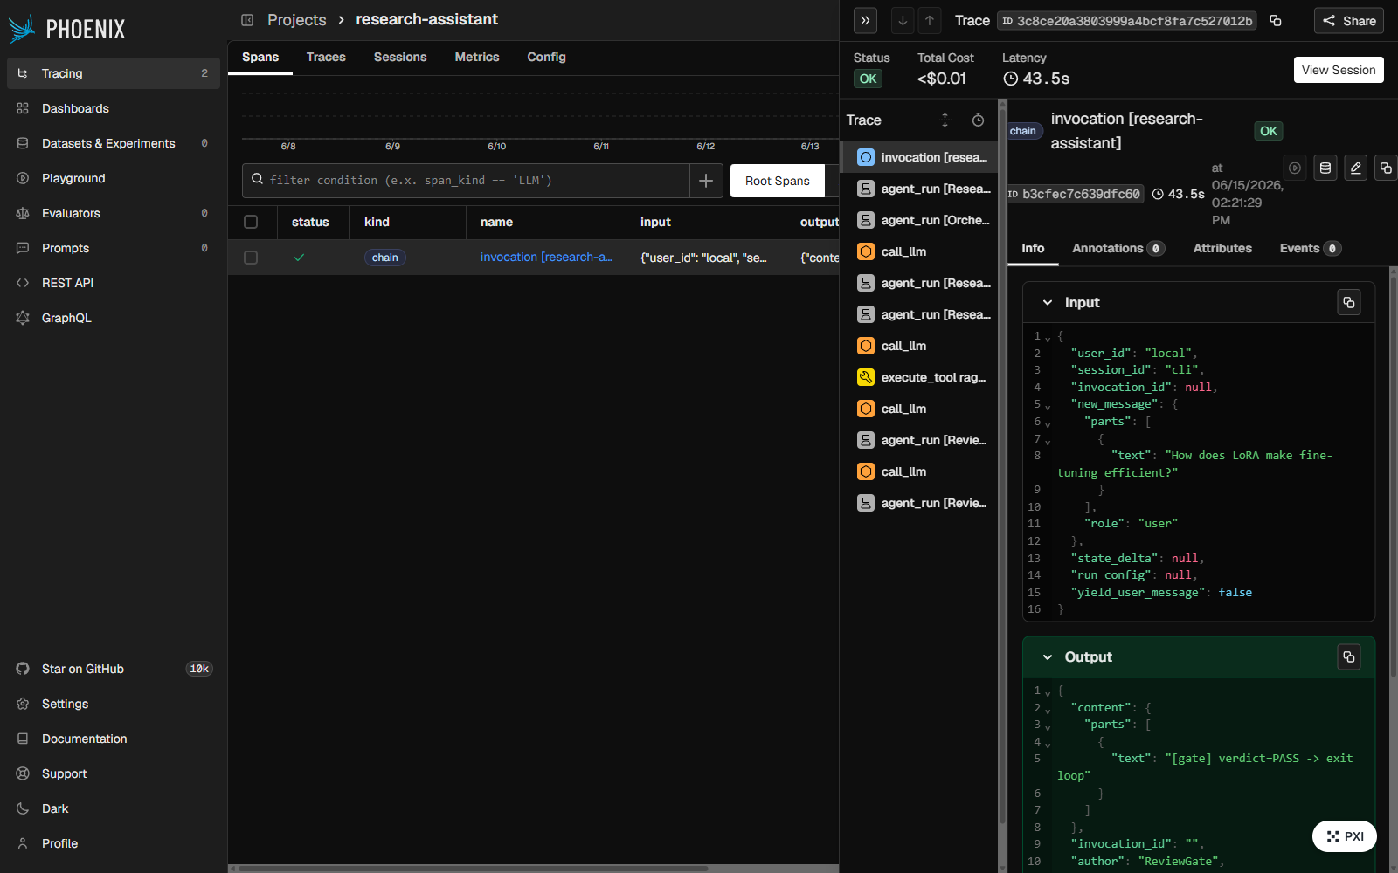
Observability
Two complementary layers — metrics for the API, traces for the eye
1 · ObservabilityPlugin (ADK)
One BasePlugin on the Runner — structured JSONL per step.
Per-agent latency, token counts, retrieval cosine scores.
Returned in the API’s metrics dict — no external service.
2 · Arize Phoenix (OpenTelemetry)
Flag-gated, self-hosted trace UI (localhost:6006).
Full agent run as a waterfall — every step, tool, token.
Eval-only dep — never in the production image.
A real run traced end-to-end: Orchestrator → Researcher (rag_search) → Reviewer → ReviewGate, with latency + tokens per span.
Research Assistant · Multi-Agent ADK Capstone
8

Slide 9
Evaluation
Ragas (Gemini 2.5 Pro judge + Vertex embeddings) over a labeled question set
0.98
0.83
0.81
0.93
Faithfulness
Answer relevancy
Context precision
Context recall
answers grounded in context
answers address the question
retrieved passages relevant
retrieval covers the reference
100%
Routing accuracy — 19 / 19
Every CORPUS / WEB / BOTH question routed correctly (deterministic check across all rows).
Research Assistant · Multi-Agent ADK Capstone
9

Slide 10
Deployment
FastAPI → Docker → Cloud Run, built in-cloud via Cloud Build
FastAPI
/ask · /health
Docker
uv from lockfile
Cloud Build
--source .
Cloud Run
live service
→
→
→
FAISS index baked into the image (no rebuild at start).
Vertex/Gemini auth via the service identity — no keys in image.
.gcloudignore uploads the gitignored index; secrets stay out.
Public, scales to zero, max-instances capped for cost safety.
LIVE
research-assistant-969189630215
.us-central1.run.app
GET /health · POST /ask { "question": "…" }
Research Assistant · Multi-Agent ADK Capstone
10

Slide 11
Key decisions & challenges
Where engineering judgment showed up
1
Deterministic loop exit
Replaced LLM exit_loop with a ReviewGate control node — fixed a bug where a needless second pass overwrote a good answer.
2
Evidence-based groundedness
The Reviewer checks every claim in the draft against the retrieved evidence the tools captured — this caught a real hallucination during testing.
3
Isolated the eval stack
Ragas needed LangChain (incompatible with v1.x) — pinned + quarantined to an eval-only group, excluded from the served app.
Research Assistant · Multi-Agent ADK Capstone
11

Slide 12
Rubric coverage
Pillar | Weight | Evidence
Multi-agent system (ADK) | 40% | 3 agents · 4 communication patterns · session state
Retrieval-augmented generation | 25% | Vertex embeddings + FAISS + page-level citations
Web search | 15% | Tavily tool + intelligent routing
Observability / deploy / presentation | 20% | Plugin + Phoenix · Cloud Run · this deck + demo
Evaluated, observable, and live — not just a prototype.
github.com/ZMalick/multi-agent-research-assistant
research-assistant-969189630215.us-central1.run.app
Thank you

