Slide 1
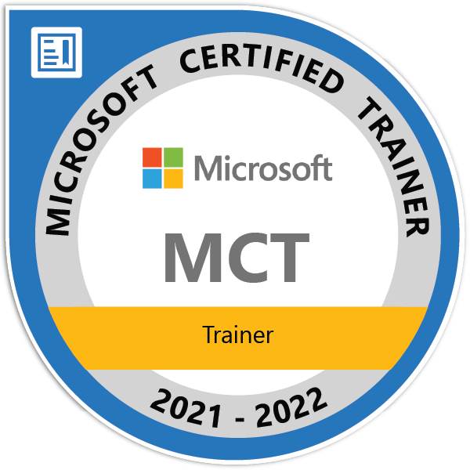



Configuring RBAC via Bicep Templates
Matt Szafir
Data Practice Lead
Professional Services
@MattSzafirPro
matt.szafir@atmosera.com

Slide 2


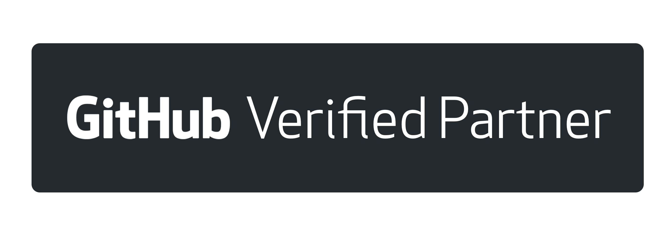
Atmosera Core Services
Consulting
Custom software application development, cloud and architecture.
Instructor-Led & On-Demand Training
We’ve trained more than 50,000 Microsoft developers and provide public & private training for businesses all around the world.
CSP and Managed Services
Full management and design of Azure environments.
Notes:
A premier Azure Expert MSP, to create an industry-leading Azure powerhouse, offering end-to-end Azure services.
We are a Microsoft Gold Partner & a GitHub Verified Partner

Slide 3

AGENDA
What is IaC (Infrastructure as Code)
ARM vs Bicep
RBAC
Hands On Deployment Using Bicep
Questions
https://github.com/ZMon3y/bicepRBAC
Notes:
Before we get started: who this webinar is for:
Audience is familiar with Azure – maybe done some deployments via portal
Like I said, My last webinar was on bicep and Synapse deployments
Many people are familiar with deploying resources via bicep but many don’t know there are other capabilities (including configuring RBAC)
What is IaC?
ARM vs Bicep – pros and cons, compare syntax
RBAC
Hands On – bulk of the time will be here where we learn many of the concepts within Bicep
Finish up with questions

Slide 4
What is Iac (Infrastructure as code)?
Notes:
Seen it pronounced YAK
In the name: defining your infrastructure using code
Terraform
Ansible
Chef
Declarative (functional) vs imperative (procedural)
2 models: Push & pull
Ansible example – use ansible pull to configure your servers / workstations from repo
Can put code into repositories and integrate into CI/CD pipelines

Slide 5
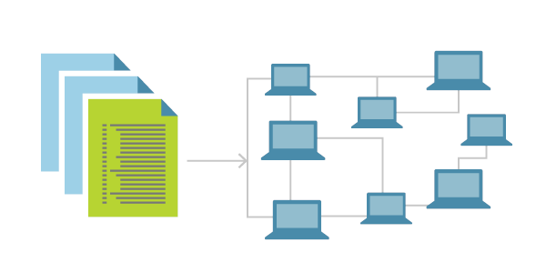
Why Use IaC in Azure?
Repeatability
Avoid snowflake environments
Saving time and money
Declarative – specifies what, not how
Orchestration / define dependencies
Apply access control using Azure RBAC (role-based access control)
Apply tagging
Notes:
Repeatability
Avoid snowflake envs – which can’t be reproduced
Saving time and money – quickly deploy (parallelism); tear down & rebuild temp envs
Declarative – takes advantage of any optimizations Azure may develop behind the scenes on deployment; easier than maintaining imperative deployment scripts
Orchestration / dependencies – parallel deployment (as opposed to sequential) where available, CI/CD pipelines
Apply access control
Apply tagging – often overlooked but can be very valuable (not going to get into this much today but can answer questions if there is time)

Slide 6
IaC Azure Options
3rd Party (Terraform)
Azure Native
ARM
JSON
Bicep
DSL (Domain Specific Language)
Concise syntax
Modularity
Integrated with Azure Blueprints
Preview Changes (what-if operation)
No Cost & Open Source
Imperative Scripting (az cli)
Notes:
A number of ways to do IaC on Azure. If you are happy with Terraform my not be a reason to migrate to Bicep
Azure Native – ARM – originally the only way to do it natively on Azure. Not as robust
Modular – meaning you can write templates and reference them in other bicep files
Blueprints – not going to cover blueprints today but if you are defining a large enterprise deployment it may be something to look at
Preview changes -
No cost & open source – easy to get started, examples, great tools & documentation (VS code & extension)
Imperative scripting – sequential, might not support the latest APIs

Slide 7
{
"$schema": "https://schema.management.azure.com/schemas/2019-04-01/deploymentTemplate.json#",
"contentVersion": "1.0.0.0",
"parameters": {
"location": {
"type": "string",
"defaultValue": "[resourceGroup().location]"
},
"storageAccountName": {
"type": "string",
"defaultValue": "[format('toylaunch{0}', uniqueString(resourceGroup().id))]"
}
},
"resources": [
{
"type": "Microsoft.Storage/storageAccounts",
"apiVersion": "2021-06-01",
"name": "[parameters('storageAccountName')]",
"location": "[parameters('location')]",
"sku": {
"name": "Standard_LRS"
},
"kind": "StorageV2",
"properties": {
"accessTier": "Hot"
}
}
]
}
Bicep vs ARM Syntax
param location string = resourceGroup().location
param storageAccountName string = 'toylaunch${uniqueString(resourceGroup().id)}'
resource storageAccount 'Microsoft.Storage/storageAccounts@2021-06-01' = {
name: storageAccountName
location: location
sku: {
name: 'Standard_LRS'
}
kind: 'StorageV2'
properties: {
accessTier: 'Hot'
}
}
Notes:
Storage account deployment

Slide 8
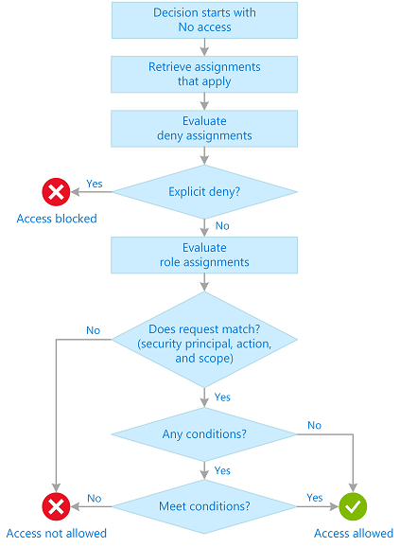
RBAC (Role-Based Access Control)
Access Management for resources on Azure
Security Principal => User, Group, Managed Identity
Role Definition – lists actions that can be performed (read/write/delete)
Built in: Owner, Contributor, Reader
Custom
Scope – Management Group, Subscription, Resource Group, Resource
(There are additional resource level access controls outside of RBAC)
Additive – Reader + Contributor = Contributor
Generally, allow model (deny available in Azure Blueprints but we aren’t covering this today)

Slide 9
Bicep Concepts Covered
Requirements
Scope
Parameters
Variables
Conditionals
Resources
Existing
Outputs
Loops
Functions
Microsoft.Authorization/roleAssignments - Bicep & ARM template reference | Microsoft Docs

Slide 10
Hands On

Slide 11
Thank You
Matt Szafir
matt.szafir@atmosera.com
@MattSzafirPro

