Slide 1
BE Project Presentation on Research Platform for Stock Market Analysis
Presented by
Crystal Cuthinho - 7053
Nevil Dsouza - 7059
Melwyn Saldanha - 7097

Slide 2
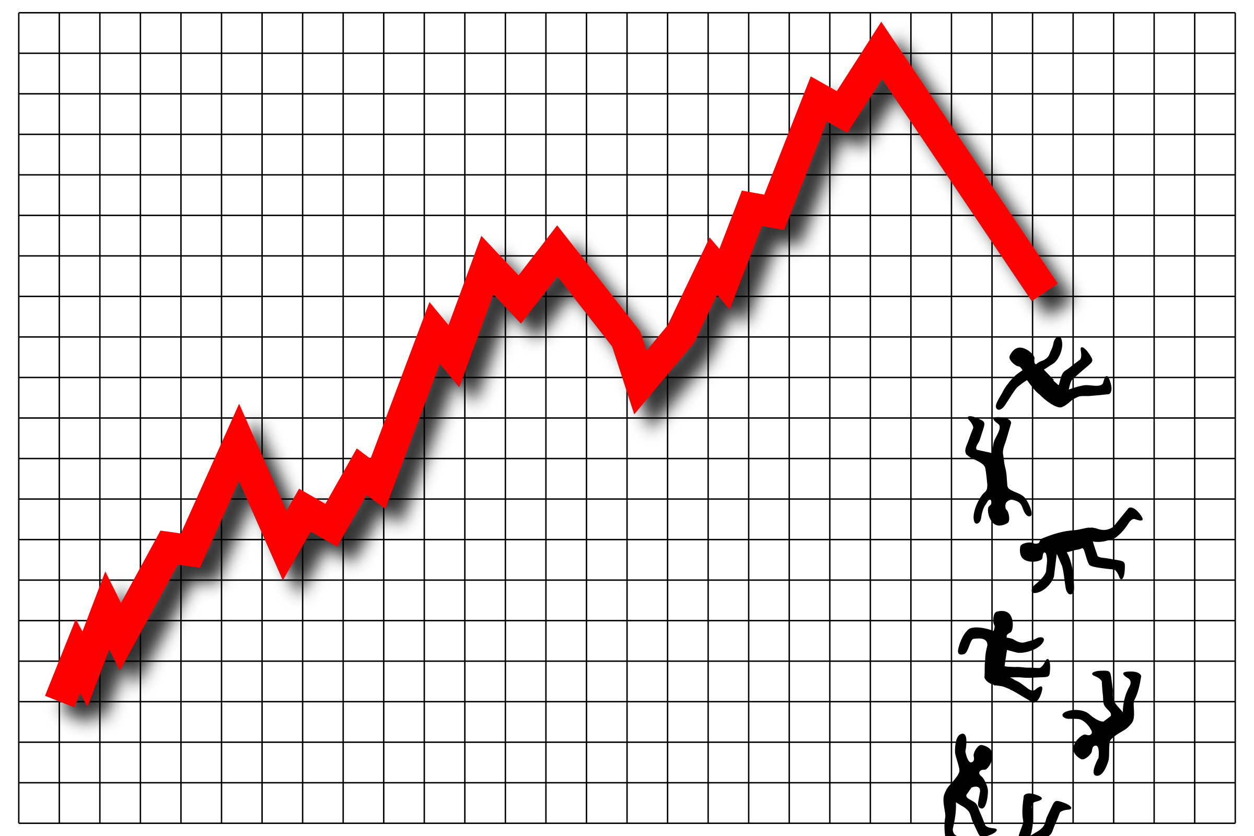
Introduction
STOCK MARKET & THE ECONOMY

Slide 3
Factors affecting Stock Market
Supply & demand
Past track record of companies
Investor opinion
Government policies
News
Stock market Indices
Expansion of business
Brand Image

Slide 4
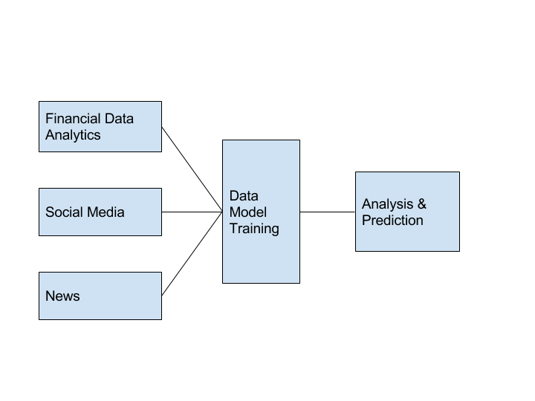
Problem Statement
ABSENCE OF A HYBRID PREDICTION MODEL

Slide 5

The BEST method is …

Slide 6
Aim, Scope & Applications
Aim : To improve accuracy of prediction by combining all 3 techniques
Scope:
Short Term trading
NSE based companies
National Sentiment Analysis
Predictive, not Prescriptive
Applications:
Investors will use predictions to buy and sell stocks to make a profit
Trends of stock market and comparisons of output

Slide 7


Existing Systems & Their Drawbacks
No hybrid model
Accuracy issues in individual techniques
Mention techniques used in unused research papers
Equity pandit
Features: daily, weekly, monthly trends, sectorwise
Stock forecasting: company screener., portfolio, profit calculator
Research paper

Slide 8


Existing Systems & Their Drawbacks
LESS ACCURACY IN INDIVIDUAL TECHNIQUES
NO HYBRID MODEL

Slide 9
Literature Review Financial Data Analytics
Explain all 3 modules – give facts and theory and background
implement, compare & find flaws in accuracy
critical appraisal of the previous work published in the literature

Slide 10
Literature Review Market Sentiment Analysis using Social Media

Slide 11
Literature Review Market sentiment analysis using News
Keyword based filtering from top financial news websites
Bag of Words
Noun Phrasing
Named Entities
SVM

Slide 12
Our approach– Proposed system
Implement the three methodologies for predictions
Record individual performance based on accuracy & CPU time
Compare all three observations based on a time period
Find patterns of inter dependency among the three strategies
Try merging 2 out of 3 strategies in combinations
Record performances
State conclusions of the experiments

Slide 13
Why we chose SVM?
Best model for text classification compared to K-NN, DT, BP-NN
Easier to implement than Neural Networks
Avoids the problem of local maxima
Faster & high accuracy
4 kernels to move data to high dimensional space
Converts non separable problem to non linear solution using hyper planes
Proper filtering and noise removal will avoid disadvantage of over fitting

Slide 14
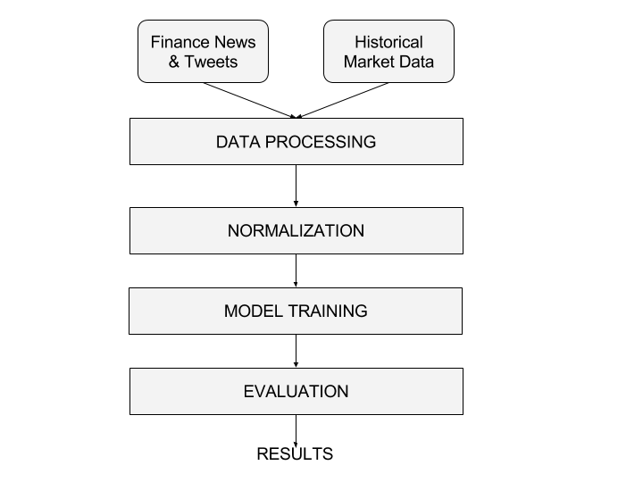
Top Level Architecture

Slide 15
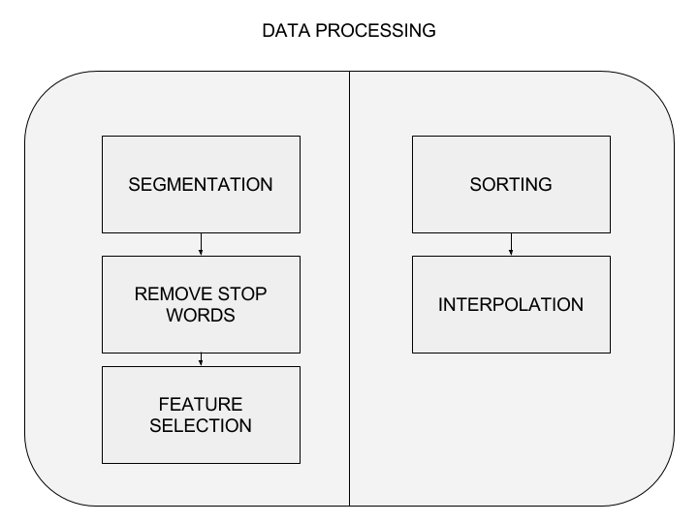
Detailed Architecture

Slide 16
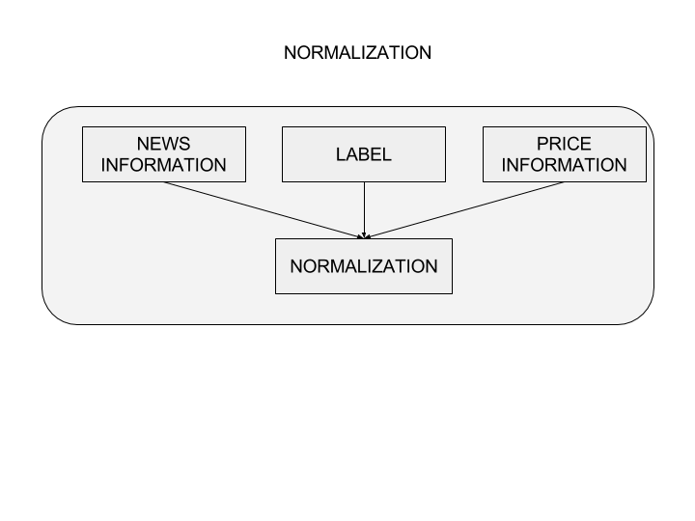
Detailed Architecture

Slide 17
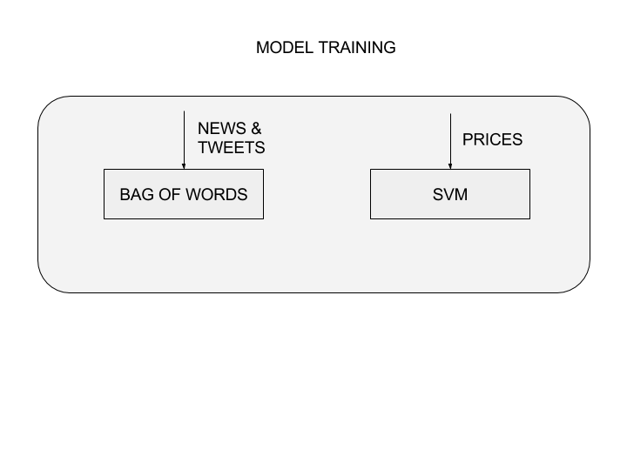
Detailed Architecture

Slide 18
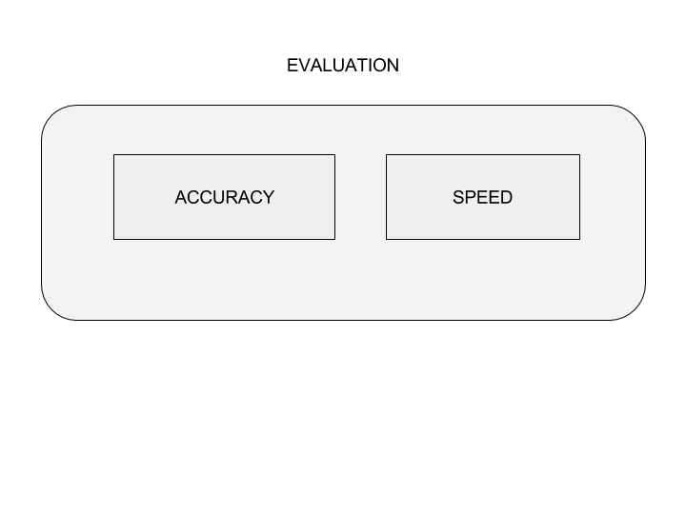
Detailed Architecture

Slide 19
Technology Stack
SOFTWARE REQUIREMENTS
Tweepy Twitter API
Scrapy Web Crawling Framework
Quandl Data Set store library
Scikit Machine Learning library
Pandas Data Formats & Interconversions library
Numpy Data Frame operations library

Slide 20
Implementation Plan Process Flow Diagram

Slide 21
Data Sets
Found on NSE website
Problem in synchronizing datasets –according to company and timeline
3-6months data required ideally

Slide 22
Research Paper
Topics on which research papers are obtained
Highlight main research paper

Slide 23
Summary & Conclusion
A brief report of the work carried out so far
Conclusions derived from the logical analysis

Slide 24
Thank You!

