Slide 1
BE Project Presentation on Research Platform for Stock Market Analysis
Presented by
Crystal Cuthinho - 7053
Nevil Dsouza - 7059
Melwyn Saldanha - 7097

Slide 2
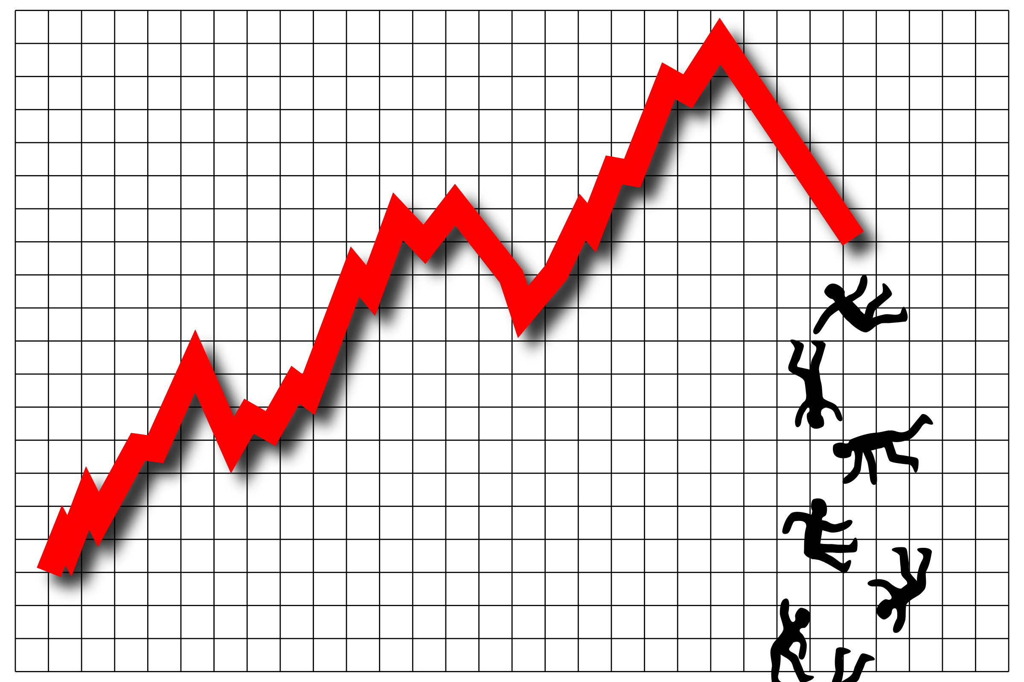
Introduction & Problem Statement
STOCK MARKET & THE ECONOMY

Slide 3
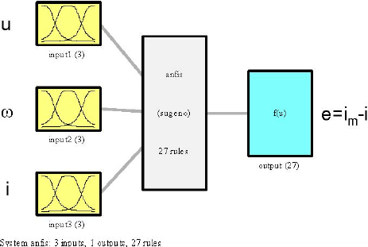
Introduction & Problem Statement
ABSENCE OF A HYBRID PREDICTION MODEL

Slide 4

The best method to predict stock market trends & gain profits is …

Slide 5
Aim, Scope & Applications
Objectives
Aim: To improve accuracy by combining all 3 techniques
Scope: Investors will use predictions to buy and sell stocks to make a profit
Trends of stock market and comparisons of output obtained with actual stock market

Slide 6
Existing Systems & Their Drawbacks
No hybrid model
Accuracy issues in individual techniques
Mention techniques used in unused research papers

Slide 7


Existing Systems & Their Drawbacks
LESS ACCURACY IN INDIVIDUAL TECHNIQUES
NO HYBRID MODEL

Slide 8
Literature Review
Explain all 3 modules – give facts and theory
implement, compare & find flaws in accuracy
critical appraisal of the previous work published in the literature

Slide 9
Our approach– Proposed system
Analysis and Design of proposed system
Methodology (Your approach to solve the problem)

Slide 10
Architecture (Top level & detailed)
Entire system architecture

Slide 11
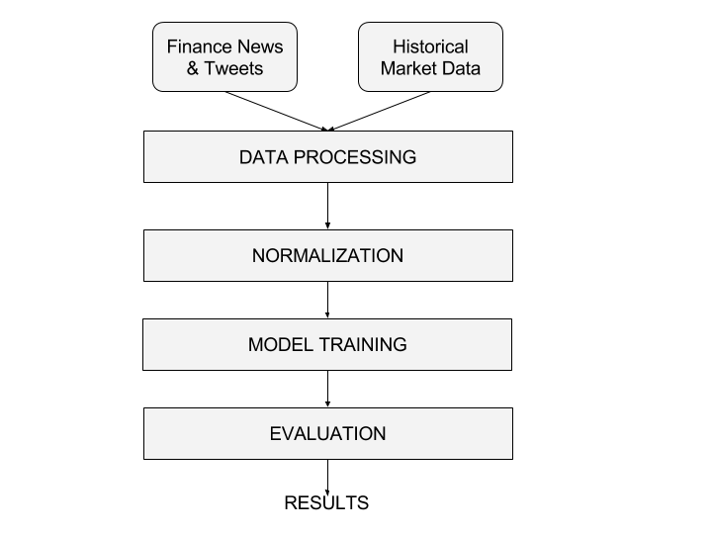
Top Level Architecture

Slide 12
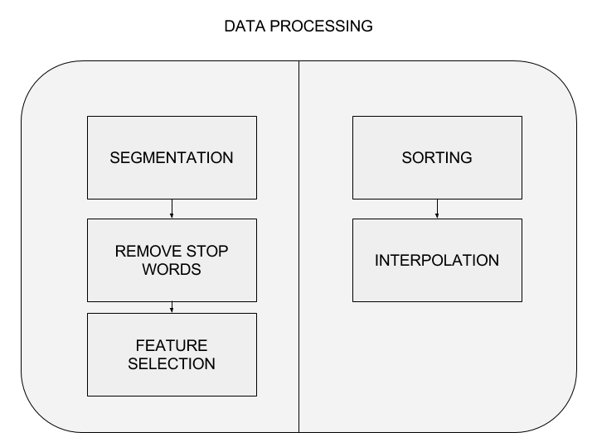
Detailed Architecture

Slide 13
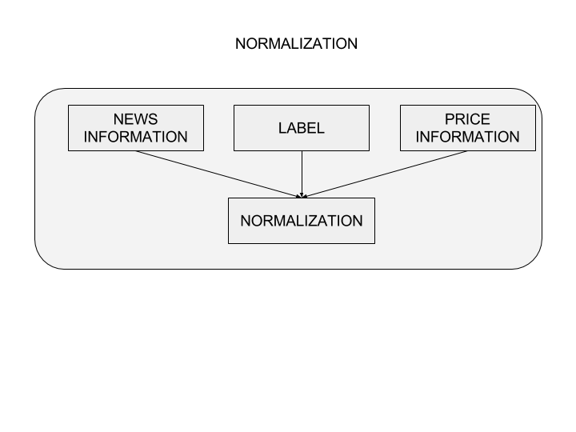
Detailed Architecture

Slide 14
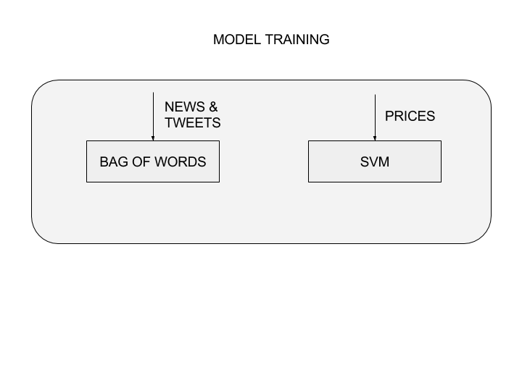
Detailed Architecture

Slide 15
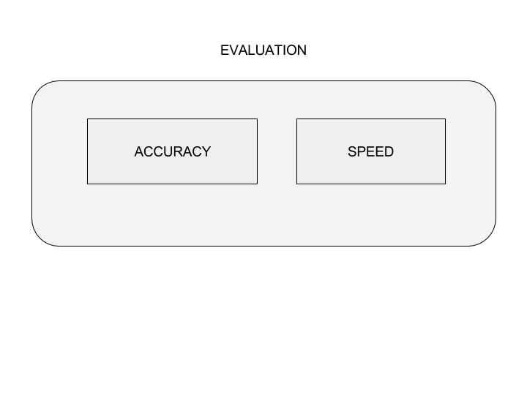
Detailed Architecture

Slide 16
Hardware & Software Requirements
Software req:
Tweepy
Scrapy
SVM
Twitter API
RDBMS
CSV files

Slide 17
Implementation Plan – Process Flow Diagrams
Make 3 slides for 3 modules
SVM?

Slide 18
Process Flow – Market Sentiment Analysis using social media

Slide 19
Data Sets
Found on kaggle
Problem in synchronizing datasets –according to company and timeline
Hence method of obtaining dataset for stock market – web scraping
3-6months data required ideally

Slide 20
Research Paper
Topics on which research papers are obtained
Highlight main research paper

Slide 21
Summary & Conclusion
A brief report of the work carried out so far
Conclusions derived from the logical analysis

Slide 22
Thank You!

