Slide 1
BE Project Presentation on Research Platform for Stock Market Analysis & Prediction
Presented by
Crystal Cuthinho - 7053
Nevil Dsouza - 7059
Melwyn Saldanha - 7097

Slide 2
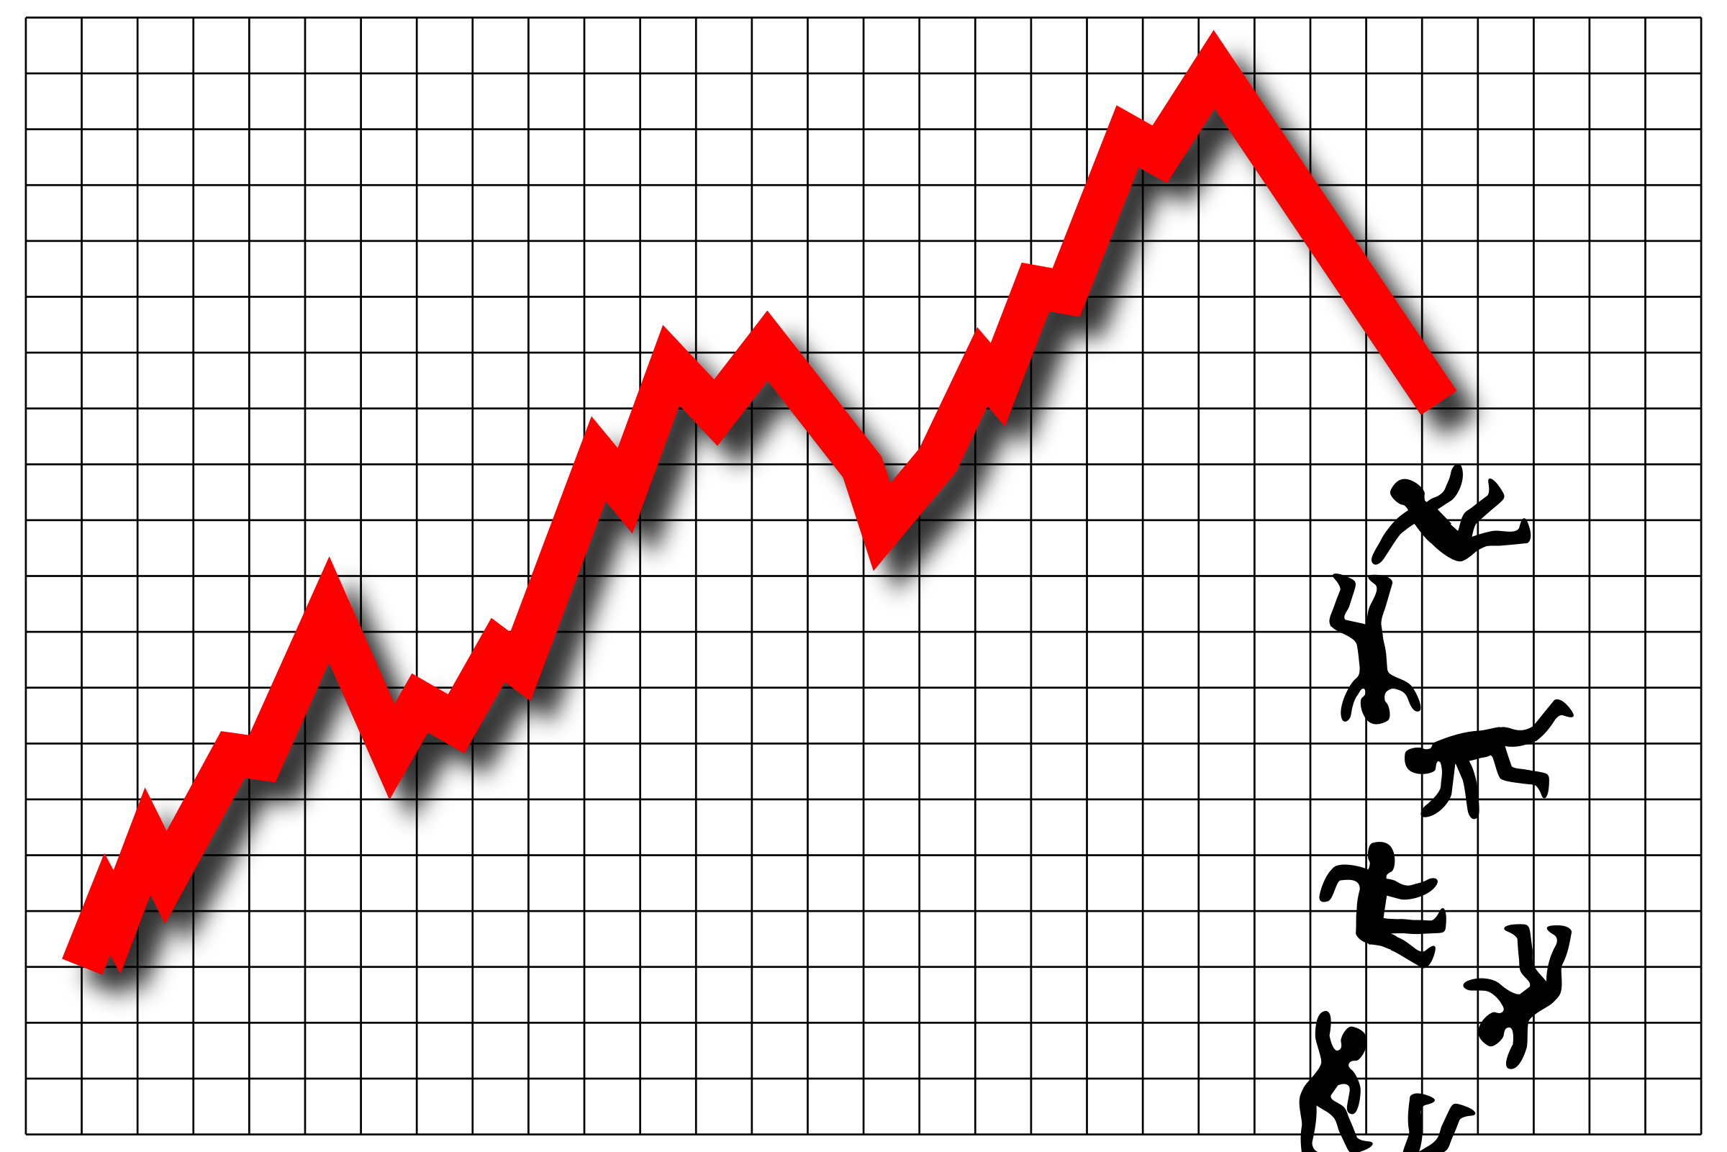
Introduction
What is stock market?
How does it affect the economy?
How accurate is prediction?
STOCK MARKET & THE ECONOMY

Slide 3
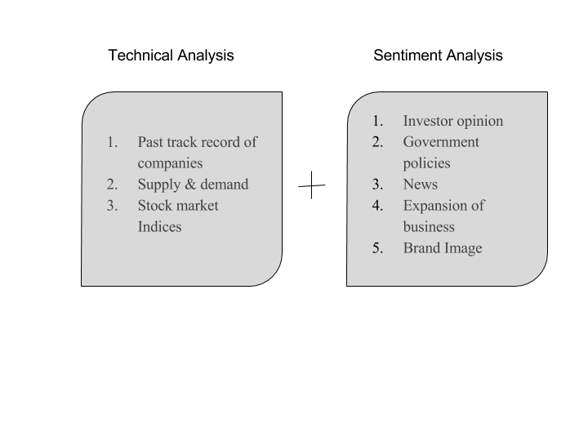
Factors affecting Stock Market

Slide 4

The BEST method is …

Slide 5
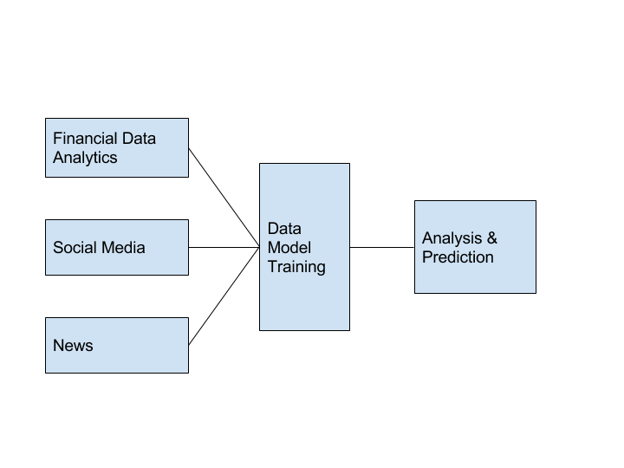
Problem Statement
WHICH TECHNIQUE IS BEST?

Slide 6
Aim, Scope & Applications
Aim : To improve accuracy of prediction by combining all 3 techniques
Scope:
Short Term trading
NSE based companies
National Sentiment Analysis
Predictive, not Prescriptive
Applications:
Investors will use predictions to buy and sell stocks to make a profit
Trends of stock market

Slide 7



Existing Systems & Their Drawbacks
Features:
Daily, Weekly, Monthly trends
Sectorwise predictions
Features:
MOBI
classifies comments made online
Features:
company screener
portfolio
profit calculator

Slide 8


Existing Systems & Their Drawbacks
LESS ACCURACY IN INDIVIDUAL TECHNIQUES
NO HYBRID MODEL

Slide 9
Literature Review Financial Data Analytics
Explain all 3 modules – give facts and theory and background
implement, compare & find flaws in accuracy
critical appraisal of the previous work published in the literature

Slide 10


Literature Review Market Sentiment Analysis using Social Media
Why sentiment analysis?
Twitter - 500 million tweets / day
Goel & Mittal, Stanford University, Self Organizing Fuzzy Neural Networks (SOFNN), 75.56% accuracy, 4 classes - Calm, Happy, Alert and Kind .
Raisa Varghese & Jayasree M , SVM classifier + bag of words model, 83% accuracy
Tweepy - > Twitter API
Process planned

Slide 11
Literature Review Market sentiment analysis using News
Keyword based filtering from top financial news websites
Bag of Words
Noun Phrasing
Named Entities
SVM

Slide 12
Our approach– Proposed system
Implement the three methodologies for predictions
Record individual performance based on accuracy & CPU time
Compare all three observations based on a time period
Find patterns of inter dependency among the three strategies
Try merging 2 out of 3 strategies in combinations
Record performances
State conclusions of the experiments

Slide 13
Why we chose SVM?
Best model for text classification compared to K-NN, DT, BP-NN
Easier to implement than Neural Networks
Avoids the problem of local maxima
Faster & high accuracy
4 kernels to move data to high dimensional space
Converts non separable problem to non linear solution using hyper planes
Proper filtering and noise removal will avoid disadvantage of over fitting

Slide 14
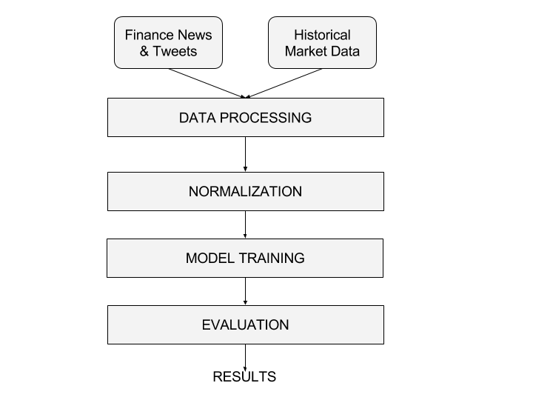
Top Level Architecture

Slide 15
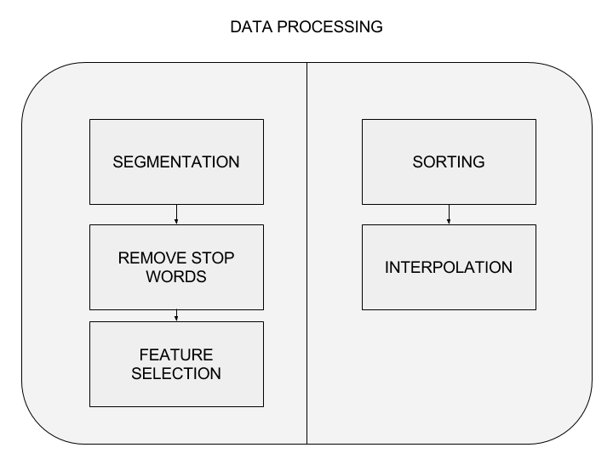
Detailed Architecture

Slide 16
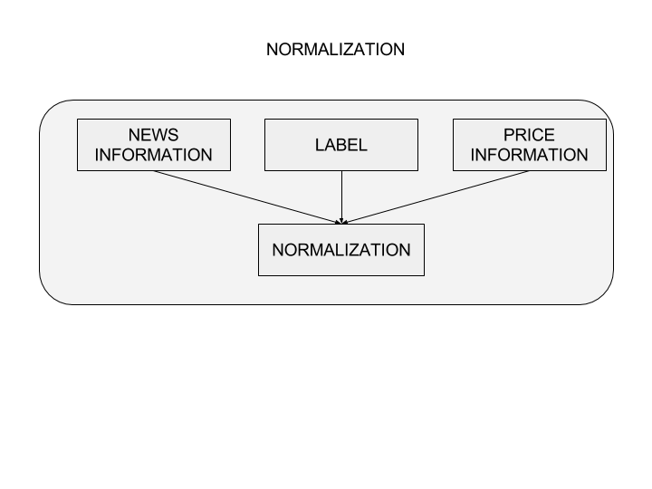
Detailed Architecture

Slide 17
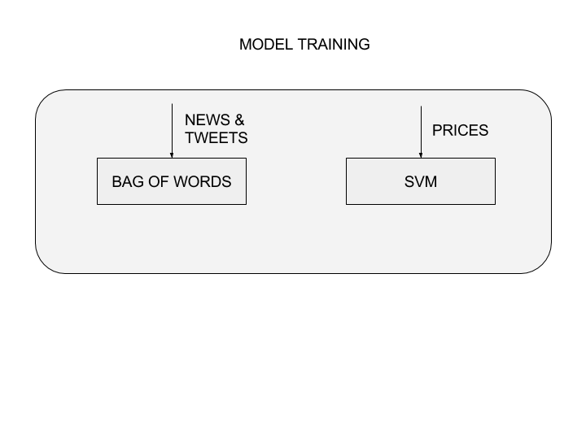
Detailed Architecture

Slide 18
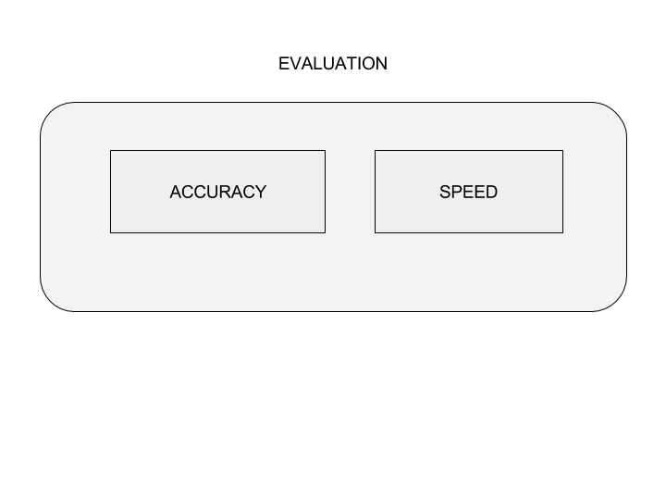
Detailed Architecture

Slide 19
Technology Stack
Software req:
Tweepy
Scrapy
Scikit
Quandl Python Api
Pandas
RDBMS
Python

Slide 20
Implementation Plan Process Flow Diagram

Slide 21
Research Paper
Empirical Analysis: stock market prediction via extreme learning

Slide 22
Summary & Conclusion
Basics of stock market
Architecture
Technology
Implementation

Slide 23
Thank You!

