Slide 1
Anomaly Detection with Robust Deep Autoencoders
Chong Zhou, Randy Paffenroth

Slide 2
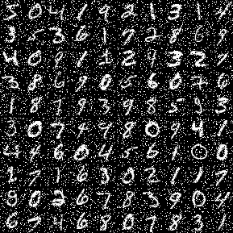
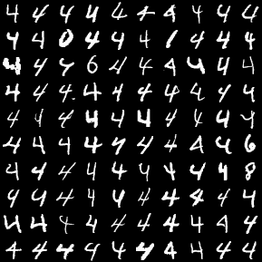
Anomalies?
Noise and Outliers
Noise
Outliers
Important point 1: Both problems can be handled in the same framework
Important point 2: We do not have any noise/outlier free training samples

Slide 3



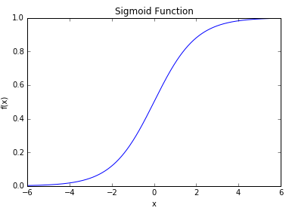
Background 1: Autoencoders
Autoencoders learn the input data themselves.
Autoencoders become non-trivial by having the hidden layers are low-dimensional and non-linear.
Cost
Input X
N * m
W
m * k
Hidden Layer
N * k
W
k * m
T
Reconstruction
N * m
Notes:
Fix fonts W
Title add backgronds
Add logit pic add cross-entro add y = logit(wx + b)

Slide 4
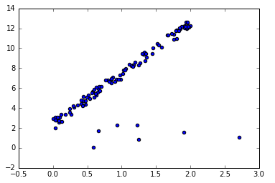
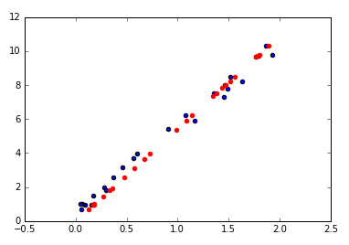
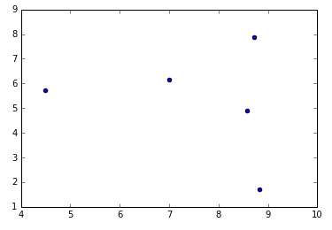

Background 2: Robust Principal Component Analysis (Robust PCA)
Notes:
Fix fonts
sayl1 is sparsity and

Slide 5
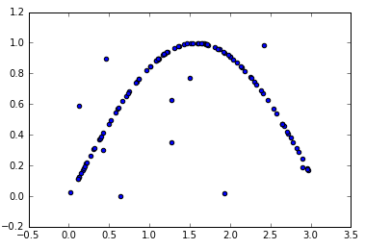
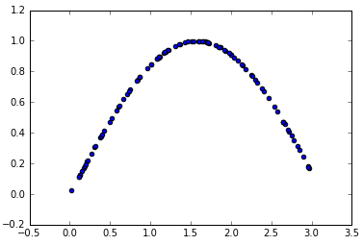
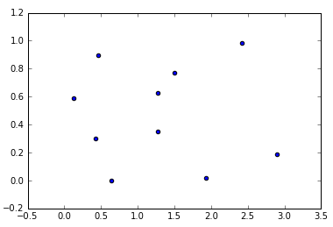
Non-linear & Filter out anomalies
Notes:
Say this is cartoon
Noise and outliers are essentially incompressible and therefore cannot effectively be projected to a low dimensional hidden layer by an autoencoder.
Anomalies are “few” and “different”. The majority of instances are normal and many.
Anomalies share less information than the normals.
It is hard to infer anomalies from the majority.
Compressing anomalies return high reconstruction errors.

Slide 6

Robust (Deep) Autoencoders
Our method can be viewed as replacing the nuclear norm with a non-linear autoencoder.
Cost2
Cost1
Outlier Filter S
N * m
Input L
N * m
W
m * k
Hidden Layer
N * k
T
Reconstruction
N * m
W
k * m

Slide 7
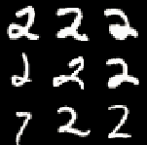
Detect Outliers?
Noise is unstructured and thus we use l1 norm.
Outliers are structured that an outlier is one row in a data matrix and we want to group elements over a row.
Features
Data X
Instances
An outlier

Slide 8
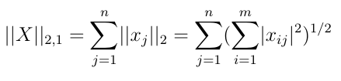
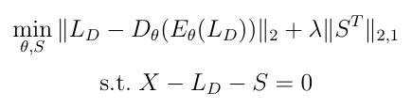
Grouped Robust Autoencoders

Slide 9
Grouped Robust Autoencoders
Cost2
Cost1
W
k * m
Outlier Filter S
N * m
Input L
N * m
W
m * k
Hidden Layer
N * k
T
Reconstruction
N * m
Notes:
Say more here

Slide 10
Training
Borrow the idea of ADMM that training each part of an complex objective separately with other parts fixed.
Training the autoencoder with S fixed.
Shrink S with the autoencoder fixed.
Notes:
L21 norm here
Add

Slide 11
More Detail
Minimize L with S fixed
Just a call to a standard autoencoder
Project onto constraint
Minimize S with L fixed
Proximal gradient problem
Project onto constraint
Key points
Theoretical justification (work in progress)
Proof ideas inspired by Dykstra’s algorithm and Alternation Direction Method of Multipliers (ADMM)
Substantial numerical evidence for good convergence

Slide 12
Result 1: Denoising
The feature quality of hidden layers in normal deep autoencoder is influenced by noise.
Denoising will increase the feature quality.
We use supervised models to exanimate the quality of features.
We compare the error rate.

Slide 13
Result 1: How to judge feature quality?
Input
X
W
H
W
Recon
T
Prediction Model
S
Input L
W
H
T
Recon
W
Compare Results

Slide 14
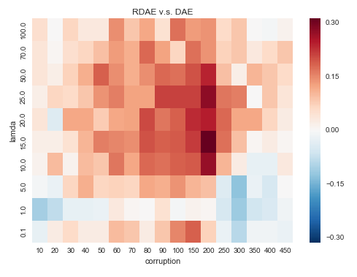
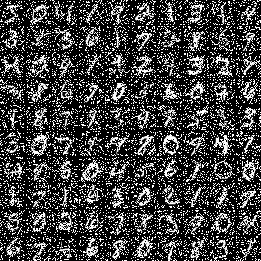
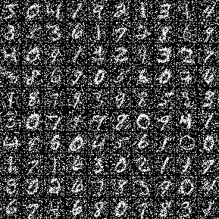
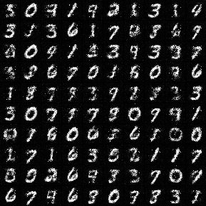
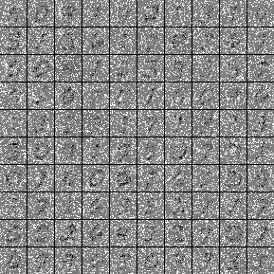
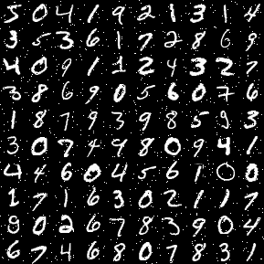
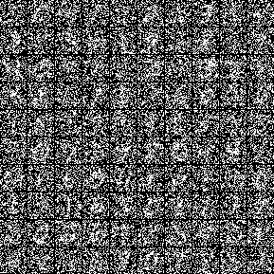
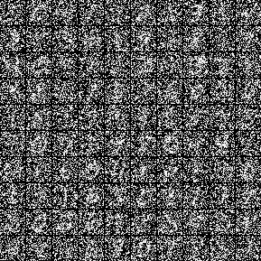
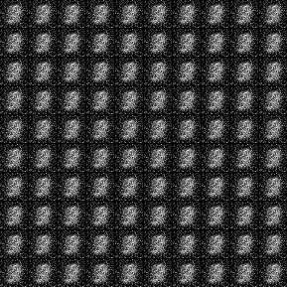
Result 1 Denoising
Input
Autoencoder
Recon
Robust Autoencoder
Recon
Robust Autoencoder
S
Autoencoder
Robust Autoencoder
Input

Slide 15
Result 2: Outlier Detection

Slide 16
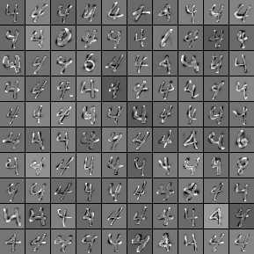
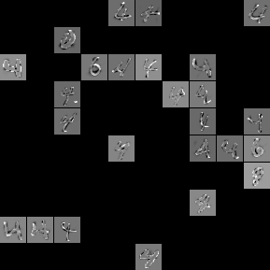
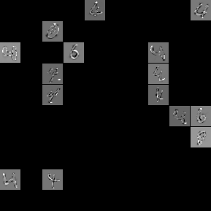
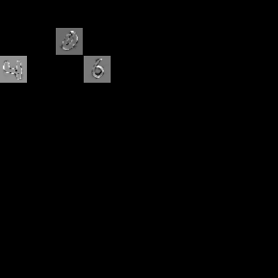
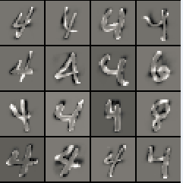
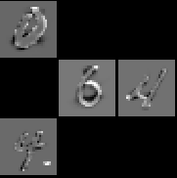
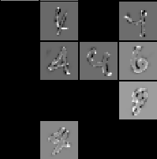
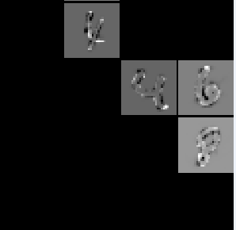
6
2
1
3
4
5
1
2
3
4

Slide 17
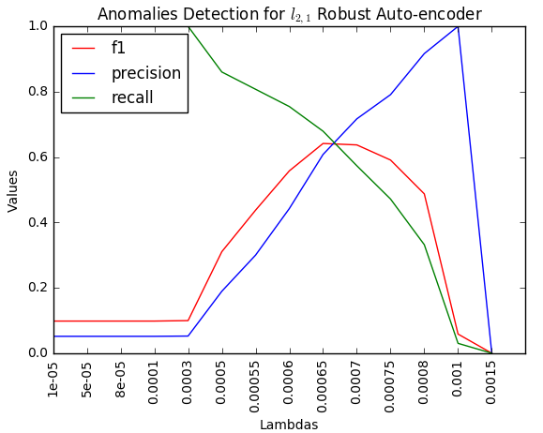
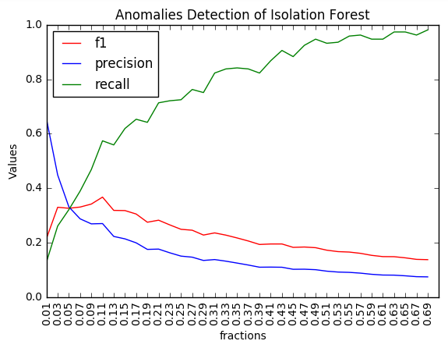
Compare with Isolation Forest
L21 Robust Autoencoder
Isolation Forest
0.64
0.37
73% Better
Notes:
These are semi-superivesed we use training data to pick out correct lambda and fraction values.

Slide 18
Conclusion
One framework that combines autoencoder and robust PCA
No clean samples as references.

Slide 19
Thank You

